Slide 1
Fundamentals of Informatics
Lecture 13
Reduction
Bas Luttik
Notes:
Goals of this le

Slide 2
Decision problems
A decision problem is a set of related yes/no questions, usually infinitely many.
For instance, the primality decision problem (“given a natural number, decide whether it is prime”) consists of the questions:
  Is 0 prime?
  Is 1 prime?
  Is 2 prime?
  Etc.
Solvable
there is an algorithm* that correctly answers all the questions of a decision problem
Unsolvable
there is no algorithm* that correctly answers all the questions of a decision problem
*By the Church-Turing thesis, we can always replace algorithm by Turing machine.
Notes:
Last lecture we discovered that there exist problems that are solvable (for which there exists an algorithm) and problems that are unsolvable (for which there exists no algorithm).
What do we mean by a decision problem?
What do we mean when we say that a decision problem is solvable?
What do we mean when we say that a decsision problem is unsolvable?

Slide 3
Mother of unsolvable problems: halting
Given a Turing machine M and an input sequence s, decide whether M’s computation on s will eventually terminate.
description of M
input sequence s for M
T
T outputs 1 if M halts on s, and 0 if M does not halt s
T reports “yes” if M halts on s, and “no” if M does not halt s
yes
no

Slide 4



Other unsolvable problems: tiling
Tile types:
Is it possible to tile every room of arbitrary size with these tile types?
Yes!

Slide 5


Other unsolvable problems: tiling
Tile types:
Is it possible to tile every room of arbitrary size with these tile types?
?
?
No!

Slide 6
Other unsolvable problems: tiling
Given a set of tile types, decide whether every room can be tiled using tiles of that type.
The Tiling Problem is unsolvable!
So: there is no computer program (and there will never be!) that decides whether arbitrary finite sets of tile types can tile rooms any size.

Slide 7
Other unsolvable problems: matching
Given two finite lists of words X and Y:
 | 1 | 2 | 3 | 4 | 5
X | abb | a | bab | baba | aba
Y | bbab | aa | ab | aa | a
Is it possible to concatenate words in X such that the concatenation of the ‘corresponding’ words from Y yields the same word?
Yes!
 | 2 | 1 | 1 | 4 | 1 | 5
X | a | abb | abb | baba | abb | aba
Y | aa | bbab | bbab | aa | bbab | a

Slide 8
Other unsolvable problems: matching
Given two finite lists of words X and Y:
 | 1 | 2 | 3 | 4 | 5
X | bb | a | bab | baba | aba
Y | bab | aa | ab | aa | a
Is it possible to concatenate words in X such that the concatenation of the ‘corresponding’ words from Y yields the same word?
No!
Notes:
Clearly cannot start with 1, 3 or 4.
Start with 2*; continuation with 5 gives immediate mismatch for the X-group will have fewer a’s before b
Start with 5, then we must continue with 1 and then with 2 and we find a mismatch.

Slide 9
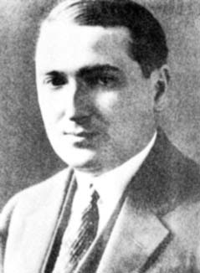
Other unsolvable problems: matching
Post Correspondence Problem:
Given two lists of words, decide whether it is possible to concatenate corresponding words from either list to get the same word.
Emil Post (1897-1954)
The Post Correspondence Problem is unsolvable!

Slide 10
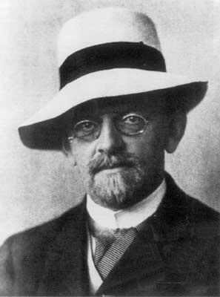
Other unsolvable problems: polynomials
Hilbert’s 10th problem:
Given a polynomial P(x₁,…,x_{n}) in variables x₁,…,x_{n} with integer coefficients, decide whether the equation
P(x₁,…,x_{n}) = 0
has a solution in integers.
David Hilbert (1862-1943)
Hilbert’s 10th problem is unsolvable!
Note: A solution to the problem is an algorithm that works for arbitrary polynomials. There exist (straightforward) algorithms for subclasses of polynomials (e.g., for 2nd degree polynomials in one variable).

Slide 11
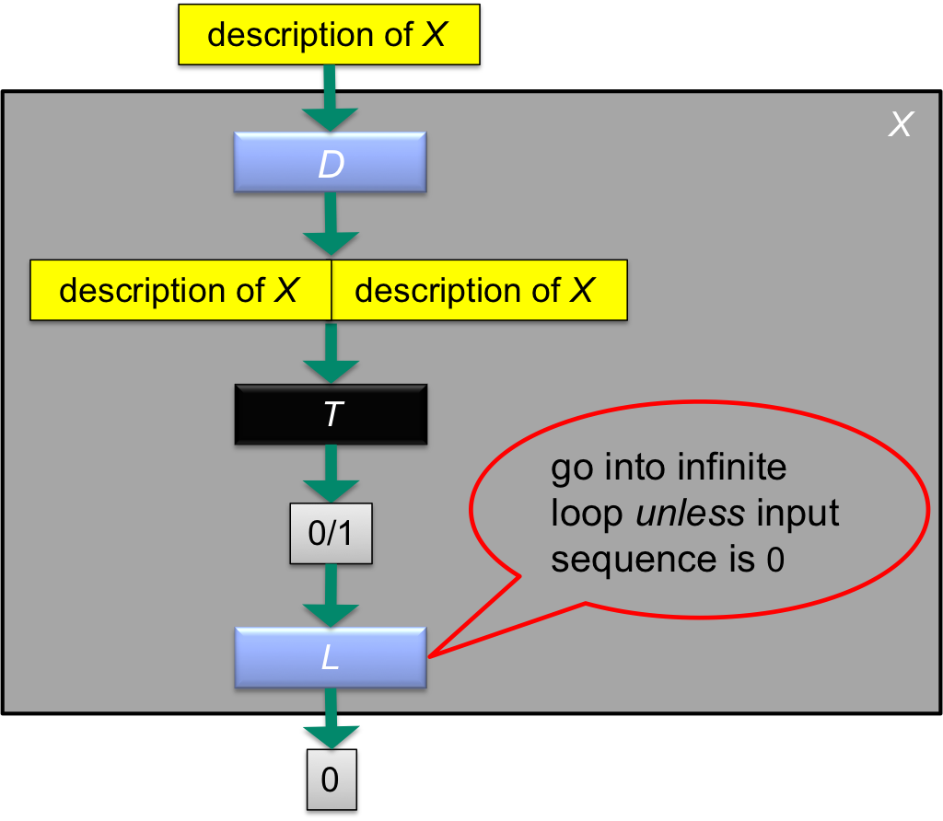
Halting problem is Unsolvable
Does X terminate on its own description?
If X terminates on its own description, then T reports 1. So L goes into an infinite loop, and thus X does not terminate. Contradiction!
If X does not terminate on its own description, then T reports 0. So L terminates, and thus X terminates. Contradiction!
Both possible answers lead to a logical contradiction.
Something must be wrong; it can only be our assumption that T exists.
Conclusion: T does not exist; the halting problem is unsolvable.

Slide 12
Logical structure of the argument
ASSUME the halting problem is solvable
DERIVE CONTRADICTION:
    Observe that if halting problem is solvable, then there must exist a Turing machine T that determines for every pair of a Turing machine M and input sequence s whether M terminates on s
    Use T to construct a paradox (i.e., the desired contradiction)
CONCLUDE the halting problem is unsolvable
Notes:
,

Slide 13
Analogy: the Barber Paradox
"The barber is a man in town who shaves all those, and only those, men in town who do not shave themselves."
Who shaves the barber?
If the barber shaves himself, then, according to the advert above, he is one of those men who do not shave themselves. Contradiction!
If the barber does not shave himself, then, according to the advert above, he is one of those men who are shaved by the barber. Contradiction!
Conclusion: there is no barber satisfying the requirements in the advert!
To eliminate the paradox: move the barber out of town.

Slide 14
Analogy: the Barber Paradox
"The barber is a man in town who shaves all those, and only those, men in town who do not shave themselves."
barber -> exTerminator, shaving -> terminating, man -> Turing machine
"The exTerminator is a Turing machine that terminates on those, and only those, Turing machines that do not terminate on themselves."
Question: Could we perhaps solve the halting problem by finding a solution outside the Turing machine formalism?
Answer: Not if we accept the Church-Turing thesis.
Notes:
Take:
barber = exTerminator
shaving = terminating
man = Turing machine
“The exTerminator is a Turing machine that terminates only on those Turing machines that do not terminate on themselves.”

Slide 15
Logical structure of the argument
Paradox requires self-referentiality:
‘problem domain’ = ‘solution domain’
ASSUME the halting problem is solvable
DERIVE CONTRADICTION:
    Observe that if halting problem is solvable, then there must exist a Turing machine T that determines for every pair of a Turing machine M and input sequence s whether M terminates on s
    Use T to construct a paradox (i.e., the desired contradiction)
CONCLUDE the halting problem is unsolvable
Notes:
,

Slide 16
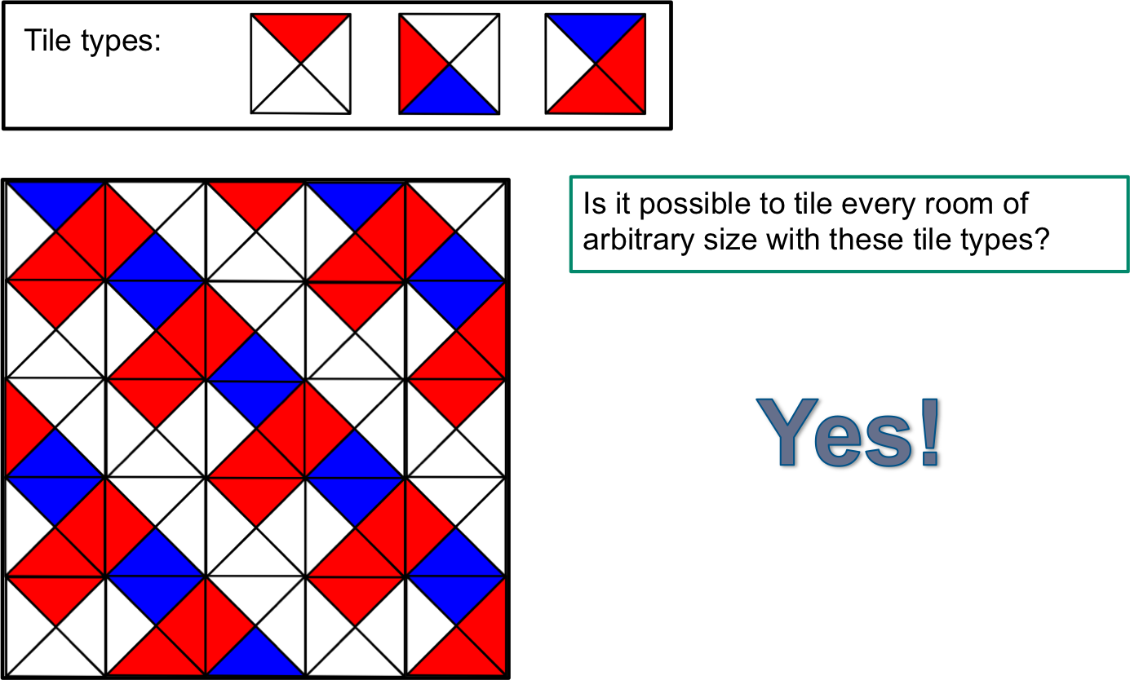
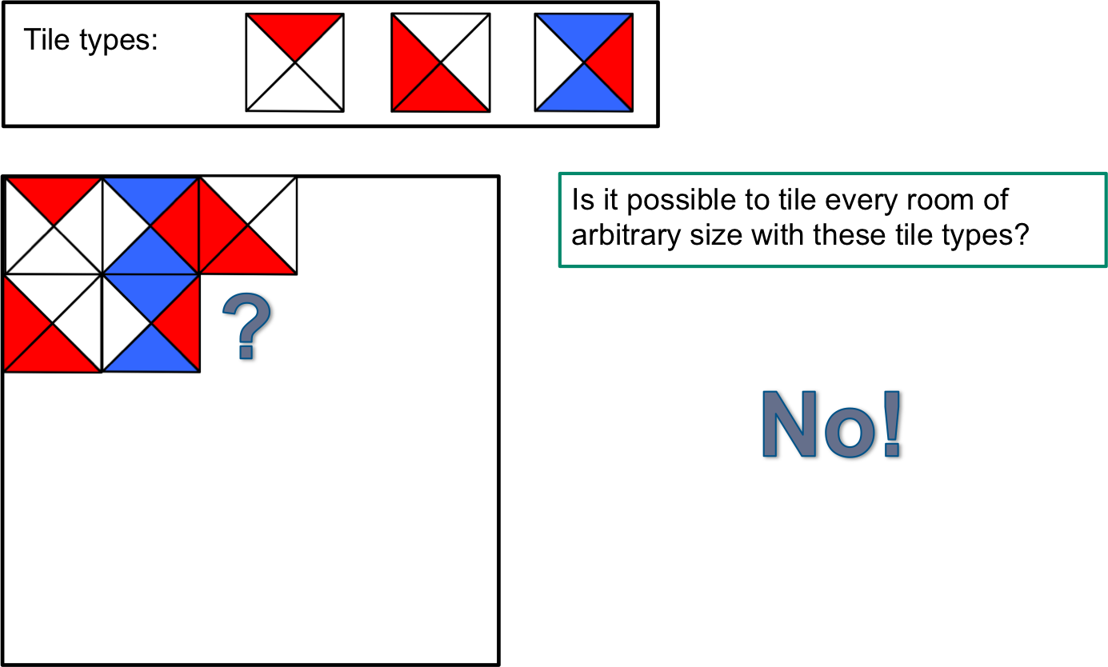
The Tiling Problem
Given a set of tile types, decide whether every room can be tiled using tiles of that type.
What would it mean to solve it?
There would have to exist a Turing machine (or algorithm) T such that:
description of set of tile types T
Decide if T admits tiling
T outputs 1 if M halts on s, and 0 if M does not halt s
T reports “yes” if set of tile types admits tiling; “no” otherwise
yes
no

Slide 17
Logical structure of the argument
ASSUME the halting problem is solvable
DERIVE CONTRADICTION:
    Observe that if halting problem is solvable, then there must exist a Turing machine T that determines for every pair of a Turing machine M and input sequence s whether M terminates on s
    Use T to construct a paradox (i.e., the desired contradiction)
CONCLUDE the halting problem is unsolvable
Notes:
,

Slide 18
Logical structure of the argument
No self-referentiality!
‘problem domain’ ≠ ‘solution domain’
ASSUME the tiling problem is solvable
DERIVE CONTRADICTION:
    Observe that if tiling problem is solvable, then there must exist a Turing machine that determines for every set of tile types whether every room can be tiled.
    How do we now get our contradiction?
CONCLUDE the tiling problem is unsolvable
Notes:
?,

Slide 19
Reduction
Problem A
Problem B
A reduction from Problem A to Problem B consists of
a general method (algorithm) for transforming every instance of problem A into an instance of problem B, together with
a general method (algorithm) for transforming the B-solution of every transformed instance of problem A back into an A-solution of the original instance of problem A
Then, if we have a solution for problem B, then we can effectively use it to solve problem A.

Slide 20
Completing the square algorithm
CSQ(a, b, c)
Input: real numbers a, b, and c.
Output: the (real) roots of the single-variable quadratic equation
      ax² + bx + c = 0
Divide each side by a
Subtract c/a from both sides of the equation
Add (b/2a)² to both sides of the equation
Write the left-hand side as a square (using x² + 2hx + h² = (x + h)²)
Produce two linear equations by equating the square root of the left-hand side with the positive and negative square roots of the right-hand side
Find the roots by solving the two linear equations

Slide 21
Completing the square algorithm
CSQ(a, b, c)
Input: real numbers a, b, and c.
Output: the (real) roots of the single-variable quadratic equation
      ax² + bx + c = 0
Divide each side by a
Subtract c/a from both sides of the equation
Add (b/2a)² to both sides of the equation
Write the left-hand side as a square (using x² + 2hx + h² = (x + h)²)
Produce two linear equations by equating the square root of the left-hand side with the positive and negative square roots of the right-hand side
Find the roots by solving the two linear equations
The completing the square algorithm is an example of reduction: it reduces the problem of solving a single-variable quadratic equation to solving two linear equations.

Slide 22
Reduction for decision problems
Problem A
Problem B
A reduction from decision Problem A to decision Problem B consists of two parts:
a general method (algorithm) for transforming every question of problem A into an question of problem B
an argument that the B-answer to every transformed A-question can be interpreted as a (correct) answer to the original A-question. (Sometimes B-answers need to be negated.)
Note that if we have a solution for decision problem B and a reduction from A to B, then we can effectively use it to solve problem A.
So: if B is (assumed to be) solvable and we can exhibit a reduction from A to B, then it follows that A is solvable too.
Hence, if A is already known to be unsolvable, we get a contradiction!

Slide 23
Logical structure of the argument
It suffices to establish a reduction from a problem already known to be unsolvable (e.g., the halting problem) to the tiling problem.
ASSUME the tiling problem is solvable
DERIVE CONTRADICTION:
    Observe that if tiling problem is solvable, then there must exist a Turing machine that determines for every set of tile types whether every room can be tiled.
    How do we now get our contradiction?
CONCLUDE the tiling problem is unsolvable
Notes:
?,

Slide 24
From halting to tiling
description of M, input sequence s for M
Transform M,s to set of tile types T that admits tiling if, and only if, M does not halt on s
Starting from the assumption that the tiling problem is solvable, we have constructed a Turing machine that solves the halting problem. Contradiction!
description of T
Decide if T admits tiling
Yes if tiling is possible No otherwise
yes
no
Yes if M halts on s No otherwise
no
yes
Notes:
An algorithm/Turing machine solving the modified tiling problem could be transformed into an algorithm/Turing machine solving the halting problem

Slide 25
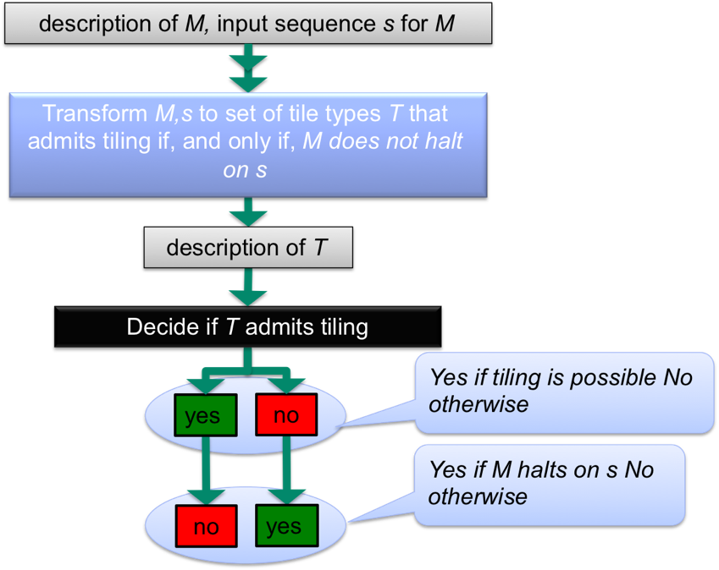
From halting to tiling
It remains to find a general method to transform M,s to suitable T
We will not complete the proof by showing the general method here. But to give you an idea, we will illustrate it on the next few slides, by showing how the computation of an example Turing machine is simulated with a tiling, in a slightly modified setting.
Notes:
An algorithm/Turing machine solving the modified tiling problem could be transformed into an algorithm/Turing machine solving the halting problem

Slide 26
The Tiling Problem (slightly modified)
Input: set of tile types and a starting tile
Problem: decide whether the upper half of the infinite integer grid can be tiled using tiles of that type.
Extra requirement: starting tile is placed somewhere on bottom row.
With the following two slides we illustrate how an example Turing machine M together with an input sequence s is transformed into an instance of the modified tiling problem (a set of tile types together with a starting tile).
Notes:
How should we prove that the tiling problem is unsolvable?

Slide 27
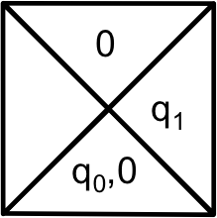
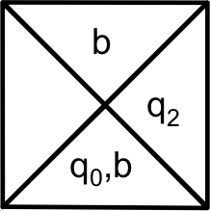
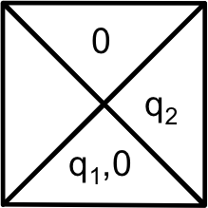
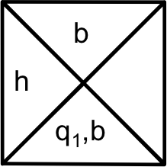
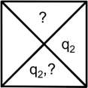
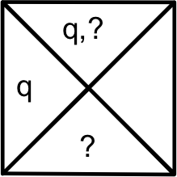
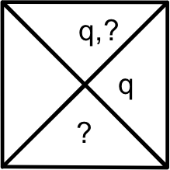
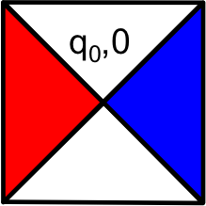
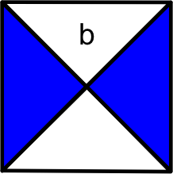


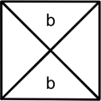
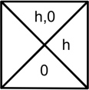

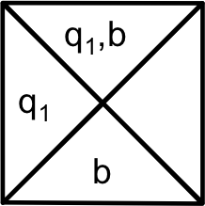
Simulating TM computations with tilings
Transition table:
Tape head movement
Tape:
Starting tile
Transitions
?

Slide 28

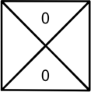
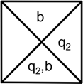
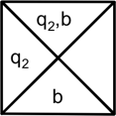
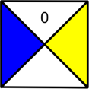
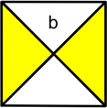
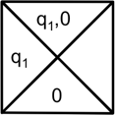
Simulating TM computations with tilings
Transition table:
Tape head movement
Tape:
Starting tile
Transitions

Slide 29
The Modified Tiling Problem
Input: set of tile types T and a starting tile t
Problem: decide whether the upper half of the infinite integer grid can be tiled using tiles in T.
Extra requirement: starting tile t is placed somewhere on bottom row.
There exists an algorithm that associates with every description of a Turing machine M and input sequence s a description of a set of tile types T and a starting tile t such that:
T, t admits tiling
if, and only if,
M does not halt on s
Notes:
How should we prove that the tiling problem is unsolvable?

Slide 30
From halting to tiling
description of M, input sequence s for M
Transform M,s to set of tile types T and starting tile t that admits tiling if, and only if, M does not halt on s
Starting from the assumption that the modified tiling problem is solvable, we have constructed a Turing machine that solves the halting problem. Contradiction!
description of T, t
Decide if T, t admits tiling
Yes if tiling is possible No otherwise
yes
no
Yes if M halts on s No otherwise
no
yes
Notes:
An algorithm/Turing machine solving the modified tiling problem could be transformed into an algorithm/Turing machine solving the halting problem

Slide 31
The Blank Tape Problem
Exercise:
Construct a Turing machine that, when started on a blank tape, halts with the sequence 0110 written on the tape, and the tape head on the left-most 0.
(We don’t care what it does when started on a tape not entirely blank.)
Now consider the blank tape problem:
  Given a Turing machine M, decide whether M’s computation will eventually halt if it is started on a blank tape.
Reduce the halting problem to the blank tape problem to prove that it is unsolvable.

Slide 32
Logical structure of the argument
ASSUME the blank tape problem is solvable
DERIVE CONTRADICTION:
    Observe that if blank tape problem is solvable, then there must exist a Turing machine that determines for every Turing machine whether it eventually terminates when started with a blank tape.
    Obtain contradiction by establishing a reduction
      from the halting problem to the blank tape problem
CONCLUDE the tiling problem is unsolvable
Mind the direction: we reduce from a problem already known to be unsolvable to the problem of which we want to establish unsolvability!
Notes:
?,

Slide 33
Reduction
description of M, input sequence s for M
Transform description of M,s to description of M’ that first writes s and then runs M
Starting from the assumption that the blank tape problem is solvable, we have constructed a Turing machine that solves the halting problem. Contradiction!
description of M’
B
Yes if M’ halts on blank tape; No otherwise
yes
no
Yes if M halts on s No otherwise
yes
no
Notes:
An algorithm/Turing machine solving the modified tiling problem could be transformed into an algorithm/Turing machine solving the halting problem

Slide 34
The Blank Tape Problem for TMs
The blank tape problem is unsolvable.
Proof. Suppose that the blank tape problem is solvable; then there exists a Turing machine B that solves it (i.e., returns yes if its input sequence is a description of a Turing machine that terminates on a blank tape).
Use B to construct a Turing machine T that runs according to the following algorithm:
Transform description of M and s into description of M’ that first writes s on its tape, moves to left-most non-blank, and then continues as M.
Run B on description of M’.
Answer yes if B answers yes; answer no if B answers no.
Since B answers yes on the description of M’ if, and only if, M halts on s, and B answers no on the description of M’ if, and only if, M does not halt on s, it follows that T solves the halting problem.
We have thus established a reduction from the halting problem to the blank tape problem. Contradiction! QED!

Slide 35
Proof by reduction
A reduction proof that a decision problem P is unsolvable consists of
The description of a general method to transform every question (input) for some other problem U, known to be unsolvable, to a question (input) for problem P.
An explanation of how the P-answer to every transformed U-question should be interpreted as an answer to the original U-question.
A conclusion stating that the presupposed solvability of P together with the reduction from U to P implies the solvability of U, and thus contradicts the unsolvability of U.

Slide 36


Material
Chapter 59 (see reader) presents a proof of the unsolvability of the Halting problem.
Chapter 66 (see reader) sheds more light on the Church-Turing thesis.
Chapter 10 discusses intractable and unsolvable problems.
Deadline:
January 15, 2016

