Slide 1
2IS80 Fundamentals of Informatics
Quartile 2, 2015–2016
Lecture 9: Information, Compression
Lecturer: Tom Verhoeff

Slide 2
Road Map
Models of Computation: Automata
Algorithms: Computations that process information
Information: Communication & Storage
Limits of Computability
Notes:
Models of computation: abstract machines of varying complexity and computational power
Algorithms: abstract programs for abstract machines; avoids technicalities of computing
A huge encyclopedia of (efficient) algorithms for a large collection of computational problems

Slide 3
Theme 3: Information

Slide 4
Road Map for Information Theme
Problem: Communication and storage of information
Not modified by computation, but communicated/stored ‘as is’
Lecture 9: Compression for efficient communication
Lecture 10: Protection against noise for reliable communication
Lecture 11: Protection against adversary for secure communication
Sender
Channel
Receiver
Storer
Memory
Retriever
Notes:
Although no modification is wanted, this will still involve many computations.
Major applications: telephony, radio/television broadcasting, internet
We will usually speak about “channel”, but that can also mean “memory”.

Slide 5
Study Material
Efficient communication: Ch. 4 + 9 of the book
Khan Academy: Language of Coins (Information Theory)
Especially: 1, 4, 9, 10, 12–14
Reliable communication: Ch. 49 of the reader
Khan Academy: Language of Coins (Information Theory)
Especially: 15
Secure communication: Ch. 8 of the book
Khan Academy: Gambling with Secrets (Cryptography)
Especially 4, 8, optionally 7
Also see relevant Wikipedia articles

Slide 6
What is Information?
That which conveys a message
Shannon (1948): “The fundamental problem of communication is that of reproducing at one point either exactly or approximately a message selected at another point.”
That which conveys a selection, a choice …
among multiple, distinguishable options
You consume information when obtaining an answer to a question
Possibly, it concerns an incomplete answer
Information reduces uncertainty in the receiver
Notes:
Claude Shannon (1948), “A Mathematical Theory of Communication”

Slide 7
Examples
Input to Finite Automaton: choice of symbol from input alphabet
Output to FA: choice among accept versus reject
Input to Turing Machine: choice of symbols on tape, at start
Output from TM: choice of symbols on tape, when halted
Input to Algorithm: choice of input data
Output from Algorithm: choice of result, or output data

Slide 8
Meaning of Information
Shannon (1948): “Frequently the messages have meaning;
that is they refer to or are correlated according to some system with certain physical or conceptual entities.
These semantic aspects of communication are irrelevant to the engineering problem.
The significant aspect is that the actual message is one selected from a set of possible messages.
The system must be designed to operate for each possible selection, not just the one which will actually be chosen since this is unknown at the time of design.”
Notes:
Quoted from “A Mathematical Theory of Communication”, The Bell System Technical Journal, Vol. 27, pp. 379–423, 623–656, July, October, 1948.
What the major engineering problems are varies over time.
In the past, they were different from nowadays.
The future will be different again.
Theory should be developed for the appropriate context.

Slide 9
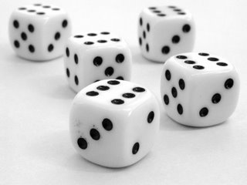
How to Measure Information? (1)
The amount of information received depends on:
The number of possible messages
More messages possible ⇒ more information
The outcome of a dice roll versus a coin flip
Notes:
Qualitative understanding of information
Encode each coin flip in one bit (0 vs 1), and a card “color” in 2 bits
Encode each dice roll in … bits: 2 not enough, 3 is “overkill”
log₂ N bits, where N is number of messages to be distinguished
Can you encode each of the 6 dice rolls into log₂ 6 = 2.585 bits?

Slide 10
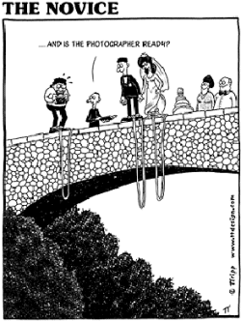
How to Measure Information? (2)
The amount of information received depends on:
Probabilities of messages
Lower probability ⇒ more information
Notes:
Qualitative understanding of information
Answer ‘Yes’ versus ‘No’ to ‘Will you marry … ?’

Slide 11
Amount of Information
The amount of information correlates to the amount of surprise
To the amount of reduction in uncertainty
Shannon’s Probabilistic Information Theory
(There is also an Algorithmic Information Theory.)

Slide 12
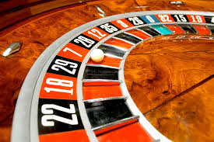
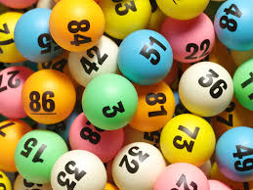
Anti-Information
Anti-Information: creates uncertainty
People like to consume information
Willing to pay for anti-information, to get into a situation where they can enjoy consumption of information: lottery, gambling
Noise in communication channel increases uncertainty

Slide 13
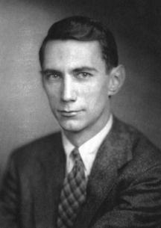
Quantitative Definition of Information
Due to Shannon (1948): incorporates role of probability
Let S be the set of possible answers (messages)
Let P(A) be the probability of answer A:
0 ≤ P(A) ≤ 1 for all A ∈ S
(all probabilities sum to 1)
Amount of information (measured in bits) in answer A:
Notes:
Shannon (1948): in particular, he incorporated the role of probability
Why the minus sign? Otherwise it would be negative (probabilities are ≤ 1)
Why a logarithm? There are 2^{N} sequences of N bits.
log pq = log p + log q

Slide 14
Unit of Information
1 bit = receiving an answer whose probability equals 0.5
bit = binary digit
Using another logarithm base: scales by a factor
Natural logarithm: information unit nat
1 bit = 0.693147 nat
1 nat = 1.4427 bit
Notes:
log₂ x = log x / log 2

Slide 15
Properties of Information Measure
I(A) → ∞, if P(A) → 0 (an impossible answer never occurs)
I(A) = 0 (no information), if P (A) = 1 (certainty): log 1 = 0
0 ≤ I(A) < ∞, if 0 < P(A) ≤ 1
I(A) > I(B), if and only if P(A) < P(B):
lower probability ⇒ higher amount of information
I(AB) ≤ I(A) + I(B): information is subadditive
AB stands for receiving answers A and B
I(AB) = I(A) + I(B) (additive), if A and B are statistically independent
P(AB) = P(A) P(B) (this motivates the logarithm)
Notes:
The last property motivates the choice of a logarithm
N.B. I(AB) = I(A) is possible (if B is repeating what was already said in A)

Slide 16
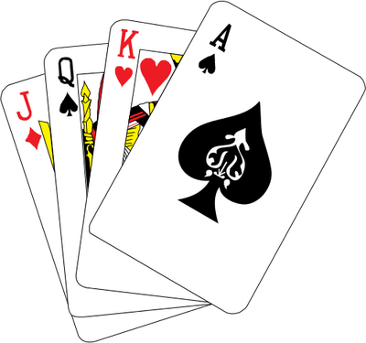
Any-Card-Any-Number (ACAN) Trick
1 volunteer
27 playing cards
1 magician
3 questions
Notes:
Show trick with sorted deck of 27 playing cards.
Explanation (to be shown later, using 27 SET cards)
Each question is a ternary question about one aspect:
Is it a squiggle, rectangle, or ellipse?
Is it red, blue, or green?
Are there one, two, or three objects?
Also observe what is invariant under the reordering of the cards

Slide 17
Communicate Ternary Choices
How to encode ternary choices efficiently on binary channel?
Binary channel: communicates bits (0, 1)
Ternary choice: symbols A, B, C
How many bits needed per symbol?
Notes:
First with binary choices, then card “color” (choice among 4)
log₂ N, because there are 2^{N} sequences of N bits
Can do it in 2 bit / symbol
Ideal: log₂ 3 = 1.58496
Consider groups of symbols: blocks of 2 symbols ➔ 3² = 9 virtual symbols, requires 4 bits
3 symbols➔ 3³ = 27 virtual symbols, requires 5 bits, i.e. 5/3 = 1.66667 per symbol on average
5 symbols➔ 3⁵ = 243 virtual symbols, requires 8 bits, i.e. 8/5 = 1.6 per symbol on average
How to encode binary choices efficiently on ternary channel?

Slide 18
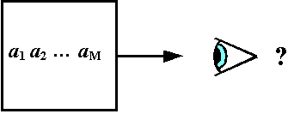
Information Source
Produces a sequence of messages (answers, symbols)
From a given set (alphabet)
With a probability distribution
Discrete memoryless:
messages are independent and identically distributed
With memory (not covered in this course):
probabilities depend on state (past messages sent)
Notes:
Memory: e.g., letter U is more probable after Q
Cf. Finite Automaton
Sender can be modeled as an information source

Slide 19
Entropy
Entropy H(S) of information source S:
Average (expected, mean) amount of information per message
Discrete memoryless information source:
Measured in bits

Slide 20
Entropy: Example 1
Source: 2 messages, probabilities p and 1 – p = q
Notes:
H(0.11) = 0.4999
– log₂ 0.11 = 3.184 multiplied by 0.11 ➔ 0.350
– log₂ 0.89 = 0.168 multiplied by 0.89 ➔ 0.150

Slide 21
Entropy: Example 2
Source: N messages, each with probability p = 1 / N

Slide 22
Entropy: Example 3
Source: 3 messages, probabilities p, p, and 1 – 2p = q
Notes:
Maximum entropy when p = 1/3: all messages equally probable

Slide 23
Properties of Entropy
Consider information source S with N messages
Entropy bounds: 0 ≤ H(S) ≤ log₂ N
H(S) = 0 if and only if P(A) = 1 for some message A∈S (certainty)
H(S) = log₂ N if and only if P(A) = 1/N for all A∈S (max. uncertainty)
Notes:
Conditions when extremes are achieved

Slide 24
Lower Bound on Comparison Sorting
Treated in more detail in tutorial session
See Algorithms Unlocked, Chapter 4
Sorting N items (keys), based on pairwise comparisons,
requires, in the worst case, Ω(N log N) comparisons
N.B. Can sort faster when not using pairwise comparisons
Counting Sort
Radix Sort
Notes:
Select one (viz. the sorted order) among the N! permutations of N keys
All permutations equally probable
Information content is log₂ N! = Ω(N log₂ N)
Each comparison yields at most 1 bit of information; hence, Ω(N log₂ N) comparison needed
N.B. A comparison could yield 0 bits: if you already know a < b and b < c, then asking a < c yields no (new) information

Slide 25
Shannon’s Source Coding Theorem
Source Coding Theorem (Shannon, 1948):
Given: information source S with entropy H
On average, each message of S can be encoded in ≈ H bits
More precisely:
For every ε > 0,
there exist lossless encoding/decoding algorithms, such that
each message of S is encoded in < H + ε bits, on average
No lossless algorithm can achieve average < H bits / message
Sender
Encoder
Channel
Decoder
Receiver

Slide 26
Notes about Source Coding Theorem
The Source Coding Theorem does not promise that the encoding always succeeds in using < H + ε bits for every message
It only states that this is accomplished on average
That is, in the long run, measured over many messages
Cf. the Law of Large Numbers
This theorem motivates the relevance of entropy:
H is a limit on the efficiency
Assumption: all channel symbols (bits) cost the same
Cost: time, energy, matter

Slide 27
Proof of Source Coding Theorem
The proof is technically involved (outside scope of 2IS80)
However, it is noteworthy that basically any ‘random’ code works
It involves encoding of multiple symbols (blocks) together
The more symbols are packed together, the better the entropy can be approached
The engineering challenge is to find codes with practical source encoding and decoding algorithms (easy to implement, efficient to execute)
Notes:
What is a disadvantage of packing more messages together? Higher latency (encoded bits arrive after a longer delay)

Slide 28
Source Coding: Example 1
2 messages, A and B, each with probability 0.5 (H = 1)
Encode A as 0, and B as 1
Mean number of bits per message: 0.5*1 + 0.5*1 = 1

Slide 29
Source Coding: Example 2
2 messages, A and B, with probabilities 0.2 and 0.8 (H = 0.72)
Encode A as 0 and B as 1
On average, 1 bit / message
Can be improved (on average):
Notes:
Variable-length to variable-length code
Why does this code “work”; that is, why can it be decoded?
N.B. Only bits (0/1) are sent; no blanks or commas or separators
Example to decode: 11010001011 ➔ BBBBBBBAABBBBBA
A kind of run-length encoding: 0, 1, 2, or 3-or-more adjacent B

Slide 30
Source Coding: Example 3
3 messages, A, B, and C, each with probability 1/3 (H = 1.58)
Encode A as 00, B as 01, and C as 10: 2 bits / message
Can be improved (on average)
27 sequences of 3 messages (equiprobable)
Encode each sequence of 3 messages in 5 bits (32 possibilities)
Mean number of bits per message: 5/3 = 1.67
243 sequences of 5 messages, encode in 8 bits (256 possibilities)
Mean number of bits per message: 8/5 = 1.6
Notes:
Could encode C as just 1: mean number of bits / message goes to 5/3 (is decodable)
Fixed-length blocks, fixed-length code words
How about dice rolls? 6 messages, probability 1/6 (H = 2.585)
How large should the groups be, to go below 2.6 bits / symbol on average?

Slide 31
Source Coding: Example 4
3 messages, A, B, C, with probabilities ¼, ¼, ½ (H = 1.5)
Encode A as 00, B as 01, and C as 10: 2 bits / message
Can be improved (on average):
Encode A as 00, B as 01, and C as 1
1.5 bits / message (expected)
Notes:
Variable-length code words
Decoding is a concern: here, it works.
Ideal compression, entropy is reached

Slide 32
Prefix-free Codes
Variable-length code words
No code word is the prefix of another code word
v is prefix of vw
Necessary and sufficient condition for unique left-to-right decoding
Without requiring special separator symbols (spaces, commas)

Slide 33
Huffman’s Algorithm
See Chapter 9 of Algorithms Unlocked
Given a set of messages with probabilities
Constructs an optimal prefix-free binary encoding
Combine two least probable messages Y and Z into a new virtual message YZ, with P(YZ) = P(Y) + P(Z)
Y and Z can be distinguished by one additional bit
Repeat until all messages are combined

Slide 34
Huffman’s Algorithm: Example
P(A) = 0.1, P(B) = 0.2, P(C) = 0.25, P(D) = 0.45 (entropy = 1.815)
Combine A + B into AB
P(C) = 0.25, P(AB) = 0.3, P(D) = 0.45
Combine C + AB into CAB
P(D) = 0.45, P(CAB) = 0.55
Combine D + CAB into DCAB
P(DCAB) = 1.0
Code for D starts with 0, code for CAB starts with 1
Code for C proceeds with 0, code for AB with 1
Code for A proceeds with 0, for B with 1
Encode A as 110, B as 111, C as 10, D as 0
Average code length = 1.85 bit / message
A
B
C
0
1
D
0
1
0
1

Slide 35
Huffman’s Algorithm: Example on TJSM
In Tom’s JavaScript Machine (TJSM),
apply Huffman_assistant.js to input
{ "a": 0.1, "b": 0.2, "c": 0.25, "d": 0.45 }
doing the appropriate merges,
obtaining the sequence
[ "a+b”, "c+ab”, "d+cab” ]
In TJSM,
apply encode_tree.js to these merges,
obtaining the encoding table
{ "a": "110”, "b": "111”, "c": "10”, "d": "0” }

Slide 36
Summary
Information, unit of information, information source, entropy
Efficient communication and storage of information
Source coding: compress data, remove redundancy
Shannon’s Source Coding Theorem: limit on lossless compression
Prefix-free variable-length binary codes
Huffman’s algorithm
Notes:
Slide includes links to Wikipedia

Slide 37
Announcements
Practice Set 3
Uses Tom’s JavaScript Machine (requires modern web browser)
Crypto part (Lecture 11) will use GPG: www.gnupg.org
Windows, Mac, Linux versions available

