Slide 1
ZKProof Community Event October 29, 2019 The Edge, Deloitte, Amsterdam
Verifiable MPC
Berry Schoenmakers
Coding & Crypto group
Dept of Mathematics & Computer Science

Slide 2
Outline
Secure Multiparty Computation (MPC)
MPyC @ TUE
Verifiable MPC
Verifiable MPyC

Slide 3
Part I
MPyC @ TUE

Slide 4
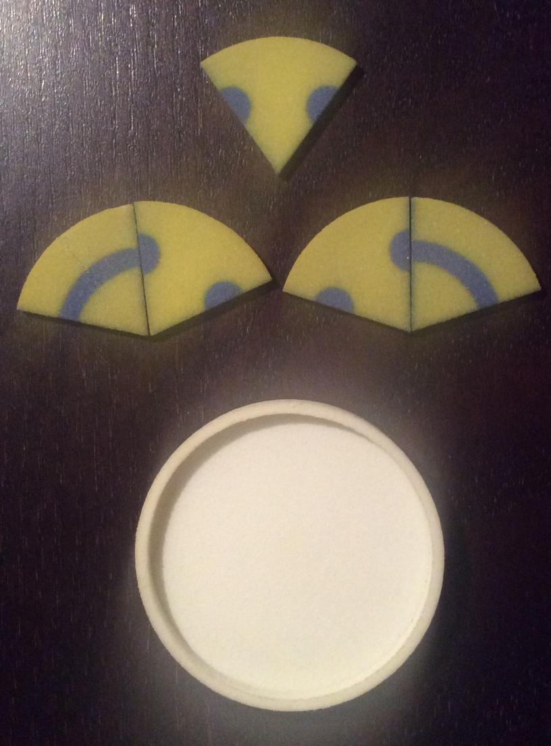
We’ve come a long way …
demonstrations.wolfram.com/ZeroKnowledgeMatchmaker
Julius Caesar’s
Crypto 1.0 gadget
Tom Verhoeff’s
Crypto 2.0 gadget

Slide 5
Crypto 1.0
Crypto 1.0 concerns
- encryption and authentication of data
- during communication and storage/retrieval
protecting against malicious outsiders
Crypto 1.0 primitives:
Keyless
Cryptographic hash functions
Hash chains, Merkle trees
Symmetric (secret key)
Stream/block ciphers
Message authentication codes
Asymmetric (public key)
Public-key encryption
Digital signatures
Key-exchange protocols
Modern Research
into Crypto 1.0:
Side channel resistant crypto
Post Quantum crypto
Lightweight crypto
Quantum crypto
…

Slide 6
Crypto 2.0
Crypto 2.0 additionally concerns
- hiding identity of data owners or any link with them
- partial information release of data
- computing with encrypted data
protecting against malicious insiders (your protocol partners)
Crypto 2.0 primitives:
homomorphic encryption Rivest/Adleman/Dertouzos ’78
secret sharing Blakley ’79, Shamir ’79
blind signatures Chaum ’82
oblivious transfer M. Rabin. ’81, EGL ’85
zero-knowledge proofs Goldwasser/Micali/Rackoff ’85, GMW’ 86
secure two/multiparty computation Yao ’82-86, GMW’87,BGW’88,CCD’88
secure time-stamping Haber/Stornetta ’90, BLLV’ 98
functional encryption Sahai/Waters ’05, Boneh/Sahai/Waters ’11, GKPVZ ’13
fully homomorphic encryption Gentry ’09
indistinguishability obfuscation Garg/Gentry/Halevi/Raykova/Sahai/Waters ’13

Slide 7
MPC @ TU Eindhoven
PhD students:
Andrey Sidorenko, Mehmet Kiraz, José Villegas, Sebastiaan de Hoogh
Current: Niels de Vreede, Frank Blom, Toon Segers
Postdocs:
Tomas Toft, Mikkel Krøigård, Meilof Veeningen
Current: Niek Bouman, Stan Korzilius
Research projects:
Cybervote, PASC, SecureSCM, CACE, PRACTICE, THeCS
Current: SODA, PRIVILEDGE
Verifiable MPC = MPC + ZKP

Slide 8
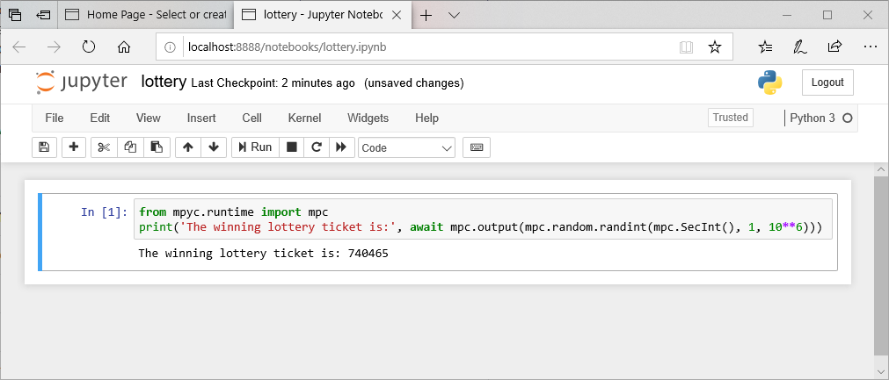
MPyC Secure Multiparty Computation in Python
VIFF (2007) --> TUeVIFF (2012) --> MPyC (2018)
Secure lottery in MPyC:

Slide 9
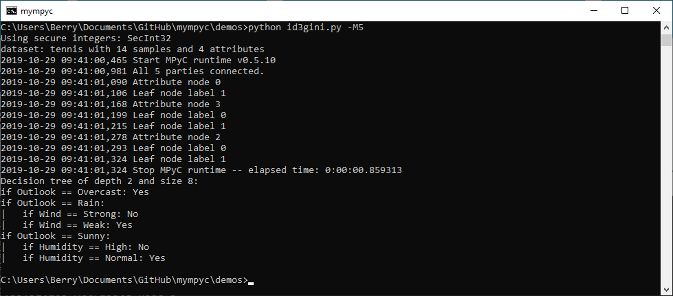
Privacy-Preserving Machine Learning
MPyC demos: ID3 decision trees, linear/ridge regression, neural networks (CNN and binarized MLP), Kaplan-Meier survival analysis, …

Slide 10
Part II
Verifiable MPC

Slide 11
Trust in MPC?
Can we trust the outcome of an MPC protocol?
Yes, possibly:
e.g., if you take part in a 2-party protocol
or, if you take part in a m-party protocol tolerating m-1 corruptions (everyone else potentially corrupt)
No, if you do not take part!
MPC gives no security if all parties are corrupt!!

Slide 12
Similar to situation for ZKPs?
Suppose you observe ZKP run between P and V:
P sends announcement a to V
V sends challenge c to P
P sends response r to V
Q: How convincing is this proof?
A: Depends on who needs convincing!
V should be convinced
But as an observer you shouldn’t
You may as well been watching a simulated (a;c;r)
Make ZKP non-interactive to convince anyone.
commitment to a nonce

Slide 13
Limited Scope of MPC
MPC → secure function evaluation y = f(x) hiding input x
What MPC does not achieve:
MPC does not stop parties from entering bogus inputs
e.g., Yao’s millionaires (1982) can lie about their riches
MPC in outsourcing scenario:
Parties performing MPC could ALL be corrupt.
Wrong result y* ≠ f(x) cannot be detected.
Simulation-based security: indistinguishable views !
Active security does not help !

Slide 14
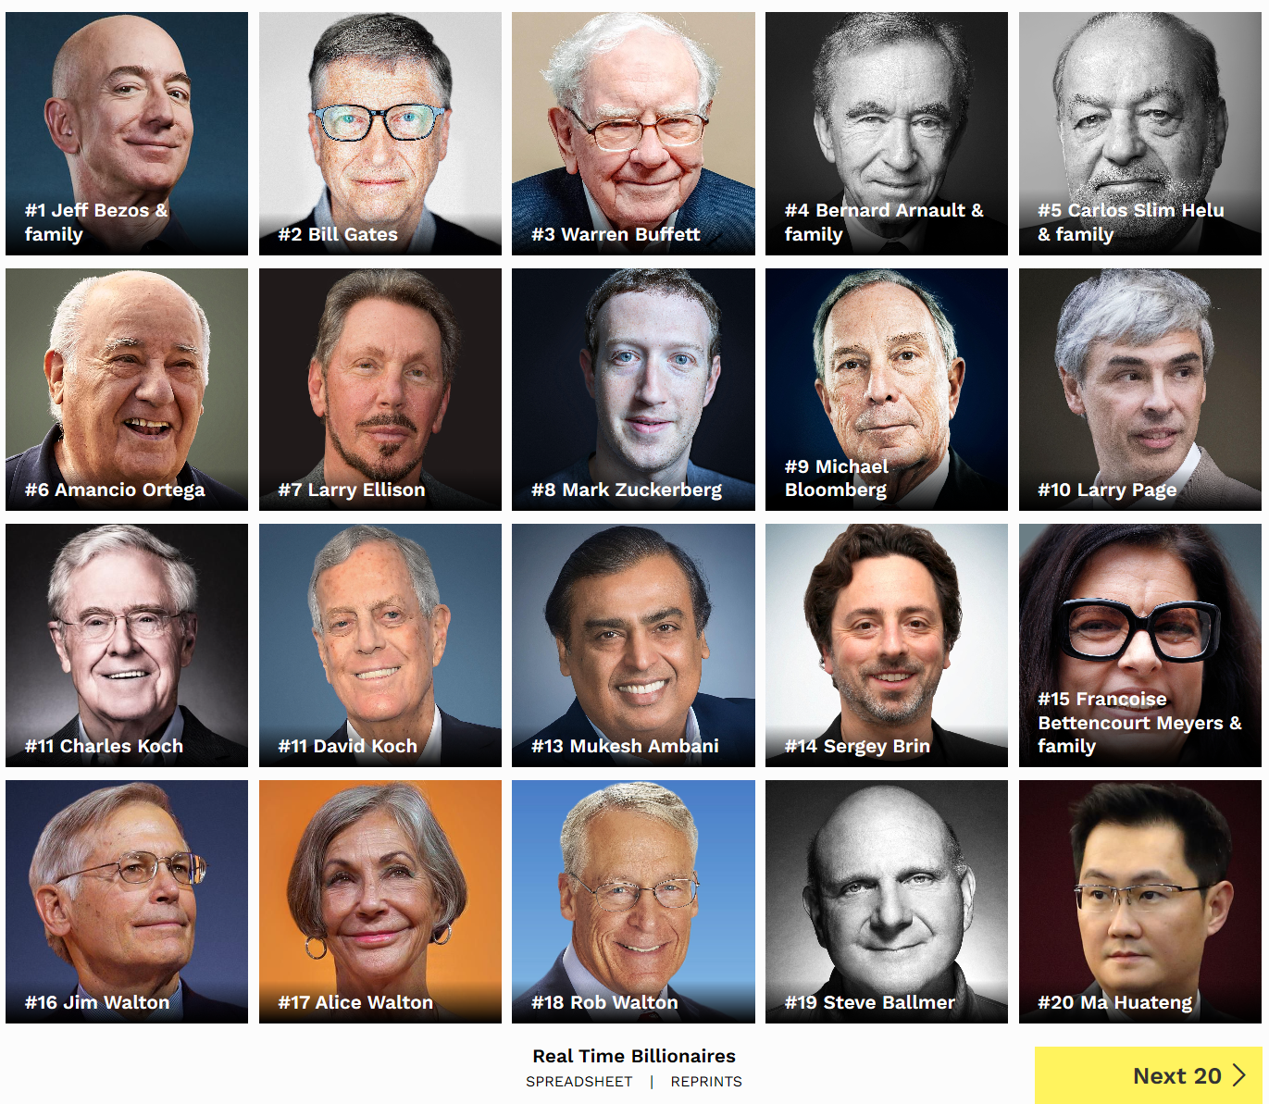
The World’s Billionaires Problem
Upgrade of Yao’s Millionaires’ problem:
Privacy of inputs, verifiable inputs and outputs
Verifiably correct input:
Committed/encrypted tax returns
Signed by the tax authority
Posted on a blockchain
Verifiably correct output:
Top 400 billionaires world-wide
Privacy:
Privacy for all outside top 400
© 2019 Forbes Media LLC. All Rights Reserved.
Source: Forbes.com, Published March 5, 2019 (link)

Slide 15
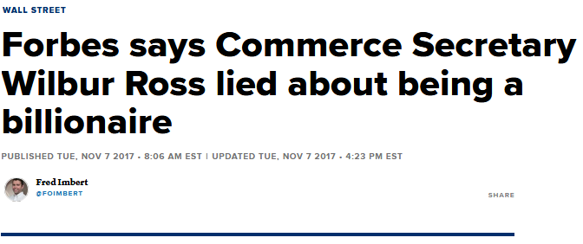
Wannabe billionaires …
© 2019 CNBC LLC. All Rights Reserved. A Division of NBCUniversal
Notes:
“Just a year ago, Forbes listed Ross’ net worth at $2.9 billion and included him in the Forbes 400 list of the richest Americans by net worth.
The new report says Ross had just under $700 million in assets. It cited financial-disclosure forms filed by Ross after being nominated for his Commerce secretary.”

Slide 16
The World’s Billionaires Problem
Upgrade of Yao’s Millionaires’ problem:
Privacy of inputs, verifiable inputs and outputs
Verifiably correct input:
Committed/encrypted tax returns
Signed by the tax authority
Posted on a blockchain
Verifiably correct output:
Top 400 billionaires world-wide
Privacy:
Privacy for all outside top 400
© 2019 Forbes Media LLC. All Rights Reserved.
World’s Billionaires ≈ sealed bid auction
(replace tax returns by sealed bids)
Source: Forbes.com, Published March 5, 2019 (link)

Slide 17
Part III
Verifiable MPyC

Slide 18
Key ingredients for verifiable MPC
ElGamal encrypted inputs E($x_{i}$)
Verifiable input x:
Committed or encrypted input values
Public input values also possible
Digitally signed
Optionally, posted on blockchain (timestamp, uniqueness)
Verifiable output y = f(x):
Committed or encrypted output values
Public output values also possible
Threshold signed
Optionally, posted on blockchain
Noninteractive ZKP that y= f(x) holds.
ElGamal encrypted output E(y) with y = $\prod_{i}{x_{i}}$
+ ZKP that
this holds

Slide 19
Computation vs proofs (verification)
For y = f(x):
Compute y from x
Compute proof for y = f(x)
Verification can be much easier than computation!
NP-complete problems:
computation -> exponential time?
verification -> polynomial time
y = 1/x harder to compute than verifying x * y = 1
y = $\sqrt{x}$ harder to compute than verifying y * y = x
…

Slide 20
Extend MPyC
Details of secure computation protocols transparent in MPyC:
sophisticated operator overloading combined with asynchronous evaluation of associated protocols
we like to retain this for verifiable MPyC
Secure m-party computation tolerating dishonest minority of t passively corrupt parties, 1 ≤ 2t+1 ≤ m
Case m = 1 included: verifiable MPC with 1 party corresponds to ordinary ZK proofs for statements of the form y = f(x)

Slide 21
Candidate ZK Proofs for MPC
Pinocchio-based: multiparty computation of proof
Prototype for simple arithmetic
Building on work by Meilof Veeningen (on GitHub)
Trinocchio/Geppetri protocols
pysnark
Sigma-proofs can be used for simple cases:
E.g., threshold Schnorr signatures are obtained for function f(sk; m) = (c; r) where c = H(g^r/pk^c; m)
Bullet-proofs: nice middle ground

Slide 22
Extend MPyC
MPyC protocols based on threshold secret sharing:
Shamir threshold scheme
PRSS (pseudorandom secret sharing)
Need conversion between encrypted inputs/outputs and secret-shared representation
involves threshold (multiparty) decryption
prototype for ElGamal encryption

Slide 23
Conclusion
MPyC: pure Python (runs on Cpython and PyPy), small footprint (5000 lines), code on GitHub
If sufficient number of parties can be trusted:
ordinary MPC for privacy and correctness,
If potentially all parties are corrupt:
verifiable MPC ensures no false results are accepted
Case m=1 party corresponds to ZKP
Much harder to do then ordinary MPC
But verification is easier than computation

Slide 24
H2020 EU-projects
priviledge-project.eu
soda-project.eu
This work is part of projects that have received funding from the European Union’s Horizon 2020 research and innovation programme under grant agreement No 780477 (PRIVILEDGE) and No 731583 (SODA)

Slide 25
MPyC: core modules

