Slide 1
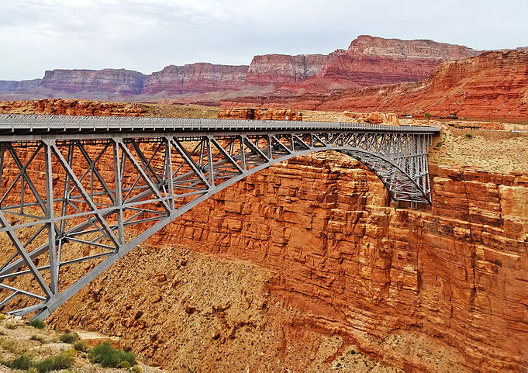
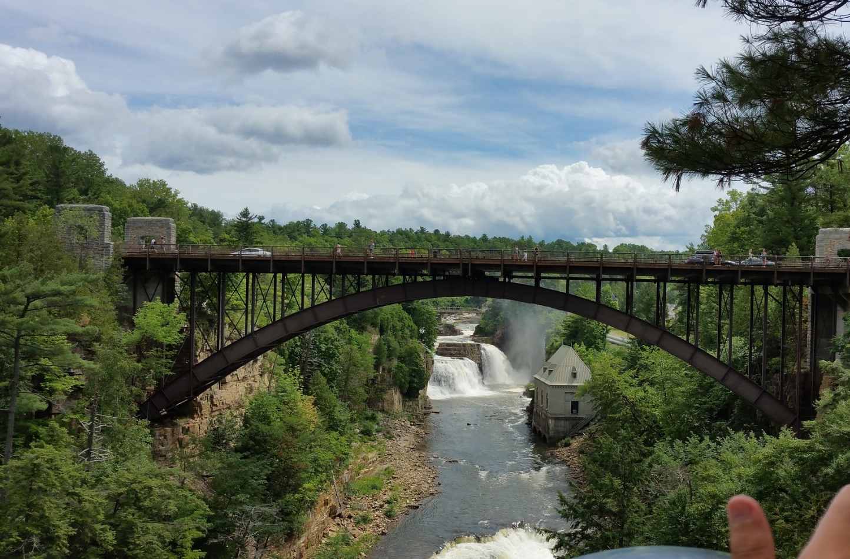
Bridge-Depth Characterizes which Structural Parameterizations of Vertex Cover Admit a Polynomial Kernel
Marin Bougeret LIRMM, Université de Montpellier Bart M. P. Jansen Eindhoven University of Technology Ignasi Sau LIRMM & CNRS, Université de Montpellier
Indian Parameterized Complexity Seminar July 20th 2020
Notes:
Photo File:Navajo Bridge over Marble Canyon, AZ 9-15 (21791439235).jpg edited from https://commons.wikimedia.org/wiki/File:Navajo_Bridge_over_Marble_Canyon,_AZ_9-15_(21791439235).jpg , cc-by-sa-2.0.
Goal of the talk: introduce the graph-parameter bridge-depth and explain how it concludes a line of research into parameterized preprocessing for vertex cover.

Slide 2
Data reduction with a guarantee for NP-hard problems
A kernelization for a parameterized decision problem $L$ is:
an algorithm that transforms inputs $(x,p)$ into $(x^{′},p^{′})$
in $poly(\left|x\right|,p)$ time
such that $(x,p)$ has answer yes iff $(x^{′},p^{′})$ has answer yes
and $\left|x^{′}\right|≤f(p)$ and $p^{′}≤f(p)$
The function $f:ℕ→ℕ$ is the size of the kernelization If the size bound $f$ is a polynomial, it is a polynomial kernelization
A kernelization guarantees that instances that are large with respect to their complexity parameter can be shrunk
$n$ bits
$f(p)$ bits
$$x$$
$poly(\left|x\right|,p)$ time
$$x′$$
$$p$$
$$p′$$

Slide 3
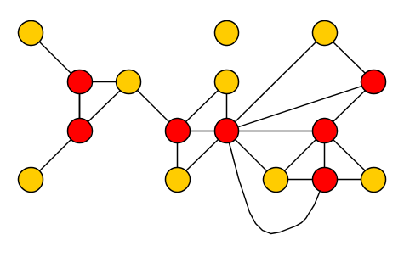
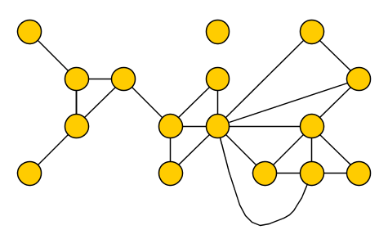
The Vertex Cover problem
Input: A graph $G$ and an integer $k$ Question: Is there a set $S$ of at most $k$ vertices in $G$, such that each edge has an endpoint in $S$?
$\min{VC(G)}$ = size of min. vertex cover = vertex deletion distance to an edgeless graph
Notes:
Optimal vertex cover size is 7: three vertex-disjoint triangles + disjoint edge. NP-complete, but fixed-parameter tractable and admits a polynomial kernel.
Introduce notion of modulator to a graph class F. Then: Go from Vertex Cover def to FVS to other parameterizations.

Slide 4
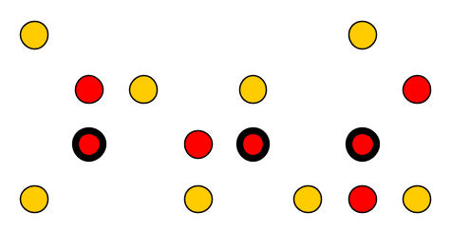
Kernel for Vertex Cover
[Nemhauser & Trotter 1975]
[Chen, Kanj & Jia 2001]
Vertex Cover has a kernel with $2k$ vertices: a polynomial-time algorithm can reduce any instance $(G,k)$ to an equivalent instance on at most $2⋅min VC\left(G\right)$ vertices
Vertex Cover has a kernel with $2k$ vertices: a polynomial-time algorithm can reduce any instance $(G,k)$ to an equivalent instance on at most $2k$ vertices
Input: A graph $G$ and an integer $k$ Question: Is there a set $S$ of at most $k$ vertices in $G$, such that each edge has an endpoint in $S$?
$\min{FVS(G)}$ = feedback vtx. number = deletion distance to a forest (acyclic graph)
Notes:
NP-complete, but fixed-parameter tractable and admits a polynomial kernel.
Introduce notion of modulator to a graph class F.
2*minVC(G) may be a bad guarantee, if minVC(G) has size proportional to |G| (like on a path). Then: Go from Vertex Cover def to FVS to other parameterizations.

Slide 5
Structural parameterizations for Vertex Cover
[J & Bodlaender 2011]
A polynomial-time algorithm can reduce any instance $(G,k)$ of Vertex Cover to an equivalent instance on $O\left({\left(\min{FVS}\left(G\right)\right)}^{3}\right)$ vertices
Input: A graph $G$ and an integer $k$ Question: Is there a set $S$ of at most $k$ vertices in $G$, such that each edge has an endpoint in $S$?
$\min{FVS(G)}$ = feedback vtx. number = deletion distance to a forest (acyclic graph)
Notes:
Optimal vertex cover size is 7: three vertex-disjoint triangles + disjoint edge. NP-complete, but fixed-parameter tractable and admits a polynomial kernel.
Introduce notion of modulator to a graph class F. Then: Go from Vertex Cover def to FVS to other parameterizations.

Slide 6
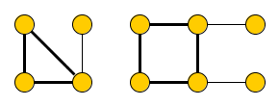
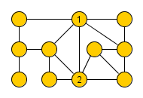
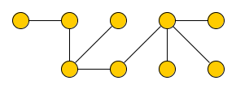
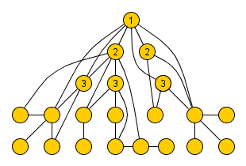
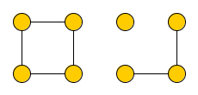
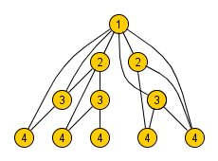
Kernels for Vertex Cover parameterized by deletion-distance to …
[Bougeret, J & Sau, ICALP]
[Fomin & Strømme, WG]
[Hols & Kratsch, IPEC]
[J & Bodlaender, STACS]
Bridge-depth $O(1)$
Pseudo-forest
$d$-quasi-forest
Forest
2010 2011 2012 2013 2014 2015 2016 2017 2018 2019 2020
Elimination depth $O(1)$ to a forest
Degree $≤$ 2
Tree-depth $O(1)$
[Majumdar, Raman, Saurabh, IPEC]
[Bougeret & Sau, IPEC]
[Hols, Kratsch & Pieterse, STACS]
Notes:
Superpolynomial lower bounds: if $ℱ$ contains all cliques or all outerplanar graphs (of treewidth 2).
75: Nemhauser – Trotter.
2001: Jianer Chen, Iyad Kanj, and Weija Jia. Vertex Cover: Further Observations and Further Improvements. They apply the NT theorem.
2011: FVS [J & Bodlaender]. STACS 2011.
2015: Diptapriyo Majumdar, Venkatesh Raman, Saket Saurabh: Kernels for Structural Parameterizations of Vertex Cover - Case of Small Degree Modulators. IPEC 2015. [Degree-2 modulator] 2016: Fedor V. Fomin, Torstein J. F. Strømme: Vertex Cover Structural Parameterization Revisited. WG 2016 [Pseudo forest, each component has at most 1 cycle; is not the same as FVS of size 1?]
2017: Marin Bougeret, Ignasi Sau: How Much Does a Treedepth Modulator Help to Obtain Polynomial Kernels Beyond Sparse Graphs?. IPEC 2017 [bounded treedepth]
2017: Eva-Maria C. Hols, Stefan Kratsch: Smaller Parameters for Vertex Cover Kernelization. IPEC 2017 [d-pseudo-forest] (FVS of size d in each component)
2020: Eva-Maria C. Hols, Stefan Kratsch, Astrid Pieterse: Elimination Distances, Blocking Sets, and Kernels for Vertex Cover. STACS 2020. Bounded elimination distance to a forest (+ randomized algorithms)

Slide 7
Our results
We introduce a new graph parameter called bridge-depth, by a recursive definition similar to tree-depth
Let $ℱ$ be a minor-closed class of graphs, and assume NP ⊈ coNP/poly
Ultimate tractable generalization of forests and bounded-tree-depth graphs
Generalizes all (deterministic) kernels known before
Proof relies on excluded-minor characterization bridge-depth, and relations to blocking sets
Vertex Cover parameterized by vertex-deletion distance to $ℱ$ has a polynomial kernel if and only if $ℱ$ has bounded bridge-depth
Notes:
Degree of the polynomial depends on the bound on the bridge-depth. Next steps: define bridgedepth, look at blocking sets, see how they relate.

Slide 8
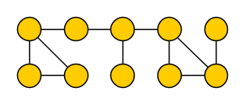
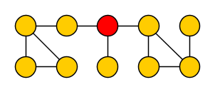
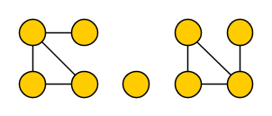
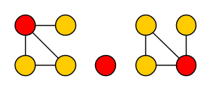
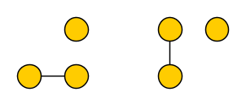
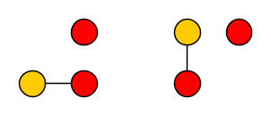
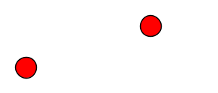
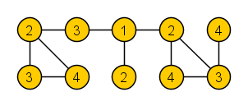
The tree-depth of a graph
Measures depth of a process that eliminates the graph by removing vertices
The tree-depth $td(G)$ of graph $G$ is defined as follows:
$td\left(G\right)=\left\{ \begin{matrix} \\ \begin{matrix} \\ \\ \end{matrix} \\ \end{matrix}\right.$
Note:
$td\left(G\right)≥tw\left(G\right)$ and does not increase when taking minors
A connected graph $G$ has a vertex whose removal decreases $td(G)$
$0$ | if $G=∅$
$1+\min_{v∈V\left(G\right)}{td(G−\left\{v\right\})}$ | if $G$ is connected
$\max_{i=1}^{m}{td\left(C_{i}\right)}$ | if $G$ has components $C_{1},…, C_{m}$
Notes:
Mention that you can equivalently the definition as how many rounds you need to get to the empty graph, where a round deletes 1 vertex in each component.

Slide 9
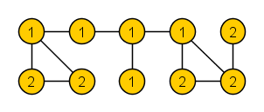
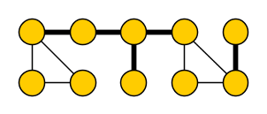
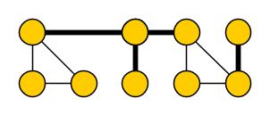
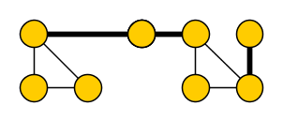
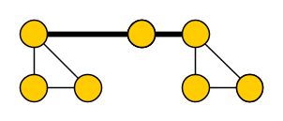
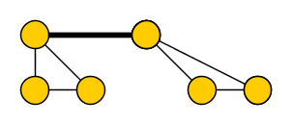
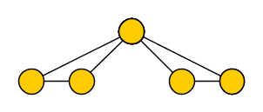
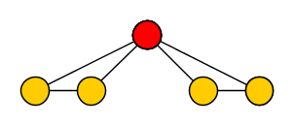
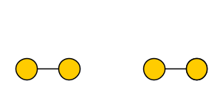
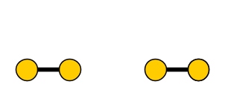
The bridge-depth of a graph
Measures depth of a process that eliminates the graph by removing trees-of-bridges
Define $G_{CB}$ as the graph obtained from $G$ by simultaneously contracting all bridges
The bridge-depth $bd(G)$ of graph $G$ is defined as follows:
$bd\left(G\right)=\left\{ \begin{matrix} \\ \begin{matrix} \\ \\ \end{matrix} \\ \end{matrix}\right.$
Note:
$td\left(G\right)≥bd\left(G\right)≥tw\left(G\right)$ and $bd\left(G\right)$ does not increase for minors
A connected $G$ has a tree-of-bridges whose removal decreases $bd\left(G\right)$
Structure of vertex covers of $G$ is related to $bd\left(G\right)$via blocking sets
$0$ | if $G=∅$
$1+\min_{v∈V\left(G_{CB}\right)}{bd(G_{CB}−\left\{v\right\})}$ | if $G$ is connected
$\max_{i=1}^{m}{bd\left(C_{i}\right)}$ | if $G$ has components $C_{1},…, C_{m}$
Notes:
To see bd is incomparable to pathwidth: the 2xn grid has bridgedepth Omega(n) but pathwidth 2.
A complete binary tree of depth n has bridgedepth 1 but pathwidth Omega(n). Bridge-depth is minor-closed.
Now to relate bridge-depth to kernels, we use the combinatorial notion of blocking sets.

Slide 10
Previous kernels are special cases of bounded bridge-depth
[Fomin & Strømme, WG]
[Hols & Kratsch, IPEC]
[J & Bodlaender, STACS]
Pseudo-forest
Forest
$d$-quasi-forest
2010 2011 2012 2013 2014 2015 2016 2017 2018 2019 2020
Elimination depth $O(1)$ to a forest
Degree $≤$ 2
Tree-depth $O(1)$
[Majumdar, Raman, Saurabh, IPEC]
[Bougeret & Sau, IPEC]
[Hols, Kratsch & Pieterse, STACS]
Notes:
75: Nemhauser – Trotter.
2001: Jianer Chen, Iyad Kanj, and Weija Jia. Vertex Cover: Further Observations and Further Improvements. They apply the NT theorem.
2011: FVS [J & Bodlaender]. STACS 2011.
2015: Diptapriyo Majumdar, Venkatesh Raman, Saket Saurabh: Kernels for Structural Parameterizations of Vertex Cover - Case of Small Degree Modulators. IPEC 2015. [Degree-2 modulator] 2016: Fedor V. Fomin, Torstein J. F. Strømme: Vertex Cover Structural Parameterization Revisited. WG 2016 [Pseudo forest, each component has at most 1 cycle; is not the same as FVS of size 1?]
2017: Marin Bougeret, Ignasi Sau: How Much Does a Treedepth Modulator Help to Obtain Polynomial Kernels Beyond Sparse Graphs?. IPEC 2017 [bounded treedepth]
2017: Eva-Maria C. Hols, Stefan Kratsch: Smaller Parameters for Vertex Cover Kernelization. IPEC 2017 [d-pseudo-forest] (FVS of size d in each component)
2020: Eva-Maria C. Hols, Stefan Kratsch, Astrid Pieterse: Elimination Distances, Blocking Sets, and Kernels for Vertex Cover. STACS 2020. Bounded elimination distance to a forest (+ randomized algorithms)
How can we characterize the graph families F for which Vertex Cover parameterized by vertex-deletion distance to F admits a polynomial kernel?
Lower bound: Deletion distance to treewidth 2, and include specific picture? Overlay on Fomin & Stromme graph?

Slide 11
Motivating examples for bridge-depth
If hereditary graph class $ℱ$ contains arbitrarily long chains of triangles:
then a superpolynomial kernel lower bound for Vertex Cover parameterized by deletion distance to $ℱ$ follows easily from known reductions [Fomin & Strømme, WG]
But for the class $ℱ′$ containing the following structures and their induced subgraphs, a polynomial kernel exists:
For a sequence of $n$ triangles, both structures have tree-depth $Θ(\log{n})$
The structure at the top has bridge-depth $Θ(\log{n)}$, the structure at the bottom $O(1)$
Notes:
So bridge-depth correctly separates the hard from the easy family of graphs. It was already known that you cannot go ‘far’ from bounded tree-depth for feasible classes $ℱ$: when $ℱ$ consists of outerplanar graphs of treewidth 2, no polynomial kernel exists.

Slide 12
For any minor-closed family $ℱ$, the following are equivalent:
$ℱ$ has bridge-depth $O(1)$
Minimal blocking sets of graphs in $ℱ$ have size $O(1)$
Necklace models in graphs in $ℱ$ have length $O(1)$
Notes:
Proof is based on graph-theoretic insights about bridge-depth and minor closed families. So before looking at kernelization algorithms, we consider the following implications.

Slide 13
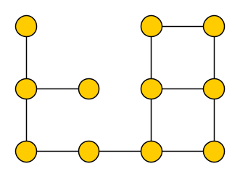
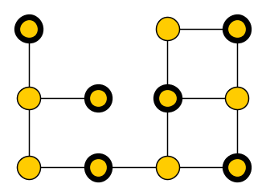
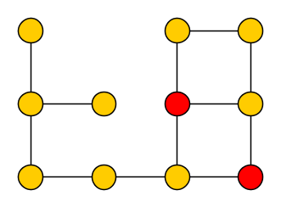
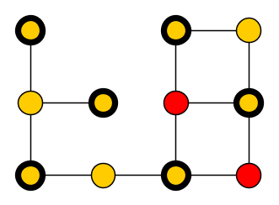
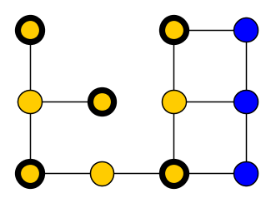
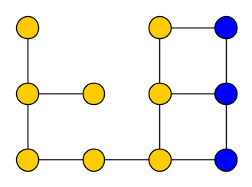
Blocking sets
Let $α\left(G\right)$ denote the maximum size of an independent set in $G$
A set $S⊆V(G)$ is a blocking set in $G$ if $α\left(G−S\right)<α(G)$
A blocking set is minimal if no proper subset is a blocking set
$S⊆V(G)$ is a blocking set in $G$ $$⇔$$
there is no minimum vertex cover in $G$ that contains all vertices of $S$
$$α\left(G\right)=6$$
$$α\left(G−S′\right)=5$$
$$α\left(G−S\right)=6$$
Notes:
So for a blocking set S, all max independent sets use at least one vertex of S; so equivalently, no minimum vertex cover contains all vertices of S.

Slide 14
Blocking sets and Vertex Cover kernelization
Historically, size of minimal blocking sets in $ℱ$ is closely related to kernels for Vertex Cover parameterized by deletion distance to $ℱ$
All known kernels are for families $ℱ$ whose minimal blocking sets have size $O(1)$
If $ℱ$ is closed under disjoint union and contains graphs with arbitrarily large minimal blocking sets, there is no polynomial kernel unless NP $⊆$ coNP/poly
Is a bound on minimal blocking set sizes in $ℱ$ sufficient, to get polynomial kernels for Vertex Cover param. by distance to $ℱ$?
Not for general $ℱ$, but it is for minor-closed $ℱ$!
?
Is a bound on minimal blocking set sizes in $ℱ$ sufficient, to get polynomial kernels for Vertex Cover param. by distance to $ℱ$?
[Hols, Kratsch & Pieterse, STACS]
[Bougeret, J & Sau, ICALP]
Notes:
So for a blocking set S, all max independent sets use at least one vertex of S; so equivalently, no minimum vertex cover contains all vertices of S.

Slide 15
Blocking sets in paths of triangles
A set $S⊆V(G)$ is a blocking set in $G$ if $α\left(G−S\right)<α(G)$
Let $Δ_{n}$ be a chain of $n$ vertex-disjoint triangles, with the first and last vertex removed:
The $n$ bottom vertices form a blocking set, which is minimal
[Fomin & Strømme, WG]
$$α\left(Δ_{n}\right)=n$$
$Δ_{n}$ has a minimal blocking set of size $n$
Notes:
So for a blocking set S, all max independent sets use at least one vertex of S; so equivalently, no minimum vertex cover contains all vertices of S.

Slide 16
Necklace models
A necklace model of length $m$ in a (simple) graph $G$ is a sequence of disjoint, connected vertex sets $S_{1},…,S_{m+1}$ such that each $S_{i}$ has at least two edges to $S_{i+1}$
If $G$ has a necklace model of length $t$, then it contains $Δ_{n}$ as a minor for $n=⌊\frac{t+1}{2}⌋$
$$S_{1}$$
$$S_{2}$$
$$S_{3}$$
$$S_{4}$$
$$S_{5}$$
$$S_{6}$$
If minor-closed $ℱ$ has a graph $H$ with a necklace model of length $t$, then some graph $H^{′}∈ℱ$ has a minimal blocking set of size $t/2$
Notes:
Follow-up: So if a minor-closed $ℱ$ contains a graph with a necklace model of length $t$, then $ℱ$ contains $Δ_{n}$ , so some graph in $ℱ$ has a minimal blocking set of size $Ω(t)$.

Slide 17
For any minor-closed family $ℱ$, the following are equivalent:
$ℱ$ has bridge-depth $O(1)$
Minimal blocking sets of graphs in $ℱ$ have size $O(1)$
Necklace models in graphs in $ℱ$ have length $O(1)$
Notes:
Later, we will connect this to complexity-theoretic statements about kernelization. So: the absence of large minimal blocking sets can be witnessed and exploited algorithmically by having small bridge-depth, giving a corresponding graph decomposition.

Slide 18
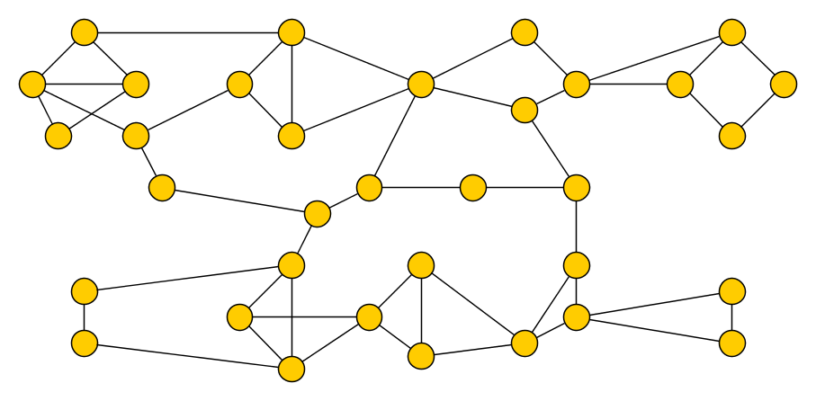
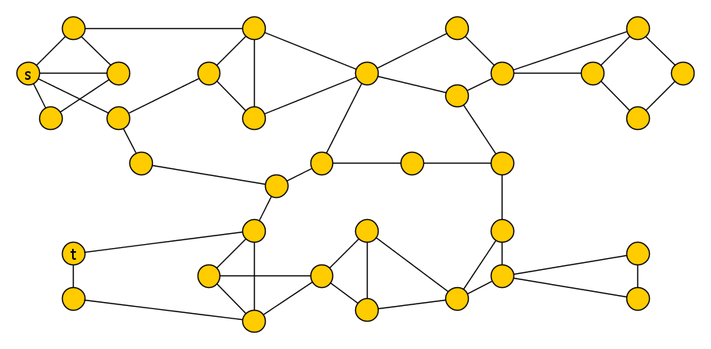
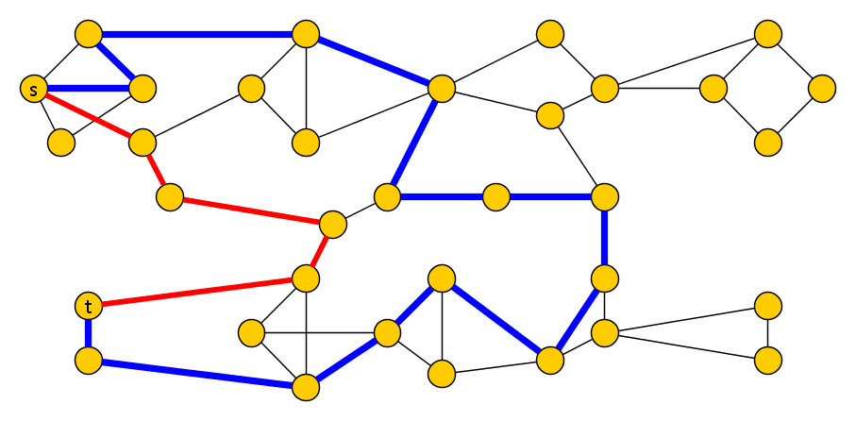
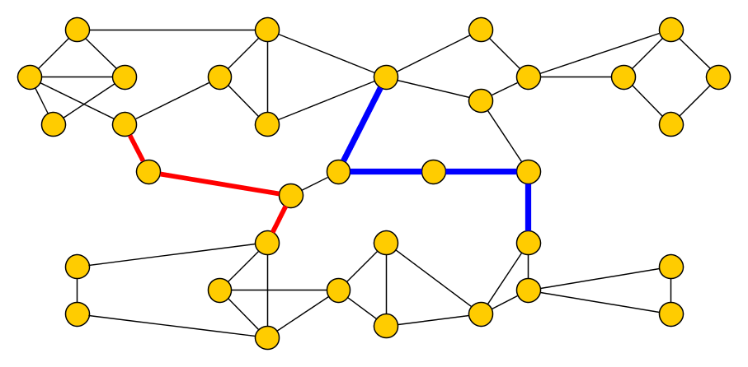
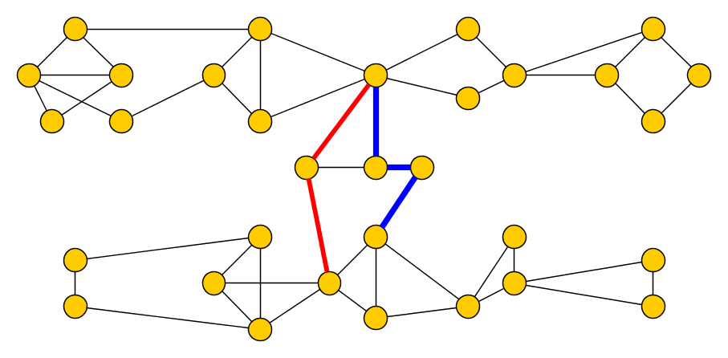
Necklace models in bridgeless graphs
If $G$ is bridge-less and connected, any two maximum-length necklace models intersect
Proof. Assume for contradiction that $G$ contains two vertex-disjoint maximum-length models $𝒮=(S_{1},…,S_{m+1})$ and $𝒯=(T_{1},…,T_{m+1})$. Pick vertices $s∈S_{1}$ and $t∈T_{1}$.
$S_{1}$
$S_{2}$
$S_{3}$
$S_{4}$
$S_{5}$
If both paths attach in the middle:
Menger’s theorem $⇒$2 edge-disjoint paths
$⇒$ 2 edge-disjoint $𝒮$-$𝒯$ paths with interiors not intersecting $𝒮∪𝒯$
If some path does not attach in the middle:
$T_{1}$
$T_{2}$
$T_{3}$
$T_{4}$
$T_{5}$

Slide 19
Necklace models in bridgeless graphs
If $G$ is bridge-less and connected, any two maximum-length necklace models intersect
[Robertson & Semour, JCTB] [van Batenburg, Huynh, Joret & Raymond, SODA]
By applications of Erdős–Pósa properties for models of planar minors:
If there is no packing of $k=2$ vertex-disjoint length-$t$ necklace models, then there is a vertex set of size $f_{t}\left(2\right)$ that hits all such models
Let $nm(G)$ denote the maximum length of a necklace model in $G$
If $G$ is bridge-less and connected, then there is a vertex set $S$ of size $f(nm\left(G\right))$ such that $nm\left(G−S\right)<nm(G)$

Slide 20
Bridge-depth is bounded in length of necklace models
Any graph $G$ can be reduced to an acyclic graph by a process of depth $nm(G)$, where each round consists of:
Contracting all bridges [preserves bridge-depth; afterwards, all pairs of maximum-length necklace models in a component intersect]
Removing a vertex set of size $f(nm\left(G\right))$ from each component [decreases maximum length of necklace models]
This implies the bridge-depth of $G$ is bounded in terms of $nm(G)$
Notes:
Since any cycle gives a necklace model of length 1, a graph that does not have necklace model of length 1 is acyclic

Slide 21
For any minor-closed family $ℱ$, the following are equivalent:
$ℱ$ has bridge-depth $O(1)$
Minimal blocking sets of graphs in $ℱ$ have size $O(1)$
Necklace models in graphs in $ℱ$ have length $O(1)$

Slide 22
Relation between blocking sets and bridge-depth
We prove the following lemma, bounding the size of minimal blocking sets:
This bound is best-possible, as witnessed by truncated triangle-paths
Generalizes result by Bougeret & Sau, who proved analogous statement for tree-depth
Proof uses induction on $bd\left(G\right)$ using the fact that: each connected graph $G$ has a tree-of-bridges $T$ such that $bd\left(G −V\left(T\right)\right)<bd(G)$
Next: Some ideas in the proof, including base case $bd\left(G\right)=1$for acyclic graphs $G$
Let $Y$ be a blocking set in a graph $G$. There is a blocking set $Y^{′}⊆Y$ in $G$ of size at most $2^{bd\left(G\right)}$.

Slide 23
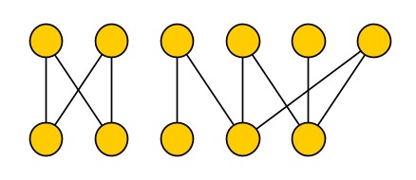
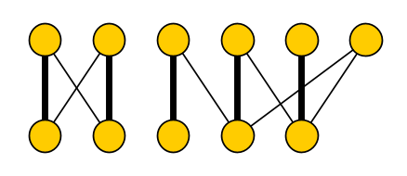
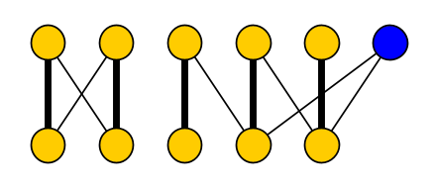
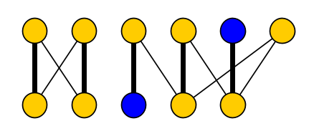
Blocking sets in forests and bipartite graphs
A set $S⊆V(G)$ is a blocking set in $G$ if $α\left(G−S\right)<α(G)$
For the base case, $bd\left(G\right)=1$ implying that $G$ is acyclic and therefore a bipartite graph
Implies that a minimal blocking set in a bipartite graph is either a single vertex, or a pair of vertices from opposite partite sets
So a minimal blocking set in a graph with $bd\left(G\right)=1$ has size at most two
Let $G$ be bipartite with partite sets $A$ and $B$, let $M$ be a maximum matching in $G$. A set $S⊆V(G)$ is a blocking set in $G$ if and only if one of the following holds:
The set $S$ contains a vertex that is not saturated by $M$.
The set $S$ contains some $a∈A$ and $b∈B$ and there exists an $M$-alternating path from $a$ to $b$, starting and ending with a matching edge.
$$A$$
$$B$$
Notes:
Konig’s theorem: in a bipartite graph, minimum size of vertex cover equals size of maximum matching. Since a vertex cover has to contain one endpoint of each matching edge: a minimum vertex cover contains exactly one endpoint of each matching edge (and no unsaturated vertices). Hence the complement, a maximum independent set, contains all unsaturated vertices and exactly one endpoint from each matching edge.

Slide 24
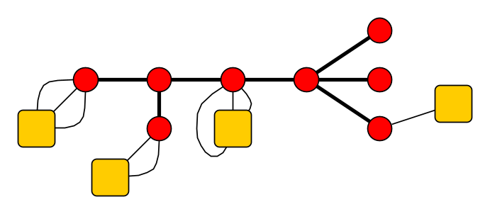
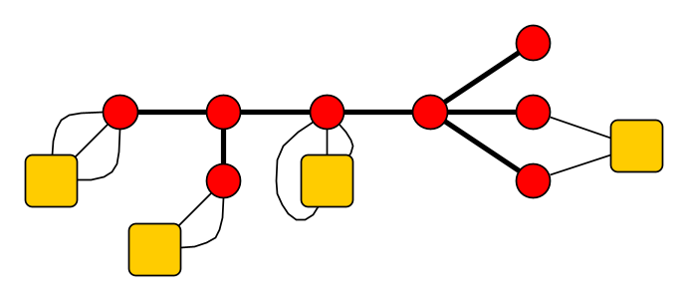
Bounding minimal blocking sets in the induction step
If $G$ is a connected graph with $bd\left(G\right)>1$, then by definition of bridge-depth there is a tree-of-bridges $T$ such that $bd\left(G −V\left(T\right)\right)<bd(G)$
Each connected component $C_{i}$ of $G−V(T)$ is adjacent to exactly one vertex from $T$
Each $C_{i}$ is a subgraph of $G−V(T)$ and has bridge-depth smaller than that of $G$
$$C_{4}$$
$$C_{1}$$
$$C_{3}$$
$$C_{2}$$
Notes:
Adjacent to at least one vertex because $G$ is connected. If a component is adjacent to 2: then some edge of $T$ lies on a cycle and is therefore NOT a bridge.

Slide 25
Bounding minimal blocking sets in the induction step
If $G$ is a connected graph with $bd\left(G\right)>1$, then by definition of bridge-depth there is a tree-of-bridges $T$ such that $bd\left(G −V\left(T\right)\right)<bd(G)$
If $C_{i}$ attaches onto $v_{i}∈V(T)$, we may have $α\left(C_{i}∪\left\{v_{i}\right\}\right)>α\left(C_{i}\right)$, but using such an independent set blocks the neighbors of $v_{i}$ in $T$ from being used
$$C_{4}$$
$$C_{1}$$
$$C_{3}$$
$$C_{2}$$
Notes:
Adjacent to at least one vertex because $G$ is connected. If a component is adjacent to 2: then some edge of $T$ lies on a cycle and is therefore NOT a bridge.

Slide 26
Bounding minimal blocking sets in the induction step
If $G$ is a connected graph with $bd\left(G\right)>1$, then by definition of bridge-depth there is a tree-of-bridges $T$ such that $bd\left(G −V\left(T\right)\right)<bd(G)$
Partial solutions interact in tree-like fashion $⇒$ can construct a bipartite graph that captures the structure of independent sets with respect to a blocking set $S$
Using previous lemma, find $C_{i}, C_{j}$ whose union of blocking sets yields one in $G$
$$C_{4}$$
$$C_{1}$$
$$C_{3}$$
$$C_{2}$$
Notes:
Since $C_{i}$ and $C_{j}$ have blocking sets of size at most $2^{bd\left(G\right)−1}$: union is sufficiently small.

Slide 27
For any minor-closed family $ℱ$, the following are equivalent:
$ℱ$ has bridge-depth $O(1)$
Minimal blocking sets of graphs in $ℱ$ have size $O(1)$
Vertex Cover parameterized by deletion distance to $ℱ$has a polynomial kernel
Necklace models in graphs in $ℱ$ have length $O(1)$

Slide 28
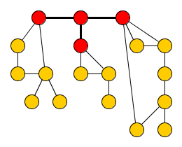
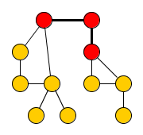
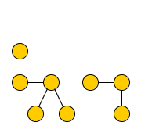
Kernelization algorithm via bridge-depth
Input: Vertex Cover instance $(G,k)$ and vertex set $X$ such that $bd\left(G−X\right)≤η$ Output: equivalent instance $(G^{′},k^{′})$ with $\left|V\left(G^{′}\right)\right|∈{\left|X\right|}^{O\left(1\right)}$
Reduce number of components of $G−X$ to $m∈{|X|}^{O\left(1\right)}$, using that its minimal blocking sets have size $≤2^{η}$
Each remaining component $C_{i}$ of $G−X$ has a tree-of-bridges $T_{i}$ such that $bd\left(C_{i} −V\left(T_{i}\right)\right)≤η−1$
Reduce to $\left(G^{′}, k^{′}\right)$ by local reduction rules that shrink each depth-decreasing tree-of-bridges $T_{i}$ to size ${\left|X\right|}^{O\left(1\right)}$
Let $X^{′}≔X∪(\bigcup_{i=1}^{m}{V(T_{i}^{′})})$, so $bd\left(G′−X^{′}\right)≤η−1∧\left|X^{′}\right|∈{\left|X\right|}^{O\left(1\right)}$
Output the result of recursively kernelizing $(G^{′},k^{′})$ for deletion set $X^{′}$
$C_{3}$
$$C_{1}$$
$$C_{2}$$
$$C_{3}$$
$$…$$
$$C_{m}$$
$$X$$
$$X′$$
Notes:
Base case: if $bd\left(G−X\right)=0$ then $G−X=∅$ so the graph has size $\left|X\right|$.
Step 1 was known from previous work; recursive scheme was known from previous work; real contribution are rules that shrink trees of bridges, which properly subsume the kernel for parameterization by FVS since bridgedepth 1 = forests.
Idea for Step 1: if you choose all of $X′$ into the vertex cover, it suffices to pick a minimum-size vertex cover from each component $C_{i}$. Only reason to pick more than the minimum from $C_{i}$, is to cover edges to vertices of $X′$ which were NOT chosen in the cover. Set $S$ is a blocking set iff $α\left(G−S\right)<S$ iff no minimum vertex cover in $G$ contains all of $S.$ If a certain choice of vertices to avoid from $X′$ forces you to pick more than minVC($C_{i}$) vertices from $C_{i}$ in a vertex cover, then there is already a subset of $2^{bd\left(C_{i}\right)}$ vertices from $X′$ which forces this. If some subset of $X′$ forces an increase in more than $|X^{′}|$ different components: no optimal vertex cover is disjoint from this subset, so optimal solutions won’t make this choice. If all ways of forcing to spend more than opt($C_{i}$) vertices in $C_{i}$ can be reasoned not to occur in an optimal solution, we can remove $C_{i}$ and decrease the target value by $opt(C_{i})$.

Slide 29
Conclusion
Generalizes all known deterministic polynomial kernels for Vertex Cover For minor-closed families, a bound on blocking set sizes yields polynomial kernels
Randomized kernel exists for $ℱ$ the class of bipartite graphs, which is not minor-closed
Open problem:
Characterize kernelization complexity for subgraph-closed / hereditary $ℱ$
Vertex Cover parameterized by deletion distance to $ℱ$has a polynomial kernel
$ℱ$ has bridge-depth $O(1)$
minor-closed $ℱ$, if $NP \text{⊈} coNP/poly$
THANK YOU!
Notes:
For minor-closed graph families, the only structure you need for lower bounds is the chain-of-triangles. For subgraph-closed families, this will not be sufficient. If we take a graph and subdivide an edge twice, the size of its minimal blocking sets stays the same. So from chains-of-triangles with large blocking sets (which act as gadgets in lower bound proofs), we can form subdivisions (that can play the same role in lower bound proofs). Such subdivided chains-of-triangles trivially have standard chains-of-triangles as minors, but not as (induced) subgraphs.

