Slide 1

The Power of Preprocessing:
Gems in Kernelization
Bart M. P. Jansen
Networks & Optimization Seminar @ CWI
November 28th 2018, Amsterdam, Netherlands

Slide 2
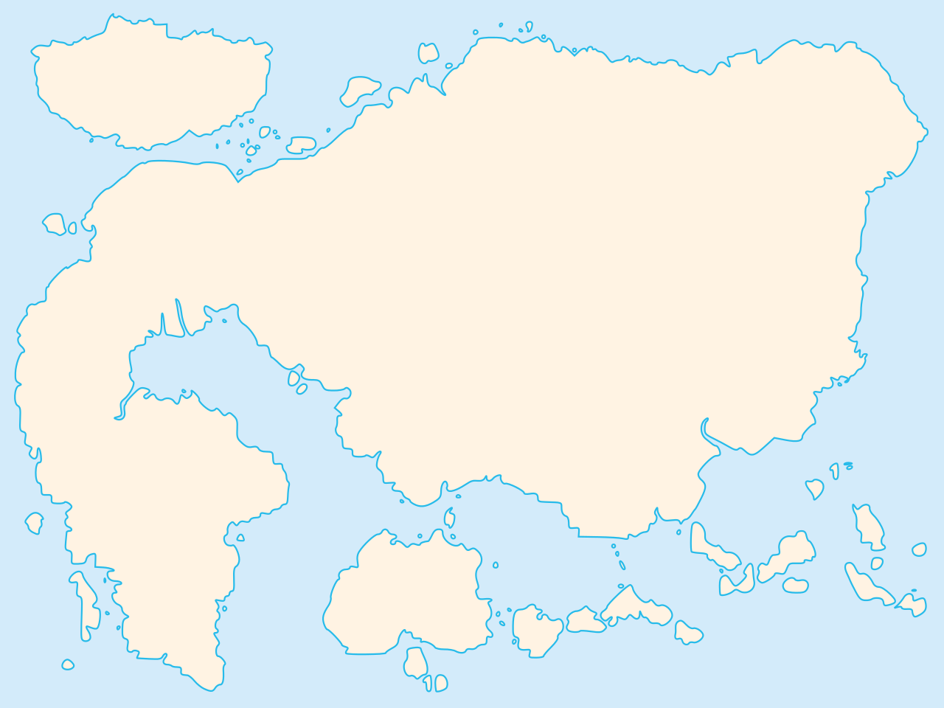
Map of polynomial-time computation
Kernelization
Primality
testing
The lost continent of polynomial time
Linear programming
Sorting
Parsing
context-free grammars
Fast Fourier transform
Shortest paths
Longest common
subsequence
Approximation
Islands of
minor-testing
Notes:
The striking realization that there are polynomial-time algorithms that hold provable power over NP-hard problems, without actually solving them.

Slide 3

Map of the lost continent
Linear algebra
Crown reduction
Protrusion
reduction
  The lost continent of polynomial time contains:
  provably effective and efficient preprocessing algorithms
  that reduce the sizes of NP-hard inputs
  (without changing the answer)
Representative sets
Concentration
bounds
Expansion lemma
Sunflower lemma
Well-quasi ordering
Notes:
there are polynomial-time algorithms that hold provable power over the solutions to NP-hard problems, without actually finding them

Slide 4



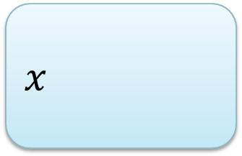
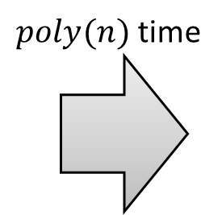



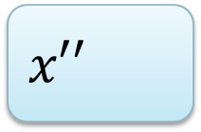
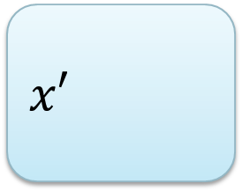


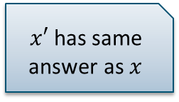

Provable preprocessing
What does provably effective and provably efficient mean?
  Efficient: preprocessing runs in polynomial time
  Effective: shrinks the input without changing the answer
How to guarantee an effective preprocessing algorithm?
$n$ bits
$n−1$ bits
$$x$$
$poly(n)$ time
$$x′$$
$x′$ has same answer as $x$
$n−2$ bits
$$⋯$$
$1$ bit
$$x′′$$
$$x^{∗}$$
$n⋅poly(n)$time

Slide 5
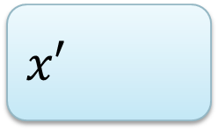
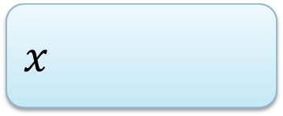
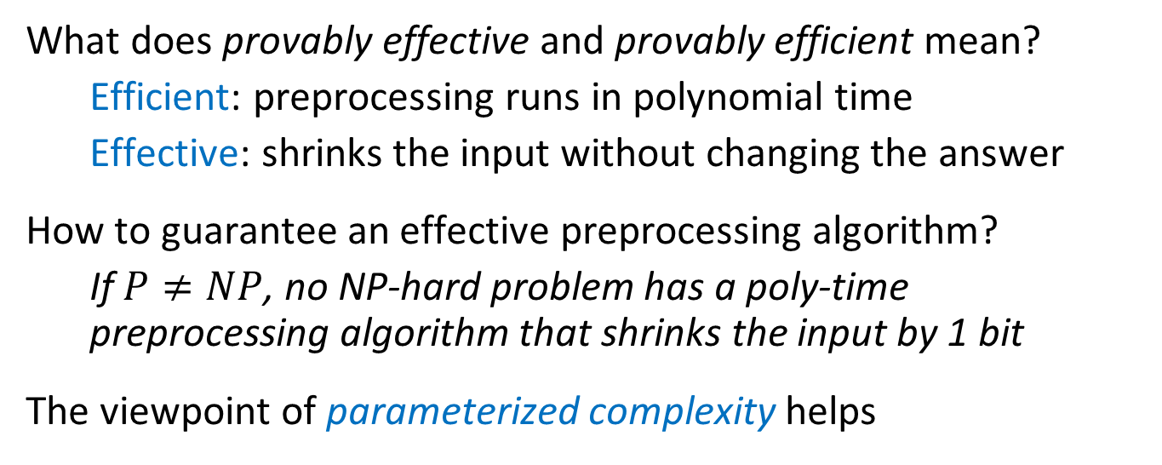
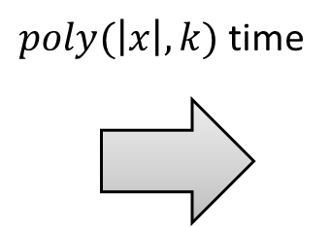




Provable preprocessing
What does provably effective and provably efficient mean?
  Efficient: preprocessing runs in polynomial time
  Effective: shrinks the input without changing the answer
How to guarantee an effective preprocessing algorithm?
  If $P≠NP$, no NP-hard problem has a poly-time preprocessing algorithm that shrinks the input by 1 bit
The viewpoint of parameterized complexity helps
$n$ bits
$f(k)$ bits
$$x$$
$poly(\left|x\right|,k)$ time
$$x′$$
$$k$$
$$k′$$

Slide 6
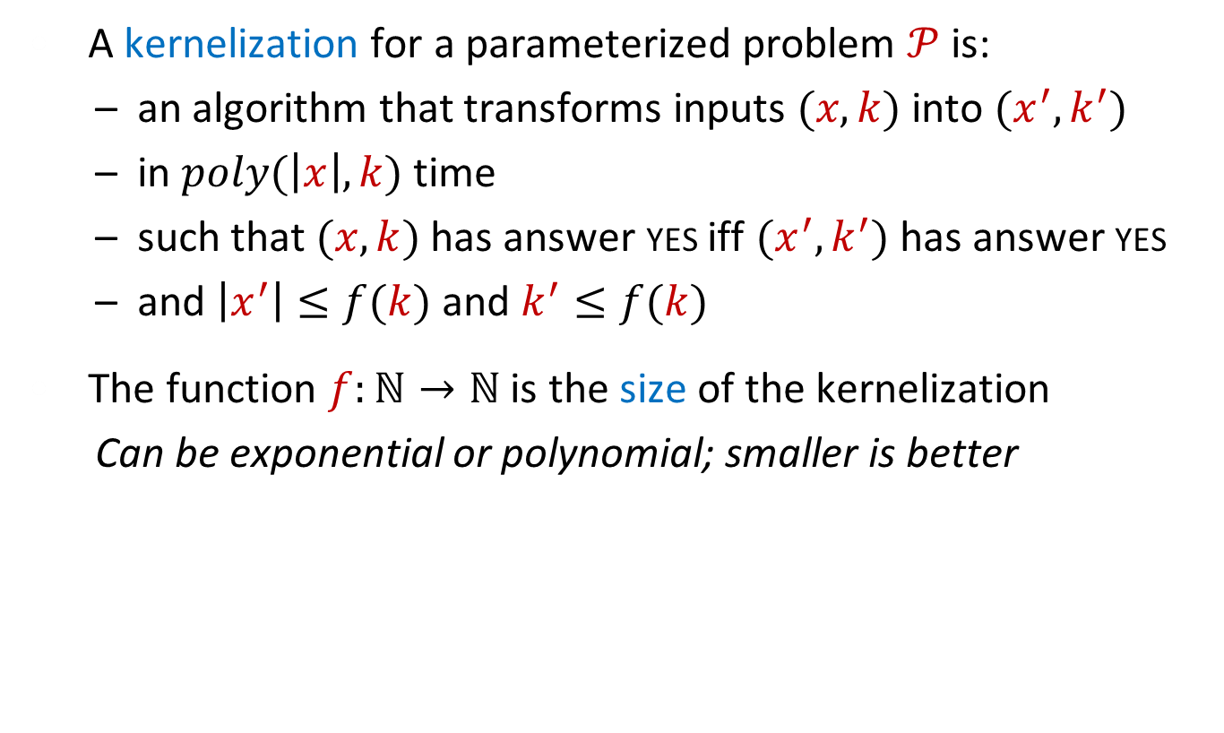
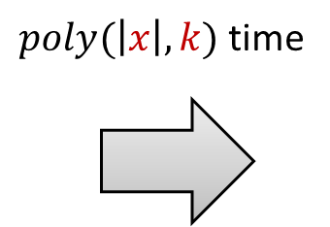


Kernelization: data reduction with a guarantee
A kernelization for a parameterized problem $𝒫$ is:
  an algorithm that transforms inputs $(x,k)$ into $(x^{′},k^{′})$
  in $poly(\left|x\right|,k)$ time
  such that $(x,k)$ has answer yes iff $(x^{′},k^{′})$ has answer yes
  and $\left|x^{′}\right|≤f(k)$ and $k^{′}≤f(k)$
The function $f:ℕ→ℕ$ is the size of the kernelization
  Can be exponential or polynomial; smaller is better
A kernelization guarantees that instances that are large with respect to their complexity parameter can be shrunk
$n$ bits
$f(k)$ bits
$$x$$
$poly(\left|x\right|,k)$ time
$$x′$$
$$k$$
$$k′$$

Slide 7
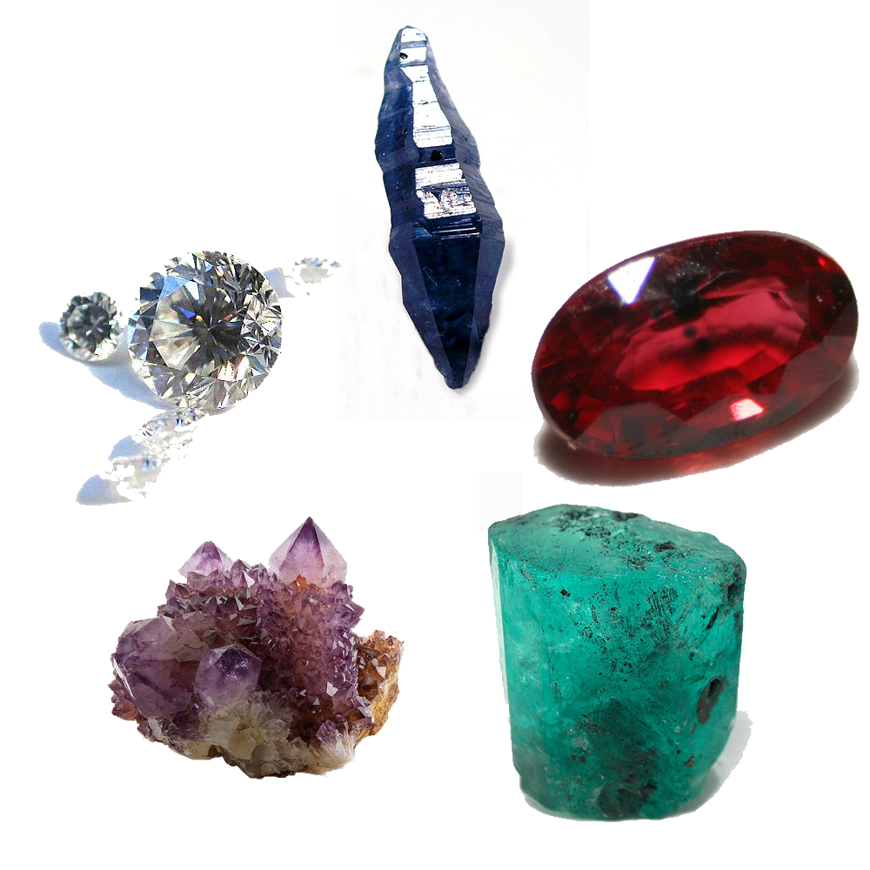
Gems in kernelization
Edge Clique Cover

Slide 8
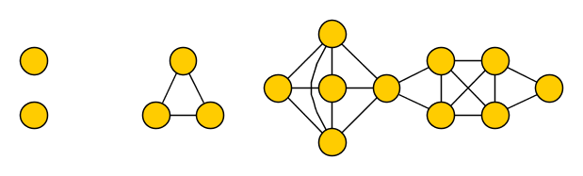
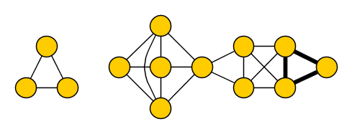
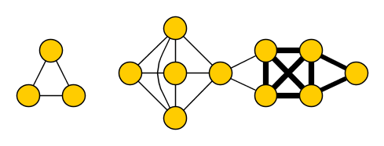
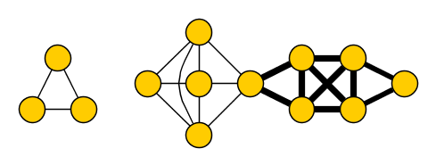
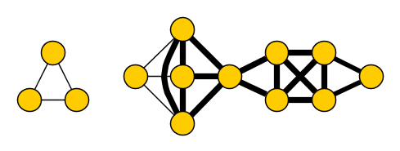
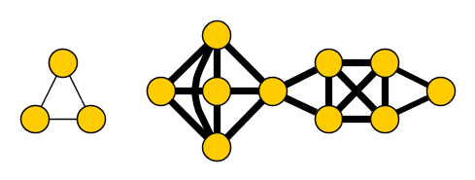
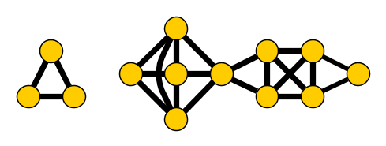
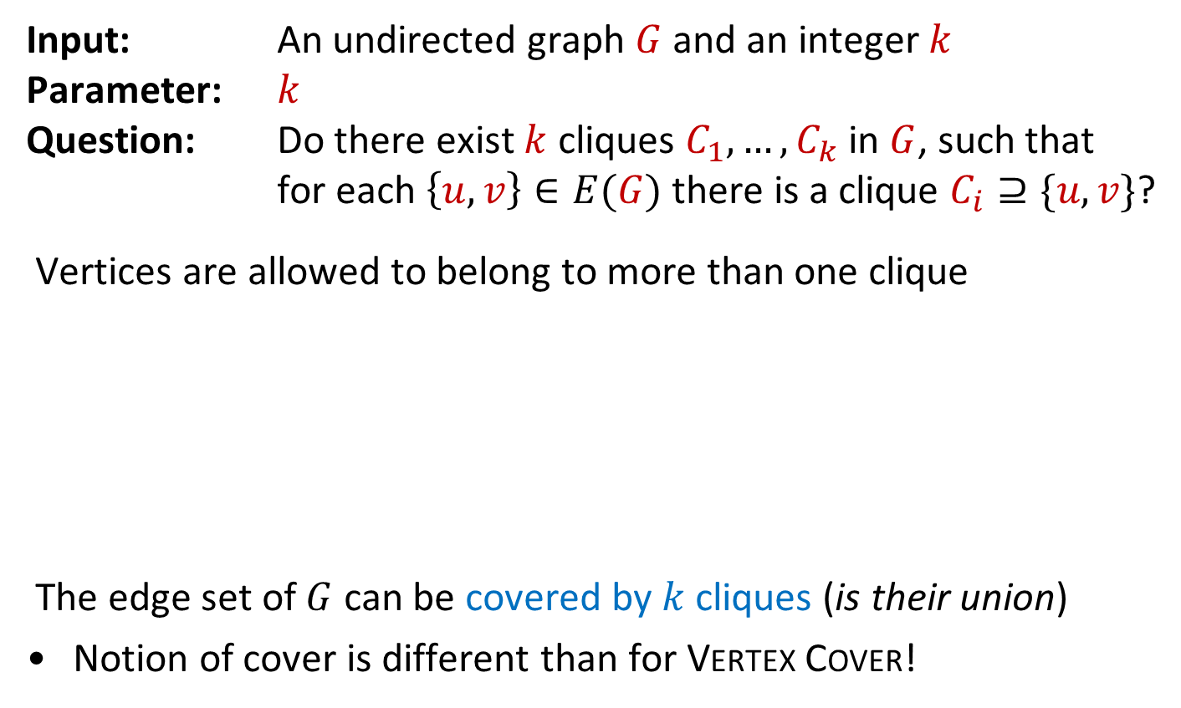

Edge Clique Cover
Input: An undirected graph $G$ and an integer $k$
Parameter: $k$
Question: Do there exist $k$ cliques $C_{1},…, C_{k}$ in $G$, such that for each $\left\{u,v\right\}∈E(G)$ there is a clique $C_{i}⊇\{u,v\}$?
Vertices are allowed to belong to more than one clique
The edge set of $G$ can be covered by $k$ cliques (is their union)
Notion of cover is different than for Vertex Cover!
yes for $k=6$
Notes:
NP-complete, has applications in finding the smallest representation of the graph as the intersection graph of a system of subsets of a size-k universe.

Slide 9
Covering edges of a 3D cube
Solution with 6 cliques: is it optimal?
Magical solution with 5 cliques

Slide 10
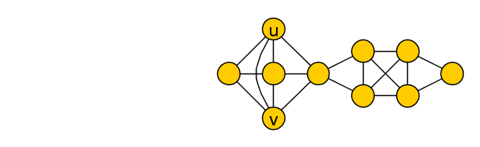
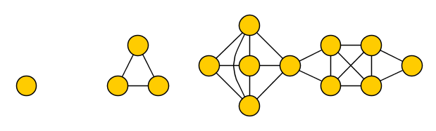
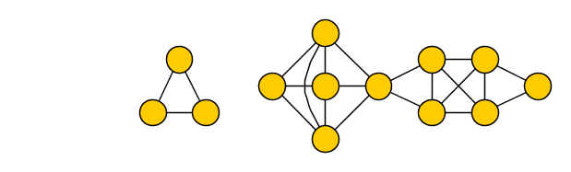
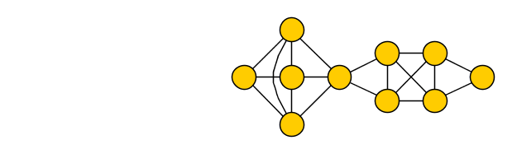
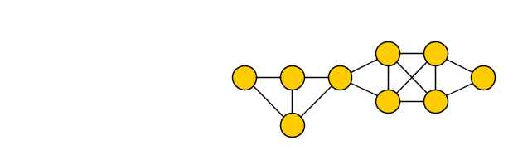
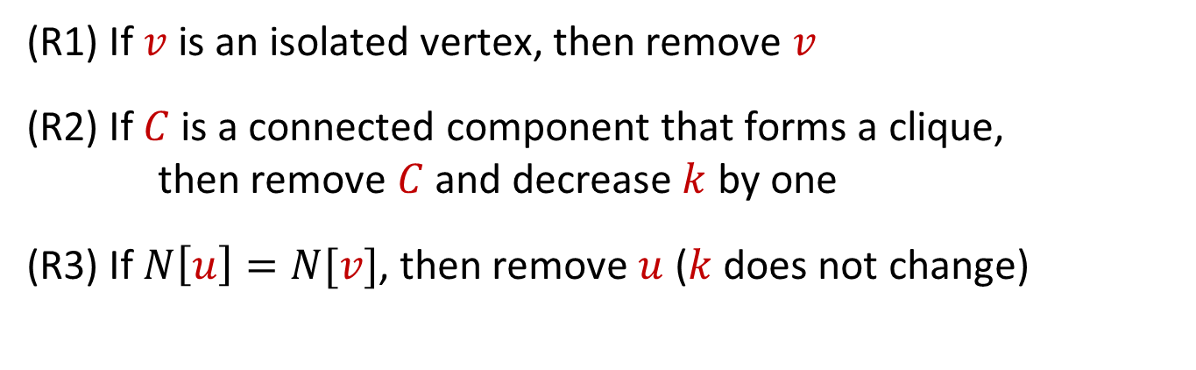
Reduction rules for Edge Clique Cover
(R1) If $v$ is an isolated vertex, then remove $v$
(R2) If $C$ is a connected component that forms a clique,
then remove $C$ and decrease $k$ by one
(R3) If $N\left[u\right]=N[v]$, then remove $u$ ($k$ does not change)

Slide 11
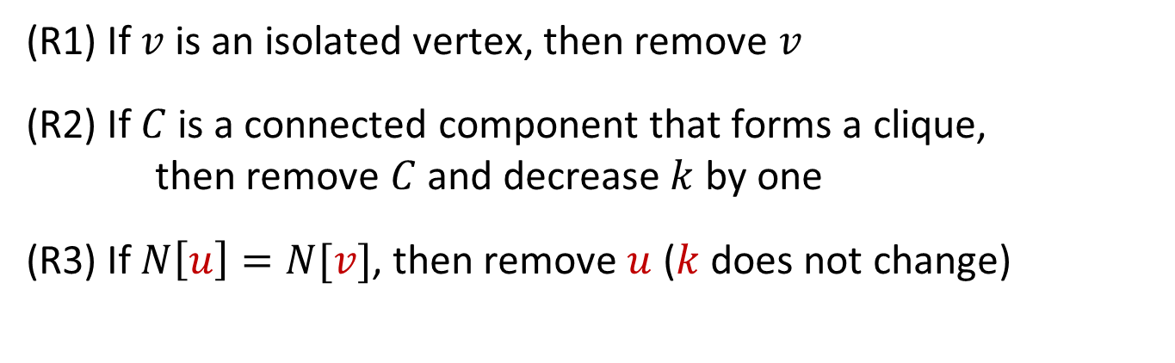
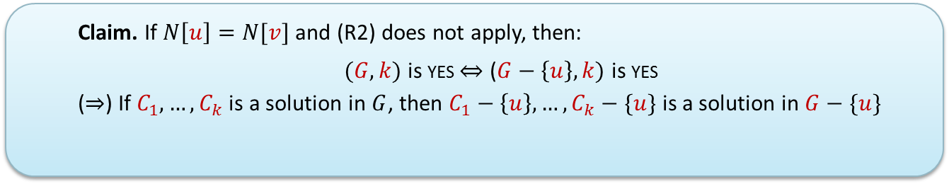
Reduction rules for Edge Clique Cover
  Claim. If $N\left[u\right]=N[v]$ and (R2) does not apply, then:
  $(G,k)$ is yes $⇔$ ($G−\left\{u\right\},k)$ is yes
  ($⇒$) If $C_{1},…, C_{k}$ is a solution in $G$, then $C_{1}−\left\{u\right\},…, C_{k}−\{u\}$ is a solution in $G−\{u\}$
(R1) If $v$ is an isolated vertex, then remove $v$
(R2) If $C$ is a connected component that forms a clique,
then remove $C$ and decrease $k$ by one
(R3) If $N\left[u\right]=N[v]$, then remove $u$ ($k$ does not change)

Slide 12
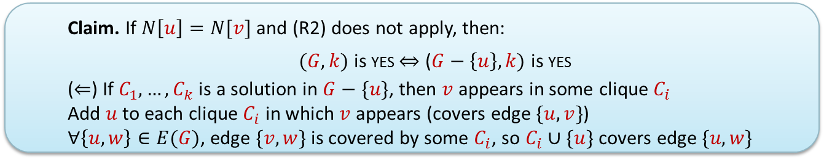
Reduction rules for Edge Clique Cover
  Claim. If $N\left[u\right]=N[v]$ and (R2) does not apply, then:
  $(G,k)$ is yes $⇔$ ($G−\left\{u\right\},k)$ is yes
  ($⇐$) If $C_{1},…, C_{k}$ is a solution in $G−\{u\}$, then $v$ appears in some clique $C_{i}$
  Add $u$ to each clique $C_{i}$ in which $v$ appears (covers edge $\{u,v\}$)
  $∀\left\{u,w\right\}∈E(G)$, edge $\{v,w\}$ is covered by some $C_{i}$, so $C_{i}∪\{u\}$ covers edge $\{u,w\}$
(R1) If $v$ is an isolated vertex, then remove $v$
(R2) If $C$ is a connected component that forms a clique,
then remove $C$ and decrease $k$ by one
(R3) If $N\left[u\right]=N[v]$, then remove $u$ ($k$ does not change)

Slide 13
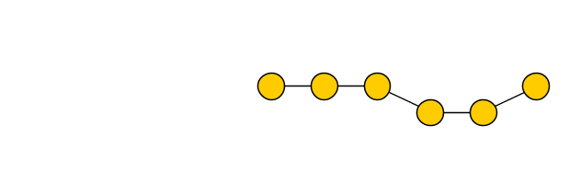
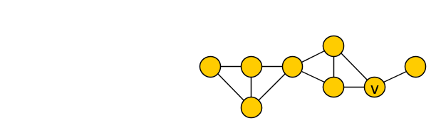
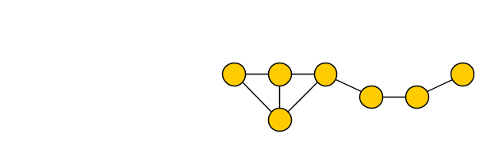

Reduction rules for Edge Clique Cover
(R1) If $v$ is an isolated vertex, then remove $v$
(R2) If $C$ is a connected component that forms a clique,
then remove $C$ and decrease $k$ by one
(R3) If $N\left[u\right]=N[v]$, then remove $u$ ($k$ does not change)

Slide 14

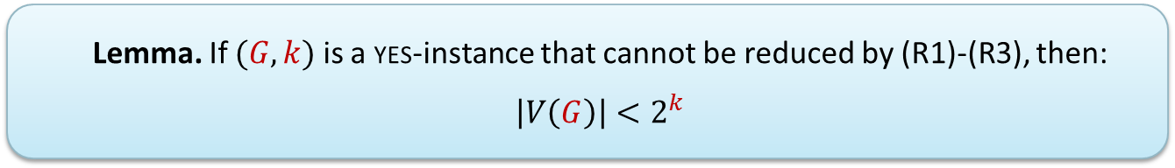
Effectiveness of reduction rules
  Lemma. If $(G,k)$ is a yes-instance that cannot be reduced by (R1)-(R3), then: $\left|V\left(G\right)\right|<2^{k}$
Proof. Fix a solution $C_{1},…, C_{k}$ and assign a bitvector to each vertex
$$vec\left(v\right)≔(v\begin{matrix}? \\ ∈ \\ \end{matrix}C_{1},v\begin{matrix}? \\ ∈ \\ \end{matrix}C_{2},…, v\begin{matrix}? \\ ∈ \\ \end{matrix}C_{k})$$
Notes:
N[u] = vertices occurring in a clique with u = vertices occurring in a clique with v = N[v]

Slide 15
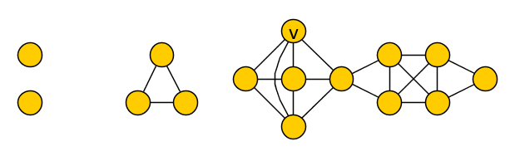

Effectiveness of reduction rules
  Lemma. If $(G,k)$ is a yes-instance that cannot be reduced by (R1)-(R3), then: $\left|V\left(G\right)\right|<2^{k}$
Proof. Fix a solution $C_{1},…, C_{k}$ and assign a vector to each vertex
$$vec\left(v\right)≔(0,1,1, 0,0,0)\begin{matrix} \\ \\ \end{matrix}$$
Notes:
N[u] = vertices occurring in a clique with u = vertices occurring in a clique with v = N[v]

Slide 16


Effectiveness of reduction rules
  Lemma. If $(G,k)$ is a yes-instance that cannot be reduced by (R1)-(R3), then: $\left|V\left(G\right)\right|<2^{k}$
Proof. If $vec\left(v\right)=000…000$: then $v$ is isolated, (R1) applies
If $vec\left(v\right)=vec(u)$: then $N\left[u\right]=N[v]$ and (R2/3) applies
So $\left|V\left(G\right)\right|<$ $|\{$bitvectors of length $k\}|$ = $2^{k}$
  High-level view of the proof:
  If $G$ has a solution, it reveals structure in the graph
  If the graph is large wrt. $k$, then its structured-ness points to an applicable rule
Notes:
N[u] = vertices occurring in a clique with u = vertices occurring in a clique with v = N[v]

Slide 17

Complete kernelization for Edge Clique Cover
Consider input $(G,k)$
Exhaustively apply (R1)-(R3) to obtain $(G^{′},k^{′})$
if $\left|V\left(G^{′}\right)\right|≥2^{k^{′}}$
  then output “$G$ has no solution of size $k$”
  else output $(G^{′},k^{′})$ with less than $2^{k^{′}}$ vertices
This kernelization is essentially the best known
  [Gramm, Guo, Hüffner and Niedermeier, ACM Exper. Alg. 08]
No kernel of bitsize $2^{o\left(k\right)}$ exists unless P=NP
  [Cygan, Pilipczuk, Pilipczuk, SICOMP’16]

Slide 18
Gems in kernelization
Edge Clique Cover
Vertex Cover

Slide 19
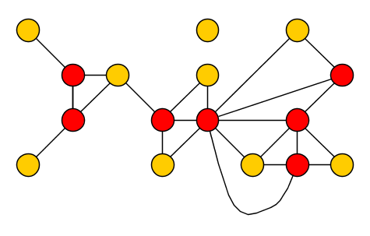
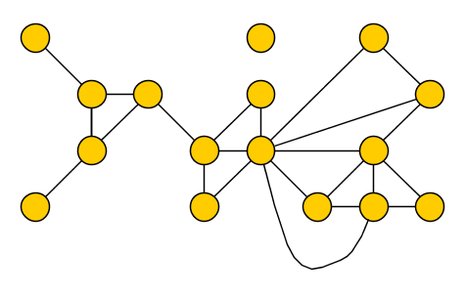
Vertex Cover
Input: A graph $G$ and an integer $k$
Parameter: $k$
Question: Is there a set $S$ of at most $k$ vertices in $G$,
such that each edge has an endpoint in $S$?
$S$ is a vertex cover of $G$ $⇔$ $G−S$ has no edges

Slide 20
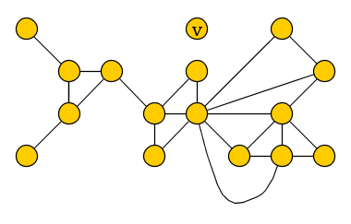
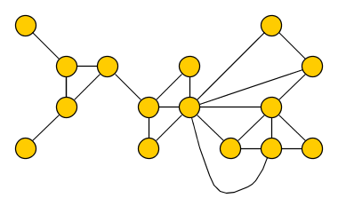
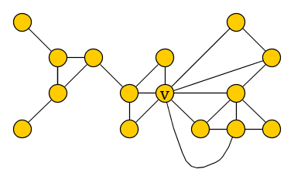
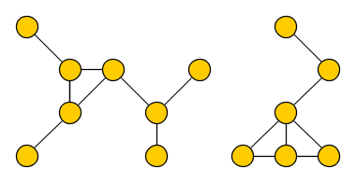

Kernelization for Vertex Cover
Reduction rules for an input $(G,k)$
(R1) If $G$ has an isolated vertex $v$, reduce to $(G−v, k)$
(R2) If $G$ has a vertex $v$ of degree $>k$, reduce to $(G−v,k−1)$
(R3) If previous rules do not apply and $\left|E\left(G\right)\right|>k^{2}$, output NO

Slide 21
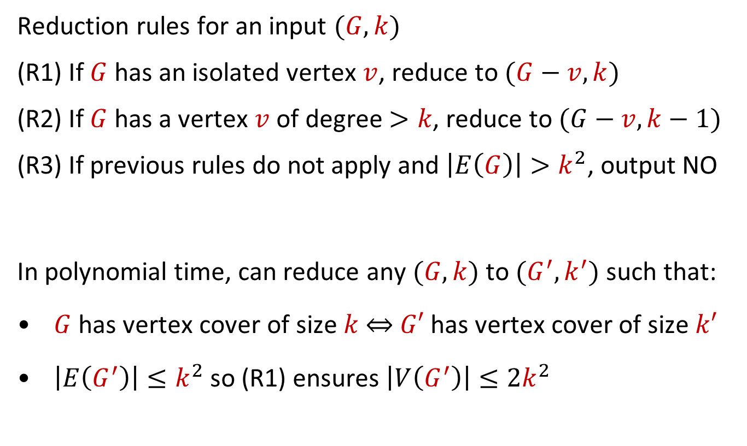
Kernelization for Vertex Cover
Reduction rules for an input $(G,k)$
(R1) If $G$ has an isolated vertex $v$, reduce to $(G−v, k)$
(R2) If $G$ has a vertex $v$ of degree $>k$, reduce to $(G−v,k−1)$
(R3) If previous rules do not apply and $\left|E\left(G\right)\right|>k^{2}$, output NO
In polynomial time, can reduce any $(G,k)$ to $(G^{′},k^{′})$ such that:
$G$ has vertex cover of size $k$ $⇔$ $G′$ has vertex cover of size $k′$
$\left|E\left(G^{′}\right)\right|≤k^{2}$ so (R1) ensures $\left|V\left(G^{′}\right)\right|≤2k^{2}$
Vertex Cover has a kernel with $O(k^{2})$ vertices and edges
Notes:
(Or we already answer the problem)

Slide 22

intermezzo
The tools used to explore the lost continent
(Picture from Parameterized Algorithms by Cygan et al.)

Slide 23
Techniques in kernelization
Linear programming
Well-quasi-ordering
Matroids
Probabilistic method
Graph minor theory
Algebraization
Structural graph theory

Slide 24

better kernel for vertex cover
Crown reductions

Slide 25
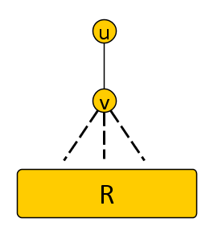
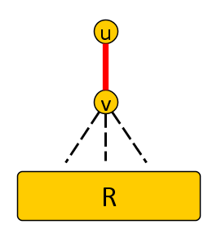



Motivating examples
If $G$ has a degree-1 vertex $u$ with neighbor $v$:
  Exists optimal vertex cover using $v$ and not $u$
  Remove $u$ and $v$ from $G$ to obtain $G′$
  $G$ has vtx-cover of size $k⇔G′$ has vtx-cover of size $k−1$
$$k^{′}≔k−1$$

Slide 26




Motivating examples
If $G$ has non-adjacent vertices $u,u′$ with neighborhood $\{v,v^{′}\}$:
  Exists optimal vertex cover using $\{v,v^{′}\}$ and not $\{u,u^{′}\}$
  Remove $\{u,u^{′},v,v^{′}\}$ from $G$ to obtain $G′$
  $G$ has vtx-cover of size $k⇔G′$ has vtx-cover of size $k−2$
$$k^{′}≔k−2$$
Notes:
Solution S contains at least one vertex of {u,v} and one of {u’,v’} => S \ {u,u’} U {v,v’} is a solution that is not bigger.

Slide 27




Crown decomposition
A crown decomposition of graph $G$ is a partition of $V(G)$ into
Crown $C$
independent set
(non-empty)
Head $H$
matched into $C$
(may contain edges)
Remainder $R$
not adjacent to $C$
$∃$ opt vertex cover containing all of $H$ and none of $C$

Slide 28





Crown reduction for Vertex Cover
$G$ has a vertex cover of size $k$ if and only if
$G−(C∪H)$ has a vertex cover of size $k−|H|$
Off with his head!
Notes:
The name of the concept is so colorful that you cannot help but remember. Combined with the generality and wide applicability of the technique, this led to many applications.

Slide 29

Crown-based kernelization for Vertex Cover
Strategy to kernelize instance $(G,k)$:
find a crown decomposition $(C,H,R)$ of $V(G)$
remove $C∪H$ from $G$
decrease $k$ by $\left|H\right|$
repeat as long as a crown decomposition can be found
1. How can we find a crown decomposition?
2. What can we guarantee when we can no longer find one?

Slide 30


Crown lemma
If graph $G$ has more than $3k$ vertices, then $G$ has
a matching of size $k+1$, or
a crown decomposition,
and one can be found in polynomial time.
If we fail to find a crown decomposition of $G$, then
$G$ has at most $3k$ vertices and is kernelized, or
$G$ has a matching of size $k+1$ $⇒$ no size-$k$ vertex cover
To get a kernel with $3k$ vertices, suffices to prove the lemma

Slide 31












Crown lemma
If graph $G$ has more than $3k$ vertices, then $G$ has
a matching of size $k+1$, or
a crown decomposition,
and one can be found in polynomial time.
Greedily find maximal matching $M$
If $\left|M\right|>k$, then (a) holds
If $\left|M\right|≤k$, then $\left|V\left(M\right)\right|≤2k$
  Unmatched vertices $I$ are independent
  Compute maximum matching $M′$
  in bipartite graph $G′$ between $V(M)$ and $I$
    If $\left|M^{′}\right|>k$, then (a) holds
    Else $M′$ leaves a vertex in $I$ unsaturated
      (If $M^{′}$ saturates $I$, then $V\left(G\right)≤3k$)
$$V(M)$$
$$I$$

Slide 32






Crown lemma
If graph $G$ has more than $3k$ vertices, then $G$ has
a matching of size $k+1$, or
a crown decomposition,
and one can be found in polynomial time.
Else $M′$ leaves a vertex in $I$ unsaturated
  $D ≔$ vertices reachable in $G′$ from an unsat. $I$-vertex by an $M′$-alternating path
This gives a crown decomposition:
  Crown: $D∩I$ [non-empty, independent]
  Head: $D∩V(M)$ [matched into crown]
  Remainder: $V\left(G\right)∖D$ [not adjacent to crown]
$$V(M)$$
$$I$$
Vertex Cover parameterized by solution size $k$
has a kernel with $3k$ vertices and $O\left(k^{2}\right)$ edges
Notes:
All vertices of D \cap V(M) are matched by M’, otherwise we would have an alternating path from unsaturated to an unsaturated vertex => matching M’ can be improved. Since you move left over unmatched edges in the alternating path, if you can reach a vertex on the left then you can also reach its matching partner => matching partners belong to D as well. For unmatched vertices in I, trivially all neighbors are in D so part of the head. For matched vertices, their matching partner is in D (the last edge reaching them is a matching edge), and all unmatched neighbors can trivially also be reached by an alternating path.

Slide 33

reductions
WG ‘04
Can be used to kernelize a wide variety of problems
Vertex Cover
Saving $k$ Colors
Saving 𝑘 Colors
Max CNF-SAT
Longest Cycle/Path
$P_{2}$-Packing
𝑃_2-Packing
Hitting Set
$k$-Internal spanning tree
𝑘-Internal spanning tree
Treewidth
Set Packing
Star packing
Triangle packing
Disjoint Cycles
Notes:
Batman-mask reduction?

Slide 34


Crown reductions and linear programming
Crowns can be used to kernelize many problems,
but have a special relation to vertex covers
Minimize $\sum_{v∈V\left(G\right)}{x_{v}}$
Subject to $x_{u}+x_{v}≥1$ $∀\left\{u,v\right\}∈E(G)$
$0≤x_{v}≤1$ $∀v∈V(G)$
$G$ has a crown decomposition
$$⇔$$
the linear programming relaxation of Vertex Cover has an optimal solution assigning $0$ to some vertex
[Abu-Khzam, Fellows, Langston, Suters ‘07] & [Chlebík, Chlebíková ‘08]

Slide 35



Open problems for Vertex Cover kernelization
Current-best kernel has $2k$ vertices [Nemhauser&Trotter’75]
Current-best runtime for a $O(k)$-vertex kernel is $Ω(n+m+k^{2})$
Does Vertex Cover have a kernel with $\left(2−ε\right)k$ vertices, for any $ε>0$?
Does Vertex Cover have a kernel with $O(k)$ vertices that can be computed in $O(n+m)$ time?
Notes:
Relation to unique-games conjecture, but a kernel is not necessarily approximation-preserving. Even for planar graphs we do not know.

Slide 36
Gems in kernelization
Graph Coloring
Edge Clique Cover
Vertex Cover

Slide 37





Graph $q$-Coloring
Input: An undirected graph $G$
Question: Can we assign each vertex a color $f\left(v\right)∈\left\{1,…, q\right\}$, such that $f\left(u\right)≠f(v)$ for all edges $\left\{u,v\right\}∈E(G)$ ?
Coloring where $f\left(u\right)≠f(v)$ for all edges is called proper
Which parameter to use?
yes for $q=3$
Notes:
Graph coloring is often used to model scheduling problems (assign each vertex (exam) a timeslot (color)). Exams that have overlap in the participants have an edge (can’t be simultaneous). Minimum number of colors in a proper coloring = smallest number of timeslots needed to schedule all exams.

Slide 38







Take one: parameterize by # allowed colors
Use the desired number of colors $q$ as the parameter
  Can we reduce to bitsize $f(q)$, for some function $f$?
Suppose such a kernelization exists; apply it to 3-Coloring
Would solve 3-Coloring (NP-complete) in polynomial time
$n$ bits
$f(3)$ bits
$$x$$
$poly(\left|x\right|,3)$ time
$$x′$$
$$3$$
$$…$$
Notes:
Can brute-force the f(3)-size input in constant time.

Slide 39
Take two: parameterize by graph complexity
Introduce a parameter that measures graph complexity
Can Coloring inputs on large but simple graphs be reduced?
Some ways to measure graph complexity:
  Treewidth
  Size of smallest edge clique cover
  Size of smallest feedback vertex set
  Size of smallest vertex cover

Slide 40




Vertex Covers
A vertex cover (VC) in a graph $G$ is a vertex set $S$
such that for each edge $\left\{u,v\right\}∈E(G)$ we have $u∈S$ or $v∈S$
Earlier we kernelized the problem of finding a vertex cover
Now: preprocess Coloring inputs on graphs with small VC’s
If a 3-Coloring input $G$ is large compared to $minVC(G)$,
can we shrink it efficiently without changing the answer?
Notes:
We look at 3-coloring for simplicity, we will generalize later.

Slide 41







Reducing 3-Coloring inputs with small covers
Input: instance $G$ of 3-Coloring
Compute 2-approximate vertex cover $X$
$∀S⊆X$ of size 3:
mark a common neighbor of $S$
Delete all unmarked $v∉X$
Output resulting $G’$ on $n’$ vertices
  $$n’≤\left|X\right|+{\left|X\right|}^{3}≤2k+{\left(2k\right)}^{3}$$
$$X$$

Slide 42









Correctness: $G$ is 3-colorable $⇔$ $G′$ is 3-colorable
($⇒$) Trivial
($⇐$) Take a 3-coloring of $G’⊇X$
Independently give each unmarked vertex $v$ a color not used on $N_{G}(v)$
Only fails if $v$ has neighbors in 3 colors
If $S=\left\{r,b,y\right\}⊆N_{G}\left(v\right)$ uses all colors:
  the vertex marked for S is improper in $G’$
$$X$$

Slide 43


Provable preprocessing for 3-Coloring
Theorem. There is a polynomial-time algorithm that, given a graph $G$, outputs a subgraph $G’$ with $O(minVC{\left(G\right)}^{3})$ vertices such that $G$ is 3-colorable iff $G’$ is
A 3-coloring of $G’$ can be lifted to a 3-coloring of $G$ in polynomial time
Algorithm and correctness proof generalize to $q$-Coloring
  Mark common neighbors of groups of $q$ vertices
  [J & Kratsch, Inform. Comput. ‘13]
Kernel size $O\left(k^{q}\right)$ vertices, dependence on $q$ is unavoidable
  [Bodlaender, J & Kratsch SIDMA’14]
Can be improved to $O\left(k^{q−1}\right)$ vertices
  [J & Pieterse IPEC’17]

Slide 44




Better preprocessing for 3-Coloring
A vertex cover $X$ of a 3-Coloring input $G$ allows re-formulation:
  Find a coloring of $G[X]$ such that for each $v∉X$,
  some color does not appear on $N_{G}(v)$
Each $v∉X$ imposes a constraint
on each set $S$ of $3$ vertices in $N_{G}(v)$:
  Use at most two colors on S
  $⇔$
  Some color occurs on $≥$2 vertices of S
$$X$$
$$S$$
Insight: Some constraints are implied by combinations of others
If all $v$’s constraints are redundant, then $v$ can be removed

Slide 45

Constraints are degree-2 polynomials
For each $v∈X$ make three variables $r_{v},b_{v},y_{v}∈\{0,1\}$
For a set $S=\{u,v,w\}$ of three vertices $u,v,w∈X$:
  Use at most two colors on S
  $⇔$
  Some color occurs on at least 2 vertices of S
  $⇔$
  $\left(r_{u}⋅r_{v} +r_{v}⋅r_{w} +r_{u}⋅r_{w} \right)+$
  $\left(b_{u}⋅b_{v}+b_{v}⋅b_{w}+b_{u}⋅b_{w}\right)+$
  $\left(y_{u}⋅y_{v}+y_{v}⋅y_{w} +y_{u}⋅y_{w}\right)≡1 (mod 2)$
  $⇔$
  Number of monochromatic pairs is 1 or 3
Observation: Constraints correspond to equalities of degree-2 polynomials

Slide 46


Linear algebra to find redundant constraints
Combine constraints for all $v∉X$, for all $S∈\left(\begin{matrix}N(v) \\ 3\end{matrix}\right)$
$$\left[\begin{matrix}c_{1,1} & ⋯ & c_{1,O\left({|X|}^{2}\right)} \\ \begin{matrix} \\ \begin{matrix} \\ ⋮ \\ \end{matrix} \\ \end{matrix} & ⋱ & \begin{matrix} \\ \begin{matrix} \\ ⋮ \\ \end{matrix} \\ \end{matrix} \\ c_{m,1} & ⋯ & c_{m,O\left({\left|X\right|}^{2}\right)}\end{matrix}\right]\left(\begin{matrix}\begin{matrix}r_{1} \\ b_{1} \\ y_{1}\end{matrix} \\ \begin{matrix}⋯ \\ r_{1}b_{1} \\ r_{1}b_{2}\end{matrix} \\ \begin{matrix}r_{1}b_{|X|} \\ … \\ b_{|X|}y_{|X|}\end{matrix}\end{matrix}\right)≡\left(\begin{matrix}1 \\ \begin{matrix}1 \\ \begin{matrix}1 \\ ⋮ \\ 1\end{matrix} \\ 1\end{matrix} \\ 1\end{matrix}\right) (mod 2)$$
Compute a row basis for the extended matrix $(C|\vec{1})$ over GF[2]
Basis consists of $O\left({\left|X\right|}^{2}\right)$ constraints that imply all others
The $O\left({\left|X\right|}^{2}\right)$ basis constraints are generated by $O\left({\left|X\right|}^{2}\right)$ vertices outside $X$
Removing all others does not change the answer

Slide 47


Improved preprocessing for 3-Coloring
Theorem. There is a polynomial-time algorithm that, given a graph $G$, outputs a subgraph $G’$ with $O(minVC{\left(G\right)}^{2})$ vertices such that $G$ is 3-colorable iff $G’$ is
A 3-coloring of $G’$ can be lifted to a 3-coloring of $G$ in polynomial time
[J&Pieterse’17]
Reduced instance can be encoded in $O(k^{2}\log{k)}$ bits
Cannot be improved to $O(k^{2−ε})$ unless NP $⊆$ coNP/poly
Generalizes to $O\left(minVC{\left(G\right)}^{q−1}\right)$-vertex kernel for $q$-coloring

Slide 48



Conclusion
Nice preprocessing algorithms found on the lost continent
Rich theory of algorithmic techniques and lower bounds
Several tantalizing open problems remain:
  Vertex Planarization? Directed Feedback Vertex Set?
Edge Clique Cover
Graph Coloring
Vertex Cover
THANK YOU!

