Slide 1
Fixed-Parameter Tractable Certified Algorithms for Covering and Dominating in Planar Graphs and Beyond
Benjamin Merlin Bumpus Bart M. P. Jansen Jaime Venne
Networks Training Week April 10th 2024, Asperen, The Netherlands
Notes:
Throwback to old open problem @ Asperen in 2019. Solved this with a master student and postdoc. This is my 100th talk!

Slide 2
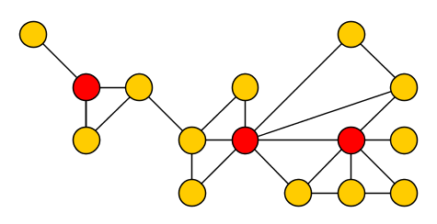
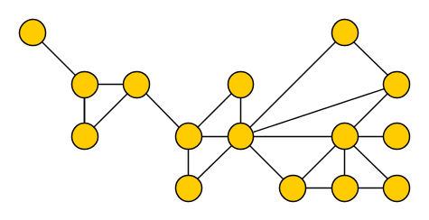
The Dominating Set problem
Input: An undirected graph $G$ Output: Vertex set $S$ such that each vertex $v$ belongs to $S$ or has a neighbor in $S$
Such a set $S$ is called a dominating set of $G$
Notes:
Do we want to give a weighted example? We probably need one when we get to certified algorithms.

Slide 3
Computing dominating sets
Computing a minimum dominating set is NP-hard
Good approximation algorithms exist for planar graphs [Baker, JACM ’94]
Global cost of computed solution is close to optimal; no guarantees on local behavior
For each $ε>0$, there is a polynomial-time algorithm that, given a planar graph $G$, outputs a dominating set in $G$ of size at most $\left(1+ε\right)⋅opt(G)$.
Approximate solution may not even be inclusion-minimal
Notes:
Restriction to planar graphs is necessary: does not even have a constant-factor approximation in general graphs, let alone a PTAS.

Slide 4
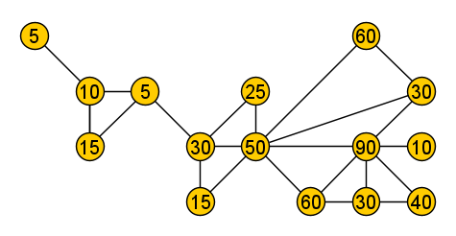
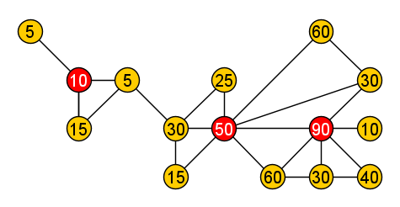
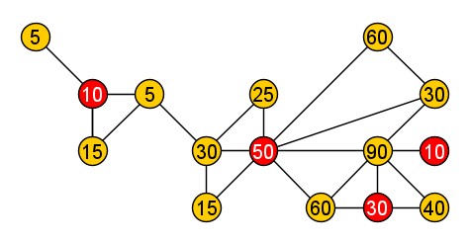
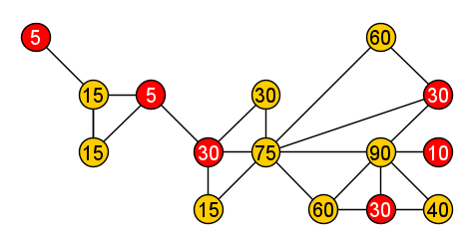
Certified algorithms
A refined view on approximation algorithms, applicable for inputs involving weights
For Weighted Dominating Set: input supplies a vertex weight function $w:V\left(G\right)→ℝ^{+}$
A $(1+ε)$-perturbation of $w$ is a function $w^{′}:V\left(G\right)→ℝ^{+}$ satisfying $$w\left(v\right)≤w^{′}\left(v\right)≤\left(1+ε\right)⋅w\left(v\right)$$
for all $v∈V(G)$.
$1.5$-perturbation
Notes:
Note that computing a suitable perturbation is trivial, once you have a dominating set $S$ for which such a perturbation exists: boost the weight of vertices outside $S$ as much as possible (by a factor $1+ε$), to make alternative dominating sets look as bad as possible.

Slide 5
Certified algorithms
A refined view on approximation algorithms, applicable for inputs involving weights
For Weighted Dominating Set: input supplies a vertex weight function $w:V\left(G\right)→ℝ^{+}$
A $(1+ε)$-certified algorithm for Weighted Dominating Set is an algorithm that:
takes a vertex-weighted graph $(G,w)$ as input,
outputs a dominating set $S$ in $G$, together with a $(1+ε)$-perturbation $w′$ of $w$,
such that $S$ is an optimal dominating set for the perturbed instance $(G,w^{′})$
A $(1+ε)$-perturbation of $w$ is a function $w^{′}:V\left(G\right)→ℝ^{+}$ satisfying $$w\left(v\right)≤w^{′}\left(v\right)≤\left(1+ε\right)⋅w\left(v\right)$$
for all $v∈V(G)$.
Notes:
Note that computing a suitable perturbation is trivial, once you have a dominating set $S$ for which such a perturbation exists: boost the weight of vertices outside $S$ as much as possible (by a factor $1+ε$), to make alternative dominating sets look as bad as possible.

Slide 6
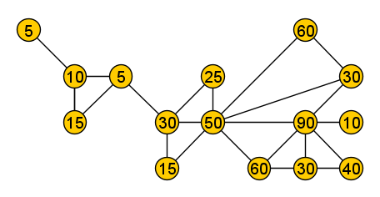
Certified algorithms
A $(1+ε)$-certified algorithm outputs a solution that is optimal for a perturbed input
A refined view on approximation algorithms, applicable for inputs involving weights
A $(1+ε)$-certified algorithm for Weighted Dominating Set is an algorithm that:
takes a vertex-weighted graph $(G,w)$ as input,
outputs a dominating set $S$ in $G$, together with a $(1+ε)$-perturbation $w′$ of $w$,
such that $S$ is an optimal dominating set for the perturbed instance $(G,w^{′})$
$1.5$-perturbation
1.5-certified algorithm
Input
Output
Notes:
Note that computing a suitable perturbation is trivial, once you have a dominating set $S$ for which such a perturbation exists: boost the weight of vertices outside $S$ as much as possible (by a factor $1+ε$), to make alternative dominating sets look as bad as possible.

Slide 7
Why are $(1+ε)$-certified algorithms useful?
If there is some $ε$-factor uncertainty in how the weight values model actual costs, solving the perturbed instance is as good as solving the original
Output has guarantees on local behavior (optimality for $w′$, inclusion-minimal)
Output forms a $\left(1+ε\right)$-approximation for the original input:
Output forms a $\left(1+ε\right)$-approximation for the dual maximization problem
Let $S^{∗}$ be an optimal solution to $(G,w)$.
Let $S$ be an optimal solution to $\left(G,w^{′}\right)$, where $w′$ is a $(1+ε)$-perturbation of $w$.
$$w\left(S\right)≤w^{′}\left(S\right)≤w^{′}\left(S^{∗}\right)≤\left(1+ε\right)⋅w\left(S^{∗}\right)$$
Perturbation can only increase weight
$S$ is optimal for $(G,w^{′})$
Perturbation multiplies weight by $≤(1+ε)$

Slide 8
History of $(1+ε)$-certified algorithms
Model was introduced in 2018 as going beyond worst-case analysis [Konstantin Makarychev & Yury Makarychev @ ICTS’20]
Originated from the study of perturbation resilience
In 2019, the first $(1+ε)$-certified algorithm was given: for Planar Independent Set
There is an algorithm that takes as input:
an $n$-vertex weighted planar graph $(G,w)$ with $w\left(v\right)∈\left\{1, …, n^{O\left(1\right)}\right\}$ $∀v∈V(G)$,
an accuracy parameter $ε>0$,
and outputs:
an independent set $S$ in $G$, and
a $(1+ε)$-perturbation $w′$ of $w$,
such that $S$ is a maximum-weight independent set of $(G,w^{′})$.
The algorithm runs in time $n^{O\left(\frac{1}{ε}\right)}$.
[Angelidakis, Awasthi, Blum, Chatziafratis, Dan @ ESA ‘19]

Slide 9
History of $(1+ε)$-certified algorithms
The algorithm is complicated, involving the $⌈1/ε⌉$-th level of Sherali-Adams Relied on a relation to treewidth that seemed very application-specific
In 2019, the first $(1+ε)$-certified algorithms on planar graphs were developed
Do $(1+ε)$-certified algorithms exist for other problems? Can the running time be improved to $f\left(1/ε\right)⋅n^{O\left(1\right)}$?
There is an algorithm that takes as input:
an $n$-vertex weighted planar graph $(G,w)$ with $w\left(v\right)∈\left\{1, …, n^{O\left(1\right)}\right\}$ $∀v∈V(G)$,
an accuracy parameter $ε>0$,
and outputs:
an independent set $S$ in $G$, and
a $(1+ε)$-perturbation $w′$ of $w$,
such that $S$ is a maximum-weight independent set of $(G,w^{′})$.
The algorithm runs in time $n^{O\left(\frac{1}{ε}\right)}$.
[Angelidakis, Awasthi, Blum, Chatziafratis, Dan @ ESA ‘19]

Slide 10
Our contributions
Fixed-parameter tractable in $(1/ε)$
A simpler approach to obtain faster $(1+ε)$-certified algorithms for more problems
There are $(1+ε)$-certified algorithms with runtime $f\left(1/ε\right)⋅n^{O\left(1\right)}$ for planar inputs of:
Minimum-Weight Dominating Set Input: A graph $(G,w)$ with polynomially bounded integer weights Output: Vertex set $S$ such that each vertex $v$ belongs to $S$ or has a neighbor in $S$
Minimum-Weight $H$-Subgraph-Free Deletion (for a fixed connected graph $H$) Input: A graph $(G,w)$ with polynomially bounded integer weights Output: Vertex set $S$ such that $G−S$ does not have a subgraph isomorphic to $H$
The case $H=K_{2}$ corresponds to Vertex Cover, whose dual is Independent Set Our result also improves the running time of the algorithm by Angelidakis et al.

Slide 11
The algorithm for Dominating Set
Lemma. The algorithm runs in time $2^{O\left(1/ε\right)}⋅n^{O\left(1\right)}$.
Proof. The initial solution has weight $w\left(V\left(G\right)\right)≤n^{O\left(1\right)}$. Each iteration decreases $w(S)$.
Since $w(S)$ cannot become negative, there are $n^{O\left(1\right)}$ iterations. Each iteration can be handled in time $2^{O\left(1/ε\right)}⋅n$ by dynamic programming on tree decompositions.
$(1+ε)$-certified algorithm for Dominating Set on a connected planar graph $(G,w)$
Initialize $S$ as the trivial solution consisting of all vertices, fix a root vertex $r∈V(G)$
Compute the number $δ(r,v)$ of edges on a shortest $r−v$ path for each $v∈V(G)$
Define $L_{i}≔\{v∈V\left(G\right)∣δ\left(r,v\right)=i\}$ as the $i$-th layer of $G$, let $λ≔⌈4+4/ε⌉$
Repeat the following process as long as it decreases the weight of solution $S$:
Consider the subgraph $G_{i}$ induced by $L_{i+1}∪L_{i+2}∪…∪ L_{i+λ}$ for each $i$
Improve the weight of dominating set $S$by replacing vertices of $G_{i}$, if possible
Output the dominating set $S$ with the obvious $(1+ε)$-perturbation $w′$:
$$w^{′}\left(v\right)=\left\{\begin{matrix}w(v) & if v∈S \\ \left(1+ε\right)w(v) & if v∉S\end{matrix}\right.$$
Computable in time $2^{O\left(λ\right)}⋅n=2^{O\left(1/ε\right)}⋅n$ since the treewidth of $G_{i}$ is $O(λ)$
Notes:
Throwback to mini-course on treewidth in Asperen, 2017.
This perturbation makes vertices outside $S$ as unappealing as possible, when it comes to making small-weight dominating sets.

Slide 12
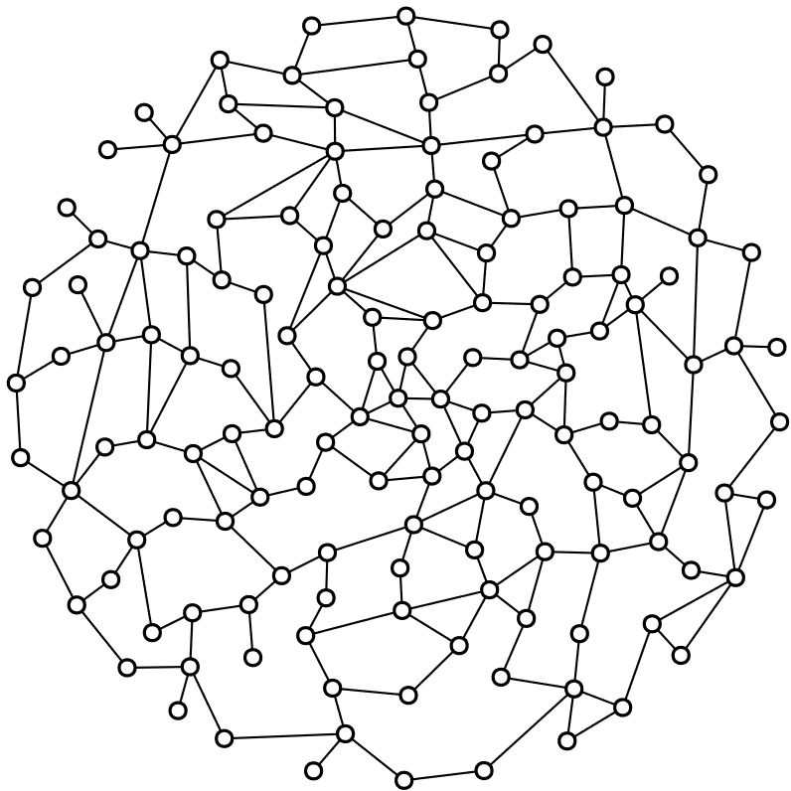
Illustration of layering
Root vertex $r$
Layer $L_{3}$
Observation. If $v$ belongs to layer $L_{i}$, then all neighbors of $v$ are in $L_{i−1}∪L_{i}∪L_{i+1}$
Notes:
So everything that you can dominate is in the next or previous layer.

Slide 13
Example for $λ=4$
Notes:
Note: each of these vertices has a weight.

Slide 14
Example for $λ=4$

Slide 15
Example for $λ=4$

Slide 16
Example for $λ=4$

Slide 17
Example for $λ=4$
The algorithm considers all subgraphs $G_{i}$ consisting of $λ$ consecutive layers, improving the current dominating set $S$ if that is possible by replacing vertices from $G_{i}$.
Notes:
(Last example)

Slide 18
Correctness of the algorithm
Lemma. Upon termination, the dominating set $S$ is optimal for $(G,w^{′})$
Proof. Assume for a contradiction there is a dominating set $S^{∗}$ with $w^{′}\left(S\right)>w′(S^{∗})$
Since $w′$ boosts the weight of all vertices outside $S$ by a factor $(1+ε)$, this implies:
$$w\left(S∖S^{∗}\right)=w^{′}\left(S∖S^{∗}\right)>w^{′}\left(S^{∗}∖S\right)=\left(1+ε\right)w(S^{∗}∖S)$$
Make groups of 4 consecutive layers, label groups cyclically from $1$ to $k≔\left\lceil 1+\frac{1}{ε}\right\rceil$
For $1≤i≤k$, let $R_{i}$ denote the union of layers labelled $i$
$$R_{2}$$
$$1$$
$$2$$
$$3$$
$$…$$
$$k$$
$$1$$
$$2$$
$$3$$
$$…$$
$$k$$
$$1$$
$$2$$
$$3$$
$$…$$
Notes:
Idea behind the proof: use $S^{∗}$ to show that there would have been a local region $G_{i}$ in which to improve the solution.

Slide 19
Correctness of the algorithm
Lemma. Upon termination, the dominating set $S$ is optimal for $(G,w^{′})$
Proof. Assume for a contradiction there is a dominating set $S^{∗}$ with $w^{′}\left(S\right)>w′(S^{∗})$
Since $w′$ boosts the weight of all vertices outside $S$ by a factor $(1+ε)$, this implies:
$$w\left(S∖S^{∗}\right)=w^{′}\left(S∖S^{∗}\right)>w^{′}\left(S^{∗}∖S\right)=\left(1+ε\right)w(S^{∗}∖S)$$
Make groups of 4 consecutive layers, label groups cyclically from $1$ to $k≔\left\lceil 1+\frac{1}{ε}\right\rceil$ $\text{For} 1≤i≤k\text{, }\text{let} R_{i} \text{denote} \text{the} \text{union} \text{of} \text{layers} \text{label}\text{l}\text{ed} i$
Pick $R_{i^{∗}}$ that minimizes $w(\left(S∖S^{∗}\right)∩R_{i^{∗}})$; then $w\left(\left(S∖S^{∗}\right)∩R_{i^{∗}}\right)≤\frac{1}{k}⋅w(S∖S^{∗})$
$$w\left(\left(S∖S^{∗}\right)∖R_{i^{∗}}\right)≥\left(1−\frac{1}{k}\right)w\left(S∖S^{∗}\right)>\left(1−\frac{1}{k}\right)\left(1+ε\right)w\left(S^{∗}∖S\right)≥w(S^{∗}∖S)$$
Notes:
Idea behind the proof: use $S^{∗}$ to show that there would have been a local region $G_{i}$ in which to improve the solution.

Slide 20
Correctness of the algorithm
Lemma. Upon termination, the dominating set $S$ is optimal for $(G,w^{′})$
Proof. Assume for a contradiction there is a dominating set $S^{∗}$ with $w^{′}\left(S\right)>w′(S^{∗})$
With respect to the original weight function, $w\left(\left(S∖S^{∗}\right)∖R_{i^{∗}}\right)>w(S^{∗}∖S)$
Partition layers of $G$ into blocks $B_{1},B_{2},…$ of $4k$ consecutive layers, starting halfway $R_{i^{∗}}$
Let ${\hat{B}}_{j}$ be block $B_{j}$ minus its first two and last two layers
The blocks ${\hat{B}}_{j}$ partition all these vertices
The blocks $B_{j}$ partition all these vertices
Updating $S$ by removing $S∩{\hat{B}}_{j^{∗}}$ while adding $S^{∗}∩B_{j^{∗}}$ yields a cheaper dominating set, by updating $4k=λ$ consecutive layers: the algorithm improves $S$ before terminating
$${R_{2}=R}_{i^{∗}}$$
$$B_{1}$$
$$B_{2}$$
$$B_{3}$$
$$B_{4}$$
$$1$$
$$2$$
$$3$$
$$…$$
$$k$$
$$1$$
$$2$$
$$3$$
$$…$$
$$k$$
$$1$$
$$2$$
$$3$$
$$…$$
$${\hat{B}}_{2}$$
$${\hat{B}}_{3}$$
$${\hat{B}}_{4}$$
There is an index $j^{∗}$ such that $w\left(\left(S∖S^{∗}\right)∩{\hat{B}}_{j^{∗}}\right)>w\left(\left(S^{∗}∖S\right)∩B_{j^{∗}}\right)$
Notes:
Idea behind the proof: use $S^{∗}$ to show that there would have been a local region $G_{i}$ in which to improve the solution.

Slide 21
Generalization of the approach
The following ingredients suffice to extend to other vertex minimization problems:
Feasibility is preserved when merging solutions along $O(1)$ layers
A polynomial-time algorithm to compute some feasible (possibly costly) solution
An algorithm that:
given a feasible solution $S$ in $(G,w)$ and a subgraph $G_{i}$ of $λ$ consecutive layers,
outputs an improved solution $S′$ in time $f\left(λ\right)⋅n^{O\left(1\right)}$, if such an improvement can be obtained by replacing vertices of $G_{i}$
There is an established toolbox of treewidth-based algorithms for (3), as long as the validity of an alternative solution can be verified by only inspecting $G_{i}$

Slide 22
Conclusion
$(1+ε)$-certified algorithms form a strengthening of approximation schemes
We gave a local search approach for $(1+ε)$-certified algorithms on planar graphs
Also works in any graph class of bounded local treewidth
Applicable to problems of dominating and covering forbidden subgraphs
Key idea: Sufficient to exhaustively optimize local regions of the graph
Open: Can the assumption of polynomially-bounded weights be avoided? Open: $(1+ε)$-certified algorithms for Feedback Vertex Set on planar graphs
Challenge: Turn your favorite $c$-approximation algorithm into a $c$-certified algorithm!

