Slide 1
Approximation and Kernelization for Chordal Vertex Deletion
Bart M. P. Jansen & Marcin Pilipczuk
SODA 2017
January 18th 2017, Barcelona, Spain

Slide 2
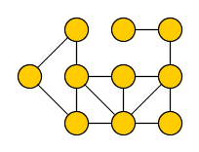
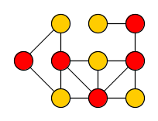
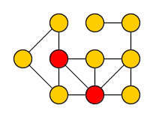
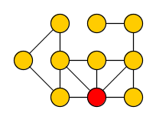
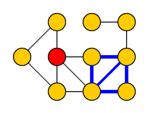
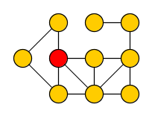
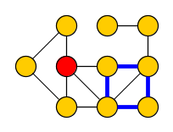
Graph modification problems
Make a minimum number of changes to obtain some graph property
All NP-complete [Lewis&Yannakakis, JCSS’80]
Vertex Cover
Delete vertices to get edgeless graph
Feedback Vertex Set
Delete vertices to get acyclic graph
Vertex Bipartization
Delete vertices to get bipartite graph
Chordal Vertex Deletion
Delete vertices to remove all induced $C_{≥4}$

Slide 3
Coping with NP-completeness
Polynomial-time approximation algorithms
Fixed-parameter tractable algorithms
Test for solution of size $k$ in time $f\left(k\right)⋅n^{O\left(1\right)}$
Kernelization algorithms
Reduce to equivalent input of bounded size in polynomial time
Function $f:ℕ→ℕ$ is the size of the kernelization
Can be exponential or polynomial; smaller is better
$n$ vertices
$f(k)$ vertices
$$G$$
$poly(\left|G\right|,k)$ time
$$G′$$
$$k$$
$$k′$$

Slide 4
Coping with graph modification problems
Vertex Cover
2-approximation
${1.2738}^{k}⋅n^{O\left(1\right)}$ algo
$2k$-vertex kernel
Feedback Vertex Set
2-approximation
${3.619}^{k}⋅n^{O\left(1\right)}$ algo
$2k^{2}+k$-vertex kernel
Vertex Bipartization
$O(\sqrt{\log{n}})$-approx
${2.3146}^{k}⋅n^{O\left(1\right)}$ algo
$O(k^{4.5})$-vtx kernel
Chordal Vertex Deletion
approximation?
$2^{O\left(k\log{k}\right)}⋅n^{O\left(1\right)}$ algo
polynomial kernel?

Slide 5
Difficulty of kernelizing Chordal Vertex Deletion
Graph Class $𝒢$ Vertex Deletion is well-understood when:
$𝒢$ is characterized by finite set of forbidden induced subgraphs
𝒢 is characterized by finite set of forbidden induced subgraphs
Kernelize using sunflower lemma (Vertex Cover)
$𝒢$ is minor-closed and has bounded treewidth
𝒢 is minor-closed and has bounded treewidth
Kernelize using protrusion reduction (Feedback Vertex Set)
For chordal graphs:
Infinitely many forbidden induced subgraphs $C_{4},C_{5},C_{6},…$
Not minor closed & unbounded treewidth (cliques are chordal)

Slide 6
Our contribution
Theorem 1.
Chordal Vertex Del. has a kernel with $O\left(k^{161}\log^{58}{k}\right)$ vertices
Resolves an open problem by Marx from 2006
Required to start the kernelization
Theorem 2.
Solution of size $O({opt}^{4}\log^{2}{opt)}$ can be found in poly-time
After our arXiv preprint in May 2016:
bounds have been improved [next talk]
analogous results for Distance Hereditary Vertex Deletion [Kim & Kwon, arXiv’16]

Slide 7
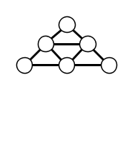
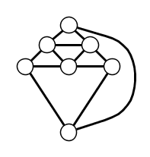
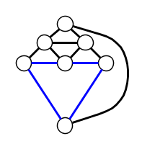
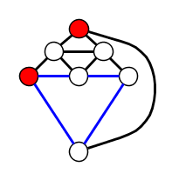
Erdös-Pósa property for chordless cycles
Lemma. If $G−\{v\}$ is chordal, then in poly-time one can find:
an integer $k$,
a set of $k$ chordless cycles that pairwise intersect only in $v$, and
a set $S⊆V\left(G\right)∖\{v\}$ of size $≤12k$ such that $G−S$ is chordal.
$$v$$
Can be used to identify vertices that must belong to any optimal solution

Slide 8
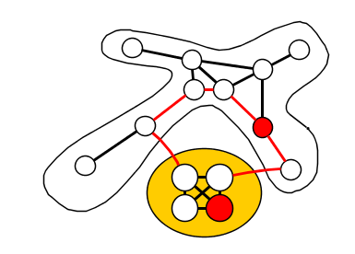
Sketch of the approximation algorithm
Reduce to the following special case:
Input graph $G$ has partition $V\left(G\right)=A\dot{⋃}B$ such that $G[A]$ is chordal, $G[B]$ is a clique
Clique $G[B]$
Chordal $G[A]$

Slide 9
Sketch of the approximation algorithm
Reduce to the following special case:
Input graph $G$ has partition $V\left(G\right)=A\dot{⋃}B$ such that $G[A]$ is chordal, $G[B]$ is a clique
Fact. Any chordal graph $G$ has a clique separator $B$ such that each component of $G−B$ has at most $\left|V\left(G\right)\right|/2$ vertices
Every instance of Chordal Vertex Deletion has a balanced separator consisting of a clique plus $opt$ vertices

Slide 10
Sketch of the approximation algorithm
Reduce to the following special case:
Input graph $G$ has partition $V\left(G\right)=A\dot{⋃}B$ such that $G[A]$ is chordal, $G[B]$ is a clique
While $G$ has a component $C$ that is not chordal:
find balanced separator for $C$ of form clique + $\tilde{O}(opt)$ vertices
add the $\tilde{O}(opt)$ vertices to the approximate solution $X_{0}$
add the clique $B$ to a list of cliques $B_{1},B_{2},…$
Terminates in $ℓ=O(opt\log{n)}$ iterations with chordal $G[A]$
$$V\left(G\right)=A∪B_{1}∪B_{2}∪…∪B_{ℓ}∪X_{0}$$
Every instance of Chordal Vertex Deletion has a balanced separator consisting of a clique plus $opt$ vertices
Notes:
Recursion tree has O(log n) levels, no level of the recusion tree has more than OPT non-chordal components because then there would be more than OPT disjoint chordless cycles => solution is larger than OPT.

Slide 11
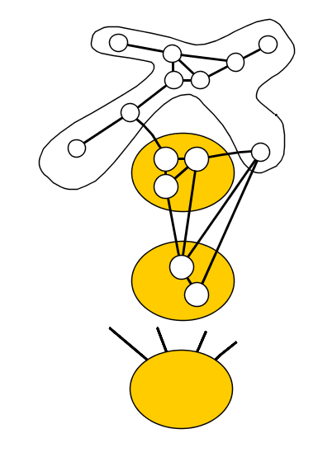
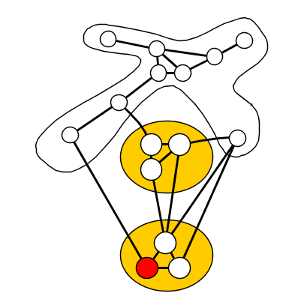
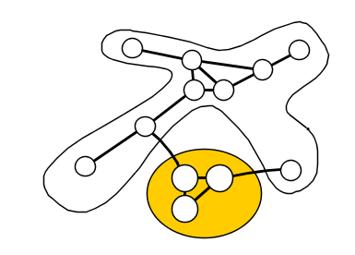
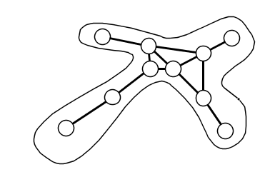
Sketch of the approximation algorithm
Reduce to the following special case:
Input graph $G$ has partition $V\left(G\right)=A\dot{⋃}B$ such that $G[A]$ is chordal, $G[B]$ is a clique
Build up global solution using algorithm for special case:
$$G[A]$$
$$G[\left(A∪B_{1}\right)∖X_{1}]$$
$$G[\left(A∪…\right)∖X_{2}]$$
$$⋯$$
$$B_{1}$$
$$B_{2}$$
$$B_{3}$$
Factor $ℓ=O(opt\log{n})$ overhead in approximation guarantee
Notes:
Recursion tree has O(log n) levels, no level of the recusion tree has more than OPT non-chordal components because then there would be more than OPT disjoint chordless cycles => solution is larger than OPT.

Slide 12
Sketch of the approximation algorithm
Reduce to the following special case:
Input graph $G$ has partition $V\left(G\right)=A\dot{⋃}B$ such that $G[A]$ is chordal, $G[B]$ is a clique
Reduce to even more special case by another decomposition
Relate special-case ChVD solutions to multicuts in a digraph
Apply Gupta’s rounding algorithm for fractional multicuts
Round fractional ChVD-solution into integral one [Gupta, SODA’02]

Slide 13
Conclusion
First polynomial kernel and poly(opt) approximation for ChVD
Based on graph-theoretic insights
Open: Poly kernel for Directed Feedback Vertex Set? Planarization?
Next talk: improvements to kernel size and approximation factor
Theorem 1.
Chordal Vertex Del. has a kernel with $O\left(k^{161}\log^{58}{k}\right)$ vertices
Theorem 2.
Solution of size $O({opt}^{4}\log^{2}{opt)}$ can be found in poly-time

