Slide 1
Parameterized Algorithms
Advanced Kernelization Techniques
Insert
«Academic unit»
on every page:
1 Go to the menu «Insert»
2 Choose: Date and time
3 Write the name of your faculty or department in the field «Footer»
4 Choose «Apply to all"
Bart M. P. Jansen
August 20th 2014, Będlewo

Slide 2
This lecture
Planar graphs
Turing kernelization
Outlook
Open problems
Properties of planar graphs
Connected Vertex Cover on planar graphs
Max Leaf Subtree
Definition
Discussion
Meta-kernelization
Beyond planar graphs

Slide 3
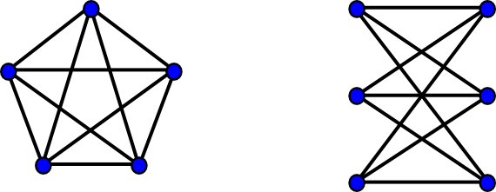
Planar graphs

Slide 4
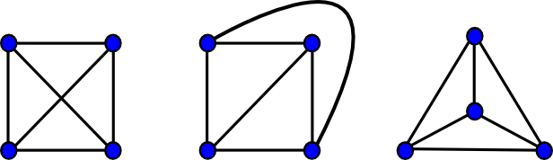
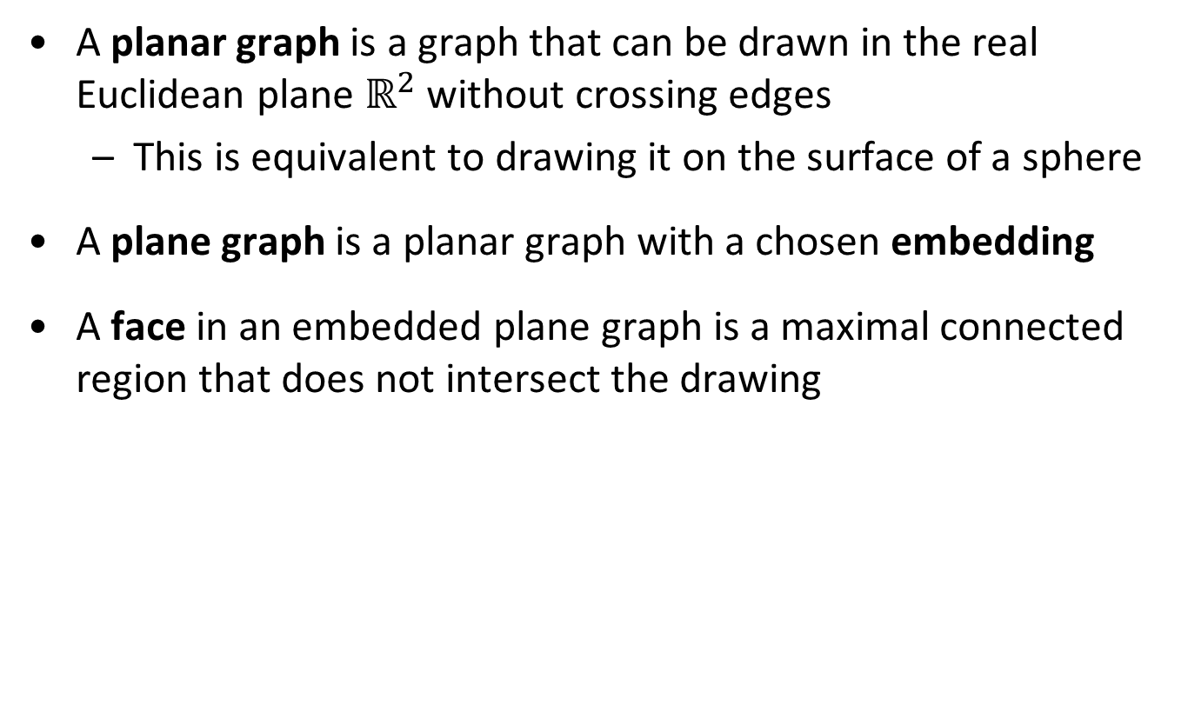
The definition
A planar graph is a graph that can be drawn in the real Euclidean plane $ℝ^{2}$ without crossing edges
  This is equivalent to drawing it on the surface of a sphere
A plane graph is a planar graph with a chosen embedding
A face in an embedded plane graph is a maximal connected region that does not intersect the drawing

Slide 5
Planar problems are easier
While most NP-complete problems remain NP-complete when the input graph is restricted to be a planar, many problems do become easier on planar graphs
Poly-time approximation algorithms give better guarantees on planar graphs
Fixed-parameter tractability
Approximation
Some problems are W[1]-hard on general graphs, but FPT on planar graphs
Kernelization
Often polynomial-time approximation schemes (PTAS’es)
For example, $k$-Independent Set
For example, 𝑘-Independent Set
Some problems have polynomial kernels on planar graphs, but not in general
For example, $k$-Connected Vertex Cover
For example, 𝑘-Connected Vertex Cover

Slide 6
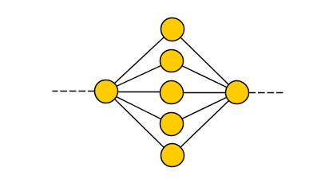
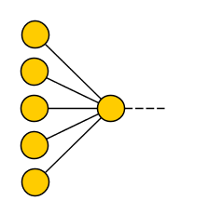
Why planar problems are easier
The parameter is often large compared to the graph size
  For several problems the only way a big planar graph can have a small solution, is simple to understand
  In general graphs, it can be very complicated
Sparsity
  Planar graphs are sparse $(m≤3n$); interactions are not as complex as in general graphs
You can exploit the drawing
  In a planar graph, you can define a sense of “locality”
  There is no direct interaction (no edges) between far away regions
Hardness proofs fail
  Many gadgets for proving $W[1]$-hardness require crossings

Slide 7
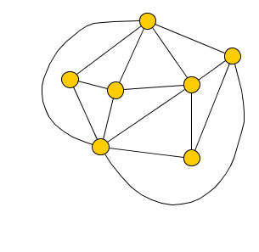
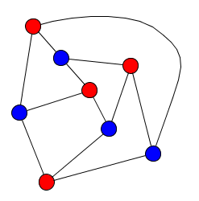

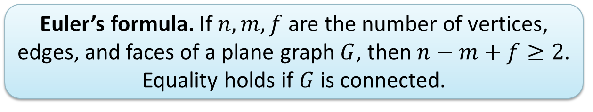
Properties of planar graphs
A simple $n$-vertex planar graph has at most $3n$ edges
A simple $n$-vertex bipartite graph has at most $2n$ edges
Every simple planar graph has a vertex of degree at most $5$
An $n$-vertex planar graph has treewidth $O\left(\sqrt{n}\right)$
Euler’s formula. If $n,m,f$ are the number of vertices, edges, and faces of a plane graph $G$, then $n−m+f≥2$.
Equality holds if $G$ is connected.

Slide 8
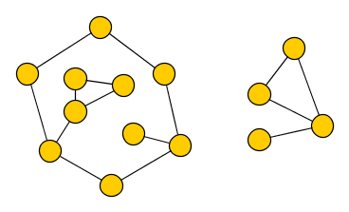
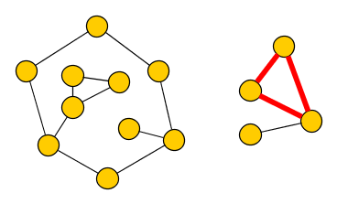
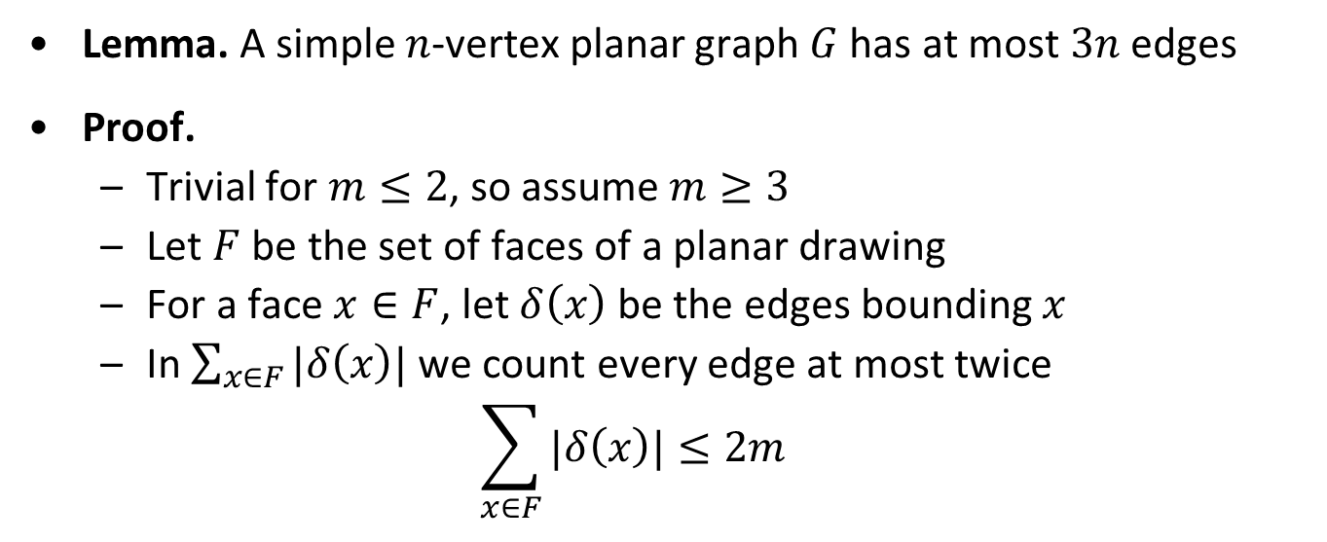

Edge counts in simple planar graphs (I)
Lemma. A simple $n$-vertex planar graph $G$ has at most $3n$ edges
Proof.
  Trivial for $m≤2$, so assume $m≥3$
  Let $F$ be the set of faces of a planar drawing
  For a face $x∈F$, let $δ\left(x\right)$ be the edges bounding $x$
  In $\sum_{x∈F}{|δ\left(x\right)|}$ we count every edge at most twice
  $$\sum_{x∈F}{|δ\left(x\right)|}≤2m$$
$$x$$

Slide 9
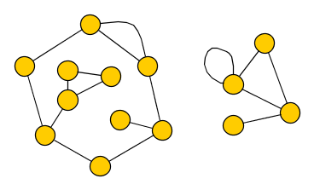
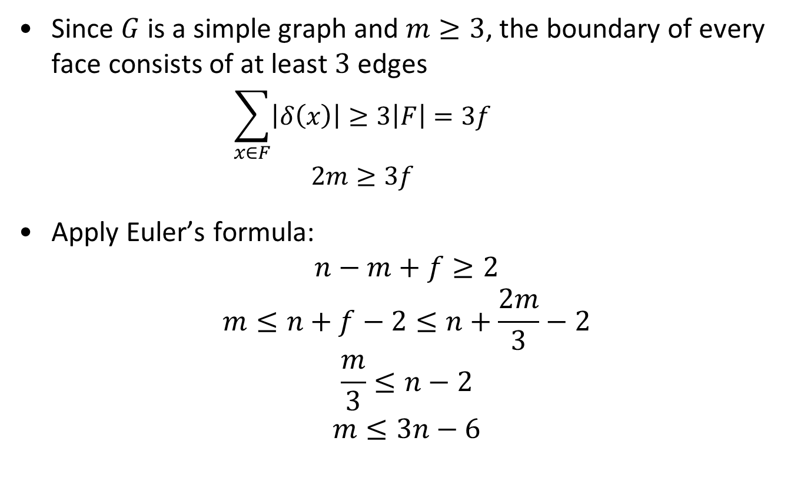
Edge counts in simple planar graphs (II)
Since $G$ is a simple graph and $m≥3$, the boundary of every face consists of at least $3$ edges
    $$\sum_{x∈F}{\left|δ\left(x\right)\right|≥3\left|F\right|=3f}$$
    $$2m≥3f$$
  Apply Euler’s formula:
  $n−m+f≥2$
  $$m≤n+f−2≤n+\frac{2m}{3}−2$$
  $$\frac{m}{3}≤n−2$$
  $$m≤3n−6$$

Slide 10
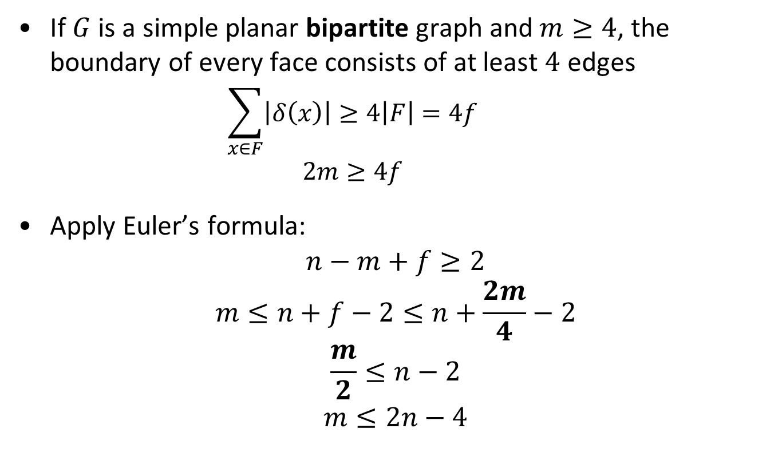
Edge counts in simple bipartite planar graphs
If $G$ is a simple planar bipartite graph and $m≥4$, the boundary of every face consists of at least $4$ edges
    $$\sum_{x∈F}{\left|δ\left(x\right)\right|≥4\left|F\right|=4f}$$
    $$2m≥4f$$
  Apply Euler’s formula:
  $n−m+f≥2$
  $$m≤n+f−2≤n+\frac{2m}{4}−2$$
  $$\frac{m}{2}≤n−2$$
  $$m≤2n−4$$

Slide 11
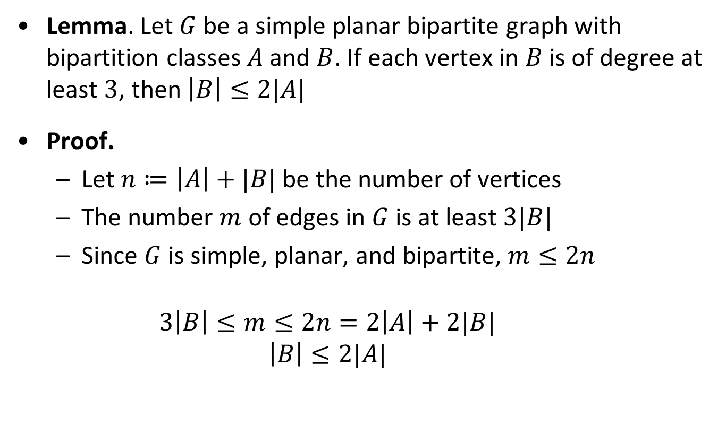
Planar bipartite neighborhood lemma
Lemma. Let $G$ be a simple planar bipartite graph with bipartition classes $A$ and $B$. If each vertex in $B$ is of degree at least $3$, then $\left|B\right|≤2|A|$
Proof.
  Let $n≔\left|A\right|+|B|$ be the number of vertices
  The number $m$ of edges in $G$ is at least $3|B|$
  Since $G$ is simple, planar, and bipartite, $m≤2n$
    $$3\left|B\right|≤m≤2n=2\left|A\right|+2|B|$$
    $$\left|B\right|≤2|A|$$

Slide 12
connected vertex cover

Slide 13
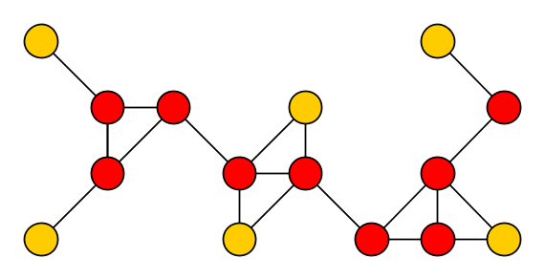
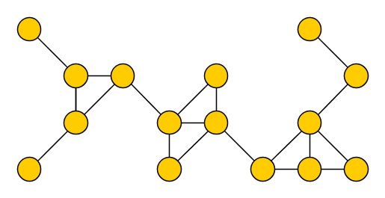
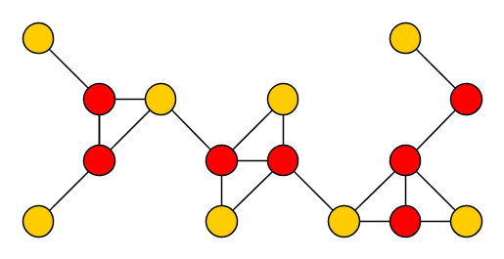

The Connected Vertex Cover problem
Input: A graph $G$ and an integer $k$
Parameter: $k$
Question: Is there a vertex cover $S$ of at most $k$ vertices in
$G$, such that $G[S]$ is connected?
Such a set $S$ is a connected vertex cover of $G$
Connected Vertex Cover does not admit a polynomial kernel in general graphs, unless $NP⊆coNP/poly$
  In sharp contrast to the $2k$-vertex kernel for Vertex Cover
  We give a $4k$-vertex kernel on planar graphs

Slide 14
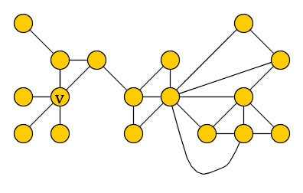
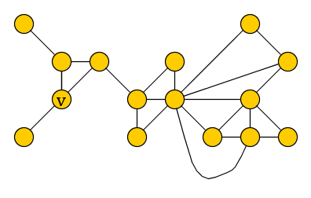
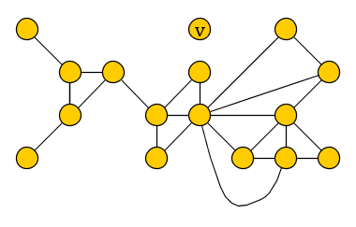
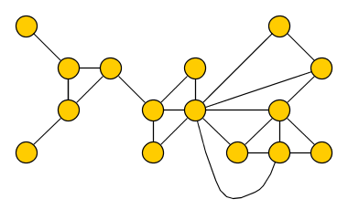

Reduction rules for Connected Vertex Cover
(R1) If $v$ is an isolated vertex, then delete $v$
(R2) If $G$ is not connected, then answer no
(R3) If $k≤0$ or $\left|V\left(G\right)\right|≤3$ then decide the problem
(R4) If vertex $v$ has multiple neighbors of degree $1$, then delete all of them except one (exercise)

Slide 15
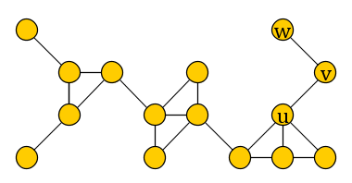
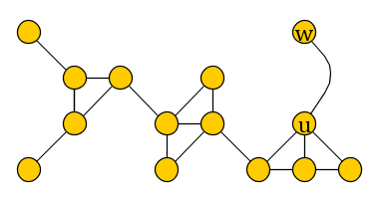

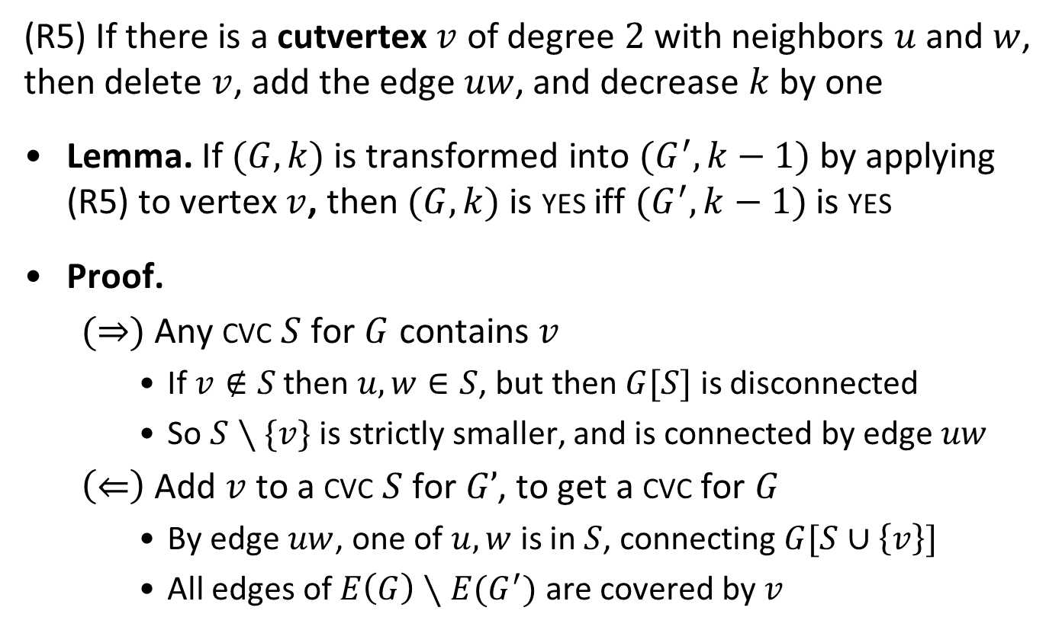
Cut vertices of degree $2$
(R5) If there is a cutvertex $v$ of degree $2$ with neighbors $u$ and $w$, then delete $v$, add the edge $uw$, and decrease $k$ by one
Lemma. If $(G,k)$ is transformed into $(G^{′},k−1)$ by applying (R5) to vertex $v$, then $(G,k)$ is yes iff $(G^{′},k−1)$ is yes
Proof.
  $(⇒)$ Any cvc $S$ for $G$ contains $v$
    If $v∉S$ then $u,w∈S$, but then $G[S]$ is disconnected
    So $S∖\{v\}$ is strictly smaller, and is connected by edge $uw$
  $\left(⇐\right)$ Add $v$ to a cvc $S$ for $G’$, to get a cvc for $G$
    By edge $uw$, one of $u,w$ is in $S$, connecting $G[S∪\left\{v\right\}]$
    All edges of $E\left(G\right)∖E(G^{′})$ are covered by $v$

Slide 16
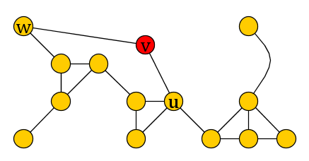
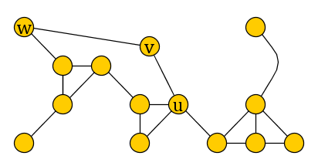
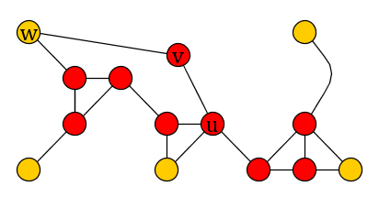
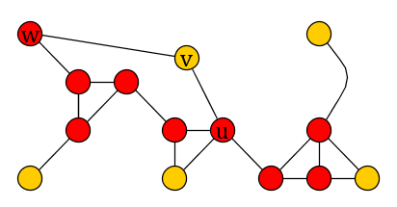
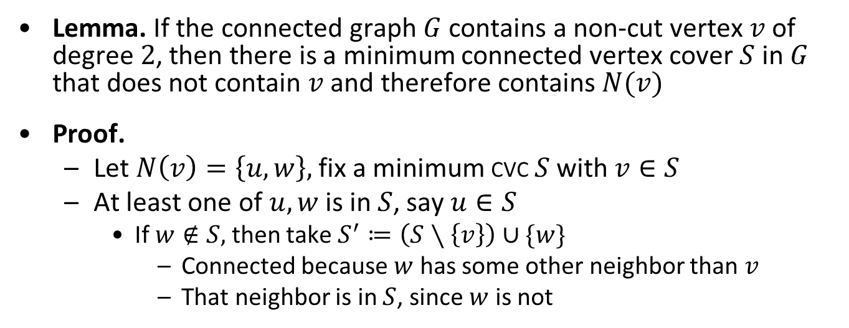
Solutions can avoid degree-2 non-cut vertices (I)
Lemma. If the connected graph $G$ contains a non-cut vertex $v$ of degree $2$, then there is a minimum connected vertex cover $S$ in $G$ that does not contain $v$ and therefore contains $N(v)$
Proof.
  Let $N\left(v\right)=\left\{u,w\right\},$ fix a minimum cvc $S$ with $v∈S$
  At least one of $u,w$ is in $S$, say $u∈S$
    If $w∉S,$ then take $S^{′}≔\left(S∖\left\{v\right\}\right)∪\{w\}$
      Connected because $w$ has some other neighbor than $v$
      That neighbor is in $S$, since $w$ is not

Slide 17
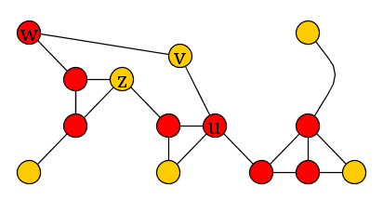

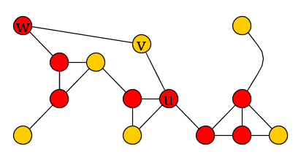
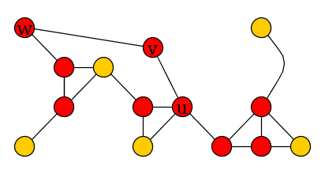
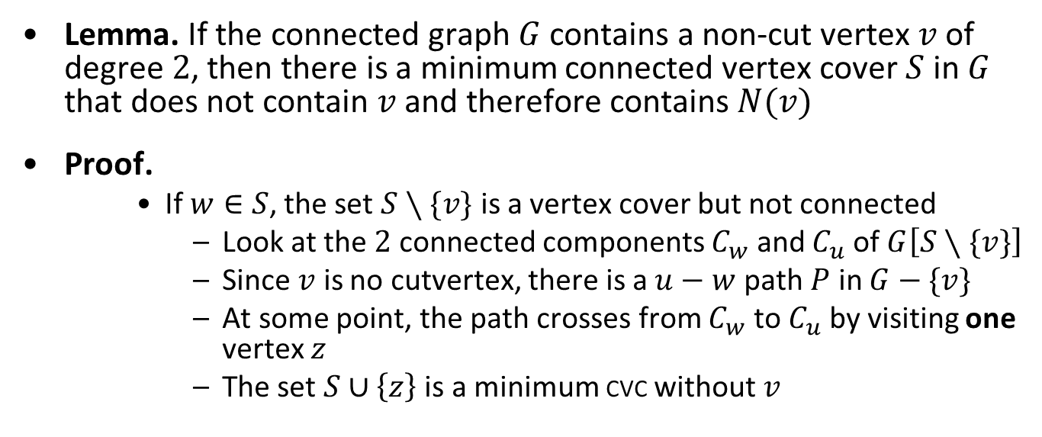
Solutions can avoid degree-2 non-cut vertices (II)
Lemma. If the connected graph $G$ contains a non-cut vertex $v$ of degree $2$, then there is a minimum connected vertex cover $S$ in $G$ that does not contain $v$ and therefore contains $N(v)$
Proof.
    If $w∈S$, the set $S∖\{v\}$ is a vertex cover but not connected
      Look at the $2$ connected components $C_{w}$ and $C_{u}$ of $G\left[S∖\{v\}\right]$
      Since $v$ is no cutvertex, there is a $u−w$ path $P$ in $G−\{v\}$
      At some point, the path crosses from $C_{w}$ to $C_{u}$ by visiting one vertex $z$
      The set $S∪\left\{z\right\}$ is a minimum cvc without $v$

Slide 18
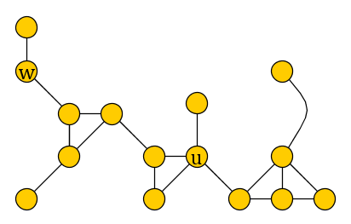


Non-cut vertices of degree $2$
(R6) If there is a vertex $v$ of degree $2$ that is not a cutvertex, then delete $v$ and add a degree-$1$ vertex to each former neighbor
Lemma. If $(G,k)$ is transformed into $(G^{′},k)$ by applying (R6) to vertex $v$, then $(G,k)$ is yes iff $(G^{′},k)$ is yes
Proof.
  $(⇒)$ Some optimal cvc for $G$ contains $u$ and $w$ but not $v$ (lemma)
    This is also a cvc for $G′$
  $\left(⇐\right)$ Any cvc $S$ for $G’$ contains both $u$ and $w$
    If one is missing, then the degree-1 neighbor covers the edge
      But then the cover is not connected
    Removing deg-1 vertices preserves connectivity, $G[S]$ is connected
    $u$ and $w$ cover all edges of $E\left(G\right)∖E(G^{′})$, so $S$ is a cvc in $G$

Slide 19
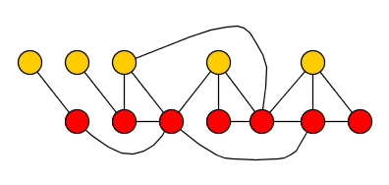
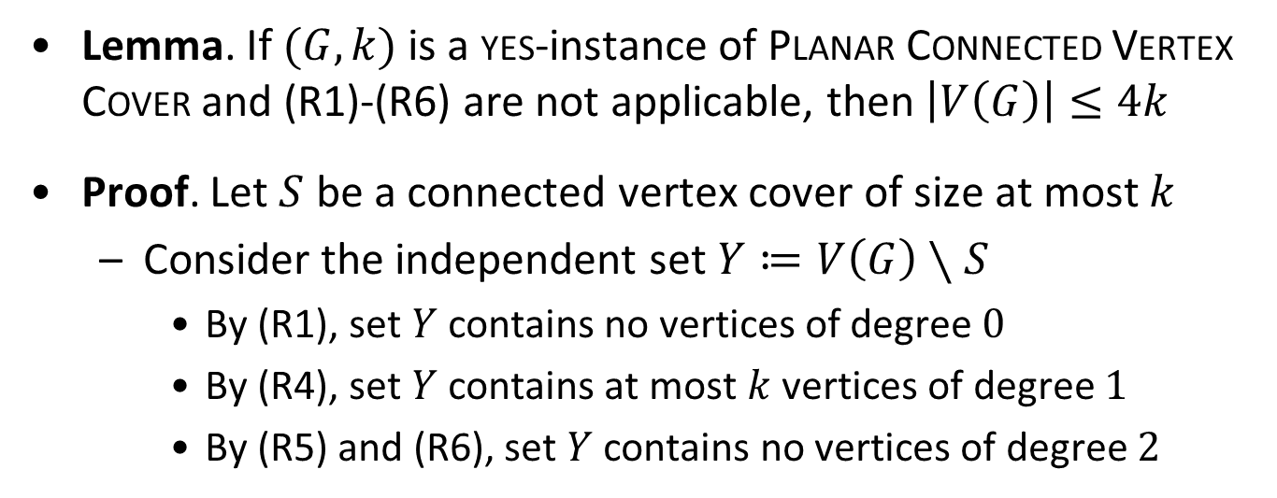
Boundary lemma
Lemma. If $(G, k)$ is a yes-instance of Planar Connected Vertex Cover and (R1)-(R6) are not applicable, then $\left|V\left(G\right)\right|≤4k$
Proof. Let $S$ be a connected vertex cover of size at most $k$
  Consider the independent set $Y≔V\left(G\right)∖S$
    By (R1), set $Y$ contains no vertices of degree $0$
    By (R4), set $Y$ contains at most $k$ vertices of degree $1$
    By (R5) and (R6), set $Y$ contains no vertices of degree $2$
S
$$≤k$$

Slide 20
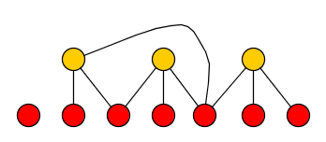
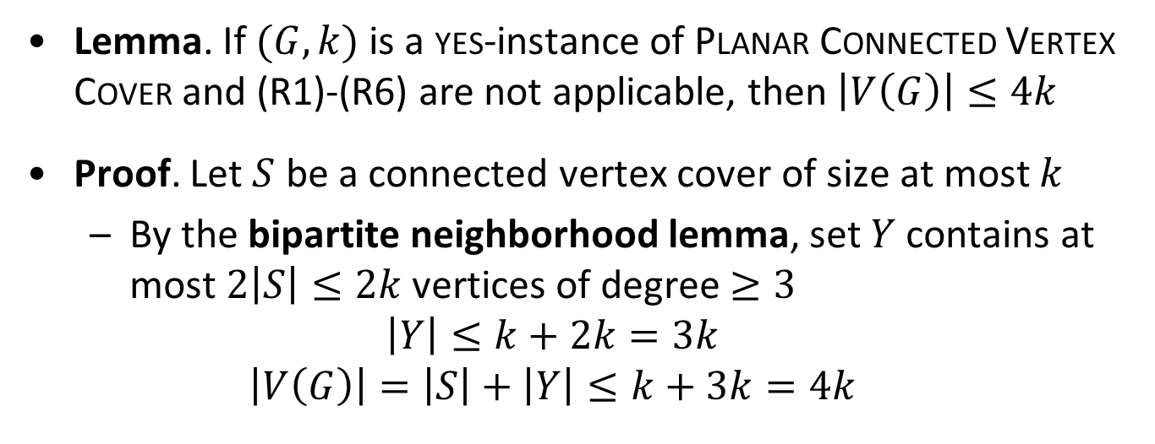
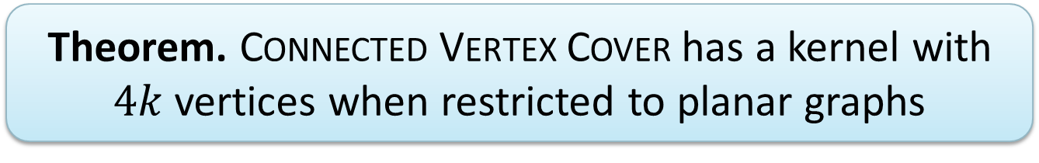

Boundary lemma
Lemma. If $(G, k)$ is a yes-instance of Planar Connected Vertex Cover and (R1)-(R6) are not applicable, then $\left|V\left(G\right)\right|≤4k$
Proof. Let $S$ be a connected vertex cover of size at most $k$
  By the bipartite neighborhood lemma, set $Y$ contains at most $2\left|S\right|≤2k$ vertices of degree $≥3$
  $$\left|Y\right|≤k+2k=3k$$
  $$\left|V\left(G\right)\right|=\left|S\right|+\left|Y\right|≤k+3k=4k$$
Theorem. Connected Vertex Cover has a kernel with $4k$ vertices when restricted to planar graphs
S
$$≤k$$

Slide 21
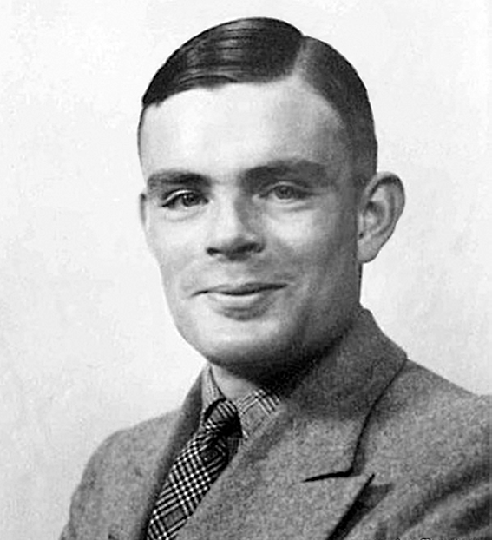
Turing kernelization

Slide 22
The limits of effective preprocessing
The composition framework presented yesterday shows that for some parameterized problems, we should not expect polynomial-size kernels
  Even for problems that are FPT
Does that mean we cannot obtain useful and provably effective preprocessing routines for such problems?
No!
  We can slightly relax the requirements to circumvent the lower bounds from compositionality

Slide 23
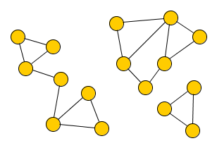
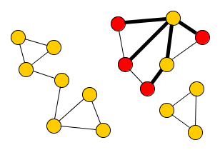
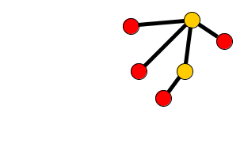

The Max Leaf Subtree problem
Input: A graph $G$ and an integer $k$
Parameter: $k$
Question: Does $G$ have a tree with $k$ leaves as a subgraph?
A leaf is a vertex with degree at most $1$
Max Leaf Subtree generalizes Max Leaf Spanning tree
  In a connected graph, any $k$-leaf tree can be extended to a spanning tree with at least $k$ leaves
  Max Leaf Subtree is NP-complete

Slide 24
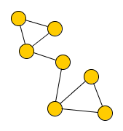









Max Leaf Subtree is or-compositional
Let $\left(G_{1},k\right), …,\left(G_{t},k\right)$ be instances of Max Leaf Subtree
Let $G^{∗}$ be the disjoint union of $G_{1},G_{2},…, G_{t}$
$(G^{∗},k)$ is a yes-instance iff at least one input $\left(G_{i},k\right)$ is yes
Theorem. $k$-Max Leaf Subtree does not admit a polynomial kernel unless $NP⊆coNP/poly$
$$G_{1}$$
$$G_{2}$$
$$G_{3}$$
$$G^{∗}$$

Slide 25




Preprocessing for Max Leaf Subtree
We cannot efficiently reduce $(G,k)$ to a single, equivalent instance of size $poly(k)$
However, we efficiently reduce $(G,k)$ to a list of instances
  each of size $poly(k)$,
  such that $\left(G,k\right)$ is yes iff there is a yes-instance on the list
The instances on the list can be solved in parallel

Slide 26




Reduction rule for Max Leaf Subtree
(R1) If there is a vertex $v$ of degree $2$, such that its neighbors $u,w$ also have degree $2$, and $uw∉E(G)$, then remove $v$ and add the edge $uw$
Lemma. If $G$ is a connected graph to which (R1) cannot be applied, and $\left|V\left(G\right)\right|≥6k^{2}$, then $G$ contains a $k$-leaf subtree

Slide 27

Preprocessing algorithm for Max Leaf Subtree
Algorithm Preprocess(Graph $G$, integer $k$)
  while (R1) is applicable to vertex $v$ with neighbors $u,w$
    remove $v$ and add the edge $uw$
  if a connected component of $G$ has $≥6k^{2}$ vertices then
    return yes
  for each connected component $C$ of $G$
    add $(C,k)$ to the list of output instances, size is $≤6k^{2}$
By the stated lemma, algorithm is correct when saying yes
Since a subtree is contained in 1 connected component, answer to $\left(G,k\right)$ is yes iff some $(C,k)$ is a yes-instance

Slide 28

Formal definition?
What is the right definition for this type of preprocessing?
The given procedure splits an instance $(x,k)$
  into a list $\left(x_{1}^{′},k_{1}^{′}\right),…,\left(x_{t}^{′}, k_{t}^{′}\right)$ of small instances, such that
  the answer to $(x,k)$ is the logical or of the $\left(x_{i}^{′},k_{i}^{′}\right)$
However, the preprocessing would also be useful if there would be a different way of efficiently finding the answer to $(x,k)$ from the answers to $\left(x_{1}^{′},k_{1}^{′}\right), …, (x_{t}^{′}, k_{t}^{′})$
  Only important that $(x,k)$ can efficiently be solved knowing just the answers to $poly(k)$-size instances

Slide 29


Turing kernelization
Let $Q⊆Σ^{∗}×ℕ$ be a parameterized problem and let $f:ℕ→ℕ$
A Turing kernelization for $Q$ of size $f$ is an algorithm that
  decides whether a given instance $\left(x,k\right)∈Σ^{∗}×ℕ$ is in $Q$
  in time polynomial in $\left|x\right|+k$
  when given access to an oracle that
    for any instance $\left(x^{′},k^{′}\right)$ with $\left|x^{′}\right|,k^{′}≤f\left(k\right)$,
    decides whether $\left(x^{′},k^{′}\right)∈Q$ in a single step

Slide 30

Results on Turing kernelization
The preprocessing algorithm for Max Leaf Subtree shows:
Create the list of instances, query each small instance from the oracle, output yes if you get a yes-answer from the oracle
The Max Leaf Subtree algorithm is non-adaptive
  It formulates all oracle queries before making a query
The definition of Turing kernelization also allows adaptivity
  Formulate next query based on previous answers
Theorem. $k$-Max Leaf Subtree has a Turing kernel
with $O\left(k^{2}\right)$ vertices and bitsize $O\left(k^{4}\right)$

Slide 31


Turing kernelization for finding paths
[J, ESA 2014]
The algorithm is crucially adaptive
  Unclear whether a non-adaptive Turing kernel exists
To show the idea, we consider the $k$-Longest Cycle problem
  Given $(G,k)$, does $G$have a simple cycle of length $≥k?$
  Behaves similarly as $k$-Longest Path, but details are easier
Theorem. $k$-Longest Path has a polynomial Turing kernel
when restricted to planar graphs

Slide 32




Long cycles through $2$-separators
Claim.
  Let $A,B⊆V(G)$ such that $A∪B=V(G)$, $A∩B=\{u,v\}$, and there are no edges between $A∖B$ and $B∖A$
  Let $S⊆V(G)$ be the vertices on a longest $uv$ path in $G[A]$
  If $G$ has a cycle of length $≥k$, then:
    The graph $G[A]$ has a cycle of length $≥k$, or
    The graph $G[S∪B]$ has a cycle of length $≥k$

Slide 33





Turing reduction rule for $k$-Longest Cycle
This info can be obtained from the decision oracle for $k$-Longest Cycle by self-reduction on the $poly(k)$-size subgraph $G[A]$
If there are $A,B⊆V(G)$ such that $A∪B=V\left(G\right)$,
$A∩B=\left\{u,v\right\}$ is a minimal separator, and
$k<\left|A\right|<k^{10}$:
  If $G[A]$ has a cycle of length at least $k$, output yes
  If $G[A]$ does not have a cycle of length at least $k$:
    Query the oracle for the vertices $S$ of a longest $uv$ path in $G\left[A\right]$
      If $\left|S\right|≥k$, then conclude that the answer is yes
      Else, remove the vertices of $A∖S$ from the graph
Query the oracle for the instance $(G\left[A\right],k)$ with at most $k^{10}$ vertices

Slide 34




Splitting rule for $k$-Longest Cycle
If there is a connected component of $G$ that is not biconnected, then split it into its biconnected components

Slide 35


Turing kernelization for $k$-Longest Cycle
If neither of the reduction rules can be applied to a planar graph $G$, and there is a connected component with $k^{10}$ vertices, then the answer is yes
  Combination of nontrivial off-the-shelf graph-theoretic results proves the existence of a $≥k$-cycle
If all connected components have at most $k^{10}$ vertices, query the oracle for each one to determine if it contains a $k$-cycle
    Afterward, we know the answer to the instance
In Turing kernelization, we can use the solutions to small instances of difficult problems to help us reduce!

Slide 36
Advanced discussion

Slide 37

Protrusions
For planar graphs, there is a single algorithmic idea that simultaneously gives polynomial-size (often even linear-size) kernels for a wide variety of graph problems
Based on the idea of protrusion replacement

Slide 38
How to replace
Goal is to replace a large but structurally simple part of the graph by a smaller gadget that enforces the same constraints
A list of possible gadgets is hardcoded into the algorithm
To determine which gadget we should use, we have to be able to analyze the behavior of the problem on the protrusion
  We demand that it has constant treewidth
If a graph problem satisfies certain simple conditions and is expressible in a general type of logic, this approach yields polynomial kernels for problems on planar graphs
  Meta-kernelization

Slide 39

Meta-kernelization results

Slide 40



Beyond planar graphs
Planar graphs have nice algorithmic properties
Similar algorithmic properties can be derived for generalizations of planar graphs
  Graphs of bounded genus
    Graphs that can be drawn without crossings onto a sphere to which a constant number of “handles” have been attached
    The handles allow some edges between distant regions, but the graph cannot be too wild
  Minor-free graphs
    A graph is planar iff it contains neither $K_{5}$ nor $K_{3,3}$ as a minor
    If a family of graphs does not contain a fixed graph $H$ as a minor, then the family contains only sparse graphs
Many algorithms first developed for planar graphs were later generalized to bounded-genus and minor-free graphs

Slide 41

Beyond planar graphs for Connected Vertex Cover
The reduction rules for Connected Vertex Cover did not rely on planarity
  They are also correct in general graphs
The boundary lemma (exhaustively reduced instances with more than $4k$ vertices have answer no) did rely on planarity
The analysis can be adapted for graphs of genus $g$
  Graphs that can be drawn onto a sphere with $g$ handles
  You can prove an upper bound of $O(k+g)$ vertices for exhaustively reduced yes-instances

Slide 42
outlook

Slide 43


Open problem: Turing kernel for $k$-Longest Path
The $k$-Longest Path problem has a polynomial Turing kernel when restricted to planar graphs
Is there a polynomial Turing kernel in general graphs?
  This is wide open!

Slide 44
Open problem: Lower bounds for Turing kernels
The composition framework allows us to prove that some problems do not have polynomial-size (standard) kernels
How can we prove that a problem does not have a polynomial Turing kernel?
Hermelin et al. [IPEC 2013] suggest that two specific problems do not admit polynomial-size Turing kernels:
  Hitting Set parameterized by # of elements
  Hitting Set parameterized by # of sets
However, no complexity-theoretic evidence is known!
  Does the polynomial-time hierarchy collapse if these problems have polynomial Turing kernels?

Slide 45
Exercises
From this lecture
9.4, 9.8
Graph-theoretic analysis
9.10
Design of kernelization algorithms
9.6

Slide 46
Conclusion
Planar graphs have many nice properties that can be exploited for kernelization
Turing kernelization is a relaxed form of preprocessing that can sometimes circumvent lower bounds for normal kernelization
  Many interesting open problems remain in this area

Slide 47
The end

