Slide 1
Parameterized Algorithms
Randomized Techniques
Insert
«Academic unit»
on every page:
1 Go to the menu «Insert»
2 Choose: Date and time
3 Write the name of your faculty or department in the field «Footer»
4 Choose «Apply to all"
Bart M. P. Jansen
August 18th 2014, Będlewo

Slide 2
Randomized computation
For some tasks, finding a randomized algorithm is much easier than finding a deterministic one
We consider algorithms that have access to a stream of uniformly random bits
  So we do not consider randomly generated inputs
The actions of the algorithm depend on the values of the random bits
  Different runs of the algorithm may give different outcomes, for the same input

Slide 3
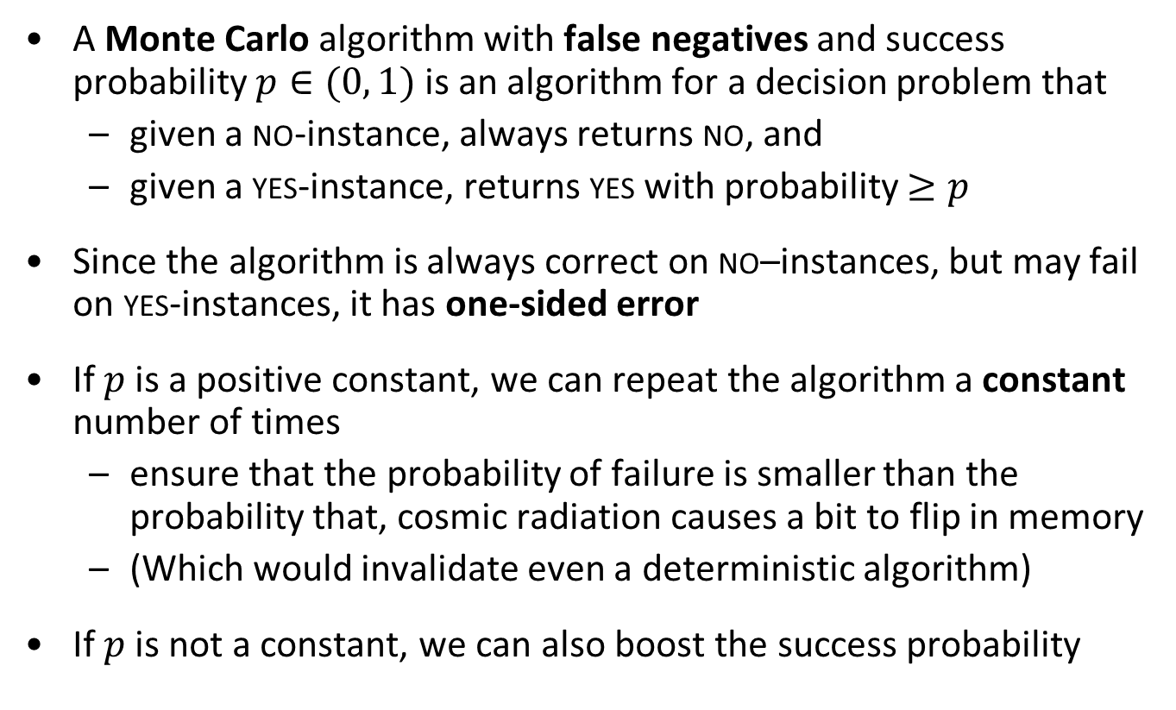
Monte Carlo algorithms
A Monte Carlo algorithm with false negatives and success probability $p∈(0, 1)$ is an algorithm for a decision problem that
  given a no-instance, always returns no, and
  given a yes-instance, returns yes with probability $≥p$
Since the algorithm is always correct on no–instances, but may fail on yes-instances, it has one-sided error
If $p$ is a positive constant, we can repeat the algorithm a constant number of times
  ensure that the probability of failure is smaller than the probability that, cosmic radiation causes a bit to flip in memory
  (Which would invalidate even a deterministic algorithm)
If $p$ is not a constant, we can also boost the success probability

Slide 4
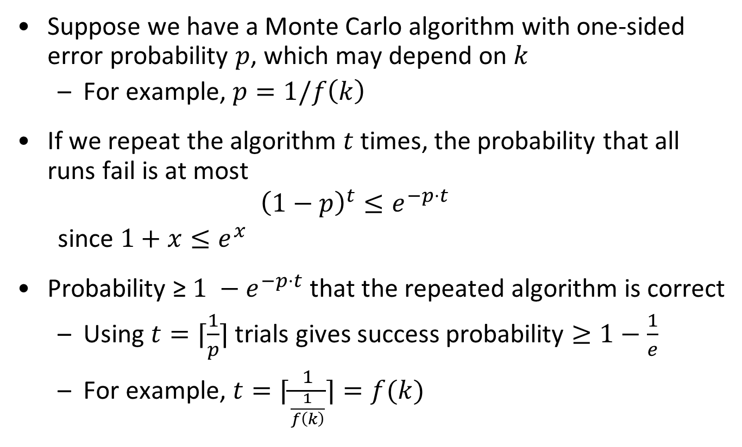
Independent repetitions increase success probability
Suppose we have a Monte Carlo algorithm with one-sided error probability $p$, which may depend on $k$
  For example, $p=1/f\left(k\right)$
If we repeat the algorithm $t$ times, the probability that all runs fail is at most
  $${\left(1−p\right)}^{t}≤e^{−p⋅t}$$
  since $1+x≤e^{x}$
Probability ≥ $1 −e^{−p⋅t}$ that the repeated algorithm is correct
  Using $t=⌈\frac{1}{p}⌉$ trials gives success probability $≥1−\frac{1}{e}$
  For example, $t=⌈\frac{1}{\frac{1}{f\left(k\right)}}⌉=f(k)$

Slide 5
This lecture
Color Coding
The Longest Path problem
Random Separation
The Subgraph Isomorphism problem
Chromatic Coding
$d$-Clustering
𝑑-Clustering
Derandomization
Monte Carlo algorithm for Feedback Vertex Set

Slide 6
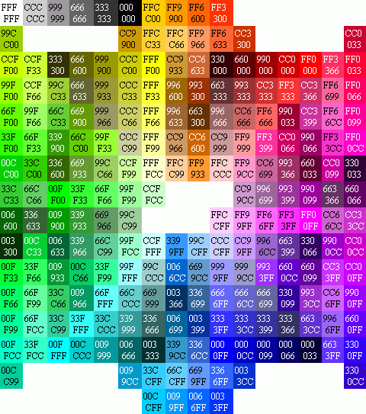
Color coding

Slide 7
Color coding
Randomly assign colors to the input structure
If there is a solution and we are lucky with the coloring, every element of the solution has received a different color
Then find an algorithm to detect such colorful solutions
  Solutions of elements with pairwise different colors

Slide 8
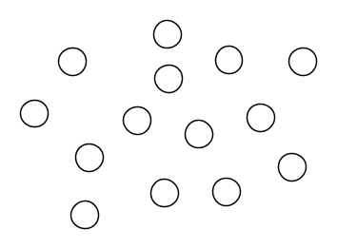
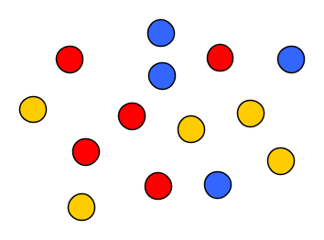


The odds of getting lucky
Lemma.
  Let $U$ be a set of size $n$, and let $X⊆U$ have size $k$
  Let $f:U→\left[k\right]=\left\{1,2,…,k\right\}$ be a coloring of the elements of $U$, chosen uniformly at random
    Each element of $U$ is colored with one of $k$ colors, uniformly and independently at random
  The probability that the elements of $X$ are colored with pairwise distinct colors is at least $e^{−k}$
Proof.
  There are $k^{n}$ possible colorings
  In $k!⋅k^{n−k}$ of them, all colors on $X$ are distinct
  $$\frac{k!⋅k^{n−k}}{k^{n}}=\frac{k!}{k^{k}}>\frac{k^{k}}{e^{k}⋅k^{k}}=e^{−k}$$
  We used $k!>k^{k}/e^{k}$
$$X$$

Slide 9
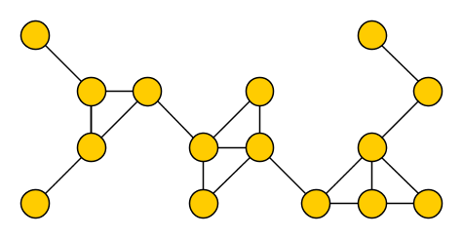
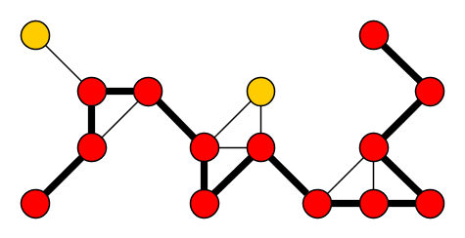

The Longest Path problem
Input: An undirected graph $G$ and an integer $k$
Parameter: $k$
Question: Is there a simple path on $k$ vertices in $G$?
A solution is a $k$-path
The Longest Path problem is a restricted version of the problem of finding patterns in graphs

Slide 10
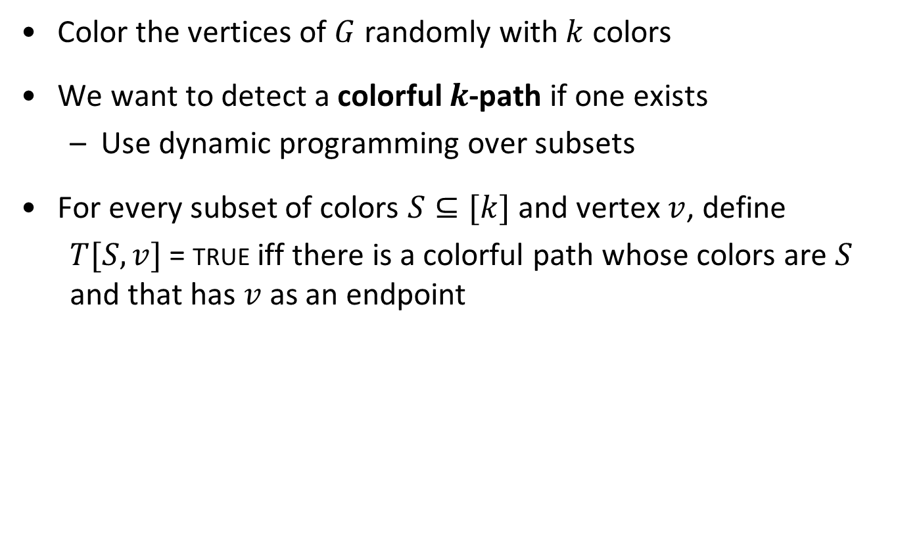
Color coding for Longest Path
Color the vertices of $G$ randomly with $k$ colors
We want to detect a colorful $k$-path if one exists
  Use dynamic programming over subsets
For every subset of colors $S⊆[k]$ and vertex $v$, define
  $T[S,v]$ = true iff there is a colorful path whose colors are $S$ and that has $v$ as an endpoint

Slide 11
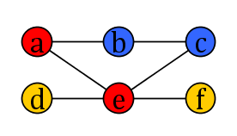
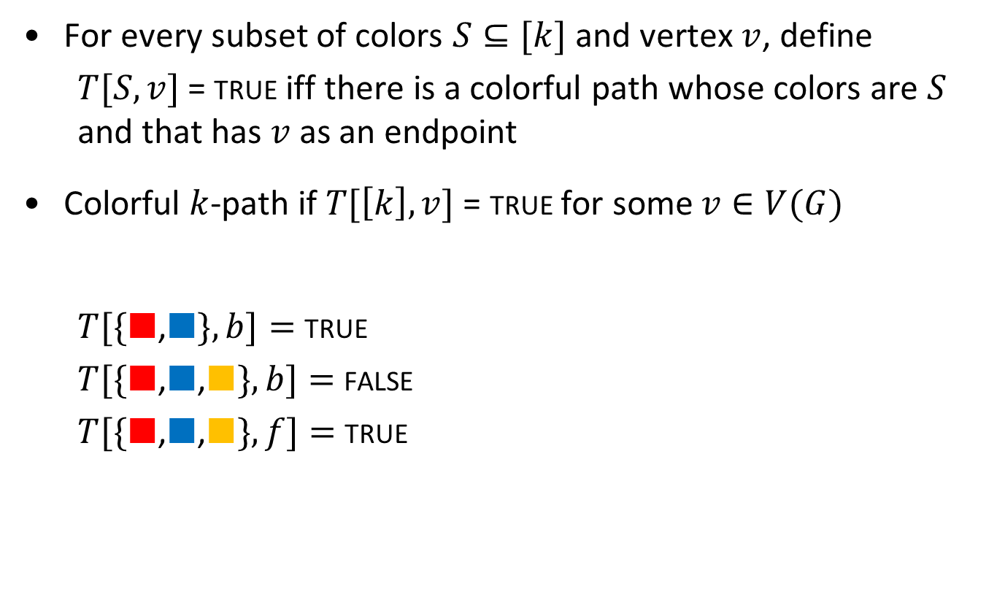
The dynamic programming table
For every subset of colors $S⊆[k]$ and vertex $v$, define
  $T[S,v]$ = true iff there is a colorful path whose colors are $S$ and that has $v$ as an endpoint
Colorful $k$-path if $T[\left[k\right],v]$ = true for some $v∈V(G)$
  $T[\{■$,$■\}, b]=$ true
  $T[\{■$,$■\text{,}■\}, b]=$ false
  $T[\{■$,$■\text{,}■\}, f]=$ true

Slide 12
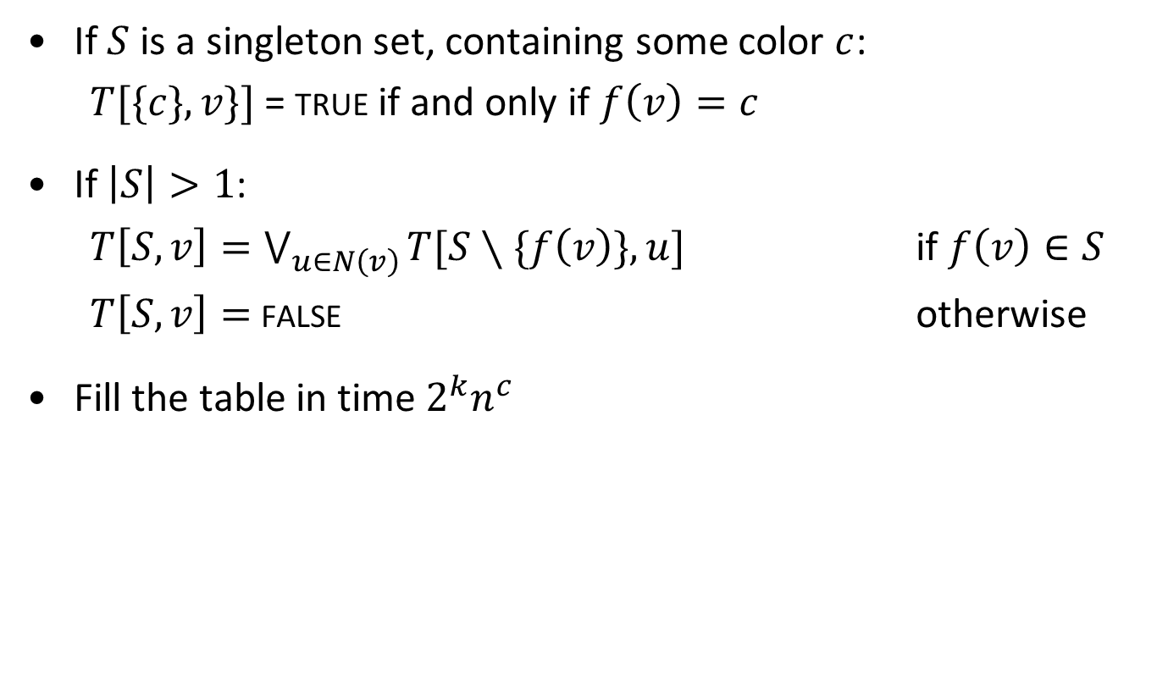
A recurrence to fill the table
If $S$ is a singleton set, containing some color $c$:
  $T[\{c\},v\}]$ = true if and only if $f\left(v\right)=c$
If $\left|S\right|>1$:
  $T\left[S,v\right]=\bigvee_{u∈N\left(v\right)}{T[S∖\{f\left(v\right)\},u]}$ if $f\left(v\right)∈S$
  $T\left[S,v\right]=$ false otherwise
Fill the table in time $2^{k}n^{c}$

Slide 13
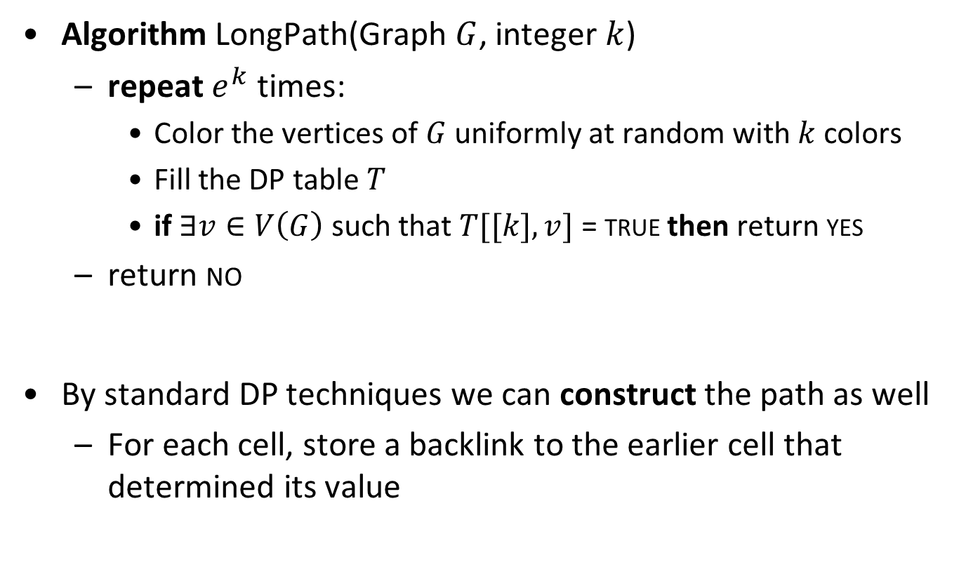
Randomized algorithm for Longest Path
Algorithm LongPath(Graph $G$, integer $k$)
  repeat $e^{k}$ times:
    Color the vertices of $G$ uniformly at random with $k$ colors
    Fill the DP table $T$
    if $∃v∈V\left(G\right)$ such that $T[[k],v]$ = true then return yes
  return no
By standard DP techniques we can construct the path as well
  For each cell, store a backlink to the earlier cell that determined its value

Slide 14
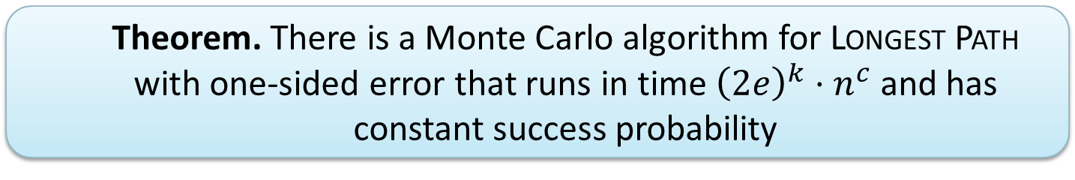
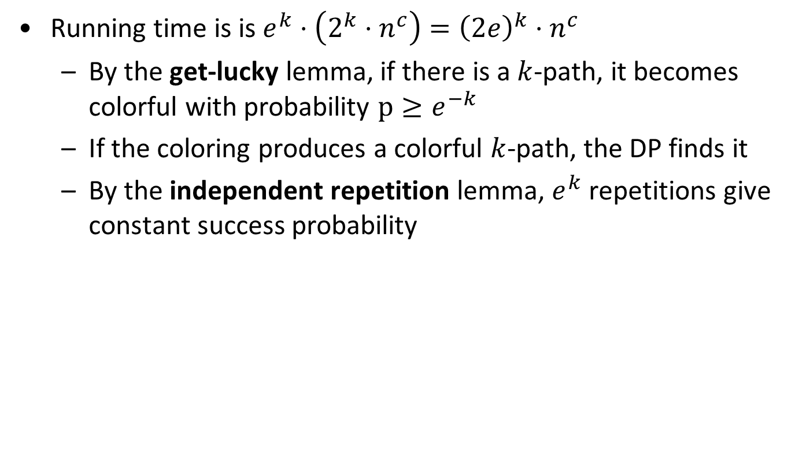
Analysis for the Longest Path algorithm
Running time is is $e^{k}⋅\left(2^{k}⋅n^{c}\right)={\left(2e\right)}^{k}⋅n^{c}$
  By the get-lucky lemma, if there is a $k$-path, it becomes colorful with probability $p≥e^{−k}$
  If the coloring produces a colorful $k$-path, the DP finds it
  By the independent repetition lemma, $e^{k}$ repetitions give constant success probability
  Theorem. There is a Monte Carlo algorithm for Longest Path with one-sided error that runs in time ${\left(2e\right)}^{k}⋅n^{c}$ and has constant success probability

Slide 15
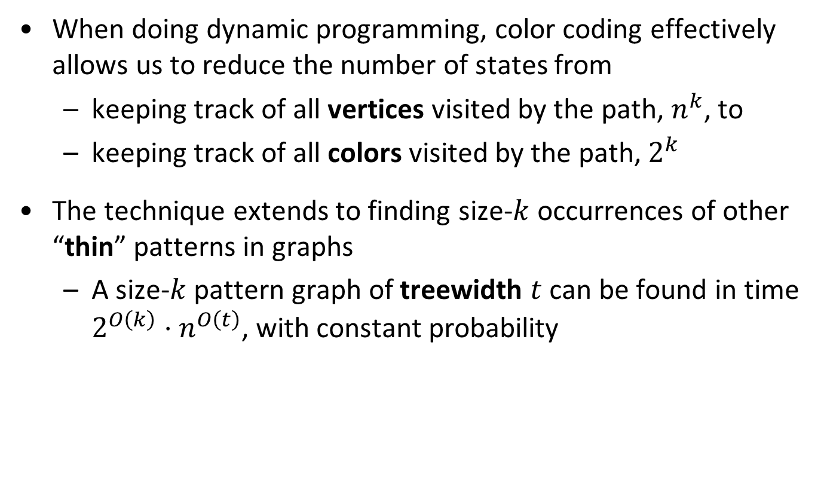
Discussion of color coding
When doing dynamic programming, color coding effectively allows us to reduce the number of states from
  keeping track of all vertices visited by the path, $n^{k}$, to
  keeping track of all colors visited by the path, $2^{k}$
The technique extends to finding size-$k$ occurrences of other “thin” patterns in graphs
  A size-$k$ pattern graph of treewidth $t$ can be found in time $2^{O\left(k\right)}⋅n^{O\left(t\right)}$, with constant probability

Slide 16
Random separation

Slide 17
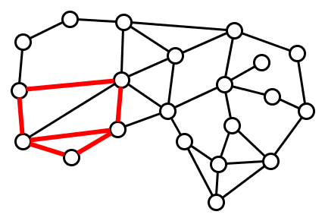
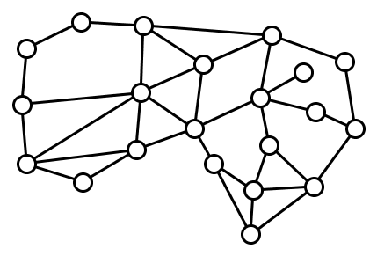
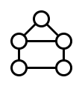

The Subgraph Isomorphism problem
Input: A host graph $G$ and pattern graph $H$ (undirected)
Parameter: $k≔|V\left(H\right)|$
Question: Does $G$ have a subgraph $\hat{H}$ isomorphic to $H$?
Does $G=$ contain $H=$ ?

Slide 18
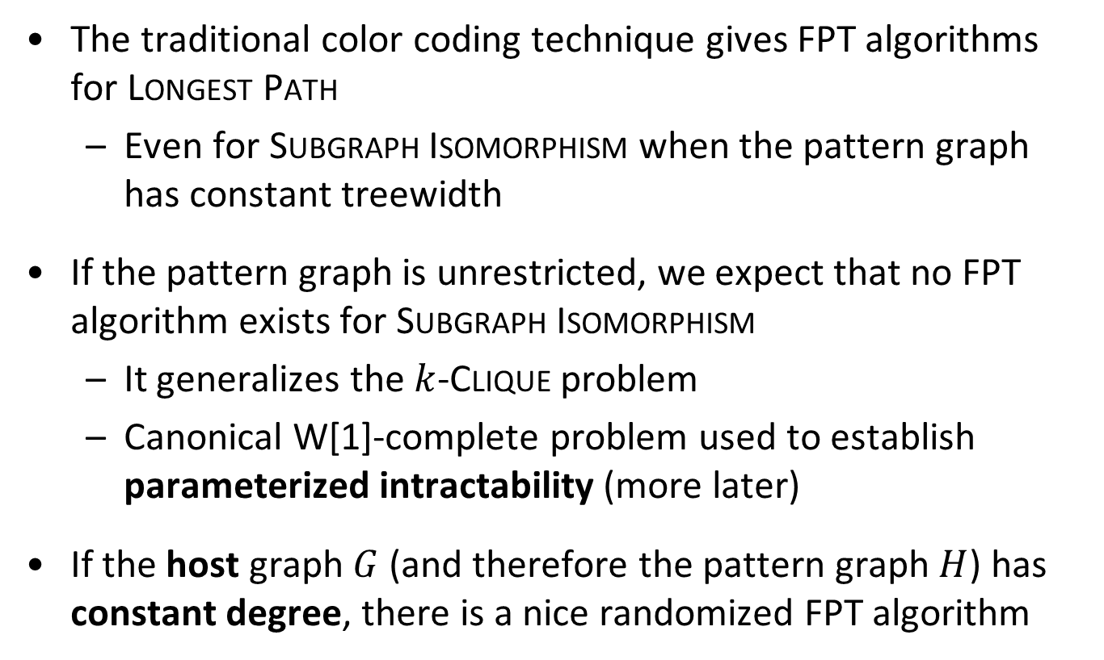
Background
The traditional color coding technique gives FPT algorithms for Longest Path
  Even for Subgraph Isomorphism when the pattern graph has constant treewidth
If the pattern graph is unrestricted, we expect that no FPT algorithm exists for Subgraph Isomorphism
  It generalizes the $k$-Clique problem
  Canonical W[1]-complete problem used to establish parameterized intractability (more later)
If the host graph $G$ (and therefore the pattern graph $H$) has constant degree, there is a nice randomized FPT algorithm

Slide 19

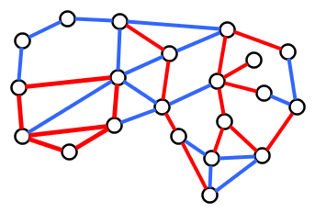
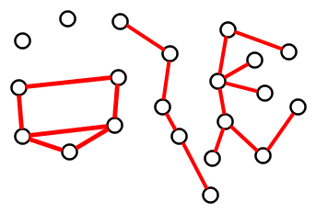
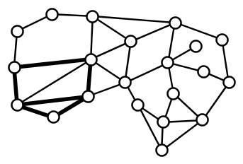
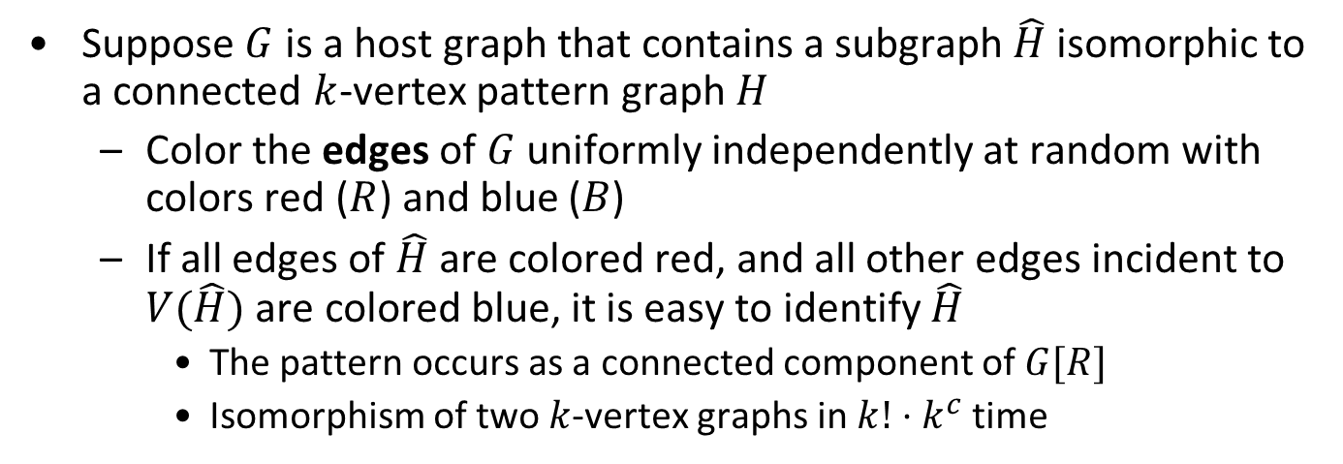
Random 2-coloring of host graphs
Suppose $G$ is a host graph that contains a subgraph $\hat{H}$ isomorphic to a connected $k$-vertex pattern graph $H$
  Color the edges of $G$ uniformly independently at random with colors red ($R$) and blue ($B$)
  If all edges of $\hat{H}$ are colored red, and all other edges incident to $V(\hat{H})$ are colored blue, it is easy to identify $\hat{H}$
    The pattern occurs as a connected component of $G[R]$
    Isomorphism of two $k$-vertex graphs in $k!⋅k^{c}$ time

Slide 20
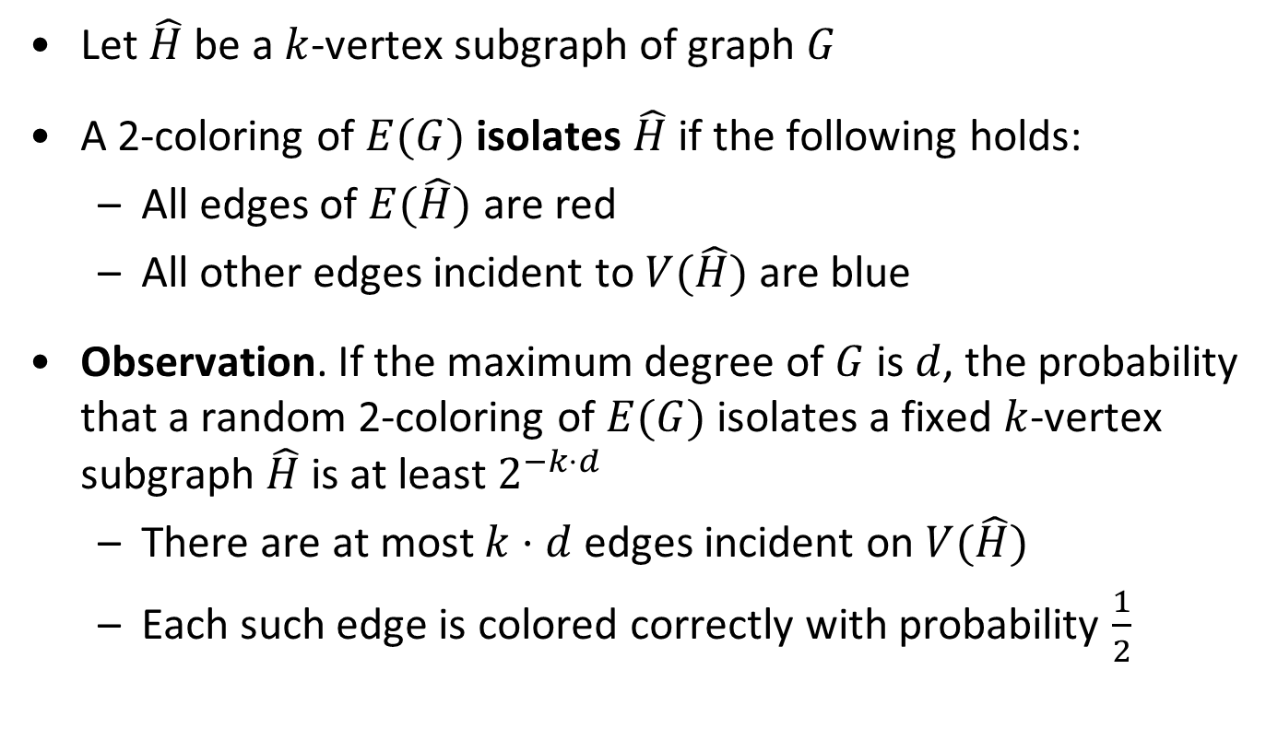
Probability of isolating the pattern subgraph
Let $\hat{H}$ be a $k$-vertex subgraph of graph $G$
A 2-coloring of $E(G)$ isolates $\hat{H}$ if the following holds:
  All edges of $E(\hat{H})$ are red
  All other edges incident to $V(\hat{H})$ are blue
Observation. If the maximum degree of $G$ is $d$, the probability that a random 2-coloring of $E(G)$ isolates a fixed $k$-vertex subgraph $\hat{H}$ is at least $2^{−k⋅d}$
  There are at most $k⋅d$ edges incident on $V(\hat{H})$
  Each such edge is colored correctly with probability $\frac{1}{2}$

Slide 21
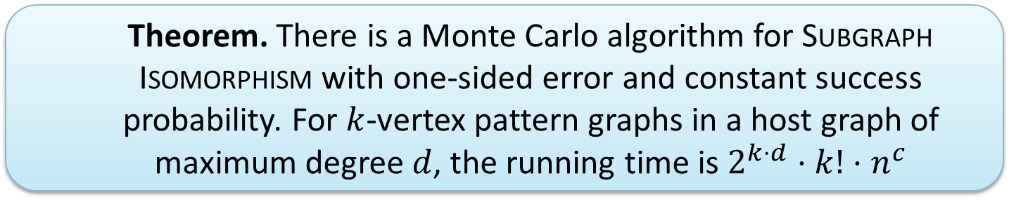
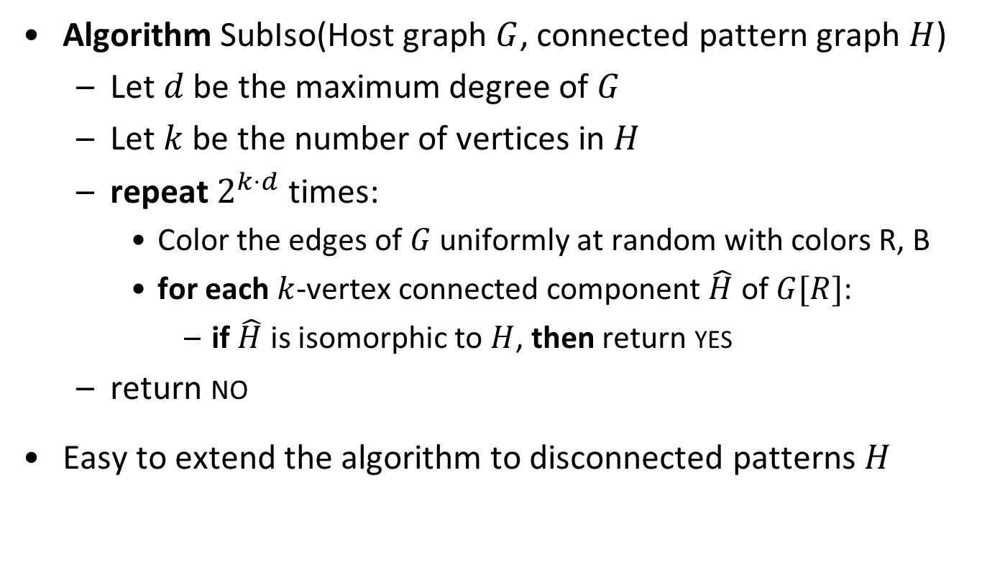
Randomized algorithm for Subgraph Isomorphism
Algorithm SubIso(Host graph $G$, connected pattern graph $H$)
  Let $d$ be the maximum degree of $G$
  Let $k$ be the number of vertices in $H$
  repeat $2^{k⋅d}$ times:
    Color the edges of $G$ uniformly at random with colors R, B
    for each $k$-vertex connected component $\hat{H}$ of $G[R]$:
      if $\hat{H}$ is isomorphic to $H$, then return yes
  return no
Easy to extend the algorithm to disconnected patterns $H$
  Theorem. There is a Monte Carlo algorithm for Subgraph Isomorphism with one-sided error and constant success probability. For $k$-vertex pattern graphs in a host graph of maximum degree $d$, the running time is $2^{k⋅d}⋅k!⋅n^{c}$

Slide 22
Chromatic coding

Slide 23
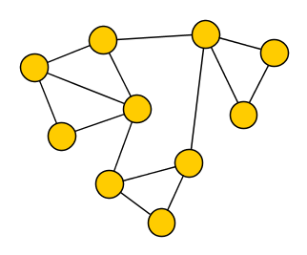
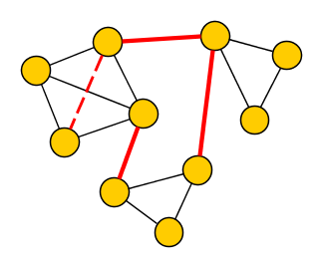
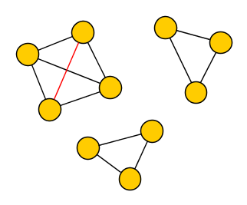


The $d$-Clustering problem
Input: A graph $G$ and an integer $k$
Parameter: $k$
Question: Is there a set $A⊆\left(\begin{matrix}V(G) \\ 2\end{matrix}\right)$ of at most $k$ adjacencies such that $G⊕A$ consists of $d$ disjoint cliques?
Such a graph is called a $d$-cluster graph

Slide 24

How to color
$d$-Clustering looks for a set of (non-)edges, instead of vertices
We solve the problem on general graphs
By randomly coloring the input, we again hope to highlight a solution with good probability, making it easier to find
  We color vertices of the graph

Slide 25
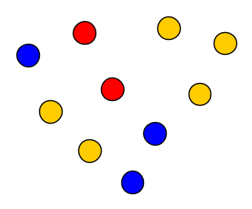
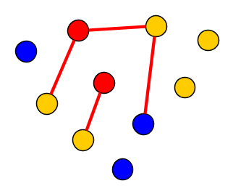
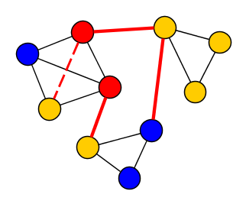

Proper colorings
A set of adjacencies $A$ is properly colored by a coloring of the vertices if:
  For all pairs $uv∈A$, the colors of $u$ and $v$ are different
As before, two crucial ingredients:
  What is the probability that a random coloring has the desired property?
  How to exploit that property algorithmically?
We assign colors to the vertices and hope to obtain a property for the (non-)edges in a solution
  This allows us to save on colors

Slide 26
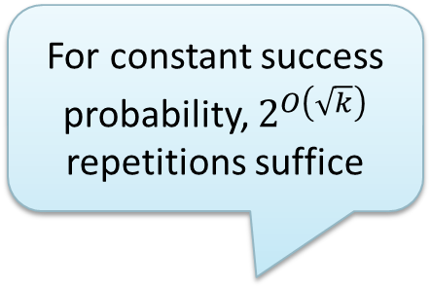
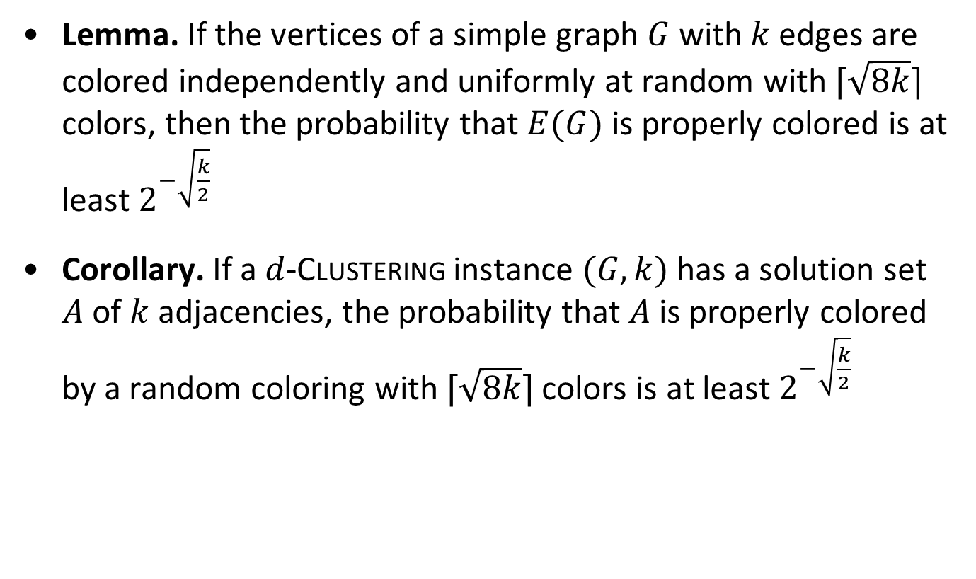
Probability of finding a proper coloring
Lemma. If the vertices of a simple graph $G$ with $k$ edges are colored independently and uniformly at random with $⌈\sqrt{8k}⌉$ colors, then the probability that $E(G)$ is properly colored is at least $2^{−\sqrt{\frac{k}{2}}}$
Corollary. If a $d$-Clustering instance $(G,k)$ has a solution set $A$ of $k$ adjacencies, the probability that $A$ is properly colored by a random coloring with $⌈\sqrt{8k}⌉$ colors is at least $2^{−\sqrt{\frac{k}{2}}}$
For constant success probability, $2^{O\left(\sqrt{k}\right)}$ repetitions suffice

Slide 27
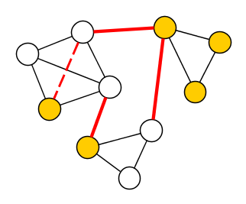
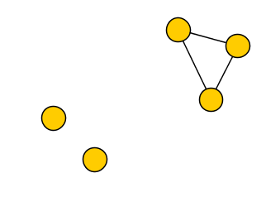
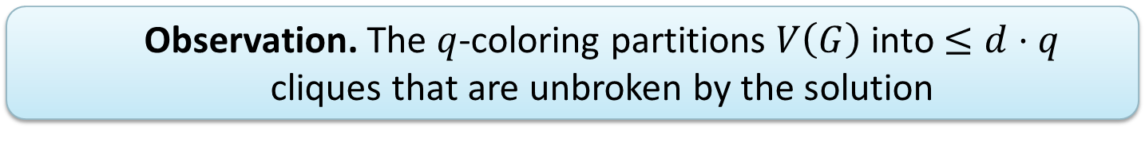
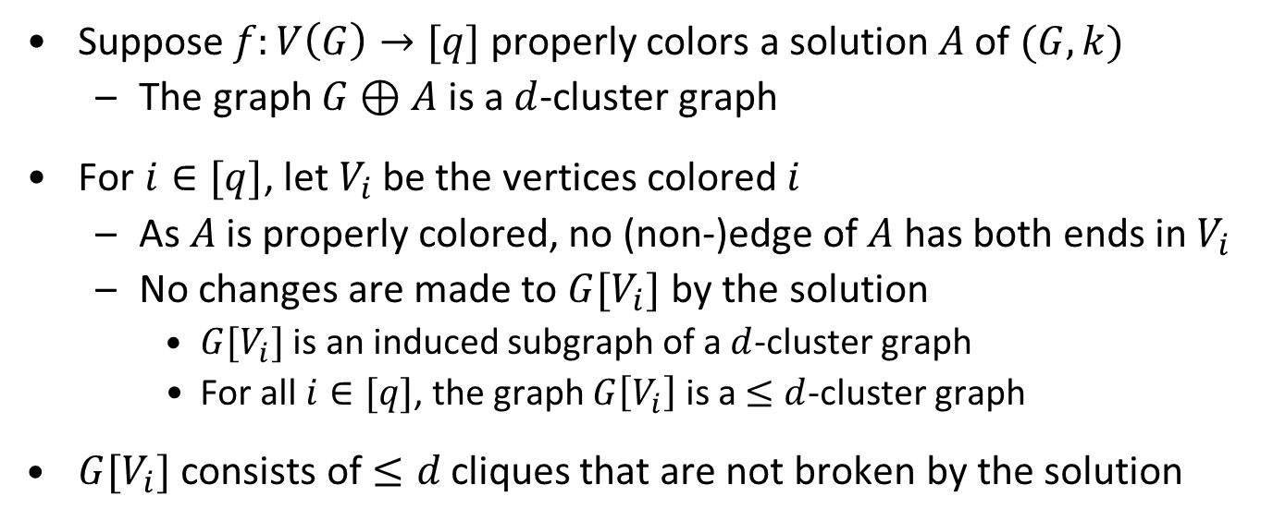
Detecting a properly colored solution (I)
Suppose $f:V\left(G\right)→[q]$ properly colors a solution $A$ of $(G,k)$
  The graph $G⊕A$ is a $d$-cluster graph
For $i∈[q]$, let $V_{i}$ be the vertices colored $i$
  As $A$ is properly colored, no (non-)edge of $A$ has both ends in $V_{i}$
  No changes are made to $G[V_{i}]$ by the solution
    $G[V_{i}]$ is an induced subgraph of a $d$-cluster graph
    For all $i∈[q]$, the graph $G\left[V_{i}\right]$ is a $≤d$-cluster graph
$G[V_{i}]$ consists of $≤d$ cliques that are not broken by the solution
  Observation. The $q$-coloring partitions $V\left(G\right)$ into $≤d⋅q$ cliques that are unbroken by the solution

Slide 28

Detecting a properly colored solution (II)
For each of the $d⋅q$ cliques into which $G$ is partitioned, guess into which of the $d$ final clusters it belongs
For each guess, compute the cost of this solution
  Count edges between subcliques in different clusters
  Count non-edges between subcliques in the same cluster
Total of $d^{q⋅d}$ guesses, polynomial cost computation for each
  Running time is $d^{q⋅d}⋅n^{c}=2^{O\left(q⋅d⋅\log{d}\right)}⋅n^{c}$ to detect a properly colored solution, if one exists
Using dynamic programming (exercise), this can be improved to $2^{O\left(q⋅d\right)}⋅n^{c}$ time
1
3
3
3
2
2

Slide 29
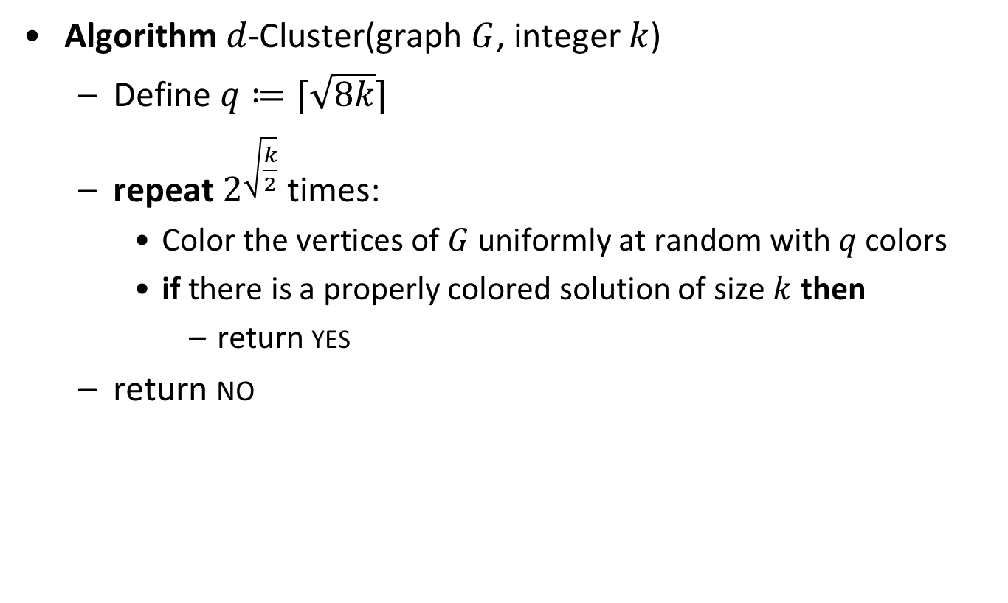

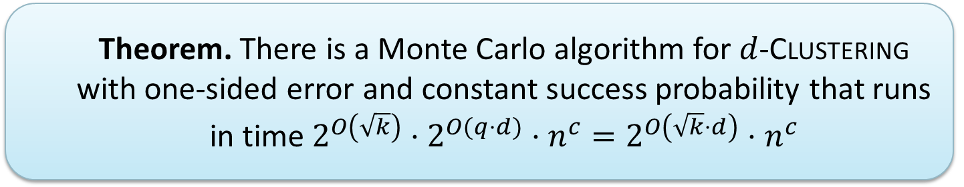
Randomized algorithm for $d$-Clustering
Algorithm $d$-Cluster(graph $G$, integer $k$)
  Define $q≔⌈\sqrt{8k}⌉$
  repeat $2^{\sqrt{\frac{k}{2}}}$ times:
    Color the vertices of $G$ uniformly at random with $q$ colors
    if there is a properly colored solution of size $k$ then
      return yes
  return no
  Theorem. There is a Monte Carlo algorithm for $d$-Clustering with one-sided error and constant success probability that runs in time $2^{O\left(\sqrt{k}\right)}⋅2^{O(q⋅d)}⋅n^{c}=2^{O\left(\sqrt{k}⋅d\right)}⋅n^{c}$

Slide 30
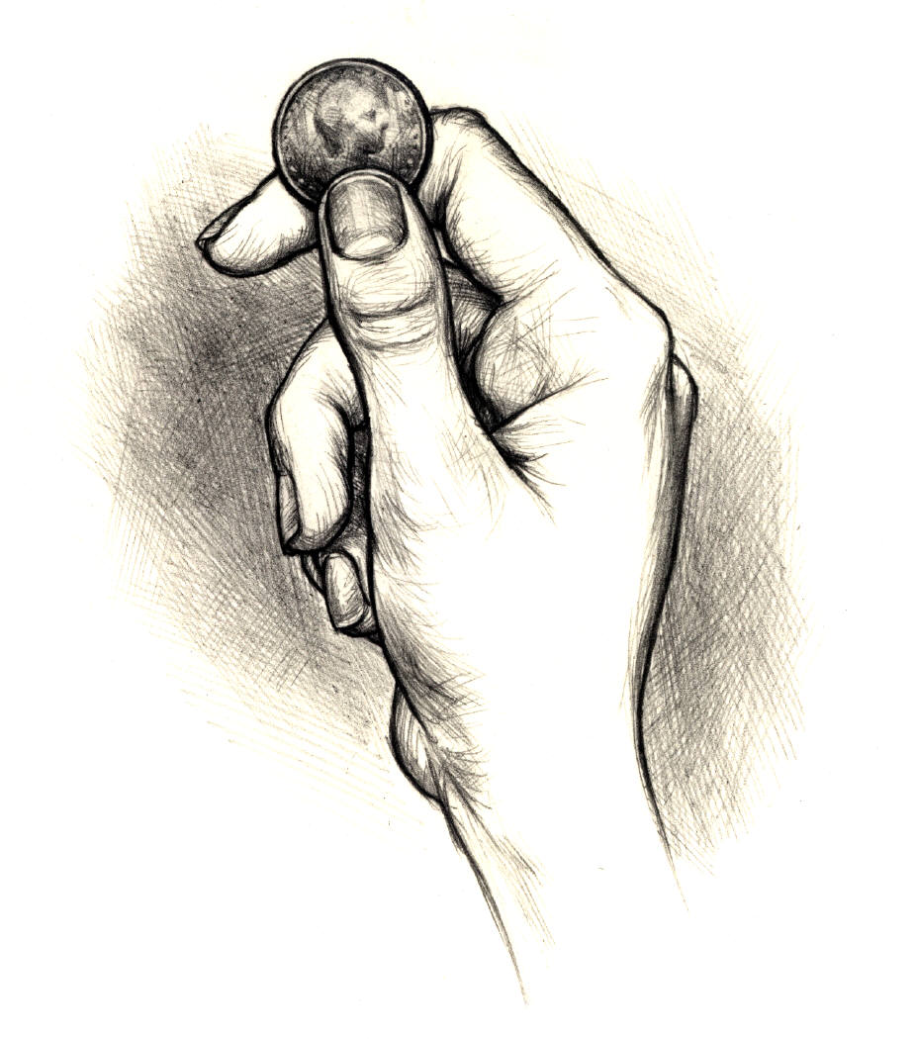
derandomization

Slide 31
Why derandomize?
Truly random bits are very hard to come by
  Usual approach is to track radioactive decay
Standard pseudo-random generators might work
  When spending exponential time on an answer, we do not want to get it wrong
Luckily, we can replace most applications of randomization by deterministic constructions
  Without significant increases in the running time

Slide 32
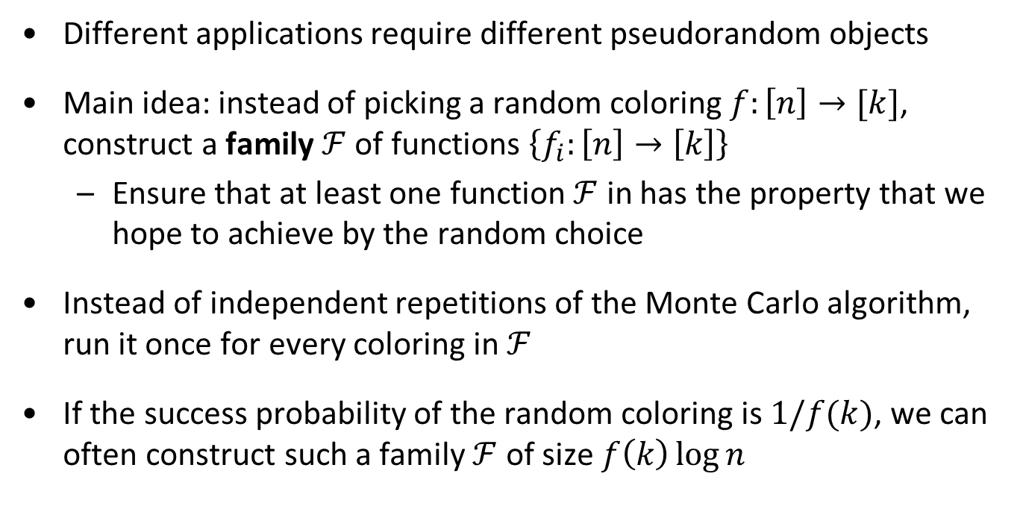
How to derandomize
Different applications require different pseudorandom objects
Main idea: instead of picking a random coloring $f:\left[n\right]→[k]$, construct a family $ℱ$ of functions $\left\{f_{i}:\left[n\right]→\left[k\right]\right\}$
  Ensure that at least one function $ℱ$ in has the property that we hope to achieve by the random choice
Instead of independent repetitions of the Monte Carlo algorithm, run it once for every coloring in $ℱ$
If the success probability of the random coloring is $1/f(k)$, we can often construct such a family $ℱ$ of size $f\left(k\right)\log{n}$

Slide 33
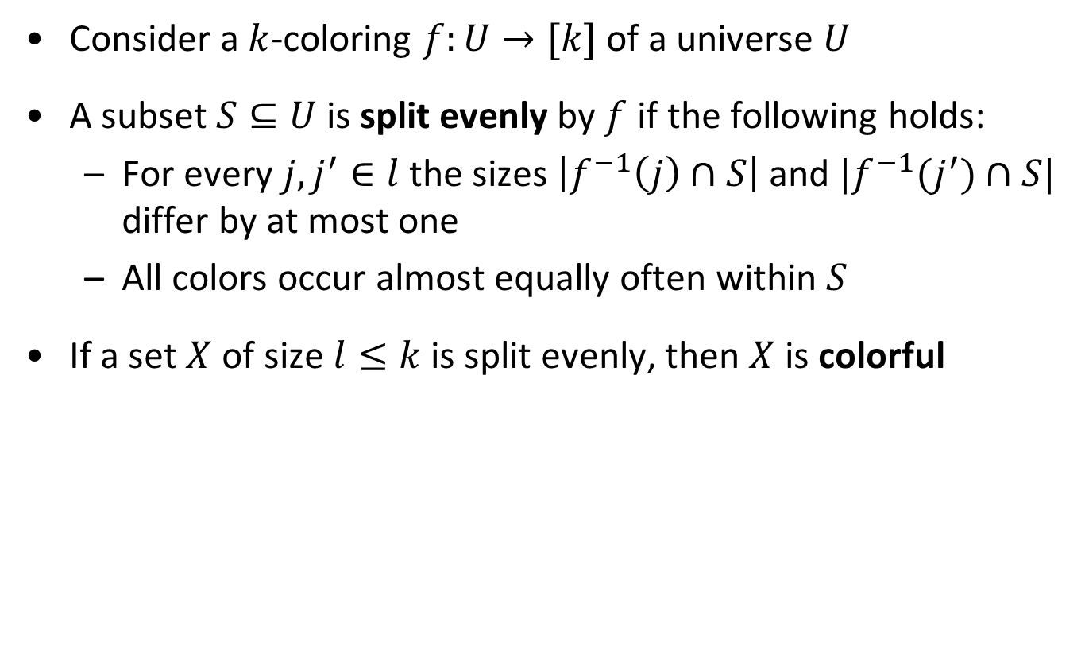
Splitting evenly
Consider a $k$-coloring $f:U→[k]$ of a universe $U$
A subset $S⊆U$ is split evenly by $f$ if the following holds:
  For every $j,j^{′}∈l$ the sizes $\left|f^{−1}\left(j\right)∩S\right|$ and $|f^{−1}(j^{′})∩S|$ differ by at most one
  All colors occur almost equally often within $S$
If a set $X$ of size $l≤k$ is split evenly, then $X$ is colorful

Slide 34


Splitters
For $n, k, l∈ℕ$, an $(n,k,l)$-splitter is a family $ℱ$ of functions from $[n]$ to $[l]$ such that:
  For every set $S⊆[n]$ of size $k$, there is a function $f∈ℱ$ that splits $S$ evenly
  Theorem. For any $n,k≥1$ one can construct an $(n,k,k^{2})$-splitter of size $k^{O(1)}⋅\log{n}$ in time $k^{O(1)}⋅n⋅\log{n}$

Slide 35


Perfect hash families derandomize Longest Path
The special case of an $(n,k,k)$-splitter is called an $(n,k)$-perfect hash family
Instead of trying $e^{k}$ random colorings in the Longest Path algorithm, try all colorings in a perfect hash family
  If $X$ is the vertex set of a $k$-path, then $\left|X\right|=k$ so some function splits $X$ evenly
  Since $\left|X\right|=l=k$, this causes $X$ to be colorful
    The DP then finds a colorful path
  Theorem. For any $n,k≥1$ one can construct an $(n,k)$-perfect hash family of size $e^{k}⋅k^{O(\log{k)}}\log{n}$ in time$e^{k}⋅k^{O(\log{k)}}n\log{n}$

Slide 36


Universal sets
For $k,n∈ℕ,$an $\left(n,k\right)$-universal set is a family $𝕌$of subsets of $[n]$ such that for any $S⊆[n]$ of size $k$, all $2^{k}$ subsets of $S$ are contained in the family:
  $$\left\{A∩S ∣ A∈𝕌\right\}$$
Universal sets can be used to derandomize the random separation algorithm for Subgraph Isomorphism (exercise)
  Theorem. For any $n,k≥1$ one can construct an $(n,k)$-universal set of size $2^{k}⋅k^{O(\log{k)}}\log{n}$ in time$2^{k}⋅k^{O(\log{k)}}n\log{n}$

Slide 37


Coloring families
For $n,k,q∈ℕ$, an $(n,k,q)$-coloring family is a family $ℱ$ of functions from $[n]$ to $[q]$ with the following property:
  For every graph $G$ on the vertex set $[n]$ with at most $k$ edges, there is a function $f∈ℱ$ that properly colors $E(G)$
Coloring families can be used to derandomize the chromatic coding algorithm for $d$-Clustering
  Instead of trying $2^{O\left(\sqrt{k}\right)}$ random colorings, try all colorings in an $\left(n,k,2\left\lceil \sqrt{k}\right\rceil \right)$-coloring family
  Theorem. For any $n,k≥1$ one can construct an $(n,k,2⌈\sqrt{k}⌉)$-coloring family of size $2^{\sqrt{k}\log{k}}⋅\log{n}$ in time$2^{\sqrt{k}\log{k }}⋅n\log{n}$

Slide 38
A randomized algorithm for feedback vertex set

Slide 39


The Feedback Vertex Set problem
Input: A graph $G$ and an integer $k$
Parameter: $k$
Question: Is there a set $S$ of at most $k$ vertices in $G$, such that each cycle contains a vertex of $S$?

Slide 40



Reduction rules for Feedback Vertex Set
(R1) If there is a loop at vertex $v$, then delete $v$ and decrease $k$ by one
(R2) If there is an edge of multiplicity larger than $2$, then reduce its multiplicity to $2$
(R3) If there is a vertex $v$ of degree at most $1$, then delete $v$
(R4) If there is a vertex $v$ of degree two, then delete $v$ and add an edge between $v$’s neighbors
  If (R1-R4) cannot be applied anymore,
  then the minimum degree is at least $3$
  Observation. If $\left(G,k\right)$ is transformed into $(G^{′},k^{′})$, then:
  fvs of size $≤k$ in $G⇔$ fvs of size $≤k′$ in $G′$
  Any feedback vertex set in $G′$ is a feedback vertex set in $G$ when combined with the vertices deleted by (R1)

Slide 41

How randomization helps
We have seen a deterministic algorithm with runtime $5^{k}⋅n^{c}$
There is a simple randomized $4^{k}⋅n^{c}$ Monte Carlo algorithm
In polynomial time, we can find a size-$k$ solution with probability at least $4^{−k}$, if one exists
  Repeating this $4^{k}$ times gives an algorithm with running time $4^{k}n^{c}$ and constant success probability
Key insight is a simple procedure to select a vertex that is contained in a solution with constant probability

Slide 42






Feedback vertex sets in graphs of min.deg. $≥3$
Lemma. Let $G$ be an $n$-vertex multigraph with minimum degree at least 3. For every feedback vertex set $X$ of $G$, more than half the edges of $G$ have at least one endpoint in $X$.
Proof. Consider the forest $H≔G−X$
  We prove that $\left|E\left(G\right)∖E\left(H\right)\right|>|E\left(H\right)|$
  $\left|V\left(H\right)\right|>\left|E\left(H\right)\right|$ for any forest $H$
    It suffices to prove $\left|E\left(G\right)∖E(H)\right|>\left|V\left(H\right)\right|$
  Let $J$ be the edges with one end in $X$ and the other in $V(H)$
  Let $V_{≤1},V_{2}$, and $V_{≥3}$ be the vertices of $H$ with $H$-degrees $≤1, 2$, $≥3$
    Every vertex of $V_{≤1}$ contributes $≥2$ to $J$
    Every vertex of $V_{2}$ contributes $≥1$ to $J$
  $$\left|E\left(G\right)∖E\left(H\right)\right|≥\left|J\right|≥2\left|V_{≤1}\right|+\left|V_{2}\right|$$
  $$>\left|V_{≤1}\right|+\left|V_{2}\right|+\left|V_{≥3}\right|=\left|V\left(H\right)\right|$$
$\left|V_{≥3}\right|<\left|V_{≤1}\right|$ in any forest

Slide 43

Monte Carlo algorithm for Feedback Vertex Set
Theorem. There is a randomized polynomial-time algorithm that, given a Feedback Vertex Set instance $(G,k)$,
either reports a failure, or
finds a feedback vertex set in $G$ of size at most $k$.
If $G$ has an fvs of size $≤k$, it returns a solution with probability at least $4^{−k}$

Slide 44

Monte Carlo algorithm for Feedback Vertex Set
Algorithm fvs(Graph $G$, integer $k$)
  Exhaustively apply (R1)-(R4) to obtain $\left(G^{′},k^{′}\right)$
    Let $X_{0}$ be the vertices with loops removed by (R1)
  if $k′<0$ then failure
  if $G′$ is a forest then return $X_{0}$
  Uniformly at random, pick an edge $e$ of $G′$
  Uniformly at random, pick an endpoint $v$ of $e$
  return $\left\{v\right\}∪X_{0}∪$ fvs($G′−v, k′−1)$

Slide 45

Correctness (I)
The algorithm outputs a feedback vertex set or failure
Claim: If $G$ has a size-$k$ fvs, then the algorithm finds a solution with probability at least $4^{−k}$
Proof by induction on $k$
  Assume $G$ has a size-$k$ feedback vertex set $X$
  By safety of (R1)-(R4), $G$’ has a size-$k$’ fvs $X’$
    We have $k^{′}=k −|X_{0}|$
    Since loops are in any fvs, we have $X_{0 }⊆X$
  If $k^{′}=0$, then $\left|X_{0}\right|=|X|$ so $G$’ is a forest
    Algorithm outputs $X_{0}=X$ which is a valid solution
  If $k^{′}≥1$, we will use the induction hypothesis

Slide 46


Correctness (II)
Case $k^{′}≥1$:
  Probability that random $e$ has an endpoint in $X′$ is $≥\frac{1}{2}$
  Probability that $v∈X′$ is $≥\frac{1}{4}$
  If $v∈X′$, then $G^{′}−v$ has an fvs of size $≤k′−1$
    Then, by induction, with probability $≥4^{−(k^{′}−1)}$ recursion gives a size-($k^{′}−1)$ fvs $X^{∗}$ of $G^{′}−v$
    So $\left\{v\right\}∪X^{∗}$ is a size-$k′$ fvs of $G’$
    By reduction rules, output$\left\{v\right\}∪X_{0}∪X^{∗}$ is an fvs of $G$
      Size is at most $k^{′}+\left|X_{0}\right|=k$
  Probability of success is $≥\frac{1}{4}⋅4^{−\left(k^{′}−1\right)}=4^{−k^{′}}≥4^{−k}$
  Theorem. There is a Monte Carlo algorithm for Feedback Vertex Set with one-sided error and constant success probability that runs in time $4^{k}n^{c}$

Slide 47

Discussion
This simple, randomized algorithm is faster than the deterministic algorithm from the previous lecture
The method generalizes to $ℱ$-minor-free deletion problems: delete vertices from the graph to ensure the resulting graph contains no member from the fixed set $ℱ$ as a minor
  Feedback Vertex Set is $\{K_{3}\}$-minor-free deletion

Slide 48
Exercises
5.1, 5.2, 5.8, 5.15, 5.19
Color coding

Slide 49

Summary
Several variations of color coding give efficient FPT algorithms
The general recipe is as follows:
  Randomly color the input, such that if a solution exists, one is highlighted with probability $1/f\left(k\right)$
  Show that a highlighted solution can be found in a colored instance in time $g\left(k\right)⋅n^{c}$
For most problems we obtained single-exponential algorithms
  For $d$-Clustering we obtained a subexponential algorithm

Slide 50
The end

