Slide 1

Introduction to Parameterized Algorithmics
Bart M. P. Jansen
July 9th 2018, Dagstuhl Seminar 18281, Germany

Slide 2
Outline
I
Introduction
II
Algorithms
III
Complexity
History
Parameters
W[1]-hard
Exp-time hypotheses
Definitions
Branching
Color coding
Kernelization lower bounds
Kernelization
Treewidth
Overview of techniques
Notes:
Main goal: show background of the field of parameterized algorithms & complexity, give some examples to show what kind of things are known, what kinds of results we like, and pointers to things I do not have time to cover.

Slide 3
History of parameterized complexity
Fine-grained complexity
PCP Theorem
Downey & Fellows book
NP-completeness
Kernelization lower bounds
1940 1950 1960 1970 1980 1990 2000 2010 2018
Dagstuhl Seminar 18281
Matching algorithm
Parameterized(in)tractability
Graph Minors Theorem
Simplex algorithm
Planar Dominating Set kernel

Slide 4
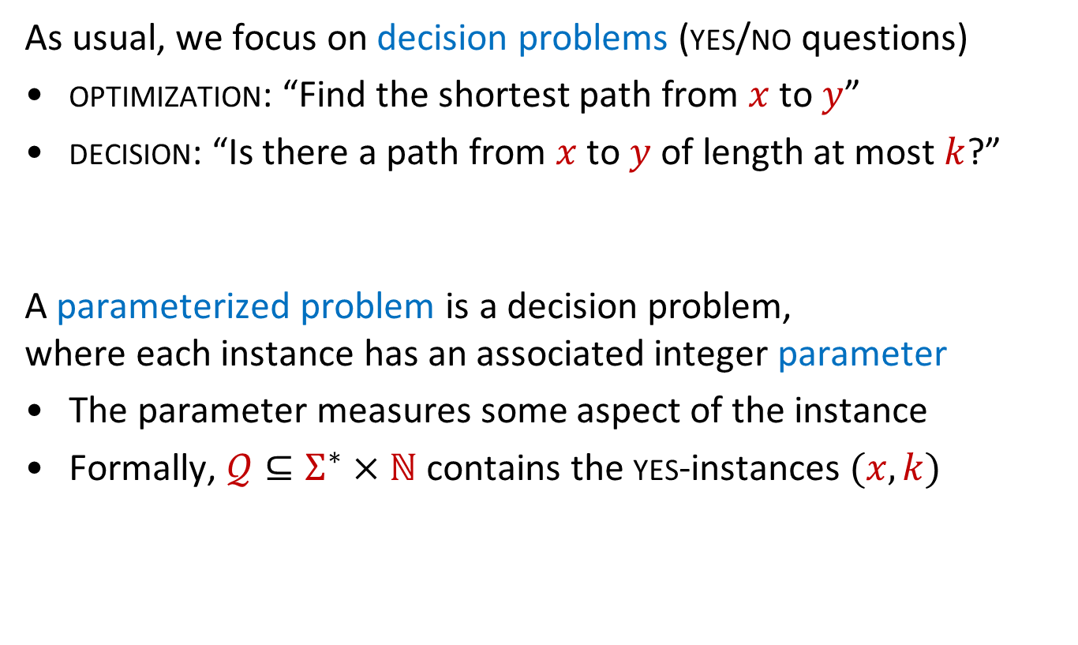
Parameterized problems
As usual, we focus on decision problems (yes/no questions)
optimization: “Find the shortest path from $x$ to $y$”
decision: “Is there a path from $x$ to $y$ of length at most $k$?”
A parameterized problem is a decision problem,
where each instance has an associated integer parameter
The parameter measures some aspect of the instance
Formally, $𝒬⊆Σ^{∗}×ℕ$ contains the yes-instances $(x,k)$
Notes:
Efficient algo for one typically gives an efficient algo for other

Slide 5
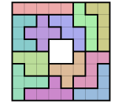
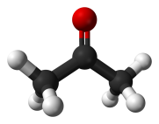
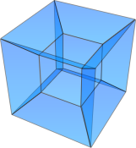
Problem parameterizations
By solution size
$k$-Vertex Cover
𝑘-Vertex Cover
By instance structure
Parameterize by closeness of input to tree
By dimension of the input
Disjoint Sphere
Packing in $ℝ^{k}$
Disjoint Sphere
Packing in ℝ^𝑘
Permutation
$k$-pattern matching
Permutation
𝑘-pattern matching
Longest $k$-common subsequence
Longest 𝑘-common subsequence
Max-cut on 1-planar graphs with $k$ crossings
Max-cut on 1-planar graphs with 𝑘 crossings
$k$-Path
𝑘-Path
Point Separation in $ℝ^{k}$ by 2 hyperplanes
Point Separation in ℝ^𝑘 by 2 hyperplanes
Closest String at Hamming Distance $k$
Closest String at Hamming Distance 𝑘
Clique in graphs with maximum-degree $k$
Clique in graphs with maximum-degree 𝑘
Relevant parameters can be identified by:
Measuring distance from triviality
Deconstructing hardness proofs
Inspecting datasets
Notes:
Many different ways to parameterize the same problem. For max cut: see https://arxiv.org/pdf/1803.10983.pdf . (The first two sets of parameterizations all yield FPT problems; the third group is all W[1]-hard: this is the curse of dimensionality.)

Slide 6
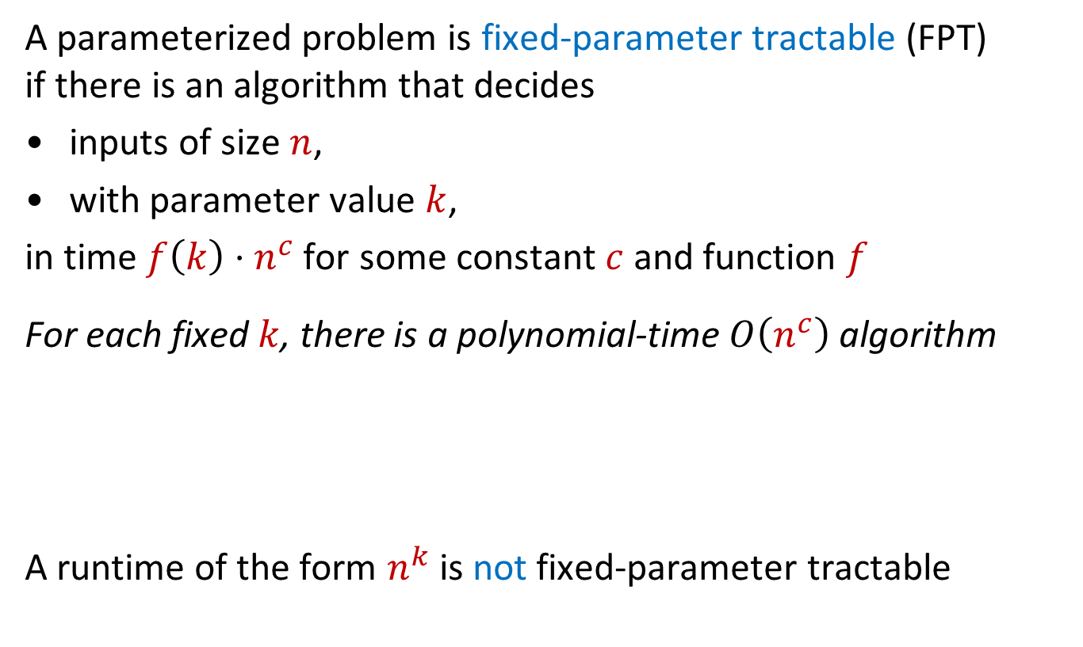
Fixed-parameter tractability
A parameterized problem is fixed-parameter tractable (FPT)
if there is an algorithm that decides
inputs of size $n$,
with parameter value $k$,
in time $f\left(k\right)⋅n^{c}$ for some constant $c$ and function $f$
For each fixed $k$, there is a polynomial-time $O\left(n^{c}\right)$ algorithm
A runtime of the form $n^{k}$ is not fixed-parameter tractable
  Can the problem be solved efficiently,
  if the parameter is small?

Slide 7
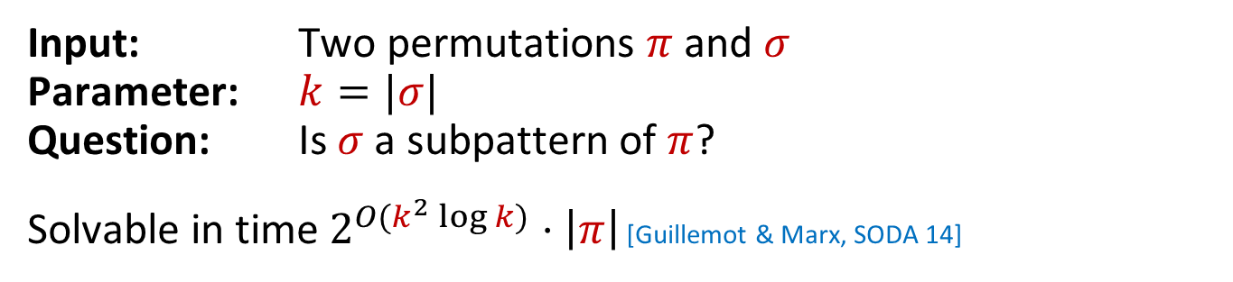
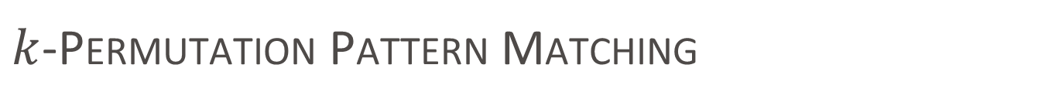


$k$-Permutation Pattern Matching
Input: Two permutations $π$ and $σ$
Parameter: $k=|σ|$
Question: Is $σ$ a subpattern of $π$?
Solvable in time $2^{O(k^{2}\log{k})}⋅\left|π\right|$ [Guillemot & Marx, SODA 14]
$$σ$$
$$π$$
1 | 4 | 2 | 3
3 | 2 | 7 | 8 | 4 | 6 | 1 | 5
3 | 2 | 7 | 8 | 4 | 6 | 1 | 5

Slide 8
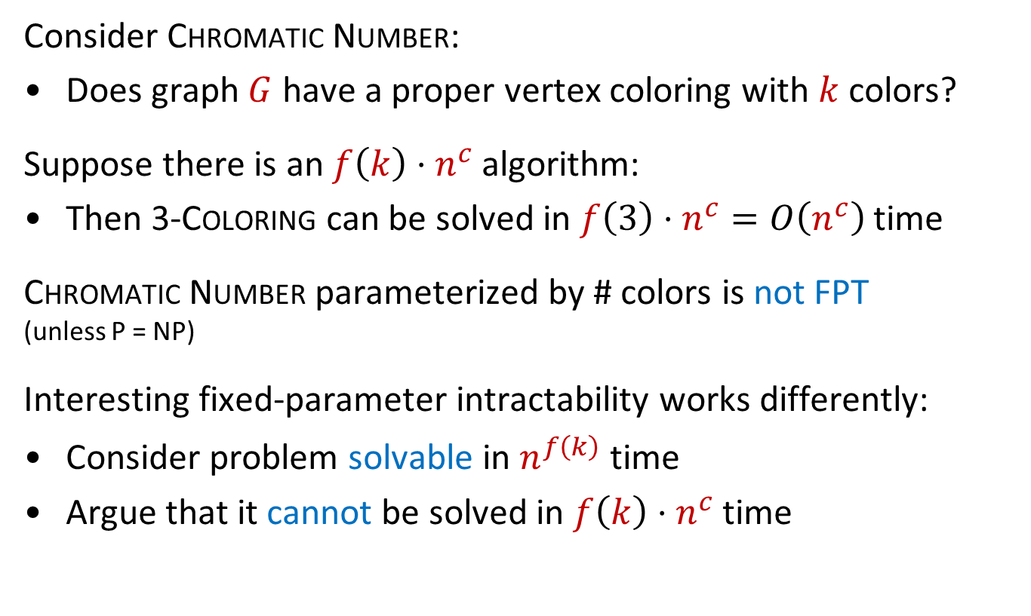
Fixed-parameter intractability
Consider Chromatic Number:
Does graph $G$ have a proper vertex coloring with $k$ colors?
Suppose there is an $f\left(k\right)⋅n^{c}$ algorithm:
Then 3-Coloring can be solved in $f\left(3\right)⋅n^{c}=O\left(n^{c}\right)$ time
Chromatic Number parameterized by # colors is not FPT
(unless P = NP)
Interesting fixed-parameter intractability works differently:
Consider problem solvable in $n^{f\left(k\right)}$ time
Argue that it cannot be solved in $f\left(k\right)⋅n^{c}$ time

Slide 9
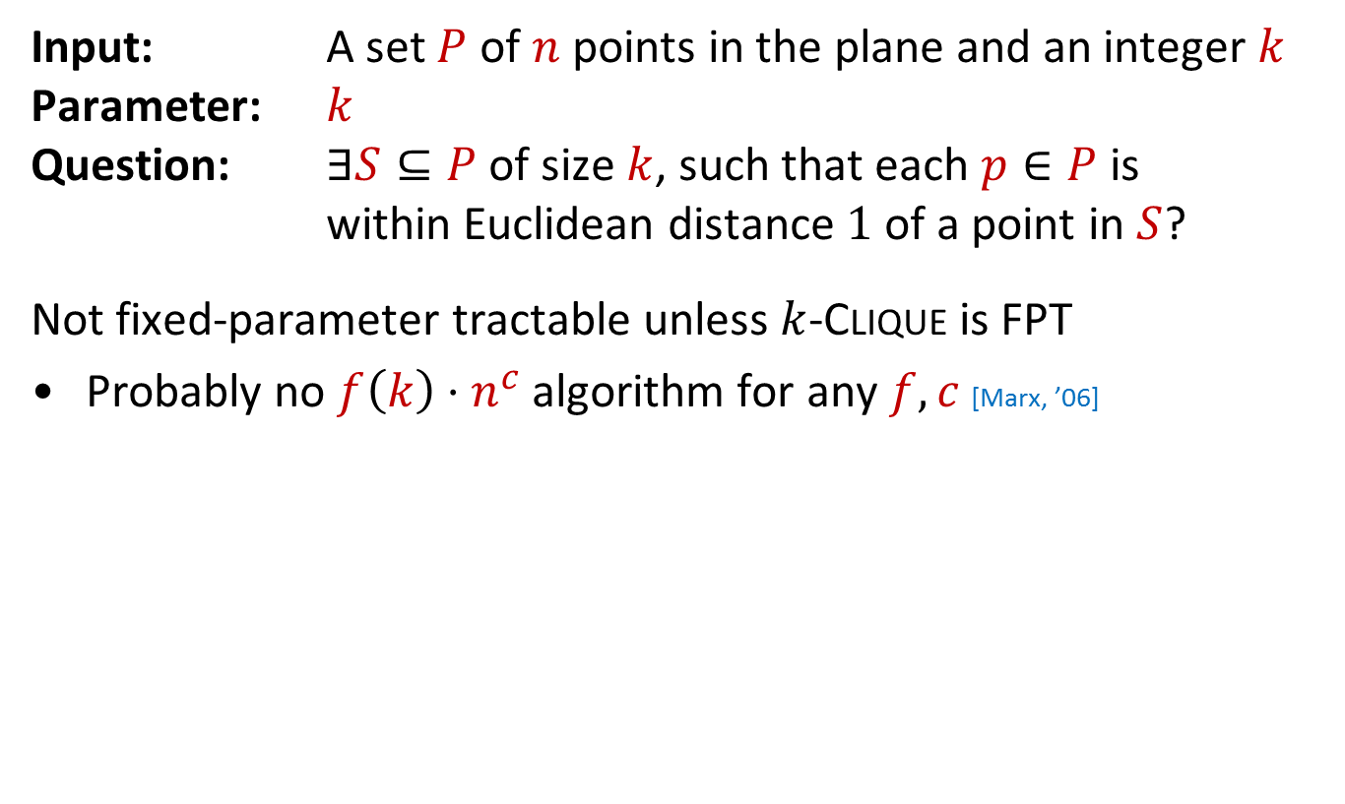
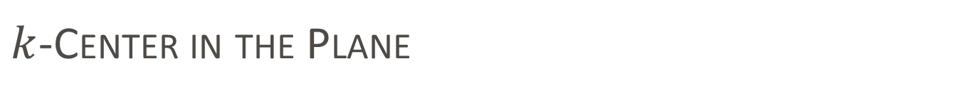
$k$-Center in the Plane
Input: A set $P$ of $n$ points in the plane and an integer $k$
Parameter: $k$
Question: $∃S⊆P$ of size $k$, such that each $p∈P$ is within Euclidean distance $1$ of a point in $S$?
Not fixed-parameter tractable unless $k$-Clique is FPT
Probably no $f\left(k\right)⋅n^{c}$ algorithm for any $f,c$ [Marx, ’06]

Slide 10
I
Introduction
II
Algorithms
III
Complexity
History
Parameters
Color coding
W[1]-hard
Exp-time hypotheses
Definitions
Branching
Kernelization lower bounds
Kernelization
Treewidth
Overview of techniques

Slide 11
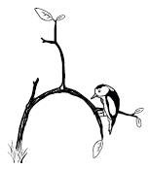

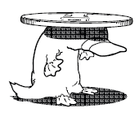

The FPT toolkit
There are many different techniques to develop FPT algorithms
Some apply only to graph problems
Bounded-depth search trees
Kernelization
Color coding
Graph minors & treewidth

Slide 12
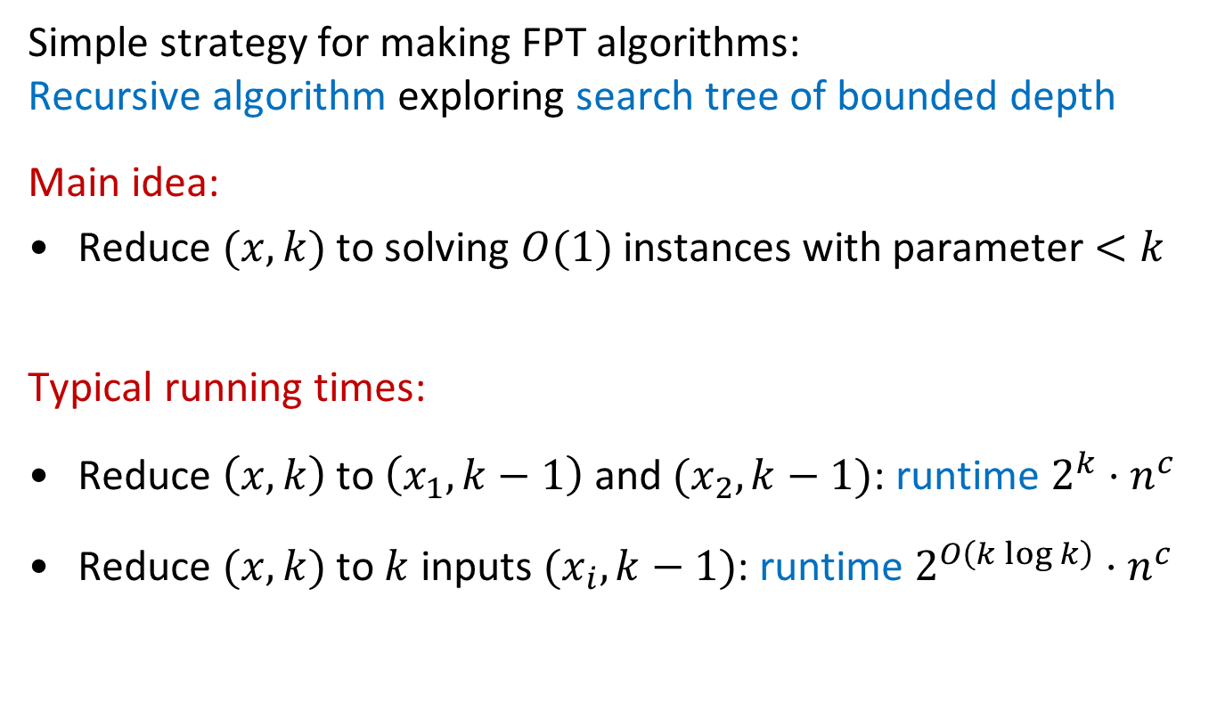
Bounded-depth search trees
Simple strategy for making FPT algorithms:
Recursive algorithm exploring search tree of bounded depth
Main idea:
Reduce $(x,k)$ to solving $O(1)$ instances with parameter $<k$
Typical running times:
Reduce $\left(x,k\right)$ to $\left(x_{1},k−1\right)$ and $(x_{2},k−1)$: runtime $2^{k}⋅n^{c}$
Reduce $(x,k)$ to $k$ inputs $(x_{i}, k−1)$: runtime $2^{O\left(k\log{k}\right)}⋅n^{c}$
Notes:
(Assuming we can solve the problem in polynomial time for k=0, and work for each node of the search tree is polynomial.)

Slide 13
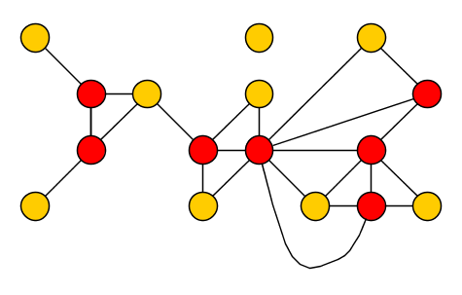
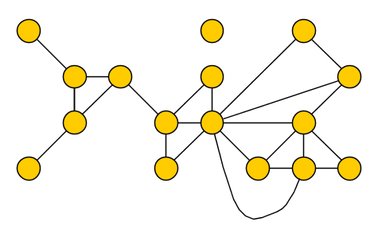

Vertex Cover
Input: A graph $G$ and an integer $k$
Parameter: $k$
Question: Is there a set $S$ of at most $k$ vertices in $G$,
such that each edge has an endpoint in $S$?
$S$ is a vertex cover of $G$ $⇔$ $G−S$ has no edges

Slide 14
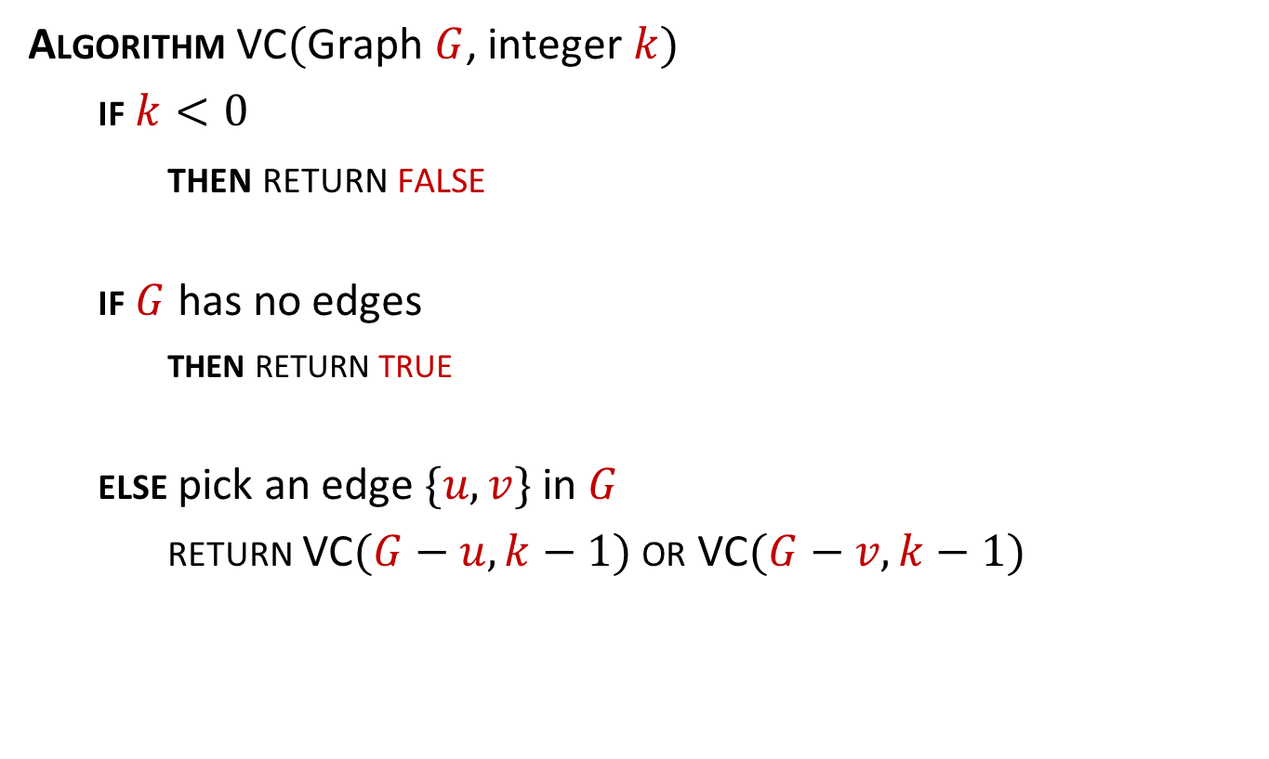
Branching algorithm for Vertex Cover
Algorithm VC$($Graph $G$, integer $k)$
  if $k<0$
  then return false
  if $G$ has no edges
    then return true
  else pick an edge $\{u,v\}$ in $G$
  return VC$(G−u, k−1)$ or VC$(G−v, k−1)$
Notes:
Correct because any vertex cover must use $u$ or $v$, and:
size-$k$ cover in $G$ using $u⇔$ size-$(k−1)$ cover in $G−u$

Slide 15


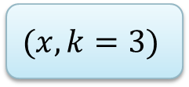













Running time for Vertex Cover
Solve the problem, or branch in 2 ways with parameter $k−1$
Tree of depth $k$ with branching factor $2$ has ${O(2}^{k})$ nodes
Running time is $2^{k}⋅(n+m)$
$$(x,k=3)$$
$$(x_{1},2)$$
$$(x_{2},2)$$
$$(x_{3},1)$$
$$(x_{4},1)$$
$$(x_{5},1)$$
$$(x_{6},1)$$
$$(x_{7},0)$$
$$(x_{8},0)$$
$$(x_{9},0)$$
$$(x_{10},0)$$
$$(x_{11},0)$$
$$(x_{12},0)$$
$$(x_{13},0)$$
$$(x_{14},0)$$

Slide 16

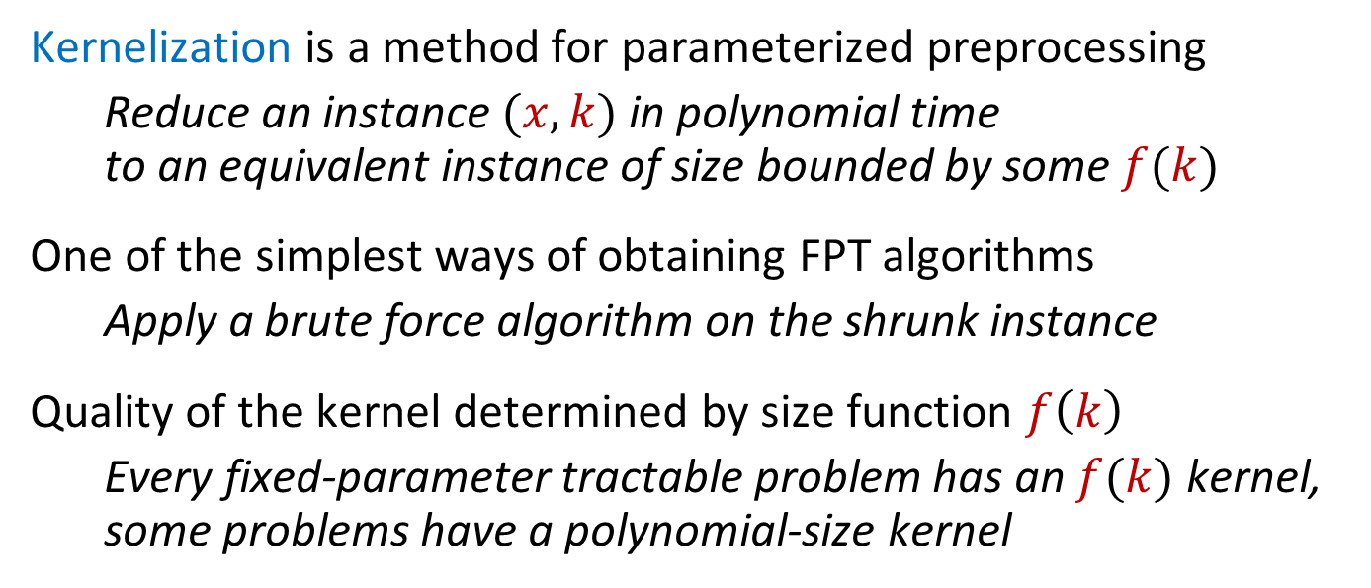
Data reduction with a guarantee
Kernelization is a method for parameterized preprocessing
  Reduce an instance $(x,k)$ in polynomial time
  to an equivalent instance of size bounded by some $f(k)$
One of the simplest ways of obtaining FPT algorithms
  Apply a brute force algorithm on the shrunk instance
Quality of the kernel determined by size function $f\left(k\right)$
  Every fixed-parameter tractable problem has an $f(k)$ kernel,
  some problems have a polynomial-size kernel
$n$ bits
$f(k)$ bits
$$x$$
$poly(\left|x\right|,k)$ time
$$x′$$
$$k$$
$$k′$$
Notes:
Let’s look at an example before giving the formal definition

Slide 17
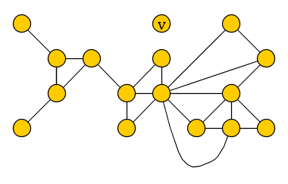
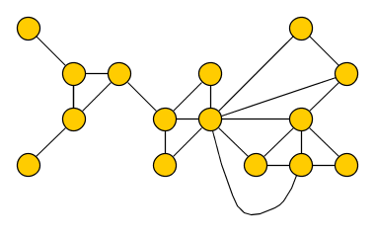
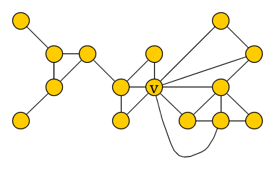
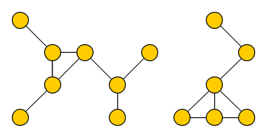

Kernelization for Vertex Cover
Reduction rules for an input $(G,k)$
(R1) If $G$ has an isolated vertex $v$, reduce to $(G−v, k)$
(R2) If $G$ has a vertex $v$ of degree $>k$, reduce to $(G−v,k−1)$
(R3) If previous rules do not apply and $\left|E\left(G\right)\right|>k^{2}$, output NO

Slide 18
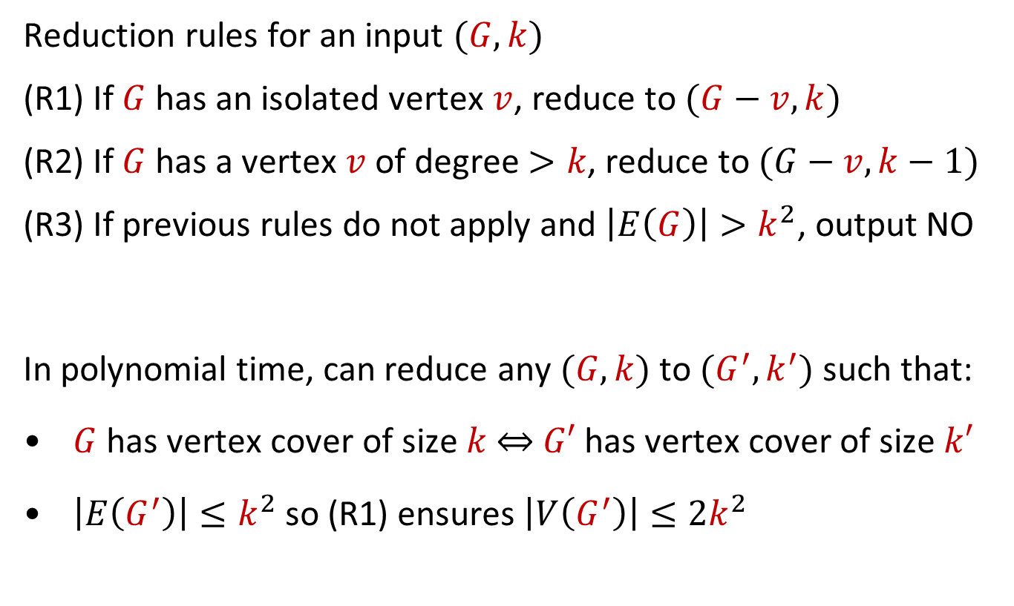
Kernelization for Vertex Cover
Reduction rules for an input $(G,k)$
(R1) If $G$ has an isolated vertex $v$, reduce to $(G−v, k)$
(R2) If $G$ has a vertex $v$ of degree $>k$, reduce to $(G−v,k−1)$
(R3) If previous rules do not apply and $\left|E\left(G\right)\right|>k^{2}$, output NO
In polynomial time, can reduce any $(G,k)$ to $(G^{′},k^{′})$ such that:
$G$ has vertex cover of size $k$ $⇔$ $G′$ has vertex cover of size $k′$
$\left|E\left(G^{′}\right)\right|≤k^{2}$ so (R1) ensures $\left|V\left(G^{′}\right)\right|≤2k^{2}$
Vertex Cover has a kernel with $O(k^{2})$ vertices and edges
Notes:
(Or we already answer the problem)

Slide 19

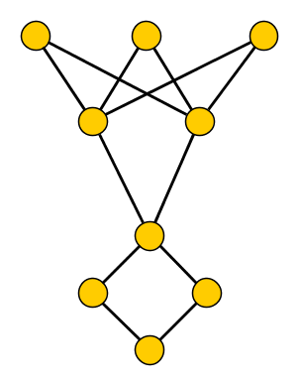
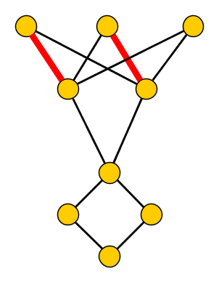

Crown decompositions
A crown decomposition of graph $G$ is a partition of $V(G)$ into
Crown $C$
independent set
Head $H$
matched into $C$
Remainder $R$
not adjacent to $C$

Slide 20
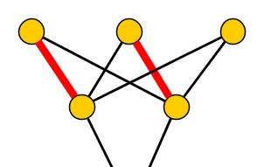
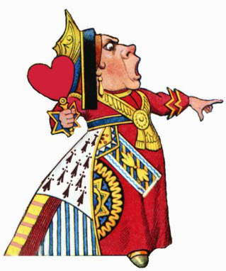

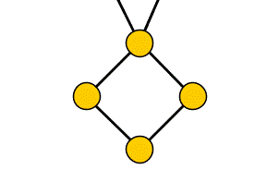
Crown reduction for Vertex Cover
$G$ has a vertex cover of size $k$ if and only if
$G−(C∪H)$ has a vertex cover of size $k−|H|$
Off with his head!
Exhaustive crown reduction gives kernel with $3k$ vertices
Notes:
The name of the concept is so colorful that you cannot help but remember. Combined with the generality and wide applicability of the technique, this led to many applications.

Slide 21
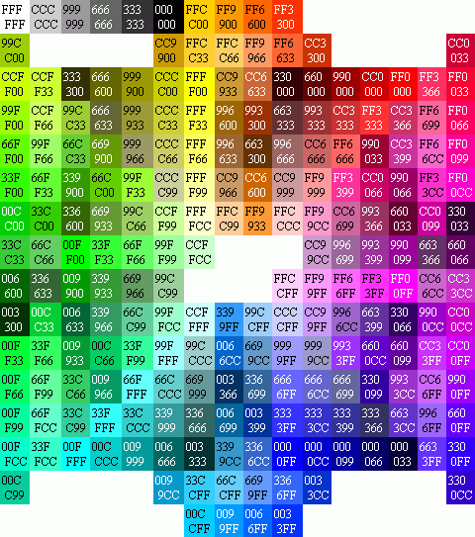
Color coding
Randomly assign colors to the input structure
If there is a solution and we are lucky with the coloring,
every element of the solution has received a different color
Develop an algorithm to detect such colorful solutions
Solutions of elements with pairwise different colors
Most applications of color coding can be derandomized efficiently

Slide 22
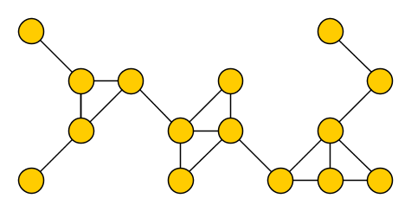
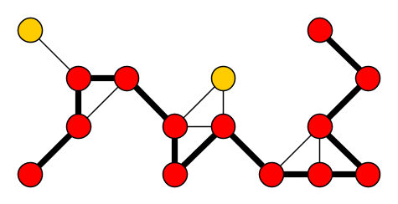



The $k$-Path problem
Input: An undirected graph $G$ and an integer $k$
Parameter: $k$
Question: Is there a simple path on $k$ vertices in $G$?
A solution is a $k$-path
NP-complete since Hamiltonian Path is a special case
$$k=13$$

Slide 23
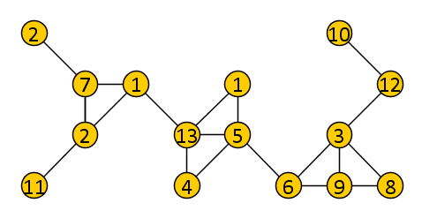
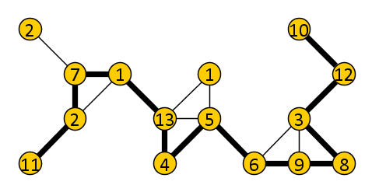


Color coding for $k$-Path
Color the vertices of $G$ randomly with colors $\left[k\right]=\{1,2,…, k\}$
We want to detect a colorful $k$-path if one exists
Any $k$-vertex path with $k$ different colors is simple
If we are lucky, a $k$-path becomes colorful
Use dynamic programming over subsets
$$k=13$$

Slide 24
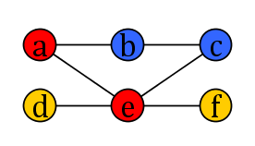
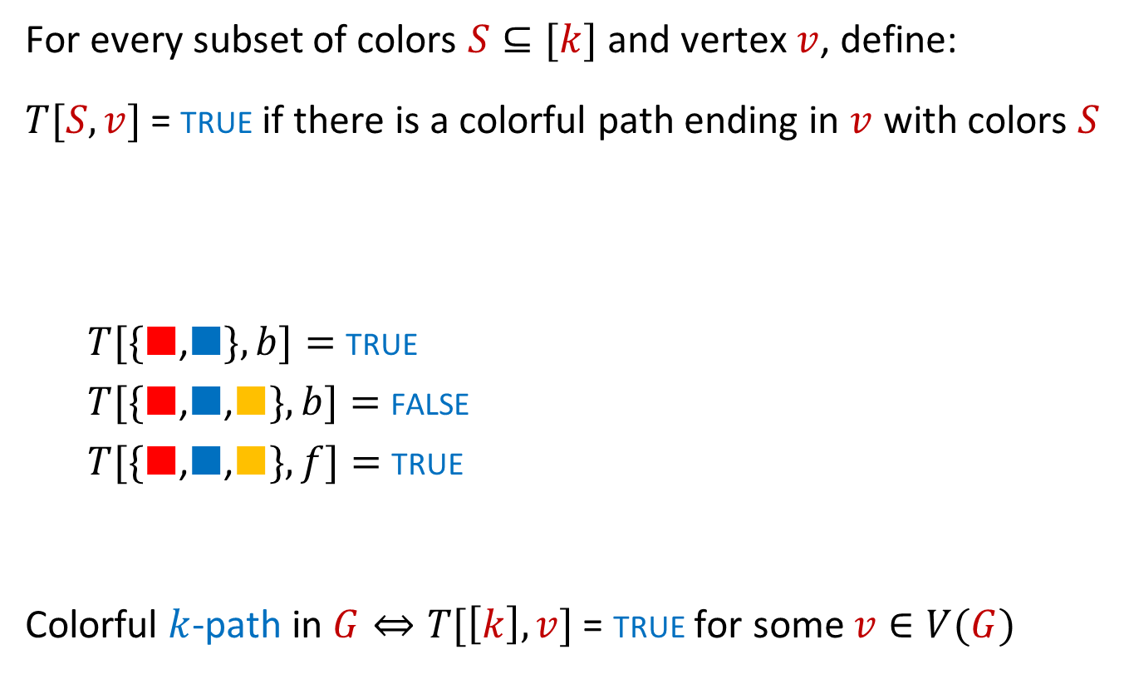
The dynamic-programming table
For every subset of colors $S⊆[k]$ and vertex $v$, define:
$T[S,v]$ = true if there is a colorful path ending in $v$ with colors $S$
  $T[\{■$,$■\}, b]=$ true
  $T[\{■$,$■\text{,}■\}, b]=$ false
  $T[\{■$,$■\text{,}■\}, f]=$ true
Colorful $k$-path in $G⇔T[\left[k\right],v]$ = true for some $v∈V(G)$

Slide 25
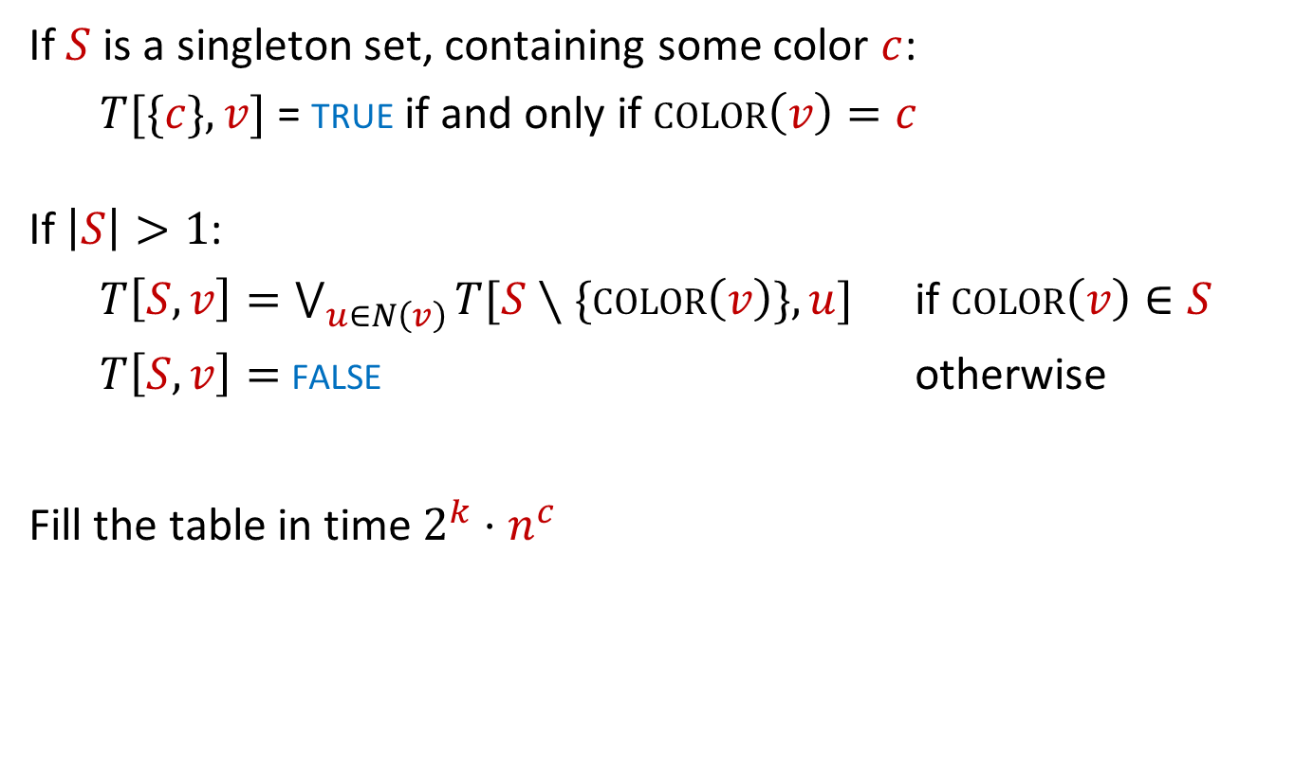
A recurrence to fill the table
If $S$ is a singleton set, containing some color $c$:
  $T[\{c\},v]$ = true if and only if $color\left(v\right)=c$
If $\left|S\right|>1$:
  $T\left[S,v\right]=\bigvee_{u∈N\left(v\right)}{T[S∖\{color\left(v\right)\},u]}$ if $color\left(v\right)∈S$
  $T\left[S,v\right]=$ false otherwise
Fill the table in time $2^{k}⋅n^{c}$

Slide 26

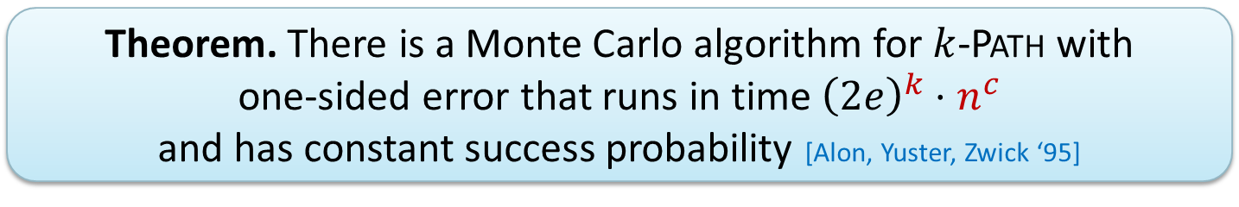
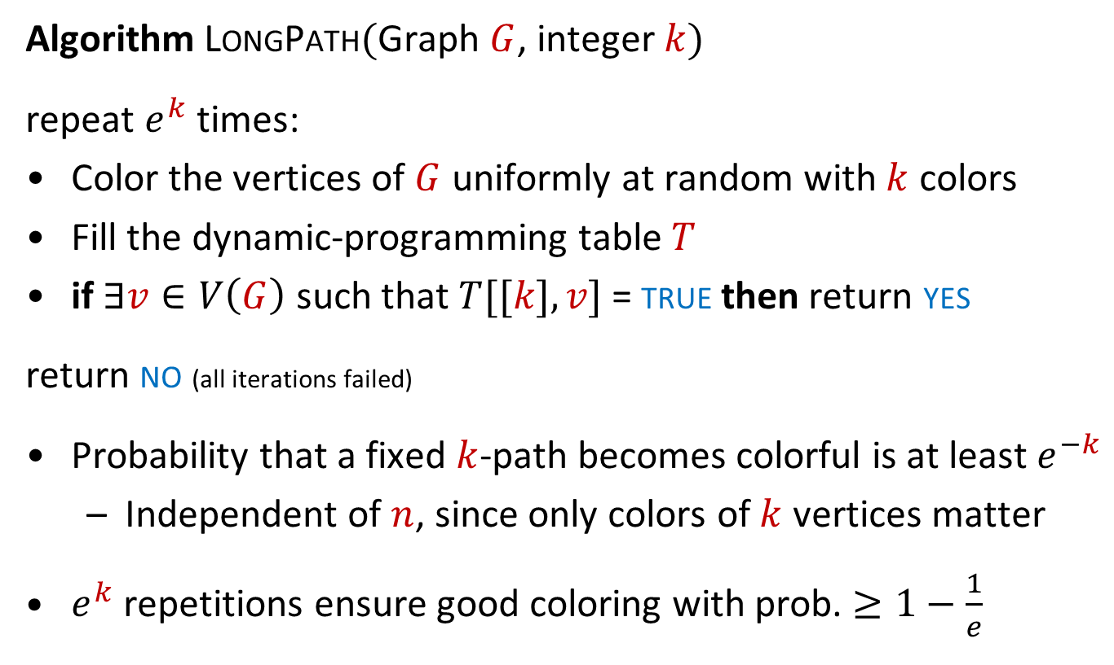
Randomized algorithm for $k$-Path
Algorithm LongPath$($Graph $G$, integer $k)$
repeat $e^{k}$ times:
Color the vertices of $G$ uniformly at random with $k$ colors
Fill the dynamic-programming table $T$
if $∃v∈V\left(G\right)$ such that $T[[k],v]$ = true then return yes
return no (all iterations failed)
Probability that a fixed $k$-path becomes colorful is at least $e^{−k}$
  Independent of $n$, since only colors of $k$ vertices matter
$e^{k}$ repetitions ensure good coloring with prob. $≥1−\frac{1}{e}$
Theorem. There is a Monte Carlo algorithm for $k$-Path with
one-sided error that runs in time ${\left(2e\right)}^{k}⋅n^{c}$
and has constant success probability [Alon, Yuster, Zwick ‘95]
Notes:
Faster algorithms exist, current-best 1.66^k.

Slide 27
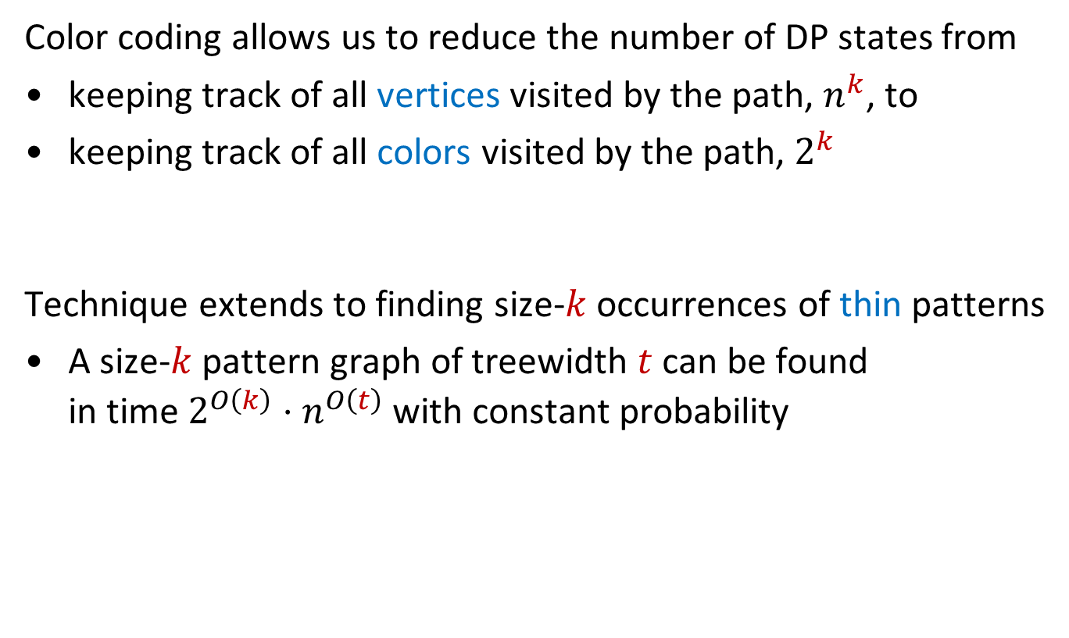
Discussion of color coding
Color coding allows us to reduce the number of DP states from
keeping track of all vertices visited by the path, $n^{k}$, to
keeping track of all colors visited by the path, $2^{k}$
Technique extends to finding size-$k$ occurrences of thin patterns
A size-$k$ pattern graph of treewidth $t$ can be found
in time $2^{O\left(k\right)}⋅n^{O\left(t\right)}$ with constant probability

Slide 28
Intermezzo: Google Scholar Papers on FPT

Slide 29
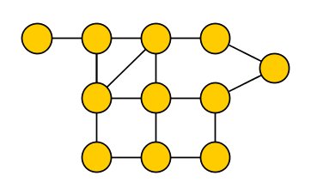
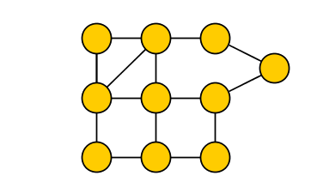
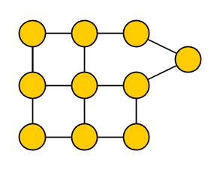
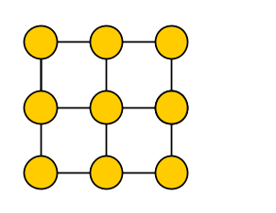



Treewidth
The treewidth $tw(G)$ of graph $G$ measures how tree-like it is
Used to solve NP-hard problems efficiently on tree-like graphs
Treewidth does not increase when taking a minor
Deleting vertices, deleting edges, contracting edges
$tw\left(T\right)=1$ for any tree $T$
$$tw\left({ G }_{k×k}\right)=k$$
Notes:
Many cryptomorphic definitions of treewidth, not very intuitive at first sight. Treewidth also pops up surprisingly when using parameterizations by solution size.

Slide 30


Graphs of bounded treewidth
If $G$ has the $k×k$ grid as a minor, then $tw\left(G\right)≥k$
Conversely: largest grid-minor in $G$ is $k×k$ $⇒$ $tw\left(G\right)≤O(k^{100})$
Treewidth does not increase when taking a minor
Deleting vertices, deleting edges, contracting edges
$tw\left(T\right)=1$ for any tree $T$
$$tw\left({ G }_{k×k}\right)=k$$
Notes:
Many cryptomorphic definitions of treewidth, not very intuitive at first sight.

Slide 31

Algorithmic use of treewidth
If $G$ has the $k×k$ grid as a minor, then $tw\left(G\right)≥k$
Conversely: largest grid-minor in $G$ is $k×k$ $⇒$ $tw\left(G\right)≤O(k^{100})$
If $tw\left(G\right)=k$, there is a tree decomposition of $G$ of width $k$:
Set of vertex separators of size $k$, organized in tree-like fashion
Dynamic programming solves many problems in time $f\left(tw\right)⋅n^{c}$
Treewidth is a measure of tree-likeness, which is
proportional to the side-length of the largest grid minor
Notes:
Many cryptomorphic definitions of treewidth, not very intuitive at first sight.

Slide 32

FPT algorithms parameterized by treewidth
Problems solvable in time $2^{O\left(tw\right)}⋅n$:
Vertex Cover, Dominating Set, Feedback Vertex Set,
Odd Cycle Transversal, 3-Coloring, Steiner Tree, Hamiltonian Cycle
Problems solvable in time $2^{O\left(tw\log{tw}\right)}⋅n$:
Chromatic Number, Vertex-Disjoint Cycle Packing, Disjoint Paths
Problems solvable in time $f\left(tw\right)⋅n$ for some function $f$:
Any problem expressible in Monadic Second-Order Logic
(Courcelle’s Theorem)

Slide 33

Techniques for building FPT algorithms
Branch in $f(k)$ ways
Decrease the parameter
Bounded-depth search trees
$$(x,k=3)$$
$$(x_{1},2)$$
$$(x_{2},2)$$
$$(x_{3},1)$$
$$(x_{4},1)$$
$$(x_{5},1)$$
$$(x_{6},1)$$
$$(x_{7},0)$$
$$(x_{8},0)$$
$$(x_{9},0)$$
$$(x_{10},0)$$
$$(x_{11},0)$$
$$(x_{12},0)$$
$$(x_{13},0)$$
$$(x_{14},0)$$

Slide 34





Techniques for building FPT algorithms
Reduce to equivalent instance of size $f(k)$
Solve by any means
Bounded-depth search trees
Kernelization
$n$ bits
$$x$$
$$k$$
$poly(\left|x\right|,k)$ time
$f(k)$ bits
$$x′$$
$$k′$$

Slide 35
Techniques for building FPT algorithms
Randomly color the input
Develop algorithm to
find colorful solutions
Bounded-depth search trees
Kernelization
Color coding

Slide 36





Techniques for building FPT algorithms
Feedback Vertex Set
Input: Graph $G$, integer $k$
Parameter: $k$
Question:
$∃S⊆V(G)$ of size $k$: $G−S$ acyclic?
Using iterative compression,
it suffices to build an FPT algorithm for:
Disjoint Feedback Vertex Set Compression
Input: $(G$,$k)$ and fvs $T$ of size $k+1$
Parameter: $k$
Question:
$∃S⊆V\left(G\right)∖T$ of size $k$: $G−S$ acyclic?
Bounded-depth search trees
Kernelization
Color coding
Iterative compression

Slide 37

Techniques for building FPT algorithms
Use a win/win approach
To find $k$-Feedback Vertex Set:
If $tw\left(G\right)≤O\left(k^{100}\right):$
  Build tree decomposition
  Solve by dynamic programming
  in time $f\left(tw\right)⋅n^{c}=f′\left(k\right)⋅n^{c}$
Else:
  $G$ contains $>k×k$ grid minor
  $G$ has $>k$ vertex-disjoint cycles
  Answer must be NO
Bounded-depth search trees
Kernelization
Color coding
Iterative compression
Graph minors & treewidth
Images from “Parameterized Algorithms” by Cygan et al.

Slide 38





More techniques for building FPT algorithms
Graph cuts & separators
Integer linear programming
Matroids
Dynamic programming over subsets
Algebraic transformations
Bounded-depth search trees
Kernelization
Color coding
Iterative compression
Graph minors & treewidth

Slide 39
I
Introduction
II
Algorithms
III
Complexity
History
Definitions
W[1]-hard
Parameters
Exp-time hypotheses
Branching
Color coding
Kernelization lower bounds
Kernelization
Treewidth
Overview of techniques

Slide 40




Hardness theory in parameterized complexity
Consists of two ingredients:
Hardness assumption about a fundamental problem
Notion of reduction to show other problems are hard
In classic complexity, the main hardness assumption is P $≠$ NP
Parameterized complexity uses several assumptions
FPT $≠$ W[1]
FPT ≠ W[1]
Used to rule out $f\left(k\right)⋅n^{c}$ algorithms
Used to rule out 𝑓(𝑘)⋅𝑛^𝑐 algorithms
Exponential Time Hypotheses
Used to give running time lower bounds
Applies to all runtimes: $O\left(n^{2}\right),$
$$O\left(n^{\sqrt{k}}\right), 2^{O\left(k\log{k}\right)}n^{c}$$
Applies to all runtimes: 𝑂(𝑛^2 ),
𝑂(𝑛^√𝑘 ), 2^𝑂(𝑘 log⁡𝑘 ) 𝑛^𝑐
NP ⊈ coNP/poly
Used to prove
super-polynomial lower bounds on kernel sizes

Slide 41

An intractable parameterized problem
$k$-Clique
Input: An undirected graph $G$ and an integer $k$
Parameter: $k$
Question: Is there a set of $k$ pairwise adjacent vertices in $G$?
Testing all size-$k$ vertex sets takes $Θ(k^{2}⋅n^{k})$ time
Our starting assumption is that $k$-Clique is not fixed-parameter tractable
Practical motivation
Despite major efforts, nothing close to an FPT algorithm known
Theoretical motivation
Equivalent to the $k$-Step Halting Problem for single-tape Turing machines with unbounded nondeterminism
Equivalent to the 𝑘-Step Halting Problem for single-tape Turing machines with unbounded nondeterminism
Fastest known algorithm is $O\left(n^{0.792⋅k}\right)$ [Nešetřil and Poljak, 85]
Fastest known algorithm is 𝑂(𝑛^(0.792⋅𝑘) ) [Nešetřil and Poljak, 85]

Slide 42





Parameterized reductions
Consider two parameterized problems $A,B⊆Σ^{∗}×ℕ$
A parameterized reduction from $A$ to $B$ is an algorithm that:
reduces each instance $\left(x,k\right)$ of $A$ to an instance $(x^{′},k^{′})$ of $B$
runs in time $f_{2}\left(k\right){\left|x\right|}^{c}$ for some $c$ and function $f_{2}$
$\left(x,k\right)∈A$ if and only if $\left(x^{′},k^{′}\right)∈B$
$k^{′}≤f_{1}(k)$ for some function $f_{1}$
$A≤_{FPT}B$ and $B$ is FPT $⇒$ FPT-algorithm for $A$
$$k^{′}≤f_{1}\left(k\right)$$
$$x$$
$f_{2}\left(k\right){\left|x\right|}^{c}$ time
$$x′$$
$$k$$
$$k′$$
Instance of $A$
Instance of $B$
Notes:
An algorithm running in time $f_{2}\left(k\right){\left|x\right|}^{c}$ outputs an instance of at most $f_{2}\left(k\right){\left|x\right|}^{c}$ characters, since each character of the output needs 1 timestep to be written down.

Slide 43
Notes on parameterized reductions
Most parameterized reductions run in polynomial time
Some (non)-examples:
Not a parameterized reduction; $k′$ is not bounded by $k$
Not a parameterized reduction; 𝑘′ is not bounded by 𝑘
Cliques versus independent sets
$G$ has a $k$-clique $⇔$ $\overline{G}$ has an independent set of size $k^{′}≔k$
𝐺 has a 𝑘-clique ⇔ 𝐺 ̅ has an independent set of size 𝑘^′≔𝑘
Independent sets versus vertex covers
Size-$k$ independent set $⇔$ vertex cover of size $k^{′}≔n−k$
Size-𝑘 independent set ⇔ vertex cover of size 𝑘^′≔𝑛−𝑘
Correct parameterized reduction

Slide 44


Problems as hard as $k$-Clique
$k$-Hitting Set
  Find a set of size $k$ that hits all sets in a given set family
$k$-Dominating Set
  Find $k$ vertices that dominate the entire graph
Partial $k$-Vertex Cover
  Find $k$ vertices that cover as many edges as possible
Longest $k$-Common Subsequence
  Find a longest subsequence that occurs in all $k$ input sequences
$k$-Independent Disks
  Select $k$ pairwise non-overlapping disks from a family in $ℝ^{2}$

Slide 45

Complexity class W[1]
Practically, showing that a parameterized problem is
“not FPT unless $k$-Clique is FPT”
is good evidence of intractability
On the theoretical side, there is a hierarchy of parameterized complexity classes defined in terms of circuits
  $W\left[1\right]⊆W\left[2\right]⊆…$
The first level of the hierarchy is called W[1]
The $k$-Clique problem is complete for W[1]
  “not FPT unless $k$-Clique is FPT” $⇔$ W[1]-hard
  “Problem $𝒬$ is contained in W[1]” $⇔$ ($Q≤_{FPT}k$-Clique)

Slide 46
On weft
weft is the thread that runs side-to-side when weaving cloth

Slide 47

Complexity class W[2]
Next level of the hierarchy is characterized by a graph problem
$k$-Dominating Set
Input: An undirected graph $G$ and an integer $k$
Parameter: $k$
Question: Is there a set $S$ of $k$ vertices such that
each vertex is in $S$ or has a neighbor in $S$?
$k$-Dominating Set is complete for W[2]
There is an FPT-reduction from $k$-Clique to $k$-Dominating Set
Reduction in the other way is not believed to exist

Slide 48
(Uniform) parameterized complexity classes
W[1]
Problems that FPT-reduce to $k$-Clique
Problems that FPT-reduce to 𝑘-Clique
Polynomial kernel
Reduce $(x,k)$ to size $k^{O\left(1\right)}$ in poly-time
Reduce (𝑥,𝑘) to size 𝑘^𝑂(1) in poly-time
W[2]
…
XP
FPT
Problems solvable in time $f\left(k\right)⋅n^{c}$
Problems solvable in time 𝑓(𝑘)⋅𝑛^𝑐
Reduce $(x,k)$ to size $f(k)$ in poly-time
Reduce (𝑥,𝑘) to size 𝑓(𝑘) in poly-time
Problems that FPT-reduce to
$k$-Dominating Set
Problems that FPT-reduce to
𝑘-Dominating Set
Infinite hierarchy $W[…]$ based on weft
Infinite hierarchy 𝑊[…] based on weft
Problems solvable in time $n^{f\left(k\right)}$
Problems solvable in time 𝑛^𝑓(𝑘)

Slide 49

Kernelization lower bounds
Assuming NP is not contained in coNP/poly,
there is no polynomial-time algorithm that:
Reduces any $n$-variable instance of 3-SAT, to
an equivalent instance encoded in $O\left(n^{3−ε}\right)$ bits
Reduces any $n$-vertex instance of Vertex Cover, to
an equivalent one with $O\left(n^{2−ε}\right)$ edges
Reduces any instance of $k$-path, to
an equivalent instance with poly$(k)$ vertices
Reduces any Clique-input having a vertex cover of size $k$, to
an equivalent instance with poly$(k)$ vertices

Slide 50


Conclusion
Parameterized algorithmics is a vibrant field of algorithm design, which uses parameterization to capture difficulty of inputs
Rich set of algorithmic techniques & lower-bound tools
Let’s explore the possibilities for cross-fertilization!
Open problem about “FPT-in-P”:
Can an instance of Maximum Matching on a graph with
a feedback vertex set of size $k$, be reduced to an
equivalent instance of size poly$\left(k\right)$ in time $O(n+m)$?

