Slide 1
Sparsification Lower Bounds for List $H$-Coloring
Hubie Chen Birkbeck London
Bart M. P. Jansen TU Eindhoven
Astrid Pieterse HU Berlin
Karolina Okrasa & U. Warsaw & Pawel Rzążewski Warsaw Uni. T.
ISAAC 2020 December 17th 2020, Hong Kong

Slide 2
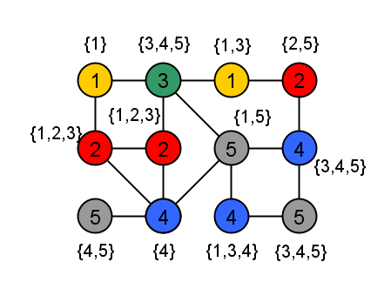
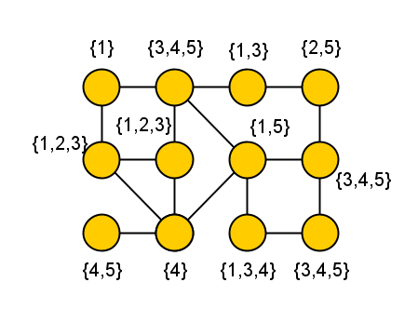
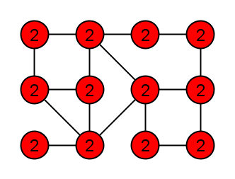
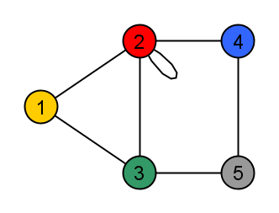
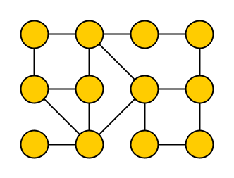
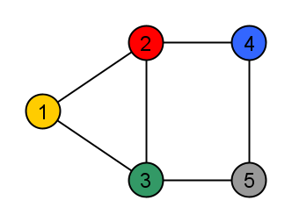
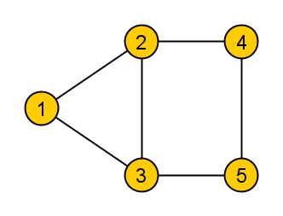
List $H$-Coloring
Let $G$ and $H$ be undirected graphs and let $L :V\left(G\right)→2^{V\left(H\right)}$
A list $H$-coloring of $G$ is a function $f:V\left(G\right)→V\left(H\right)$ such that for all $\left\{u,v\right\}∈E(G)$we have $\left\{f\left(u\right),f\left(v\right)\right\}∈E\left(H\right)$, and for all $v∈V(G)$ we have $f\left(v\right)∈L(v)$
$$G$$
$$H$$
Notes:
H-Coloring == homomorphism from G to H.

Slide 3
Complexity of List $H$-Coloring
Decision problem for fixed $H$: does a list $H$-coloring exist?
Complexity dichotomy was proven in three steps:
If $H$ is reflexive (each vertex has a loop) then List $H$-Coloring is in P when $H$ is an interval graph (and NP-complete otherwise) [Feder & Hell, JCTB ‘98]
If $H$ is irreflexive (no vertex has a loop) then List $H$-Coloring is in P when $H$ is a bipartite graph whose complement is a circular arc graph (and NP-complete otherwise) [Feder, Hell & Huang, Combinatorica ‘99]
In general, List $H$-Coloring is in P when $H$ is a bi-arc graph (and NP-complete otherwise) [Feder, Hell & Huang, JGT ‘03]

Slide 4
A different algorithmic paradigm
Sparsification for (NP-hard) decision problems: Efficiently reduce a dense input into an equivalent sparse one
Allows it to be stored, manipulated, and solved more efficiently
For fixed $H$, an $n$-vertex instance $(G,L)$ of List $H$-Coloring can be encoded in $O(n^{2})$ bits via its adjacency matrix
Does any NP-hard List $H$-Coloring problem admit a polynomial-time sparsification to $O\left(n^{2−ε}\right)$ bits?
$O(n^{d})$ bits
$$I$$
polynomial time
$$I′$$
$$n$$
$$n$$

Slide 5
Timeline of polynomial-time sparsification
[Chen, J & Pieterse, IPEC]
[Dell & van Melkebeek, STOC]
Characterizations for symmetric and low-arity CSP with $\tilde{O}(n)$-bit sparsification
$k$-SAT cannot be sparsified to $O(n^{k−ε})$ bits
Vertex Cover cannot be sparsified to $O\left(n^{2−ε}\right)$ bits
[J & Pieterse, IPEC]
$k$-NAE-SAT can be sparsified to $\tilde{O}\left(n^{k−1}\right)$ bits
(unless $NP⊆coNP/poly)$
2010 2011 2012 2013 2014 2015 2016 2017 2018 2019 2020
3-Coloring cannot be sparsified to $O(n^{2−ε})$ bits
ISAAC 2020
Dominating Set cannot be sparsified to $O(n^{2−ε})$ bits
[J & Pieterse, IPEC]
Full sparsification complexity characterization for Boolean Max-CSP
Exact SAT can be sparsified to $\tilde{O}(n)$ bits
[J & Pieterse, IPEC]
[J & Pieterse, MFCS]
[J & Włodarczyk, ESA]
Notes:
Reasonable understanding of sparsification standard coloring problems and Boolean CSPs. List H-Coloring problems extend both: variation of coloring, corresponding to non-Boolean CSP.
Lower bounds for standard graph coloring, some nontrivial upper bounds for CSPs. List H-coloring is a non-Boolean CSP that captures all graph coloring problems: is there some H for which a nontrivial sparsification exists?
Observe from this overview: several nontrivial upper bounds for NP-hard CSPs with constraints of arity three or more, but no nontrivial sparsification for graph problems ($≈$ CSP with constraints of arity 2). Also: we understand Boolean CSPs to some extent, and H-Coloring problems form a restricted class of CSPs with larger domains to attack next.

Slide 6
Our results
If $H$ is an undirected graph that is not a bi-arc graph, possibly with loops, then List $H$-Coloring does not admit a polynomial-time sparsification to instances of $O\left(n^{2−ε}\right)$ bits for any $ε>0$ unless $NP⊆coNP/poly$
By the dichotomy, the lower bound applies to all NP-hard cases
Proof identifies on a new structure present in all hard graphs $H$

Slide 7
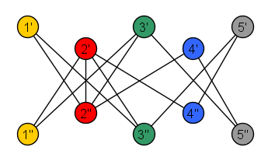
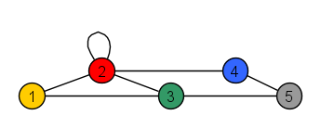
Opening step of the proof
Inspired by Feder, Hell & Huang [JGT ‘03]
Map each graph $H$ to a simple bipartite graph $H^{∗}$, such that if List Coloring is NP-hard for $H$, then it is hard for $H^{∗}$ as well
There is a known reduction from List $H^{∗}$-Coloring to List $H$-Coloring that preserves the vertex set (and therefore transfers sparsification lower bounds)
Consequence: To prove the lower bound for all NP-hard cases of List Coloring, suffices to prove lower bounds for all hard simple bipartite $H^{∗}$
$$H$$
$$H^{∗}$$

Slide 8
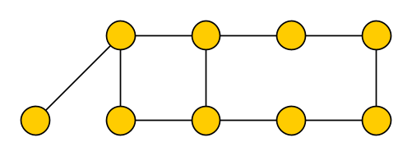
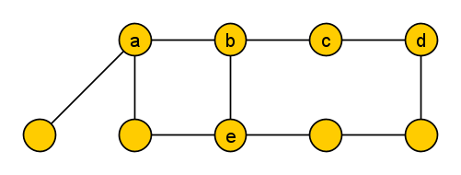
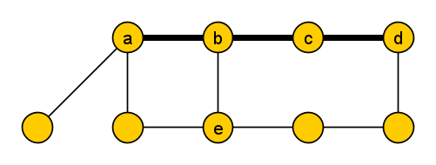
Local structure
If $H$ is a simple bipartite graph that is not the complement of a circular arc graph, then there exist $a,b,c,d,e∈V(H)$ such that
the graph $H\left[\left\{a,b,c,d\right\}\right]$ is isomorphic to $P_{4}$
the sets $N_{H}\left(a\right), N_{H}\left(c\right), N_{H}(e)$ are pairwise incomparable
the sets $N_{H}\left(b\right),N_{H}(d)$ are pairwise incomparable
Notes:
Take-away message: any hard graph H contains a P_4 with some additional properties, which can be used to construct gadgets, which can be used to simulate an Annotated P_4-List-Coloring instance, for which we prove a lower bound.

Slide 9
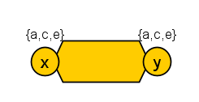
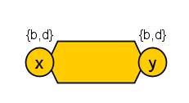
Local structure
(1) allows List $H$-Coloring to mimic $P_{4}$-Coloring
(2&3) lead to gadgets for lists $\{a,c,e\}$ and $\{b,d\}$, which enforce that two vertices get different values
If $H$ is a simple bipartite graph that is not the complement of a circular arc graph, then there exist $a,b,c,d,e∈V(H)$ such that
the graph $H\left[\left\{a,b,c,d\right\}\right]$ is isomorphic to $P_{4}$
the sets $N_{H}\left(a\right), N_{H}\left(c\right), N_{H}(e)$ are pairwise incomparable
the sets $N_{H}\left(b\right),N_{H}(d)$ are pairwise incomparable
$$≠$$
$$≠$$
Notes:
Take-away message: any hard graph H contains a P_4 with some additional properties, which can be used to construct gadgets, which can be used to simulate an Annotated P_4-List-Coloring instance, for which we prove a lower bound.

Slide 10
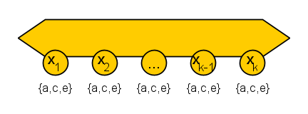
Local structure
(1) allows List $H$-Coloring to mimic $P_{4}$-Coloring
(2&3) lead to gadgets for lists $\{a,c,e\}$ and $\{b,d\}$, which enforce that two vertices get different values
and via [Jaffke & J, CIAC ‘17] to:
If $H$ is a simple bipartite graph that is not the complement of a circular arc graph, then there exist $a,b,c,d,e∈V(H)$ such that
the graph $H\left[\left\{a,b,c,d\right\}\right]$ is isomorphic to $P_{4}$
the sets $N_{H}\left(a\right), N_{H}\left(c\right), N_{H}(e)$ are pairwise incomparable
the sets $N_{H}\left(b\right),N_{H}(d)$ are pairwise incomparable
$O\left(k\right)$ vertices
$$∃x_{ℓ}:f\left(x_{ℓ}\right)≠c$$
Notes:
Take-away message: any hard graph H contains a P_4 with some additional properties, which can be used to construct gadgets, which can be used to simulate an Annotated P_4-List-Coloring instance, for which we prove a lower bound.

Slide 11
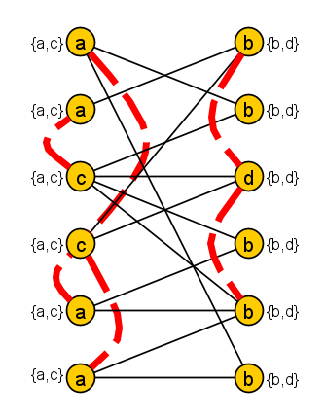
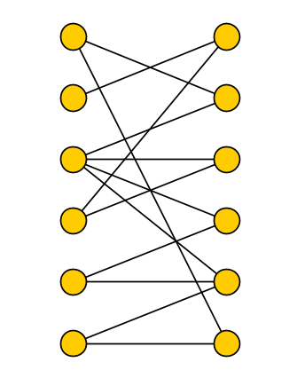
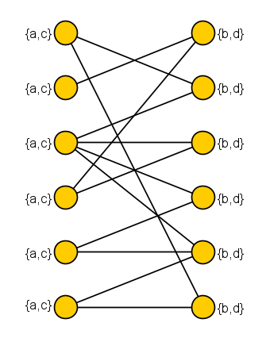
Annotated List $P_{4}$-Coloring
$$S_{1}$$
Input: Simple bipartite graph $G=(V_{1}∪V_{2},E)$,
list function $L\left(v\right)=\left\{\begin{aligned}\begin{matrix}\{a,c\} & v∈V_{1}\end{matrix} \\ \begin{matrix}\{b,d\} & v∈V_{2}\end{matrix}\end{aligned}\right.$
set $F⊆\left({V_{1} \atop 2}\right)∪\left({V_{2} \atop 2}\right)$ with $\left|F\right|≤|V\left(G\right)|$,
sequence $𝒮=S_{1},…, S_{m}$ of subsets of $V_{1}$
with $\sum_{i=1}^{m}{\left|S_{i}\right|≤3|V\left(G\right)|}$
Question: Does $G$ have a list $P_{4}$-coloring $f:V\left(G\right)→\{a,b,c,d\}$ such that:
for all $\left\{u,v\right\}∈F$ we have $f\left(u\right)≠f(v)$, and
for all $S_{i}∈𝒮$ there exists $x_{ℓ}∈S_{i}$ with $f\left(x_{ℓ}\right)≠c$ ?
$$S_{2}$$
Can be enforced by previous gadgets
Notes:
Observe that when doing a $P_{4}$-coloring, giving a vertex with list {a,c} color c, or a vertex with list {b,d} color d, will never violate any homomorphism requirements because c is adjacent to all vertices in the other partite set, and d is also adjacent to all vertices in the other partite set.

Slide 12
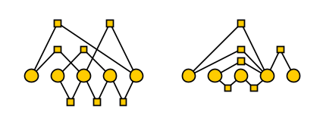
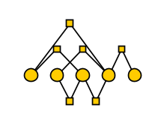
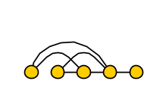
Annotated List $P_{4}$-Coloring parameterized by the number of vertices $n$ does admit a generalized kernelization of bitsize $O\left(n^{2−ε}\right)$ for any $ε>0$, unless NP $⊆$ coNP/poly
Annotated List $P_{4}$-Coloring does not admit a polynomial-time sparsification to $O\left(n^{2−ε}\right)$ bits for any $ε>0$ unless $NP⊆coNP/poly$
Lower bound using cross-composition framework: Embed $t^{2}$ instances of Clique $G_{i,j}$ for $i,j∈\left[t\right]$ all on $n$ vertices, asking for clique of size $k$
$t^{2}⋅n^{2}$ bits of information in total
$$⋯$$
$$G_{1,1}$$
$$G_{1,2}$$
$$G_{t,t}$$
into one Annotated List $P_{4}$-Coloring instance on $N=O(t⋅n^{O\left(1\right)})$ vertices,
which has a solution if and only if some input graph $G_{i,j}$ has a $k$-clique
$O(N^{2})=$ $O(t^{2}⋅n^{O(1)})$ bits of information in total
$$2$$
$$t$$

Slide 13
Summary of the reductions
Annotated List $P_{4}$-Coloring
Annotated List 𝑃_4-Coloring
List $H^{∗}$-Coloring
List 𝐻^∗-Coloring
List $H$-Coloring
List 𝐻-Coloring
Logical OR of $t^{2}$ Clique instances
Logical OR of 𝑡^2 Clique instances
Cross-composition
Sparsification lower bound for Annotated List $P_{4}$-Coloring
Gadgets from hard local structure
Sparsification lower bound for List $H^{∗}$-Coloring for simple bipartite graphs $H^{∗}$
Reduction of Feder, Hell & Huang
Sparsification lower bound for List $H$-Coloring for all NP-hard graphs $H$

Slide 14
Conclusion
No NP-hard List $H$-Coloring problem admits a nontrivial polynomial-time sparsification (unless $NP⊆coNP/poly)$
Proof identified special $P_{4}$’s in all hard graphs
Open problems:
Sparsification for non-list problem $H$-Coloring?
Does there exist any NP-hard graph problem, defined on general graphs, that admits a polynomial-time sparsification to $O(n^{2−ε})$ bits for some $ε>0?$
Postdoc positions available!
Notes:
We know sparsification lower bounds for all graphs H which have a triangle. (The problem is easy for all bipartite graphs).

