Slide 1
Kernel Bounds for Path and Cycle Problems
Bart M. P. Jansen
Joint work with
Hans L. Bodlaender & Stefan Kratsch
September 8th 2011, Saarbrucken
Notes:
TODO: Maybe: put in a slide showing what the problem looks like with a structural parameter.

Slide 2
Path and Cycle problems
Long Path
Given G and pairs of vertices (s₁, t₁), … , (s_{l}, t_{l}), are there vertex-disjoint paths connecting each s_{i} to t_{i}?
Disjoint Cycles
Given G and an integer l, are there l vertex-disjoint simple cycles in G?
Given G and an integer l, does G contain a path on at least l vertices?
Disjoint Paths
Long Cycle
Given G and an integer l, does G contain a cycle on at least l vertices?

Slide 3
Background
Various path and cycle problems have been important to the development of parameterized complexity
Theoretical
Disjoint Paths lies at the heart of the Graph Minors algorithm
Long Path was one of the first problems known to be fixed-parameter tractable
Practical
Long Path has applications in computational biology
Disjoint Cycles inspired one of the first non-trivial compositions
…
Long Path was one of the main motivations for the kernel lower-bound framework

Slide 4
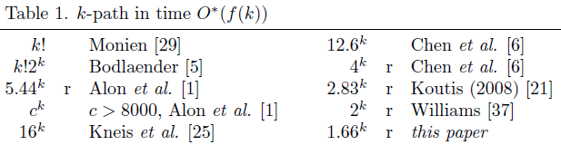
Previous results
Many recent developments in FPT algorithms
  Disjoint Paths: improvements to the Unique Linkage Theorem for planar graphs [AdlerKKLSThilikos@ICALP’11]
  k-Path continues to inspire new algorithmic techniques [BjörklundHKK’10]
Natural parameterizations k-Path, k-Disjoint Paths, k-Disjoint Cycles are fixed-parameter tractable but do not admit polynomial kernels unless NP ⊆ coNP/poly [BodlaenderDFH@ICALP’08, BodlaenderTY@ESA’09, Robertson&Seymour]
  For k-Path: not even a polynomial kernel on connected planar graphs [ChenFM@CiE’09]

Slide 5
Preprocessing for path & cycle problems
Even though natural parameterizations do not admit polynomial kernels, we might still benefit from preprocessing
How to guide the search for good reduction rules?
  Non-standard parameters!
One example known:
Hamiltonian Cycle parameterized by Max Leaf Number has a kernel with 5.75k vertices [FellowsLMMRS@CiE’07]

Slide 6

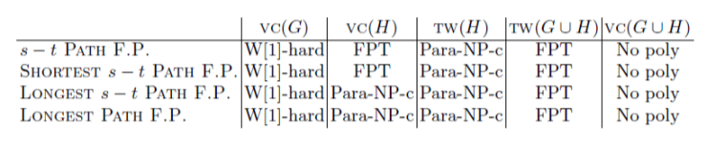
Our results
Long Path, Long Cycle,
Disjoint Paths, Disjoint Cycles
Long Path & Long Cycle
Hamiltonian Path & Hamiltonian Cycle
Admit O(k²)-vertex kernels parameterized by Vertex Cover Number
Admit polynomial kernels parameterized by Max Leaf Number
Admit polynomial kernels parameterized by vertex-deletion distance to a Cluster graph
Do not admit polynomial kernels parameterized by vertex-deletion distance to an outerplanar graph
Path problems with Forbidden Pairs
First study of parameterized complexity: para-NP-completeness, FPT, W[1]-hardness and kernel lower-bounds
Generalizes kernel for Hamiltonian Cycle by [FellowsLMMRS@CIE’07]

Slide 7
long cycle
Quadratic-vertex kernel parameterized by Vertex Cover #

Slide 8
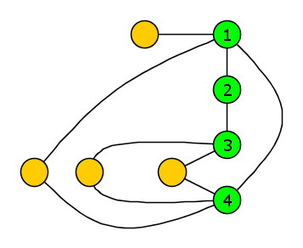
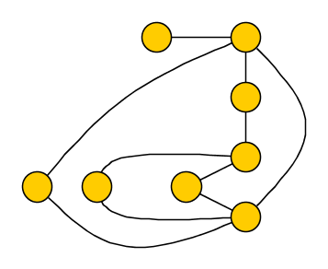
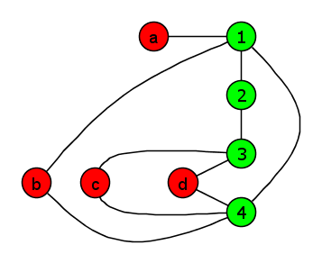
Quadratic-vertex kernel for Long Cycle by Vertex Cover
Input: Graph G, vertex cover X of G, integer l
Question: Does G have a cycle on at least l vertices?
  Assume l > 4 (otherwise, solve by brute force)
Example for l = 6

Slide 9
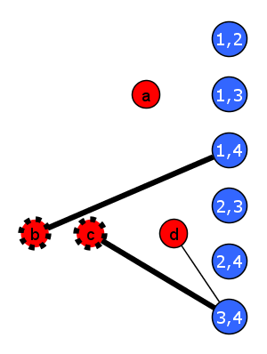
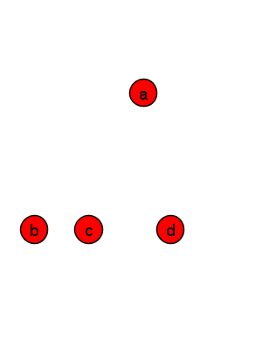
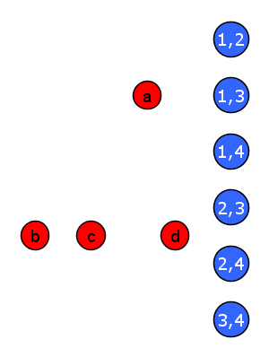
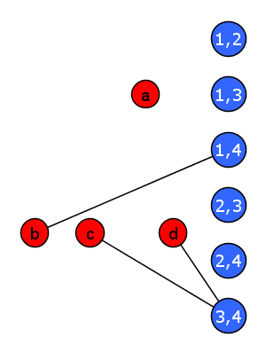
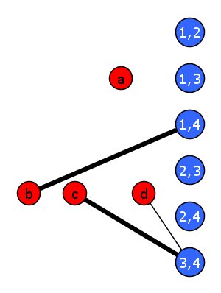
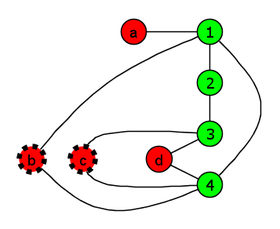
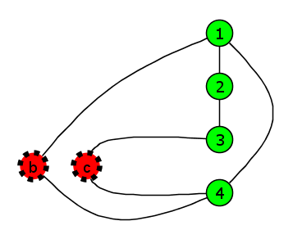
Reduction algorithm
Bipartite auxiliary graph H = (R ∪ B, E)
  Red vertices are V(G) \ X
  Blue vertex v(p,q) for each pair p,q ∈ X
    v(p,q) adjacent to N(p)∩N(q) \ X
Compute maximum matching in H
  Let R_{U} be the unsaturated red vertices
Output G – R_{U} with ≤ |X| + |X|² vertices

Slide 10
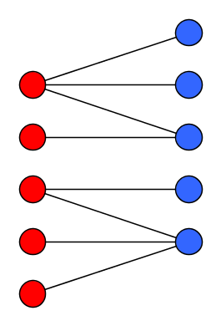
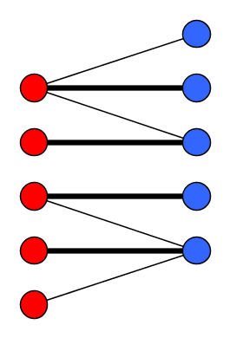
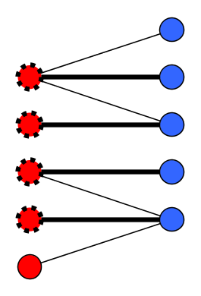
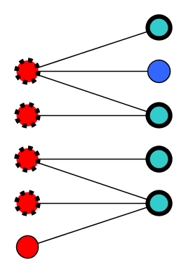
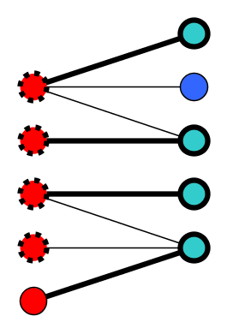
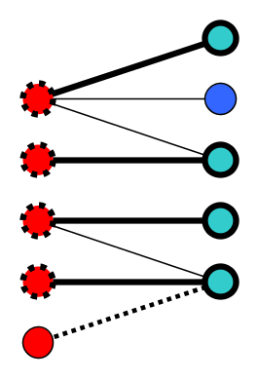
Property of maximum matchings
Let H = (R ∪ B, E) be a bipartite graph
Let M be a maximum matching in H
Let R_{U} be vertices of R not saturated by M
Theorem. For all B’  B:
if H has a matching saturating B’,
then H – R_{U} has a matching saturating B’.
Proof using augmenting paths

Slide 11
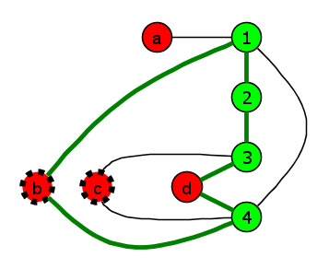
Correctness (I)
G has a cycle of length l ⬄ G – R_{U} has a cycle of length l
(⬅) Trivial since cycle in subgraph gives cycle in G
(➔) Proof using a matching property
  Suppose G has a cycle C of length l > 4

Slide 12
Correctness (II)
All (green) vertices and edges of G[X] are still present
Red vertices in G-X are used to connect two green vertices in X
Subpath (g₁, r, g₂) of C is an indirect connection
  r ∈ N(g₁) ∩ N(g₂) \ X
Find red vertices in R \ R_{U} to replace all indirect connections

Slide 13
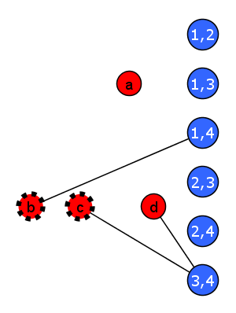
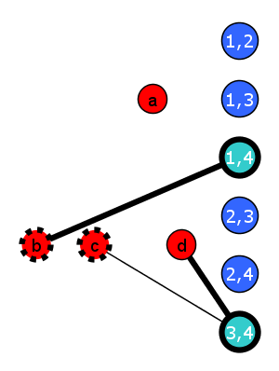
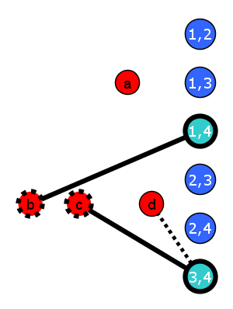
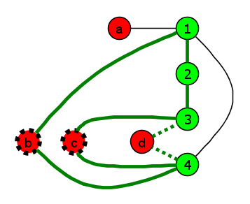
Correctness (III)
No two connections (g₁, r, g₂) and (g₁, r’, g₂) since l > 4
For each connection (g₁, r, g₂):
  match v(g₁,g₂) to r in H
  matching in H saturating all connected pairs
By matching property: exists matching in H – R_{U} saturating all connected pairs
Update cycle accordingly

Slide 14
The kernel
For the decision problem with a vertex cover in the input:
Kernel does not depend on desired length of the cycle
  Works for optimization problem as well
If X is not given:
  Compute a 2-approximate vertex cover, use it as X
Also applies to Long Path, Disjoint Paths, Disjoint Cycles
Long Cycle parameterized by a vertex cover X has a kernel with |X| + |X|² vertices.

Slide 15
Long cycle
Polynomial kernel by Max Leaf Number

Slide 16

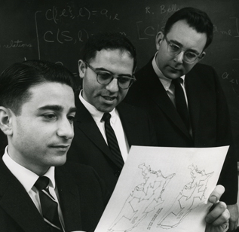
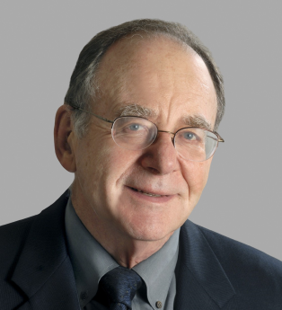
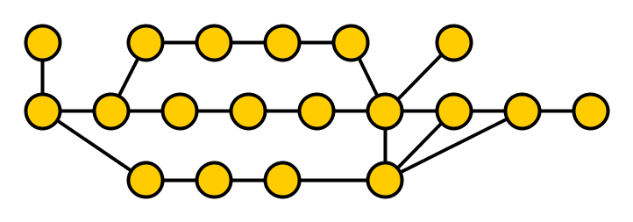
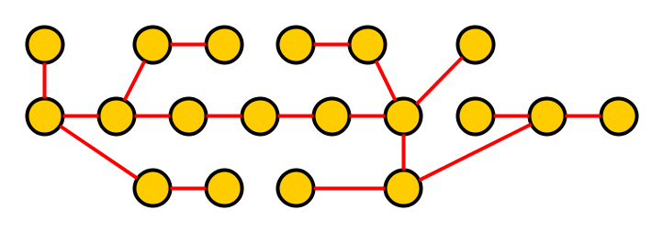

Long Cycle parameterized by Max Leaf Number
Input: Graph G, integer l, integer k.
Parameter: k, promised to be the max leaf number of G.
Question: Does G contain a simple cycle of length ≥l ?
1. Kleitman-West Theorem
2. Held-Karp Dynamic Programming
3. Karp Reduction

Slide 17

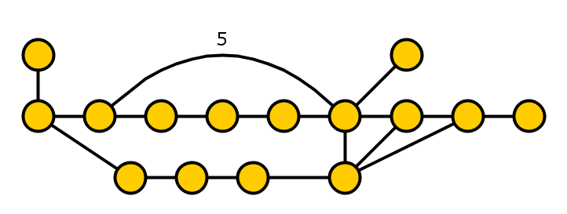
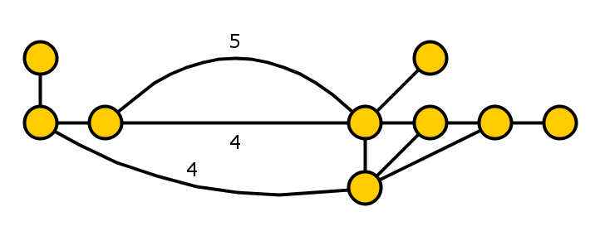
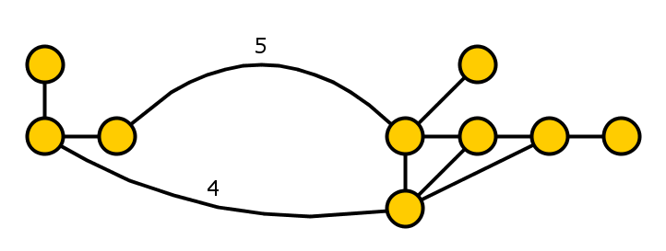
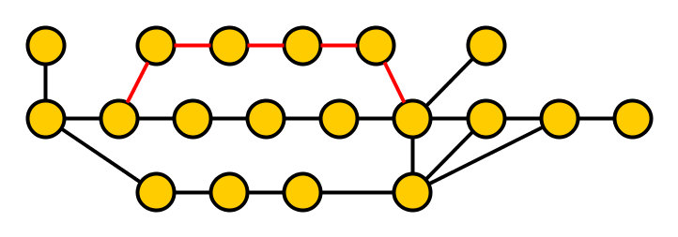
The kernelization algorithm
Kleitman-West Theorem
  Let X be vertices of degree ≠ 2: |X| ≤ c·k
  Transform paths of degree-2 vertices into weighted edges
  Reduce to weighted simple graph (G’, w’) with |V(G’)| = |X| ≤ c·k

Slide 18
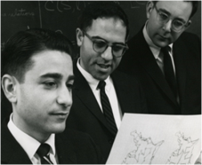
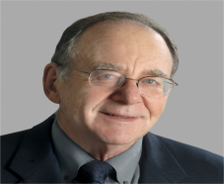
The kernelization algorithm
Kleitman-West Theorem
  Let X be vertices of degree ≠ 2: |X| ≤ c·k
  Transform paths of degree-2 vertices into weighted edges
  Reduce to weighted simple graph (G’, w’) with |V(G’)| = |X| ≤ c·k
Held-Karp Dynamic Programming
  If binary encoding of a weight uses > c·k bits:
    There were > 2^{c·k} degree-2 vertices so n > 2^{c·k}
    Solve weighted instance: O(2^{|X|} |X|³) is O(n⁴) time
Karp Reduction
  If binary encoding is small: (G’, w’, l’) has bitsize poly(k)
    Weighted Long Cycle is in NP
    Reduce to back to unweighted problem
    Polynomial-time transformation, output has size poly(k)

Slide 19
discussion & conclusion

Slide 20

Structural parameterizations of Hamiltonian Cycle (& related)
Vertex Cover Number
  Deletion distance to treewidth 0
Feedback Vertex Number
  Deletion distance to treewidth 1
Deletion distance to Outerplanar
  Deletion distance to treewidth 2

Slide 21
Polynomial kernels
Vertex Cover
Distance to Clique
Max Leaf #
Distance to Co-cluster
Distance to Cluster
FPT
poly kernel?
Distance to linear forest
Distance to Cograph
Distance to Interval
Feedback Vertex Set
FPT?
poly kernel?
Distance to Outerplanar
Pathwidth
Distance to Chordal
Odd Cycle Transversal
FPT, no poly
kernel unless
NP⊆coNP/poly
Treewidth
Distance to Perfect
NP-complete for k=0
Chromatic Number
Complexity overview for Long Cycle parameterized by…

Slide 22
Conclusion
Structural parameterizations of Path and Cycle problems admit polynomial kernels
Various upper and lower-bound results
Poly kernels for Long Path parameterized by:
feedback vertex number
vertex-deletion distance to a cograph
Is Longest Path in FPT …
parameterized by a (given) deletion set to an Interval graph?
Poly kernels for Long Path parameterized by:
Max Leaf Number, without using binary encoding?
THANK YOU!

