Slide 1
Parameterized algorithmics
Bart M. P. Jansen
October 17th, Networks project meeting

Slide 2
Outline
1. About me
2. My research background
3. Contributions to Networks
Parameterized algorithmics
Approximate network methods
Spatial networks
Classic complexity theory
4. Conclusion
Stochastics

Slide 3
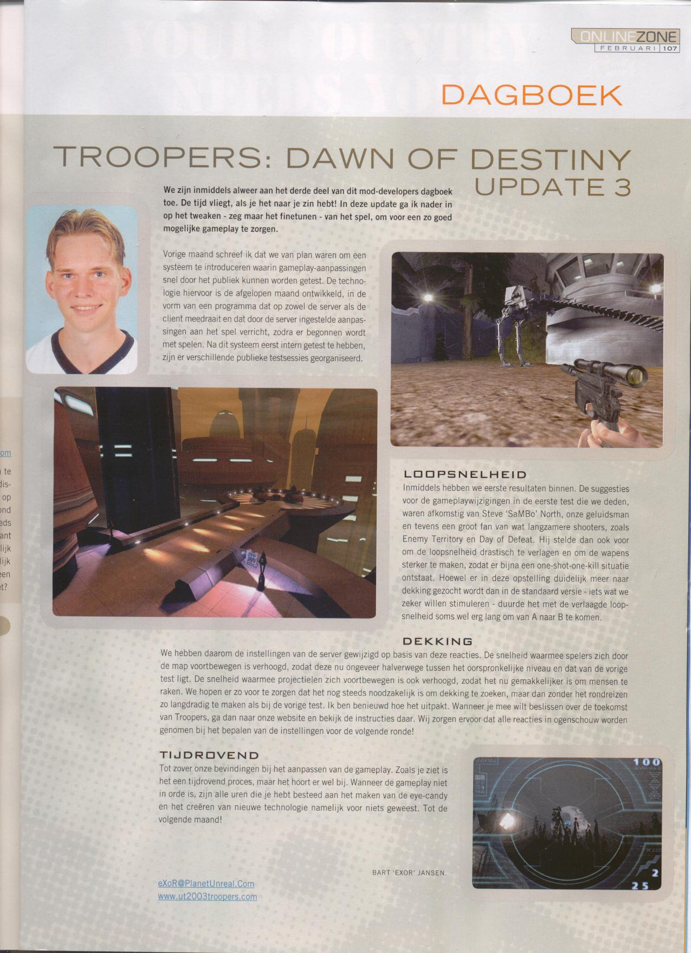
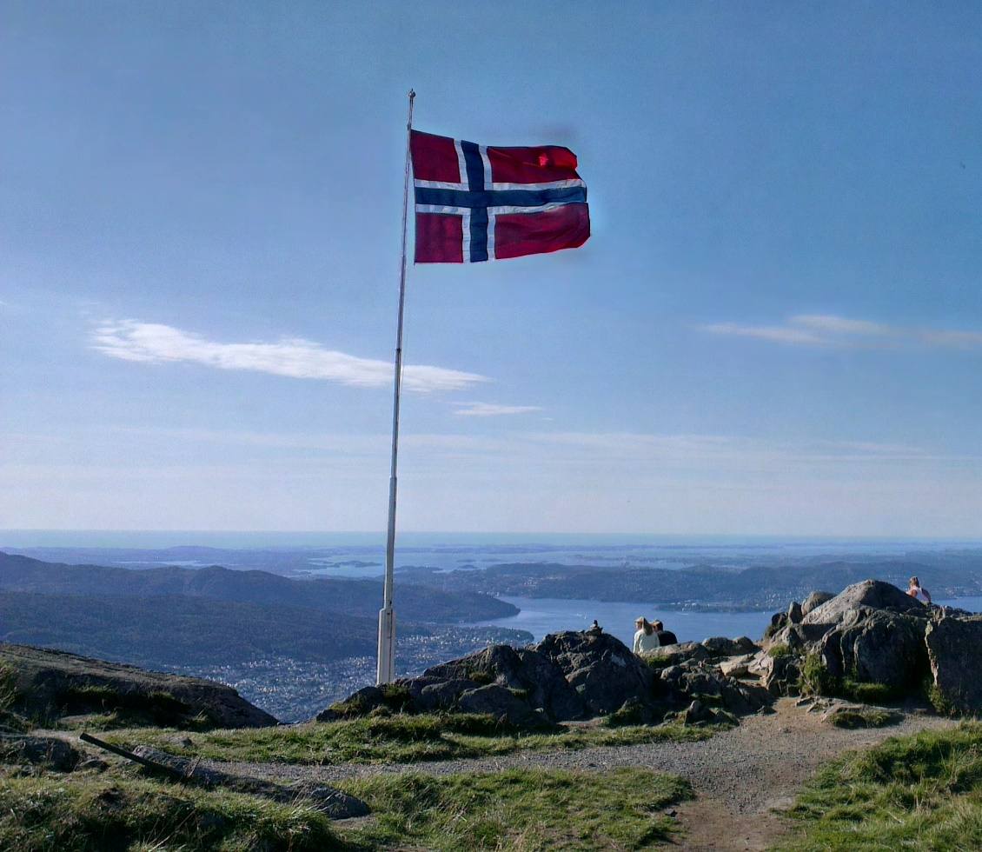
About me
1986 – 2004
Grew up around Nijmegen
Programmed extensions to computer games
2004 – 2009
Game design at Utrecht University
Later Applied computing science
2009 – 2013
Ph.D. student in Utrecht
Supervised by Hans Bodlaender & Jan van Leeuwen
2013 – 2014
Postdoc at the University of Bergen, Norway
September 2014
VENI grant
Assistant professor at TU/e

Slide 4
My research background

Slide 5
Classic algorithm design and analysis
Classic algorithm design uses a one-dimensional framework
The quality of an algorithm is determined by the dependence of the running time on the total input size $n$
The complexity of an input is measured only by its size
An algorithm is (classically) considered good if:
it always finds the correct answer
its running time on an input of $n$ bits is bounded by a polynomial in $n$

Slide 6
Polynomial-time solvable
NP-complete
Sorting $$O(n\log{n})$$
Minimum Vertex Cover $$O(2^{n}⋅n^{2})$$
Shortest path $$O(m+n\log{n})$$
Longest Path $$O\left(2^{n}⋅n^{2}\right)$$
Linear programming $$O(n^{3.5}⋅L)$$
Maximum Clique $$O(2^{n}⋅n^{2})$$
Maximum matching $$O(m \sqrt{n})$$
Chromatic Number $$O\left(2^{n}⋅n^{2}\right)$$
Unfortunately, for the large class of NP-complete problems we do not know polynomial-time algorithms
We have reason to believe such algorithms do not exist

Slide 7
Parameterized algorithmics
A two-dimensional framework for analyzing algorithms
Besides the total input size $n$, we choose a parameter $k$ that is a secondary measurement of the complexity of the input
Can we efficiently solve a large input whose parameter is small?
$$O\left(2^{k}⋅n^{2}\right) O\left(k^{k}⋅n\right) O\left(2^{2^{k}}⋅n^{2}\right)$$
Polynomial-time algorithms if the value of $k$ is kept fixed
Fixed-Parameter Tractability
A parameterized problem is FPT if it is solvable in time:
$f\left(k\right)⋅n^{c}$, for a constant $c$ and arbitrary function $f$

Slide 8
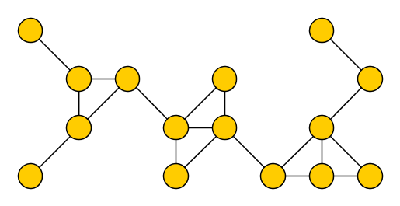
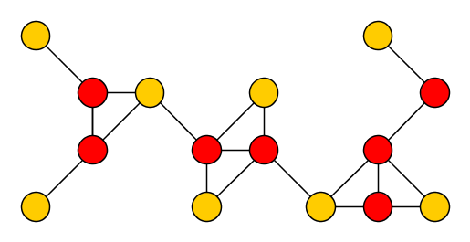
$k$-Vertex Cover
Input: An undirected graph $G$ and an integer $k$ Parameter: $k$ Question: Is there a set $S$ of at most $k$ vertices in $G$, such that each edge of $G$ has an endpoint in $S$?
Such a set $S$ is a vertex cover of $G$
We choose the size of the solution as the parameter $k$
Can we efficiently find a small vertex cover in a big graph?
There is an algorithm with running time $O(2^{k}⋅n)$, so FPT

Slide 9
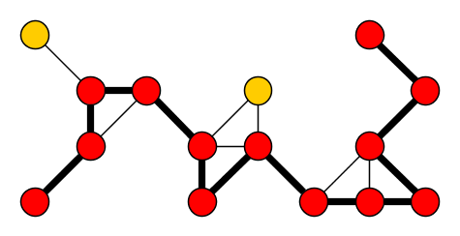
$k$-Longest Path
Input: An undirected graph $G$ and an integer $k$ Parameter: $k$ Question: Is there a simple path of length $k$ in $G$?
Generalizes Hamiltonian Path, so $NP$-complete
$k$- Longest Path is fixed-parameter tractable
Solvable in ${1.66}^{k}⋅n^{c}$ time

Slide 10
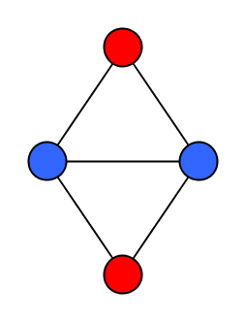
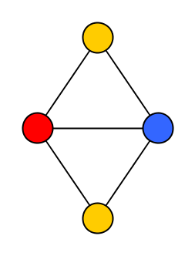
$k$-Chromatic Number
Input: An undirected graph $G$ and an integer $k$ Parameter: $k$ Question: Is there a proper coloring of $G$ using $≤k$ colors?
Models scheduling and frequency assignment problems
If $k$-Chromatic Number is fixed-parameter tractable, then we can test for 3-colorability in $f\left(3\right)⋅n^{c}∈O\left(n^{c}\right)$ time
Since $3$-Coloring is NP-complete:
$k$-Chromatic Number is not FPT unless $P=NP$

Slide 11
$k$-Clique
Input: An undirected graph $G$ and an integer $k$ Parameter: $k$ Question: Is there a clique of $k$ vertices in $G?$
Can be solved in $O(n^{k+2})$ time
Polynomial for each fixed $k$, but the degree depends on $k$
Main working hypothesis of parameterized complexity:
There is no algorithm for $k$-Clique with runtime $f\left(k\right){⋅n}^{c}$
Equivalent to a statement about a parameterized version of the Halting problem

Slide 12
NP-complete
Longest Path $$O\left(2^{n}⋅n^{2}\right)$$
Longest Path 𝑂(2^𝑛⋅𝑛^2 )
Chromatic Number $$O\left(2^{n}⋅n^{2}\right)$$
Chromatic Number 𝑂(2^𝑛⋅𝑛^2 )
Minimum Vertex Cover $$O(2^{n}⋅n^{2})$$
Minimum Vertex Cover 𝑂(2^𝑛⋅𝑛^2)
Maximum Clique $$O(2^{n}⋅n^{2})$$
Maximum Clique 𝑂(2^𝑛⋅𝑛^2)
Fixed-parameter tractable
(Probably) not fixed-parameter tractable
$k$-Vertex Cover $$O(2^{n}⋅n^{2})$$
𝑘-Vertex Cover 𝑂(2^𝑛⋅𝑛^2)
$k$-Longest Path $$O\left(2^{n}⋅n^{2}\right)$$
𝑘-Longest Path 𝑂(2^𝑛⋅𝑛^2 )
$k$-Leaf Spanning Tree $$O\left(4^{k}⋅n^{2}\right)$$
𝑘-Leaf Spanning Tree 𝑂(4^𝑘⋅𝑛^2 )
$k$-Vertex Disjoint Paths $O(f\left(k\right)⋅n^{2}$)
𝑘-Vertex Disjoint Paths 𝑂(𝑓(𝑘)⋅𝑛^2)
$k$-Independent Set $$O(n^{k+2})$$
𝑘-Independent Set 𝑂(𝑛^(𝑘+2))
$k$-Dominating Set $$O(n^{k+2})$$
𝑘-Dominating Set 𝑂(𝑛^(𝑘+2))
$k$-Clique $$O(n^{k+2})$$
𝑘-Clique 𝑂(𝑛^(𝑘+2))
$k$-Chromatic Number $$O(2^{n}⋅n^{2})$$
𝑘-Chromatic Number 𝑂(2^𝑛⋅𝑛^2)
The parameter “solution size” affects the complexity of various NP-complete problems in a very different way!

Slide 13
Different parameterizations
Instead of defining $k$ as the solution size, we could also use:
Some structural measure of the complexity of the network
A measure of the geometry of the input
Modification distance from easily solvable subcases
The hope is to find an FPT algorithm for a parameter that is small on the instances encountered in practice
We can also combine parameters
Define $k$ as “network complexity + solution size”
Can the problem be solved efficiently when $k$ is small and $n$ big?
Leads to an extended dialogue with a hard computational problem targeted at identifying tractable classes of instances

Slide 14
Bottom line
The parameterized paradigm entails a new way of thinking when dealing with NP-hard problems
The problem inputs encountered in practice are very different from the adversarial inputs used in hardness proofs
Real-life problem inputs are generated by processes that are themselves computationally bounded
Attack NP-hard problems by finding FPT algorithms for parameters that are small in practice

Slide 15
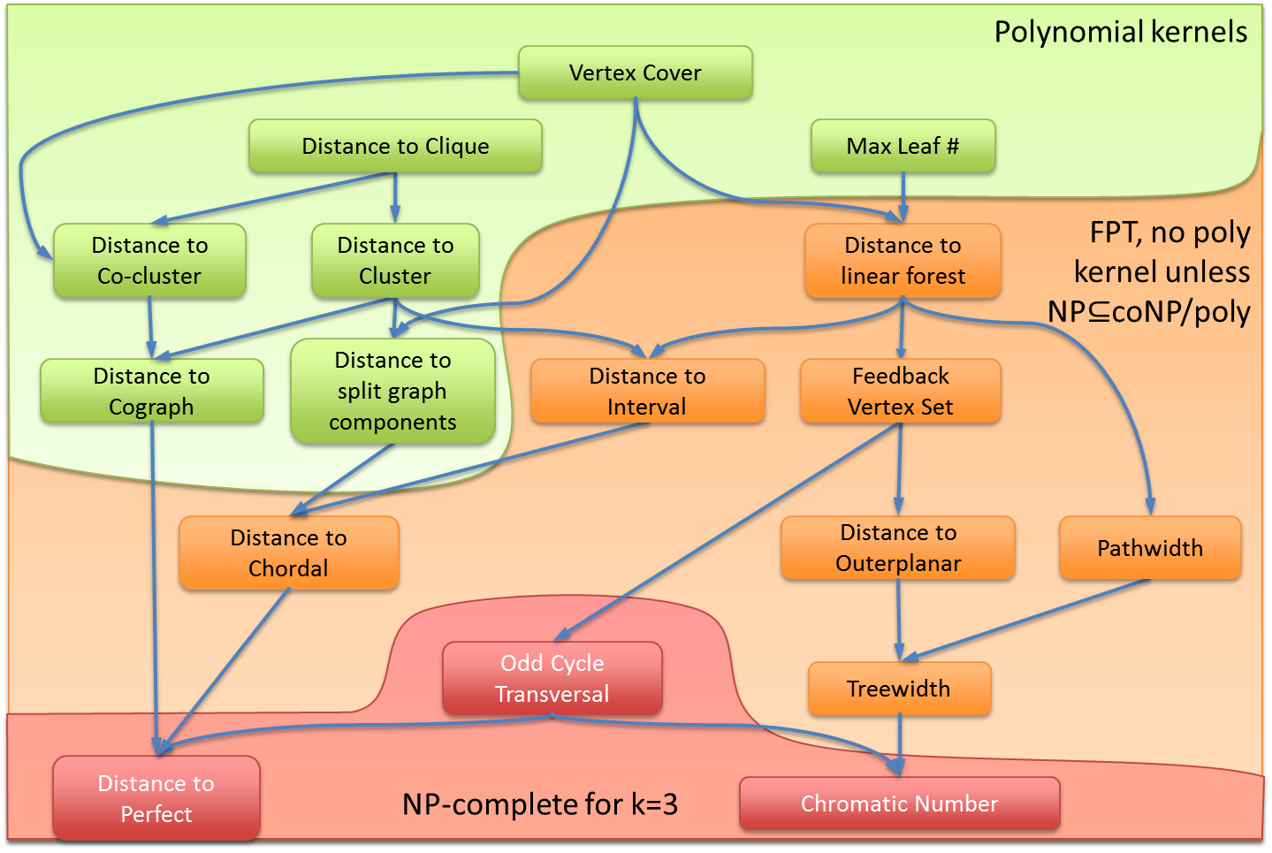
Structural graph theory
To analyze how the complexity of the network affects the time needed to solve the problem, you need some structural graph theory
Treewidth, graph minors, classes of restricted graphs

Slide 16
Contributions to Networks

Slide 17
Theme 1: Approximate network methods
“
A key question is which structural properties of real-world networks facilitate the development of algorithms that are fast for “most” instances
”
This is exactly what parameterized analysis studies
Usually, parameterized analysis aims for exact algorithms
However, the same ideas can be applied in the approximate setting

Slide 18
Parameterized analysis of approximation
Traditional approximation challenges:
Efficient algorithm to find a solution of cost $≤c⋅opt$?
Approximation scheme, giving cost $≤\left(1+ε\right)⋅opt$?
Parameterized approximation challenges:
Efficient algorithm to find a solution of cost $≤k⋅$ opt?
$f\left(k\right)⋅n^{c}$-time algorithm to find a $2$-approximation?

Slide 19
Theme 2: Spatial Networks
We can define networks using geometric notions
Euclidean graph. Every node corresponds to a point in the plane, and the cost of an edge equals the Euclidean distance between the points
Geometric intersection graph. Every node corresponds to a geometric shape, and there is an edge between nodes if their shapes intersect
Planar graph. The network can be drawn in the plane without crossing edges
Several applications yield such networks
We can investigate whether the geometric properties of the network can be exploited to solve problems more efficiently than in general networks
Let’s consider some examples of work in this direction

Slide 20
$k$-Center in the Plane
Input: A set of $n$ points in the plane and an integer $k$ Parameter: $k$ Question: Is there a set $S$ of $k$ points, such that every point is within Euclidean distance $1$ of a point in $S$?
Not fixed-parameter tractable unless $k$-Clique is FPT
Probably no $f\left(k\right)⋅n^{c}$ algorithm for any $f,c$

Slide 21
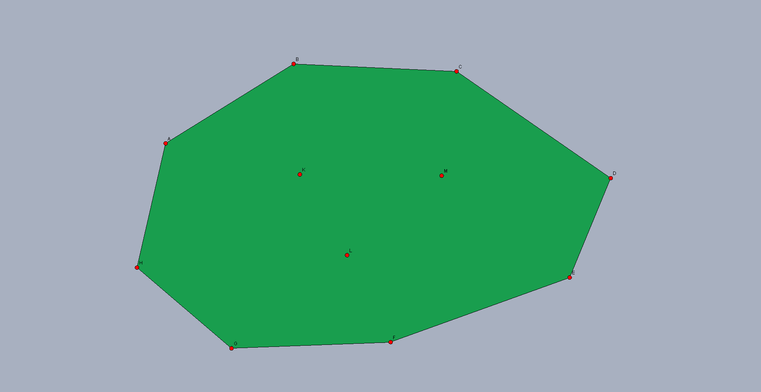
$k$-Geometric Traveling Salesman
Input: A set of $n$ points in the plane, of which $k$ lie in the interior of the convex hull, and an integer $ℓ$ Parameter: $k$ Question: Is there a tour of length $≤ℓ$ that visits all points?
Solvable in time $O\left(2^{k}⋅k^{2}⋅n\right)$

Slide 22
Work in progress: Clique in unit disk graphs
Input: A set of $n$ disks in the plane and an integer $k$ Parameter: $k$ Question: Is there a set $S$ of $k$ disks that pairwise all intersect?
Not known to be polynomial-time solvable or NP-complete
Polynomial-time if all disks have the same size

Slide 23
Other themes: Connections to stochastics
An alternative way to circumvent the artificial difficulty of “adversarial inputs” is to consider random input networks
Several problems are provably more tractable on random inputs than on worst-case inputs
Can provably be solved faster (with high probability), or
Can be approximated with better quality guarantees
To understand why this happens, and what its relevance is for real-life inputs, we can try to relate the good algorithmic behavior to parameters that are small on random inputs

Slide 24
Explaining tractability on random inputs
We can explain why problem $Π$ is easy for random inputs if we have the following:
An FPT algorithm for $Π$ under some suitable parameterization
A proof that, on random inputs, the value of the parameter is small (e.g., $\log{n}$) with high probability
Using parameterized analysis of approximation algorithms, we can hope for similar explanations in the approximate regime

Slide 25
Problems that are easier on random graphs
Hamiltonian Path
Consider random graphs $G_{n,p}$ in the Erdős–Rényi model for constant $p∈[0..1]$
There is an algorithm with expected linear running time to find find a Hamiltonian path in a random graph $G_{n,p}$, or determine that such a path does not exist
Independent Set
In general graphs, there is no approximation algorithm for Independent Set with ratio $n^{1−ε}$ (unless $P=NP)$
For fixed $p$, there is a polynomial-time algorithm for Independent Set in random graphs $G_{n,p}$ that gives a 2-approximation with high probability
Same applies to Chromatic Number

Slide 26
Problems that are easier on random graphs
Planted Clique
Generate a graph $G_{n,p}$ in the Erdős–Rényi model, turn the first $k$ vertices into a clique
For an appropriate range of $k$, a maximum clique in the resulting graph can be found in polynomial time w.h.p.
Coloring 3-Chromatic graphs
Consider the task of properly coloring a graph that is guaranteed to be 3-colorable, in polynomial time
For random 3-colorable graphs, we can give much better approximation guarantees than for general 3-colorable graphs

Slide 27
Boolean-width: An interesting parameter
A graph has small Boolean-width you can decompose it by vertex cuts $(A,B)$ such that, for every cut in the decomposition, the number of distinct neighborhoods of subsets of $A$-vertices into the $B$-side is small
Many combinatorial problems can be solved by dynamic programming on a decomposition
For a graph of Boolean width $k$, the 3-Coloring problem can be solved in time ${O(2}^{k^{2}}⋅n^{c})$
A random graph $G_{n,p}$ has Boolean width $O(\log^{2}{n)}$ w.h.p.
3-coloring on a random graph can be solved in time $O\left(2^{{O\left(\log^{2}{n}\right)}^{2}}⋅n^{c}\right)=O(n^{O(\log^{3}n)})$ w.h.p.

Slide 28
Conclusion
I work on parameterized algorithmics
Analyze how different aspects of a problem contribute to its difficulty, with the goal of obtaining efficient algorithms for real-life inputs
My veni project concerns parameterized preprocessing
Analyzing relevant parameters of random graphs could be a start to merge parameterized algorithmics and stochastics
THANK YOU!

