Slide 1
Search-Space Reduction Beyond Kernelization
Bart M. P. Jansen
based on joint work with: Huib Donkers / Benjamin Bumpus & Jari de Kroon
Advances in Parameterized Graph Algorithms 2022 May 5th 2022, Calpe, Spain

Slide 2
Yes
No
$n$ bits
$f(k)$ bits
$$x$$
$n^{O\left(1\right)}$ time
$$x′$$
$g(k)$ time
$$k$$
$$k′$$
Kernelization originated as a method to obtain FPT algorithms
Notes:
In this paper, Downey and Fellows presented the method of reduction to a problem kernel for the first time as a systematic approach to obtaining FPT algorithms. They gave two examples: the quadratic kernelization for Vertex Cover due to Sam Buss, and a quadratic kernel for Max Leaf Spanning Tree that they developed.
Instead of saying YES/NO: in practice, you solve the kernel and translate the solution back to the original input.

Slide 3
Notes:
In 2002: Planar Dominating Set kernel.

Slide 4
SWAT 2002
IWPEC 2006
Experiments showed great speed-ups through kernelization
Notes:
Already knew FVS (graph minors) and Planar DomSet (SWAT 2000) to be FPT at the time.

Slide 5
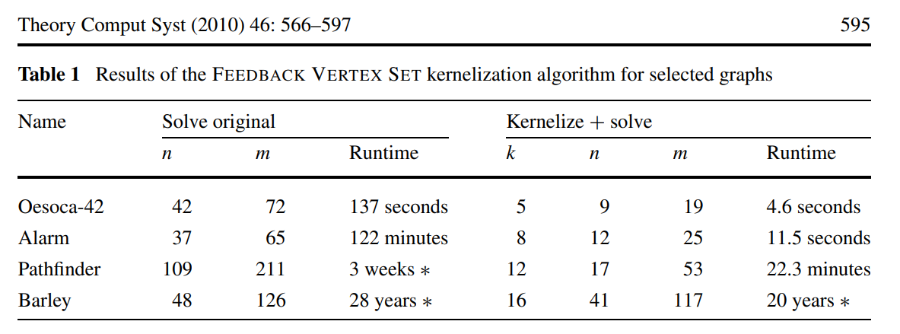
[Alber 2002]
[Bodlaender & van Dijk @TCS‘08]
Experiments showed great speed-ups through kernelization
Notes:
Cubic kernel by Hans. The Planar DomSet kernel was also very effective; we’ll get back to that in a second.

Slide 6
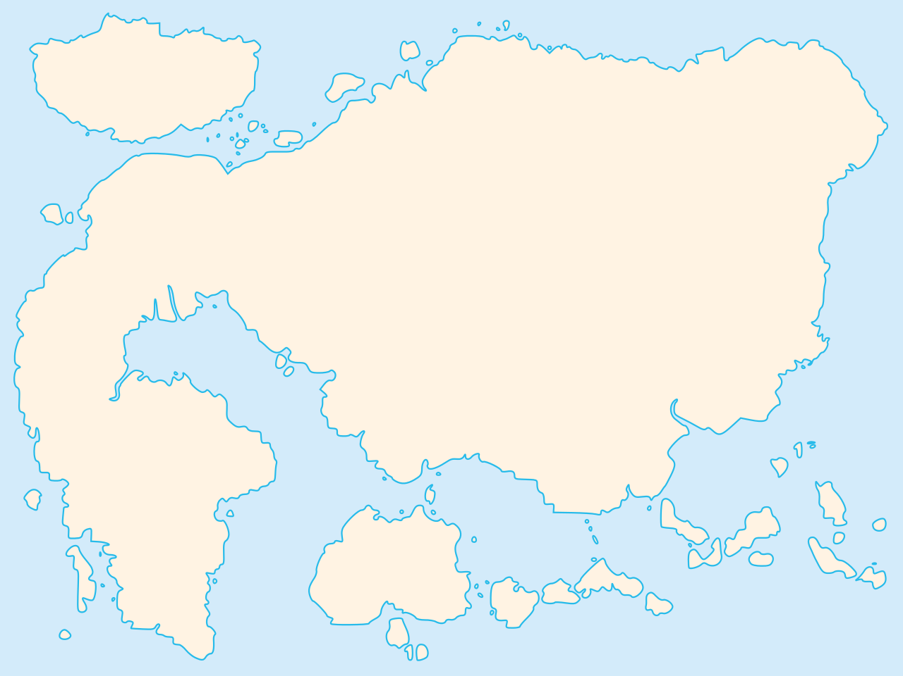
Map of polynomial-time computation
Kernelization
Primality
testing
The lost continent of polynomial time
Network flows
Sorting
Parsing context-free grammars
Fast Fourier transform
Shortest paths
Longest common subsequence
Approximation
Islands of minor-testing
Notes:
Survey talk by Mike during the same IWPEC where the first polynomial kernel for FVS was presented. The striking realization that there are polynomial-time algorithms that hold provable power over NP-hard problems, without actually solving them.

Slide 7
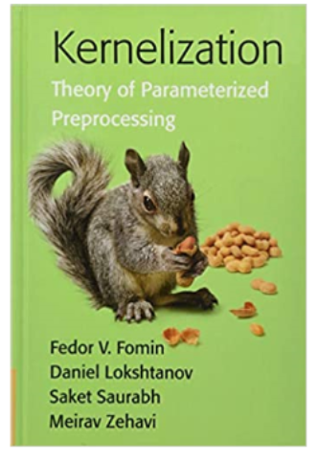
Timeline of kernelization research
[Dell & van Melkebeek]
Vertex Cover has no kernel of $O(k^{2−ε})$ bits
[Downey & Fellows]
Kernels as a method for building FPT algorithms: Max Leaf Spanning Tree
[Fortnow & Santhanam]
Lower bounds for $k$-Path & OR-composable problems
[Pilipczuk² Sankowski & van Leeuwen]
[J.]
Sparsification for Planar Steiner Tree
Turing kernel for planar $k$-Path
[Bodlaender, Downey, Fellows, Hermelin]
1988 1990 1992 1996 1998 2000 2002 2004 2006 2008 2010 2012 2014 2016 2018 2020 2022
[Sam Buss]
Rep-set kernels for Almost 2-SAT
Quadratic kernel for Vertex Cover
Kernel of $O\left(k^{11}\right)$ vertices for Feedback Vertex Set
[Drucker]
Lower bounds for (quantum) kernels for AND-composable problems
[Burrage, Estivill-Castro, Fellows, Langston, Mac, Rosamond]
[Kratsch, Wahlström]²
Linear kernel for Planar Dominating Set
Protrusion-based meta-kernelization for planar graphs
Compression via matroids for Odd Cycle Transversal
[Bodlaender, Fomin, Lokshtanov, Penninkx, Saurabh, Thilikos]
[Albert, Fellows, Niedermeier]
Notes:
Other cool things are not mentioned: improved kernels for FVS, Planar F-Deletion, lossy kernels, deletion to subclasses of perfect graphs like chordal, (proper) interval, etc.

Slide 8
Impact of research into kernelization
Intensive research over the last two decades yielded many important insights:
connections to bidimensionality, matroids, complexity theory, well-quasi ordering, extremal combinatorics, approximation algorithms, Myhill-Nerode theory ...
What about the role of kernelization:
as a method for obtaining fixed-parameter tractable algorithms?
as a model for the study of polynomial-time preprocessing to speed up algorithms?
The resulting body of deep research accurately describes
polynomial-time data compression for NP-hard problems
Notes:
Does anyone know a recent paper where the only FPT classification is by kernelization? We have other generic tools now, like Courcelle’s theorem, recursive understanding, iterative compression, important separators.

Slide 9
Kernelization as a model for effective preprocessing
Definition of kernelization yields an improvement in running time, compared to solving the input instance by brute force
Yes
No
$n$ bits
$f(k)$ bits
$$x$$
$n^{O\left(1\right)}$ time
$$x′$$
$g(k)$ time
$$k$$
$$k′$$

Slide 10
Kernelization as a model for effective preprocessing
Definition of kernelization yields an improvement in running time, compared to solving the input instance by brute force
What if a nontrivial (parameterized) algorithm is used afterwards?
[Marcin Pilipczuk & Michal Ziobro, 2018]
Notes:
From Marcin Pilipczuk and Michal Ziobro in https://arxiv.org/pdf/1811.07779.pdf .

Slide 11
Kernelization as a model for effective preprocessing
Definition of kernelization yields an improvement in running time, compared to solving the input instance by brute force
Kernelization guarantees that the size of the preprocessed instance is bounded. For exponential speed-ups, it is important to reduce the search space instead.
$n$ bits
$f(k)$ bits
$$k$$
$$k′$$
depth $k′$
depth $k$
Notes:
How ‘search space’ should be interpreted depends on the type of follow-up algorithm. Some options: size of the search tree for recursive algorithms; number of partial solutions considered in dynamic programming algorithms.
In a certain sense (which can be made surprisingly concrete!) kernelization asks about proving upper-bounds on sizes of obstruction sets, rather than reducing search space.

Slide 12
Kernelization as a model for effective preprocessing
Definition of kernelization yields an improvement in running time, compared to solving the input instance by brute force
How can we rigorously reason about preprocessing aimed at reducing search space?
Preprocessing to decrease the parameter in polynomial time?
Such a preprocessing guarantee for an NP-hard problem in XP would imply $P=NP$
Kernelization guarantees that the size of the preprocessed instance is bounded. For exponential speed-ups, it is important to reduce the search space instead.
Notes:
How ‘search space’ should be interpreted depends on the type of follow-up algorithm. Some options: size of the search tree for recursive algorithms; number of partial solutions considered in dynamic programming algorithms.
In a certain sense (which can be made surprisingly concrete!) kernelization asks about proving upper-bounds on sizes of obstruction sets, rather than reducing search space.

Slide 13
Rigorous analysis of search space reduction
Goal for search space reduction depends on the nature of the follow-up algorithm
Dynamic-programming algorithms over graph decompositions Search space reduction = finding a better decomposition to work with
Branching algorithms based on parameterizations by solution size Identify some elements of an optimal solution to decrease the parameter!
Notes:
Nice tree decomposition, not many join bags, refer back to work on $ℋ$-elimination distance and $ℋ$-treewidth.
Does the model of kernelization ask the right questions for obtaining practical algorithms? (Exponents in recent kernel sizes are comparable to the exponents of PTAS’es that Mike once complained about).

Slide 14
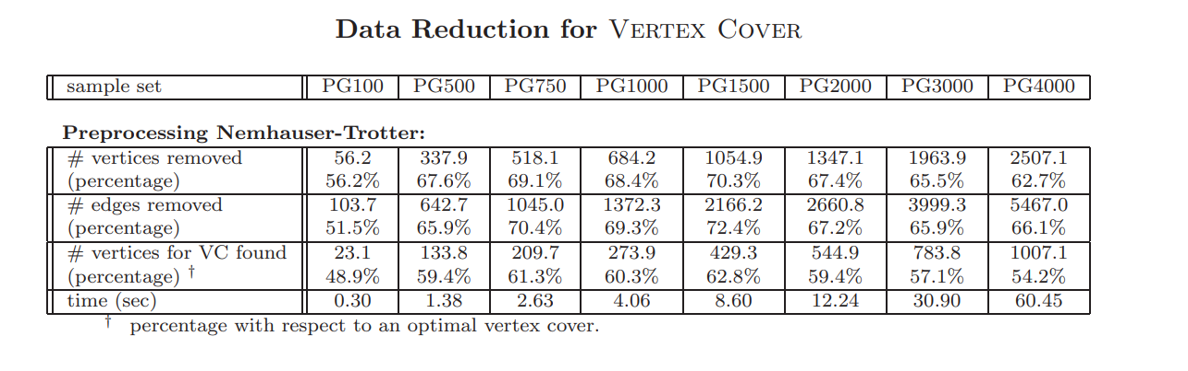
Rigorous analysis of search space reduction
Goal for search space reduction depends on the nature of the follow-up algorithm
Dynamic-programming algorithms over graph decompositions Search space reduction = finding a better decomposition to work with
Branching algorithms based on parameterizations by solution size Identify some elements of an optimal solution to decrease the parameter!
[Alber 2002]
Notes:
Nice tree decomposition, not many join bags, refer back to work on $ℋ$-elimination distance and $ℋ$-treewidth.
Does the model of kernelization ask the right questions for obtaining practical algorithms? (Exponents in recent kernel sizes are comparable to the exponents of PTAS’es that Mike once complained about).

Slide 15
Rigorous analysis of search space reduction
Goal for search space reduction depends on the nature of the follow-up algorithm
Dynamic-programming algorithms over graph decompositions Search space reduction = finding a better decomposition to work with
Branching algorithms based on parameterizations by solution size Identify some elements of an optimal solution to decrease the parameter!
How can a rigorous theory of search space reduction be formulated?
Questions posed by the formalism of kernelization do not always lead to the identification of practical preprocessing algorithms
Notes:
Nice tree decomposition, not many join bags, refer back to work on $ℋ$-elimination distance and $ℋ$-treewidth.
Does the model of kernelization ask the right questions for obtaining practical algorithms? (Exponents in recent kernel sizes are comparable to the exponents of PTAS’es that Mike once complained about).
Think back to the quote of Roger Bacon: half of science is asking the right questions. Has the formalism of kernelization been asking the right questions to identify practical preprocessing algorithms?

Slide 16
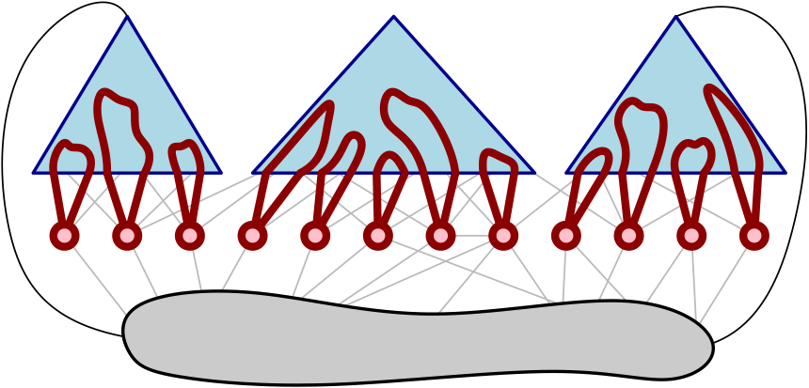
Formalisms for rigorous search-space space reduction
Targeted at parameterizations by solution size
Two recent case studies: efficiently find part of the optimum if:
Give efficient algorithms that, under as mild conditions as possible, guarantee to find at least one element of an optimal solution
Guarantees to decrease the parameter for vertex-deletion problems and many others
1. there is an essential vertex that belongs to all reasonable solutions
2. there is a vertex set with a simple certificate for membership in OPT
[Bumpus, Kroon, J. ‘22]
[Donkers, J. ‘21]

Slide 17
search-space reduction via essential vertices

Slide 18
Search space reduction for deletion problems
Many classic problems can be phrased in terms of vertex deletions to a graph class $ℱ$
$ℱ$-deletion Input: A graph $G$ Output: A minimum vertex set $S$ such that $G−S∈ℱ$
Such a set $S$is called a modulator to $ℱ$ The minimum size of an $ℱ$-modulator is denoted $opt_{ℱ}(G)$
When can an efficient algorithm find a vertex belonging to an optimal $ℱ$-modulator?

Slide 19
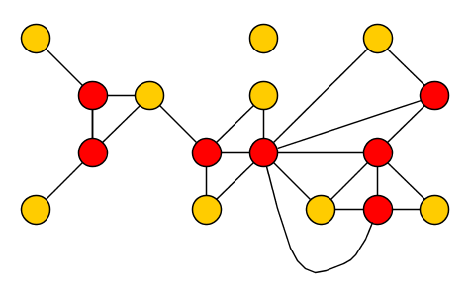
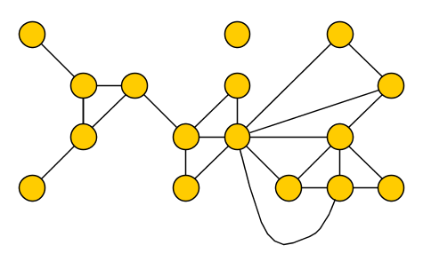
Detect parts of OPT that stand out
When solving problems by hand, some vertices stand out as belonging to OPT
Can we detect those vertices that must be used in every good solution to the problem?
When can an efficient algorithm find a vertex belonging to an optimal $ℱ$-modulator?
Notes:
Example for vertex cover. It is the basis of the high-degree rule for vertex cover, which works well.

Slide 20
Detect parts of OPT that stand out
When solving problems by hand, some vertices stand out as belonging to OPT
Rigorous approach to search-space reduction:
formalize when a vertex belongs to all good solutions
guarantee to find all such vertices during a polynomial-time preprocessing step
Probably not: it would solve instances with unique solutions in polynomial time, which implies $NP=RP$ [Valiant & Vazirani ‘86]
Attempt #1:
Can we efficiently detect those vertices which are part of all optimal solutions?
Notes:
Example for vertex cover.

Slide 21
Essential vertices for deletion problems
When solving problems by hand, some vertices stand out as belonging to OPT
Rigorous approach to search-space reduction:
formalize when a vertex belongs to all good solutions
guarantee to find all such vertices during a polynomial-time preprocessing step
Say a vertex $v∈V(G)$ is $c$-essential for $ℱ$-Deletion on $G$ if:
each $ℱ$-modulator of size at most $c⋅opt_{ℱ}(G)$ contains $v$
Attempt #2:
Can we efficiently detect the $c$-essential vertices in a solution?
(Or a superset of them contained in an optimal solution)
Attempt #2:
Can we efficiently detect those vertices which are part of all $c$-approximate solutions?
Notes:
Example for vertex cover. “Yes we can!”

Slide 22
Detecting 2-essential vertices for Vertex Cover
There is a polynomial-time algorithm that, given $G$, outputs $S⊆V(G)$ such that:
There is an optimal vertex cover containing $S$, and
the set $S$ contains all 2-essential vertices ($S$ contains all vertices that belong to all 2-approximations)
Based on the linear programming relaxation:
minimize $\sum_{v∈V\left(G\right)}{x_{v}}$ subject to: $x_{v}+x_{u}≥1$ $∀uv∈E(G)$ $0≤x_{v}≤1$ $∀v∈V(G)$
There is an optimal solution to the LP with $x_{v}∈\{0,\frac{1}{2},1\}$ for all $x_{v}∈V(G)$, and [Nemhauser-Trotter] some optimal vertex cover contains all vertices $v$ with $x_{v}=1$.
Notes:
In a half-integral optimal solution, each edge is either covered by a vertex of value 1, or has BOTH endpoints at value 0.5. (So dropping one vertex of value 0.5 means you still cover the edge.)

Slide 23
Detecting 2-essential vertices for Vertex Cover
There is a polynomial-time algorithm that, given $G$, outputs $S⊆V(G)$ such that:
There is an optimal vertex cover containing $S$, and
the set $S$ contains all 2-essential vertices ($S$ contains all vertices that belong to all 2-approximations)
Algorithm: Compute a half-integral LP-optimum and output $S≔\{v∣x_{v}=1\}$
For each $v∉S$: all $u∈N_{G}(v)$ satisfy $x_{u}≥\frac{1}{2}$ ($x_{v}+x_{u}≥1$ and $x_{v}≤\frac{1}{2}$)
so $X_{v}=\{u∣x_{u}≥\frac{1}{2}∧u≠v\}$ is a valid vertex cover without $v$,
of size at most $2⋅opt_{LP}\left(G\right)≤2⋅opt\left(G\right)$ since LP pays $≥1/2$ for each $u∈X_{v}$
There is an optimal solution with $x_{v}∈\{0,\frac{1}{2},1\}$ for all $x_{v}∈V(G)$, and [Nemhauser-Trotter] some optimal vertex cover contains all vertices $v$ with $x_{v}=1$.

Slide 24
Beyond the fruit fly
Positive result for Vertex Cover not so surprising: it is FPT and has $O(1)$-approximations
Can we find $c$-essential vertices for problems which do not have these? (Attempt #3)
$c$-Essential Detection for $ℱ$-deletion Input: A graph $G$ and integer $k$ Output: A vertex set $S$ such that:
1) If ${opt}_{ℱ}\left(G\right)≤k$, then some optimal $ℱ$-modulator contains $S$, and 2) If ${opt}_{ℱ}\left(G\right)=k$, then $S$ contains all $c$-essential vertices.

Slide 25
Results for $c$-Essential Detection
We give polynomial-time detection algorithms for:
Vertex Cover | $$c=2$$
Feedback Vertex Set | $$c=2$$
Directed Feedback Vertex Set | $$c=2$$
Odd Cycle Transversal | $$c=2$$ | No $O(1)$-approximation unless Unique Games fails
Directed Odd Cycle Transversal | $$c=3$$ | $W[1]$-hard parameterized by solution size
Chordal Vertex Deletion | $$c=13$$ | No $O(1)$-approximation known
All algorithms exploit linear covering/packing duality for obstructions to $ℱ$ in special circumstances
$c$-Essential Detection for $ℱ$-deletion Input: A graph $G$ and integer $k$ Output: A vertex set $S$ such that:
1) If ${opt}_{ℱ}\left(G\right)≤k$, then some optimal $ℱ$-modulator contains $S$, and 2) If ${opt}_{ℱ}\left(G\right)=k$, then $S$ contains all $c$-essential vertices.
Model can be used to obtain algorithms to find a minimum $ℱ$-modulator on a graph $G$, without any specific target value $k$
Notes:
Can do many more for problems with $O(1)$-approximation, but we won’t mention all of them. We consider the identification of this model (and the step taking it into FPT algorithms) as a significant part of our contribution.

Slide 26
Consequences for search-space reduction
We give polynomial-time detection algorithms for: |  | Running time for $ℱ$-deletion:
Vertex Cover | $$c=2$$ | ${1.2738}^{ℓ}⋅n^{O\left(1\right)}$ via [Chen, Kanj & Xia ‘10]
Feedback Vertex Set | $$c=2$$ | ${2.7}^{ℓ}⋅n^{O\left(1\right)}$ via [Li & Nederlof ‘20]
Directed Feedback Vertex Set | $$c=2$$ | $4^{ℓ}⋅ℓ!⋅n^{O\left(1\right)}$ via [Chen, Liu, Lu, O’Sullivan, & Razgon ’08]
Odd Cycle Transversal | $$c=2$$ | ${2.3146}^{ℓ}⋅n^{O\left(1\right)}$ via [Lokshtanov, Narayanaswamy, Raman, Ramanujan, Saurabh ‘14]
Directed Odd Cycle Transversal | $$c=3$$ | W[1]-hard via [Lokshtanov, Ramanujan, Saurabh & Zehavi ‘20]
Chordal Vertex Deletion | $$c=13$$ | $2^{O\left(ℓ\log{ℓ}\right)}⋅n^{O\left(1\right)}$ via [Cao and Marx, ’16]
For fixed $c∈ℝ$, define a refined complexity measure of inputs $G$ to $ℱ$-deletion:
the number $ℓ$ of vertices in an optimal $ℱ$-modulator which are not $c$-essential
Well-defined since each optimal $ℱ$-modulator contains all $c$-essential vertices
Notes:
Not so clear that detection algorithms which are only correct when certain guarantees on $k$ are met are useful for building FPT algorithms – but they are!

Slide 27
Consequences for search-space reduction
We give polynomial-time detection algorithms for: |  | Running time for $ℱ$-deletion:
Vertex Cover | $$c=2$$ | ${1.2738}^{ℓ}⋅n^{O\left(1\right)}$ via [Chen, Kanj & Xia ‘10]
Feedback Vertex Set | $$c=2$$ | ${2.7}^{ℓ}⋅n^{O\left(1\right)}$ via [Li & Nederlof ‘20]
Directed Feedback Vertex Set | $$c=2$$ | $4^{ℓ}⋅ℓ!⋅n^{O\left(1\right)}$ via [Chen, Liu, Lu, O’Sullivan, & Razgon ’08]
Odd Cycle Transversal | $$c=2$$ | ${2.3146}^{ℓ}⋅n^{O\left(1\right)}$ via [Lokshtanov, Narayanaswamy, Raman, Ramanujan, Saurabh ‘14]
Directed Odd Cycle Transversal | $$c=3$$ | W[1]-hard via [Lokshtanov, Ramanujan, Saurabh & Zehavi ‘20]
Chordal Vertex Deletion | $$c=13$$ | $2^{O\left(ℓ\log{ℓ}\right)}⋅n^{O\left(1\right)}$ via [Cao and Marx, ’16]
Detecting $c$-essential vertices shrinks search space from exponential in $opt_{ℱ}(G)$, to exponential in the number of non-essential vertices in an optimal modulator
New perspective on what makes instances easy
Notes:
So by

Slide 28
Lower bounds for $c$-Essential Detection
We give polynomial-time detection algorithms for: |  | Running time for $ℱ$-deletion:
Vertex Cover | $$c=2$$ | ${1.2738}^{ℓ}⋅n^{O\left(1\right)}$ via [Chen, Kanj & Xia ‘10]
Feedback Vertex Set | $$c=2$$ | ${2.7}^{ℓ}⋅n^{O\left(1\right)}$ via [Li & Nederlof ‘20]
Directed Feedback Vertex Set | $$c=2$$ | $4^{ℓ}⋅ℓ!⋅n^{O\left(1\right)}$ via [Chen, Liu, Lu, O’Sullivan, & Razgon ’08]
Odd Cycle Transversal | $$c=2$$ | ${2.3146}^{ℓ}⋅n^{O\left(1\right)}$ via [Lokshtanov, Narayanaswamy, Raman, Ramanujan, Saurabh ‘14]
Directed Odd Cycle Transversal | $$c=3$$ | W[1]-hard via [Lokshtanov, Ramanujan, Saurabh & Zehavi ‘20]
Chordal Vertex Deletion | $$c=13$$ | $2^{O\left(ℓ\log{ℓ}\right)}⋅n^{O\left(1\right)}$ via [Cao and Marx, ’16]
We give lower bounds for Perfect Deletion and Wheel-Free Deletion for $c∈O(1)$:
no polynomial-time or $f\left(k\right)⋅n^{O\left(1\right)}$-time algorithm exists for $c$-Essential Detection
assuming $FPT≠W[1]$
Notes:
Based on hardness of approximation for Dominating Set due to Karthik C. S. Bundit Laekhanukit and Pasin Manurangsi.

Slide 29
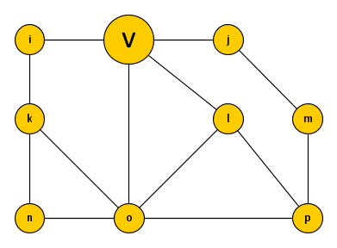
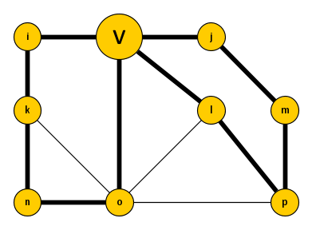
Odd flowers for detecting 2-essential vertices for OCT
For an undirected graph $G$ and vertex $v$, an odd $v$-flower is a set of odd cycles $C_{1},…, C_{p}$ containing $v$ such that $V\left(C_{i}\right)∩V\left(C_{j}\right)=\{v\}$ for $1≤i<j≤p$
The odd cycles $C_{1},…, C_{p}$ are the petals of the odd $v$-flower
If a minimum odd cycle transversal in $G$ has size $k$, and there is an odd $v$-flower with $k+1$ petals, then every minimum OCT in $G$ contains $v$.

Slide 30
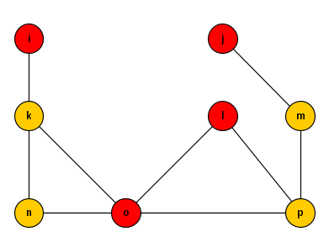
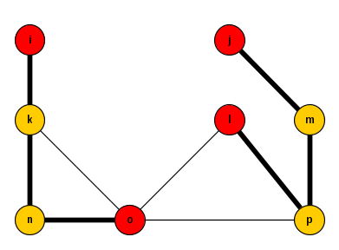
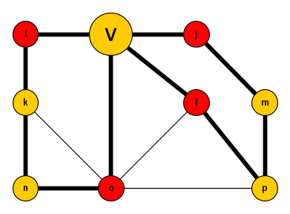
Computing odd $v$-flowers
A maximum odd $v$-flower can be computed in polynomial time, by reduction to matching from [Geelen, Gerards, Reed, Seymour & Vetta @ JCTB ’02]
Let $G$ be an undirected graph and $T⊆V\left(G\right)$ A $T$-path is a simple path ending in distinct vertices of $T$
A $T$-path is odd if it has an odd number of edges
$C_{1},…, C_{p}$ is an odd $v$-flower in $G$
$$⇔$$
$C_{1}−v,…, C_{p}−v$ are vertex-disjoint odd $T$-paths in $G−v$ for $T=N_{G}(v)$

Slide 31
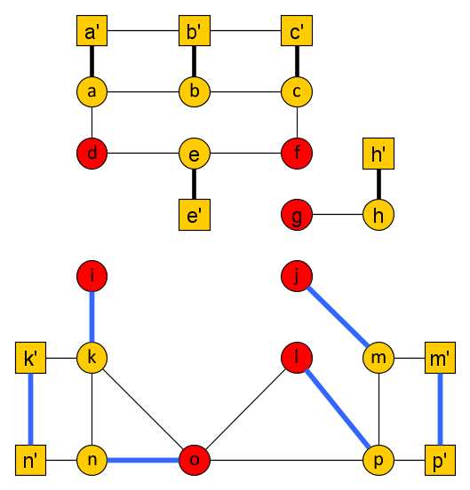
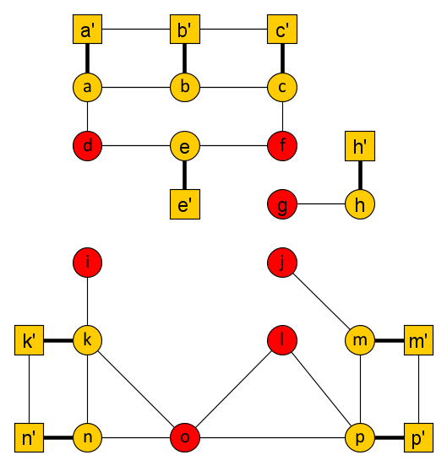
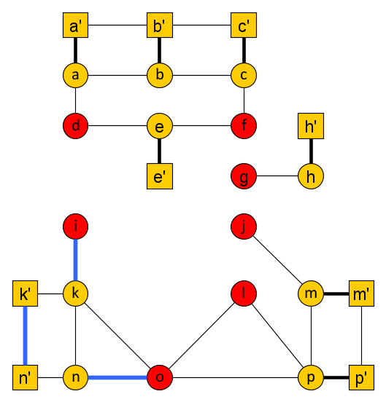
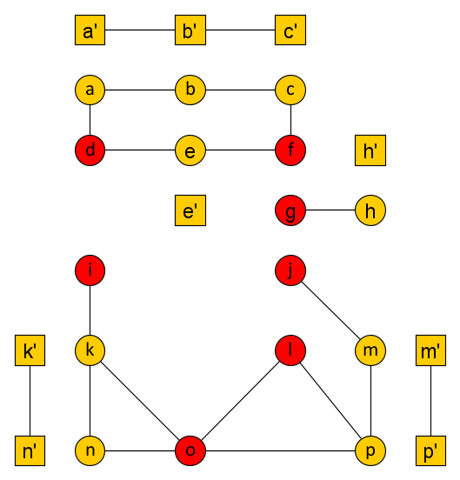
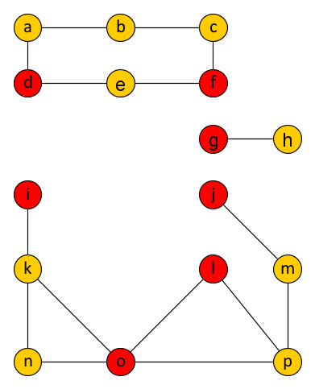
Packing odd $T$-paths in a graph $G$
Given $G$ and $T⊆V(G)$, construct graph $G′$:
Take the disjoint union of $G$ and $G−T$
For each $u∈V\left(G\right)∖T$, insert an edge between its two copies in $G′$
$(⇒)$ there is a matching $M_{0}$ of size $\left|V\left(G\right)∖T\right|$, matching each $u∈\left|V\left(G\right)∖T\right|$to copy $u′$
odd $T$-paths yield $M_{0}$-augmenting paths
$G$ has a packing of $k$ odd $T$-paths $⇔$ $G′$ has a matching of size $\left|V\left(G\right)∖T\right|+k$
Notes:
If you have vertex-disjoint odd $T$-paths: you can augment separately over each of them, so the matching becomes $k$ larger.

Slide 32
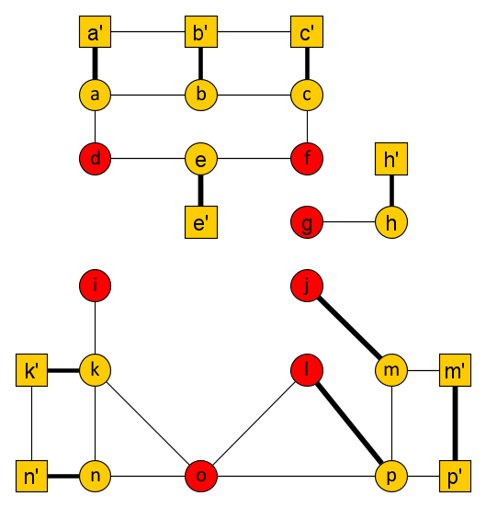
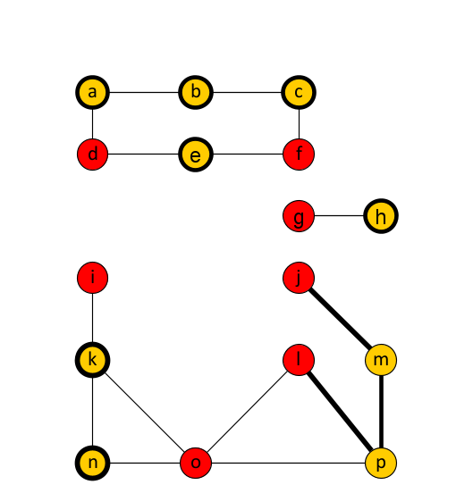
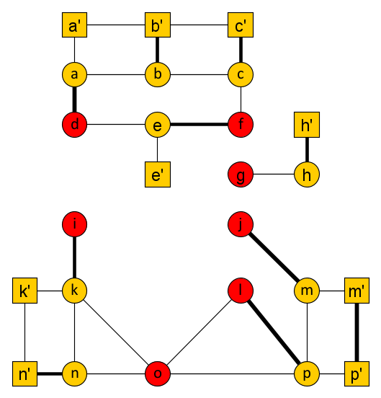
Packing odd $T$-paths in a graph $G$
Given $G$ and $T⊆V(G)$, construct graph $G′$:
Take the disjoint union of $G$ and $G−T$
For each $u∈V\left(G\right)∖T$, insert an edge between its two copies in $G′$
$(⇐)$ $∃$matching $M_{1}$ of this size saturating all vertices of $V\left(G\right)∖T$ and their copies
project matching edges back to $G$ to find collection of $k$ odd $T$-paths
$G$ has a packing of $k$ odd $T$-paths $⇔$ $G′$ has a matching of size $\left|V\left(G\right)∖T\right|+k$
Notes:
Nontrivial paths in the projection can only end in $T$, since all other vertices have both copies matched. If a path of the projection has $ℓ$ internal vertices, it is the projection of $ℓ+1$ matching edges. For each $T$-path in the projection, the matching size is 1 larger than the number of nonterminals involved in the path. Since the matching size is $k$ larger than the number of nonterminals, the projection has $k$ odd $T$-paths.

Slide 33
Covering odd $T$-paths in a bipartite graph $G$
If the graph $G$ is bipartite, then so is $G′$
For bipartite graphs $G$:
$G$ has a maximum packing of $k$ odd $T$-paths $⇔$ $G′$ has a max. matching of size $\left|V\left(G\right)∖T\right|+k$ $$⇔$$
$G′$ has a min. vertex cover of size $\left|V\left(G\right)∖T\right|+k$ $$⇔$$
$G$ has a hitting set for odd $T$-paths of size $k$
Notes:
To see $G^{′}$ is bipartite: any closed walk in $G$’ traverses an even number of edges between copies, since it has to end in the same half of the graph as it starts. Hence any closed walk in $G′$ translates to a closed walk of the same parity in $G$ by omitting the edges between copies. Since $G$ is bipartite and has no odd closed walks, neither does $G′$.
To get the hitting set: take a vertex cover $S$ of$G′$, let the hitting set consist of all vertices of $S∩T$ and all vertices of $S∖T$ for which $S$ contains both copies. Since any vertex cover spends $|V\left(G\right)∖T|$ vertices covering edges between copies, this yields a set of size at most $k$.
Another way to see this statement on bipartite graphs: something is an odd $T$-path if and only if it connects a terminal in one partite set to a terminal in the other. So this is Menger’s theorem in the bipartite graph.

Slide 34
Erdős-Pósa property for odd cycles in near-bipartite graphs
If $G$ is bipartite, then:
Recall the relation between odd $v$-flowers in $G$ and odd $N_{G}\left(v\right)$-paths in $G−v$
For a graph $G$ and vertex $v$ for which $G−v$ is bipartite, we obtain:
(No Erdős-Pósa relation holds for covering versus packing odd cycles in general)
maximum size of a packing of vertex-disjoint odd $T$-paths
=
minimum size of a hitting set for all odd $T$-paths
maximum size of an odd $v$-flower in $G$
=
minimum size of a $v$-avoiding hitting set for all odd cycles (through $v$)
Notes:
This equality, together with the polynomial-time algorithm to compute maximum odd $v$-flowers in general, will lead to an algorithm to detect 2-essential vertices for OCT. Escher wall rules out statement of the form ‘OCT of size $f(k)$ or packing of $k$ odd cycles’. Similar statement is true for chordal graphs: no linear covering vs packing in general, but linear for covering versus packing holes avoiding v when $G−v$ is chordal.

Slide 35
2-essential detection for Odd Cycle Transversal
$2$-Essential Detection for Odd Cycle Transversal Input: A graph $G$ and integer $k$ Output: A vertex set $S$ such that:
1) If $opt\left(G\right)≤k$, then some optimal odd cycle transversal contains $S$, and 2) If $opt\left(G\right)=k$, then $S$ contains all $2$-essential vertices.
Given $G$ and $k$, the algorithm initializes $S=∅$ and proceeds as follows:
For each $v∈V(G)$, compute a maximum odd $v$-flower $C_{1},…, C_{p}$ in $G$
If the odd flower has $p>k$ petals, then add $v$ to $S$
Output the resulting set $S$
Notes:
Recall that 2-essential = contained in all 2-approximations. Easy to see that (1) holds. Why does (2) hold?

Slide 36
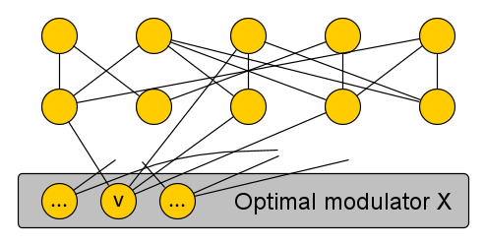
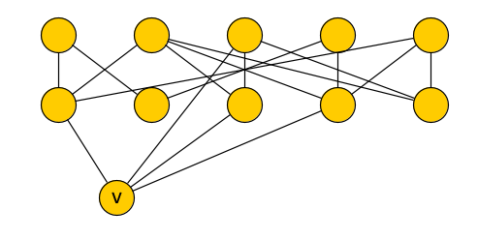
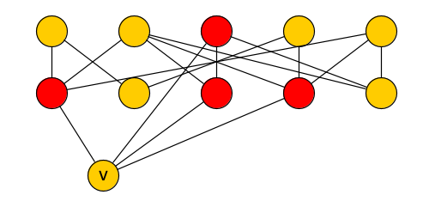
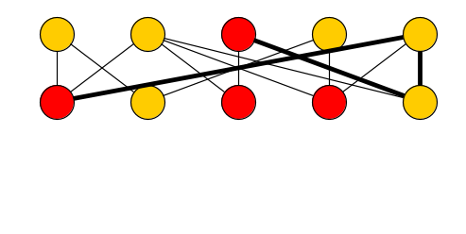
2-essential detection for Odd Cycle Transversal
$2$-Essential Detection for Odd Cycle Transversal Input: A graph $G$ and integer $k$ Output: A vertex set $S$ such that:
1) If $opt\left(G\right)≤k$, then some optimal odd cycle transversal contains $S$, and 2) If $opt\left(G\right)=k$, then $S$ contains all $2$-essential vertices. If $v∉S$, then a maximum odd $v$-flower in $G$ has at most $k$ petals
$2$-Essential Detection for Odd Cycle Transversal can be solved in polynomial-time.
The only reason a vertex $v$ is 2-essential for odd cycle transversal on $G$, is that $v$ is at the center of an odd flower with more than $opt(G)$ petals.
If $opt\left(G\right)=k$, the union of these sets of size at most $k$:
$X∖\left\{v\right\}$
hitting set for odd cycles through $v$ in $G−(X∖\left\{v\right\})$
is a 2-approximation in $G$ avoiding $v$
Notes:
This concludes the discussion of essential vertices for search space reduction.

Slide 37
search-space reduction via antlers and simple witnesses

Slide 38
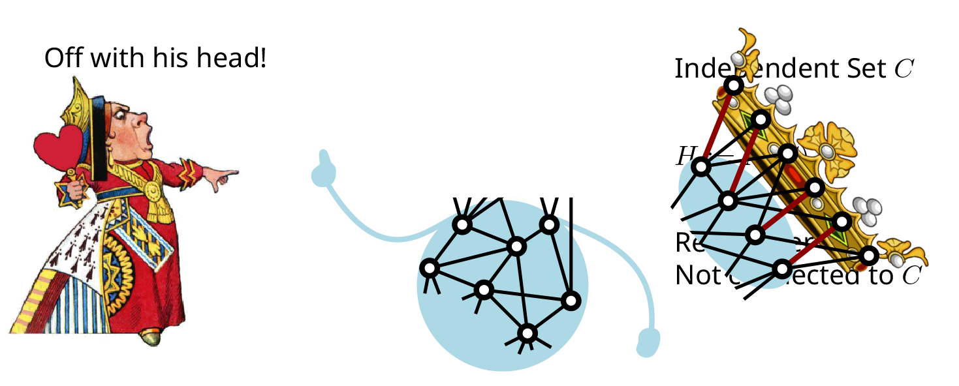
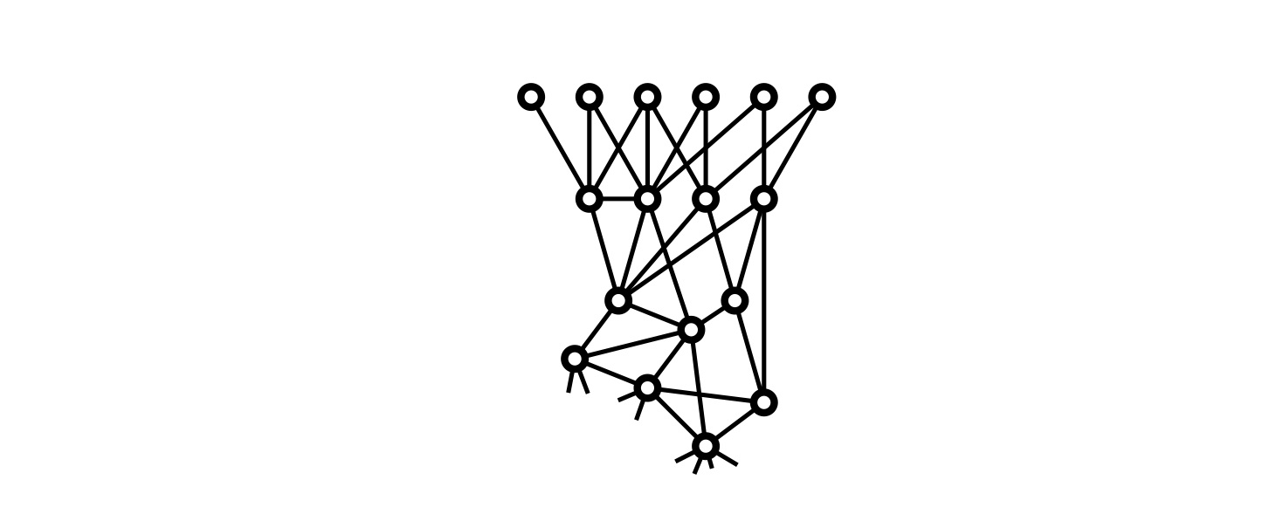
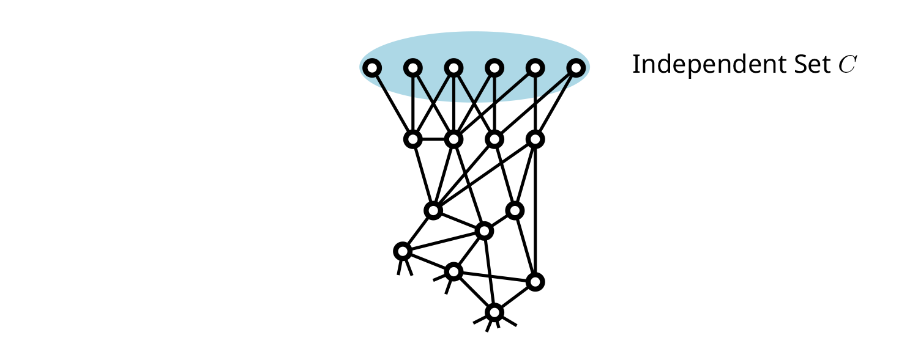
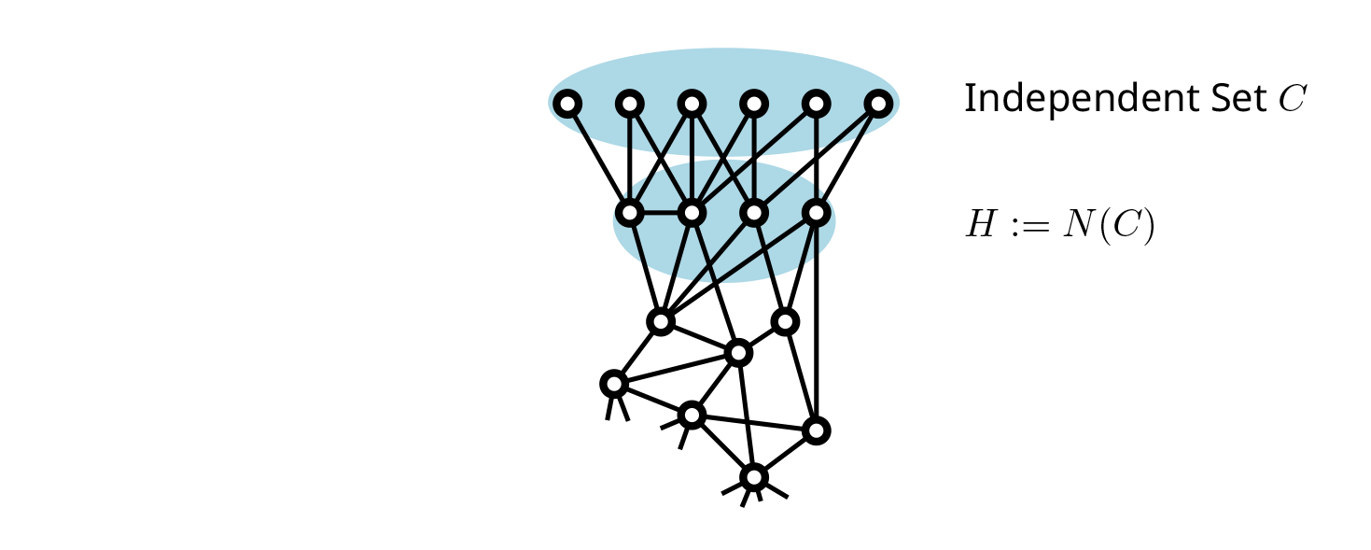
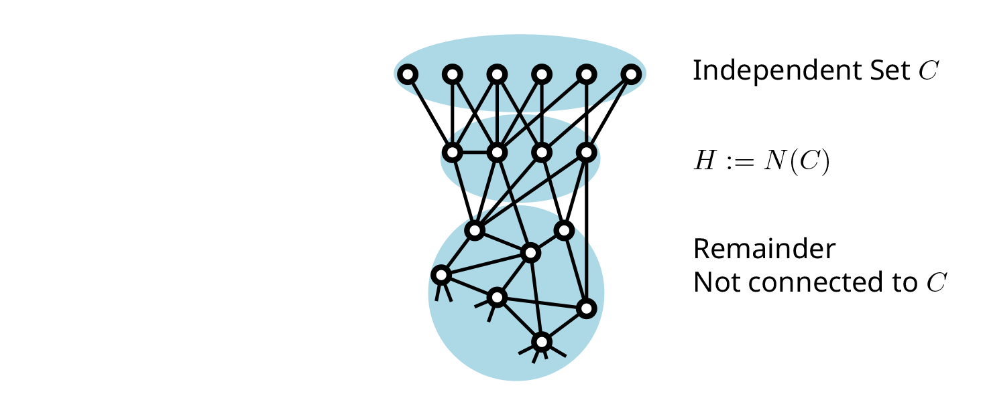
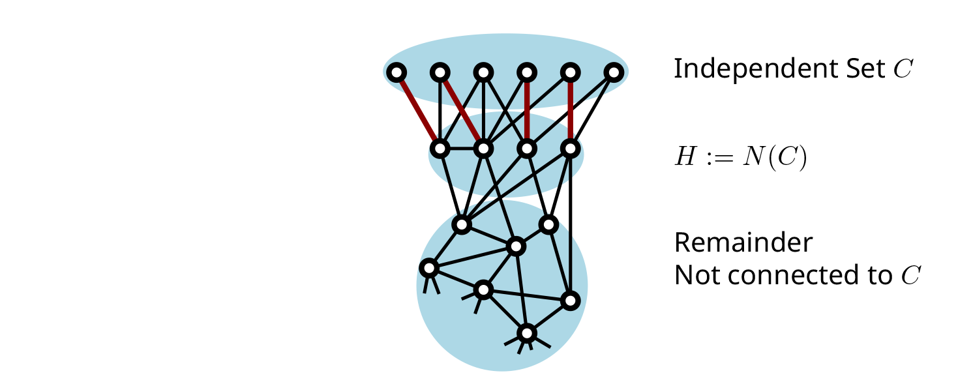
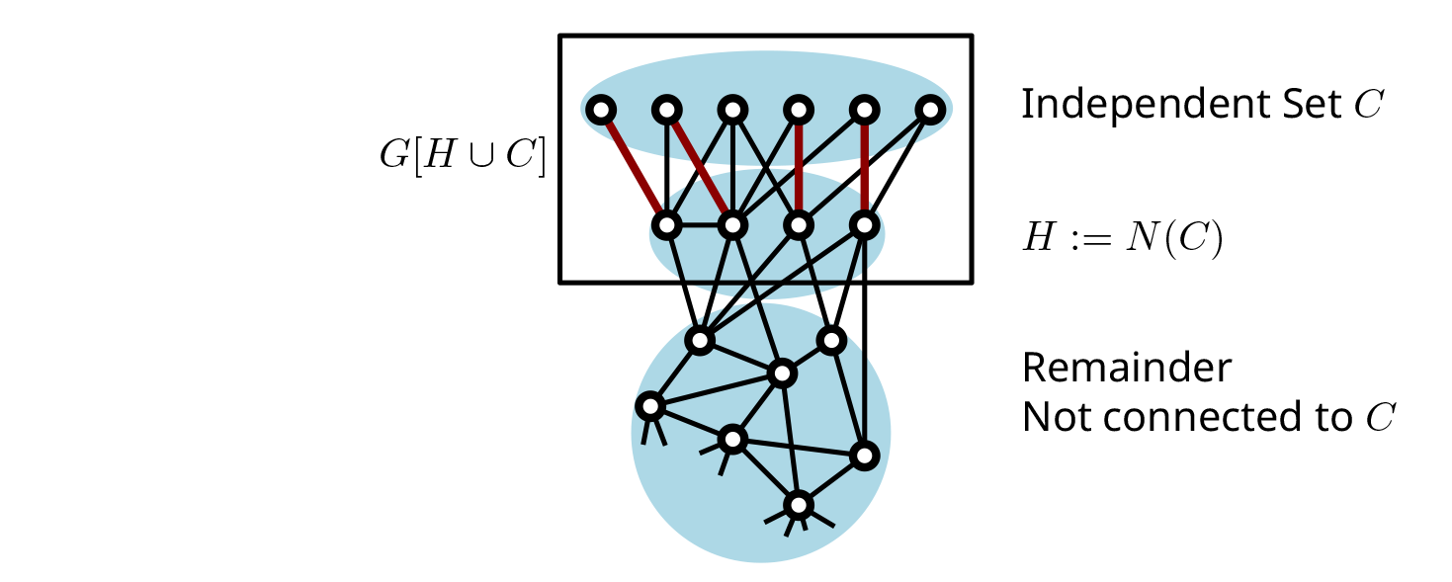
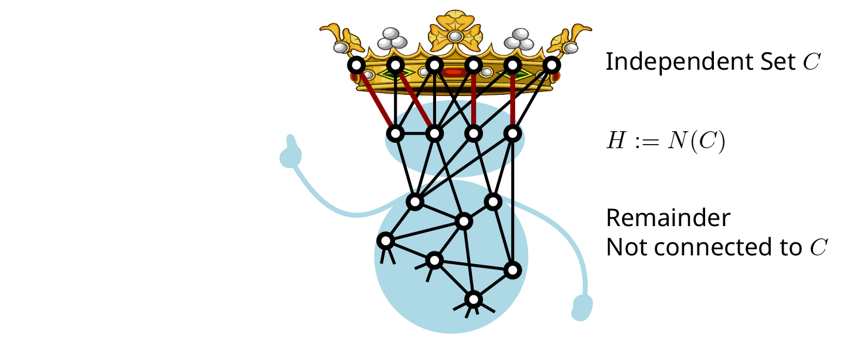
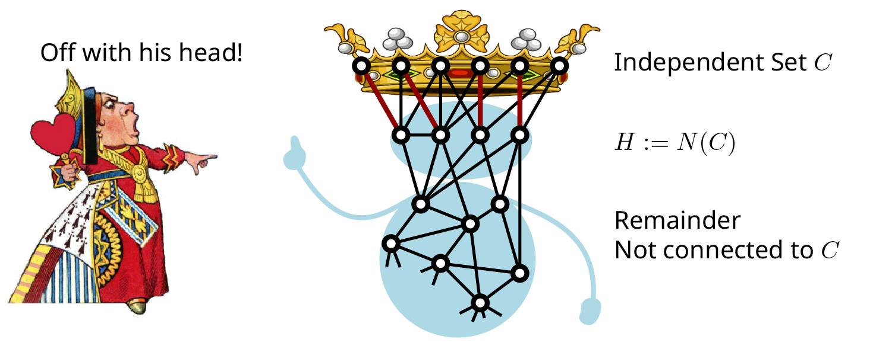
Crown reduction for Vertex Cover
Off with his head!
Matched into $C$
There is an optimal vertex cover in $G$ containing $H$:
Any vertex cover contains $|H|$ vertices from $G[H∪C]$ to cover the matching
For any vertex cover $X$, we can replace $X∩(H∪C)$ by $H$ to get another vertex cover ($C$ is independent and not connected to the remainder)
Notes:
So the decomposition provides a simple witness for the fact that some optimal solution contains $C$. It turns out that, whenever there are vertices that have a certificate for membership in an optimal solution of this form, we can find them efficiently: crowns can be found in polynomial time. Does this extend to other problems?

Slide 39
A crown decomposition forms a simple witness
The crown decomposition witnesses that some optimal solution contains $H$
If an input graph $G$ for Vertex Cover has a vertex with such a simple certificate, a polynomial-time algorithm can find a vertex of an optimal solution Crown decompositions can be found in polynomial time
Can we build a framework of search-space reduction out of this?
If there is a vertex with a simple certificate of its membership in an optimal solution, can such a vertex by found by an efficient preprocessing algorithm?
There is an optimal vertex cover in $G$ containing $H$:
Any vertex cover contains $|H|$ vertices from $G[H∪C]$ to cover the matching
For any vertex cover $X$, we can replace $X∩(H∪C)$ by $H$ to get another vertex cover ($C$ is independent and not connected to the remainder)
Notes:
So the decomposition provides a simple witness for the fact that some optimal solution contains $C$ (but generally not all).

Slide 40
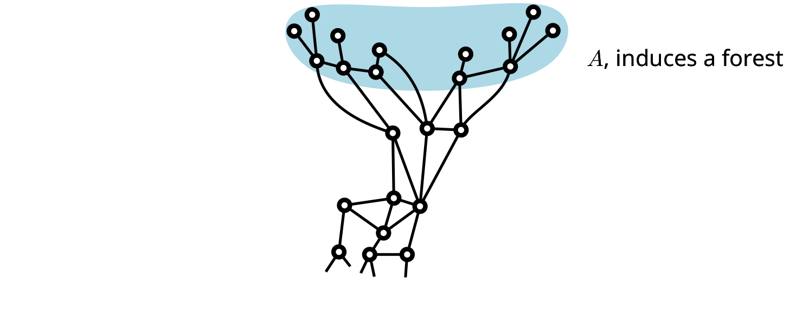
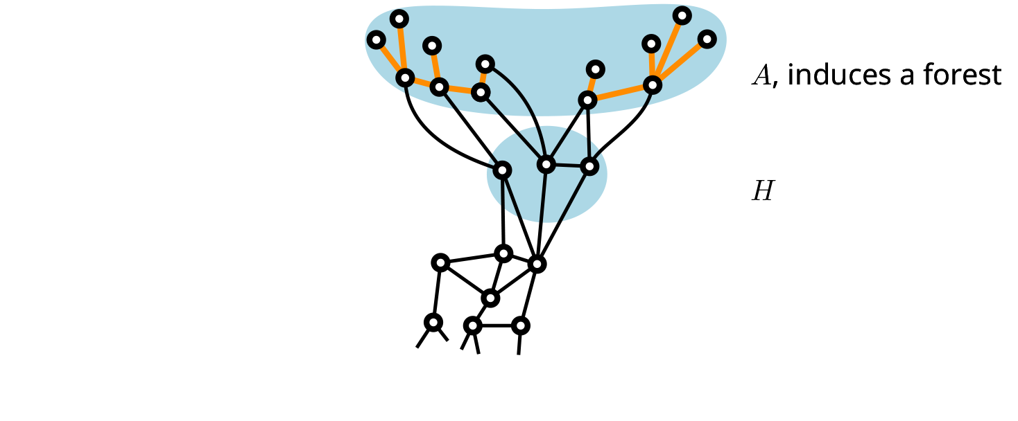
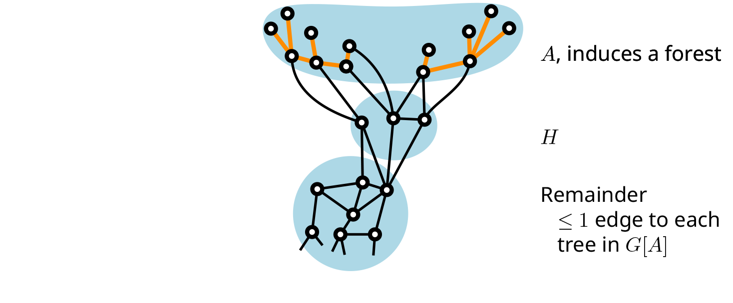
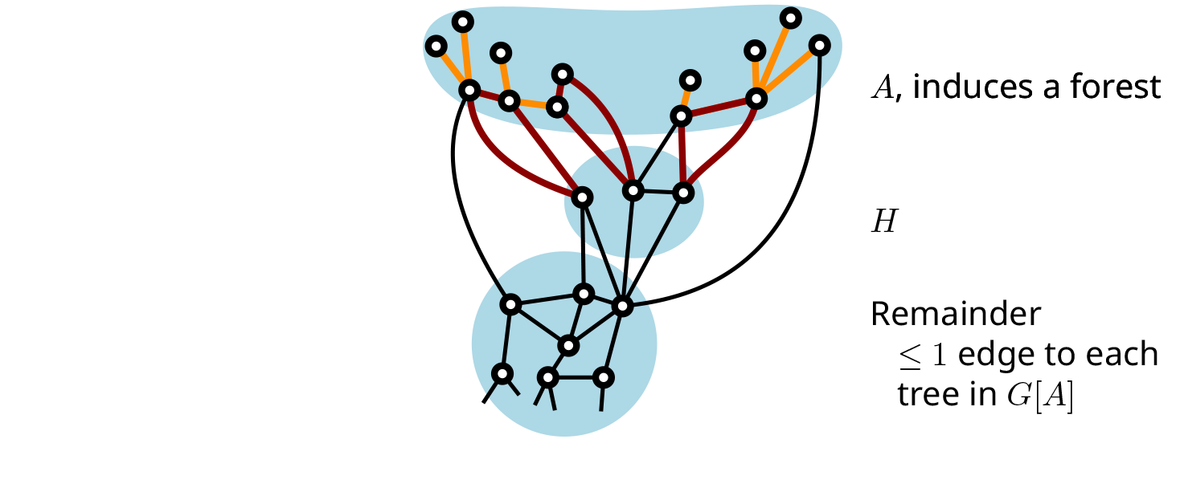
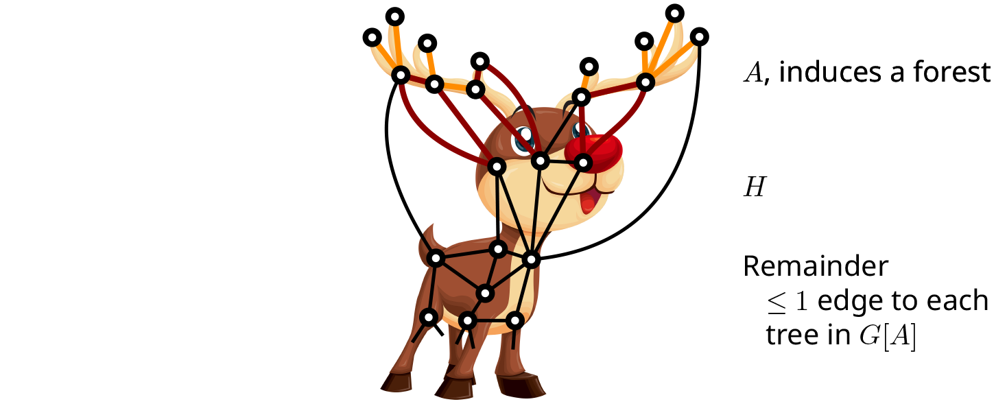
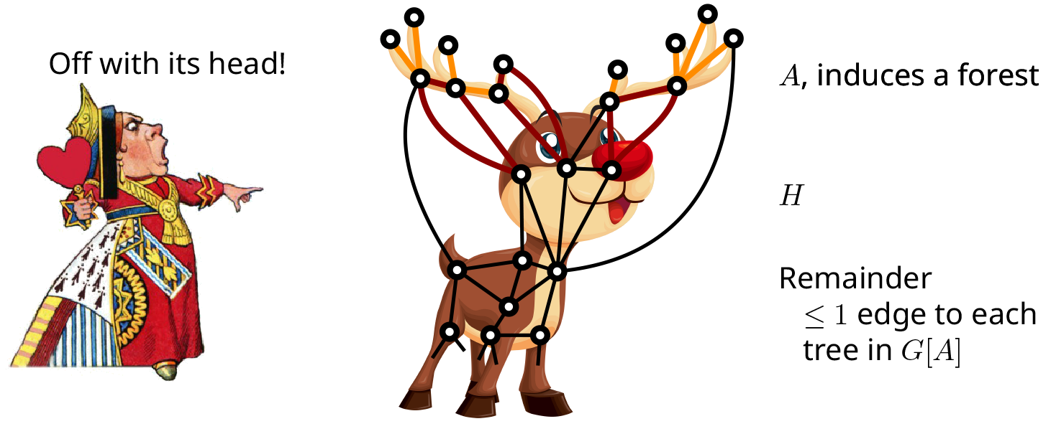
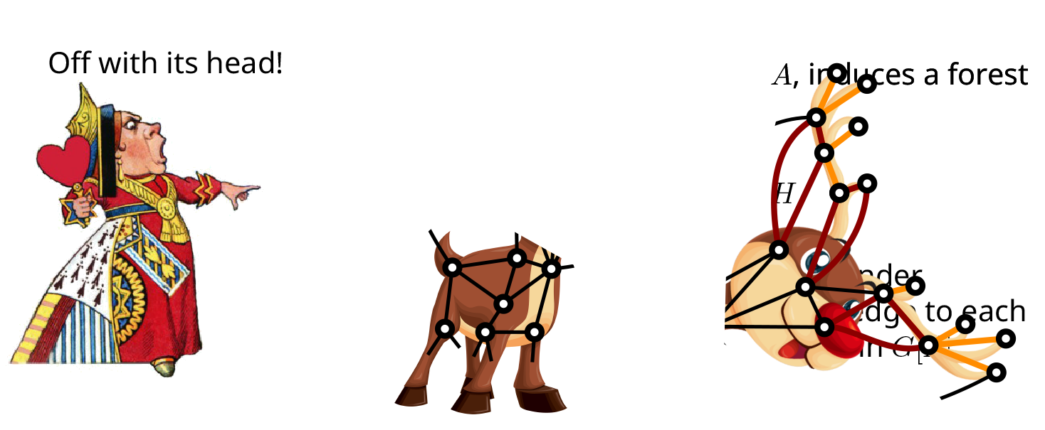
Antler reduction for Feedback Vertex Set
Off with its head!
$|H|$ vertex-disjoint cycles in $G[H∪A]$
There is an optimal feedback vertex set in $G$ containing $H$:
Any feedback vertex set contains $|H|$ vertices from $G[H∪A]$ to hit the $|H|$ cycles
For any feedback vertex set $X$, we can replace $X∩(H∪A)$ by $H$ to get another one ($A$ induces a forest and all cycles passing through it intersect $H$)
Notes:
Definition of Antler.

Slide 41
Search-space reduction by detecting antlers
Unlike crowns, antler decompositions cannot be found in polynomial time
Difficulty caused by the fact that the following problem is NP-hard:
Input: A graph $G$ and packing of $k$ vertex-disjoint cycles in $G$ Question: Does $G$ have a feedback vertex set of size $k$?
Analogous task for Vertex Cover is polynomial-time solvable (is the vertex cover number equal to the size of a maximum matching?)
But: we can efficiently find part of an optimal FVS if there is an antler with small head
There is a $2^{O\left(k^{5}\right)}⋅n^{O\left(1\right)}$-time algorithm that, given an $n$-vertex graph $G$ and integer $k$, either:
correctly determines that $G$ does not contain an antler whose head has size at most $k$, or
outputs $S⊆V(G)$ of size at least $k$ such that some optimal feedback vertex set in $G$ contains of $S$.
[Donkers & J. ‘21]
Notes:
Algorithm based on reduction rules to reduce the size of any antler in proportion to the size of its head, followed by color-coding to detect a superset of an antler structure if one exists. Significant technical challenges due to the fact that there can be multiple antlers: how do they interact, what remains of one when you remove another? [Konig graphs]

Slide 42
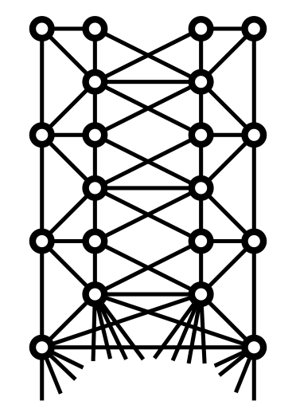
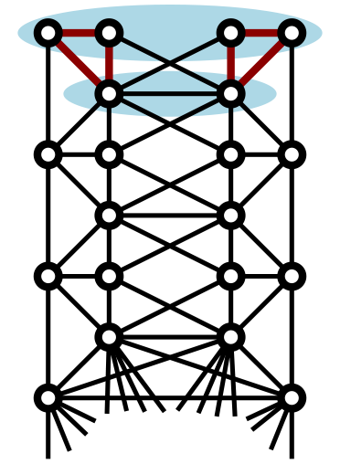
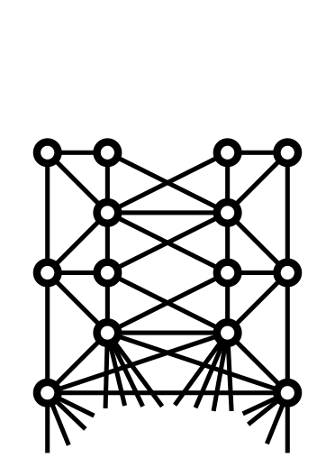
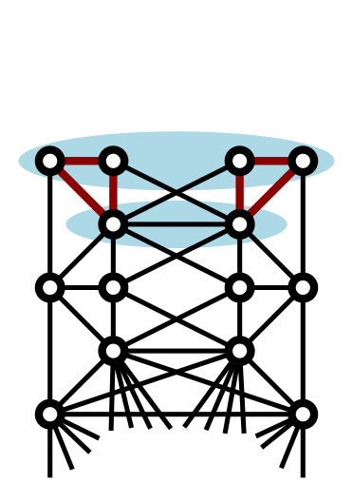
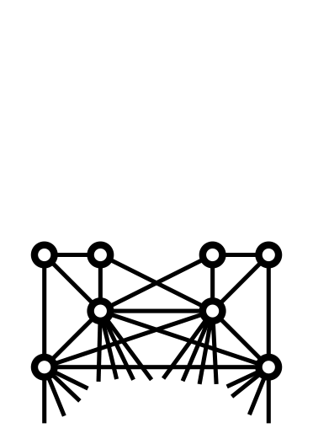
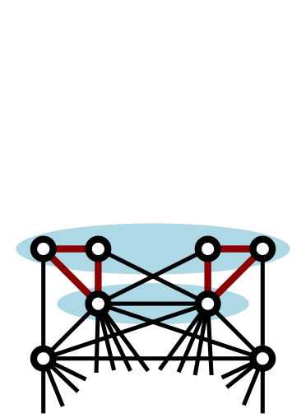
Antler reductions can cascade
Notes:
Sequence of new antlers created when old ones are removed. (Note that originally, there also was a large 1-antler containing the union, but its width is larger.)

Slide 43
Antler reductions can cascade
Through cascades, it may be possible to:
find a large optimal solution
by repeatedly extracting small antlers,
via an algorithm of small running time
Suggests an alternative complexity measure for $ℱ$-deletion problems:
smallest $k$ for which optimal solution can be built as $S_{1}∪…∪S_{t}$, such that each $S_{i}$ has a certificate of complexity $k$ for belonging to OPT in $G−\bigcup_{j<i}{S_{i}}$
Can this be made rigorous for other problems than Feedback Vertex Set?
Notes:
To make this well-defined, you have to argue there is always a solution of this form. For that, the antlers whose witness certificate is a set of disjoint cycles are not enough; we define more general types in the paper (but to find them, you pay in the exponent on $n$).

Slide 44
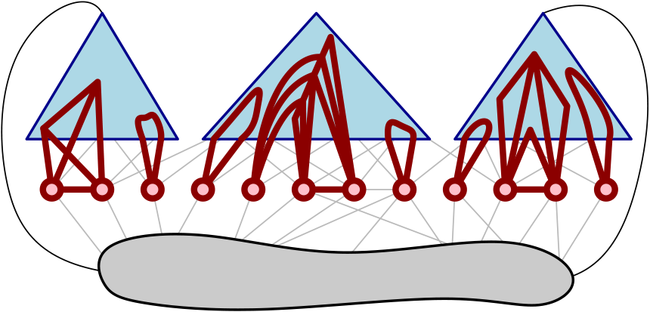
A sketch of more complicated certificates
Simplest witness: $H$ is optimal for $G[H∪A]$ because that subgraph has $|H|$ vertex-disjoint cycles,
so $G[H∪A]$ has a subgraph $G′$ for which $H$ is an optimal FVS and each component of $G′$ is a cycle
$z$-complex witness: $H$ is optimal for $G\left[H∪A\right]$, the graph $G[H∪A]$ has a subgraph $G′$ for which $H$ is an optimal FVS, and each component of $G′$ has feedback vertex number at most $z$
$$z=3$$
There is a $2^{O\left(k^{5}z^{2}\right)}⋅n^{O\left(z\right)}$-time algorithm that, given an $n$-vertex graph $G$ and integers $k≥z$, either:
correctly determines that $G$ does not contain a $z$-antler whose head has size at most $k$, or
outputs $S⊆V(G)$ of size at least $k$ such that some optimal feedback vertex set in $G$ contains of $S$.
[Donkers & J. ‘21]
Notes:
Antler complexity. $z$-antler = variation of antler where the certificate that $fvs\left(G\left[H∪A\right]\right)≥|H|$ has complexity $z$. This concludes our discussion of antlers; now some open problems and then we finish.

Slide 45
Open problem: Antlers with a head of size 2
Antlers with a head of size 1 can be detected in linear time: standard reduction rules reduce them to a degree-3 vertex with a double-edge
Can antlers with a head of size 2 be detected in linear time?
Notes:
More generally: what is the largest width of antler that you can detect in linear time? Can you prove lower bounds based on fine-grained hypotheses?

Slide 46
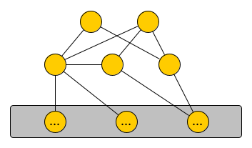
Open problem: generalized crowns
Can the following task be solved in time $f\left(k\right)⋅n^{O\left(1\right)}$?
Generalized Crown Input: A graph $G$ and integer $k$ Output: If there exists an independent set $I$ such that:
the set $C≔N_{G}(I)$ is a minimum vertex cover for $G[C∪I]$ of size at most $k$,
then output a vertex $v$ that belongs to a minimum vertex cover of $G$
$$I$$
$$C$$
$$R$$
Notes:
The running time cannot be polynomial in $k$, because it would allow vertex cover to be solved in polynomial time. Note that if $I$ exists, then $C$ is part of an optimal vertex cover; the statement of the problem is slightly more relaxed since it also allows you to output a different vertex that belongs to OPT. Note there is no crown structure to witness that $C$ is part of an optimal solution: the edge between the members of $C$ is crucial here. The vertex cover number of $G[C∪H]$ is at least 3 because it contains $K_{3}+K_{2}$.

Slide 47
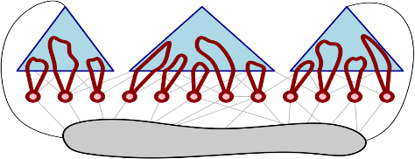
Conclusion
Kernelization is a beautiful concept for the study of polynomial-time data compression
To understand how preprocessing gives exponential speed-ups, data compression alone is not sufficient; search-space reduction is vital
Case studies for rigorous search-space reduction:
Which theoretical questions should we ask to find practical preprocessing algorithms?
?
essential vertices
simple certificates
Notes:
Can we extend the scope of these first two case studies? Apply the notion of essential elements beyond vertex-subset minimization problems? Apply ideas on finding parts of solutions for which there are simple certificates, beyond FVS? Experiment with these ideas in practice! Other ways to formulate rigorous search-space reduction, based on the stability of optimal solutions?

