Slide 1
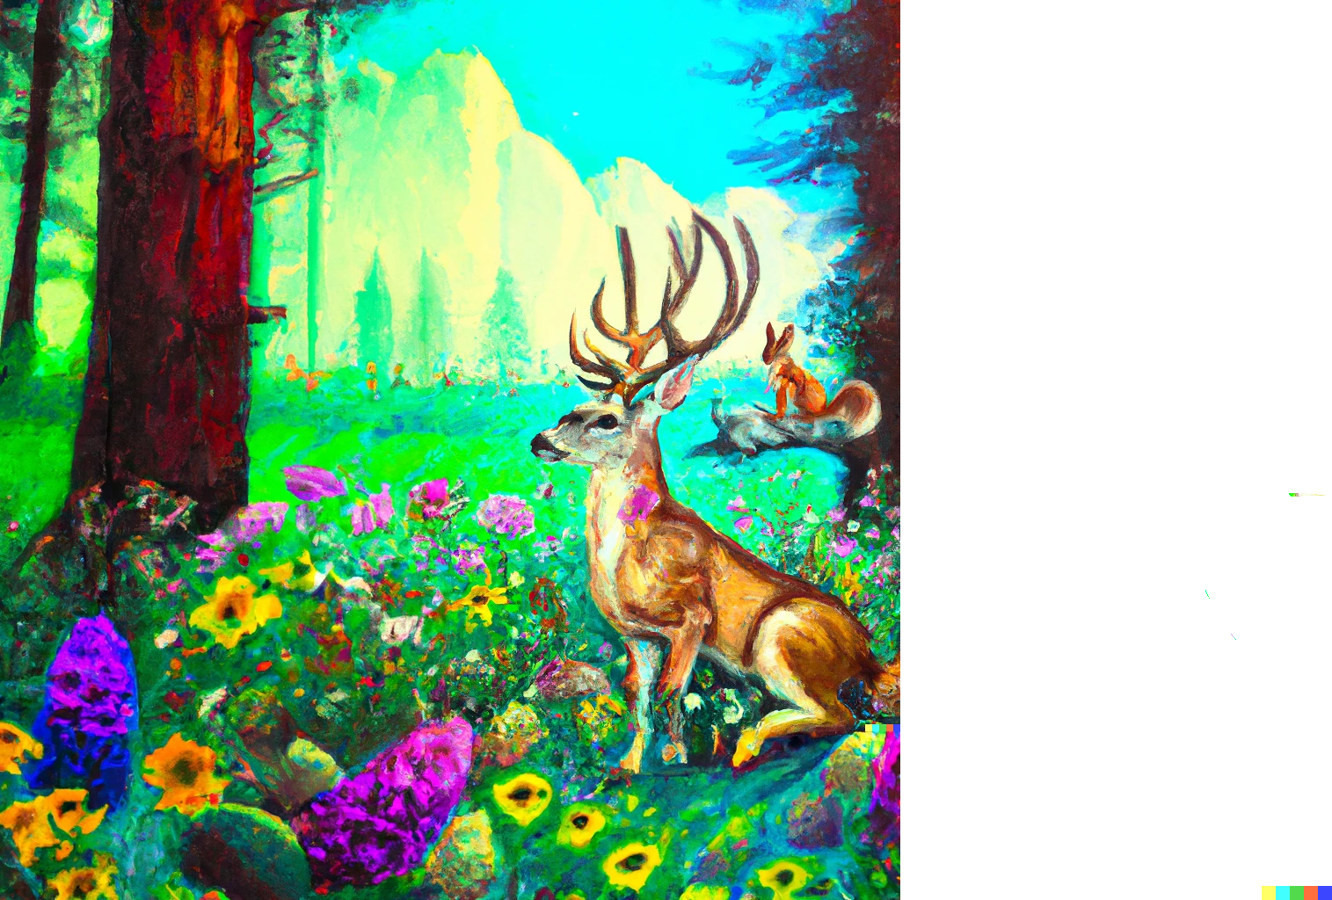

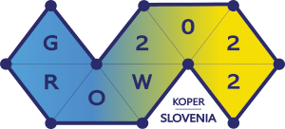
Search-Space Reduction Beyond Kernelization
Bart M. P. Jansen
based on joint work with:
Huib Donkers / Benjamin Bumpus & Jari de Kroon
10th Workshop on Graph Classes, Optimization, and Width Parameters - GROW 2022
September 20th 2022, Koper, Slovenia
Notes:
Painting credit due to OpenAI’s Dall-E. Throughout the talk we will see the meaning of the squirrel, the antlers, and the flowers. July 2020: first invitation for this talk. This will be a big-picture type of talk; so let’s see a big picture.

Slide 2
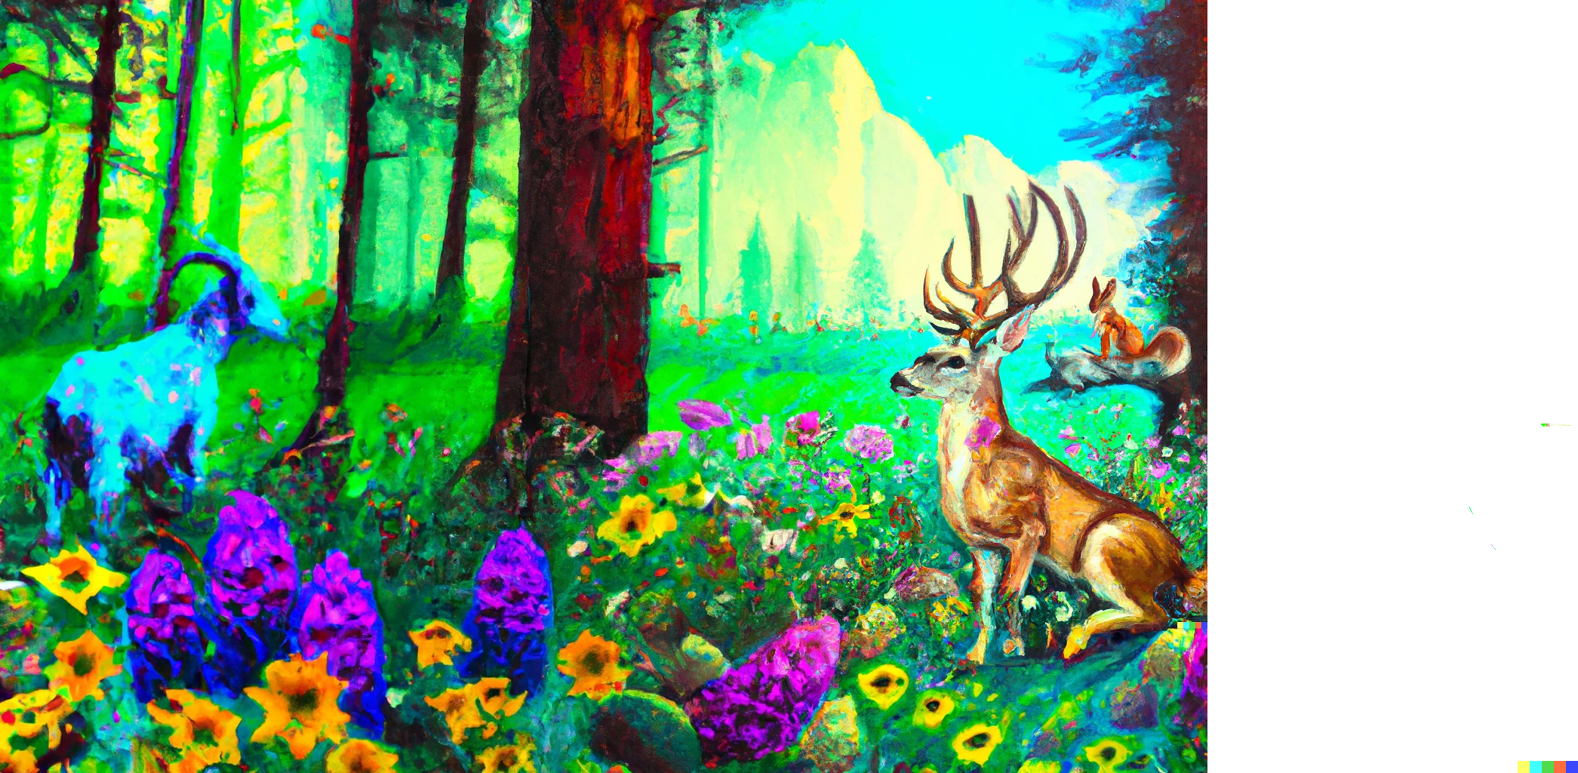
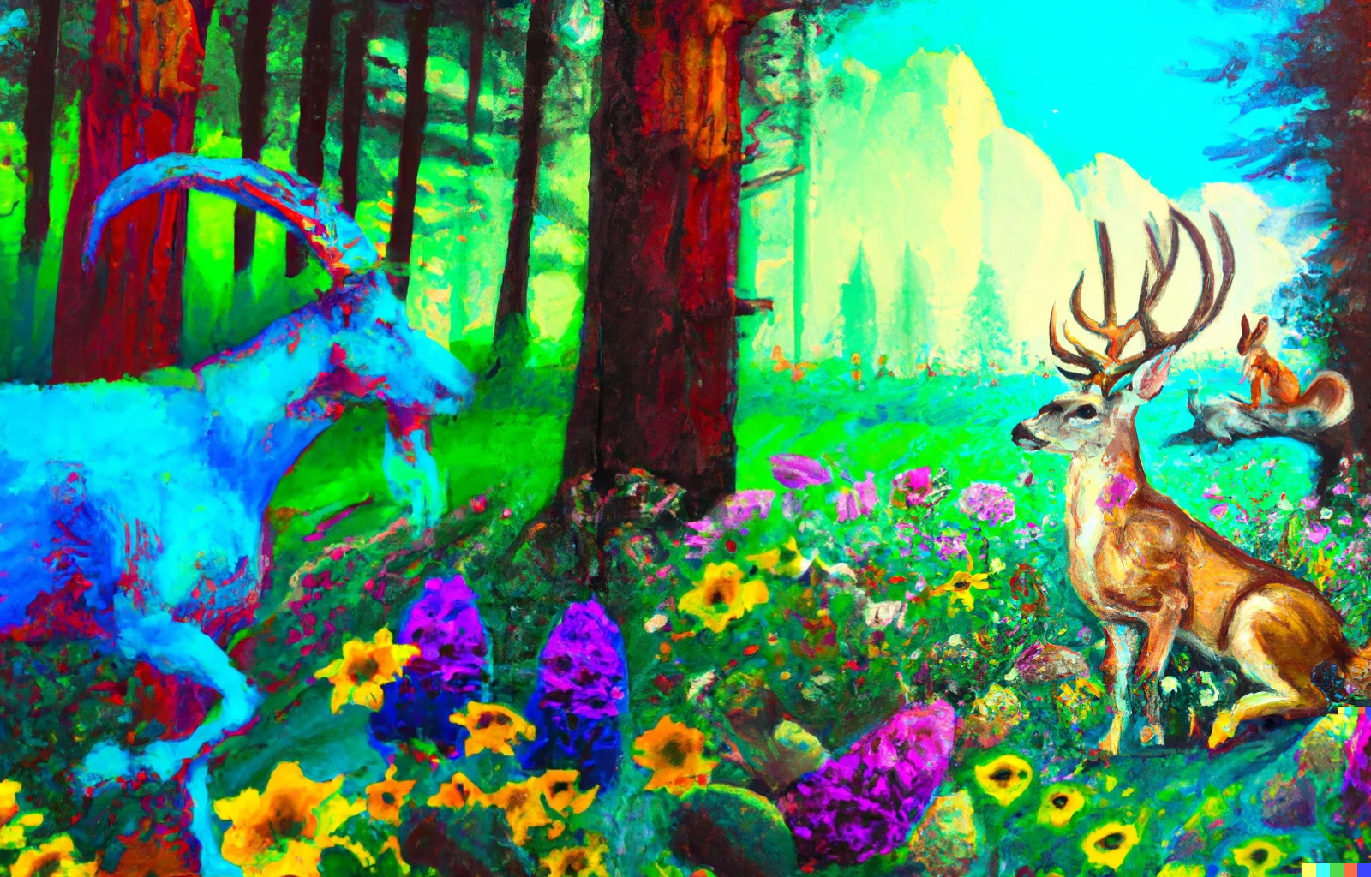

Slide 3
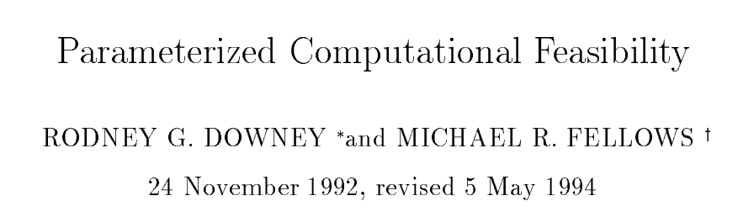
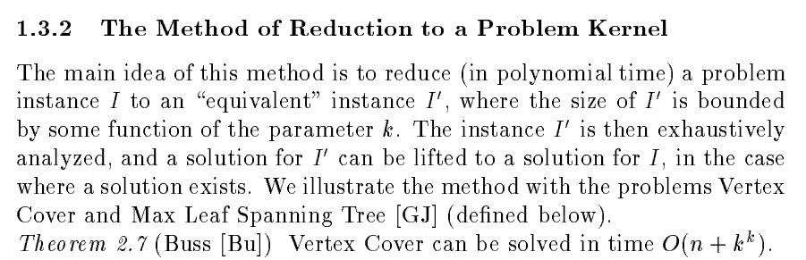


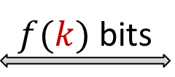
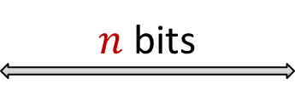
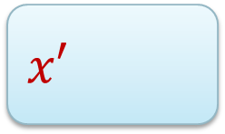
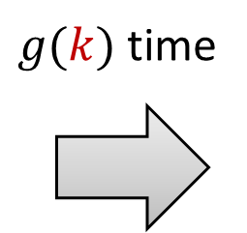

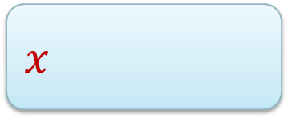



Yes
No
$n$ bits
$f(k)$ bits
$$x$$
$n^{O\left(1\right)}$ time
$$x′$$
$g(k)$ time
$$k$$
$$k′$$
Kernelization originated as a method to obtain FPT algorithms
Notes:
In this paper, Downey and Fellows presented the method of reduction to a problem kernel for the first time as a systematic approach to obtaining FPT algorithms. They gave two examples: the quadratic kernelization for Vertex Cover due to Sam Buss, and a quadratic kernel for Max Leaf Spanning Tree that they developed.
Instead of saying YES/NO: in practice, you solve the kernel and translate the solution back to the original input.
---
Later on, lots of effort was invested in finding the best-possible bounds on the size of the reduced instance. The name kernelization comes from the analogy to the actions of a squirrel: we unwrap the boring ‘outer shell’ of the problem to leave only the juicy core or kernel, which contains the information needed to get the answer.

Slide 4
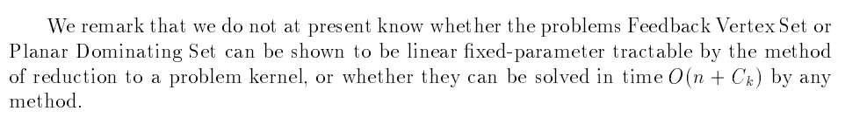

Notes:
In 2002: Planar Dominating Set kernel.

Slide 5
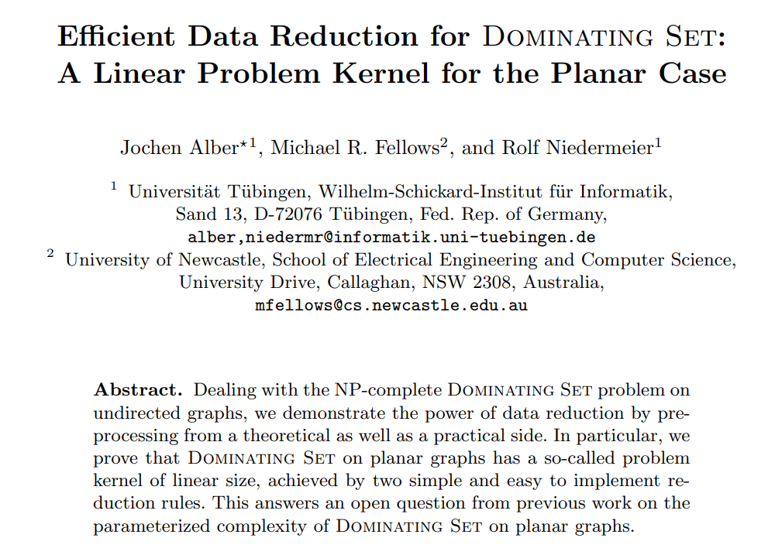
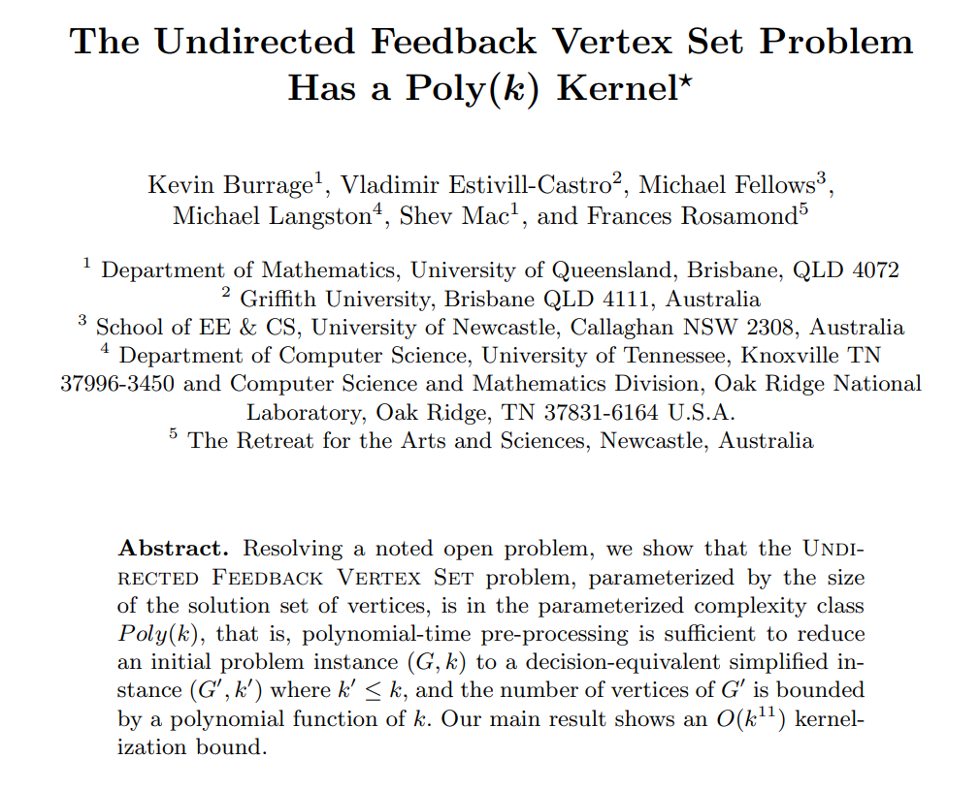
SWAT 2002
IWPEC 2006
Experiments showed great speed-ups through kernelization
Notes:
Already knew FVS (graph minors) and Planar DomSet (SWAT 2000) to be FPT at the time.

Slide 6
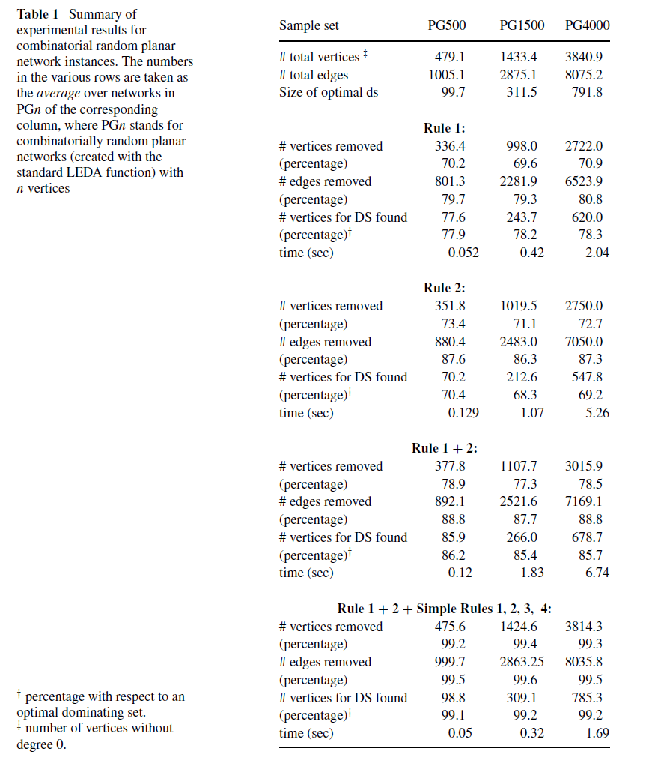
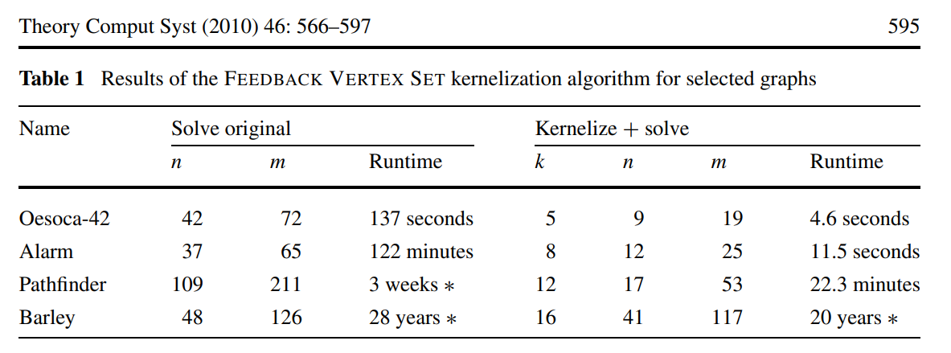










[Alber 2002]
[Bodlaender & van Dijk @TCS‘08]
Experiments showed great speed-ups through kernelization
Notes:
Cubic kernel by Hans. The Planar DomSet kernel was also very effective; we’ll get back to that in a second.

Slide 7
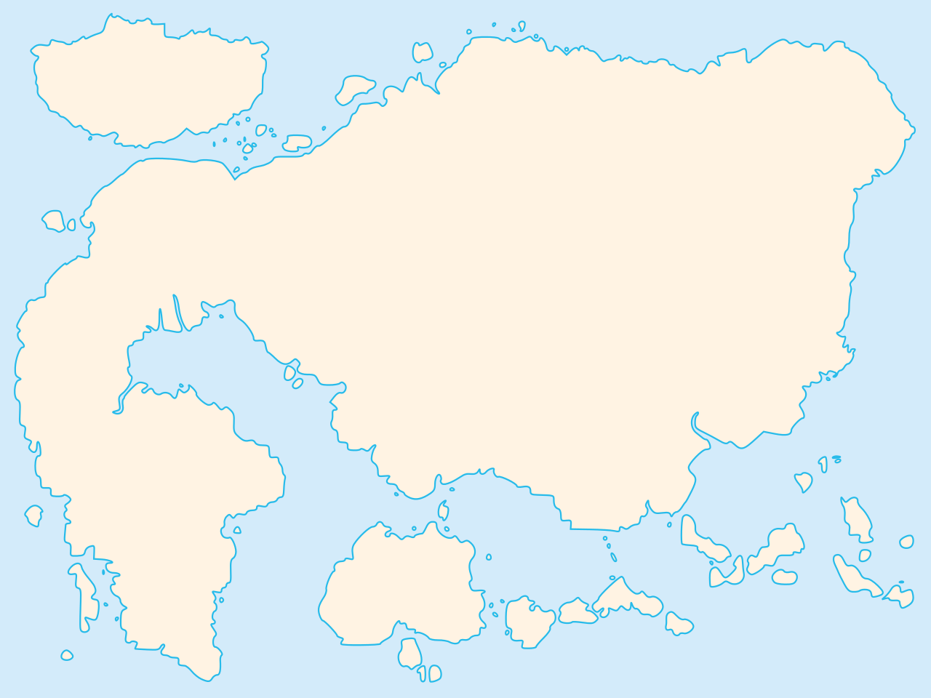
Map of polynomial-time computation
Kernelization
Primality
testing
The lost continent of polynomial time
Network flows
Sorting
Parsing
context-free grammars
Fast Fourier transform
Shortest paths
Longest common
subsequence
Approximation
Islands of
minor-testing
Notes:
Survey talk by Mike during the same IWPEC where the first polynomial kernel for FVS was presented. The striking realization that there are polynomial-time algorithms that hold provable power over NP-hard problems, without actually solving them.

Slide 8

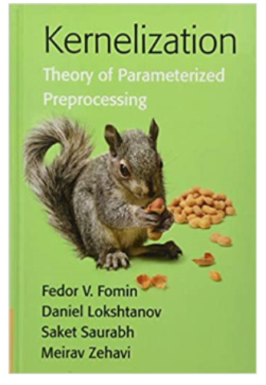

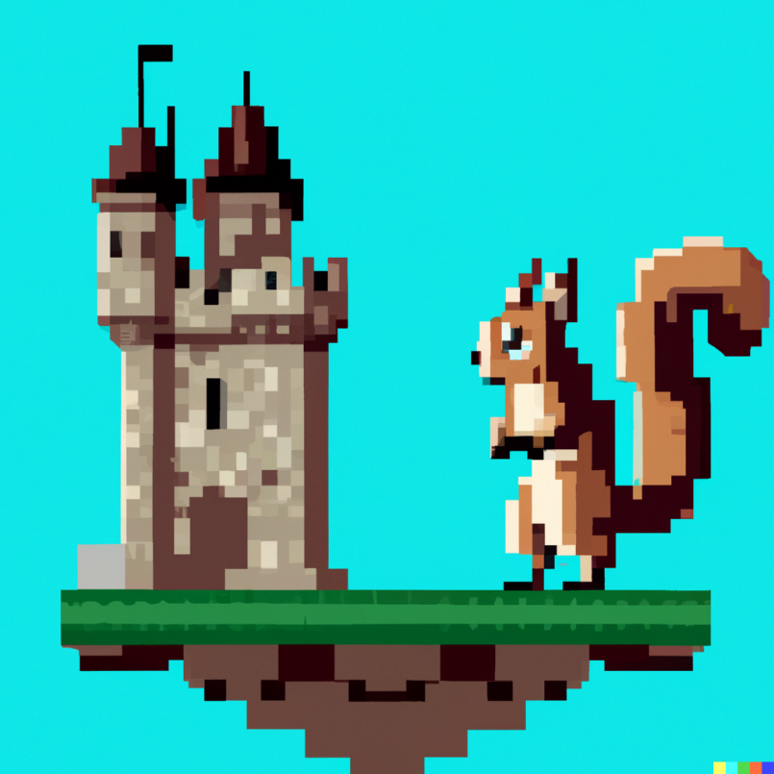
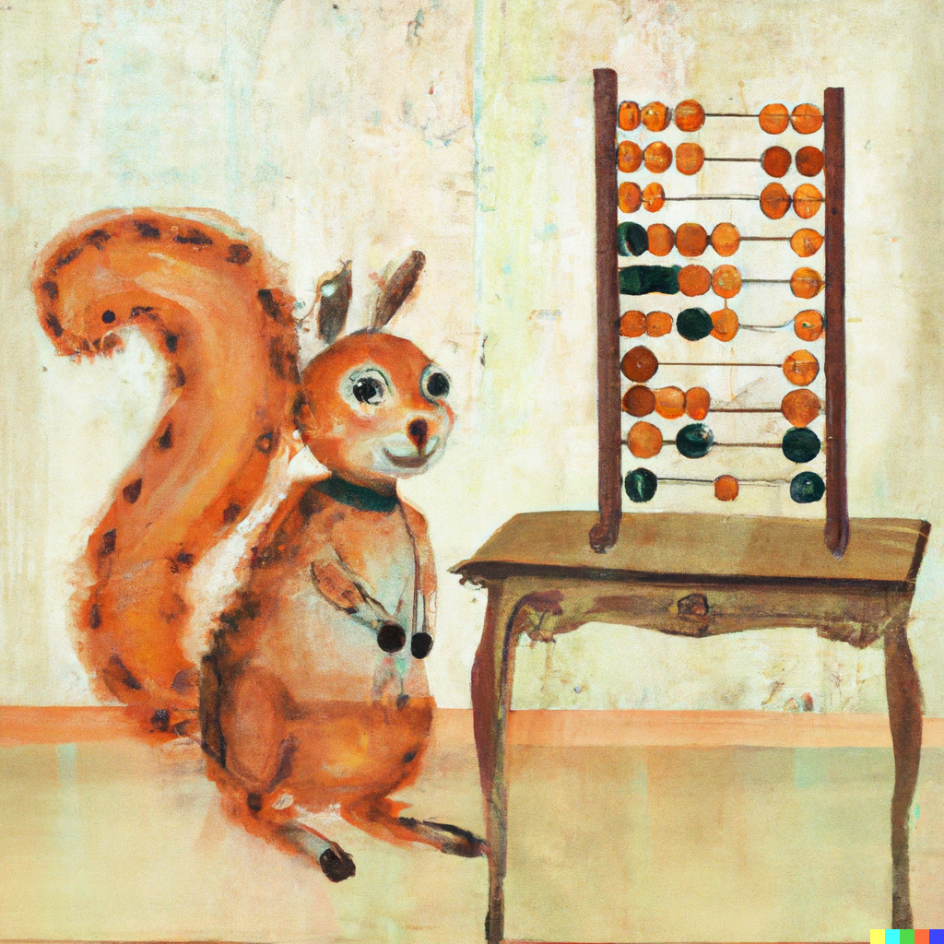
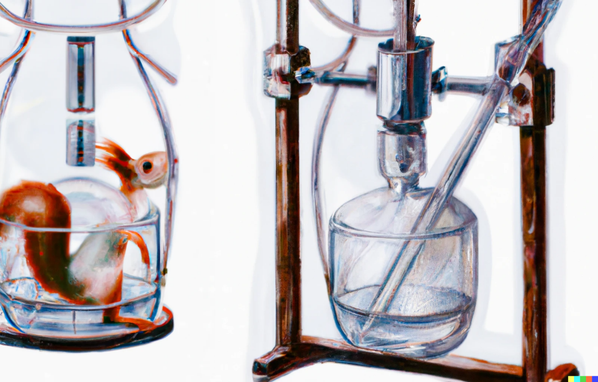
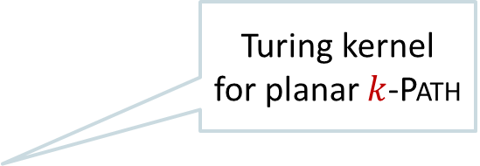
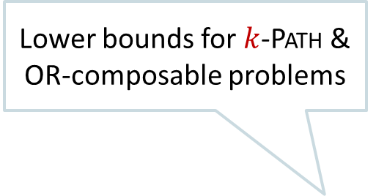
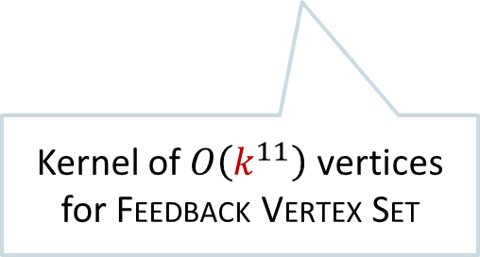
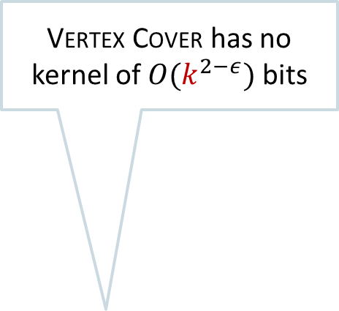
Timeline of kernelization research
[Dell & van Melkebeek]
Vertex Cover has no kernel of $O(k^{2−ε})$ bits
[Downey & Fellows]
Kernels as a method for building FPT algorithms: Max Leaf Spanning Tree
[Fortnow & Santhanam]
Lower bounds for $k$-Path & OR-composable problems
[Pilipczuk² Sankowski
& van Leeuwen]
[J.]
Sparsification for Planar Steiner Tree
Turing kernel
for planar $k$-Path
[Bodlaender, Downey,
Fellows, Hermelin]
1988 1990 1992 1996 1998 2000 2002 2004 2006 2008 2010 2012 2014 2016 2018 2020 2022
[Sam Buss]
Rep-set kernels for Almost
2-SAT
Quadratic kernel for Vertex Cover
Kernel of $O\left(k^{11}\right)$ vertices for Feedback Vertex Set
[Drucker]
Lower bounds for (quantum) kernels for AND-composable problems
[Burrage, Estivill-Castro, Fellows, Langston, Mac, Rosamond]
[Kratsch, Wahlström]²
Linear kernel for Planar Dominating Set
Protrusion-based meta-kernelization for planar graphs
Compression via matroids for Odd Cycle Transversal
[Bodlaender, Fomin, Lokshtanov,
Penninkx, Saurabh, Thilikos]
[Albert, Fellows, Niedermeier]
Notes:
Other cool things are not mentioned: improved kernels for FVS, Planar F-Deletion, lossy kernels, deletion to subclasses of perfect graphs like chordal, (proper) interval, etc.

Slide 9
Impact of research into kernelization
Intensive research over the last two decades yielded many important insights:
connections to bidimensionality, matroids, complexity theory, well-quasi ordering, extremal combinatorics, approximation algorithms, Myhill-Nerode theory ...
What about the role of kernelization:
as a method for obtaining fixed-parameter tractable algorithms?
as a model for the study of polynomial-time preprocessing to speed up algorithms?
The resulting body of deep research accurately describes
polynomial-time data compression for NP-hard problems
Notes:
Does anyone know a recent paper where the only FPT classification is by kernelization? We have other generic tools now, like Courcelle’s theorem, recursive understanding, iterative compression, important separators.

Slide 10








Kernelization as a model for effective preprocessing
Definition of kernelization yields an improvement in running time,
compared to solving the input instance by brute force
What if a nontrivial (parameterized) algorithm is used afterwards?
Yes
No
$n$ bits
$f(k)$ bits
$$x$$
$n^{O\left(1\right)}$ time
$$x′$$
$g(k)$ time
$$k$$
$$k′$$

Slide 11
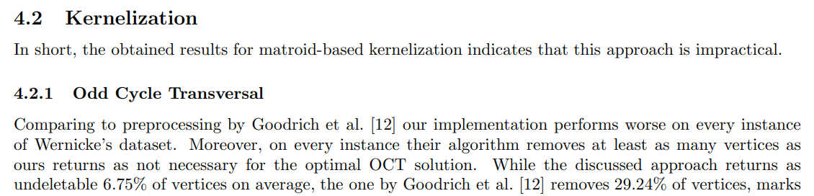

Kernelization as a model for effective preprocessing
Definition of kernelization yields an improvement in running time,
compared to solving the input instance by brute force
What if a nontrivial (parameterized) algorithm is used afterwards?
[Marcin Pilipczuk & Michal Ziobro, 2018]
Notes:
From Marcin Pilipczuk and Michal Ziobro in https://arxiv.org/pdf/1811.07779.pdf .

Slide 12
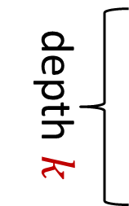




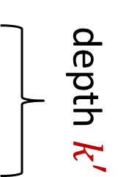
Kernelization as a model for effective preprocessing
Definition of kernelization yields an improvement in running time,
compared to solving the input instance by brute force
Kernelization guarantees that the size of the preprocessed instance is bounded.
For exponential speed-ups, it is important to reduce the search space instead.
$n$ bits
$f(k)$ bits
$$k$$
$$k′$$
depth $k′$
depth $k$
Notes:
How ‘search space’ should be interpreted depends on the type of follow-up algorithm. Some options: size of the search tree for recursive algorithms; number of partial solutions considered in dynamic programming algorithms.
In a certain sense (which can be made surprisingly concrete!) kernelization asks about proving upper-bounds on sizes of obstruction sets, rather than reducing search space.

Slide 13
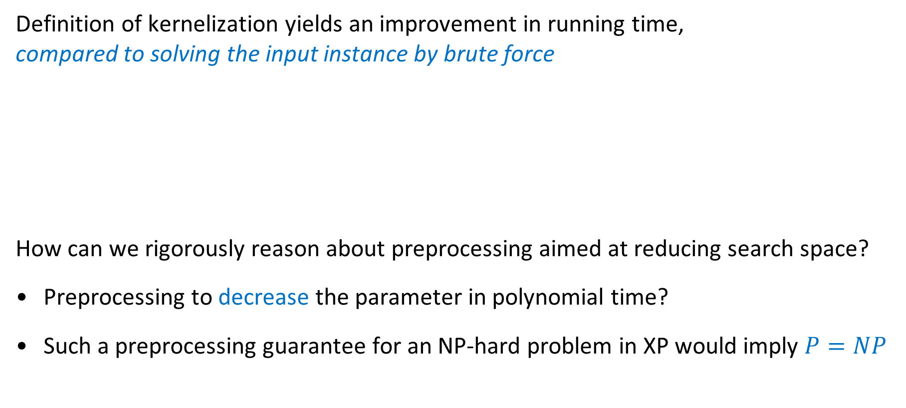
Kernelization as a model for effective preprocessing
Definition of kernelization yields an improvement in running time,
compared to solving the input instance by brute force
How can we rigorously reason about preprocessing aimed at reducing search space?
Preprocessing to decrease the parameter in polynomial time?
Such a preprocessing guarantee for an NP-hard problem in XP would imply $P=NP$
Kernelization guarantees that the size of the preprocessed instance is bounded.
For exponential speed-ups, it is important to reduce the search space instead.
Notes:
How ‘search space’ should be interpreted depends on the type of follow-up algorithm. Some options: size of the search tree for recursive algorithms; number of partial solutions considered in dynamic programming algorithms.
In a certain sense (which can be made surprisingly concrete!) kernelization asks about proving upper-bounds on sizes of obstruction sets, rather than reducing search space.

Slide 14




Rigorous analysis of search space reduction
Goal for search space reduction depends on the nature of the follow-up algorithm
Dynamic-programming algorithms over graph decompositions
Search space reduction = finding a better decomposition to work with
Branching algorithms based on parameterizations by solution size
Identify some elements of an optimal solution to decrease the parameter!
Notes:
Nice tree decomposition, not many join bags, refer back to work on $ℋ$-elimination distance and $ℋ$-treewidth.
Does the model of kernelization ask the right questions for obtaining practical algorithms? (Exponents in recent kernel sizes are comparable to the exponents of PTAS’es that Mike once complained about).

Slide 15
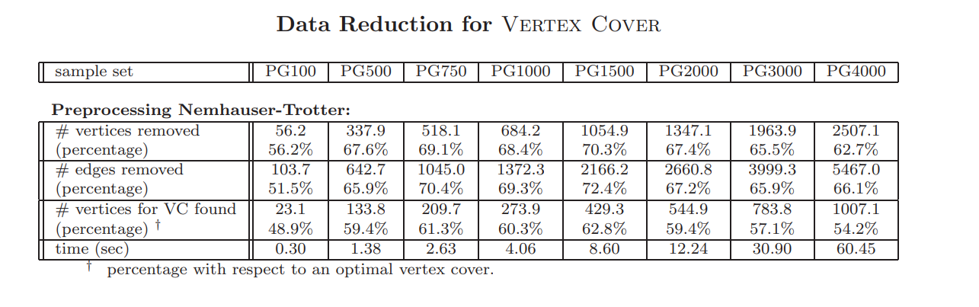

Rigorous analysis of search space reduction
Goal for search space reduction depends on the nature of the follow-up algorithm
Dynamic-programming algorithms over graph decompositions
Search space reduction = finding a better decomposition to work with
Branching algorithms based on parameterizations by solution size
Identify some elements of an optimal solution to decrease the parameter!
[Alber 2002]
Notes:
Nice tree decomposition, not many join bags, refer back to work on $ℋ$-elimination distance and $ℋ$-treewidth.
Does the model of kernelization ask the right questions for obtaining practical algorithms? (Exponents in recent kernel sizes are comparable to the exponents of PTAS’es that Mike once complained about).

Slide 16
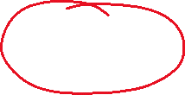
Rigorous analysis of search space reduction
Goal for search space reduction depends on the nature of the follow-up algorithm
Dynamic-programming algorithms over graph decompositions
Search space reduction = finding a better decomposition to work with
Branching algorithms based on parameterizations by solution size
Identify some elements of an optimal solution to decrease the parameter!
How can a rigorous theory of search space reduction be formulated?
Questions posed by the formalism of kernelization
do not always lead to the identification of practical preprocessing algorithms
Notes:
Nice tree decomposition, not many join bags, refer back to work on $ℋ$-elimination distance and $ℋ$-treewidth.
Does the model of kernelization ask the right questions for obtaining practical algorithms? (Exponents in recent kernel sizes are comparable to the exponents of PTAS’es that Mike once complained about).
Think back to the quote of Roger Bacon: half of science is asking the right questions. Has the formalism of kernelization been asking the right questions to identify practical preprocessing algorithms?

Slide 17

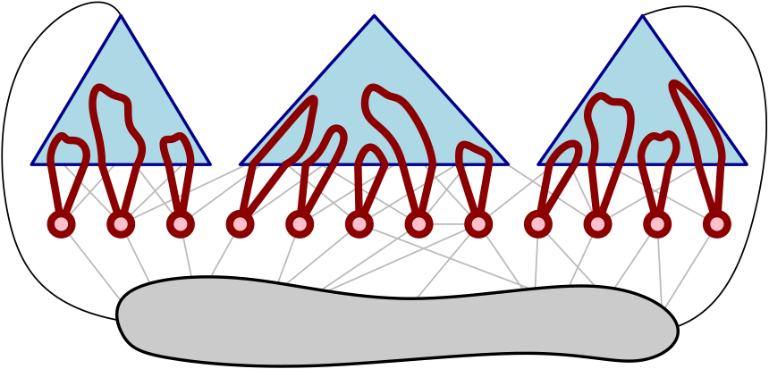
Formalisms for rigorous search-space space reduction
Targeted at parameterizations by solution size
Two recent case studies: efficiently find part of the optimum if:
Give efficient algorithms that, under as mild conditions as possible,
guarantee to find at least one element of an optimal solution
Guarantees to decrease the parameter for vertex-deletion problems and many others
1. there is an essential vertex that
belongs to all reasonable solutions
2. there is a vertex set with a simple certificate for membership in OPT
[Bumpus, Kroon, J. ESA ‘22]
[Donkers, J. WG ‘21]

Slide 18
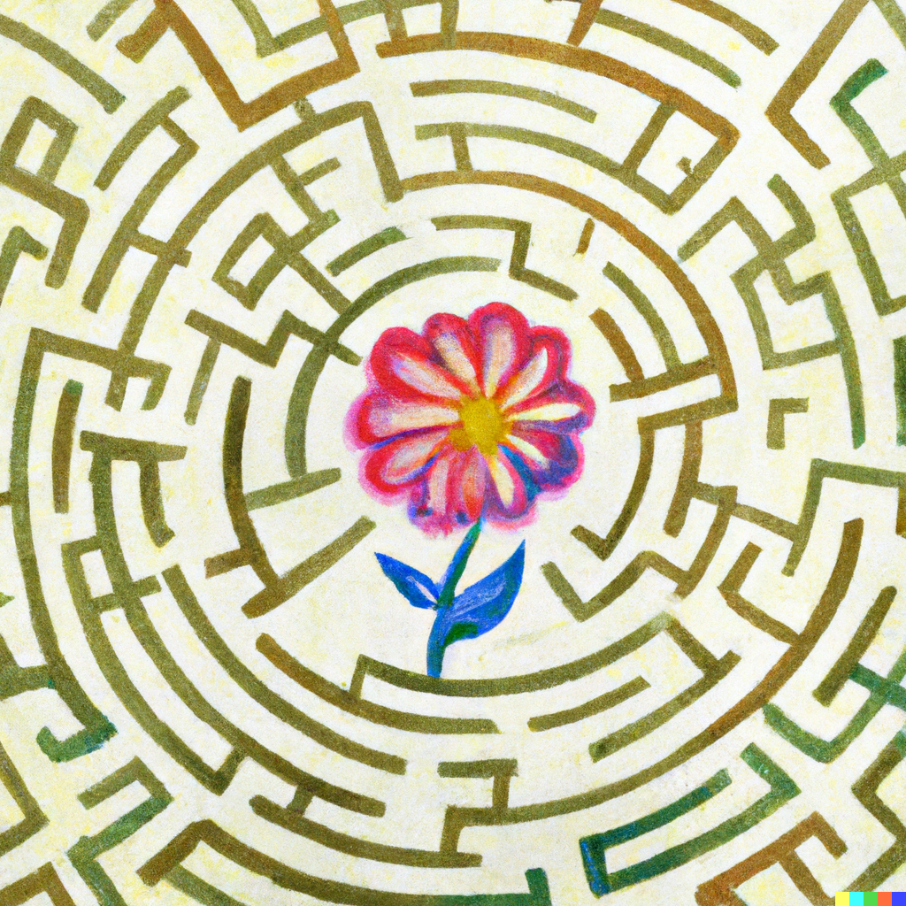
search-space reduction via essential vertices

Slide 19
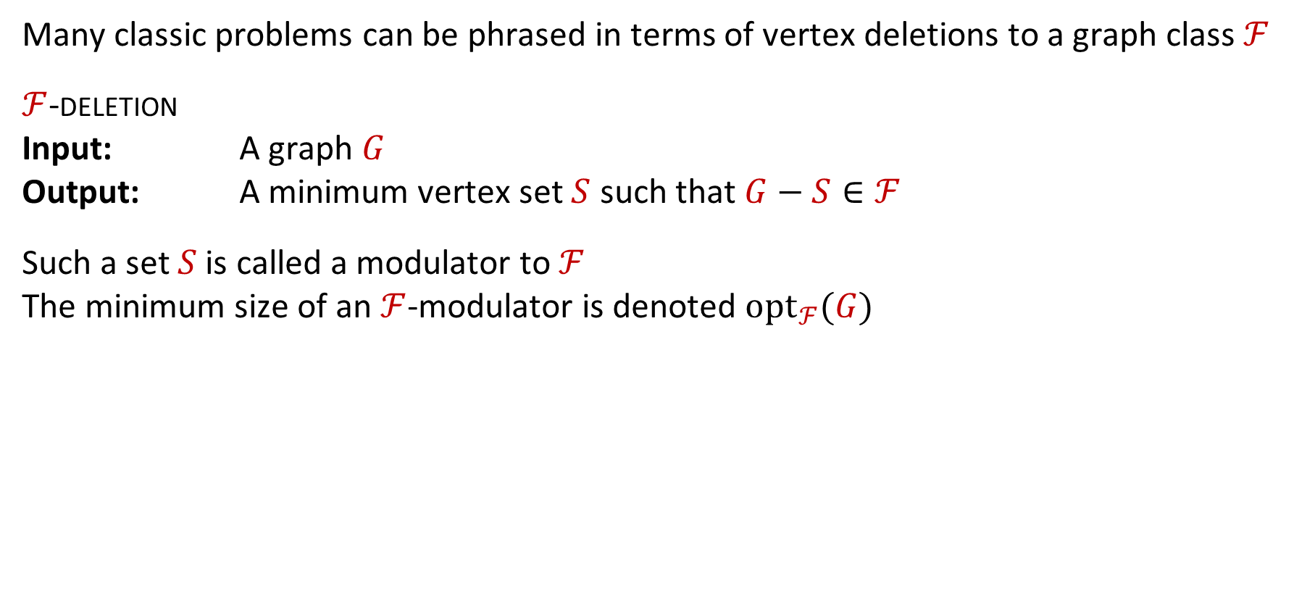
Search space reduction for deletion problems
Many classic problems can be phrased in terms of vertex deletions to a graph class $ℱ$
$ℱ$-deletion
Input: A graph $G$
Output: A minimum vertex set $S$ such that $G−S∈ℱ$
Such a set $S$is called a modulator to $ℱ$
The minimum size of an $ℱ$-modulator is denoted $opt_{ℱ}(G)$
When can an efficient algorithm find a vertex belonging to an optimal $ℱ$-modulator?

Slide 20
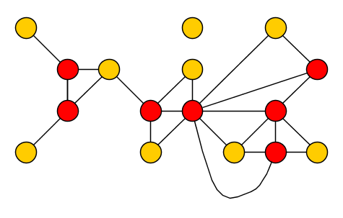
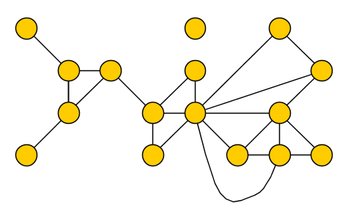

Detect parts of OPT that stand out
When solving problems by hand, some vertices stand out as belonging to OPT
Can we detect those vertices that must be used in every good solution to the problem?
When can an efficient algorithm find a vertex belonging to an optimal $ℱ$-modulator?
Notes:
Example for vertex cover. It is the basis of the high-degree rule for vertex cover, which works well.

Slide 21
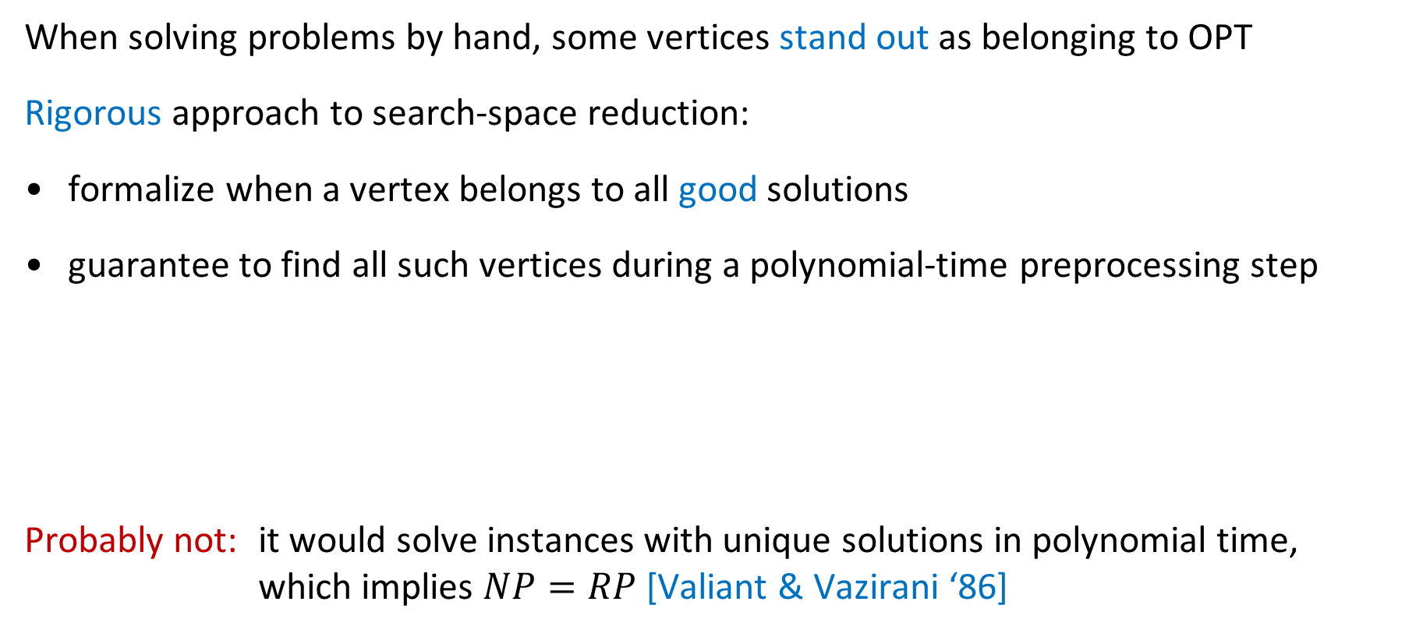
Detect parts of OPT that stand out
When solving problems by hand, some vertices stand out as belonging to OPT
Rigorous approach to search-space reduction:
formalize when a vertex belongs to all good solutions
guarantee to find all such vertices during a polynomial-time preprocessing step
Probably not: it would solve instances with unique solutions in polynomial time,
which implies $NP=RP$ [Valiant & Vazirani ‘86]
Attempt #1:
Can we efficiently detect those vertices which are part of all optimal solutions?
Notes:
Example for vertex cover.

Slide 22
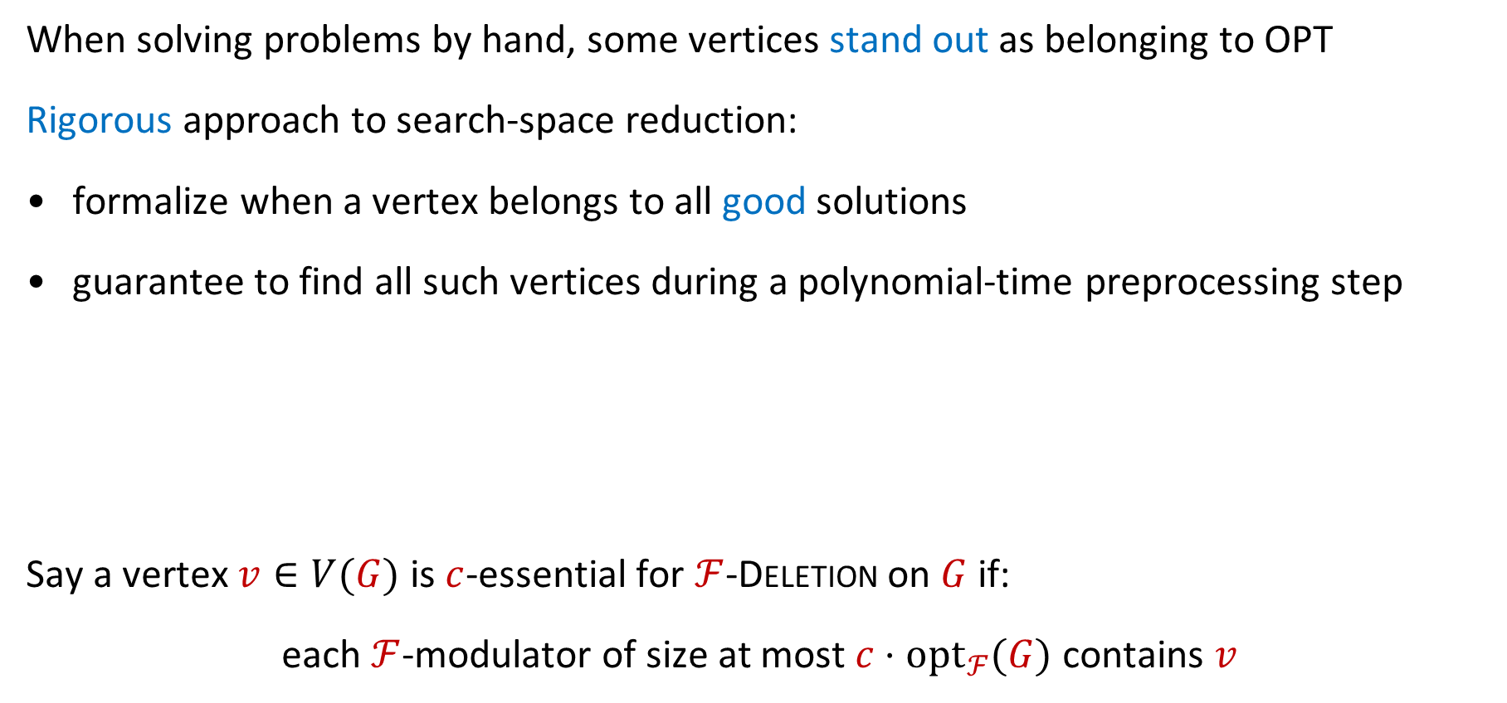


Essential vertices for deletion problems
When solving problems by hand, some vertices stand out as belonging to OPT
Rigorous approach to search-space reduction:
formalize when a vertex belongs to all good solutions
guarantee to find all such vertices during a polynomial-time preprocessing step
Say a vertex $v∈V(G)$ is $c$-essential for $ℱ$-Deletion on $G$ if:
each $ℱ$-modulator of size at most $c⋅opt_{ℱ}(G)$ contains $v$
Attempt #2:
Can we efficiently detect the $c$-essential vertices in a solution?
(Or a superset of them contained in an optimal solution)
Attempt #2:
Can we efficiently detect those vertices which are part of all $c$-approximate solutions?
Notes:
Example for vertex cover. “Yes we can!”

Slide 23
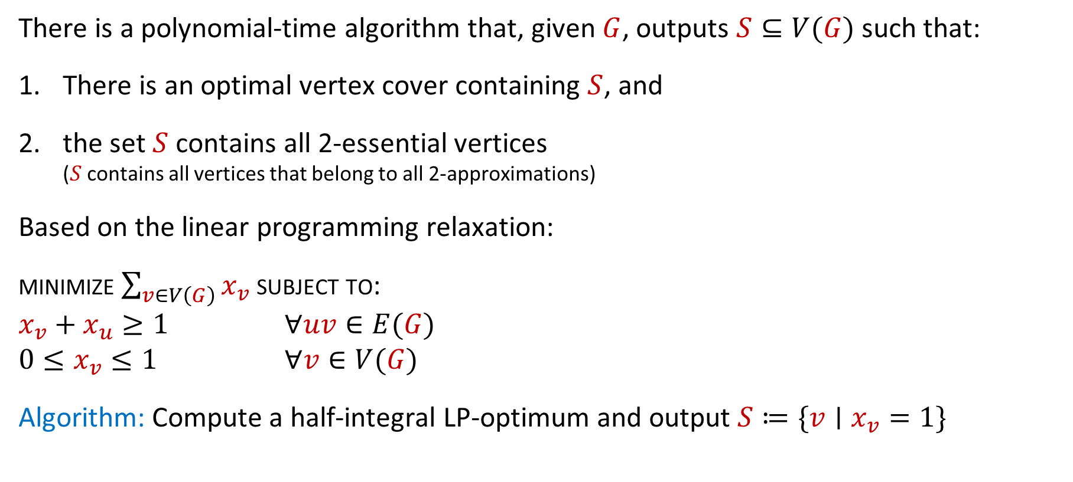
Detecting 2-essential vertices for Vertex Cover
There is a polynomial-time algorithm that, given $G$, outputs $S⊆V(G)$ such that:
There is an optimal vertex cover containing $S$, and
the set $S$ contains all 2-essential vertices
($S$ contains all vertices that belong to all 2-approximations)
Based on the linear programming relaxation:
minimize $\sum_{v∈V\left(G\right)}{x_{v}}$ subject to:
$x_{v}+x_{u}≥1$ $∀uv∈E(G)$
$0≤x_{v}≤1$ $∀v∈V(G)$
Algorithm: Compute a half-integral LP-optimum and output $S≔\{v∣x_{v}=1\}$
Notes:
In a half-integral optimal solution, each edge is either covered by a vertex of value 1, or has BOTH endpoints at value 0.5. (So dropping one vertex of value 0.5 means you still cover the edge.)

Slide 24
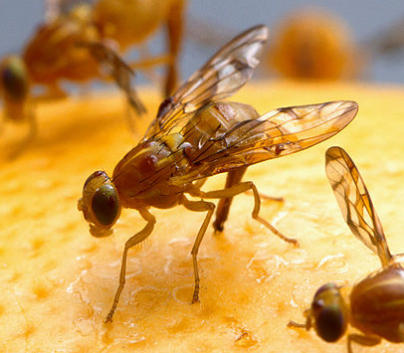
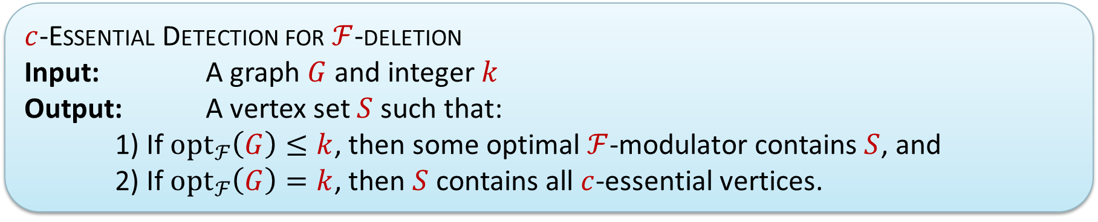

Beyond the fruit fly
Positive result for Vertex Cover not so surprising:
it is FPT and has $O(1)$-approximations
Can we find $c$-essential vertices for problems which do not have these? (Attempt #3)
$c$-Essential Detection for $ℱ$-deletion
Input: A graph $G$ and integer $k$
Output: A vertex set $S$ such that:
1) If ${opt}_{ℱ}\left(G\right)≤k$, then some optimal $ℱ$-modulator contains $S$, and
2) If ${opt}_{ℱ}\left(G\right)=k$, then $S$ contains all $c$-essential vertices.

Slide 25
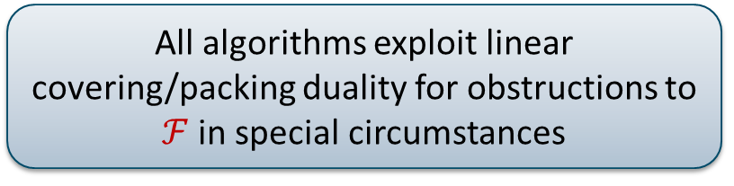
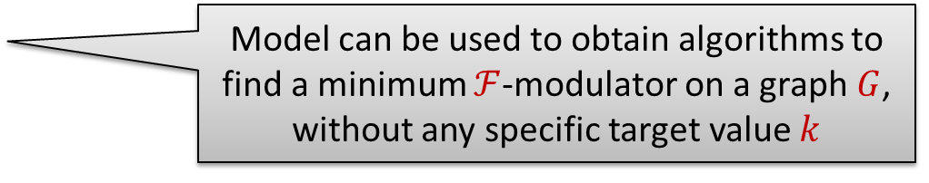
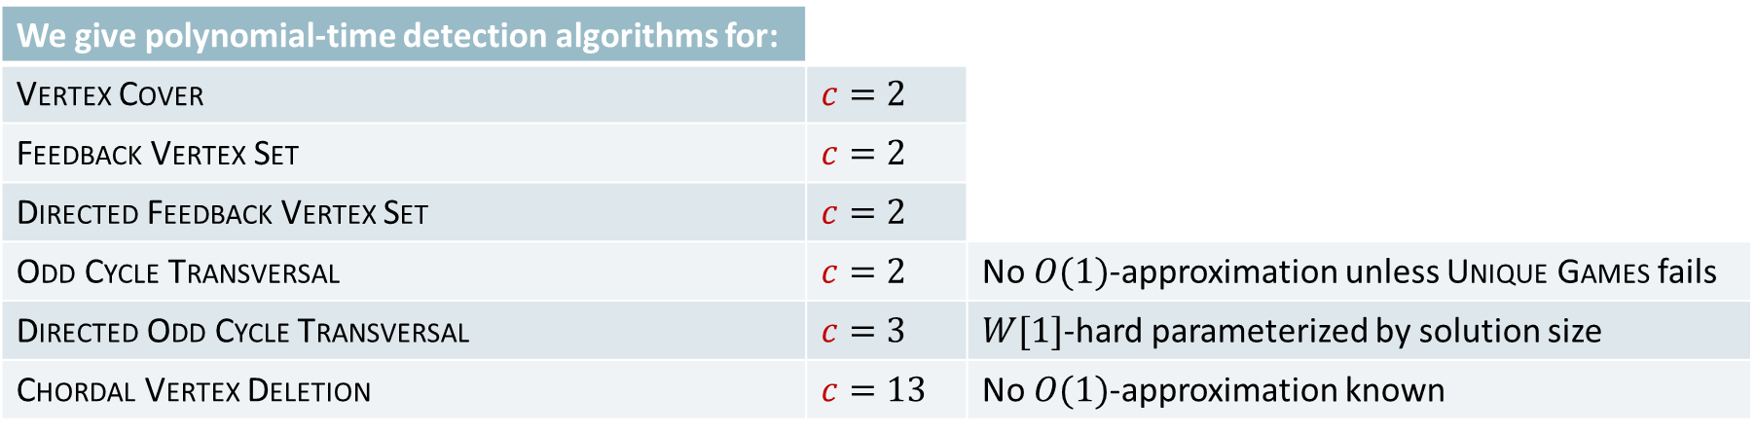
Results for $c$-Essential Detection
We give polynomial-time detection algorithms for:
Vertex Cover | $$c=2$$
Feedback Vertex Set | $$c=2$$
Directed Feedback Vertex Set | $$c=2$$
Odd Cycle Transversal | $$c=2$$ | No $O(1)$-approximation unless Unique Games fails
Directed Odd Cycle Transversal | $$c=3$$ | $W[1]$-hard parameterized by solution size
Chordal Vertex Deletion | $$c=13$$ | No $O(1)$-approximation known
All algorithms exploit linear covering/packing duality for obstructions to $ℱ$ in special circumstances
$c$-Essential Detection for $ℱ$-deletion
Input: A graph $G$ and integer $k$
Output: A vertex set $S$ such that:
1) If ${opt}_{ℱ}\left(G\right)≤k$, then some optimal $ℱ$-modulator contains $S$, and
2) If ${opt}_{ℱ}\left(G\right)=k$, then $S$ contains all $c$-essential vertices.
Model can be used to obtain algorithms to find a minimum $ℱ$-modulator on a graph $G$,
without any specific target value $k$
Notes:
Can do many more for problems with $O(1)$-approximation, but we won’t mention all of them. We consider the identification of this model (and the step taking it into FPT algorithms) as a significant part of our contribution.

Slide 26
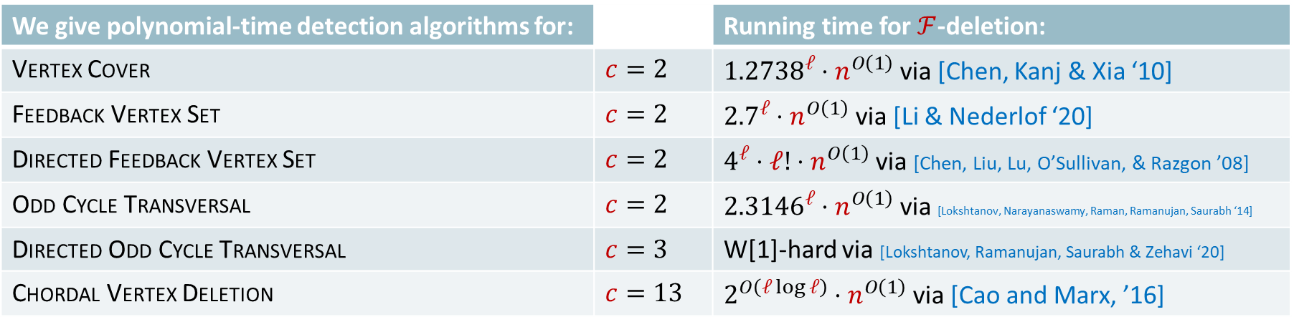
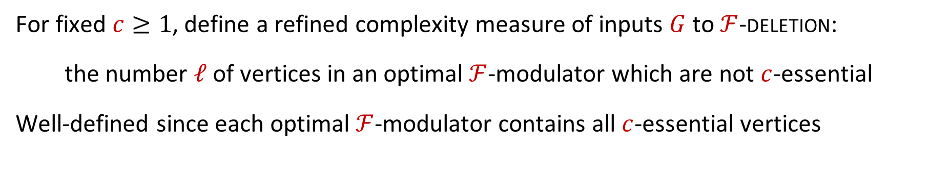
Consequences for search-space reduction
We give polynomial-time detection algorithms for: |  | Running time for $ℱ$-deletion:
Vertex Cover | $$c=2$$ | ${1.2738}^{ℓ}⋅n^{O\left(1\right)}$ via [Chen, Kanj & Xia ‘10]
Feedback Vertex Set | $$c=2$$ | ${2.7}^{ℓ}⋅n^{O\left(1\right)}$ via [Li & Nederlof ‘20]
Directed Feedback Vertex Set | $$c=2$$ | $4^{ℓ}⋅ℓ!⋅n^{O\left(1\right)}$ via [Chen, Liu, Lu, O’Sullivan, & Razgon ’08]
Odd Cycle Transversal | $$c=2$$ | ${2.3146}^{ℓ}⋅n^{O\left(1\right)}$ via [Lokshtanov, Narayanaswamy, Raman, Ramanujan, Saurabh ‘14]
Directed Odd Cycle Transversal | $$c=3$$ | W[1]-hard via [Lokshtanov, Ramanujan, Saurabh & Zehavi ‘20]
Chordal Vertex Deletion | $$c=13$$ | $2^{O\left(ℓ\log{ℓ}\right)}⋅n^{O\left(1\right)}$ via [Cao and Marx, ’16]
For fixed $c≥1$, define a refined complexity measure of inputs $G$ to $ℱ$-deletion:
the number $ℓ$ of vertices in an optimal $ℱ$-modulator which are not $c$-essential
Well-defined since each optimal $ℱ$-modulator contains all $c$-essential vertices
Notes:
Not so clear that detection algorithms which are only correct when certain guarantees on $k$ are met are useful for building FPT algorithms – but they are!

Slide 27
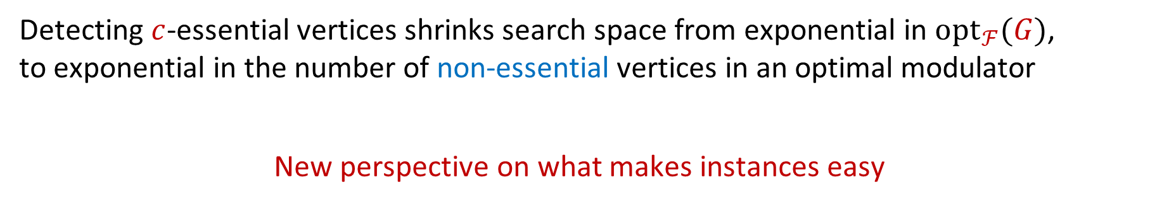
Consequences for search-space reduction
We give polynomial-time detection algorithms for: |  | Running time for $ℱ$-deletion:
Vertex Cover | $$c=2$$ | ${1.2738}^{ℓ}⋅n^{O\left(1\right)}$ via [Chen, Kanj & Xia ‘10]
Feedback Vertex Set | $$c=2$$ | ${2.7}^{ℓ}⋅n^{O\left(1\right)}$ via [Li & Nederlof ‘20]
Directed Feedback Vertex Set | $$c=2$$ | $4^{ℓ}⋅ℓ!⋅n^{O\left(1\right)}$ via [Chen, Liu, Lu, O’Sullivan, & Razgon ’08]
Odd Cycle Transversal | $$c=2$$ | ${2.3146}^{ℓ}⋅n^{O\left(1\right)}$ via [Lokshtanov, Narayanaswamy, Raman, Ramanujan, Saurabh ‘14]
Directed Odd Cycle Transversal | $$c=3$$ | W[1]-hard via [Lokshtanov, Ramanujan, Saurabh & Zehavi ‘20]
Chordal Vertex Deletion | $$c=13$$ | $2^{O\left(ℓ\log{ℓ}\right)}⋅n^{O\left(1\right)}$ via [Cao and Marx, ’16]
Detecting $c$-essential vertices shrinks search space from exponential in $opt_{ℱ}(G)$,
to exponential in the number of non-essential vertices in an optimal modulator
New perspective on what makes instances easy
Notes:
So by

Slide 28
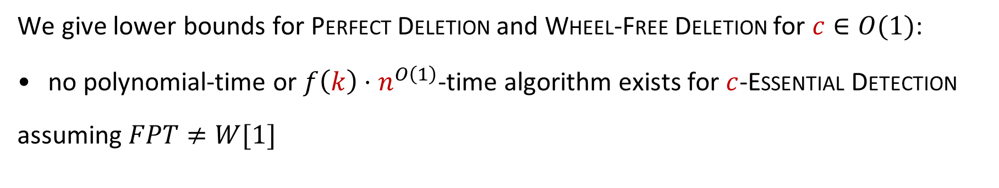
Lower bounds for $c$-Essential Detection
We give polynomial-time detection algorithms for: |  | Running time for $ℱ$-deletion:
Vertex Cover | $$c=2$$ | ${1.2738}^{ℓ}⋅n^{O\left(1\right)}$ via [Chen, Kanj & Xia ‘10]
Feedback Vertex Set | $$c=2$$ | ${2.7}^{ℓ}⋅n^{O\left(1\right)}$ via [Li & Nederlof ‘20]
Directed Feedback Vertex Set | $$c=2$$ | $4^{ℓ}⋅ℓ!⋅n^{O\left(1\right)}$ via [Chen, Liu, Lu, O’Sullivan, & Razgon ’08]
Odd Cycle Transversal | $$c=2$$ | ${2.3146}^{ℓ}⋅n^{O\left(1\right)}$ via [Lokshtanov, Narayanaswamy, Raman, Ramanujan, Saurabh ‘14]
Directed Odd Cycle Transversal | $$c=3$$ | W[1]-hard via [Lokshtanov, Ramanujan, Saurabh & Zehavi ‘20]
Chordal Vertex Deletion | $$c=13$$ | $2^{O\left(ℓ\log{ℓ}\right)}⋅n^{O\left(1\right)}$ via [Cao and Marx, ’16]
We give lower bounds for Perfect Deletion and Wheel-Free Deletion for $c∈O(1)$:
no polynomial-time or $f\left(k\right)⋅n^{O\left(1\right)}$-time algorithm exists for $c$-Essential Detection
assuming $FPT≠W[1]$
Notes:
Based on hardness of approximation for Dominating Set due to Karthik C. S. Bundit Laekhanukit and Pasin Manurangsi.

Slide 29

Detecting essential vertices for odd cycle transversal and multicut
Notes:
This is what Dall-E thinks a field of odd flowers looks like.

Slide 30




Odd flowers for detecting 2-essential vertices for OCT
For an undirected graph $G$ and vertex $v$, an odd $v$-flower is a set of odd cycles $C_{1},…, C_{p}$ containing $v$ such that $V\left(C_{i}\right)∩V\left(C_{j}\right)=\{v\}$ for $1≤i<j≤p$
The odd cycles $C_{1},…, C_{p}$ are the petals of the odd $v$-flower
A maximum odd $v$-flower can be computed in polynomial time,
by reduction to matching [Geelen, Gerards, Reed, Seymour & Vetta @ JCTB ’02]
If a minimum odd cycle transversal in $G$ has size $k$, and
there is an odd $v$-flower with $k+1$ petals,
then every minimum OCT in $G$ contains $v$.

Slide 31


2-essential detection for Odd Cycle Transversal
$2$-Essential Detection for Odd Cycle Transversal
Input: A graph $G$ and integer $k$
Output: A vertex set $S$ such that:
1) If $opt\left(G\right)≤k$, then some optimal odd cycle transversal contains $S$, and
2) If $opt\left(G\right)=k$, then $S$ contains all $2$-essential vertices.
Given $G$ and $k$, the algorithm initializes $S=∅$ and proceeds as follows:
For each $v∈V(G)$, compute a maximum odd $v$-flower $C_{1},…, C_{p}$ in $G$
If the odd flower has $p>k$ petals, then add $v$ to $S$
Output the resulting set $S$
Notes:
Recall that 2-essential = contained in all 2-approximations. Easy to see that (1) holds. Why does (2) hold?

Slide 32








2-essential detection for Odd Cycle Transversal
$2$-Essential Detection for Odd Cycle Transversal
Input: A graph $G$ and integer $k$
Output: A vertex set $S$ such that:
1) If $opt\left(G\right)≤k$, then some optimal odd cycle transversal contains $S$, and
2) If $opt\left(G\right)=k$, then $S$ contains all $2$-essential vertices.
If $v∉S$, then a maximum odd $v$-flower in $G$ has at most $k$ petals
$$A$$
Let $H≔G−(X∖\{v\})$, so $H−v$ is bipartite
Let $(A,B)$ be some bipartition of $H−v$
Odd cycles in $H$ correspond to paths connecting $N_{H}\left(v\right)∩A$ to $N_{H}\left(v\right)∩B$ in $H−v$
$$B$$
Notes:
This concludes the discussion of essential vertices for search space reduction.

Slide 33

2-essential detection for Odd Cycle Transversal
$2$-Essential Detection for Odd Cycle Transversal
Input: A graph $G$ and integer $k$
Output: A vertex set $S$ such that:
1) If $opt\left(G\right)≤k$, then some optimal odd cycle transversal contains $S$, and
2) If $opt\left(G\right)=k$, then $S$ contains all $2$-essential vertices.
If $v∉S$, then a maximum odd $v$-flower in $G$ has at most $k$ petals
$$A$$
Since $G$ has no odd $v$-flower with $>k$ petals,
neither does $H$
So in $H−v$, there is no packing of $>k$ paths connecting $N_{H}\left(v\right)∩A$ to $N_{H}\left(v\right)∩B$
$$B$$
Notes:
This concludes the discussion of essential vertices for search space reduction.

Slide 34


2-essential detection for Odd Cycle Transversal
$2$-Essential Detection for Odd Cycle Transversal
Input: A graph $G$ and integer $k$
Output: A vertex set $S$ such that:
1) If $opt\left(G\right)≤k$, then some optimal odd cycle transversal contains $S$, and
2) If $opt\left(G\right)=k$, then $S$ contains all $2$-essential vertices.
If $v∉S$, then a maximum odd $v$-flower in $G$ has at most $k$ petals
$$A$$
There is a vertex set of size $≤k$ in $H−v$ hitting all $(N_{H}\left(v\right)∩A,N_{H}\left(v\right)∩B)$-paths
So in $H−v$, there is no packing of $>k$ paths connecting $N_{H}\left(v\right)∩A$ to $N_{H}\left(v\right)∩B$
$$B$$
Notes:
This concludes the discussion of essential vertices for search space reduction.

Slide 35




2-essential detection for Odd Cycle Transversal
$2$-Essential Detection for Odd Cycle Transversal
Input: A graph $G$ and integer $k$
Output: A vertex set $S$ such that:
1) If $opt\left(G\right)≤k$, then some optimal odd cycle transversal contains $S$, and
2) If $opt\left(G\right)=k$, then $S$ contains all $2$-essential vertices.
If $v∉S$, then a maximum odd $v$-flower in $G$ has at most $k$ petals
$2$-Essential Detection for Odd Cycle Transversal can be solved in polynomial-time.
The only reason a vertex $v$ is 2-essential for odd cycle transversal on $G$,
is that $v$ is at the center of an odd flower with more than $opt(G)$ petals.
$$A$$
There is a vertex set of size $≤k$ in $H−v$ hitting all $(N_{H}\left(v\right)∩A,N_{H}\left(v\right)∩B)$-paths
It hits all odd cycles of $H$
If $opt\left(G\right)=k$, the union of these sets of size at most $k$:
$X∖\left\{v\right\}$
hitting set for odd cycles through $v$ in $H$
is a 2-approximation in $G$ avoiding $v$
$$B$$
Notes:
So the key property we exploited here is a covering/packing duality for odd cycles and OCTs: the maximum size of an odd v-flower in H is equal to the minimum size of a v-avoiding OCT in H. Next, we will see another example where the duality is expressed in terms of the integrality gap of an LP.

Slide 36





A different type of application: Multicut
(Vertex) Multicut
Input: A graph $G$ and terminal pairs $\{s_{1},t_{1}\}, …, \{s_{ℓ}, t_{ℓ}\}$
Output: A minimum vertex $X$ such that in $G−X$, no terminal pair $\{s_{i}, t_{i}\}$
is contained in a single connected component
Parameterization by solution size $k$solvable in time $2^{O\left(k^{3}\right)}⋅n^{O\left(1\right)}$
[Marx & Razgon, SICOMP 2014]
No constant-factor approximation under the Unique Games conjecture
Notes:
Independently shown to be FPT by Nicolas Bousquet, Jean Daligault, Stephan Thomasse.

Slide 37


3-essential detection for Multicut
$3$-Essential Detection for Multicut
Input: A graph $G$, a set of terminal pairs, and an integer $k$
Output: A vertex set $S$ such that:
1) If $opt\left(G\right)≤k$, then some optimal multicut contains $S$, and
2) If $opt\left(G\right)=k$, then $S$ contains all $3$-essential vertices.
Based on the $v^{∗}$-Avoiding Multicut LP for a distinguished $v^{∗}∈V(G)$:
minimize $\sum_{v∈V\left(G\right)}{x_{v}}$ subject to:
$\sum_{v∈V\left(P\right)}{x_{v}≥1}$ $∀$path $P$ connecting a terminal pair $\{s_{i}, t_{i}\}$
$0≤x_{v}≤1$ $∀v∈V\left(G\right)$
$x_{v^{∗}}=0$ for the distinguished vertex $v^{∗}$
If $(G,{(\left\{s_{i}, t_{i}\right\})}_{i∈\left[ℓ\right]})$ is an instance of Multicut and $\{v^{∗}\}$ is a solution,
then the integrality gap of the $v^{∗}$-Avoiding Multicut LP is bounded by 2.
Notes:
Recall that 2-essential = contained in all 2-approximations. Easy to see that (1) holds. Why does (2) hold?

Slide 38



3-essential detection for Multicut
If $(G,{(\left\{s_{i}, t_{i}\right\})}_{i∈\left[ℓ\right]})$ is an instance of Multicut and $\{v^{∗}\}$ is a solution,
then the integrality gap of the $v^{∗}$-Avoiding Multicut LP is bounded by 2.
Consider a fractional solution ${\left(x_{v}\right)}_{v∈V\left(G\right)}$, which serve as weights for shortest-path computations
Some terminal in each pair has dist. $≥0.5$ to $v^{∗}$
Let $D≔\{u∈V\left(G\right)∣δ\left(v^{∗},u\right)≥0.5\}$
Any set separating $v^{∗}$ from $D$ is a multicut
Notes:
Since $\{v^{∗}\}$ is a solution, all request paths go through $v^{∗}$. So if $v^{∗}$ cannot reach BOTH vertices of a pair, then that pair is separated.

Slide 39


3-essential detection for Multicut
If $(G,{(\left\{s_{i}, t_{i}\right\})}_{i∈\left[ℓ\right]})$ is an instance of Multicut and $\{v^{∗}\}$ is a solution,
then the integrality gap of the $v^{∗}$-Avoiding Multicut LP is bounded by 2.
The assignment $y_{v}≔2⋅x_{v}$ gives a fractional $(v^{∗},D)$-separator of cost $2⋅\sum_{v∈V\left(G\right)}{x_{v}}$
Menger: integral separator of size $2⋅\sum_{v∈V\left(G\right)}{x_{v}}$
Let $D≔\{u∈V\left(G\right)∣δ\left(v^{∗},u\right)≥0.5\}$
Any set separating $v^{∗}$ from $D$ is a multicut
Notes:
Doubling trick inspired by the LP-rounding 2-approximation for Weighted Edge Multicut in trees due to Garg, Vazirani, Yannakakis [Algorithmica ‘97]. If there is no such separator, then by Menger’s theorem there is a collection of more than $2\left|x\right|$ paths which are disjoint except for sharing $v^{∗}$.

Slide 40

3-essential detection for Multicut
$3$-Essential Detection for Multicut
Input: A graph $G$, a set of terminal pairs, and an integer $k$
Output: A vertex set $S$ such that:
1) If $opt\left(G\right)≤k$, then some optimal multicut contains $S$, and
2) If $opt\left(G\right)=k$, then $S$ contains all $3$-essential vertices.
Given $G$ and $k$, the algorithm initializes $S=∅$ and proceeds as follows:
For each choice of $v^{∗}∈V(G)$, solve the $v^{∗}$-Avoiding Multicut LP
If the cost is more than $k$, add $v^{∗}$ to $S$
Output the resulting set $S$
Notes:
Recall that 2-essential = contained in all 2-approximations. Easy to see that (1) holds. Why does (2) hold?

Slide 41






3-essential detection for Multicut
$3$-Essential Detection for Multicut
Input: A graph $G$, a set of terminal pairs, and an integer $k$
Output: A vertex set $S$ such that:
1) If $opt\left(G\right)≤k$, then some optimal multicut contains $S$, and
2) If $opt\left(G\right)=k$, then $S$ contains all $3$-essential vertices.
If $v^{∗}∉S$, then the $v^{∗}$-Avoiding Multicut LP has a fractional solution of cost $≤k$
$3$-Essential Detection for Multicut can be solved in polynomial-time, based on a bound on the integrality gap for instances with a singleton solution.
Let $H≔G−(X∖\{v^{∗}\})$
Since the $v^{∗}$-Avoiding Multicut LP has a fractional solution of cost $≤k$ on $G$, it has one on $H$
So in $H$ there is an integral solution of cost $≤2k$
If $opt\left(G\right)=k$, the union of these sets:
$X∖\left\{v^{∗}\right\}$
$v^{∗}$-avoiding multicut of size $2k$ in $H$
is a 3-approximation in $G$ avoiding $v^{∗}$
Notes:
Also means that the exponential dependence of the Marx-Razgon algorithm can be reduced from ‘solution size’ to ‘solution size minus number of 3-essential vertices’.

Slide 42
Reflection
To understand essential vertices, suffices to analyze the following:
We exploited two different interpretations
How do $v^{∗}$-avoiding solutions behave in instances where $\{v^{∗}\}$ is a solution?
Odd Cycle Transversal: if $G−v^{∗}$ is bipartite, then
Odd Cycle Transversal: if 𝐺−𝑣^∗ is bipartite, then
minimum size of $v^{∗}$-avoiding OCT = maximum order of odd $v^{∗}$-flower
minimum size of 𝑣^∗-avoiding OCT = maximum order of odd 𝑣^∗-flower
Multicut: if $v^{∗}$ separates all terminal pairs, then
Multicut: if 𝑣^∗ separates all terminal pairs, then
integrality gap for $v^{∗}$-avoiding solutions is at most 2
integrality gap for 𝑣^∗-avoiding solutions is at most 2

Slide 43

search-space reduction via antlers and simple witnesses

Slide 44











Crown reduction for Vertex Cover
Off with his head!
Matched into $C$
There is an optimal vertex cover in $G$ containing $H$:
Any vertex cover contains $|H|$ vertices from $G[H∪C]$ to cover the matching
For any vertex cover $X$, we can replace $X∩(H∪C)$ by $H$ to get another vertex cover
($C$ is independent and not connected to the remainder)
Notes:
So the decomposition provides a simple witness for the fact that some optimal solution contains $C$. It turns out that, whenever there are vertices that have a certificate for membership in an optimal solution of this form, we can find them efficiently: crowns can be found in polynomial time. Does this extend to other problems?

Slide 45

A crown decomposition forms a simple witness
The crown decomposition witnesses that some optimal solution contains $H$
If an input graph $G$ for Vertex Cover has a vertex with such a simple certificate,
a polynomial-time algorithm can find a vertex of an optimal solution
Crown decompositions can be found in polynomial time
Can we build a framework of search-space reduction out of this?
If there is a vertex with a simple certificate of its membership in an optimal solution,
can such a vertex by found by an efficient preprocessing algorithm?
There is an optimal vertex cover in $G$ containing $H$:
Any vertex cover contains $|H|$ vertices from $G[H∪C]$ to cover the matching
For any vertex cover $X$, we can replace $X∩(H∪C)$ by $H$ to get another vertex cover
($C$ is independent and not connected to the remainder)
Notes:
So the decomposition provides a simple witness for the fact that some optimal solution contains $C$ (but generally not all).

Slide 46













Antler reduction for Feedback Vertex Set
Off with its head!
$|H|$ vertex-disjoint cycles in $G[H∪A]$
There is an optimal feedback vertex set in $G$ containing $H$:
Any feedback vertex set contains $|H|$ vertices from $G[H∪A]$ to hit the $|H|$ cycles
For any feedback vertex set $X$, we can replace $X∩(H∪A)$ by $H$ to get another one
($A$ induces a forest and all cycles passing through it intersect $H$)
Notes:
Definition of Antler.

Slide 47



Search-space reduction by detecting antlers
Unlike crowns, antler decompositions cannot be found in polynomial time
Difficulty caused by the fact that the following problem is NP-hard:
Input: A graph $G$ and packing of $k$ vertex-disjoint cycles in $G$
Question: Does $G$ have a feedback vertex set of size $k$?
Analogous task for Vertex Cover is polynomial-time solvable
(is the vertex cover number equal to the size of a maximum matching?)
But: we can efficiently find part of an optimal FVS if there is an antler with small head
There is a $2^{O\left(k^{5}\right)}⋅n^{O\left(1\right)}$-time algorithm that, given an $n$-vertex graph $G$ and integer $k$, either:
correctly determines that $G$ does not contain an antler whose head has size at most $k$, or
outputs $S⊆V(G)$ of size at least $k$ such that some optimal feedback vertex set in $G$ contains of $S$.
[Donkers & J. ‘21]
Notes:
Algorithm based on reduction rules to reduce the size of any antler in proportion to the size of its head, followed by color-coding to detect a superset of an antler structure if one exists. Significant technical challenges due to the fact that there can be multiple antlers: how do they interact, what remains of one when you remove another? [Konig graphs]

Slide 48







Antler reductions can cascade
Notes:
Sequence of new antlers created when old ones are removed. (Note that originally, there also was a large 1-antler containing the union, but its width is larger.)

Slide 49

Antler reductions can cascade
Through cascades, it may be possible to:
find a large optimal solution
by repeatedly extracting small antlers,
via an algorithm of small running time
Suggests an alternative complexity measure for $ℱ$-deletion problems:
smallest $k$ for which optimal solution can be built as $S_{1}∪…∪S_{t}$, such that
each $S_{i}$ has a certificate of complexity $k$ for belonging to OPT in $G−\bigcup_{j<i}{S_{i}}$
Can this be made rigorous for other problems than Feedback Vertex Set?
Notes:
To make this well-defined, you have to argue there is always a solution of this form. For that, the antlers whose witness certificate is a set of disjoint cycles are not enough; we define more general types in the paper (but to find them, you pay in the exponent on $n$).

Slide 50





Conclusion
Kernelization is a beautiful concept for the study of polynomial-time data compression
To understand how preprocessing gives exponential speed-ups,
data compression alone is not sufficient; search-space reduction is vital
Case studies for rigorous search-space reduction:
Which theoretical questions should we ask to find practical preprocessing algorithms?
?
essential vertices
simple certificates
Notes:
Can we extend the scope of these first two case studies? Apply the notion of essential elements beyond vertex-subset minimization problems? Apply ideas on finding parts of solutions for which there are simple certificates, beyond FVS? Experiment with these ideas in practice! Other ways to formulate rigorous search-space reduction, based on the stability of optimal solutions?

Slide 51


Open problem: $v^{∗}$-Avoiding Planarization LP
$v^{∗}$-Avoiding Planarization LP for a distinguished $v^{∗}∈V(G)$:
minimize $\sum_{v∈V\left(G\right)}{x_{v}}$ subject to:
$\sum_{v∈V\left(H\right)}{x_{v}≥1}$ $∀$non-planar induced subgraphs $H⊆G$
$0≤x_{v}≤1$ $∀v∈V\left(G\right)$
$x_{v^{∗}}=0$ for the distinguished vertex $v^{∗}$
Is the integrality gap of this LP constant, on inputs where $G−v^{∗}$ is planar?

Slide 52




A sketch of more complicated certificates
Simplest witness: $H$ is optimal for $G[H∪A]$ because that subgraph has $|H|$ vertex-disjoint cycles,
so $G[H∪A]$ has a subgraph $G′$ for which $H$ is an optimal FVS and each component of $G′$ is a cycle
$z$-complex witness: $H$ is optimal for $G\left[H∪A\right]$,
the graph $G[H∪A]$ has a subgraph $G′$ for which $H$ is an optimal FVS,
and each component of $G′$ has feedback vertex number at most $z$
$$z=3$$
There is a $2^{O\left(k^{5}z^{2}\right)}⋅n^{O\left(z\right)}$-time algorithm that, given an $n$-vertex graph $G$ and integers $k≥z$, either:
correctly determines that $G$ does not contain a $z$-antler whose head has size at most $k$, or
outputs $S⊆V(G)$ of size at least $k$ such that some optimal feedback vertex set in $G$ contains of $S$.
[Donkers & J. ‘21]
Notes:
Antler complexity. $z$-antler = variation of antler where the certificate that $fvs\left(G\left[H∪A\right]\right)≥|H|$ has complexity $z$. This concludes our discussion of antlers; now some open problems and then we finish.

