Slide 1
On Sparsification for Computing Treewidth
Insert «Academic unit» on every page: 1 Go to the menu «Insert» 2 Choose: Date and time 3 Write the name of your faculty or department in the field «Footer»
4 Choose «Apply to all"
Bart M. P. Jansen
November 27th 2013, research colloquium "Algorithmik und Komplexitätstheorie", TU Berlin

Slide 2
Outline
Treewidth
Sparsification
Results
Sparsification lower bound for Treewidth
Quadratic-vertex kernel upper bound for Treewidth [vc]
Conclusion

Slide 3
Treewidth
Measure of how “tree-like” a graph is
Decompose a graph into a tree decomposition of small width to reveal its internal structure
Dynamic programming solves many optimization problems when a tree decomposition is known
First step: find good tree decomposition
Treewidth Input: A graph G, an integer k Question: Is the treewidth of G at most k?
NP-complete [Arnborg et al.’87]

Slide 4
Sparsification
The task of making a problem instance less dense, without changing its answer
Density
.. of a CNF formula: ratio of clauses to variables
.. of a graph: ratio of edges to vertices
Work on sparsification
Eppstein et al. @ J.ACM’97: Sparsification to speed up dynamic graph algorithms
Impagliazzo et al. @ JCSS’01: Subexponential-time Sparsification Lemma for Satisfiability
Dell & van Melkebeek @ STOC’10: No nontrivial polynomial-time sparsification for d-cnf-sat

Slide 5
Sparsification for Computing Treewidth
Given a graph G, we want to make it easier to find a good tree decomposition of G
Main idea:
quickly compute G’ which is “simpler” than G,
such that minimum-width decomposition of G’ easily leads to minimum-width decomposition of G
Possible ways to make G’ provably simpler than G:
Upper bound on the density of G’
Upper bound on the order of G’, in terms of structural measures of G
Notes:
Say that simpler can mean less edges.

Slide 6
Parameterized Complexity and Kernelization
A parameterized problem is a subset Q ⊆ Σ* × ℕ
For an instance (x,k) ∈ Σ* × ℕ, we call k the parameter
Let Q, Q’ be parameterized problems and $f:\text{ℕ}→\text{ℕ}$
A generalized kernelization of Q into Q’ with size $f$ is
an algorithm that takes (x,k) as input,
runs in poly(|x| + k) time,
outputs (x’,k’) such that:
(x,k) ∈ Q iff (x’,k’) ∈ Q’
|x’|, k’ ≤ $f$(k)
It is a kernelization (or kernel) if Q = Q’
Poly-time mapping from Q to Q’
preserves the answer
$f$(k)-size output bound

Slide 7
Sparsification Analysis using Kernelization
Based on the parameterization by vertex count:
n-Treewidth Input: n ∈ ℕ, an n-vertex graph G, an integer k Parameter: n Question: Is the treewidth of G at most k?
An instance (G,k,n) can be encoded in O(n²) bits
Most relaxed form of polynomial-time sparsification:
generalized kernel for n-Treewidth of size O(n^{2-ε}) for ε > 0
Theorem. n-Treewidth does not have a generalized kernel of bitsize O(n^{2-ε}), for any ε > 0, unless NP ⊆ coNP/poly

Slide 8
Proof Technique
Corollary of Bodlaender et al.’12:
If there is a polynomial-time algorithm that:
composes the or of t² similar size-s instances of an NP-hard problem,
into an instance (G*,n*,k*) of n-Treewidth with n* ∈ O(t · s^{O(1)}),
then n-Treewidth does not have a generalized kernel of bitsize O(n^{2-ε}), for any ε > 0, unless NP ⊆ coNP/poly
Proof using cross-composition of bounded cost
Introduced in the journal version of the paper on cross-composition [Bodlaender, J, Kratsch ’12]
Easier front-end to the complementary witness lemma of Dell & van Melkebeek [STOC’10]
x_{1,1}
x_{1,2}
x…
x_{1,t}
NP-hard inputs
x_{2,1}
x_{2,2}
x…
x_{2,t}
x…
x …
x…
x …
x_{t,1}
x_{t,2}
x…
x_{t,t}
poly(s · t)-time
n-Treewidth
instance
(G*,k*,n*)
n* ∈ O(t · s^{O(1)})

Slide 9
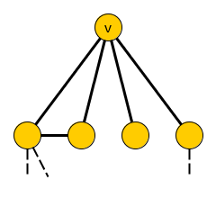
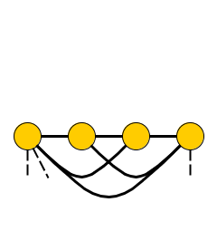
Ingredients
Proof Strategy
Vertex eliminations and orderings
Cobipartite Graph Elimination
Embedding into a t × 2 table
Gadgets enforce an or-gate through the cobipartite graph
Eliminate a vertex v from a graph:
Remove it, complete N(v) into a clique
Elimination order:
Permutation π of the vertices
Eliminate first vertex from G to obtain G₁, eliminate second vertex from G₁ to obtain G₂, ... eliminate last vertex from G_{n-1} to obtain ∅
Cost of π on G is the maximum, over all v ∈ V(G), of deg(v) + 1 when v is eliminated
Fact. The treewidth of a graph is the cost of its cheapest elimination order (minus one)

Slide 10
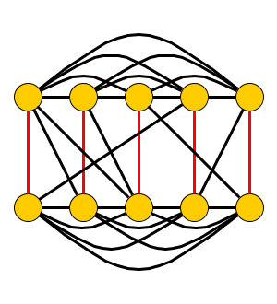
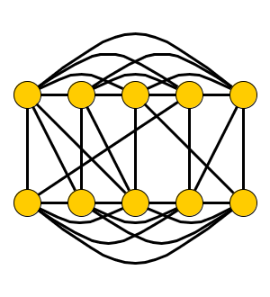
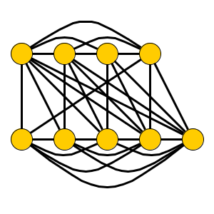
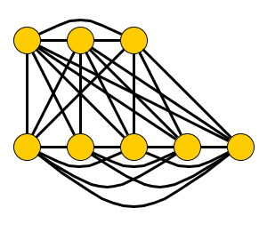
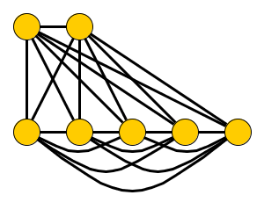
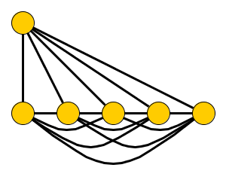
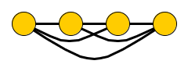
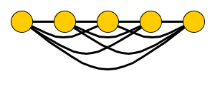
Ingredients
Proof Strategy
Vertex eliminations and orderings
Cobipartite Graph Elimination
Embedding into a t × 2 table
Gadgets enforce an or-gate through the cobipartite graph
Cobipartite Graph Elimination Input: A cobipartite graph G with partite sets A,B of size n, such that G has a perfect matching between A and B. An integer k. Question: Does G have an elimination order of cost at most n + k?
A
(n=5, k=2)
B
Notes:
Q: Should we incorporate k < n/4 to match the paper?

Slide 11
Ingredients
Proof Strategy
Vertex eliminations and orderings
Cobipartite Graph Elimination
Embedding into a t × 2 table
Gadgets enforce an or-gate through the cobipartite graph
Embedding into a table-like structure
Inspired by Dell & Marx [SODA’12]
Compose the or of t² n-vertex instances of Cobipartite Graph Elimination into t × 2 table
To compose 16 instances: 4 × 2 table
O(t · n) vertices
Turn each row into a clique
Inputs are induced subgraphs of the composed instance
A1 | A2 | A3 | A4
B1 | B2 | B3 | B4

Slide 12
Ingredients
Proof Strategy
Vertex eliminations and orderings
Cobipartite Graph Elimination
Embedding into a t × 2 table
Gadgets enforce an or-gate through the cobipartite graph
How to enforce or-behavior?
Add a group of blankers for each bottom cell
Eliminating a blanker X_{i} “blanks out” the adjacency of the remainder of the bottom clique to A_{i}
If all blankers except X_{i*} are eliminated before eliminating B_{j*}, then behavior matches A_{i*}-B_{j*}
More gadgets & 10 pages of proof makes this work
A1 | A2 | A3 | A4
B1 | B2 | B3 | B4

Slide 13
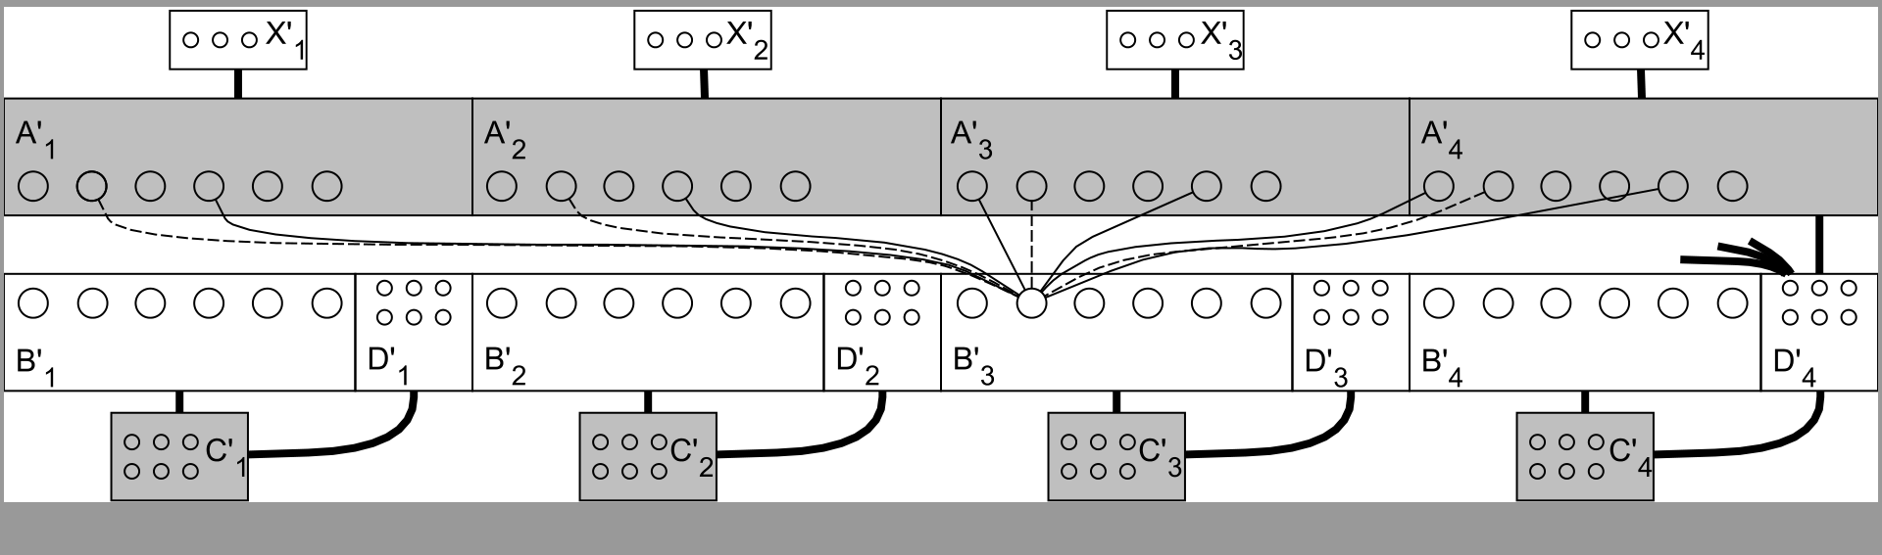
Complete construction

Slide 14
Consequences of the Lower Bound
Corollary 1. For every ε > 0 and every parameter Π that does not exceed the vertex count, Treewidth [Π] does not have a kernel of bitsize O(k^{2-ε}), unless NP ⊆ coNP/poly
Applies to parameterizations by Vertex Cover, Feedback Vertex Set, Vertex-Deletion Distance to …
The constructed graph is cobipartite
For cobipartite graphs, treewidth equals pathwidth
Corollary 2. n-Pathwidth does not have a generalized kernel of bitsize O(n^{2-ε}), for any ε > 0, unless NP ⊆ coNP/poly

Slide 15
Treewidth Parameterized by Vertex Cover
Treewidth [vc] Input: A graph G, vertex cover X of G, and an integer k Parameter: |X| Question: Is the treewidth of G at most k?
Lower bound implies:
No kernel with bitsize O(|X|^{2-ε}) unless NP ⊆ coNP/poly
Previous-best was a kernel with O(|X|³) vertices
Bodlaender, J, Kratsch [ICALP’11]
We improve this to |X|² vertices
Can be encoded in O(|X|³) bits

Slide 16
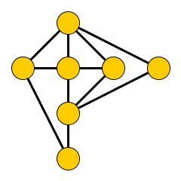
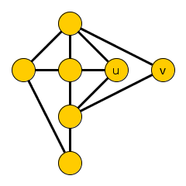
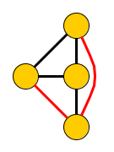
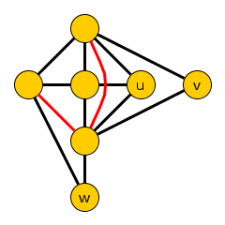
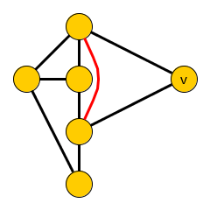
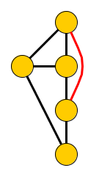
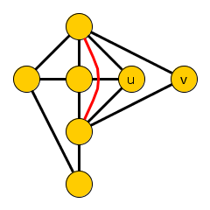
Treewidth-Invariant Sets
Kernel is based on treewidth-invariant sets
Vertex sets whose elimination has a predictable effect on treewidth
Consider a graph G with an independent set T
Let Ĝ_{T} be the result of eliminating T from G, one vertex at a time (order does not matter)
If Ĝ_{T} is a minor of G – {z} for every z ∈ T, then T is a treewidth-invariant set in G
Simplest case: T = {z} is a simplicial vertex
N_{G}(z) is a clique so Ĝ_{{z}} = G – {z}
Ĝ_{{u,v}}
Ĝ_{{u,v,w}}

Slide 17
Invariance Property
Let Δ(T) := max_{v∈T} deg(v)
Lemma. If T is a treewidth-invariant set in G,
then tw(G) = max{tw(Ĝ_{T}), Δ(T)}
Proof.
(≥) G contains Ĝ_{T} and a (Δ(T)+1)-clique as a minor
(≤) Consider a tree decomposition T of Ĝ_{T}
For every v ∈ T, N_{G}(v) exists in Ĝ_{T} and forms a clique there
So T has a bag containing N_{G}(v)
Append a new bag with N_{G}(v) U {v}, of size ≤ Δ(T) + 1
Update independently for each v ∈ T

Slide 18
Reduction Based on Treewidth-Invariant Sets
Consider an instance (G,k) of Treewidth with a treewidth-invariant set T:
If Δ(T) ≥ k + 1: output no
Else reduce to Ĝ_{T}
Invariance lemma shows that tw(G) ≤ k iff tw(Ĝ_{T}) ≤ k, reduction is safe
Remaining issue: how to find treewidth-invariant sets?
Seems hard in general
NP-complete to test if a given set is treewidth-invariant!
q-Expansion
Lemma

Slide 19
q-Expansion Lemma
Let H be a bipartite graph with partite sets A and B, and q ∈ ℕ
A subset A’ ⊆ A is saturated by q-stars into B’ if we can assign to each v ∈ A’ a set of q private neighbors from B’
N_{H}(T)
A
A’
T
B
B’
q-Expansion Lemma [Fomin et al.@STACS’11]
Let m be the size of a maximum matching in H. If |B| > m · q, then there is a nonempty set T ⊆ B such that N_{H}(T) is saturated by q-stars into T. It can be found in polynomial time.

Slide 20
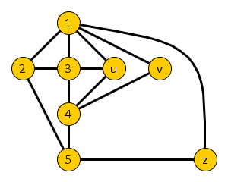
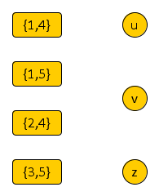
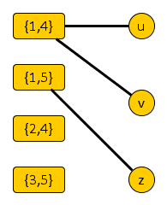
Finding Treewidth-Invariant Sets (I)
Given a graph G with vertex cover X, form a bipartite non-edge connection graph H_{G,X}
One side corresponds to non-edges in G[X]
One side consists of the independent set $\overline{X}$
H_{G,X} has an edge between non-edge {p,q} and v ∈ $\overline{X}$, if v is adjacent to both p and q in G
Contracting v into p or q creates the edge {p,q}
G
H_{G,X}
X

Slide 21
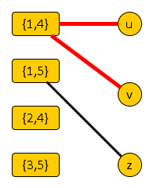
Finding Treewidth-Invariant Sets (II)
Lemma. If H_{G,X} contains a set T ⊆ $\overline{X}$ such that N_{H}(T) can be saturated by 2-stars into T, then T is a treewidth-invariant set
To prove: for all x ∈ T, Ĝ_{T} is a minor of G – {x}
Consider a non-edge {p,q} in N_{G}(y) for y ∈ T
Since y is adjacent to p and q, we have {p,q} in N_{H}(T)
In H there is a 2-star into T, centered at {p,q}
Pick a leaf of the star ≠ x, contract it into p to create {p,q}
Can be done independently for all non-edges, as each star center is assigned private neighbors in T
We realize all non-edges; delete remainder of T to get Ĝ_{T} -minor
Recall: Ĝ_{T} is G – T with each N_{G}(v)
turned into a clique for v ∈ T

Slide 22
Kernel Size Bound
Maximum matching in H_{G,X} has size at most $\left({|X| \atop 2}\right)$
Non-edge side has at most this many vertices
q-Expansion Lemma [Fomin et al.@STACS’11]
Let m be the size of a maximum matching H. If |B| > m · q, then there is a nonempty set T ⊆ B such that N_{H}(T) is saturated by q-stars into T. It can be found in polynomial time.
If |$\overline{X}$| > 2 $\left({|X| \atop 2}\right)$, find a 2-expansion in poly-time and reduce
Reduced instances have ≤ |X| + 2$\left({|X| \atop 2}\right)$ = |X|² vertices
Encoding into O(|X|³) bits
Theorem. Treewidth [vc] has a kernel with |X|² vertices that can be encoded in O(|X|³) bits

Slide 23
Refined analysis & implementation
Based on the number m_{X} of non-edges in G[X]
Size of a matching in H_{G,X} is at most m_{x}
If |$\overline{X}$| > 2 m_{X}, the algorithm finds a treewidth-invariant set
Reduced instances have at most |X| + 2 m_{X} vertices
Exhaustive reduction by computing a single maximum matching in H’_{G,X} (duplicate the non-edge side)
Time bound for the reduction algorithm:
O(n + m + |X|² + min {$\sqrt{\overline{X}}$, m_{X}} · |$\overline{X}$| · m_{x})

Slide 24
Challenges
Stated version of reduction rule finds special types of treewidth invariant sets relative to some vertex cover
Treewidth invariant sets T where each non-edge is covered by two unique vertices from T
Questions:
Can we find such sets in polynomial time without choosing a particular vertex cover?
Can we find more general treewidth-invariant sets?
How to find a vertex cover inducing few non-edges?
Lots of possibilities for algorithmic engineering!

Slide 25
Conclusion
Main contributions
1. No nontrivial polynomial-time sparsification for Treewidth and Pathwidth, unless NP ⊆ coNP/poly
2. Treewidth [vc] has a kernel with |X|² vertices
Open problems
1. Are there dense, minor-minimal treewidth obstructions that do not have a treewidth-invariant set?
2. Are there problems admitting nontrivial polynomial-time sparsification?
3. Does Treewidth [vc] have a kernel of bitsize O(k²)?
4. Does Pathwidth [vc] have a kernel with O(k²) vertices?

Slide 26
Conclusion
Main contributions
1. No nontrivial polynomial-time sparsification for Treewidth and Pathwidth, unless NP ⊆ coNP/poly
2. Treewidth [vc] has a kernel with |X|² vertices
Thank you!
Open problems
1. Are there dense, minor-minimal treewidth obstructions that do not have a treewidth-invariant set?
2. Are there problems admitting nontrivial polynomial-time sparsification?
3. Does Treewidth [vc] have a kernel of bitsize O(k²)?
4. Does Pathwidth [vc] have a kernel with O(k²) vertices?

