Slide 1
Bart Jansen Vertex Cover Kernelization Revisited: Upper and Lower Bounds for a Refined Parameter
Joint work with Hans Bodlaender
STACS 2011, Dortmund
March 10th, 2011

Slide 2
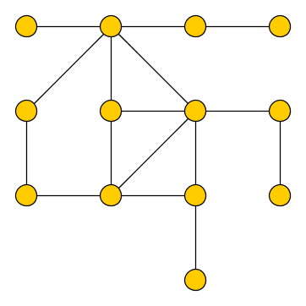
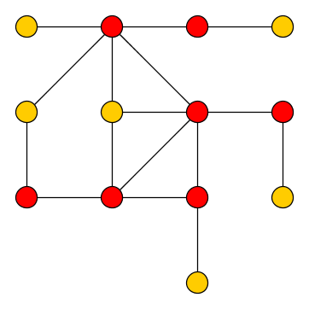
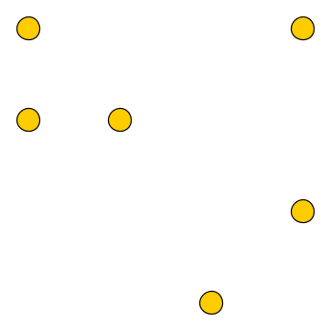
Vertex Cover
Input: Graph G, integer k
Question: Does G have a vertex cover of size ≤ k?
S is a Vertex Cover of G ⬄ Graph G – S is edgeless

Slide 3
Preprocessing for Vertex Cover
Preprocess by computing a small, equivalent instance in polynomial time
Reduce (G,k) to an equivalent instance on f(k) vertices
Evidence that factor 2 is optimal under UGC
O(k²)
Sam Buss [SIAM J. Comput. 1993]
High-degree rule
2k
Chen, Kanj and Jia [J. Algorithms 2001]
Linear-programming theorem by Nemhauser and Trotter
3k
Abu-Khzam, Fellows, Langston and Suters [Theory Comput. Syst. 2007]
Combinatorial algorithm by Crown Reduction

Slide 4
Relevant values of k
Consider instance (G,k) of Vertex Cover
Compute a 2-approximation set S in linear time
VC(G) ≤ |S| ≤ 2 VC(G)
In interesting situations we have:
VC(G) / 2 ≤ k ≤ 2 VC(G)
So for relevant instances k is Θ(VC(G))
k < |S|/2
k ≥ |S|
k < VC(G)
Output NO
k ≥ VC(G)
Output YES

Slide 5
Alternative parameterizations
Existing results guarantee that the size of instance (G,k) of Vertex Cover can be reduced to O(VC(G)) vertices
In polynomial time, without changing the answer
VC(G) is just a measure of the complexity of a graph
Take any measure  which maps graphs to N, and ask:
Can we reduce an instance (G,k) to poly[ (G) ] vertices?
Stronger data reduction if we can ensure (G) ≤ VC(G)

Slide 6
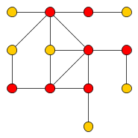
Graph parameters
Vertex Cover Number VC(G)
Size of a smallest set S such that G – S is edgeless
Vertex Cover
Edgeless Graphs

Slide 7
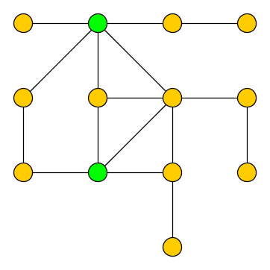
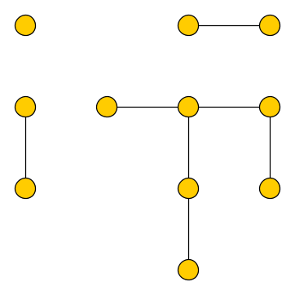
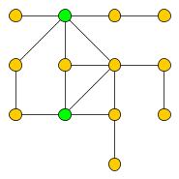
Graph parameters
Feedback Vertex Set Number FVS(G)
Size of a smallest set S such that G – S is a forest (acyclic)
Feedback vtx Set
Forests
Vertex Cover
Edgeless Graphs

Slide 8
A refined parameter
The difference can be arbitrarily large
The feedback vertex number is a refined parameter
Feedback vtx Set
Forests
Vertex Cover
Edgeless Graphs
≤

Slide 9
Our results
The size of an instance can efficiently be reduced to a polynomial in the size of the minimum FVS
(G,k)
p-time
O(FVS(G)³)
vertices

Slide 10
Our results
The size of an instance can efficiently be reduced to a polynomial in the size of the minimum FVS
In the language of parameterized complexity:
Vertex Cover parameterized by the size of a feedback vertex set admits a cubic-vertex kernel
(G,k)
p-time
O [min
VC(G), FVS(G)³ ]
vertices

Slide 11
Our results
The Weighted Vertex Cover problem cannot be reduced to an instance on poly[VC(G)] vertices *
(unless the polynomial hierarchy collapses)
where VC(G) is the cardinality of a minimum vertex cover
Reduction to O( (W-VC(G) ) vertices is possible
where W-VC(G) is the weight of a minimum vertex cover [Chlebík and Chlebíková, Disc Appl M 2008]
Weighted Vertex Cover can be solved in 2^{VC(G)} poly(n) time
* This strenghtens the result as given in the paper

Slide 12
the upper bounds
Sketch of the reduction rules

Slide 13
Outline of the reduction algorithm
Input: an instance (G,k) of Vertex Cover
Apply the Nemhauser-Trotter reduction
This effectively deletes vertices, so FVS(G) is not increased
Compute a 2-approximate Feedback Vertex Set X
[Bafna, Berman and Fujito, SIAM J Disc M 1999]
Use the structure of X within G to apply reduction rules
When no rules apply, the instance is provably small

Slide 14
Change of perspective
Instance (G,k) of Vertex Cover is equivalent to asking “Does G have an Independent Set of size n – k?”
Reduction rules are easier to formulate in Independent Set perspective
Interpret (G,k) as an instance (G, n – k) of Independent Set
Apply reduction rules to obtain a small instance of Independent Set (G’, n’ – k’)
Equivalent to the small Vertex Cover instance (G’, k’)

Slide 15
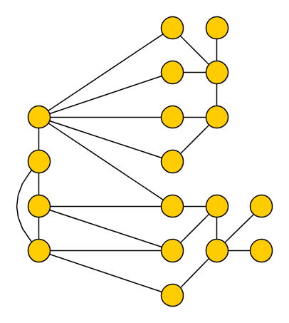
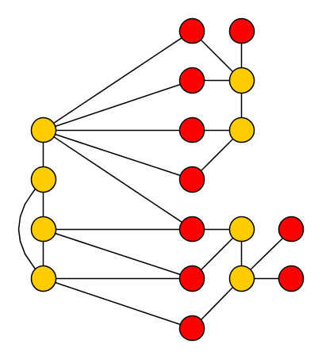
Structure of an instance: a canonical solution
F := G - X
Let forest F := G – X
Maximum Independent Set (MIS) of F is poly-time computable
Canonical solution=MIS(F)
Better solutions may exist using some vertices of X
We can test the effect of using single vertex
X

Slide 16
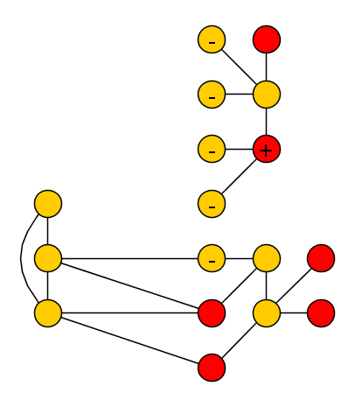
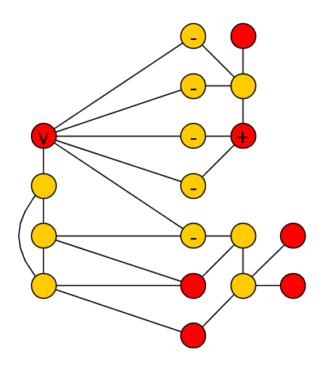
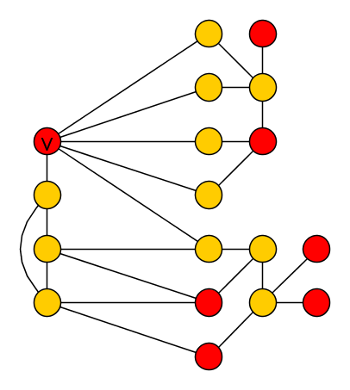
Using vertices from X
F := G - X
Consider using vertex v in X in an independent set
This IS cannot use any neighbors of v
Compare canonical solution to MIS(F – N(v))
If difference ≥ |X|:
Solutions containing v are not better than canonical
Delete v from the instance
X

Slide 17
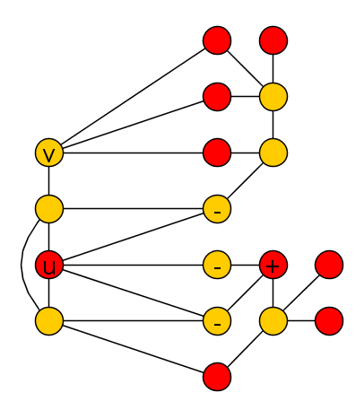
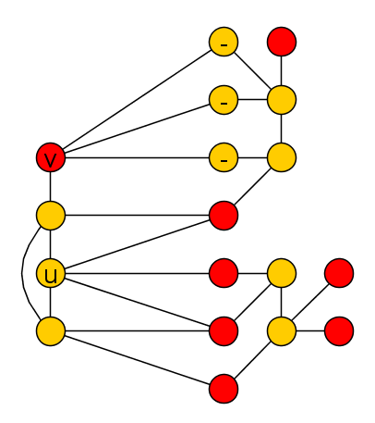
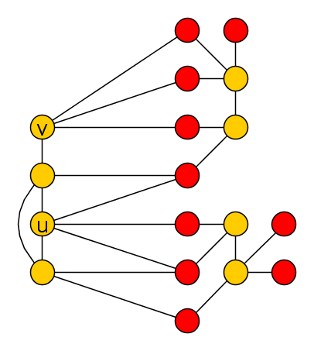
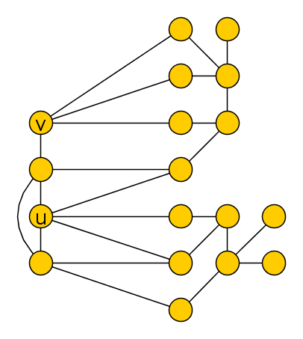
Using pairs of vertices from X
F := G - X
Different situation
No single vertex triggers the reduction rule
X

Slide 18
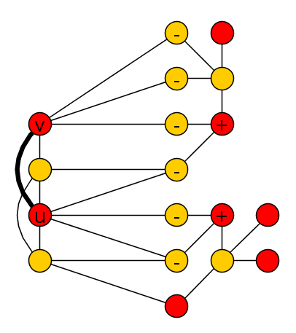
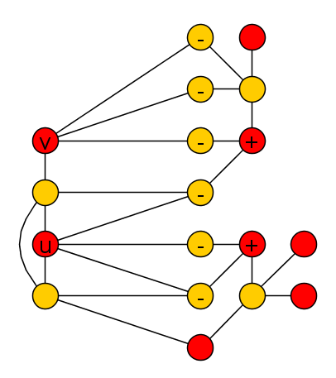
Using pairs of vertices from X
F := G - X
Consider using {u,v} from X in the independent set
Impossible if {u,v} adjacent
Compare canonical solution to MIS(F – N(u,v))
If difference ≥ |X|:
Solutions containing {u,v} are not better than canonical
Exists optimal solution which does not use both
Add edge {u,v}
X

Slide 19
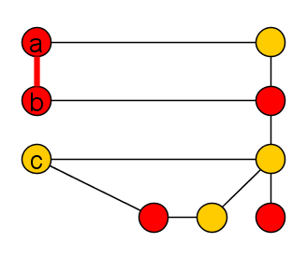
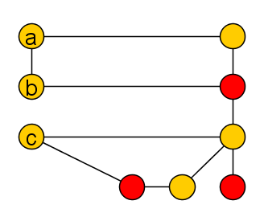
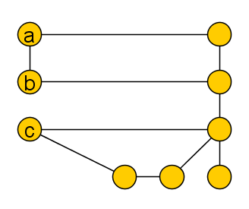
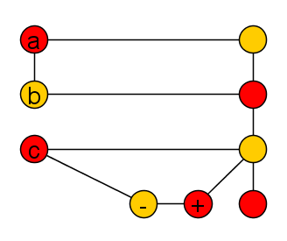
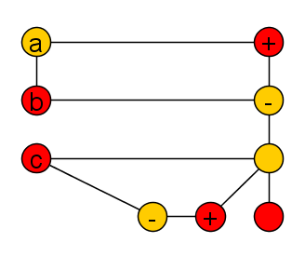
Deleting trees from F: An example
Consider this tree T in forest F
Any independent set in X can be augmented with MIS(T) vertices from T
Delete T, decrease k by MIS(T)
F := G - X
X

Slide 20
Deleting trees from F: the rule
If there is a tree T in the forest F, such that:
for all non-adjacent pairs {u,v} in X: MIS(T) = MIS(T – N(u,v))
Then delete T from the instance, decrease k by MIS(T)
Justified by the following lemma:
If there is an independent set X’ ⊆ X such that MIS(T) > MIS(T – N(X’))
then there is such a set of size at most 2

Slide 21
Overview of the reduction process
Two more rules to simplify the trees in F
Effect of the rules:
For each vertex v in X, the amount you have to “pay” in F for using v is at most |X|
Similar for pairs of vertices in X
But for each tree, some pair makes you pay in that tree
Long proof shows that |F| is O(|X|³) after reduction
Size of vertex set is |X| + O(|X|³)

Slide 22
conclusion and discussion

Slide 23
Kernelizability of (Unweighted) Vertex Cover
Vertex Cover
Increasing size
Cluster Deletion Distance
Feedback Vertex Set
?
?
Chordal Deletion Distance
Odd Cycle Transversal
Outerplanar Deletion Distance
Treewidth
All parameterizations are fixed-parameter tractable

Slide 24
Conclusion
We have studied data reduction for Vertex Cover using a “refined” parameter: Feedback Vertex Number
Kernel with O(|X|³) vertices
Usage of vertex weights affects kernelizability
No polynomial kernel for weighted problem parameterized by VC-size (unless…)
Hierarchy of parameters to explore
Open problems:
Deletion distance to bipartite/outerplanar graphs
Improve the degree of the polynomial: cubic to quadratic?
Thank you!

