Slide 1

Vertex Deletion Parameterized by Elimination Distance
and Even Less
Bart M. P. Jansen
Jari J. H. de Kroon
Michał Włodarczyk
Dagstuhl Seminar 22481. Vertex Partitioning in Graphs: From Structure to Algorithms
November 30th 2022
Notes:
Headsup: full paper in STOC is 76 pages, cannot describe all results. I’ll spend most time on motivating the results and the background.

Slide 2
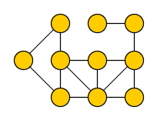
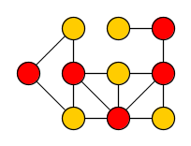
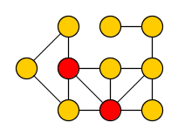
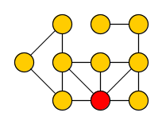
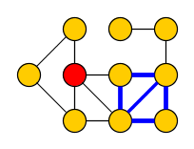
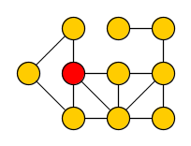
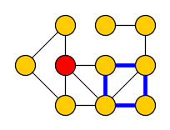

Vertex-deletion problems
Vertex Deletion to Graph Class $ℋ$
Input: Undirected graph $G$
Output: Minimum vertex set $S$ such that $G−S$ belongs to graph class $ℋ$
Many classic NP-hard graph problems can be phrased in this way:
Vertex Cover
Delete vertices to get edgeless graph
Feedback Vertex Set
Delete vertices to get acyclic graph
1
2
1
Odd Cycle Transversal
Delete vertices to get bipartite graph
Chordal Vertex Deletion
Delete vertices to get graph without chordless cycles
2
2
1
2
1
1
Notes:
The first two are among Karp’s 21. VC, FVS and OCT are ‘graph partitioning problems’ as per the seminar’s description.

Slide 3

Fixed-parameter tractable algorithms for vertex deletion
Fixed-parameter tractability gives a way to cope with these NP-hard problems:
Choose a complexity parameter $k$ independent of the number of vertices $n$
Find an optimal solution in time $f\left(k\right)⋅n^{O(1)}$ for some function $f$ ?
Vertex Cover
Delete vertices to get edgeless graph
Feedback Vertex Set
Delete vertices to get acyclic graph
Odd Cycle Transversal
Delete vertices to get bipartite graph
Chordal Vertex Deletion
Delete vertices to get graph without chordless cycles
Notes:
Using approximation algorithms is one way of coping with NP-hardness. Main point of our paper: new FPT algorithms for solving vertex-deletion problems with parameterizations that dominate the ones previously used.

Slide 4





Vertex-deletion problems parameterized by solution size
Natural choice: use the size opt of the optimal solution as the complexity parameter
Develop algorithms which can efficiently find a small solution in a large graph
When opt $≈n$, these FPT algorithms are not much better than brute-force $2^{n}$
Vertex Cover
${1.27}^{\text{opt}}⋅n^{O\left(1\right)}$
Feedback Vertex Set
${2.7}^{\text{opt}}⋅n^{O(1)}$
Can we develop algorithms which are provably optimal and efficient
on classes of inputs whose optimal solutions are large?
[Chen, Kanj, Xia’10]
[Li, Nederlof ’19]
Odd Cycle Transversal
${2.31}^{\text{opt}}⋅n^{O(1)}$
Chordal Vertex Deletion
$2^{O\left(\text{opt}\log{\text{opt}}\right)}n^{O(1)}$
[LNRRS’14]
[Cao, Marx’16]
Notes:
Can we develop algorithms which are provably optimal and efficient in graphs whose solutions are large?

Slide 5




Vertex-deletion problems parameterized by graph complexity
Alternative: use a complexity measure of the graph as the parameter
Develop algorithms for graphs which are large but simply structured
Popular width measures of graphs include treedepth (td) and treewidth (tw)
Vertex Cover
$2^{\text{tw}}⋅n^{O(1)}$
Feedback Vertex Set
$3^{\text{tw}}⋅n^{O(1)}$
[CNPPRW’11]
Odd Cycle Transversal
$3^{\text{tw}}⋅n^{O(1)}$
Chordal Vertex Deletion
$f(\text{tw})⋅n^{O(1)}$
Notes:
Simply structure: think treelike. Same running time bounds can be obtained for treedepth, sometimes in polynomial space.
For all of them: can replace TW by TD. For VC and OCT, this gives poly-space algorithms.

Slide 6
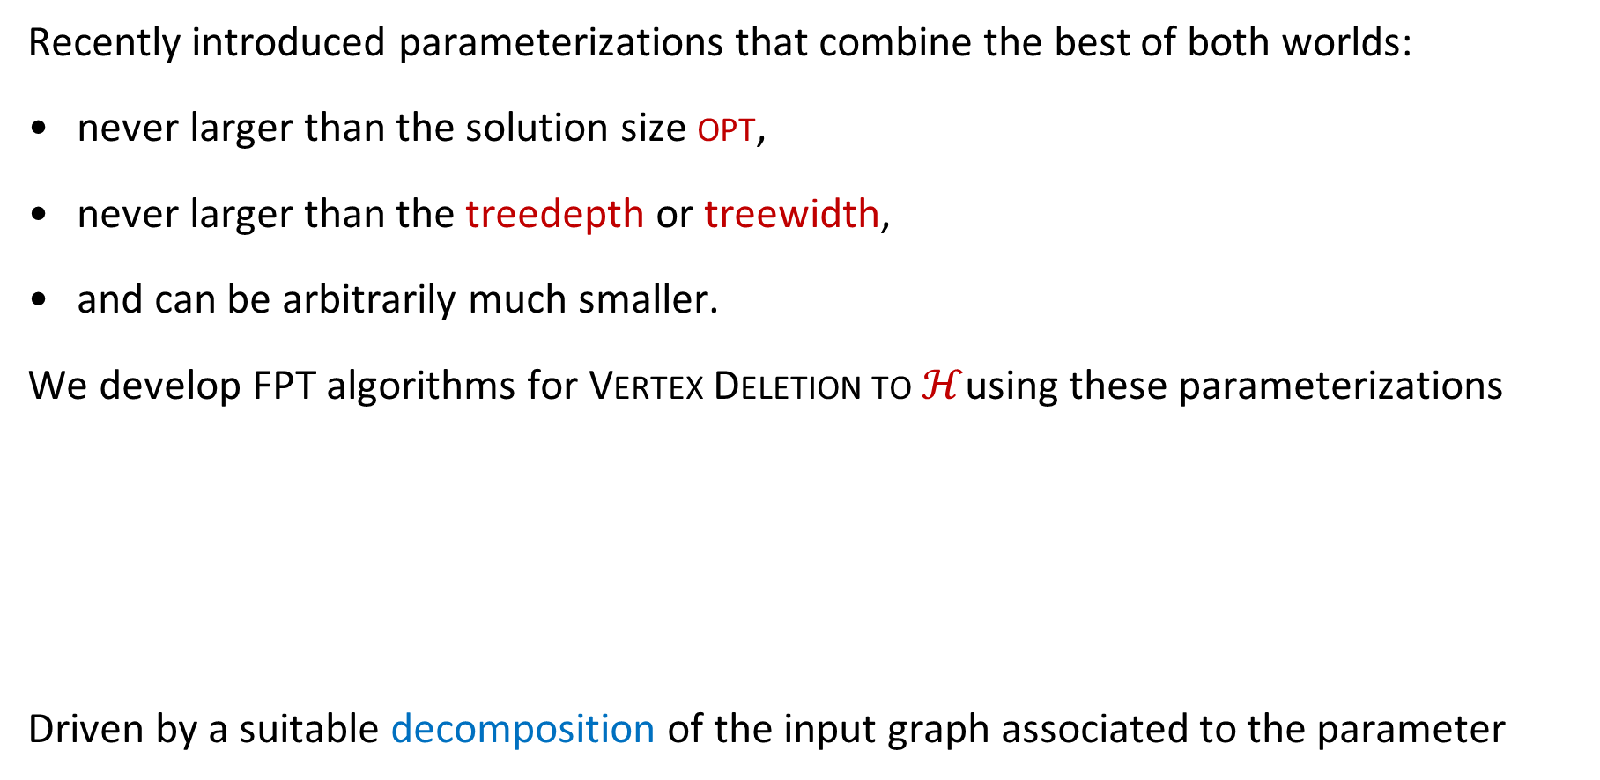
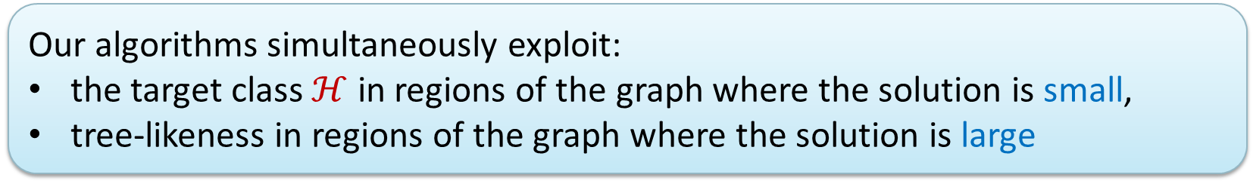
Hybrid problem parameterizations
Recently introduced parameterizations that combine the best of both worlds:
never larger than the solution size opt,
never larger than the treedepth or treewidth,
and can be arbitrarily much smaller.
We develop FPT algorithms for Vertex Deletion to $ℋ$using these parameterizations
Driven by a suitable decomposition of the input graph associated to the parameter
Our algorithms simultaneously exploit:
the target class $ℋ$ in regions of the graph where the solution is small,
tree-likeness in regions of the graph where the solution is large
Notes:
Yields algorithms that are guaranteed to efficiently yield optimal solutions in classes of inputs that cannot be handled by either of the previous approaches alone.

Slide 7
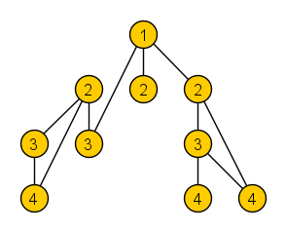
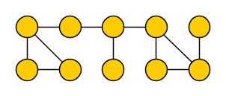
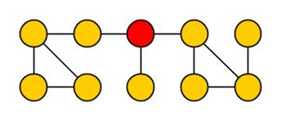
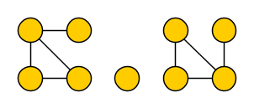
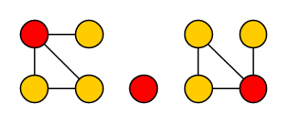
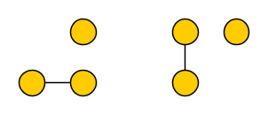
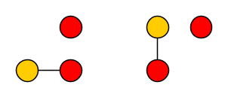

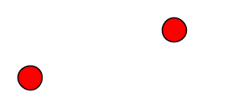
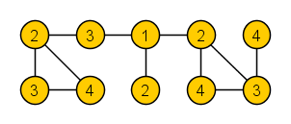
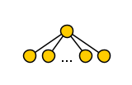





Treedepth
The treedepth $td(G)$ of graph $G$ is:
the minimum number of rounds to reduce $G$ to an empty graph without vertices,
when deleting one vertex from each connected component per round
Yields elimination forest in which all edges of $G$ connect ancestors to descendants
Note:
$td(G)$ is the minimum depth of an elimination forest
Intuitively, $td(G)$ captures how star-like the graph is: $td\left( \right)=2$
Notes:
Well-known to those of you who participated in the PACE challenge last year! Treedepth can be large even though solution to vertex-deletion can be small: an n*n grid has treedepth >= n but since it is bipartite, the empty set is a solution to odd cycle transversal on the grid.

Slide 8
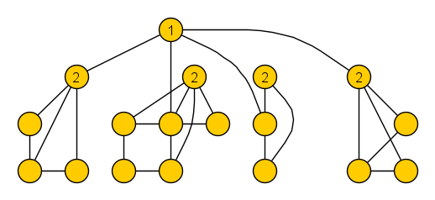
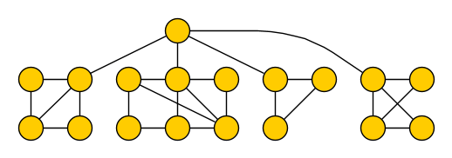
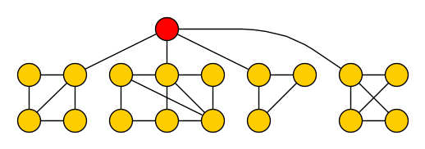
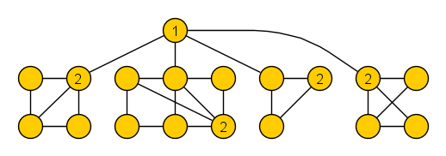
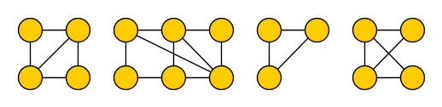
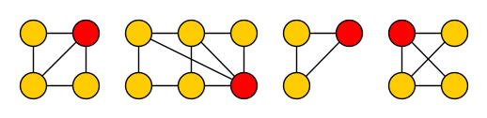
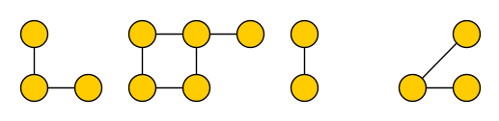













Elimination distance to $ℋ$
For a graph class $ℋ$, the elimination distance $ed_{ℋ}(G)$ of graph $G$ to $ℋ$ is:
the minimum number of rounds to reduce $G$ to a graph in class $ℋ$,
when deleting one vertex from each connected component per round
Yields $ℋ$-elimination forest whose leaves are connected subgraphs belonging to $ℋ$
Note:
$ed_{ℋ}(G)$ is the minimum depth of an $ℋ$-elimination forest
$ed_{ℋ}(G)$ is never larger than treedepth or vertex-deletion distance to $ℋ$
$ℋ$= bipartite
we refer to these as base components
Notes:
Treedepth is also known as vertex ranking number or vertex elimination number. Depth of elimination tree corresponds to number of rounds.

Slide 9

Prior work on computing treedepth and elimination distance
Treedepth can be computed exactly in time $2^{O\left(n\right)}$ and $2^{O(OPT^{2})}⋅n$
[Reidl, Rossmanith, Sánchez Villaamil, Sikdar, ICALP ’14] [Nadara, Michal Pilipczuk, Smulewicz, ESA ’22]
Elimination forest of depth $OPT^{2}\log{OPT}$ can be computed in polynomial time
[Czerwinski, Nadara, Marcin Pilipczuk, ESA ’19]
$ℋ$-elimination distance was introduced by Bulian & Dawar [IPEC ’14, Algorithmica ‘16]
$ℱ$-minor-free graphs
[Bulian & Dawar]
ℱ-minor-free graphs
[Bulian & Dawar]
Bounded-degree graphs (approximation)
[Bulian & Dawar]
Bounded-degree graphs
(planar inputs)
[Lindermayr, Siebertz,
Vigny, MFCS‘20]
Cluster graphs
[Agrawal & Ramanujan, IPEC‘20]
Bipartite graphs
[J. & de Kroon, WG ’21]
All classes defined by a finite set of forbidden induced subgraphs
[Agrawal, Kanesh, Panolan, Ramanujan, Saurabh, STACS’21]
Rankwidth $≤c$
[Eiben, Ganian, Hamm,
Kwon, MFCS‘19]
Rankwidth ≤𝑐
[Eiben, Ganian, Hamm,
Kwon, MFCS‘19]
CMSO-definable graph classes $ℋ$ closed under disjoint union for which $ℋ$-deletion is FPT by solution size
(non-uniform)
[Agrawal, Kanesh, Lokshtanov, Panolan, M. S.R., Saurabh, Zehavi, SODA ‘22]
CMSO-definable graph classes ℋ closed under disjoint union for which ℋ-deletion is FPT by solution size
(non-uniform)
[Agrawal, Kanesh, Lokshtanov, Panolan, M. S.R., Saurabh, Zehavi, SODA ‘22]
Notes:
In all cases: huge parameter dependence.
Measuring what matters: A hybrid approach to dynamic programming with treewidth. Eiben Ganian Hamm Kwon.’21.

Slide 10
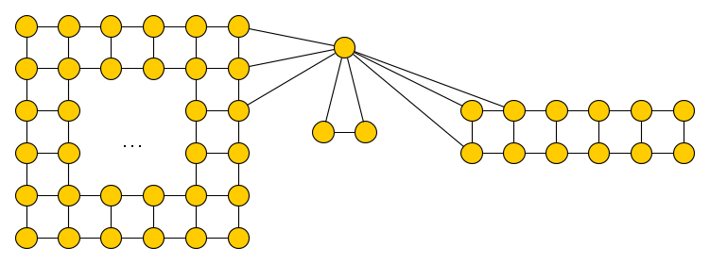
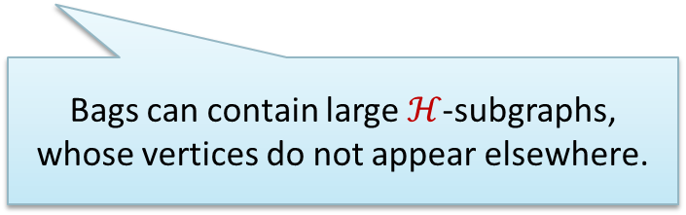
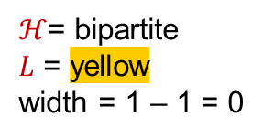

$ℋ$-treewidth
For a graph class $ℋ$, a tree $ℋ$-decomposition of graph $G$ is a triple $\left(T,bag,L\right)$, where
$T$ is a rooted tree, $bag:V\left(T\right)→2^{V\left(G\right)}$, and $L⊆V(G)$ such that:
For each $v∈V(G)$, the nodes $\{t∈V\left(T\right)∣v∈bag(t)\}$ form a non-empty subtree of $T$
For each edge $uv∈E(G)$ there is a node $t∈V(T)$ with $\{u,v\}⊆bag(t)$
For each $v∈L$, there is a unique $t∈V(T)$ with $v∈bag(t)$
For each node $t∈V(T)$ the graph $G[bag\left(t\right)∩L]$ belongs to $ℋ$.
The width of $(T,χ,L)$ is defined as $\max_{t∈V\left(T\right)}{|χ\left(t\right)∖L|}−1$
$ℋ$= bipartite
$L$ = yellow
width = 1 – 1 = 0
Bags can contain large $ℋ$-subgraphs, whose vertices do not appear elsewhere.
Notes:
Note that, by properties 1 and 2, the pair $(T,bag)$ is simply a tree decomposition of $G$. The set $L$ contains vertices that you do not pay for in the width, but they can appear in only 1 bag and should induce $ℋ$-subgraphs.
Originally introduced by Eduard Eiben, Robert Ganian, Thekla Hamm, O-joung Kwon in MFCS 2019.

Slide 11
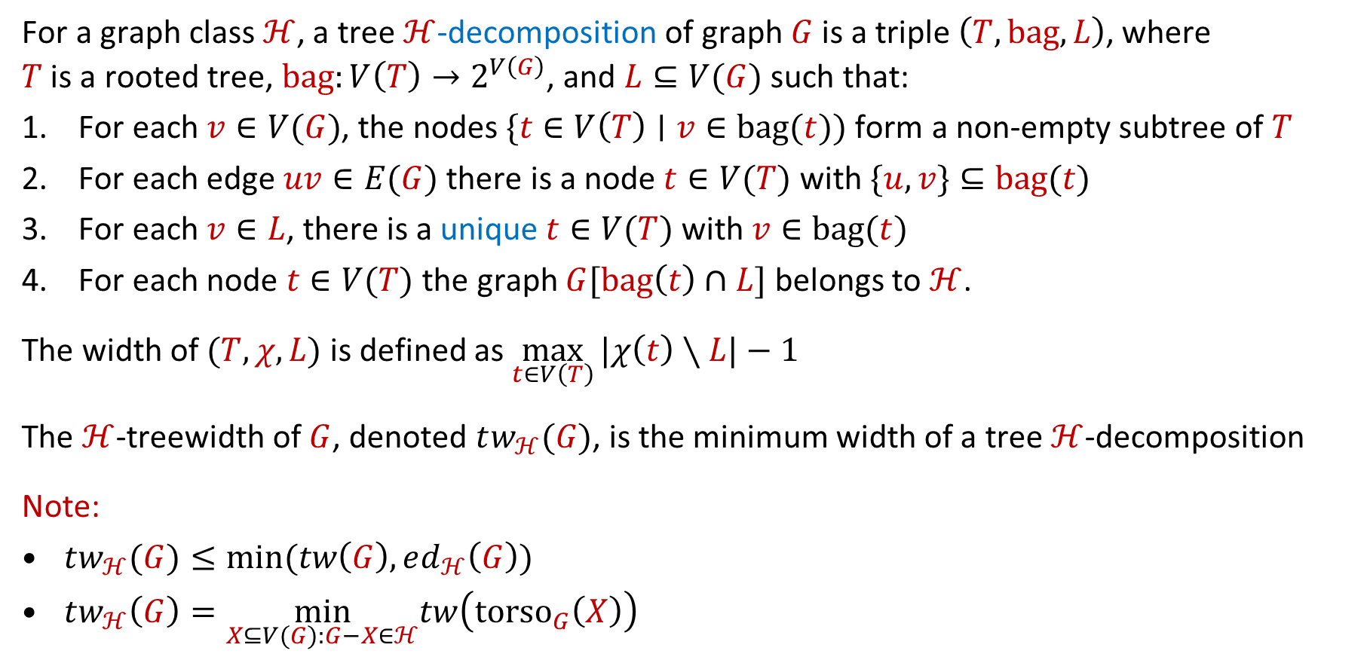
$ℋ$-treewidth
For a graph class $ℋ$, a tree $ℋ$-decomposition of graph $G$ is a triple $\left(T,bag,L\right)$, where
$T$ is a rooted tree, $bag:V\left(T\right)→2^{V\left(G\right)}$, and $L⊆V(G)$ such that:
For each $v∈V(G)$, the nodes $\{t∈V\left(T\right)∣v∈bag(t))$ form a non-empty subtree of $T$
For each edge $uv∈E(G)$ there is a node $t∈V(T)$ with $\{u,v\}⊆bag(t)$
For each $v∈L$, there is a unique $t∈V(T)$ with $v∈bag(t)$
For each node $t∈V(T)$ the graph $G[bag\left(t\right)∩L]$ belongs to $ℋ$.
The width of $(T,χ,L)$ is defined as $\max_{t∈V\left(T\right)}{|χ\left(t\right)∖L|}−1$
The $ℋ$-treewidth of $G$, denoted $tw_{ℋ}(G)$, is the minimum width of a tree $ℋ$-decomposition
Note:
$tw_{ℋ}(G)≤min⁡(tw\left(G\right),ed_{ℋ}\left(G\right))$
$tw_{ℋ}\left(G\right)=\min_{X⊆V(G):G−X∈ℋ}tw\left(torso_{G}\left(X\right)\right)$
Notes:
Note that, by properties 1 and 2, the pair $(T,bag)$ is simply a tree decomposition of $G$. The set $L$ contains vertices that you do not pay for in the width, but they can appear in only 1 bag and should induce $ℋ$-subgraphs.
Originally introduced by Eduard Eiben, Robert Ganian, Thekla Hamm, O-joung Kwon in MFCS 2019.

Slide 12
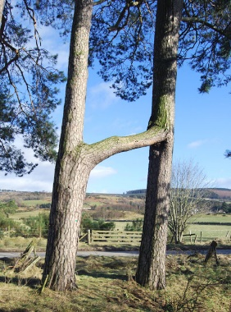
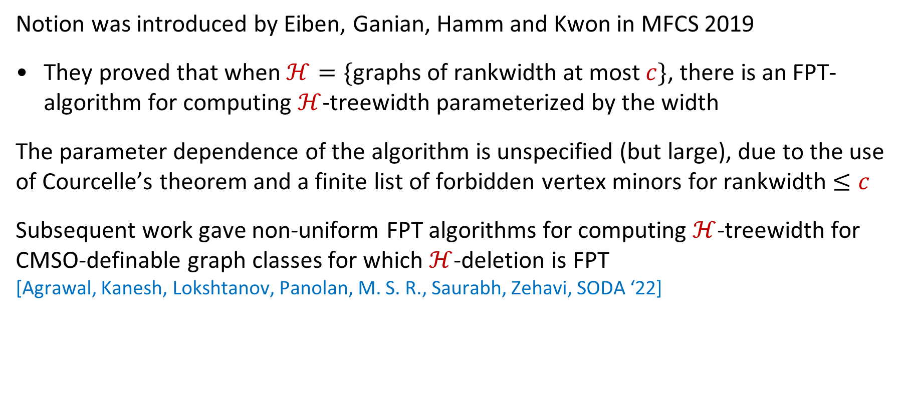
Work on $ℋ$-treewidth
Notion was introduced by Eiben, Ganian, Hamm and Kwon in MFCS 2019
They proved that when $ℋ=\{$graphs of rankwidth at most $c\}$, there is an FPT-algorithm for computing $ℋ$-treewidth parameterized by the width
The parameter dependence of the algorithm is unspecified (but large), due to the use of Courcelle’s theorem and a finite list of forbidden vertex minors for rankwidth $≤c$
Subsequent work gave non-uniform FPT algorithms for computing $ℋ$-treewidth for CMSO-definable graph classes for which $ℋ$-deletion is FPT
[Agrawal, Kanesh, Lokshtanov, Panolan, M. S. R., Saurabh, Zehavi, SODA ‘22]

Slide 13
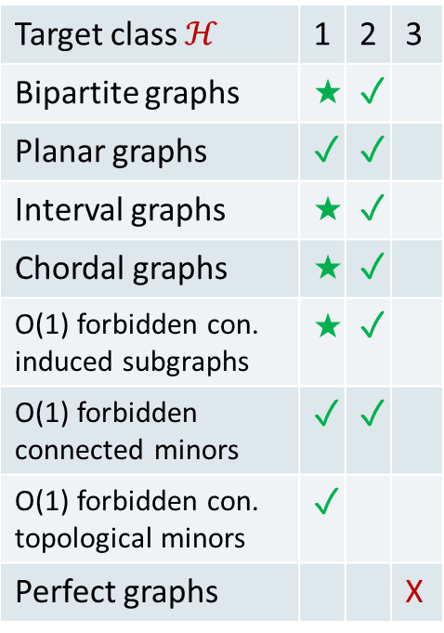

Results
We obtained three types of results for various hereditary graph classes $ℋ$:
1. Uniform FPT-approximate decomposition algorithms
2. Algorithms solving Vertex Deletion to $ℋ$
2. Algorithms solving Vertex Deletion to ℋ
3. Hardness proofs
Given a graph $G$ with $ed_{ℋ}\left(G\right)=k$ or $tw_{ℋ}\left(G\right)=k$, output an $ℋ$-elimination
forest or $ℋ$-tree decomposition of cost $k^{O\left(1\right)}$ in time $f(k)⋅n^{O\left(1\right)}$(✓)
or even $2^{k^{O\left(1\right)}}⋅n^{O\left(1\right)}$ (★)
Given a graph 𝐺 with 𝑒𝑑_ℋ (𝐺)=𝑘 or 𝑡𝑤_ℋ (𝐺)=𝑘, output an ℋ-elimination
forest or ℋ-tree decomposition of cost 𝑘^𝑂(1) in time 𝑓(𝑘)⋅𝑛^𝑂(1) (✓)
or even 2^(𝑘^𝑂(1) )⋅𝑛^𝑂(1) (★)
Given an $ℋ$-elimination forest or $ℋ$-tree decomposition of cost $k$ of a graph $G$,
output a minimum set $S$ such that $G−S∈ℋ$ in time $2^{k^{O\left(1\right)}}⋅n^{O\left(1\right)}$
Given an ℋ-elimination forest or ℋ-tree decomposition of cost 𝑘 of a graph 𝐺,
output a minimum set 𝑆 such that 𝐺−𝑆∈ℋ in time 2^(𝑘^𝑂(1) )⋅𝑛^𝑂(1)
For some graph classes for which we did not find algorithms as above,
no such algorithms exist unless $FPT=W[1]$
For some graph classes for which we did not find algorithms as above,
no such algorithms exist unless 𝐹𝑃𝑇=𝑊[1]
Target class $ℋ$ | 1 | 2 | 3
Bipartite graphs | ★ | ✓
Planar graphs | ✓ | ✓
Interval graphs | ★ | ✓
Chordal graphs | ★ | ✓
O(1) forbidden con. induced subgraphs | ★ | ✓
O(1) forbidden connected minors | ✓ | ✓
O(1) forbidden con. topological minors | ✓
Perfect graphs |  |  | X
Notes:
When combining 1&2: solve vertex-deletion optimally in FPT-time parameterized by elimination distance. For some $ℋ$ we can even do it in polynomial space, such as for bipartite graphs.
In the paper, we present similar results for the parameterization that extends treewidth.

Slide 14
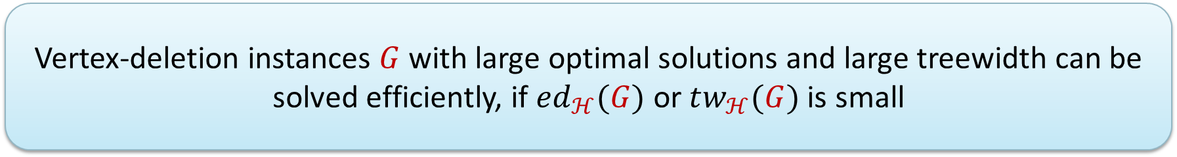
Conceptual message of the advances in hybrid parameterizations
Old mindset of the complexity of exactly solving vertex-deletion problems:
can only be done efficiently when the solution is small,
or the graph is treelike
High-level message of these results:
Running times and parameter dependence of the resulting algorithms are in the same ballpark as state of the art for parameterizations by solution size and treewidth
Vertex-deletion instances $G$ with large optimal solutions and large treewidth can be solved efficiently, if $ed_{ℋ}(G)$or $tw_{ℋ}(G)$is small
Notes:
Wide applicability came as a surprise: initially thought this was a ‘fluke’, only for OCT based on polynomial-time compression problem. Remainder of the talk: some technical details of 1) decomposition algorithms and 2) solving vertex-deletion problems.

Slide 15


High-level idea to approximate $ℋ$-elimination distance
Exploit existing algorithms to compute or approximate treedepth
Applying them directly is not useful:
$td(G)$ can be arbitrarily large compared to $ed_{ℋ}(G)$
$ℋ$= bipartite
$k=1$

Slide 16
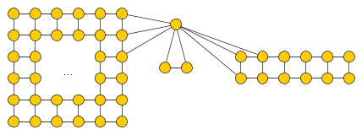
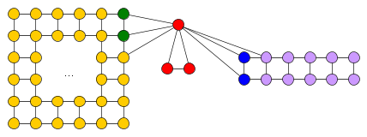
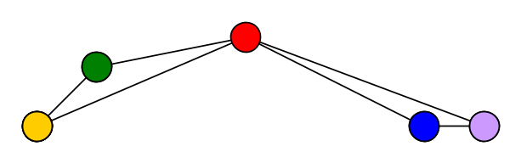

High-level idea to approximate $ℋ$-elimination distance
Exploit existing algorithms to compute or approximate treedepth
1. Treedepth of $G′$ is bounded in terms of $ed_{ℋ}\left(G\right)$
Base components of large treedepth should be contracted to small vertex sets
2. Given elimination forest of $G′$ depth $k$,
can find $ℋ$-elimination forest of $G$ of depth $poly\left(k\right)$
Each contracted set $S$ should be $C∪N_{G}(C)$, where $G\left[C\right]∈ℋ$ and $\left|N_{G}\left(C\right)\right|≤{ed_{ℋ}(G)}^{O\left(1\right)}$
Idea: Contract $G$ into a graph $G′$ such that $td\left(G′\right)≈ed_{ℋ}(G)$
Notes:
Then you can mimic an elimination process on $G′$ to the empty graph, by an elimination process in $G$ that ends with a graph from $ℋ$. For each vertex of $G′$ that you eliminate: eliminate the corresponding boundary, leave the H-subgraph alive.

Slide 17







Finding $ℋ$-subgraphs with small neighborhoods
Leads to the following algorithmic problem for fixed graph classes $ℋ$:
$ℋ$-separation
Input: Graph $G$, integer $k$, connected vertex set $Z$
Output: A connected vertex set $C⊇Z$ with $G\left[C\right]∈ℋ$ and $\left|N_{G}\left(C\right)\right|≤k$,
if such a set exists
$ℋ$= bipartite
$k=2$
$$Z$$
$$C$$
Notes:
Related to secluded subgraph problems studied earlier in the literature, but with additional requirement of containing a set Z.
High-level approach: by repeatedly calling the algorithm we can find ‘maximal’ sets of potential base components. Based on these we partition the vertex set of the graph into connected sets, and establish a relation between the $ℋ$-elimination distance of $G$ and the treedepth of the graph you get when contracting each set into a single vertex.

Slide 18


Finding $ℋ$-subgraphs with small neighborhoods
Leads to the following algorithmic problem for fixed graph classes $ℋ$:
$ℋ$-separation
Input: Graph $G$, integer $k$, connected vertex set $Z$
Output: A connected vertex set $C⊇Z$ with $G\left[C\right]∈ℋ$ and $\left|N_{G}\left(C\right)\right|≤k$,
if such a set exists
We develop FPT-approximation algorithms for extensions of this problem, based on:
important separators, the Erdős–Pósa property,
bounded-depth branching algorithms, min-cut max-flow
Lemma. If $ℋ$-separation can be solved in time $f(n,k)$,
then there is an algorithm that, given a graph $G$ with $ed_{ℋ}\left(G\right)=k$,
outputs an $ℋ$-elimination forest of depth $O(k^{3}\log{k})$ in time $f\left(n,k\right)⋅n^{O\left(1\right)}$.
Notes:
High-level approach: by repeatedly calling the algorithm we can find ‘maximal’ sets of potential base components. Based on these we partition the vertex set of the graph into connected sets, and establish a relation between the $ℋ$-elimination distance of $G$ and the treedepth of the graph you get when contracting each set into a single vertex. The restricted problem is a technical bicriteria variant.

Slide 19
















Approximating $bipartite$-separation
Approximate $bipartite$-separation
Input: Graph $G$, integer $k$, connected vertex set $Z$
Output: Connected set $C⊇Z$ such that $G\left[C\right]$ is bipartite and $\left|N_{G}\left(C\right)\right|≤2k$,
if such a set with a neighborhood of size $k$ exists
Given a graph $G$ with elimination distance $k$ to a bipartite graph, a
$bipartite$-elimination forest of depth $O(k^{3}\log{k})$ can be computed in polynomial time.
Polynomial-time algorithm:
Fix 2-coloring of $G[Z]$ with color classes $A,B$
Create parity graph $G′$ on $\left\{v^{′},v^{′′} ∣ v∈V\left(G\right)\right\},$
edges $u^{′}v^{′′} and u^{′′}v^{′}$ for all $uv∈E\left(G\right)$
Define two sets:
$S=\left\{v^{′} ∣ v∈Z∩A\right\}∪\{v^{′′}∣v∈Z∩B\}$
$T=\left\{v^{′′} ∣ v∈Z∩A\right\}∪\{v^{′}∣v∈Z∩B\}$
Find $(S,T)$ separator $X′⊆V\left(G^{′}\right)∖(S∪T)$
If $X^{′}>2k$: fail (neighborhood $≤k$ is impossible)
Let $X=\{v∈V\left(G\right)∣v^{′}∈X^{′}∨v^{′′}∈X^{′}\}$
Output component $C$ of $G−X$ containing $Z$
$$X$$
$$X$$
$$Z$$
$$C$$
Notes:
If you take a closed walk in a bipartite subgraph: the parity of the vertex from which you start is equal to that from which you return. To return to a vertex of opposite parity, you have to traverse an odd cycle. This means that a path that switches parity contains an odd cycle. It turns out that breaking paths which allows you to switch parity, is sufficient to break all reachable odd cycles.

Slide 20




Conclusion
We provided three types of results for hybrid parameterizations of Vertex deletion:
Open problems:
Can every $ℋ$-Deletion problem solvable in time $2^{p\left(OPT\right)}⋅n^{O\left(1\right)}$ and $2^{p\left(tw\right)}⋅n^{O\left(1\right)}$,
be solved in time $2^{p\left(tw_{ℋ}\right)}⋅n^{O\left(1\right)}$?
Can a $c$-approximation to $ed_{ℋ}$ be computed in time $2^{k^{O\left(1\right)}}⋅n^{O\left(1\right)}$ ?
Can variants of these hybrid parameterizations be effective for directed graphs?
1. Decomposition algorithms
3. Hardness proofs
2. Algorithms solving Vertex Deletion to $ℋ$

