Slide 1
Introduction to
Automotive Software Systems
2IN60: Real-time Architectures
(for automotive systems)

Slide 2
Why should I get up early in the morning to follow this course?
More and more car functions are being implemented in software
Developing software is expensive
$$$
Notes:
Most innovation in cars is happening in electronics, a lot moving to software.
Preface lecture motivates the large cost of software development (i) costs for software and electronics and (ii) #MLOCs. -

Slide 3
Goals for this slide set
Describe different functional domains in a car
Explain the problem of system complexity
Describe how complexity is addressed in automotive systems
Give examples of important requirements for the realization of car functions

Slide 4
Outline
Functional domains
Network architecture of a car
Requirements for function realizations

Slide 5
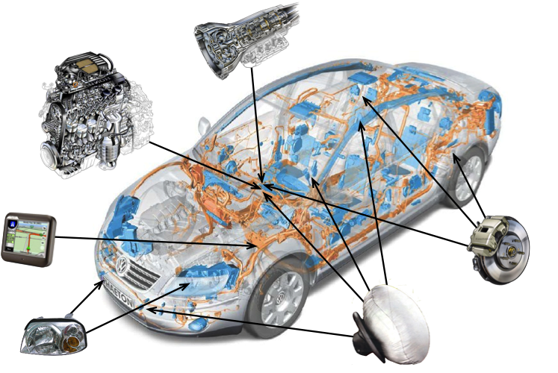
Car functions
Notes:
1. Airbag (passivesafety)
2. Gear (power-train)
3. Radar (passivesafety)
4. Infotainment (telematics)
5. ABS (chassis)
6. Powertrain

Slide 6
Automotive functional domains
powertrain, e.g.
  engine control, transmission and gear control;
chassis, e.g.
  ABS (Antilock Braking System), ESP (Electronic Stability Program), ASC (Automatic Stability Control), ACC (Adaptive Cruise Control);
body (comfort), e.g.
  air conditioning and climate control, dash board, wipers, lights, doors, seats, windows, mirrors, cruise control, park distance control;
telematics/wireless, e.g.
  multimedia, infotainment, GPS and in-vehicle navigation systems, CD/DVD players, rear-seat entertainment;
passive safety (emerging), e.g.
  rollover sensors, airbags, belt pretensioners.

Slide 7
Automotive domains
 | Powertrain | Chassis | Body | Telematics | Passive safety
Program size | 2 MB | 4.5 MB | 2.5 MB | 100 MB | 1.5 MB
Number of ECUs | 3-6 | 6-10 | 14-30 | 4-12 | 11-12
Number of messages | 36 | 180 | 300 | 660 | 20
Bus topology | Bus | Bus | Bus | Ring | star
Bandwidth | 500 Kb/s | 500 Kb/s | 100 Kb/s | 22 Mb/s | 10 Mb/s
Cycle time | 10 ms – 10 s | 10 ms – 10 s | 50 ms 2 s | 20 ms 0 5 s | 50 ms
Safety requirements | High | High | Low | Low | Very high

Slide 8
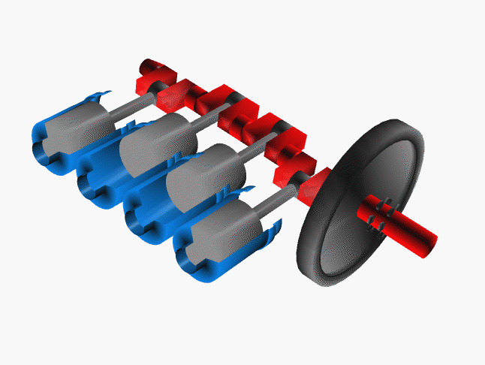
Engine control
Task of engine control:
  calculate amount of fuel and
  exact moment of injection
Dependencies:
  pedal (driver)
  load of the engine
  temperature
  etc.
Sensors and actuators:
  position of crankshaft
  valves
Relevance:
  avoid mechanical damage
  provide quality of control (e.g. fuel efficiency)
Crankshaft (red), pistons (grey) in their
cylinders (blue), and flywheel (black)
Notes:
<reference>[Kopetz 98], Section 1.7.2</reference>
2nd task: the exact moment at which the fuel must be injected in the combustion chamber of each cylinder.
Up to 100 concurrently executing software tasks must cooperate in tight synchronization (for engine control) to achieve the desired goal,
a smoothly running and efficient engine with a minimal output of pollution!

Slide 9
Engine control
Real-time requirements for fuel injection:
  Keep the fuel intake valve open for f(x) μs at x rpm
  Crankshaft position accuracy: 0.1 degree
    At 100 rps ⇒ 3μs temporal accuracy
Challenges:
  latency between sending “close” command to valve and the actual time when the valve closes
    Communication latency
    Environmental conditions (e.g. temperature)
Approach:
  compensate for latency:
    sensor signal indicates when valve closes
    latency is measured during every engine cycle
    determine when “close” command must be sent
Notes:
10ms for 360 degree rotation => 10ms/3600 ≈ 3μs
Latency between command and the actual opening of the valve is in the order of 100 μs!

Slide 10
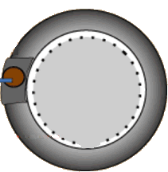
Anti-lock Braking System
2. Pressure passed to the brake fluid
3. Wheel disc brakes squeezed
1. Brake pedal pushed
5. Controller releases the pressure on the discs by releasing some brake fluid in a container
6. The fluid is pumped back to repeat the pressure on the discs
4. If the brake pedal is pushed too hard, the wheel will lock → a sensor detects this and notifies the controller
Controller
7. Entire process is repeated about 15 times/sec
(by courtesy of Damir Isovic)
Notes:
Mention:
ECU, sensors, actuators
distribution (4 wheels)
embedded and invisible to the driver!

Slide 11
Anti-lock Braking System
Electronic system:
  Sensor: detects that the wheel will lock
  Actuator: release and repeat the pressure on the discs
  Controller: requires an ECU
Distributed:
  Controller, sensors, and actuators at different locations
  Requires wires or a network
Embedded and invisible to the driver

Slide 12
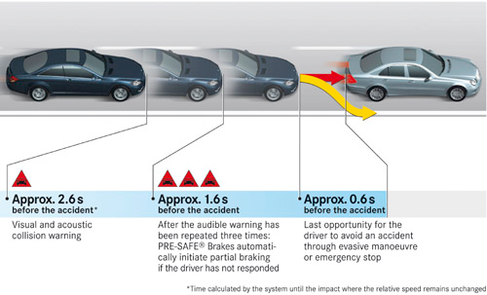
Pre-crash system
Reduce severity of head-to-tail crash
Notes:
History (Mercedes)
early 1990: Firstpre-crashsystems
an automatic rollbar that automatically adjusted its position in 0.3 seconds if the system detects the risk of an accident
2002: Pre-SAFE launched

Slide 13
Pre-crash system
Collision avoidance zone
Stage 1 (~2.6s to impact):
  Provide visual and audible collision warning
    shine lights and sound
Stage 2 (~1.6s to impact):
  Automatically initiate partial braking at 4m/s²
  Move the front passenger seat to safe position
    Height, fore/aft adjustment, backrest angle
    Inflate air-chambers inside seat for better support
  If skidding: close front windows and sunroof
Stage 3 (~0.6s to impact):
  Tighten the seatbelts (e.g. fire pyrotechnics or pulleys)
  Prepare airbags for deployment
Damage mitigation zone
Notes:
Stage 2:
Communicate with ABS system
Closing windows and sunroof avoids occupants to be thrown out of the care in case of a rollover and provides better support (also for airbags) for side impact

Slide 14
Pre-crash system
Relies on several subsystems
  Radar for detecting potential collision
  Anti-lock Braking System to apply partial braking
  Traction Control to identify if skidding
  Window Control System to close windows
  …

Slide 15
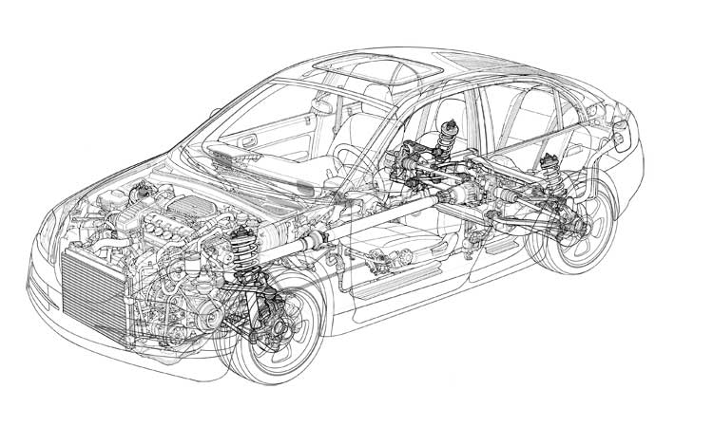
Fighting complexity: modular design
Complexity is due to the many dependencies
  E.g. communication
Communication is expensive
  Surface area, power consumption, latency, ability to understand system behavior, …
Modular design:
  Divide an integrated system into independent modules
  Define interfaces between the modules
  Keep the interfaces thin!
Advantages
  Separation of concerns
  Flexibility
  Maintainability
  Security
Notes:
Modular design effective in many domains, not only software systems.

Slide 16
Outline
Functional domains
Network architecture of a car
Requirements for function realizations

Slide 17
Modeling software systems
When investigating the root causes for traffic jams in a city, it is infeasible to consider the interactions between molecules comprising the car or the driver’s brain.
A model is an abstraction of the key elements which are relevant for achieving a given goal
  Example: traffic in a city can be modeled by means of a queue network representing the streets, and Markov chains describing the arrival of cars
Notes:
It is crucial to stress that every model serves a particular purpose.

Slide 18
System architecture
A system is a set of interacting components forming an integrated whole
Architecture is a description of the individual components and their interactions
  Collection of models describing the system from different views

Slide 19
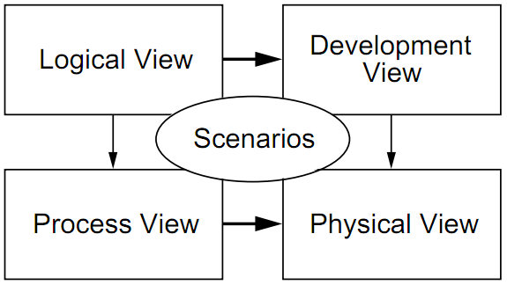
4+1 Architectural View Model *
Describes the architecture of software-intensive systems
  Logical view: functionality that the system provides to end-users
  Development view: implementation from programmers perspective
  Process view: runtime behavior (tasks and how they communicate)
  Physical view: mapping of the software onto physical layer
  Scenarios: illustrates the architecture description based on several use cases

Slide 20
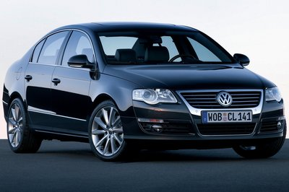
Network architecture of a car
Electronic Control Unit (ECU)
  Sensors and actuators
  Microcontroller
  Software
Bus
  Connects individual ECUs
Interconnect between buses

Slide 21
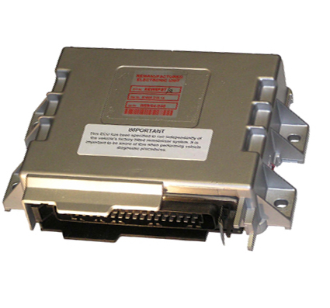
Electronic Control Unit (ECU)
Controls one or more car functions
Types of electronic control units
  Airbag (ACU), Engine (ECU), Transmission (TCU), …
70 – 100 ECUs inside a car (nearly as many as inside Airbus A380)
Microprocessor-based

Slide 22
An ECU and its interfaces
Power
Debug port
Digital and Analog
I/O ports
CAN port
FlexRay port

Slide 23
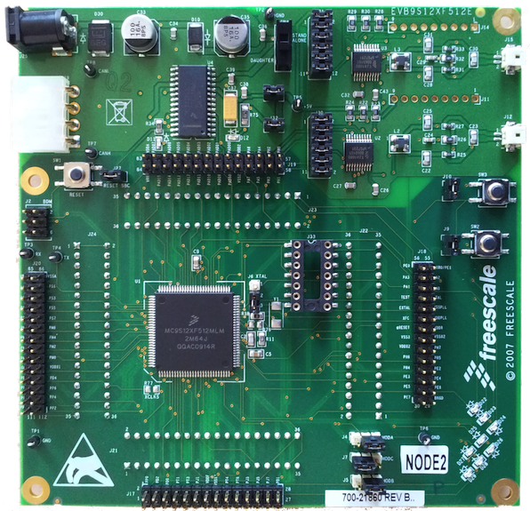
Example ECU (Freescale board EVB9512XF)
Power
CAN controller
CAN port
FlexRay port
Reset button
Digital and
Analog
I/O ports
Debug port
Microcontroller
(CPU + memory)
LEDs

Slide 24
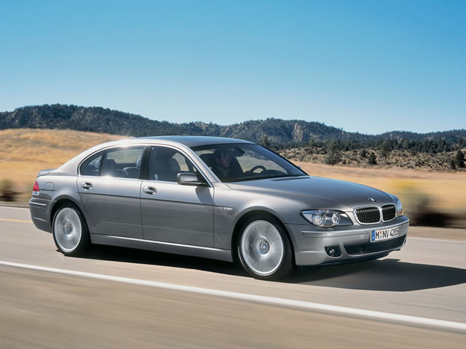
Bus
Connects individual ECUs
Examples: CAN, FlexRay, I2C, IEEE 802.11p
Notes:
A particular bus defines the communication protocol (including message format and possible message exchanges), bandwidth, physical interfaces.

Slide 25
Outline
Functional domains
Network architecture of a car
Requirements for function realizations

Slide 26
Requirements for function realizations
Also referred to as “non-functional requirements” or “extra-functional requirements”
  Timeliness/Predictability
    Hard timing requirements: functional
    Firm/soft timing requirements: non-functional (can be traded for others, e.g. a bit later but much cheaper to realize)
  Dependability
  Maintainability: ability for software to undergo modifications and repairs
  Scalability: ability to scale a metric with changing architecture
    Example: maintainability will decrease when increasing number of ECUs in a car
  Security
Notes:
Our focus in this course lies on Timeliness and predictability
Dependability is an umbrella term for Availability, Reliability and Safety

Slide 27
Timeliness requirements
Notes:
A real-time system is one with very strict timing constraints. For example, during a crash you would like the airbag to inflate just at the right time: not too early and not too late. So, the airbag controller must guarantee that the strict timing constraints are met.

Slide 28


Slide 29
Timeliness requirements
Example: inflation of an air bag
  real-time ≠ fast
  real time: fulfill specific timing requirements
Notes:
This slide alreadyintroduces the essentialelements of real-time systems;
event, response, and deadline(s).
Fromthisexample, itimmediatelyfollowsthatresponses shouldnotbe “toofast”.
Stateddifferently, itprovides a “reasond’etre” for “best-case deadlines”.
In many cases, we willonlyencounter “worst-case deadlines”.

Slide 30
Timeliness requirements
Example: Software controlling the deployment of airbags has 15 to 40 milliseconds to determine which and in what order to activate
Specification:
  Lower and upper bounds on the response time
Metrics:
  Worst-case response time
  Tardiness
Notes:
Response time = latency

Slide 31
Dependability requirements
Specification in 3 dimensions:
  Availability: readiness for correct service
    Metric: probability of the system being ready to use
      Mean Time To Failure (MTTF), Mean Time To Repair (MTTR)
      Availability: MTTF/(MTTF+MTTR)
  Reliability: continuity of correct service
    Metric: expected time until not being available
  Safety: absence of catastrophic consequences on the user and the environment
    Metric: catastrophic states are not reachable

Slide 32
Dependability requirements
In 2005, Toyota recalled 160 000 Prius hybrids, because of software causing car to stall and shutdown.
  Fix required 90 min per car = 240 000 man hours
In 2008, VW recalled 6500 cars, because of software causing unexpected increase in RPM when air-conditioning is turned on.
Notes:
These are nice examples for the 50% warranty cost mentioned on the earlier slides on Evolution of function realization.

Slide 33
Safety requirements
The controlled system must remain safe
  hazardous states unreachable (e.g., extremely high temperatures)
  even in erroneous conditions, safety must be maintained (no “error exit”)
Certification: approval by independent agency

Slide 34
Security requirements
Security: when the system is open to external observation and control (e.g., via Internet)
  confidentiality, integrity and non-repudiation
    validation of privileges (authentication, authorization)
    secure protocols to make intrusion impossible

Slide 35
References
Recommended reading:
  [Burns] Ch. 1.1-1.3, 2.1-2.2, 2.10
Optional reading:
  N. Navet, F. Simonot-Lion, “Automotive Embedded Systems Handbook”, CRC Press, 2009
  G. Leen, D. Hefferenan, “Expanding automotive electronics systems”, Computer, 35(1), 2002
  U. Keskin, “In-Vehicle Communication Networks: A Literature Survey”, TU/e CS-Report 09-10, 2009
  P. Kruchten, “Architectural Blueprints—The 4+1 View Model of Software Architecture”, Software 12 (6), 1995

