Slide 1
Multitasking
2IN60: Real-time Architectures
(for automotive systems)

Slide 2
Goals for this slide set
Describe several methods for multiplexing several (periodic) tasks onto a shared ECU
Describe problems which are addressed by each of these methods, and new problems they may introduce
Select the right method for a given set of tasks and requirements

Slide 3
Outline
Cyclic executive
  AFAP
  Time-driven AFAP
  Multi-rate time-driven AFAP
  Multi-rate periodic

Slide 4
Example: read two sensors
Two tasks:
  Task1: Read rotation sensor to detect skidding and activate ABS if threshold crossed
  Task2: Read pressure sensor to detect a collision and inflate airbag if a threshold crossed
void Task1() {
a = ReadRotation();
if (a < A) ActivateABS();
}
void Task2() {
p = ReadPressure();
if (p > P) InflateAirbag();
}
Notes:
Execution time of each task depends on context: if there is no skidding, then no work required.
How would you schedule these tasks?

Slide 5
Real-time terminology
t
Task τ_{i} generates an infinite sequence of jobs τ_{i,k}
Jobs of a periodic task τ_{i} are activated periodically
  Inter-arrival time T_{i,k} of two consecutive jobs τ_{i,k} and τ_{i,k+1}
  Each job τ_{i,k} executes for C_{i,j} time, where BC_{i} ≤ C_{i,j} ≤ WC_{i}
    BC_{i}: best-case execution time
    WC_{i}: worst-case execution time
Notes:
A time line visualizes the runtime behavior of tasks. It shows on a time axis when which task is executing.
Job represents the execution of a task.
Taskispecifies the BCi and Wci constraints on the execution time of its jobs.
Activation jitter: Fluctuation in activation times of jobs of a task

Slide 6
“Cyclic executive” approach
Application is written as a single repetition executing the tasks sequentially
Typically, the timing is determined offline based on full information of a task set
Events are detected through polling (e.g. reading sensors)
  Polling frequency determines the latency between the occurrence of an event and its detection
Notes:
In the single executive approach we just have our program and nothing else except, perhaps, a library of support functions.
Typically, the timing is determined offline based on full information of a task set. The entire execution is driven through a table or control mechanism that determines for each moment in time which code has to be executed.
This approach is typical for PLC (Programmable Logic Controllers)based systems with few resources.
Interrupts in this case are included only to the extent of flagging their occurrence and performing basic handling via a buffer. As this is, in fact, concurrent execution of interrupt handler and the program, care must be taken to avoid interference problems (described later) leading to inconsistencies of shared data structures, like such a buffer. If the interrupt handler would take too long, the accuracy of the timing is jeopardized.

Slide 7
“Cyclic executive” approach
Typical for programming Programmable Logic Controllers (PLC)
  Reliable, cheap, sturdy, simple to program
  Used e.g. by the Electric Lupo
Several variants:
  AFAP – as fast as possible
  Time-driven AFAP
  Multi-rate time-driven AFAP
  Multi-rate periodic
Notes:
In the single executive approach we just have our program and nothing else except, perhaps, a library of support functions.
Typically, the timing is determined offline based on full information of a task set. The entire execution is driven through a table or control mechanism that determines for each moment in time which code has to be executed.
This approach is typical for PLC (Programmable Logic Controllers)based systems with few resources.
Interrupts in this case are included only to the extent of flagging their occurrence and performing basic handling via a buffer. As this is, in fact, concurrent execution of interrupt handler and the program, care must be taken to avoid interference problems (described later) leading to inconsistencies of shared data structures, like such a buffer. If the interrupt handler would take too long, the accuracy of the timing is jeopardized.

Slide 8
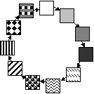
As Fast As Possible (AFAP)
Execute tasks AFAP
while true do
Task1();
Task2();
.....
Taskn();
od
Notes:
In the simplest form the program iterates through all the tasks. A task gets executed as often as the processor gets to it. There may be no work that often. For example, each task may check whether its enabling event has occurred and then handle it.
On the one hand: the distance between two iterations (jobs) of the same task can be prohibitively large. To solve this, the program needs to be rewritten, which leads to a mix of programming and scheduling.
On the other hand: this may waste energy while no work needs to be done.
Picture by D. Kalinsky

Slide 9
Example: Lupo-EL
Single loop, executing on the PLC
  All functionalities are executed sequentially
  Cycle-time is approximately 7 ms.
The loop
  “sampling”: reading all inputs
    including messages arriving via CAN-buses
  “computation” for all functionalities (sequentially)
  “actuation”: writing all outputs
    The output of individual functionalities is buffered till the “actuation”, allowing to replace (or overwrite) the output whenever an erroneous situation is detected.

Slide 10
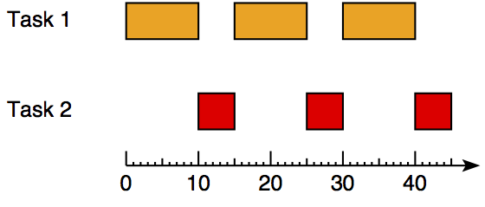
Example: read two sensors
(AFAP)
BC_{i} = WC_{i}
ms
while (1) {
Task1();
Task2();
}
Notes:
The inter-arrival of two consecutive jobs of a task is equal to the C1 + C2.

Slide 11
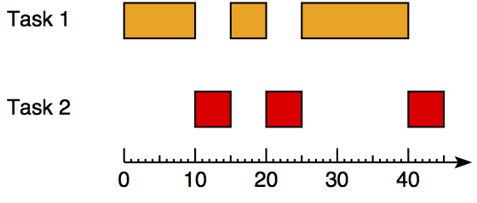
Example: read two sensors
(AFAP)
BC₁ < WC₁
ms
while (1) {
Task1();
Task2();
}
Notes:
When BCi < WCi then the jobs of both tasks will suffer activation jitter.

Slide 12
Real-time terminology
t
Task τ_{i} generates an infinite sequence of jobs τ_{i,k}
Jobs of a periodic task τ_{i} are activated periodically
  Inter-arrival time T_{i,k} of two consecutive jobs τ_{i,k} and τ_{i,k+1}
  Minimum and maximum bounds on period T_{min} and T_{max}
  Activation jitter AJ_{i,k}
    Length of activation interval of job τ_{i,k}
Notes:
Job represents the execution of a task
Activation jitter: Fluctuation in activation times of jobs of a task

Slide 13
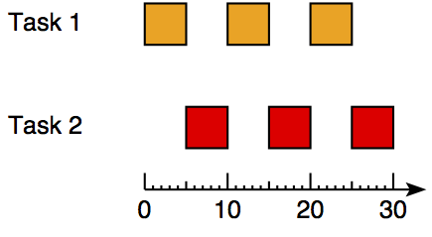
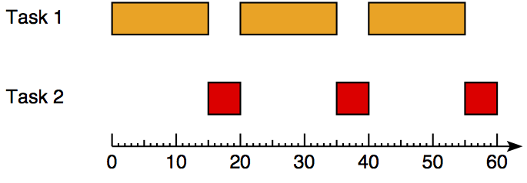
Example: read two sensors
(AFAP)
BC₁ < WC₁
ms
ms
Notes:
Two possible scenarios:
Task 1 executes always for BC1
Task 1 executes always for WC1
Consequently: it is impossible to predict accurately when the k’th job of Task 1 or Task 2 is going to execute.

Slide 14
Real-time terminology
T_{min}: minimum inter-arrival time of Task1
T_{max}: maximum inter-arrival time of Task1
AJ(3): activation jitter of job 3 of Task1
Task1()
Task1()
Drift: unbounded activation jitter
Notes:
Job represents the execution of a task
Period: Intended inter-arrival time of two consecutive jobs
Activation time: Actual activation time of a job
Activation jitter: Fluctuation in activation times of jobs of a task

Slide 15
Patriot missile failure at Dhahran
Drift example

Slide 16
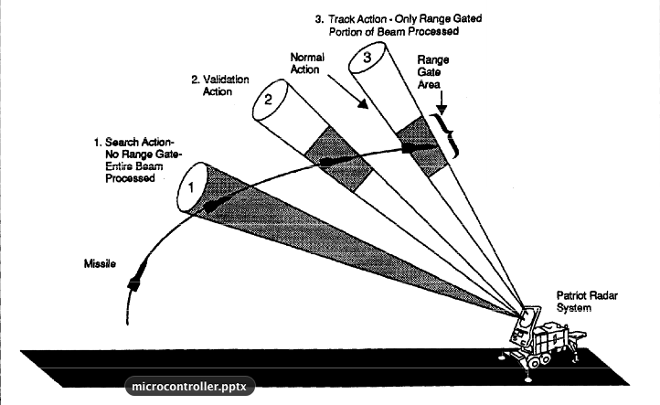
Intended behavior

Slide 17
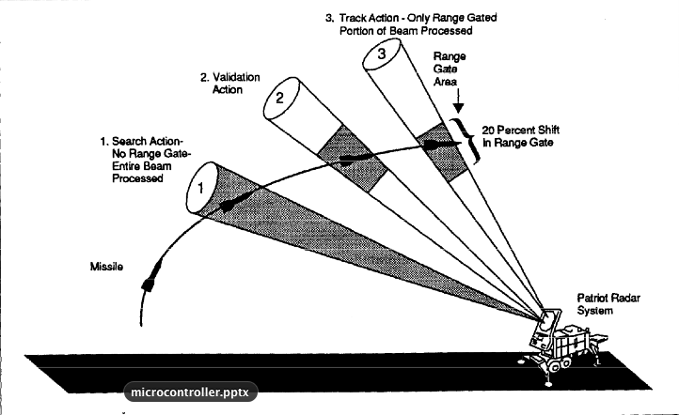
Behavior after 8 hours of operation

Slide 18
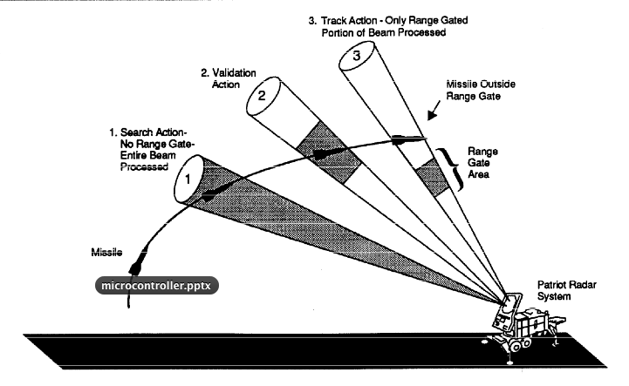
Behavior after 100 hours of operation

Slide 19
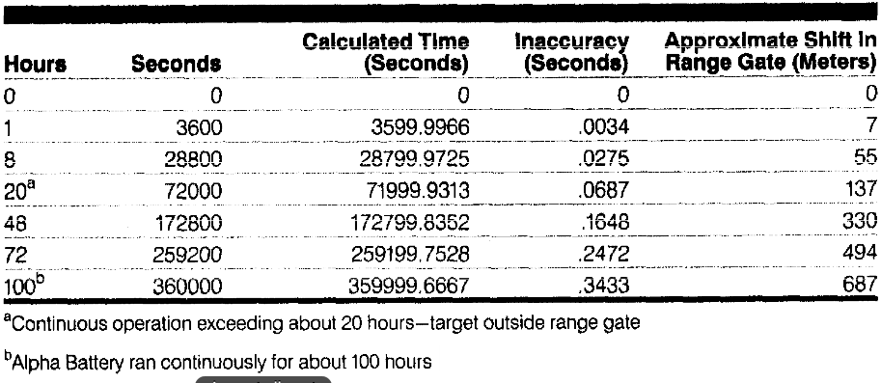
Shift in range due to drift
Notes:
“On the night of the 25th of February, 1991, a Patriot missile system operating in Dhahran, Saudi Arabia, failed to track and intercept an incoming Scud. The Iraqi missile impacted into an army barracks, killing 28 U.S. soldiers and injuring another 98.”

Slide 20
Real-time requirement example
Real-time requirement:
  Activate tasks strictly periodically, i.e. with bounded activation jitter

Slide 21
As Fast As Possible (AFAP)
Shortcomings:
  Large release jitter
    Timing of one task heavily dependent on computation times of other tasks
  Drift (i.e. accumulated jitter)
    Impossible to predict accurately when a task executes
while true do
Task1();
Task2();
.....
Taskn();
od
Notes:
Shortcomings: think real-time requirements!
On the one hand: the distance between two iterations (jobs) of the same task can be prohibitively large. To solve this, the program needs to be rewritten, which leads to a mix of programming and scheduling.
On the other hand: this may waste energy while no work needs to be done.
Picture by D. Kalinsky

Slide 22
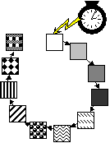
Time-driven AFAP
Timer triggers task sequence
Notion of periodic execution
  All tasks share the same period
No drift
  Jitter is “reset” at every timer invocation, i.e. does not accumulate
while true do
‘wait for timer’;
Task1();
Task2();
.....
Taskn();
od
Notes:
The only addition is that the start of the sequence is periodic now. The entire sequence executes fast enough for this ‘super period’.
This removes drift and makes the system more predictable. Some of the other concerns remain.

Slide 23
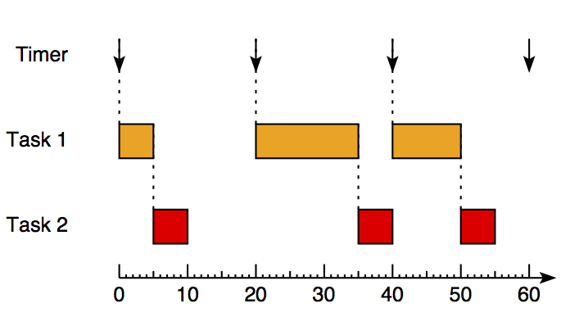
Example: read two sensors
(time-driven AFAP)
ms
while (1) {
‘wait for timer’;
Task1();
Task2();
}
Notes:
The timer period is 20.
Fluctuations in execution-time of task 1 causes release jitter of task 2.
Note that there is idle time (after the first job of task 2). This is part of the price that needs to be often paid for predictability.

Slide 24
Time-driven AFAP
Shortcomings:
  Large release jitter (albeit smaller than with AFAP)
  All tasks must complete within a single tick
  Same period for all tasks
while true do
‘wait for timer’;
Task1();
Task2();
.....
Taskn();
od
Notes:
The only addition is that the start of the sequence is periodic now. The entire sequence executes fast enough for this ‘super period’.
This removes drift and makes the system more predictable. Some of the other concerns remain.

Slide 25
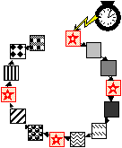
Multi-rate time-driven AFAP
Timer triggers task sequence
Tasks may have different periods
Shortcomings:
  Large release jitter
  All tasks must complete within a single tick
while true do
‘wait for timer’;
Task1();
Task2();
Task3();
Task1();
.....
Taskn();
od
Notes:
In the end the aim is mostly to execute a task not too early and not too late. With the cyclic executive method this boils down to achieving this by hand.
This removes the earlier problem of a too long delay.

Slide 26
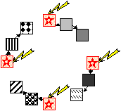
Multi-rate periodic
IsTimeFor determines for a task sequence whether it should run at the current time
  Tasks can have different periods
Time Division Multiple Access (TDMA)
  Special case of multi-rate periodic
    task sequences contain 1 task
  Also called: Table driven or Offline scheduling
while true do
‘wait for timer’;
if IsTimeFor (1) then
Task1(); Task2(); Task3() fi;
if IsTimeFor (2) then
Task1(); Task4(); Task5() fi;
.....
od
Notes:
Function IsTimeForis here for the sake of explanation, although in practice it could be like this. Alternatively, the tasks to execute can be looked up in a table, or stored in queues, the queue filled in when setting the timer. When the timer fires at the greatest common divisor of the periods then during the ‘superperiod’ of the least common multiple there can be many empty firings. These can be removed using a table. The timer is then set to expire at the start of the next block of tasks.
An extreme case is when each block consists of just one task.
Notice that this approach requires that each block completes before the timer for the next block expires. In other words, the tasks are executed non-preemptively and together must fit in the slot assigned to their block.
The non-preemption means in practice that the original tasks need to be decomposed into subtasks. This represents, in fact, preemption, but now explicitly programmed. Since this is rather complicated and also inflexible, this can best be computed through some optimizing program.

Slide 27
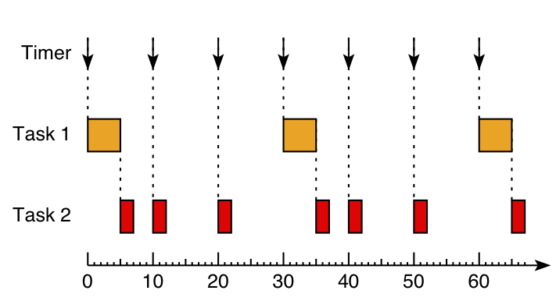
Example: read two sensors
(multi-rate periodic)
ms
while (1) {
‘wait for timer’;
if (IsTimeFor(1)) Task1();
if (IsTimeFor(2)) Task2();
}
Notes:
Task 1 has a period of 30, Task 2 of 10.
Nicely illustrates release jitter!

Slide 28
Example: read two sensors
(multi-rate periodic)
ms
while (1) {
‘wait for timer’;
if (now % 30 == 0) Task1();
if (now % 10 == 0) Task2();
now = now + 10;
}
Notes:
Task 1 has a period of 30, Task 2 of 10.
Nicely illustrates release jitter!

Slide 29
Multi-rate periodic
Shortcomings:
  Requires timer to fire at greatest common divisor of task periods
    The overall period is then the least common multiple of these task periods
  Needs careful calibration to make sure tasks complete before next timer expiration
  All tasks triggered by the same tick must complete before the next tick
while true do
‘wait for timer’;
if IsTimeFor (1) then
Task1(); Task2(); Task3() fi;
if IsTimeFor (2) then
Task1(); Task4(); Task5() fi;
.....
od
Notes:
Function IsTimeForis here for the sake of explanation, although in practice it could be like this. Alternatively, the tasks to execute can be looked up in a table, or stored in queues, the queue filled in when setting the timer. When the timer fires at the greatest common divisor of the periods then during the ‘superperiod’ of the least common multiple there can be many empty firings. These can be removed using a table. The timer is then set to expire at the start of the next block of tasks.
An extreme case is when each block consists of just one task.
Notice that this approach requires that each block completes before the timer for the next block expires. In other words, the tasks are executed non-preemptively and together must fit in the slot assigned to their block.
The non-preemption means in practice that the original tasks need to be decomposed into subtasks. This represents, in fact, preemption, but now explicitly programmed. Since this is rather complicated and also inflexible, this can best be computed through some optimizing program.

Slide 30
References
Recommended reading:
  [Burns] Ch. 11.1, 12.1
  D. Kalinsky Associates, “A Survey of Task Schedulers”, http://www.kalinskyassociates.com/Wpaper3.html

