Slide 1
Preemption
2IN60: Real-time Architectures (for automotive systems)

Slide 2
Evaluation of the cyclic executive
Advantages:
Very simple implementation (especially AFAP)
Shortcomings:
Difficult to predict accurately the timing of task arrivals
Inconvenient code structure, maintenance, update
Ineffective coding of a tasks’ relative importance
Non-preemptive task execution
Notes:
Difficult to predict accurately the timing of task arrivals
Variable task execution will affect the arrival time of the following tasks, leading to jitter (and drift in AFAP)
Inconvenient code structure, maintenance, update
Schedule is explicitly encoded in the program
Schedule is based on an offline analysis and requires a change of the program when tasks are added or removed
See [Locke, 1992]
Adding or removing a task will impact the arrival time of all following tasks, invalidating the offline timing analysis and requiring a change in the schedule and hence the program.
Ineffective coding of a tasks’ relative importance
A failing task may dominate the platform;
“Importance” can only be encoded by performing tasks more frequently;
Non-preemptive task execution
Needs careful calibration to make sure tasks complete within a timer period
During task execution, timer interrupts may be delayed, or events missed (if execution spans across several timer periods)

Slide 3
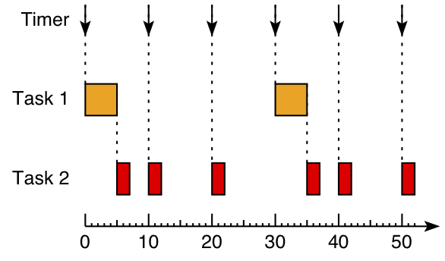
Example: non-preemptive execution
Timing requirements:
Deadline = next activation of the task
Works well if total execution time of tasks triggered by the same tick fits within a tick period
Task 1 period: 30
Task 2 period: 10

Slide 4
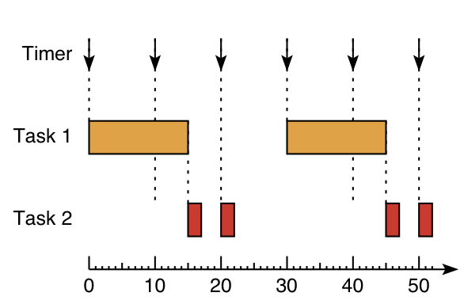
Example: non-preemptive execution
Timing requirements:
Deadline = next activation of the task
Problem:
If Task1 execution time spans across several periods of Task2, then Task2 will miss its deadlines
Task 1 period: 30
Task 2 period: 10

Slide 5
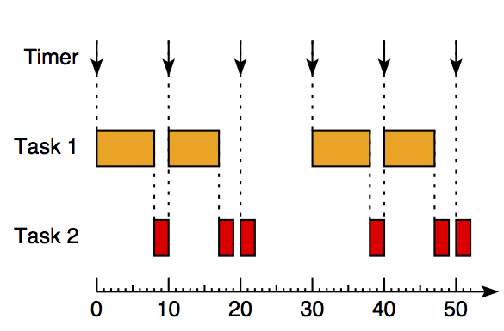
Example: non-preemptive execution
Timing requirements:
Deadline = next activation of the task
Solution 1:
Split long tasks into several shorter “sub-tasks”
Shortcoming:
Higher priority tasks are not protected from misbehaving lower priority tasks
Task 1 period: 30
Task 2 period: 10
Notes:
This “slicing” could of course also be done (manually or) by tooling…

Slide 6
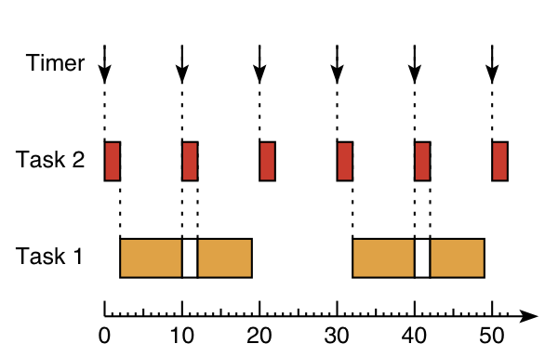
Example: preemptive execution
Timing requirement:
Deadline = next activation of the task
Solution 2:
Allow Task2 to preempt Task1
Introduce preemption:
Preemptive priority-based scheduler: at any moment execute the highest priority ready task (if possible)
E.g. Task2 has higher priority than Task1
Note:
Move from offline determined schedule to online determined schedule
Task 1 period: 30
Task 2 period: 10
Notes:
In cyclic executive the schedule is determined offline. Under preemptive scheduling decisions are made during runtime.
While in general priority and importance are not the same, in this case priority also reflects importance.
We assume a uniprocessor with a single core CPU. On a uniprocessor only one job can execute at a time (n.b. on a multicore or multiprocessor computer several jobs can execute simultaneously)

Slide 7
Goals for this slide set
Describe the concept of preemption
Explain when preemption is needed
Describe how preemption can be supported by an operating system
Explain the problems which preemption may introduce and how they may be addressed

Slide 8
Outline
Evaluation of the cyclic executive
Preemption
Atomicity

Slide 9
Real-time terminology
Jobs of a periodic task τ_{i} are activated periodically
T_{i} is the task period, i.e. (desired) inter-arrival time of two consecutive jobs τ_{i,k} and τ_{i,k+1}
φ_{i} is the task phasing, i.e. arrival time of the first job τ_{i,0}
If phasing is not specified then we implicitly assume φ_{i} = 0
a_{i,k} is the activation time of job τ_{i,k} and is given by
Notes:
Jobs are indexed from 0, i.e. the first job of a task has index k = 0.
During the multitasking lecture we have seen that sometimes the desired inter-arrival time is difficult or impossible to achieve.

Slide 10
Priorities
Each task is assigned a priority
Priority based scheduler:
At any moment execute the highest priority ready task (if possible)
Priorities are a “scheduling aid”
Decide in which order to execute tasks when more than one task is ready to execute
In an offline schedule (e.g. AFAP) priorities are irrelevant
Sometimes priority = importance
Limit the effect of misbehaving lower priority tasks
We assume fixed and unique priorities
In this course: lower number = higher priority
Notes:
Arbitrate between tasks competing for the processor

Slide 11
Interrupts
Interrupts are signals which need immediate attention
They can arrive at an arbitrary moment during task execution
The code triggered by an interrupt is called an Interrupt Service Routine (ISR), or Interrupt Handler
Examples:
Sensed temperature is above a threshold
CAN controller received a message
Timer expired
Timer interrupts are especially important
E.g. trigger periodic tasks in control applications
Two types of timers: periodic vs. one-shot

Slide 12
Interrupt Handlers
Notes:
Interrupt handlers are not triggered form the main(). They are triggered by incoming interrupts, asynchronously with the main() program execution.

Slide 13
Application structure
Multi-rate periodic cyclic scheduler
Preemptive scheduler
void Task1() {...}
void Task2() {...}
int main() {
/* setup the timer interrupt */
/* enable interrupts */
while (1) {
/* wait for timer interrupt */
if (IsTimeFor(1)) Task1();
if (IsTimeFor(2)) Task2();
}
return 0;
}
void Task1() {...}
void Task2() {...}
int main() {
/* setup the timer interrupt */
/* setup task data structures */
RegisterTask(Task2, 10, 0, 1);
RegisterTask(Task1, 30, 0, 2);
/* enable interrupts */
while (1) {}
return 0;
}
Upon timer interrupt {
if (IsTimeFor(1)) Task1();
if (IsTimeFor(2)) Task2();
}
Notes:
Preemption requires managing the state of the tasks.

Slide 14
Task Control Block
Task parameters are stored in the Task Control Block (TCB)
TCB is a C structure, stored in a global array
One TCB per task
Task parameters:
Pointer to the C function
Phasing
Period
Priority, etc.

Slide 15
Preemption
A periodic task generates a sequence of jobs. A job is called active between the moment it arrives (or is activated) and the moment it completes.
Preemption:
Stop current task execution and switch control to a new task
Reason for preemption:
Occurrence of task trigger, e.g. timer or external (e.g. sensor) interrupt
Timing analysis required
Need information about when these events occur
Task 1 period: 30
Task 2 period: 10
Notes:
In fact we see three tasks here: two ‘regular’ tasks and one timer interrupt handler. For predictable behavior we need to have assumptions about event occurrences, e.g. how often they can occur and how long they take. The real-time analysis based on these assumptions leads to the particular choices for task priorities as seen here.
Preemption is due to higher priority task.

Slide 16
Interference due to preemption
void Task1(void) {
SetLed(LED_D22,
ATDReadChannel(PAD14) > LT);
}
void Task2(void) {
ToggleLed(LED_D23);
}
LDAB #14
JSR ATDReadChannel
CPD #20
BLE *+7
BCLR _PT01AD:1,#1
RTS
BSET _PT01AD:1,#1
RTS
LDAB _PT01AD:1
EORB #2
STAB _PT01AD:1
RTS
Notes:
Example taken from the last exercises (week 2).
LT = 20
CPD: Compare D with #20 (where data was returned from ATDReadChannel)
BLE: Branch if last comparison was Less Equal
Notice that both tasks load data into register B

Slide 17
Interference due to preemption
Interference!
LDAB #14
JSR ATDReadChannel
CPD #20
BLE *+7
BCLR _PT01AD:1,#1
RTS
BSET _PT01AD:1,#1
RTS
LDAB _PT01AD:1
EORB #2
STAB _PT01AD:1
RTS
LDAB _PT01AD:1
EORB #2
STAB _PT01AD:1
RTS
LDAB _PT01AD:1
EORB #2
STAB _PT01AD:1
RTS
LDAB _PT01AD:1
EORB #2
STAB _PT01AD:1
RTS
LDAB _PT01AD:1
EORB #2
STAB _PT01AD:1
RTS
LDAB _PT01AD:1
EORB #2
STAB _PT01AD:1
RTS
LDAB #14
JSR ATDReadChannel
CPD #20
BLE *+7
BCLR _PT01AD:1,#1
RTS
BSET _PT01AD:1,#1
RTS
LDAB _PT01AD:1
EORB #2
STAB _PT01AD:1
RTS
LDAB #14
JSR ATDReadChannel
CPD #20
BLE *+7
BCLR _PT01AD:1,#1
RTS
BSET _PT01AD:1,#1
RTS
LDAB #14
JSR ATDReadChannel
CPD #20
BLE *+7
BCLR _PT01AD:1,#1
RTS
BSET _PT01AD:1,#1
RTS
LDAB #14
JSR ATDReadChannel
CPD #20
BLE *+7
BCLR _PT01AD:1,#1
RTS
BSET _PT01AD:1,#1
RTS
LDAB #14
JSR ATDReadChannel
CPD #20
BLE *+7
BCLR _PT01AD:1,#1
RTS
BSET _PT01AD:1,#1
RTS
LDAB #14
JSR ATDReadChannel
CPD #20
BLE *+7
BCLR _PT01AD:1,#1
RTS
BSET _PT01AD:1,#1
RTS
LDAB #14
JSR ATDReadChannel
CPD #20
BLE *+7
BCLR _PT01AD:1,#1
RTS
BSET _PT01AD:1,#1
RTS
Upon preemption:
Need to store registers!
Notes:
Example taken from the last exercises (week 2).
Interference is the result of preemption; it appears, in fact, as if tasks execute concurrently.

Slide 18
Task state
During execution a task may be preempted by a higher priority task at an arbitrary moment
Due to interrupts arriving at unpredictable moments during task execution
Upon preemption we need to store the contents of the CPU registers (A, B, PC, SP, …)

Slide 19
Outline
Evaluation of the cyclic executive
Preemption
Atomicity

Slide 20
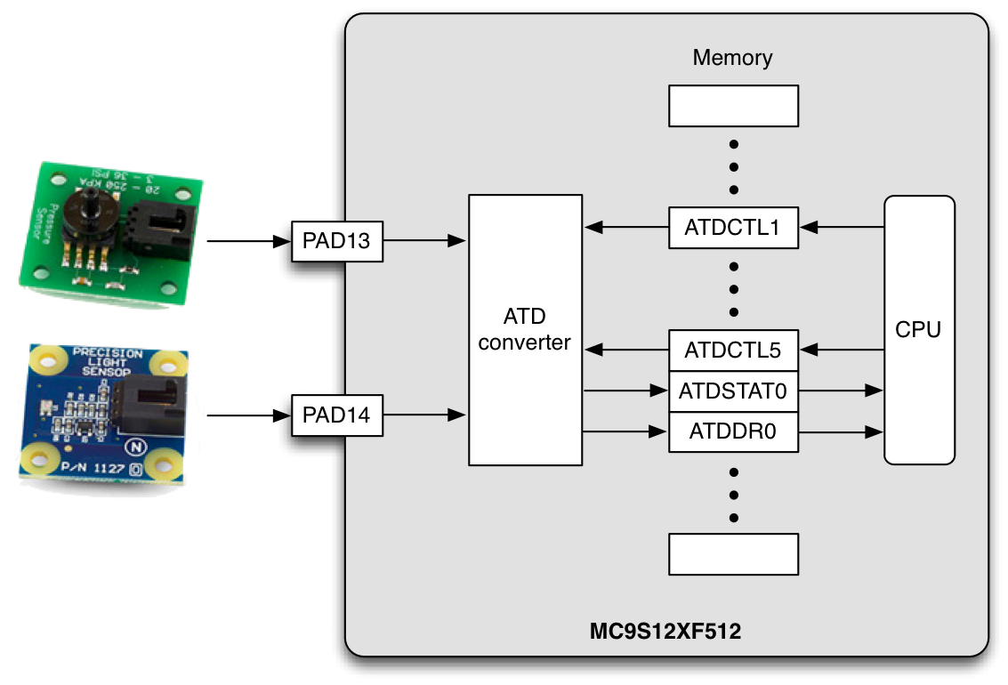
Example: corrupted sensor reading

Slide 21
Example: corrupted sensor reading
ATD conversion is done by ATDReadChannel()
Set conversion parameters (controlled by registers ATDCTL1 – ATDCTL5)
Conversion is started by writing to ATDCTL5
Important: any previous conversion is silently aborted
When conversion is finished a bit in ATDSTAT0 is set
Current implementation: poll the ATDSTAT0 flag
Results are stored in registers ATDDR0 – ATDDR15

Slide 22
Example: corrupted sensor reading
Low priority Task 2 reads the light sensor
The sensor driver sets up a conversion and then polls a flag in an ATD register until it is set
Reading takes a long time
High priority Task 1 reads another sensor
When a new conversion is started, any ongoing conversion is aborted
When Task 1 attempts to read another sensor (connected via the same ATD converter) it aborts the ongoing conversion of the signal from the light sensor

Slide 23
Race conditions on global data structures
Problem: preemption may result in inconsistencies with respect to global data structures
Examples:
A global variable may be used by two tasks
The ready flag inside of the TCB can be written by a completing task or the timer ISR
Need to prevent interference!
Note: storing registers is not sufficient
Notes:
Race condition: two or more tasks race to access shared data storage (e.g. a variable), with at least one task trying to modify the data.

Slide 24
Atomicity
An operation is said to be atomic if it appears to the rest of the system to occur instantaneously

Slide 25
Example x = y; || y = x;
|| : parallel composition
Desired behavior of “x = y; || y = x;”:
x = y ; y = x ; OR y = x ; x = y ;
Assume initially x == 1 and y == 2. Then, after “x = y; || y = x;”, we expect:
x == 2 && y == 2 OR x == 1 && y == 1
Notes:
Parallel composition:imaginetwo concurrent tasks Task1 and Task2, with “x = y;” executedby Task1and “y = x” executedbyTask2, where x and y are global variables.

Slide 26
Example x = y; || y = x;
Let:
I₁: LDAA y
I₂: STAA x
I₃: LDAB x
I₄: STAB y
hence:
x = y; ➔ I₁ ; I₂ ;
y = x; ➔ I₃ ; I₄ ;
Let (x, A, y, B) represent the state, where A and B refer to registers A and B accessed by the instructions LDAA, LDAB, …
x, A, y, B
initial state: (1, -, 2, -)
I₁
I₃
(1, 2, 2, -)
(1, -, 2, 1)
I₂
I₃
I₁
I₄
(2, 2, 2, -)
(1, 2, 2, 1)
(1, -, 1, 1)
I₃
I₂
I₄
I₁
(2, 2, 2, 2)
(2, 2, 2, 1)
(1, 2, 1, 1)
(1, 1, 1, 1)
I₄
I₄
I₂
I₂
(2, 2, 2, 2)
(2, 2, 1, 1)
(1, 1, 1, 1)

Slide 27
Atomic?
✓
x = 1
LDAB #1; STAB x
no ‘internal’ interference point, hence to be regarded as atomic, assuming a correct implementation of interrupt handling
x = y
LDAB y; STAB x
‘internal’ interference point: register B may store an old copy of y for a long time while computations with y continue.
x = x+1
LDAB x; INCB; STAB x
✗
✗
Notes:
We assume here that memory operations are atomic.
What statements in a high-level language like C can be regarded as atomic? Generally, assignments and tests. However, not all of these as it depends on the instruction set.
At the instruction set level, only instructions are atomic (exceptions documented in the ISA description).
x := 1 can be regarded as atomic even though the actual execution is not. In case an interrupt occurs at the semicolon, any correct implementation of OS and supporting hardware must restore the internal state (i.e. B) before the interrupted process is resumed.
x := y is not atomic. If an interrupt occurs in the middle, register B stores an old copy of y. When y is subsequently modified, this old copy gets stored in x. This means that there is a possible interleaving that has this interference.
x := x+1 has a similar problem.
Notice that the problem stems from shared variables. If y were to be a private variable no such problem occurs. Also, the problem comes from the two references. Hence, if we replace
x := y
by
r := x; y := r
with private variable r we now have statements that can be regarded as atomic. The interference point is no longer anonymous but visible in our program.
Define atomicity is used to explain the effect of some hardware or OS operations. These operations implement a sequence of instructions as non-interruptable.
RJB-100910:
“< >” and non-maskable interrupts: P(S) and V(S) do not guarantee that the access can not be interrupted. It only guarantees that IF all users use this guarding mechanisms THEN only “S” can access the data…
perhaps atomicity can be best explained in combination with another statement as on the next slide: we wouldlike the final state of the parallel composition of two statements X and Y tobeeither X ; Y or Y ; X.

Slide 28
Atomic?
✓
x = 1
LDAB #1; STAB x
no ‘internal’ interference point, hence to be regarded as atomic, assuming a correct implementation of interrupt handling
x = y
LDAB y; STAB x
‘internal’ interference point: register B may store an old copy of y for a long time while computations with y continue.
x = x+1
LDAB x; INCB; STAB x
Single reference rule: a statement (expression) in a programming language may be regarded as atomic if at most one reference to a shared variable occurs (on both sides of the assignment)
Defined atomicity: when we want to regard a non-atomic statement S as atomic, we write < S > , e.g. < x = x+1 >
needs a motivation, e.g. refer to OS or hardware that guarantees this
✗
✗
Notes:
We assume here that memory operations are atomic.
What statements in a high-level language like C can be regarded as atomic? Generally, assignments and tests. However, not all of these as it depends on the instruction set.
At the instruction set level, only instructions are atomic (exceptions documented in the ISA description).
x := 1 can be regarded as atomic even though the actual execution is not. In case an interrupt occurs at the semicolon, any correct implementation of OS and supporting hardware must restore the internal state (i.e. B) before the interrupted process is resumed.
x := y is not atomic. If an interrupt occurs in the middle, register B stores an old copy of y. When y is subsequently modified, this old copy gets stored in x. This means that there is a possible interleaving that has this interference.
x := x+1 has a similar problem.
Notice that the problem stems from shared variables. If y were to be a private variable no such problem occurs. Also, the problem comes from the two references. Hence, if we replace
x := y
by
r := x; y := r
with private variable r we now have statements that can be regarded as atomic. The interference point is no longer anonymous but visible in our program.
Define atomicity is used to explain the effect of some hardware or OS operations. These operations implement a sequence of instructions as non-interruptable.
RJB-100910:
“< >” and non-maskable interrupts: P(S) and V(S) do not guarantee that the access can not be interrupted. It only guarantees that IF all users use this guarding mechanisms THEN only “S” can access the data…
perhaps atomicity can be best explained in combination with another statement as on the next slide: we wouldlike the final state of the parallel composition of two statements X and Y tobeeither X ; Y or Y ; X.

Slide 29
Adding support for atomicity
A critical section represents a sequence of instructions which must execute atomically,
i.e. without interference from other tasks or ISRs
A critical section has the following structure:
(* disable interrupts *);
(* code to be executed atomically *);
(* enable interrupts *);

Slide 30
Interrupts and the CCR
Interrupts are enabled or disabled via a bit in the Condition Code Register (CCR)
CCR stores the state of the processor
8bits:
Enabling/disabling interrupts clears/sets the I flag
When interrupts become enabled (by writing to CCR) the controller checks if any interrupts are pending, in which case it immediately executes the corresponding ISRs
When interrupt arrives, the I flag is consulted before dispatching the ISR
CCR is sometimes called Status Word register
S X H I N Z V C
Interrupts enabled flag

Slide 31
Nested critical sections
...
(* disable interrupts *)
...
(* disable interrupts *)
...
(* enable interrupts *)
...
(* enable interrupts *)
...

Slide 32
Nested critical sections
...
(* set I flag in CCR *)
...
(* set I flag in CCR *)
...
(* clear I flag in CCR *)
...
(* clear I flag in CCR *)
...
Interrupts enabled
✓
✗
✗
✗
✗
✓
✓
✓

Slide 33
Nested critical sections
int x, y;
...
(* store CCR in x and disable interrupts *)
...
(* store CCR in y and disable interrupts *)
...
(* restore CCR from y *)
...
(* restore CCR from x *)
...
Interrupts enabled
✓
✗
✗
✗
✗
✗
✗
✓

Slide 34
Critical sections in uC/OS-II
OS_CPU_SR cpu_sr
Stores the Condition Code Register (CCR)
OS_ENTER_CRITICAL()
Saves the CCR to cpu_sr
Disables interrupts
OS_EXIT_CRITICAL()
Restores the CCR from cpu_sr
These functions are intended for system use and very brief critical sections. Using them for arbitrary applications is not advised
OS_CPU_SR cpu_sr = 0u;
:
OS_ENTER_CRITICAL();
(* code to be executed atomically *)
OS_EXIT_CRITICAL();

Slide 35
Evaluation of preemption
Advantages:
Shorter latency for higher priority tasks
In fixed priority systems: tasks are not affected by misbehaving lower priority tasks
Shortcomings:
Preemption at an arbitrary moment can lead to undesired interference between tasks
Requires atomicity
Notes:
With preemption we need to take extra precautions to provide atomicity for certain sequences of code. Non-preemptive execution provides one possibility.

Slide 36
References
Recommended reading:
[Burns]: Ch. 5.1, 5.2, 7.1, 7.2.1
C. Locke, “Software architecture for hard real-time applications: cyclic executives vs. fixed priority executives”, Real-time Systems, vol. 4, 1, 1992

