Slide 1
μC/OS-II
2IN60: Real-time Architectures
(for automotive systems)

Slide 2
Goals for this slide set
Explain the motivation behind an operating system and describe the layered architecture
Describe how the task state is maintained
Explain how the μC/OS-II scheduler works
Describe the timer management in μC/OS-II

Slide 3
Outline
Introduction to operating systems
Overview of μC/OS-II
Tasks
Scheduling
Interrupts

Slide 4



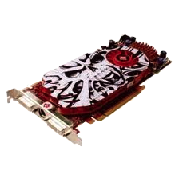
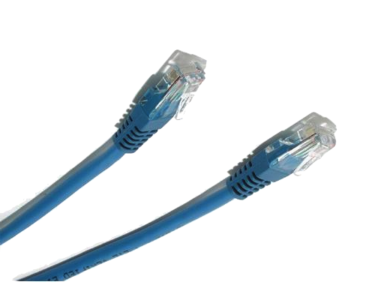
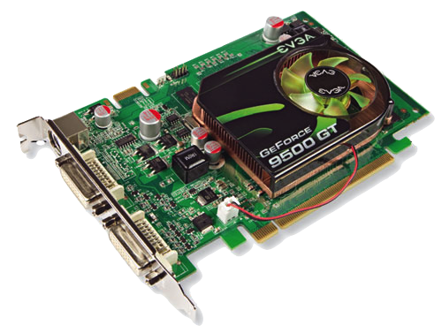
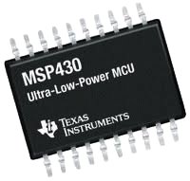
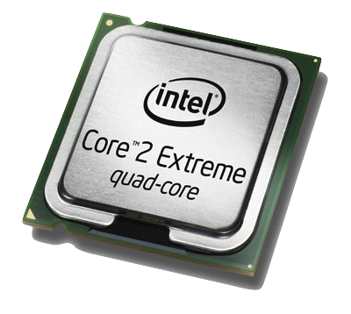
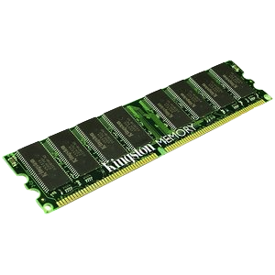

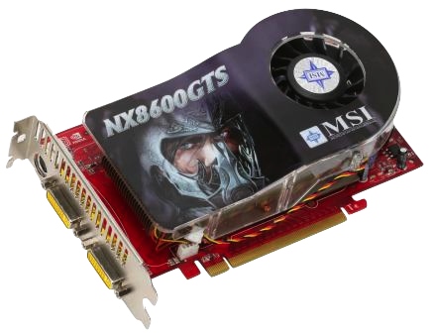
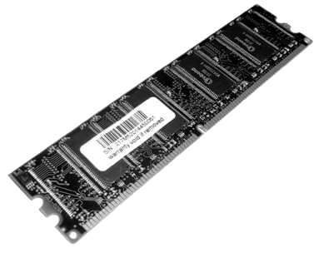
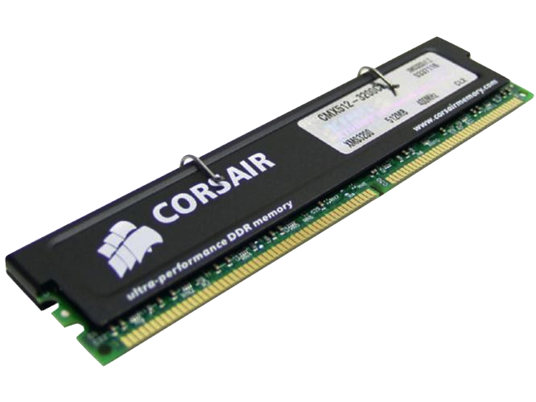
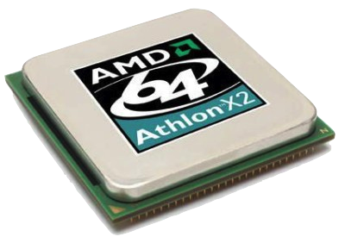
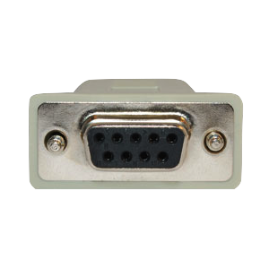
Why operating systems?
Notes:
Top: Applications
Middle: OS
Bottom: Hardware
There are standards (or specifications) which operating systems should satisfy, in order to provide the desired portability.

Slide 5
Operating system
Hardware abstraction
  Generic interfaces hiding hardware details
  Convenient abstractions, addressing common problems
    Tasks, file system, unix pipes, ...
Virtualization
  Give applications the illusion they have access to dedicated resources
Resource management
  Multiplex application tasks efficiently on the shared resources
    Processor, bus, network, memory, timers, …
Notes:
Hardware abstraction:
Generic interfaces: device drivers (e.g. ATDReadChannel(), CAN driver)),
Resource management aims at maximizing the overall system performance, while addressign the needs of individual applications/task.
AFAP is an example of lack of virtualization. Time-driven AFAP is a step towards virtualization, but inefficient due to idle time.

Slide 6
Operating system
Monolithic vs. microkernel based operating system
  Microkernel:
    Kernel implements only basic services (task and memory management, and task communication)
    Higher level services are implemented on top
    Increased maintainability, security and stability
  Monolithic:
    Provides an integrated set of services (basic + higher level)
Notes:
The microkernel design allows for easier management of code due to its division into user space services. This also allows for increased security and stability resulting from the reduced amount of code running in kernel mode. For example, if a networking service crashed due to buffer overflow, only the networking service's memory would be corrupted, leaving the rest of the system still functional.
Microkernel API should be scalable too.

Slide 7
Real-time operating system (RTOS)
Manage tasks and communication between tasks
  Task scheduling
  Context switching between tasks
  Task synchronization and communication:
    Semaphores, mutexes, timers, ...
Interrupt handling
Predictable performance
  low and bounded latencies and jitter for API calls and ISRs
Small memory foot print (for embedded use)
  Configurable (no cost for unused functionality)
Notes:
Our focus: Tasks (with suspension) Timer management (activating tasks)
Configurability is particularly important when you have a family of processors (e.g. 8/16/32/64 bit) and want to run the code across the entire product family.

Slide 8
Example: OSEK/VDX
Joint project in German/French automotive industry
Interface specification (API)
Motivation:
  High, recurring expenses in the development of control software (i.e. non-application)
  Incompatibility of control units made by different manufactures due to different interfaces and protocols
Goal: “create an industry standard for an open-ended architecture for distributed control units in vehicles”
  Support for portability and reusability, through:
    Specification of abstract interfaces (i.e. independent of applications and hardware)
    Configurable and efficient architecture
Notes:
http://portal.osek-vdx.org/index.php?option=com_content&task=view&id=4&Itemid=4
OSEK (1993): BMW, Bosch, DaimlerChrysler, Opel, Siemens, VW, University of KarlsruheOSEK/VDX (1994): PSA, Renault
OSEK is an abbreviation for the German term "Offene Systeme und deren Schnittstellen für die Elektronik im Kraftfahrzeug" (English: Open Systems and the Corresponding Interfaces for Automotive Electronics).
Motivation for OSEK is similar as for operating systems: reuse. OSEK is tailored to automotive. Repeat the motivation for OS, but with automotive examples. Care only about interfaces, not their implementations. Link to high level languages.
API: Application Programming Interface

Slide 9
Example: OSEK/VDX
Several OSEK specifications:
  Operating System (OS)
    Real-time execution of ECU software and base for the other OSEK/VDX modules
  Communication
    Data exchange within and between ECUs
  Network Management
    Configuration and monitoring

Slide 10
Example: OSEK OS
Task management
  Basic and Extended tasks
    Activation, suspension and termination of tasks
  Task switching
  Task synchronization
  Note: tasks, semaphores, ... must be statically allocated!
Interrupt management
Alarms (i.e. Timers)
Error treatment
Notes:
All memory allocation must be static! Dynamic memory allocation is unpredictable.
Synchronization: Priority Ceiling

Slide 11
Outline
Introduction to operating systems
Overview of μC/OS-II
Tasks
Scheduling
Interrupts

Slide 12
What is μC/OS-II?
Real-time operating system
Used in medical, military, aerospace, automotive, consumer electronics, ...
Commercial, but “open source”
Notes:
uC/OS-III is deployed inside one of the Analysis Labs on the Mars Rover.

Slide 13
Properties of μC/OS-II
Fixed-priority preemptive multitasking
  Up to 64 or 256 tasks (configurable)
Small and deterministic overheads
  Short and predictable interrupt path
Scalable
  Many services: semaphores, mutexes, flags, mailboxes, ...
  Enable services with conditional compilation directives
No periodic tasks
Notes:
uC/OS also provide nested interrupts (outside the scope of this course)

Slide 14
μC/OS-II architecture
Notes:
Connections are allowed between neighboring layers. Cross layer calls are very much discouraged, and should be used only in extreme cases (e.g. specific parts of an application written in assembly).
“uC/OS-II Port” contains platform specific code, such as context switching and interrupt initialization. Porting uC/OS-II to a new platform requires to change only the “uC/OS-II Port”.

Slide 15
μC/OS-II + RELTEQ architecture
Notes:
RELTEQ adds support for periodic tasks.
Reasons for placing RELTEQ inside uC/OS-II: increased performance and predictability

Slide 16
Outline
Introduction to operating systems
Overview of μC/OS-II
Tasks
Scheduling
Interrupts

Slide 17
Nested function calls
Iterative implementation
Recursive implementation
int main(void) {
int i = 0;
int j = 0;
int k = 0;
while (i < 100) {
j = 0;
while (j < i) {
k++;
j++;
}
i++;
}
(void)k;
return (0);
}
int f(unsigned int n) {
if (n == 0) {
return 0;
} else {
return n + f(n - 1);
}
}
int main(void) {
int k = f(99);
(void)k;
return (0);
}
Notes:
Example taken from the first exercises (week 1).

Slide 18
Nested function calls
int f(unsigned int n) {
if (n == 0) {
return 0;
} else {
return n + f(n - 1);
}
}
int main(void) {
int k = f(99);
(void)k;
return (0);
}
int f(unsigned int 99) {
if (99 == 0) {
return 0;
} else {
return 99 + f(98);
}
}
int main(void) {
int k = f(99);
(void)k;
return (0);
}
int f(unsigned int 98) {
if (98 == 0) {
return 0;
} else {
return 98 + f(97);
}
}
int main(void) {
int k = f(99);
(void)k;
return (0);
}
int f(unsigned int 97) {
if (97 == 0) {
return 0;
} else {
return 97 + f(96);
}
}
int main(void) {
int k = f(99);
(void)k;
return (0);
}
int f(unsigned int 1) {
if (1 == 0) {
return 0;
} else {
return 1 + f(0);
}
}
int main(void) {
int k = f(99);
(void)k;
return (0);
}
int f(unsigned int 0) {
if (0 == 0) {
return 0;
} else {
return n + f(n - 1);
}
}
int main(void) {
int k = f(99);
(void)k;
return (0);
}
int f(unsigned int 1) {
if (1 == 0) {
return 0;
} else {
return 1 + 0;
}
}
int main(void) {
int k = f(99);
(void)k;
return (0);
}
int f(unsigned int 2) {
if (2 == 0) {
return 0;
} else {
return 2 + 1;
}
}
int main(void) {
int k = f(99);
(void)k;
return (0);
}
int f(unsigned int 97) {
if (97 == 0) {
return 0;
} else {
return 97 + 4656;
}
}
int main(void) {
int k = f(99);
(void)k;
return (0);
}
int f(unsigned int 98) {
if (98 == 0) {
return 0;
} else {
return 98 + 4753;
}
}
int main(void) {
int k = f(99);
(void)k;
return (0);
}
int f(unsigned int 99) {
if (99 == 0) {
return 0;
} else {
return 99 + 4851;
}
}
int main(void) {
int k = f(99);
(void)k;
return (0);
}
int f(unsigned int n) {
if (n == 0) {
return 0;
} else {
return n + f(n - 1);
}
}
int main(void) {
int k = 4950;
(void)k;
return (0);
}
int f(unsigned int 2) {
if (2 == 0) {
return 0;
} else {
return 2 + f(1);
}
}
int main(void) {
int k = f(99);
(void)k;
return (0);
}
Memory
0
1
3
2
97
4753
98
4851
99
4950
Notes:
Example taken from the first exercises (week 1).

Slide 19
Stacks stored inside of memory

Slide 20
Function call
int f(int x, int y) {
return x + y;
}
f: PULB
PULA
ABA
PSHA
RTS
:
LDAX #1
LDAY #2
PSHX
PSHY
JSR f
PULX
f(1, 2);
Notes:
The stack is used for any function calls, not only for nested function calls.
<presentation>Animate this slide on the board</presentation>

Slide 21
Task state
At any moment in time a task is defined by its state
  CPU status registers (PC, SP, …)
  Local variables
The state of a task is stored in its TCB and on its stack
  TCB contains
    Static parameters (priority, period, phasing, …)
    Stack Pointer (SP) pointing to the top of the stack
  Each “stack frame” on the stack contains:
    CPU status registers (PC, CCR, …) Note: SP is stored in the TCB
    Local variables
    Return address (to the calling function)
    Function parameters and result address
Notes:
A new stack frame is created upon: a (timer) interrupt, a function call.
If we have N tasks, and if at most one job of a task can be active, at most N different stacks are needed

Slide 22
Switching tasks
Task switch (from A to B):
  Store the state of task A on the stack
  Store the SP inside the TCB of task A
  Load the SP from the TCB of task B
  Load the state of task B from the stack
Notes:
The state of a task is described by two kinds of variables:
Task Control Block stores task variables which are common in all tasks.
Task state contains the rest, e.g. local variables used during task execution, special registers.

Slide 23
OSTaskCreate()
task function
INT8U OSTaskCreate(void (*task)(void* pd),
void* pdata,
OS_STK* ptos,
INT8U prio);
argument to
task function
pointer to the stack
task priority
Notes:
Each task has its own state (to support blocking).

Slide 24
Task example
#define Task1Prio 1
OS_STK Task1Stack[TASK_STACK_SIZE];
void TaskCheckPad(void* p_args) {
int pad = (int)p_args;
while (1) {
ToggleLed(LED_D22);
SetLed(LED_D23, ATDReadChannel(pad) > 0);
OSTimeDly(1000);
}
}
void main(void) {
...
OSTaskCreate(TaskCheckPad, PAD14,
&Task1Stack[TASK_STK_SIZE-1], Task1Prio);
...
}
Notes:
NOTE: the stack can grow up or down, depending on the underlying architecture, i.e. how the push() and pop() methods work.

Slide 25
Task example
...
void TaskCheckPad(void* p_args) {
int pad = (int)p_args;
while (1) {
ToggleLed(LED_D22);
SetLed(LED_D23, ATDReadChannel(pad) > 0);
OSTimeDly(1000);
}
}
void main(void) {
...
OSTaskCreate(TaskCheckPad, PAD14,
&Task1Stack[TASK_STK_SIZE-1], Task1Prio);
OSTaskCreate(TaskCheckPad, PAD10,
&Task2Stack[TASK_STK_SIZE-1], Task2Prio);
...
}
Notes:
Question: Assuming that we want to check PAD14 periodically using the above approach, what is a problem?
Answer: drift.

Slide 26
OSTaskCreatePeriodic()
task function
INT8U OSTaskCreatePeriodic(void (*task)(void),
INT16U period,
              INT16U phasing,
              OS_STK* ptos,
              INT8U prio);
period
phasing
pointer to the
beginning of the stack
priority
(Provided by the RELTEQ extension)
Notes:
Each task has its own state (to support blocking).

Slide 27
Periodic task example
#define Task1Prio 1
OS_STK Task1Stack[TASK_STACK_SIZE];
void TaskCheckPad14(void) {
ToggleLed(LED_D22);
SetLed(LED_D23, ATDReadChannel(PAD14) > 0);
}
void main(void) {
...
OSTaskCreatePeriodic(TaskCheckPad14, 1000, 0,
&Task1Stack[TASK_STK_SIZE-1], Task1Prio);
...
}

Slide 28
Direct vs. suspending task
✓
Suspending task (also called a thread)
  Suspension: release the processor allowing lower priority tasks to run
  Preserves its state on its own stack
    Stack stored in main memory
    Can preserve state between activations
Direct task
  Cannot suspend
  Can be executed as plain function call
  Executed within the context of the ISR
    State can be preserved between activations using global variables
Notes:
Direct tasks are executed from scratch upon every ISR invocation (just like the tasks in Johan’s kernel).
uC/OS-II implements suspending tasks.

Slide 29
Outline
Introduction to operating systems
Overview of μC/OS-II
Tasks
Scheduling
Interrupts

Slide 30
Task states
[Labrosse, 2002]
Notes:
The waiting state is reached by a task e.g. when it is waiting for the expiration of OSTimeDly(), or posting of a mutex (later in the course).

Slide 31
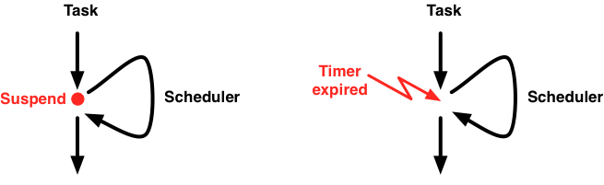
Scheduler
Fixed-Priority Preemptive Scheduler
Unique priorities (lower number means higher priority)
Triggered synchronously and asynchronously w.r.t. control flow
  Synchronously: called from e.g. OSTimeDly() or OSSemPend()
  Asynchronously: called from OSIntExit()
Scheduler:
  Selects highest priority ready task
  Switches if it has higher priority than current task
Notes:
Preemptive kernels are used when responsiveness is important (the highest ready task is always given control of the CPU, as long as data consistency is preserved).
Unique priorities avoid round robin and simplify resource sharing.
Implemented by OSSchedNew(). Called from OSSched() and OSIntExit(). OSSched() is called from synchronization primitives. OSIntExit() is called at the end of an interrupt handler, in particular the tick interrupt handler.
Suspend (e.g. due to a sempahore) vs. asynchronous trigger

Slide 32
Scheduler
How does the scheduler select the highest priority task?
  Maintain a ready queue keeping track which tasks are ready and which are not
  Maintain the queue when tasks become ready or not ready
  When scheduler is invoked, consult the queue to select the highest priority task

Slide 33
Scheduler: ready queue
Possible implementations:
  A list ordered by priority
    Task becomes ready: insert task into the list
    Task becomes not ready: remove task from the list
    Select highest priority task: take the task from the head
  A bitmap, with one bit per task
    Bit is 1 means task is ready, bit is 0 means task is not ready
    Task becomes ready: set the corresponding bit to 1
    Task becomes not ready: set the corresponding bit to 0
    Select highest priority task: select the “earliest” set bit
✓

Slide 34
[Labrosse, 2002]

Slide 35
Scheduler
The ready state of all tasks is managed with global variables
  OSRdyTbl[] and OSRdyGrp
Making a task ready
Checking if a task is ready
Both can be done in constant time!
  At the memory cost of lookup tables OSMapTbl and OSUnMapTbl
OSRdyGrp |= OSMapTbl[prio >> 3];
OSRdyTbl[prio >> 3] |= OSMapTbl[prio & 0x07];
y = OSUnMapTbl[OSRdyGrp];
x = OSUnMapTbl[OSRdyTbl[y]];
prio = (y << 3) + x;
Notes:
OSMapTbl[] and OSUnMapTbl[] are arrays in ROM mapping between:
numbers in the range 0..7 and the corresponding bit mask, containing a 1 at the position indicated by the number,
255 bit patterns and the index of the highest set bit
The thing to take away from this slide is that the ready table can be managed in constant time, due to the lookup tables, at the cost of additional memory requirements for storing the lookup tables.

Slide 36
Outline
Introduction to operating systems
Overview of μC/OS-II
Tasks
Scheduling
Interrupts

Slide 37
Interrupts
An incoming interrupt dispatches the associated interrupt service routine (ISR)
  Represents a high priority event (which needs to be handled)
ISRs have higher priority than any task
  ISRs interfere with tasks
  Needs to have a short and predictable execution time
  Tasks can disable interrupts
Notes:
There is a tradeoff: interrupts should be handled with little latency, but can lead to high interference of other tasks.

Slide 38
Interrupt Service Routine
General structure of an ISR in μC/OS-II:
ISR executes within the context of the currently running task
  It uses the stack space of the current task
void SomeISR(void) {
Save processor registers;
Call OSIntEnter();
Call SomeISRBody();
Call OSIntExit();
Restore processor registers;
Execute a return from interrupt instruction;
}
Notes:
Save processor registers saves PC, PSW, and all other register which may be used within the ISR.
OSIntEnter() increments a nesting counter to allow nested interrupts.
OSTimeTick() is the actual handler for this interrupt.
OSIntExit() decrements a nesting counter. If 0 then it:
Selects highest priority task.
If highest priority task is different from the currently running one, then
Restore registers of the highest priority task
Return from the interrupt into the highest priority task
Restore processor registers restores the PC, PSW, and all other registers which may have been used in the ISR.
Return from interrupt

Slide 39
Interrupts
Notes:
Question: How would you measure interrupt latency?
Interrupt latency = longest critical section
Response time may be defined slightly different by different people, e.g. in Johan’s slides (S05.14) and Reinder’s: the response is the time until the beginning of the User ISR, rather than its end. (Also their task response time in [Labrosse] is until the beginning of the task, rather than its completion).
Scenario A is selected when the same task is resumed after the interrupt.
Scenario B is selected when a higher priority task is ready to execute. Includes a context switch to the higher priority task. Note that this scenario will always happen when the scheduler is disabled.

Slide 40
Interrupt timing
Interrupt latency
  Max time interrupts are disabled
  Time to start executing first instruction of the ISR
Interrupt response
  Interrupt latency
  Time to save CPU state (i.e. registers)
  Time to enter the ISR ( OSIntEnter())
Interrupt recovery
  Time to exit the ISR ( OSIntExit())
  Time to restore CPU state
void SomeISR(void) {
Save processor registers;
Call OSIntEnter();
Call SomeISRBody();
Call OSIntExit();
Restore processor registers;
Return from interrupt;
}
Notes:
Time to Start executing the first instruction of ISR includes waiting for last instruction to complete.
Interrupt latency: latency from the interrupt till the start of the ISR. In contrast to task response time in the analysis, where task execution time is included in the response time.
OSIntExit() includes time to determine if higher priority task is ready and switching to it.

Slide 41
Timer interrupt
Timer interrupts are especially important
  Keep track of time by incrementing the global OSTime variable

Slide 42
Timer interrupt
System clock is connected to the MCU via a pin
  Clock operates independently of the MCU
Clock sets the pin high periodically
Setting a pin high triggers an interrupt on the MCU
Interrupt is handled by an ISR, which sets the pin low
Notes:
Clock only sets the pin high. It sets the pin high irrespective of the state of the pin (write only).
MCU only sets the pin low, however, it also reads the pin and chooses its actions accordingly (read and write).
The clock frequency is programmed (e.g. in cpu.c by setting the RTICTL register)

Slide 43
Timer interrupt (interrupts enabled)
Notes:
Assume Time unit is ms, OSTime unit is tick, and 1 tick takes 1 ms.

Slide 44
Timer interrupt (interrupts disabled)

Slide 45
Disabling interrupts
Tasks can disable interrupts
  OS_ENTER_CRITICAL() and OS_EXIT_CRITICAL()
  Can lead to increased interrupt latency or missed interrupts
  Keep interrupts disabled for as little time as possible!
  Use only for short critical sections
Tasks can also disable preemption while keeping interrupts enabled
  OSSchedLock() and OSSchedUnlock()
  Scheduler is disabled, but interrupts are not disabled
  Task maintains control of the CPU, but incoming interrupts are handled
Notes:
There is a tradeoff: interrupts should be handled with little latency, but can lead to high interference of other tasks.

Slide 46
Timer interrupt
Timer interrupts are especially important
  Keep track of time by incrementing the global OSTime variable
  Delay a task for number of ticks: OSTimeDly()

Slide 47
Timer interrupt
Notes:
Here is a logical view on the timer interrupts: each task wants to be triggered by its own timer.
The different sizes represent the work that needs to be done by the task.

Slide 48
Timer interrupt
Notes:
Most platforms provide a single hardware timer, so we need to multiplex the logical (or software) timers onto the single timer.

Slide 49
Timer interrupt
Notes:
The Multiplexer box represents the overhead for multiplexing several software timers on a single hardware timer.
Note that the multiplexer delays the time when a task can start responding to the expiration of its timer.

Slide 50
Timer interrupt

Slide 51
Timer interrupt
Timer interrupts are especially important
  Keep track of time by incrementing the global OSTime variable
  Delay a task for number of ticks: OSTimeDly()
Handled by OSTimeTick()
  Called within the timer ISR
  Loops through all tasks:
    Decrement the OSTimeDly field in their TCB
    If OSTimeDly is 0, then make the task ready

Slide 52
Timer ISR
void OSTickISR(void) {
Save processor registers;
Call OSIntEnter();
Call OSTimeTick();
Call OSIntExit();
Restore processor registers;
Execute a return from interrupt instruction;
}

Slide 53
OSTimeTick() in μC/OS-II
void OSTimeTick(void) {
for all tasks {
  OS_ENTER_CRITICAL();
  if (task->OSTCBDly > 0) {
    if (--task->OSTCBDly == 0) {
      (* make task ready *)
    }
  }
  OS_EXIT_CRITICAL();
}
OS_ENTER_CRITICAL();
OSTime++;
OS_EXIT_CRITICAL();
}
Notes:
Looping through all the tasks is costly.
Within SAN we have developed a really neat timed event management component, called RELTEQ, and integrated it with uC/OS-II. It avoids looping through all the tasks upon every tick.
Question: why making the task delay operations atomic?
Answer: nested interrupts. Since on the board there are no nested interrupts, it is not necessary.

Slide 54
References
Recommended reading:
  “MicroC/OS-II, The Real-time Kernel”,
  J. Labrosse, 2002, Second Endition
  “μC/OS-II Reference Manual”
    Chapter 16 from the book (available on the website)
  μC/OS-II source code
    Download from http://micrium.com
    Included in the exercises from last week

