Slide 1
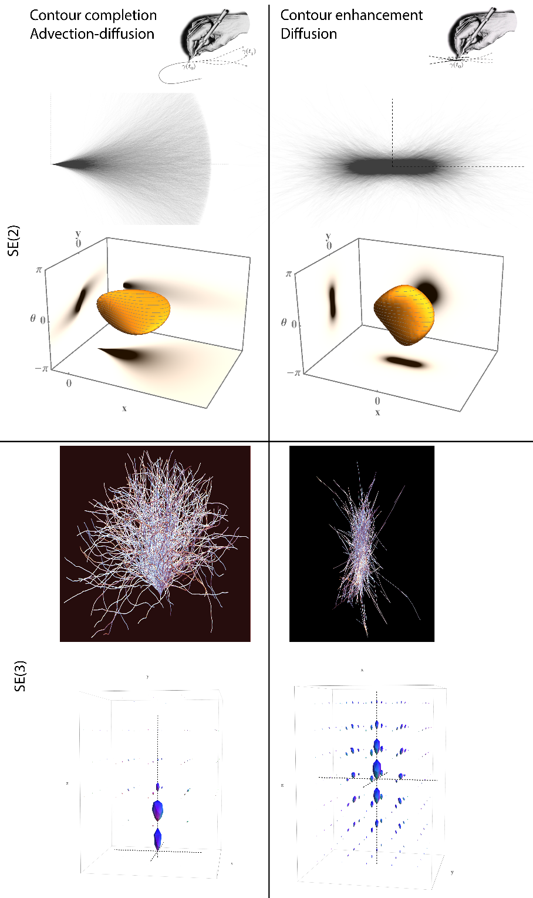

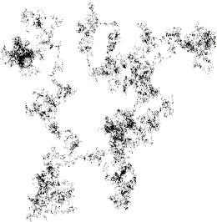
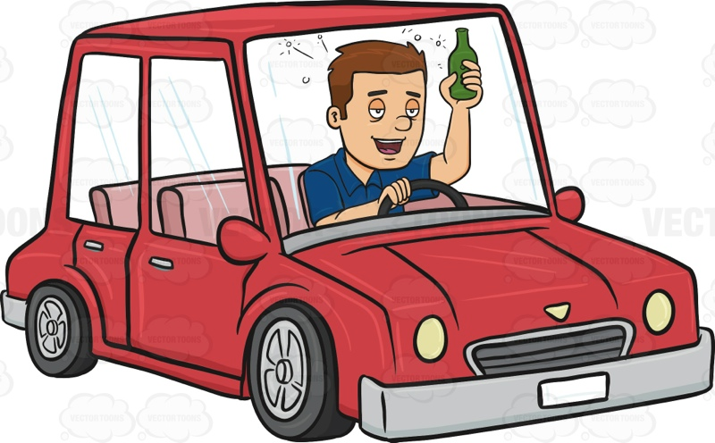
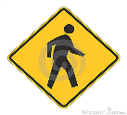

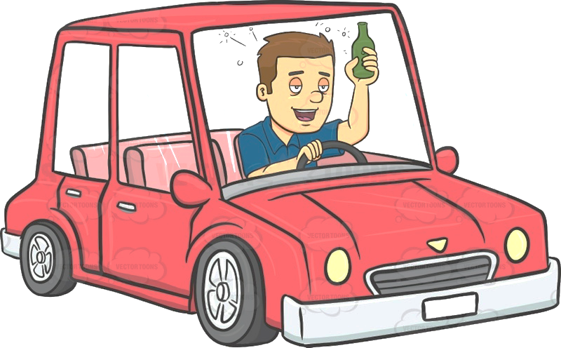
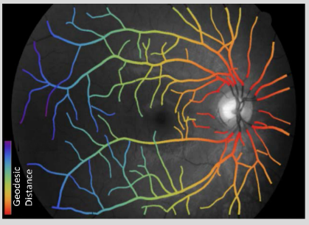

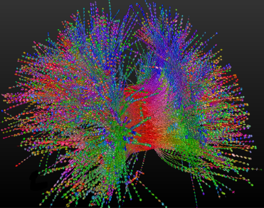



type 1
type 2
The Drunk Man’s Walk , Drive , and Flight ,
and Applications to Medical Image Analysis
Remco Duits
CASA, BMIa, TU/e, Eindhoven
Lie Analysis
MANET

Slide 2
Overview of the Talk
Research Overview Lie group analysis for medical image processing
Part Ia Probability theory for drunk traffic:
Drunk man’s walk
Drunk man’s drive
- type I - type II
Drunk man’s flight
Part Ib Optimal control for sober traffic
Part II Medical image analysis applications

Slide 3
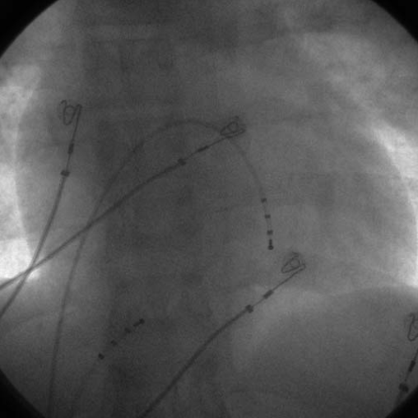
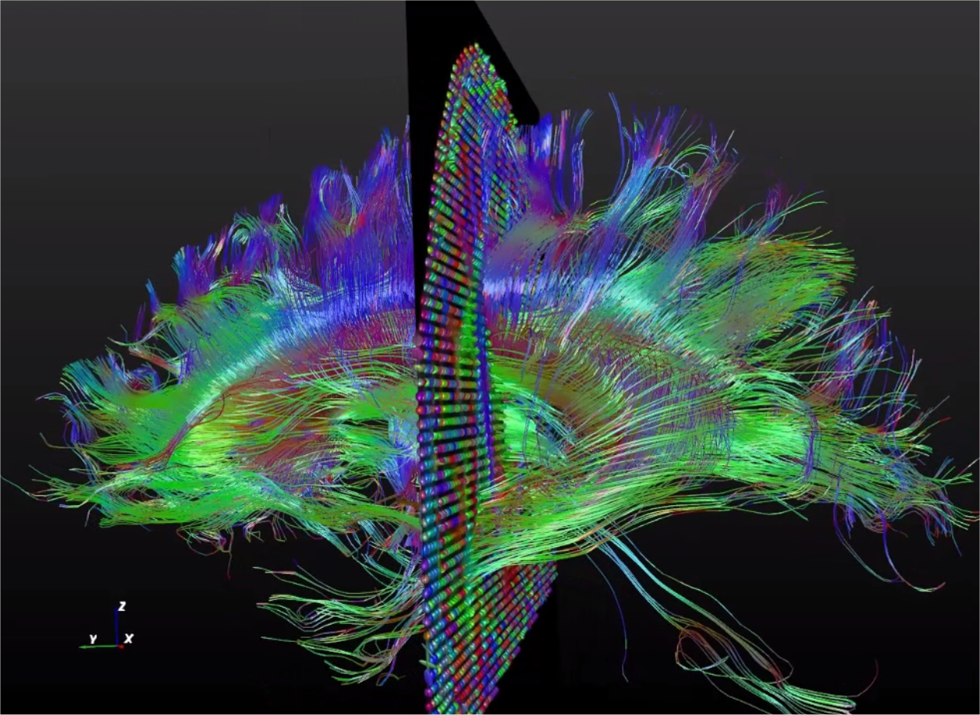
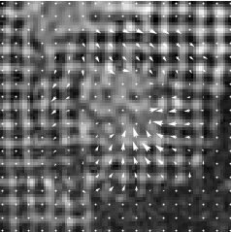
Lie Group Analysis for Medical Image Processing
catheters
neural fibers
cardiac wall
hart
Problem: Automated recognition of basic patterns often fails
Solution: Contextual image processing via Lie group analysis

Slide 4
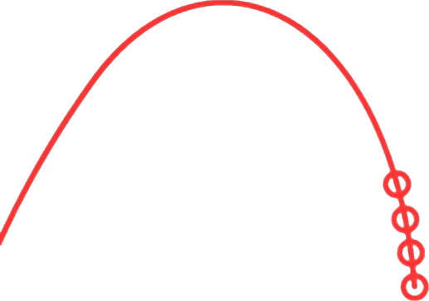

Contextual Image Analysis
I propose a generic mathematical model for contextual image analysis
via scores on Lie groups with many applications.
Notes:
Contextual image processing example
Consider the patch within the red circle. Then
Surpising how the surroundings contribute contributes
This phenomenon is called contextual image analysis
To see whether patch matches the surrounding patches one needs Lie group actions
In this particular case the group SE(2) of rotations and translation in the plane.
Such contextual image processing generalizes to other basic patterns than lines such as for instance frequencies and velocities requiring other group actions .
To this end I propose generic contextual image analysis via scores on Lie groups. Such scores are typically obtained by probing image f by a family of group coherent wavelets.

Slide 5
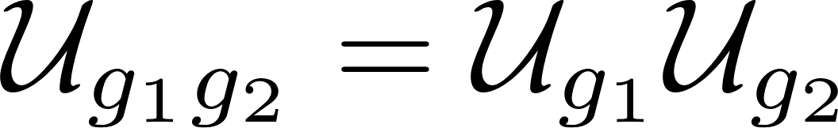


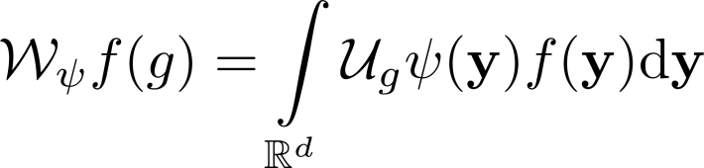

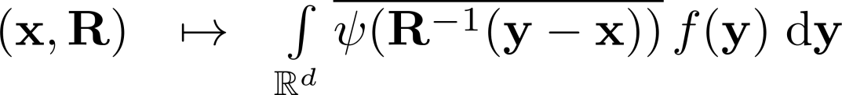
Lie Group and Score
Lie group: differentiable manifold with group product (compatible)
In high school: scaling & shifting of function
Lie group
In image analysis:
- image:
- kernel:
- score:
e.g. on Lie group:

Slide 6
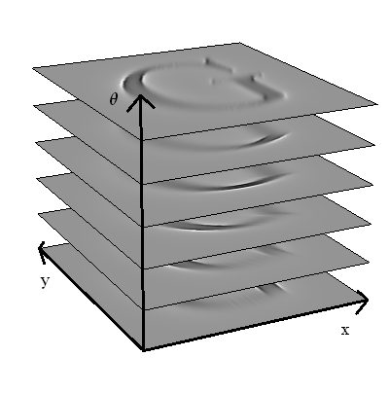
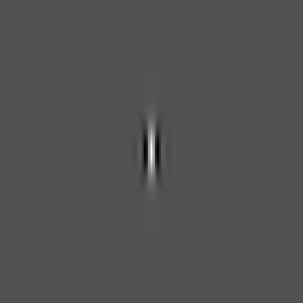
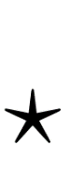


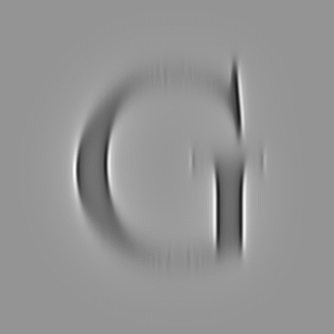
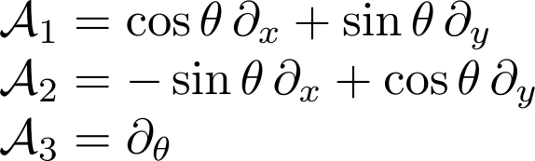
Invertible Orientation Scores
Image
Curved Geometry of SE(2) visible in Score:
Moving frame
Orientation Score
Cake wavelets
Gabor wavelets

Slide 7
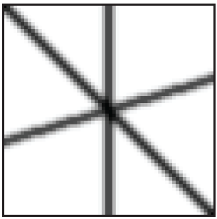
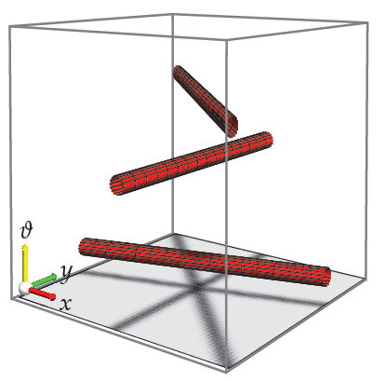
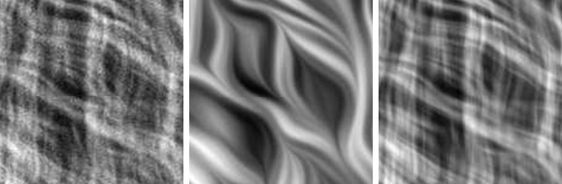
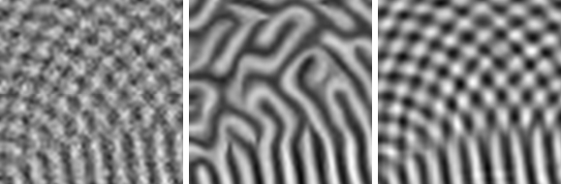
Contextual Diffusion in Orientation Scores
image
orientation score
original
CED on image
our method

Slide 8




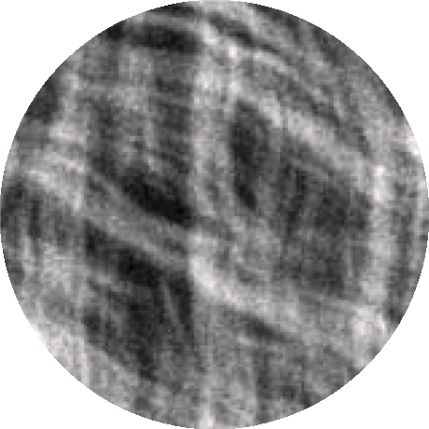
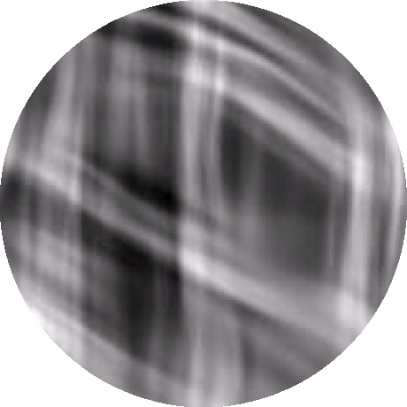
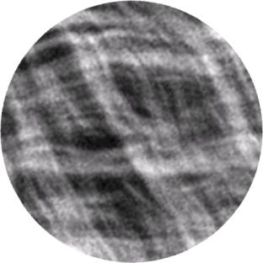
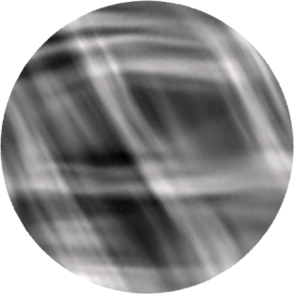
Lie Group Analysis via Invertible Scores
Image
Score
Processed
image
Processed
Score
Processing on the score must be left-invariant
E.g. for diffusions

Slide 9
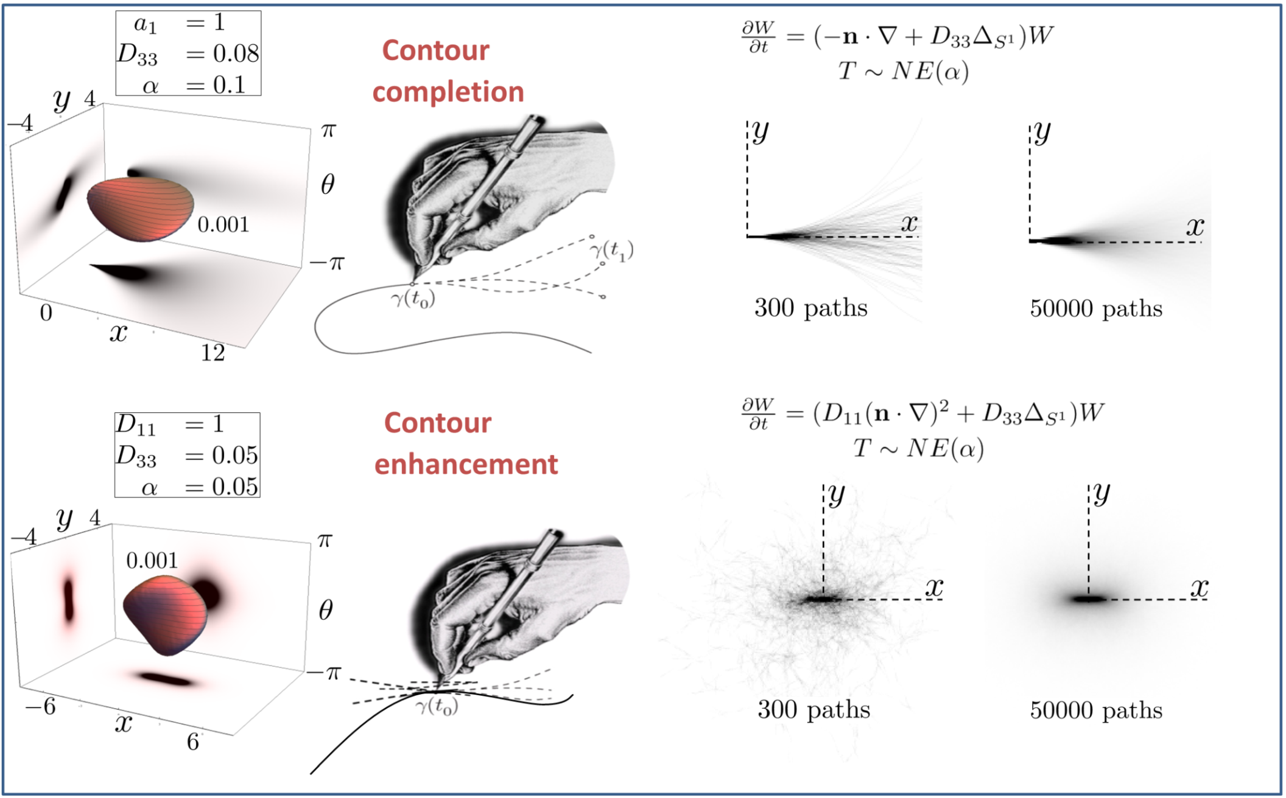
SE(2): Underlying Probability Theory on Lie group
Exact solution:
Exact Limits
Exact solution:

Slide 10
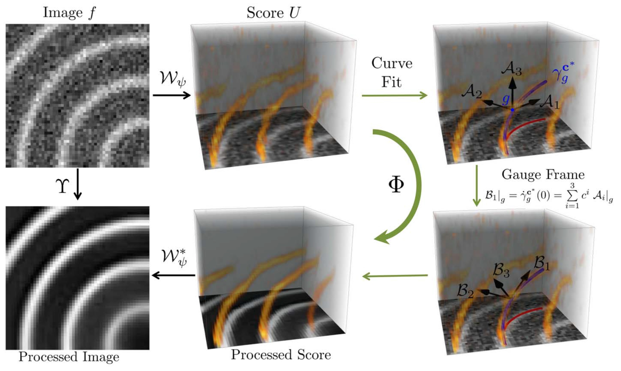
SE(2): Inclusion adaptivity via local frames

Slide 11
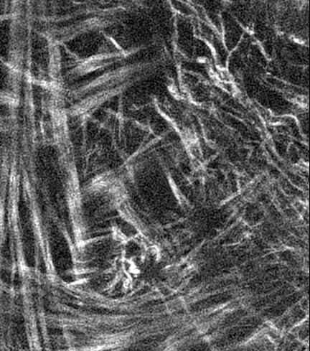
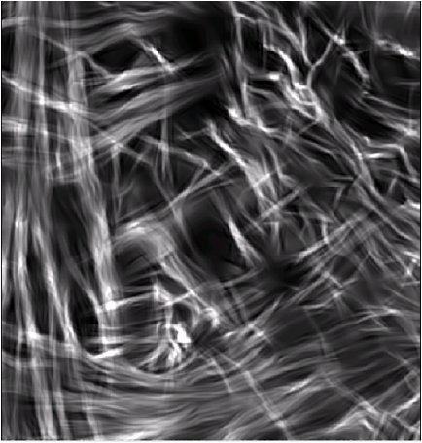
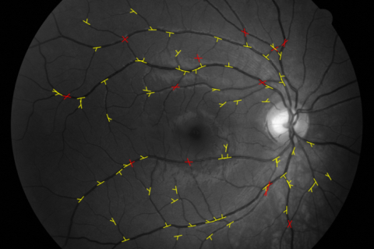

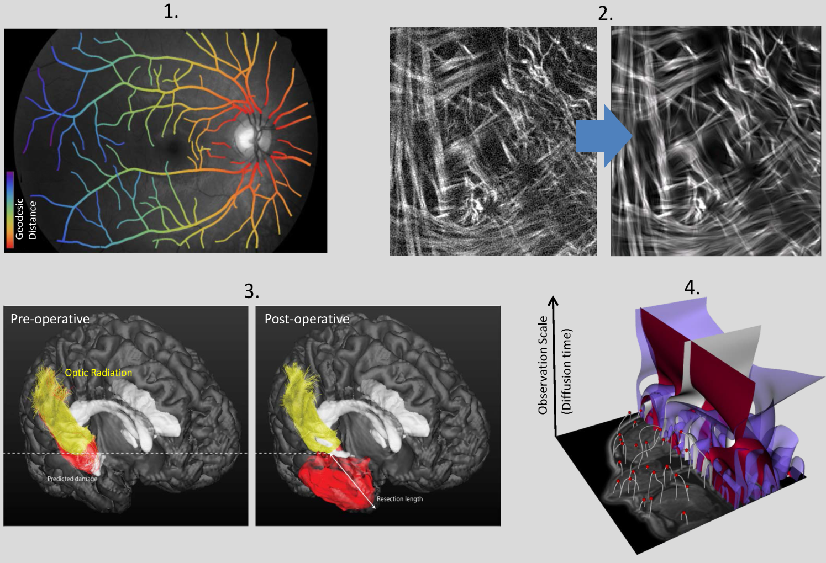
Lie groups Scores Applications
SE(2) Orientation scores of 2D images
Crossing-preserving denoising
& detection of curvilinear structures
in low contrast medical images.
Biomarkers for diabetes.
SE(3) Orientation scores of 3D images
DW-MRI
SIM(2) Continuous wavelet transforms multiple-scale extensions
SO(3) Orientation scores Detect vascular tree in spherical images
H(5) Gabor transforms Quantify cardiac wall deformation in MR-tagging velocity scores Track moving objects in crowds
Fiber tracking & connectivity for therapy planning

Slide 12
Part IA: Probability Theory for Drunk Traffic
The Drunk Man’s
Walk Drive Flight

Slide 13

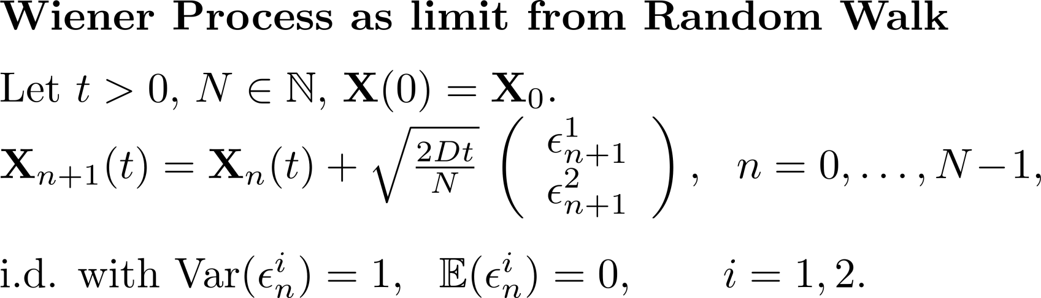
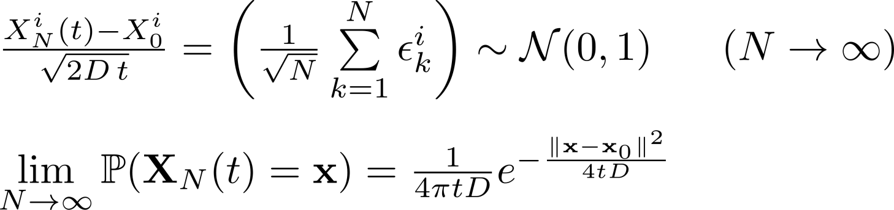


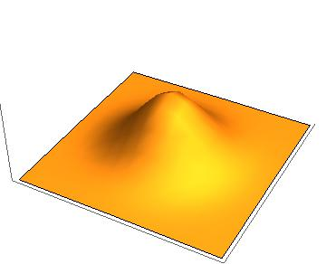
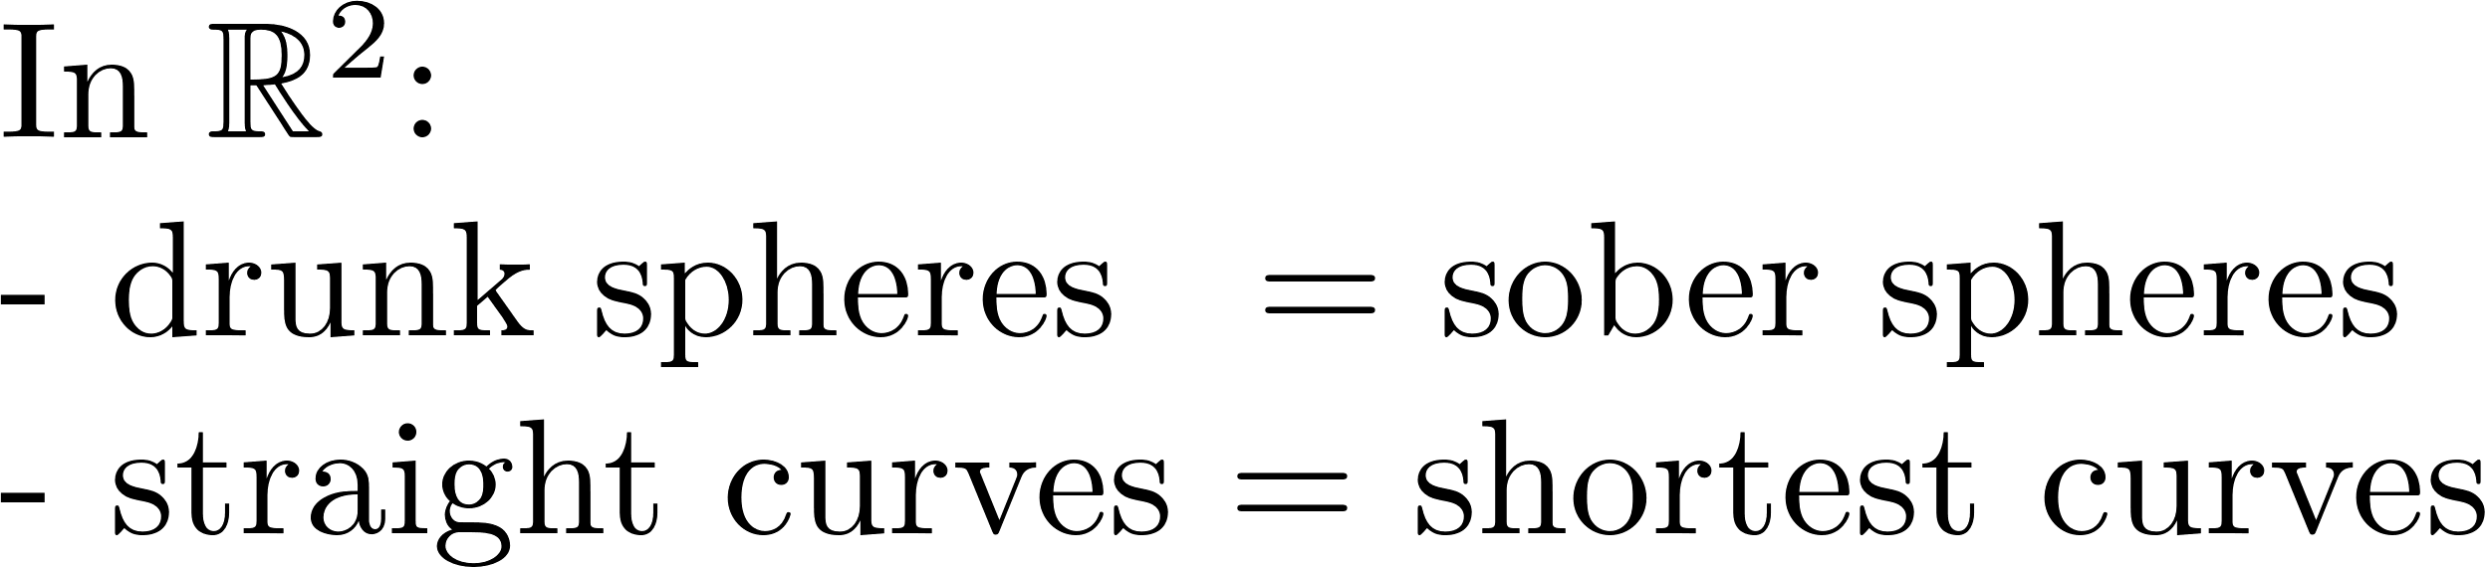
The Drunk Man’s Walk on

Slide 14
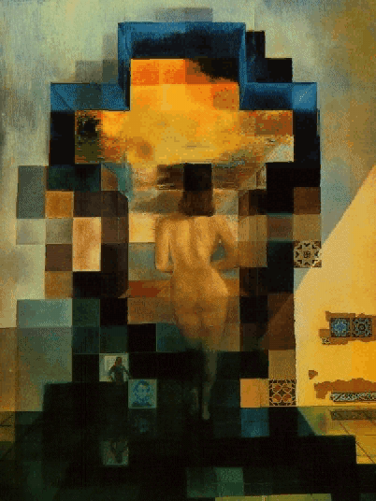

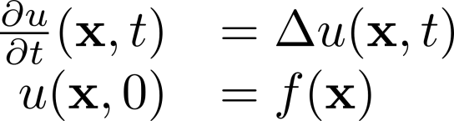


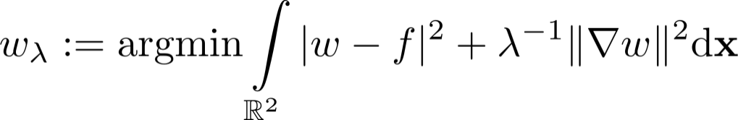
Wiener Process & Resolvent

Slide 15


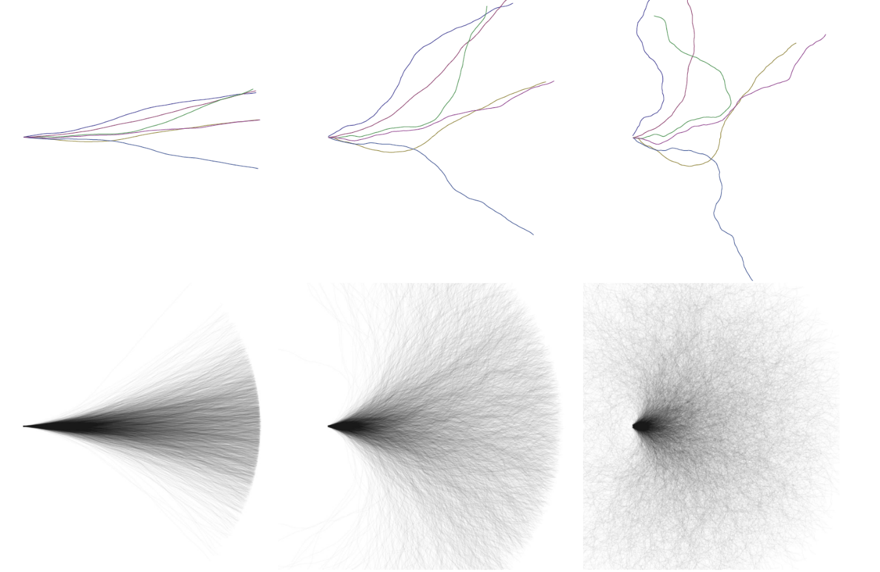
The Drunk Man’s Drive on SE(2)
Similar to the drunk man’s walk on Lie group
we consider the drunk man’s drive
as a stochastic processes in Lie group

Slide 16
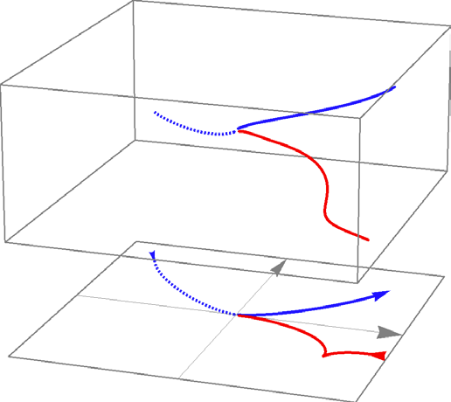
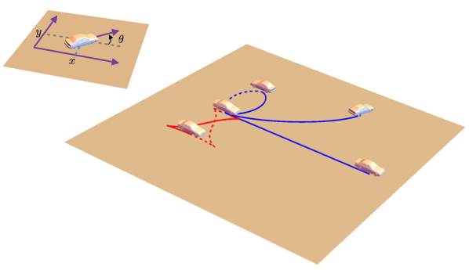
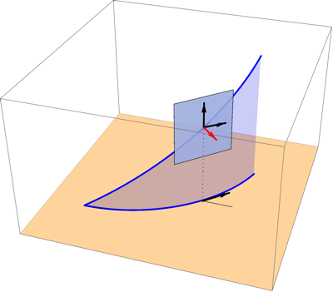
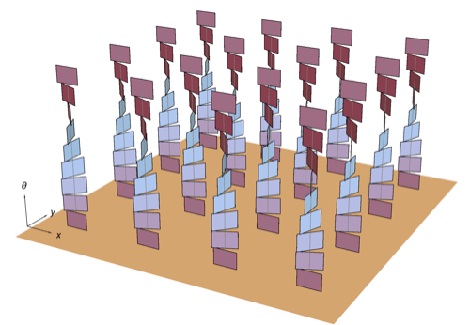
The Drunk Man’s Drive on SE(2)
Lifts: Car paths can be “lifted” to SE(2)
Cars are allowed to move forward and backwards,
to change their orientation, but they cannot move sidewards
We endow Lie group SE(2) with a sub-Riemannian metric (tensor)

Slide 17
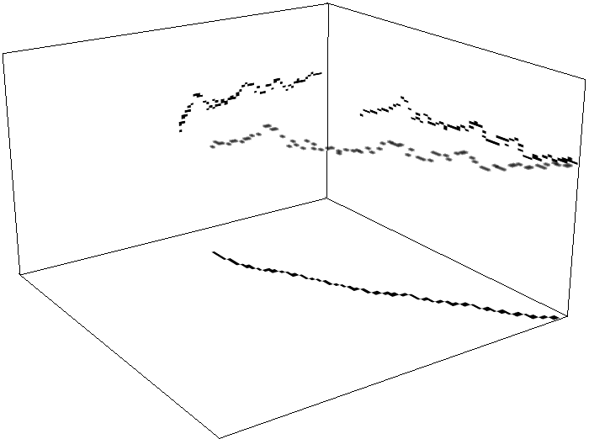
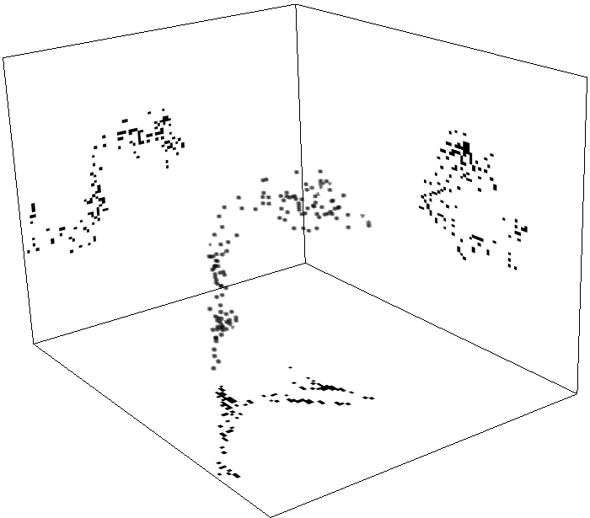
Type I:
(Contour completion)
Exact Limits of Resolvents
Type II:
(Contour enhancement)

Slide 18

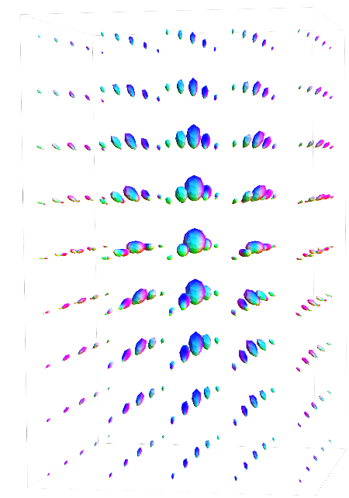
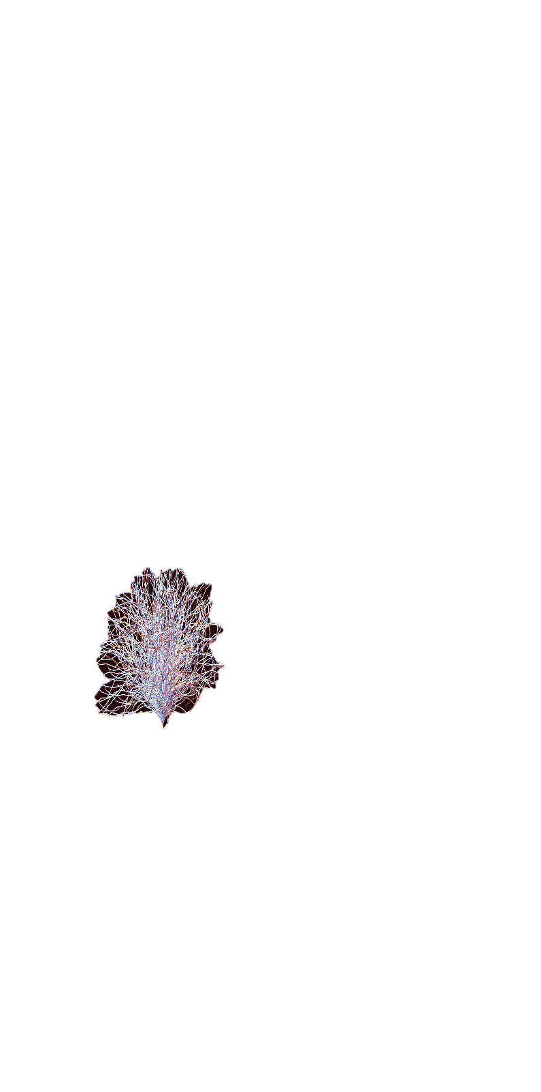
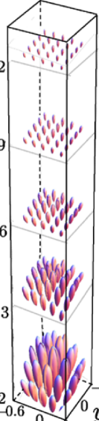
Lifts: Flight paths can be “lifted” in sub-Riemannian manifold
within quotient
The Drunk Man’s Flight in SE(3)
Our Exact Limit
(resolvent)
Our Exact Limit
Type I:
Type II:
Exact formulas and again verified by Monte Carlo simulations

Slide 19






Part Ib: Optimal control for Sober Drivers
Shortest curves
Straight curves

Slide 20

Shortest Paths for Sober Drivers
A sub-Riemannian (SR) sphere is the set of endpoints of
the shortest curves with equal length departing from the origin.
Theorem
- Shortest curves have parallel momentum w.r.t.
partial left-Cartan connection.
- Straight curves have parallel velocity
horizontal exponential curves

Slide 21


Shortest Paths for Sober Drivers
Observations
1. Sometimes cusps in spatial projections.
2. Folds on SR-spheres.

Slide 22








Shortest Paths for Sober Drivers
Explanation Observations:
Sometimes cusps in spatial projections – must put car in reverse
Theorem
2. Folds on SR-spheres – Maxwell points
Before cusp geodesic
is unique minimizer

Slide 23





Shortest Paths for Sober Drivers with Cost
Metric tensor
low
high

Slide 24




Shortest Paths for Sober Pilots
Metric Tensor
Spatially projected curves in
Reachable cones (no cusps)

Slide 25




Part II: Medical Imaging Applications
Detect vascular tree in images of the eye
Application: Early diagnosis of diabetes
Problem: Low contrast & crossings & bifurcations & scales
Aim: Reliable tracking of all blood vessels in retina
Industry : PhD E.J. Bekkers
Math: Sober & drunk drives in SE(2)

Slide 26


Vessel Tracking via fast marching in SE(2)
our method

Slide 27


Vessel Tree from Optic Nerve Head
Automatic ONH detection by template matching in orientation scores via machine learning:
smoothed regression with
SR-Tikhonov regularization and GCV.
drunkman’s drive
99.8 % succes on 1700 bench-mark images,
outperforming state of art.
2. Tracking of
vascular tree
sober drive

Slide 28




Biomarkers for diabetic retinopathy
Sober drive
“straight curves”
Best exponential
curve fits in SE(d)
Average curvature
increases with
progression towards
diabetic retinopathy

Slide 29
Medical Imaging Application
Denoising of crossing elongated structures
Application: Analysis of orientation of collagen fibers
Problem: Many Crossings & multiple scales
Aim: Crossing-preserving Enhancement
Math: Drunk man’s drive in SE(2)

Slide 30









Two Extensions of Crossing Preserving Diffusion
Image
CED
CED-OS
To multiple scales
Image
ISKR
BM3D
To 3D

Slide 31
Medical Imaging Application
Detect Neural Tracts in DW-MRI
Application: Fiber tracking for diagnosis & therapy planning
Problem: Only parallel bundles → resolve crossings
Aim: Generic resolving of crossing without increase of scanning time!
Clinics: Kempenhaeghe, Hospital Clinic Barcelona, SCIL
Math: Drunkman’s Flight and Sober Flight
vIST/e

Slide 32








Crossing-preserving PDE Flows & Geometric Control in DW-MRI
Pipeline Processing DW-MRI of Brain
Data UzM
Data (Optic Radiation)
Cortex
LGN
Cortex
Phantom data
LGN
ML-TP
Improved Stability/Accuracy

Slide 33
Conclusion
We have solved for the exact limiting distributions of the
drunk man’s drive and the drunk man’s flight.
Useful for crossing preserving PDE’s.
We also considered optimal path planning for sober traffic.
Useful for tracking in SE(d).
Specific Part of new PDE framework on Lie groups via invertible scores
- New exact and numerical solutions of PDE’s
- New geometric control theory in Lie groups
Impact in medical image analysis & computer vision
- Growing interest from medical communities & industry
Fundamental mathematics and medical image analysis

Slide 34
References
See homepage of Remco Duits
http://bmia.bmt.tue.nl/people/RDuits/
(with links to key publications)
Selection in view of this presentation:
Sober man’s drive/flight On sub-Riemannian geodesics in SE(d)
Bekkers, E.J. and Duits, R. and Mashtakov, A. and Sanguinetti, G.
A PDE approach to Sub-Riemannian Fast Marching in SE(2).
SIAM Journal on Imaging Sciencens, 2015
Sanguinetti, G., Bekkers,E.J., Duits, R., Mashtakov, A. & Mirebeau, JM.
Sub-Riemannian Fast Marching in SE(2).
Proceedings of CIARP, 2015
Duits, R., Ghosh, A., Dela Haije, T.C.J. and Sachkov, Y.L. Cuspless Sub-Riemannian Geodesics within the Euclidean Motion Group SE(d) Chapter 5, p.173-215,
in Neuromathematics of Vision, eds: Citti and Sarti, ISBN 978-3-642-34443-5, Springer-Verlag, 2014.
Duits, R, Ghosh, A., Dela Haije, T.C.J. and Mashtakov, A.. On Sub-Riemannian Geodesics within SE(3)/({0} × SO(2)) whose spatial projections do not have cusps
ArxiV, submitted 2015.
Duits, R., Boscain, U., Rossi, F., & Sachkov, Y.L. Association Fields via Cuspless Sub-Riemannian Geodesics in SE(2),
JMIV Journal of Mathematical Imaging and Vision , vol. 49, no. 2 pp. 384--417, 2014.
Drunk man’s drive; On sub-Riemannian stochastic processes in SE(2)
Duits, R. and Van Almsick, M.A.
The explicit solutions of linear left-invariant second order stochastic evolution equations on the 2D Euclidean motion group
Quarterly of Applied Mathematics, AMS, 2008
Duits, R. and Franken, E.M.
Left-invariant parabolic evolutions on SE (2) and contour enhancement via invertible orientation scores—part I:
Linear left-invariant diffusion equations on SE (2)
Quarterly of Applied mathematics, AMS, 2010
Zhang, J. & Duits, R., Sanguinetti, G. and ter Haar Romeny, B.M.
Numerical Approaches for Linear Left-invariant Diffusions on SE(2), their Comparison to Exact Solutions, and their Applications in Retinal Imaging.
Numerical Mathematics, Theory Methods and Applications, accepted to appear in 2016. Also available on arXiv.

Slide 35
Invertible Orientation Scores
Duits, R. (PhD-thesis, Perceptual Organization: A Mathematical Approach Based on Scale, Orientation and Curvature, 2005)
Franken, E.M. (PhD-thesis, Enhancement of Crossing Elongated Structures, 2008)
Duits, R., Felsberg, M., Granlund, G. & ter Haar Romeny, B.M.
Image Analysis and Reconstruction using a Wavelet Transform based on a Reducible Representation of the Euclidean Motion Group
International Journal of Computer Vision, IJCV, 79(1), 2007.
Duits, R. and Franken, E.M.
Left-invariant parabolic evolutions on SE (2) and contour enhancement via invertible orientation scores—part I:
Linear left-invariant diffusion equations on SE (2)
Quarterly of Applied mathematics, AMS, 2010.
Sharma, U. & Duits, R.
Left-invariant evolutions of wavelet transforms on the Similitude Group.
ACHA Applied and Computational Harmonic Analysis 2015. Vol. 39, p.110—137, 2015.
Medical Image Analysis Applications
Portegies, J., Fick, R., Sanguinetti, G., Meesters, S., Girard, G. & Duits, R.
Improving Fiber Alignment in HARDI by Combining Contextual PDE flow with Constrained Spherical Deconvolution. Plos ONE 2015
Bekkers, E.J., Loog, M., ter Haar Romeny, B.M. & Duits, R. Template Matching on the Roto-Translation Group, submitted 2015, available on arXiv.
Bekkers, E.J., Duits, R., Berendschot, T. and ter Haar Romeny, B.M. A Multi-Orientation Analysis Approach to Retinal Vessel Tracking JMIV, 49 (3), 583-610, 2014.
Bekkers, E.J., Duits, R., Loog, M. Training of Templates for Object Recognition in Invertible Orientation Scores: Application to
Optic Nerve Head Detection in Retinal Images EMMCVPR, LNCS 8932, pp.464-477, 2015.
Duits, R., Dela Haije, T.C.J., Creusen, E.J. & Ghosh, A. Morphological and Linear Scale Spaces for Fiber Enhancement in DW-MRI JMIV, 2014.
Duits, R., Führ, H., Janssen, B.J., Bruurmijn, L.M.C., Florack, L. & van Assen, H.C. Evolution Equations on Gabor Transforms and their Applications ACHA, 35(3), 483-526, 2013.
Hannink, J., Duits, R. and Bekkers, E.J. Crossing-Preserving Multi-Scale Vesselness (MICCAI main conference) LNCS 8674, pp.603--610, 2014.
Locally Adaptive Frame Theory in SE(d)
Duits, R. and Janssen M.H.J., Hannink, J. & Sanguinetti, G. Locally Adaptive Frames in the Roto-translation Group and their Applications in Medical Imaging
(available on arXiv) Submitted to Journal of Mathematical Imaging and Vision 2015.
Drunk man’s flight
Portegies, J., Sanguinetti, G.R., Meesters, S.P.L. and Duits, R..
New Approximation of a Scale Space Kernel on SE(3) and Applications in Neuroimaging,
Proc. SSVM 2015 (eds. Aujol, Nikolova, Papadakis), LNCS 9087, p.40-52, 2015.
(NB. exact solutions in preparation for submission Portegies & Duits in 2016)

