Slide 1
Legal Informatics, Privacy and Cyber Crime
Part Three: Advanced Attacks
Sandro Etalle
03/05/2018
2017/2018

Slide 2
About this part of the course
Topic: real-life example of targeted attacks.
Underlying material: [OBLIGATORY READ!]
The Real Story of Stuxnet, Posted 26 Feb 2013, by David Kushner
https://spectrum.ieee.org/telecom/security/the-real-story-of-stuxnet
W32.Stuxnet Dossier. By Symantec https://www.wired.com/images_blogs/threatlevel/2011/02/Symantec-Stuxnet-Update-Feb-2011.pdf
Read Only: Executive Summary,
T. Conway, R. M. Lee, M. J. Assante. Analysis of the cyber attack on the Ukrainian power grid. SANS ICS, 2016.
https://ics.sans.org/media/E-ISAC_SANS_Ukraine_DUC_5.pdf
On Ransomware:
https://www.csoonline.com/article/3212260/ransomware/the-5-biggest-ransomware-attacks-of-the-last-5-years.html
https://www.csoonline.com/article/3233210/ransomware/petya-ransomware-and-notpetya-malware-what-you-need-to-know-now.html

Slide 3
Critical infrastructure

Slide 4
SCADA and PLC (in a nutshell)
SCADA (Supervisory Control and Data Acquisition)
sends control commands to remote devices such as PLCs
example of commands:
‘set the level of water to value x’
‘give me the current water flow rate’
‘give me the current level of water’
PLC (Programmable Logic Controller)
process the commands sent by the SCADA
makes decisions on its control program in order to produce the output required
SCADA and PLC communicates via industrial protocols such as MODBUS, DNP3, IEC-104, etc.

Slide 5
General Architecture

Slide 6
For instance
Business LAN
Internet
www
@
Supervisory
Network
(ISA 95 – Level 2)
SCADA/
HMI
Historian
DNS server
Control
network
Field network
(ISA 95 – Level 1)
Engineering WS
NTP server
• • • • • • • •
• • • • • • • •
IEDs/PLCs
RTU
MTU
IEDs/PLCs
Notes:
To describe the basic principles of the ICS Networks pointing out the connection among business lan, supervisory network and control system network.
An industrial network is most typically made up of several distinct areas, which are simplified here as a business network or enterprise, business operations, a supervisory network, and process and control networks.
The separation of assets into functional groups allows specific services to be tightly locked down and controlled, and is one of the easiest methods of reducing the attack surface that is exposed to attackers. Simply by disallowing all unnecessary ports and services, we also eliminate all of the vulnerabilities—known or unknown—that could potentially allow an attacker to exploit those services. That’s why we expect to find firewall to isolate these three areas.
--------------- ISA 95 levels
Level0: Defines the actual physical processes.
Level1: Defines the activities involved in sensing and manipulating the physical processes.
Level2: Defines the activities of monitoring and controlling the physical processes.
Level3: Defines the activities of the work flow to produce the desired end-products.
Level4: Defines the business-related activities needed to manage a manufacturing organization.

Slide 7
Protocol by Example: DNP3 & ICCP
DNP3 & ICCP are used mainly electric and water companies.
DNP3 is primarily between a master station and RTUs or IEDs
ICCP is used for inter-master station communications.
Competing standards: Modbus and IEC 61850 protocol.

Slide 8
The trouble with SCADA
Designed 20 Years ago:
Isolated
With no security in mind
Access was local (not remote, there was no internet)
Today
Connected through the backoffice
Allow remote control
In general
Lots of proprietary protocols
Very hard to patch (vendors are very reluctant)
Question: why there are relatively few attacks on SCADA?
We will get back on this.

Slide 9
2009: Stuxnet Attack
The first example of Cyber Weapon
Birth Date: Before June 2009
Discovered: June 2010 by VirusBlokAda.
Retirement Date: June 24, 2012
# of computers infected: >= 100.000
Sources:
The Real Story of Stuxnet, Posted 26 Feb 2013, by DAVID KUSHNER
https://spectrum.ieee.org/telecom/security/the-real-story-of-stuxnet
Not technical. Obligatory read, there is a lot of FLAME in it
W32.Stuxnet Dossier. By Symantec
Read: Executive Summary,
Stuxnet Under the Microscope, by ESET (RU)
Too technical for our purposes

Slide 10
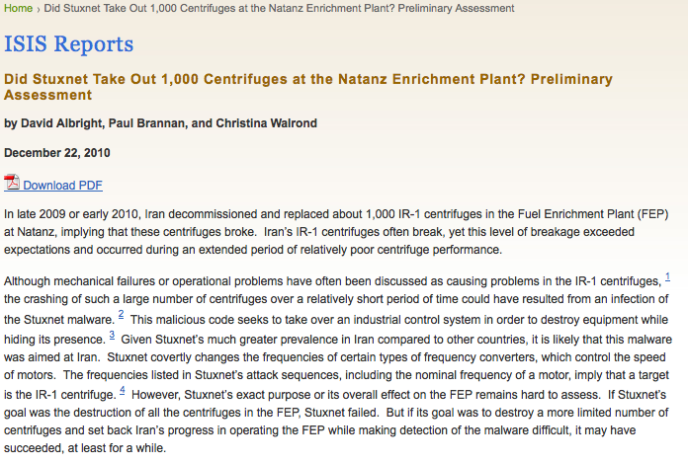
Stuxnet: Consequences
Did it serve the purpose?

Slide 11
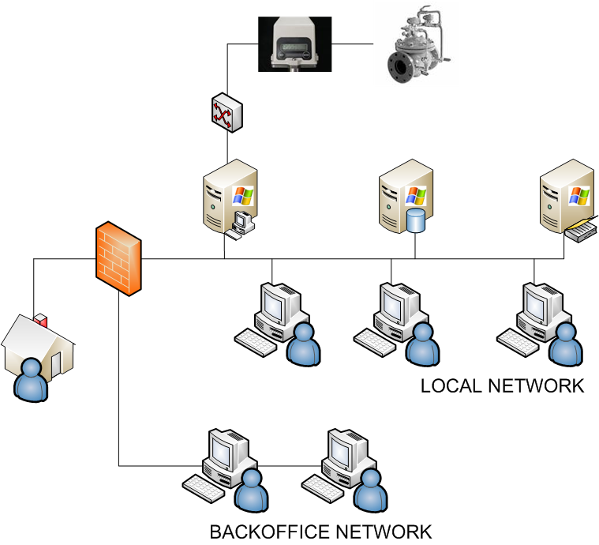
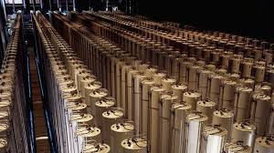
Stuxnet!
PHASE 2
PHASE 3
PHASE 1

Slide 12
The attack phases
PHASE 1: an almost normal worm, amazingly smart
It spreads, hides, updates itself (C&C communication)
It looks around
To duplicate itself
TO SEE IF IT CAN ENTER PHASE 2
PHASE 2: attacking the Siemens + PLC systems
Infects the SIEMENS System
It modifies the PLC programming
PHASE 3: sabotage
Check for a specific factory environment.
If it does not find it, it does nothing
If it finds it changes the speed of the centrifuges

Slide 13
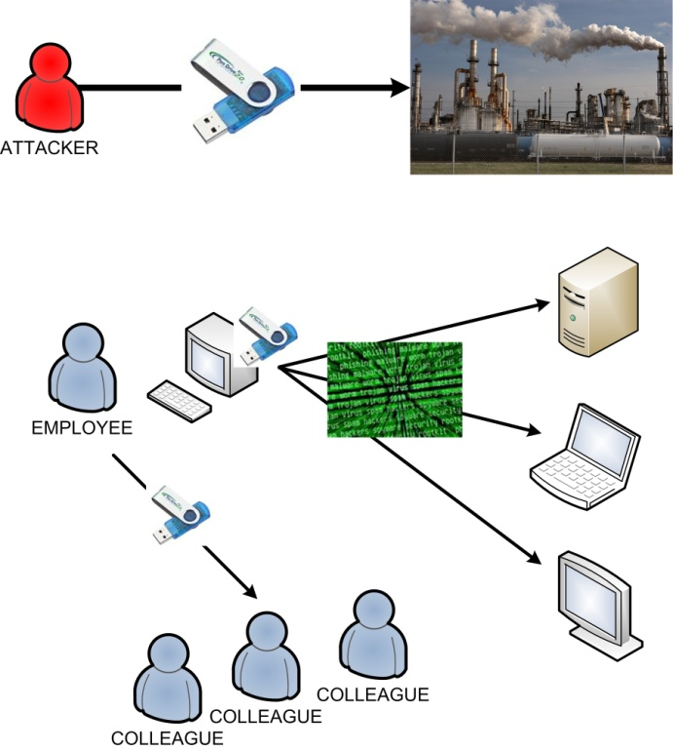
Phase 1: the Windows system
A very elaborate standard worm
To get inside the LAN: USB Sticks
Within a LAN: USB Sticks + Print Spooler, Shared Folders etc
4 zero-days vulnerabilities
LNK (MS10-046)
Print Spooler (MS10-061)
Server Service (MS08-067)
Privilege escalation
Siemens Step 7 project folders
Installs a rootkit that makes it invisible
first checks which antivirus is active then chooses the target executable accordingly.

Slide 14
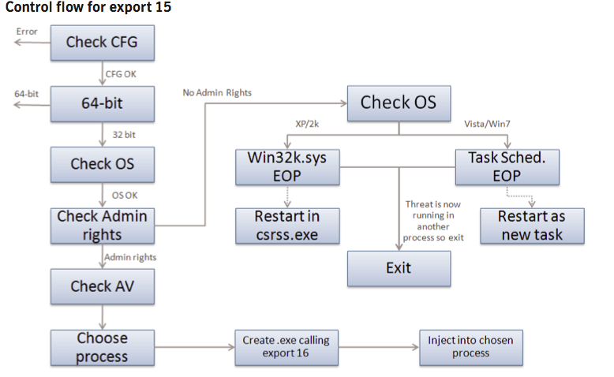
Phase 1: complexity (part 2)
Escalation
Of
Privileges

Slide 15
Phase 2: targeted attack
Looks for systems running
WinCC and PCS 7 SCADA MANAGEMENT PROGRAMS
Finds them even if disconnected (via USB sticks)
It attacks them, exploiting
Hard-wired password (WinCC)
Uploads as stored procedure
Siemens Project 7 folder vulnerabilities
Hooks into specific Step 7 dll to communicate with the PLC
It replaces the PLC Code
Hides using Rootkit techniques
First PLC rootkit EVER

Slide 16
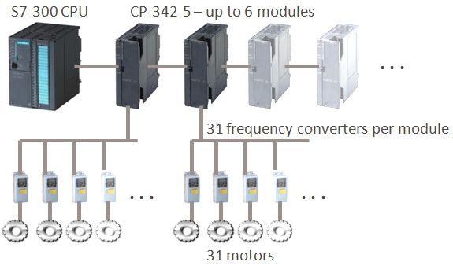
Phase 3: the targeted part
Designed to hit a specific plant: Stuxnet requires the industrial control system to have frequency converter drives from at least one of two specific vendors, one headquartered in Finland and the other in Tehran, Iran.
Stuxnet requires the frequency converter drives to be operating at speeds between 807Hz and 1210Hz. Used only in a limited number of applications.
Stuxnet changes the output frequencies and thus the speed of the motors for short intervals over periods of months.
And makes sure that you don’t see it from behind your console
http://www.symantec.com/connect/blogs/stuxnet-breakthrough

Slide 17
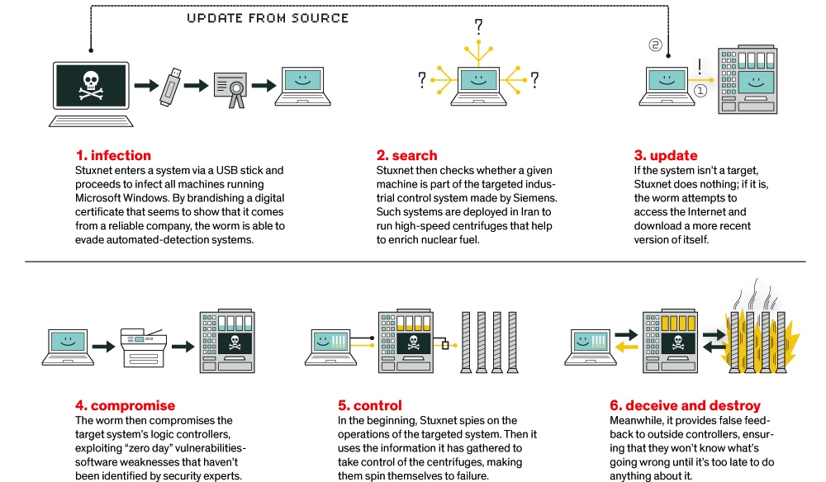
Stuxnet summarized
Encryption in ICS – SmartGridComm ‘17
Image by L-Dopa: https://spectrum.ieee.org/telecom/security/the-real-story-of-stuxnet
Notes:
The most common technical misconception about Stuxnet that appears in almost every publication on the malware is that the rotor speed attack would record and play back process values by means of the recording and playback of signal inputs that we uncovered back in 2010 and that is also highlighted in my TED talk. Slipping the attention of most people writing about Stuxnet, this particular and certainly most intriguing attack component is only used in the overpressure attack. The S7-315 attack against the Centrifuge Drive System simply doesn’t do this
During the attack, legitimate control code is simply suspended.
If a SCADA application did monitor rotor speeds by communicating with the infected S7-315 controllers, it would simply have seen the exact speed values from the time before the attack sequence executes. The SCADA software gets its information from memory in the controller, not by directly talking to the frequency converter. Such memory must be updated actively by the control logic, reading values from the converter. However if legitimate control logic is suspended, such updates no longer take place, resulting in static values that perfectly match normal operation.

Slide 18
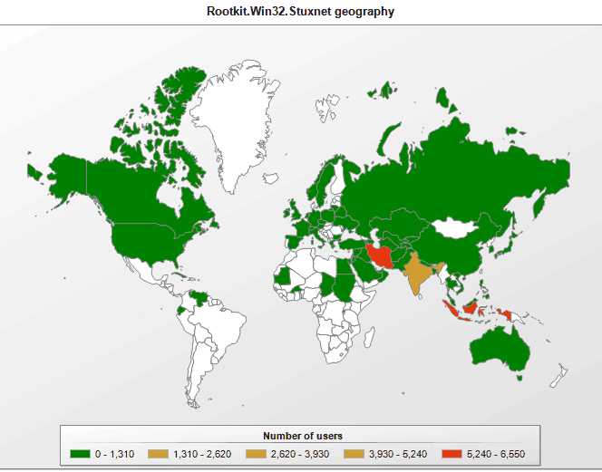
StuxNet
http://ebiquity.umbc.edu/blogger/2010/09/23/is-stuxnet-a-cyber-weapon-aimed-at-an-iranian-nuclear-site/

Slide 19
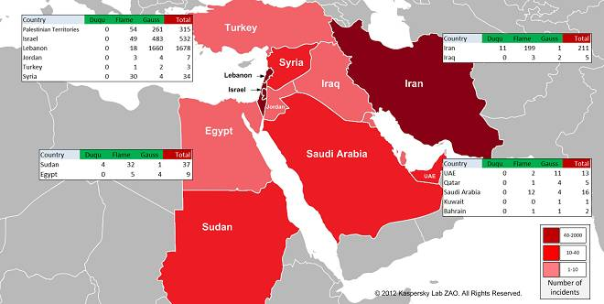
After Stuxnet: Duqu, Flame, Gauss

Slide 20
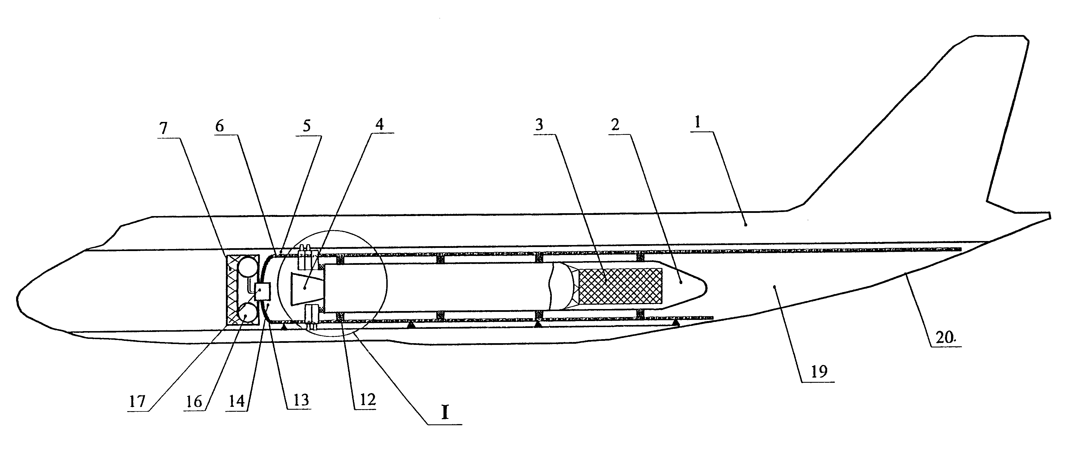
Duqu
http://www.securelist.com/en/blog/208193425/The_mystery_of_Duqu_Part_Ten
History
First in the wild: November 2010?, C&C systems ready as early as 2009
Discovered: September 1, 2011
“Wiped”: October 20, 2011, Reborn: February 2012 (variant)
Spreading mechanism:
Dropper: MS word document, with a 0-day exploit in it waits until the computer is idle for 10 minutes + other side conditions are met.
In the network, then copies itself into a shared folder (using a password stolen with the keylogger) and creates a scheduled job in the target computer.
Same building platform of StuxNet
“same” vector, different payload
default: after 30 days, it wipes itself off
only few instances of Duqu found in the wild, unlike Flame.
Purpose
Information gathering on PC
contains keylogger
espionage software

Slide 21
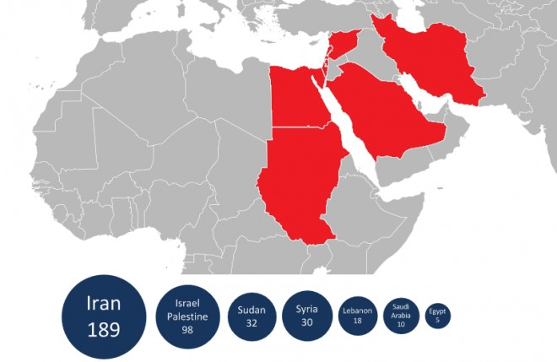
Flame
Information-collecting malware.
Discovered: May 2012
Much larger and more complex than StuxNet
A different platform, but shares code parts with an early Stuxnet variant
Rumor: “they” started with StuxNet, and then it became two different projects handled by different teams.
>10.000 instance found
http://www.wired.com/threatlevel/2012/05/flame/

Slide 22
Flame (cont)
Spreading mechanism
Dropper:??? (we don’t know)
Locally:
uses the same print spooler exploit (MS10-061) and LNK exploit (MS10-046) to spread locally as Stuxnet, and
very elaborate MD5 hash collision attack that enabled Flame to masquerade as a proxy for Windows Update
Collected information
passwords, screenshots, audio, skype conversations, particularly eager to collect pdf and autocad files.
Exfiltration
collected intelligence is sent remote C&C servers
if no network is available,
saves gathered intelligence on USB sticks, through which it can infect other computers and use their network connections to communicate with the C&C servers.

Slide 23
Gauss
Same platform as Flame
modules: Gauss, Lagrange, Goedel, Taylor
Discovered: June 2012
Part of it is a “mere” banking trojan
Includes stealing of credentials of social networks, instant messaging, etc
Part of it is the most targeted attack to date:
one of its modules (Goedel) is encrypted in such a way that that it can only be decrypted on its target system; has not been decrypted yet
http://www.theregister.co.uk/2012/08/10/gauss_middle_east_malware/

Slide 24
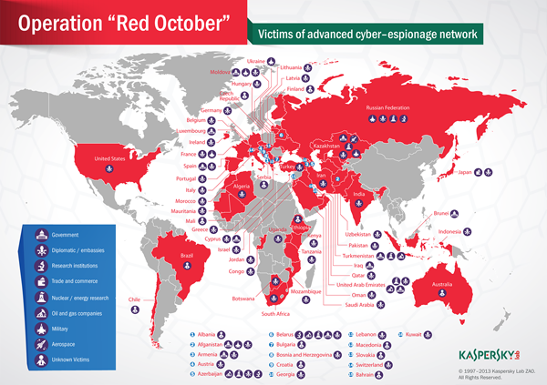
Red October
infection method “low profile”, but organizationally huge and well-orchestrated
“The attackers have been active since at least 2007, focusing on diplomatic and governmental”
“resistant to C&C server takeover”
“Resurrection module”
terabytes of stolen data
info & images by Kasperski
http://thenextweb.com/insider/2013/01/14/kaspersky-uncovers-red-october-malware-campaign-targeting-governments-for-the-last-5-years/
Notes:
The attackers created a multi-functional attack platform that includes several extensions and malicious files designed to quickly adjust to different systems’ configurations and harvest intelligence from infected machines. The platform is unique to Rocra and has not been identified by Kaspersky Lab in previous cyber-espionage campaigns. Notable characteristics include:
“Resurrection” module: A unique module that enables the attackers to “resurrect” infected machines. The module is embedded as a plug-in inside Adobe Reader and Microsoft Office installations and provides the attackers a foolproof way to regain access to a target system if the main malware body is discovered and removed, or if the system is patched. Once the C2s are operational again the attackers send a specialized document file (PDF or Office document) to victims’ machines via e-mail which will activate the malware again.
Advanced cryptographic spy-modules: The main purpose of the spying modules is to steal information. This includes files from different cryptographic systems, such as Acid Cryptofiler, which is known to be used in organizations of NATO, the European Union, European Parliament and European Commission since the summer of 2011 to protect sensitive information.
Mobile Devices: In addition to targeting traditional workstations, the malware is capable of stealing data from mobile devices, such as smartphones (iPhone, Nokia and Windows Mobile). The malware is also capable of stealing configuration information from enterprise network equipment such as routers and switches, as well as deleted files from removable disk drives.

Slide 25
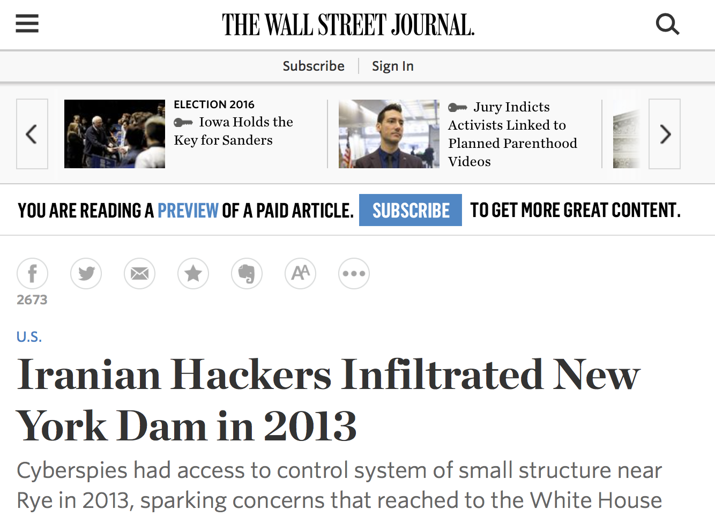

Slide 26
HAVEX Dragonfly energetic bear

Slide 27
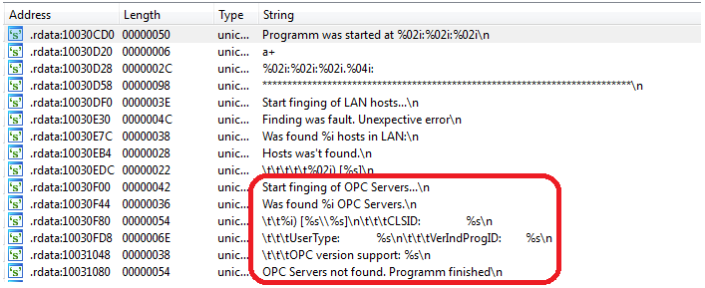
HAVEX: advanced malware
Spread through multiple vectors
E-mail, watering hole attacks, infection of vendors websites and software
88 observed variants
Main goal: gather information and gain persistent access
Enumeration and qualification of network hosts
Particular interest on OPC servers and VPN connections to PLCs
First step of a cyberwarfare campaign?
Notes:
Air gaps useless
So many vectors: USB, laptops (employees, contractors), even ICS equipment software (see Havex)

Slide 28
Havex/Dragonfly: reconnaissance
The Dragonfly group, (aka Energetic Bear), in operation since at least 2011 … It initially targeted defense and aviation, before shifting its focus to US and European energy firms in early 2013.
phishing emails + watering hole attacks The exploit kit on websites delivered malware to the victim’s computer. The third phase of the campaign was the Trojanizing of legitimate software bundles belonging to three different ICS equipment manufacturers.
Dragonfly bears the hallmarks of a state-sponsored operation, displaying a high degree of technical capability.
Analysis of the compilation timestamps … Based on this information, it is likely the attackers are based in Eastern Europe.
Source: Symantec

Slide 29
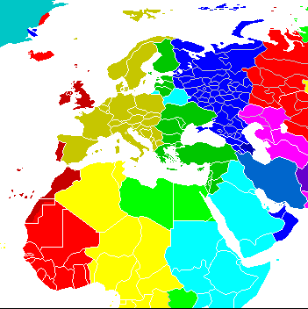
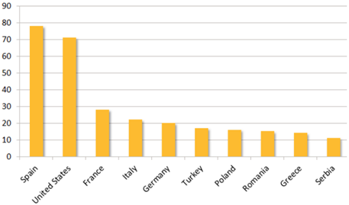
Havex state sponsored operation?
Dragonfly hacker group
Allegedly Eastern European
In operation since 2011
Hundreds of organizations affected
Mostly energy companies in Europe and US
More than 1500 infected hosts
Notes:
Air gaps useless
So many vectors: USB, laptops (employees, contractors), even ICS equipment software (see Havex)

Slide 30
Detecting Havex
There are two main behavioral anomalies introduced by Havex that could be exploited for detection.
Detection the moment in which it performs a network scan (not really difficult)
Detection of communication with C&C server (this is generally much more difficult to detect, provided the attackers don’t do something “silly”)
Notes:
Air gaps useless
So many vectors: USB, laptops (employees, contractors), even ICS equipment software (see Havex)

Slide 31
Ukraine 2015 and 2016 blackenergy 3 & industroyer

Slide 32
The Ukrainian 2015 Power Grid Attack BlackEnergy 3
December 23rd , 2015.
affected up to 225,000 customers in three different distribution-level service territories and lasted for several hours.

Slide 33
The Ukrainian 2015 Power Grid Attack
Malware used: Blackenergy 3
Sources
T. Conway, R. M. Lee, M. J. Assante. Analysis of the cyber attack on the Ukrainian power grid. SANS ICS, 2016.
Very well done, obligatory read
D. Trivellato, D. Murphy. Lights Out! Who’s Next?
SecurityMatter’s Whitepaper available at www.secmatters.com (soon, www.forescout.com)
Less technical

Slide 34
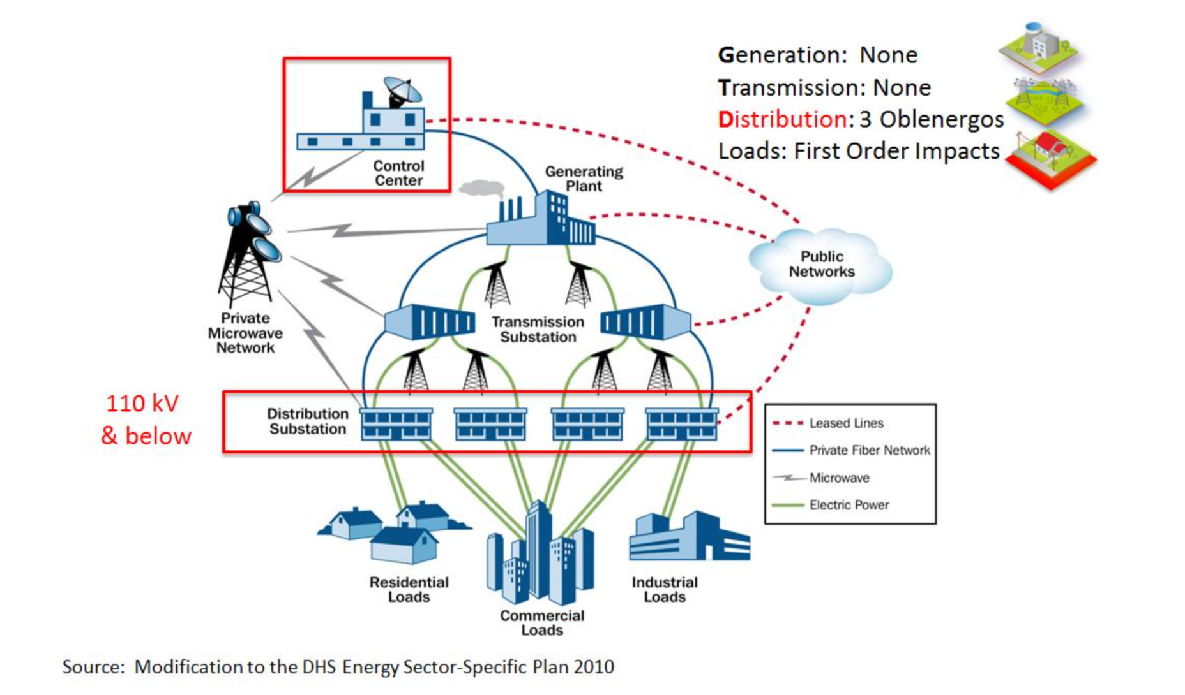
Energy System Overview
Picture from: T. Conway, R. M. Lee, M. J. Assante. Analysis of the cyber attack on the Ukrainian power grid. SANS ICS, 2016.
3 parts: generation, transmission, distribution
Oblenergo = energy company

Slide 35
Ukraine 2015 in a Nutshell
Phishing email containing a malware-rigged attachment.
Different malware components for information gathering, gaining remote access to the victims' ICS network and damaging their SCADA system and other key components, with the goal of delaying process restoration and complicating forensic analysis. Some of the malware used was targeted to specific ICS vendors
The opening of substation breakers to cause the outage. Most likely, the attackers opened the breakers by remotely operating the operators' HMIs.
A denial of service to the utilities' call center, during which the attackers
the target infrastructure to prevent customers from successfully reporting the outage.

Slide 36
Stage 1 of the attack
Spear Phishing with word documents
In the attack, the adversary delivered a targeted email with a malicious attachment (a word document) that appeared to come from a trusted source to specific individuals within the organizations.
The documents contained a version of the Blackenergy 3 malware
BlackEnergy 3 connected to command and control CC
actions to establish persistent access to the targets.
Harvesting of credentials (keyloggers) that could be used to connect directly via VPN (avoiding the use of the CC, more “dangerous”)
Using native connections the attackers certainly did some discovery
In at least one of the oblenergos, the attackers discovered a network connected to a UPS and reconfigured it
the three oblenergos used different distribution management systems (DMSs), and the attackers have customized their tactics to the specific place

Slide 37
Stage 2 (preparation)
Preparation
Attacker learned how to interact with the three Distribution Management Systems (DMS)
They used the native control and operator screens.
They must have done some noise here.
Developed malicious firmware for the serial-to-ethernet devices
They must have had the devices in house to test what they had developed
Installed the KillDisk application
Finally: Attack
Primary: Breakers open
Secondary:
Simultaneous upload of new firmware in the serial-to-ethernet devices
KillDisk
Supporting
UPS modification
Telephonic floods against at least one oblenergos’ customer support line

Slide 38
The Ukraine 2015 attack in one slide

Slide 39
Ukraine 2015: How could we possibly detect it
Phishing?
Difficult to counter
Watering hole (standard malware)?
Idem
Communication with the C&C:
Possible if the workstation in question does not usually connect to the internet.
Network whitelisting in the internal network
Possibly. “ SilentDefense would have reported the upload of malicious firmware to the serial-to-ethernet devices, if such operation was performed from a workstation that was not normally used for maintenance operations”

Slide 40
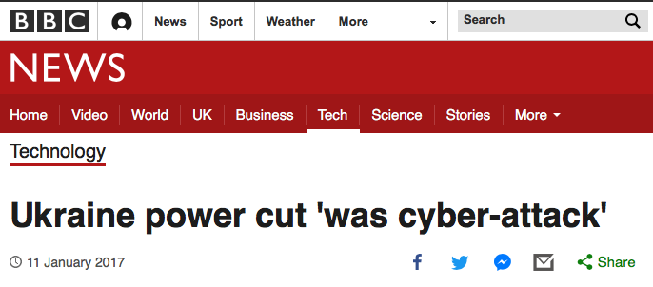
One Year Later: Ukraine 2016
A power cut that hit part of the Ukrainian capital, Kiev, in December has been judged a cyber-attack by researchers investigating the incident.
The blackout lasted just over an hour and started just before midnight on 17 December.

Slide 41
This time it was more automatized
Industroyer (also referred to as Crashoverride) is a malware framework considered to have been used in the cyberattack on Ukraine’s power grid on December 17, 2016. ^{[1]} ^{[2]} ^{[3]} The attack cut a part of Kiev, the capital, off power for one hour and is considered to have been a large-scale test. ^{[4]} Industroyer is the first ever known malware specifically designed to attack electrical grids. ^{[5]} At the same time, it is the fourth malware publicly revealed to target Industrial Control Systems, after Stuxnet, Havex, and BlackEnergy.^{[5]}
Source: Wikipedia
2018: new report by Dragos (well-done): Anatomy of an Attack: Detecting and Defeating CRASHOVERRIDE, by Joe Slowik, https://dragos.com/media/CRASHOVERRIDE2018.pdf
TBD: see whether including it.

Slide 42
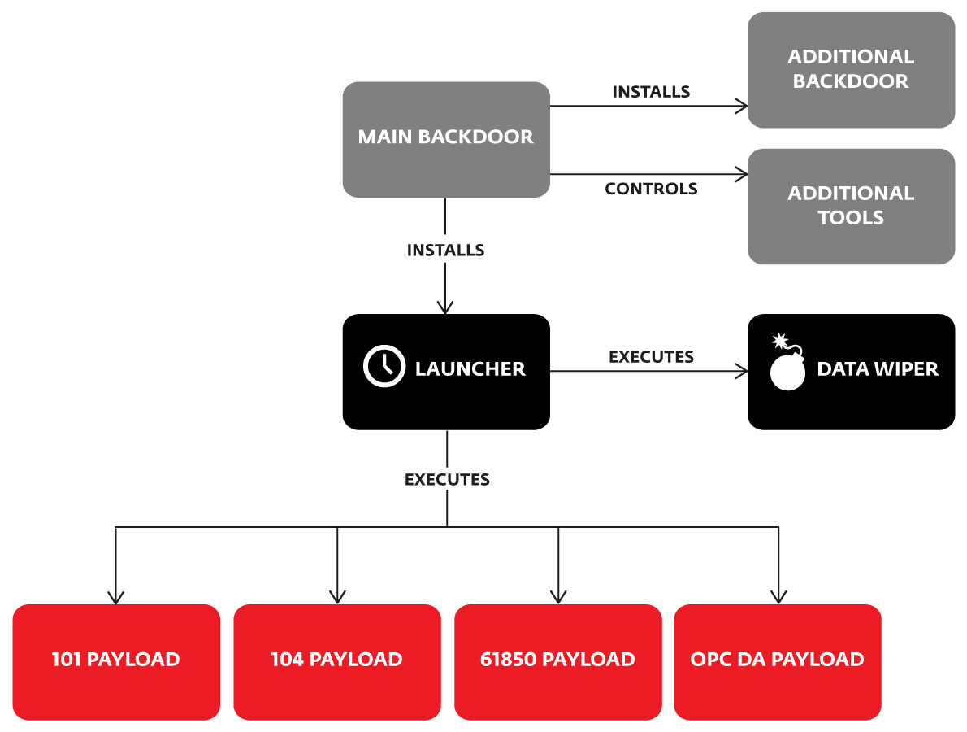
Industroyer
Malware specifically designed to attack energy companies
Modular: a backdoor to manage it and specific modules which are designed to gain direct control of switches and circuit breakers at an electricity distribution substation.
Each of these components targets particular communication protocols specified in the following standards: IEC 60870-5-101, IEC 60870-5-104, IEC 61850, and OLE for Process Control Data Access (OPC DA).

Slide 43
Encryption in ICS – SmartGridComm ‘17

Slide 44
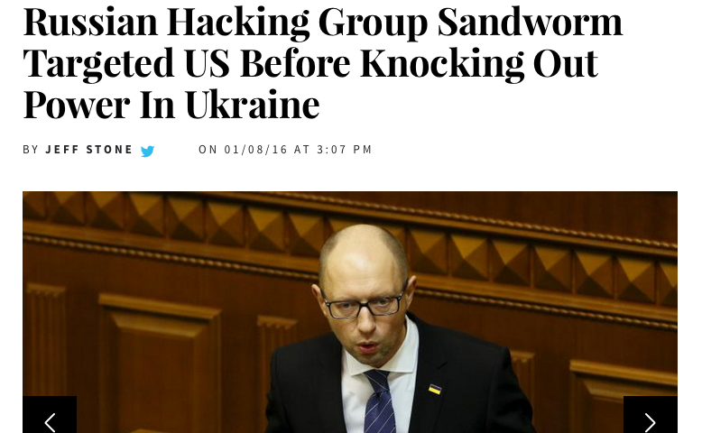
It was just a matter of time…

Slide 45
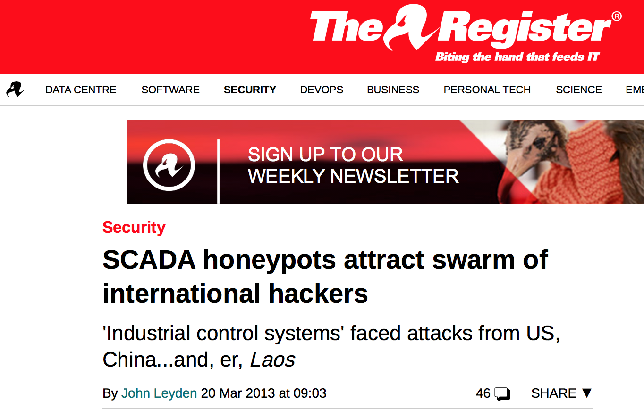
News from 2013
https://www.theregister.co.uk/2013/03/20/scada_honeypot_research/

Slide 46
In 2019: Attacks against India’s Energy Sector
With an evident increase in the frequency and volume of cyber-attacks on India, government sectors are in the foremost line of fire. Explaining the rise of targeted cyber-attacks in India to News18, Saurabh Sharma, senior security researcher at Kaspersky APAC's global research and analysis team, said, "Most of the cyber attacks on Indian government are targeting the defence and energy sectors."

Slide 47
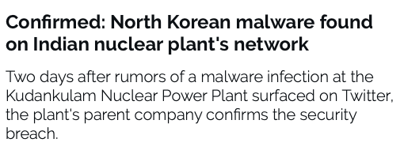
In 2019: Attacks against India’s Energy Sector (part 2)
Researchers identified the malware as a version of Dtrack, a backdoor trojan developed by the Lazarus Group, North Korea's elite hacking unit.
Features According to an analysis of the Dtrack malware by Kaspersky,
keylogging, retrieving browser history, gathering host IP addresses, information about available networks and active connections…
Dtrack is usually used for reconnaissance purposes and as a dropper for other malware payloads

Slide 48
SCADA for sale? (1)
ENGERATI, Published: Tue 07 Aug 2018
https://www.engerati.com/smart-infrastructure/article/cybersecurity/industrial-control-systems-ics-under-attack-and-sale-days

Slide 49
SCADA for sale? (2)
Cybereason researchers who analysed the data collected in a honeypot that masqueraded as a power transmission substation of a major electricity provider.
Judging by how quickly the attackers operated, they’re very familiar with ICS and the security measures that utility providers implement, and know how to move from an IT environment to an OT (operational technology) environment. Just two days after the honeypot went live, attackers had discovered it, prepared the asset for sale on the dark web and sold it to another criminal entity who was also interested in ICS environments.
QUESTION: WHY IS THIS IMPORTANT?

Slide 50
QUESTIONS?

