Slide 1
Lecture 5: Algorithmic Methods for for finite Quasi-birth death processes
Dr. Ahmad Al Hanbali
Department of Industrial Engineering
University of Twente
a.alhanbali@utwente.nl

Slide 2
Lecture 5
This Lecture deals with continuous time Markov chains with finite state space and special structure as opposed to infinite space Markov chains in Lecture 3 and 4
Objective: To find equilibrium distribution of the Markov chain

Slide 3
Finite Quasi-Birth Death processes
In many applications, the level is the number of customers in a system can be finite
Subset of state space with common $i$ entry is called level $i (0≤i≤M)$ and denoted $l(i)=\{(i,0),(i,1),…,(i,m−1)\}$. This means state space is restricted $∪_{0≤i≤M}l(i)$
The generator of the irreducible continuous time finite QBD has the following form
$$Q=\left(\begin{aligned}B_{00} \\ A_{2} \\ 0 \\ ⋮ \\ ⋮ \\ ⋮ \\ 0\end{aligned}\begin{aligned}A_{0} \\ A_{1} \\ A_{2} \\ ⋱ \\ ⋱ \\ ⋱ \\ ⋱\end{aligned}\begin{aligned}0 \\ A_{0} \\ A_{1} \\ ⋱ \\ ⋱ \\ ⋱ \\ ⋱\end{aligned}\begin{aligned}0 \\ 0 \\ A_{0} \\ ⋱ \\ ⋱ \\ A_{2} \\ 0\end{aligned}\begin{aligned}… \\ ⋱ \\ ⋱ \\ ⋱ \\ ⋱ \\ A_{1} \\ A_{2}\end{aligned}\begin{aligned}0 \\ ⋱ \\ ⋱ \\ ⋱ \\ ⋱ \\ A_{0} \\ B_{MM}\end{aligned}\right)$$
How to find the equilibrium probabilities, $pQ=0$? Three methods

Slide 4
Method 1: Linear level reduction
Let us define the following matrices:
$C_{0}=B_{00}$,
$C_{i}=A_{1}−A_{2}{\left(C_{i−1}\right)}^{−1}A_{0}, 1≤i≤M−1$,
$C_{M}=B_{MM}−A_{2}{\left(C_{M−1}\right)}^{−1}A_{0}$,
-${\left(C_{i}\right)}^{−1}A_{0}$ records first passage probabilities from $l\left(i\right)$ to $l\left(i+1\right)$
Theorem: the equilibrium probability $p=\left(p_{0},…,p_{M}\right)$ is determined by:
$p_{M}C_{M}=0$,
$p_{i}=−p_{i+1}A_{2}{\left(C_{i}\right)}^{−1}$, $≤i≤M−1$,
$\sum_{i=0}^{M}{p_{i}e}=1$
Notes:
In the theorem here we are cutting off the levels from the level 0 and moving up to level M. One might also proceed in the reverse direction by starting to cut off level M down to level 0.

Slide 5
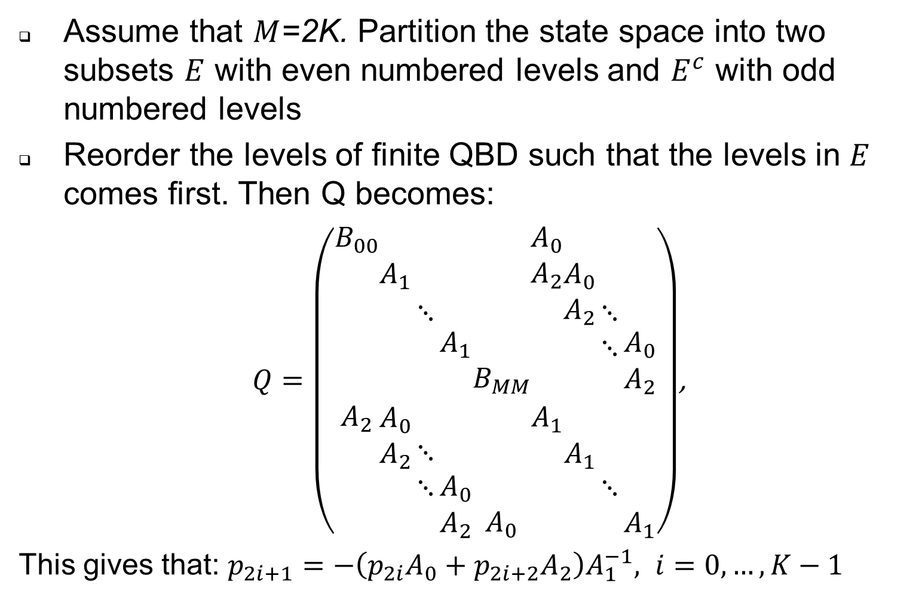
Method 2: Method of Folding (1)
Assume that $M$=2K. Partition the state space into two subsets $E$ with even numbered levels and $E^{c}$ with odd numbered levels
Reorder the levels of finite QBD such that the levels in $E$ comes first. Then Q becomes:
$Q=\left(\begin{aligned}B_{00} \\ \\ \\ \\ \\ A_{2} \\ \\ \\ \end{aligned}\begin{aligned} \\ A_{1} \\ \\ \\ \\ A_{0} \\ A_{2} \\ \\ \end{aligned}\begin{aligned} \\ \\ ⋱ \\ \\ \\ \\ ⋱ \\ ⋱ \\ \end{aligned}\begin{aligned} \\ \\ \\ A_{1} \\ \\ \\ \\ A_{0} \\ A_{2}\end{aligned}\begin{aligned} \\ \\ \\ \\ B_{MM} \\ \\ \\ \\ A_{0}\end{aligned}\begin{aligned}A_{0} \\ A_{2} \\ \\ \\ \\ A_{1} \\ \\ \\ \end{aligned}\begin{aligned} \\ A_{0} \\ A_{2} \\ \\ \\ \\ A_{1} \\ \\ \end{aligned}\begin{aligned} \\ \\ ⋱ \\ ⋱ \\ \\ \\ \\ ⋱ \\ \end{aligned}\begin{aligned} \\ \\ \\ A_{0} \\ A_{2} \\ \\ \\ \\ A_{1}\end{aligned}\right)$,
This gives that: $p_{2i+1}=−\left(p_{2i}A_{0}+p_{2i+2}A_{2}\right)A_{1}^{−1}, i=0,…,K−1$

Slide 6
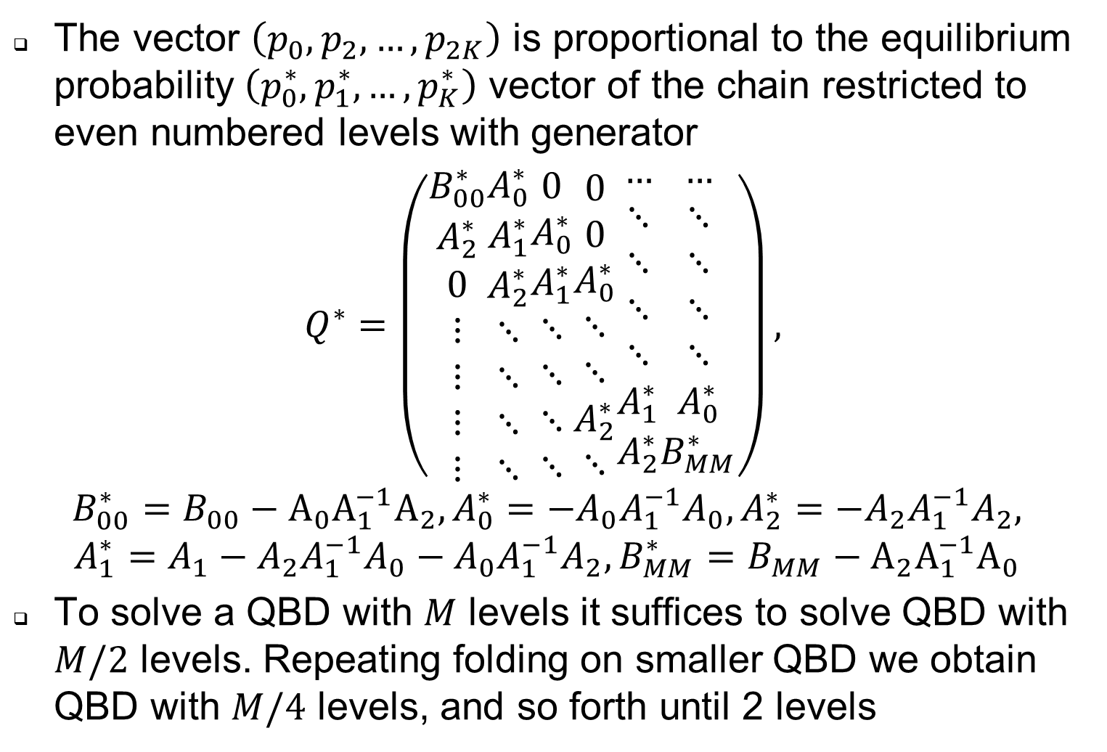
Method 2: Method of Folding (2)
The vector $\left(p_{0},p_{2},…,p_{2K}\right)$ is proportional to the equilibrium probability $\left(p_{0}^{∗},p_{1}^{∗},…,p_{K}^{∗}\right)$ vector of the chain restricted to even numbered levels with generator
$$Q^{∗}=\left(\begin{aligned}B_{00}^{∗} \\ A_{2}^{∗} \\ 0 \\ ⋮ \\ ⋮ \\ ⋮ \\ ⋮\end{aligned}\begin{aligned}A_{0}^{∗} \\ A_{1}^{∗} \\ A_{2}^{∗} \\ ⋱ \\ ⋱ \\ ⋱ \\ ⋱\end{aligned}\begin{aligned}0 \\ A_{0}^{∗} \\ A_{1}^{∗} \\ ⋱ \\ ⋱ \\ ⋱ \\ ⋱\end{aligned}\begin{aligned}0 \\ 0 \\ A_{0}^{∗} \\ ⋱ \\ ⋱ \\ A_{2}^{∗} \\ ⋱\end{aligned}\begin{aligned}… \\ ⋱ \\ ⋱ \\ ⋱ \\ ⋱ \\ A_{1}^{∗} \\ A_{2}^{∗}\end{aligned}\begin{aligned}… \\ ⋱ \\ ⋱ \\ ⋱ \\ ⋱ \\ A_{0}^{∗} \\ B_{MM}^{∗}\end{aligned}\right), \\ B_{00}^{∗}=B_{00}−{A_{0}A}_{1}^{−1}A_{2},A_{0}^{∗}=−A_{0}A_{1}^{−1}A_{0},A_{2}^{∗}=−A_{2}A_{1}^{−1}A_{2}, \\ A_{1}^{∗}=A_{1}−A_{2}A_{1}^{−1}A_{0}−A_{0}A_{1}^{−1}A_{2},B_{MM}^{∗}=B_{MM}−{A_{2}A}_{1}^{−1}A_{0}$$
To solve a QBD with $M$ levels it suffices to solve QBD with $M/2$ levels. Repeating folding on smaller QBD we obtain QBD with $M/4$ levels, and so forth until 2 levels

Slide 7
Method 3: Matrix geometric combination
Let $R$ be the minimal nonnegative solution of
$$A_{0}+RA_{1}+R^{2}A_{2}=0$$
Let $\hat{R}$ be the minimal nonnegative solution of
$$A_{2}+\hat{R}A_{1}+{\hat{R}}^{2}A_{0}=0$$
Theorem Let $A=A_{0}+A_{1}+A_{0}$ be irreducible and $πA=0, πe=1$. If $πA_{0}e≠πA_{2}e$, the equilibrium probability of the finite QBD is given by
$$p_{i}=x_{0}R^{i}+x_{M} {\hat{R}}^{M−i}, i=0,…,M$$
where $\left(x_{0},x_{M}\right)$ is the solution of the system
$$\left(x_{0},x_{M}\right)\left(\begin{aligned}B_{00}+RA_{2} \\ {\hat{R}}^{M}B_{00}+{\hat{R}}^{M−1}A_{2}\end{aligned}\begin{aligned}R^{M}B_{MM}+R^{M−1}A_{0} \\ B_{MM}+\hat{R}A_{0}\end{aligned}\right)=0$$
with $x_{0}\sum_{i=0}^{M}{R^{i}}e+x_{M}\sum_{i=0}^{M}{{\hat{R}}^{i}}e=1$
Notes:
Let $\hat{R}$ be the minimal nonnegative solution of (level reversed process)

Slide 8
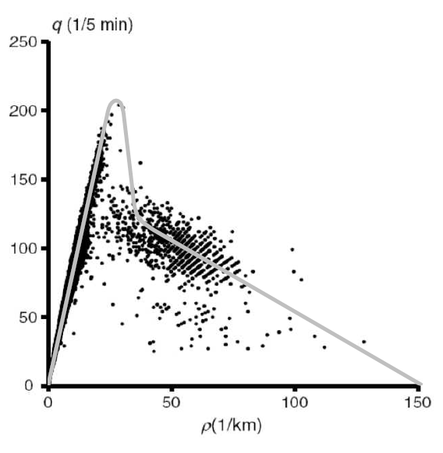
Example: uninterrupted traffic on a highway
Level dependent and independent QBDs were applied to mimic the traffic behavior on highways especially the fundamental diagram (flow-density diagram)
To model this Niek Baer used the so-called four stage M/M/1 threshold queues

Slide 9
References
Niek Baer. Queueing and Traffic, PhD thesis University of Twente 2015
G. Latouche and V. Ramaswami (1999), Introduction to Matrix Analytic Methods in Stochastic Modeling. SIAM.

