Slide 1
Architecture of Distributed Systems Homework Assignment 1 2019-2020
R. H. Mak

Slide 2
Exercise
Consider the models on the following slides and answer the following questions. Each model is provided with a hyperlink to acknowledge its source and for additional information.
What building blocks do you see? What do they represent? Are they conceptual/generic (C) or physical/specific (P)?
Same questions as 1, but now for connectors? Do not forget (C) or (P)!
To which viewpoints (1 up to 3) does the model belong?
Motivate why, and identify corresponding stakeholders and their concerns.
You may choose from both Kruchten and Rozanski-Woods libraries.
Which of the following EFRs are addressed (Y + motivation | N)?
Performance/scalability, availability/reliability, security, maintainability, other?
Is there a concept of distribution (Y + motivation | N)?
Comment on the clarity/semantics of the diagram
☺ | 😐 | ☹ , plus motivation
Keep you answers crisp!

Slide 3
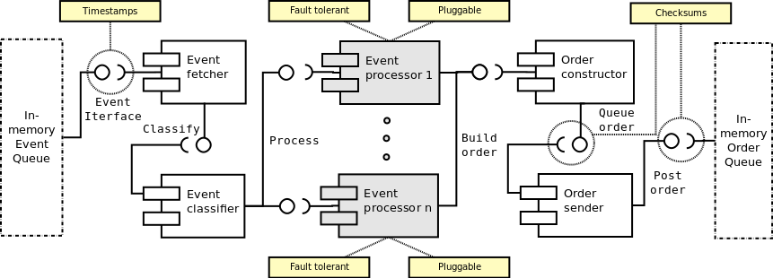
Taken from: Algorithmic Trading System Architecture
Notes:
Building blocks Which, what + (C | P):
Conceptual/generic BBs
Physical/specific BBs
Connectors Which, what + (C | P):
Conceptual/generic Conns
Physical/specific Conns
View – concern – stakeholder (1..*):
…
…
…
Extra-functional requirements (Y + motivation) | N :
Security:
Availability & reliability:
Maintainability:
Performance and scalability:
Distribution (Y + motivation) | N:
Because …
Clarity/Semantics ( ☺ | 😐 | ☹) + motivation:
Because …

Slide 4
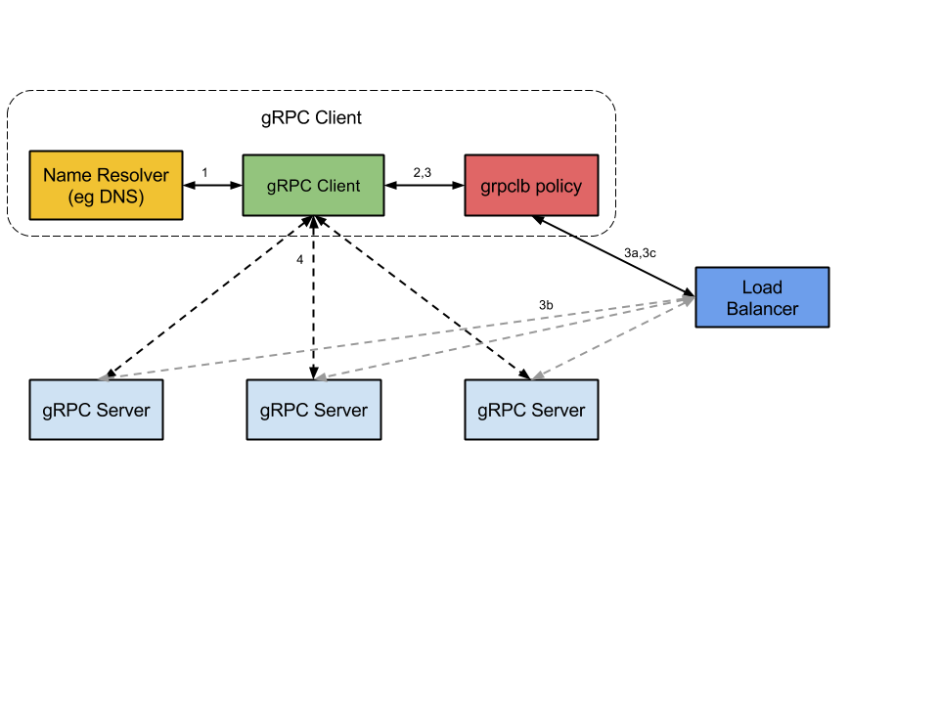
Taken from:
https://github.com/grpc/grpc/blob/master/doc/load-balancing.md
Notes:
Building blocks Which, what + (C | P):
Conceptual/generic BBs
Physical/specific BBs
Connectors Which, what + (C | P):
Conceptual/generic Conns
Physical/specific Conns
View – concern – stakeholder (1..*):
…
…
…
Extra-functional requirements (Y + motivation) | N :
Security:
Availability & reliability:
Maintainability:
Performance and scalability:
Distribution (Y + motivation) | N:
Because …
Clarity/Semantics ( ☺ | 😐 | ☹) + motivation:
Because …

Slide 5
Taken from:
http://www.ibm.com/developerworks/library/x-NIEM1/
Notes:
Building blocks Which, what + (C | P):
Conceptual/generic BBs
Physical/specific BBs
Connectors Which, what + (C | P):
Conceptual/generic Conns
Physical/specific Conns
View – concern – stakeholder (1..*):
…
…
…
Extra-functional requirements (Y + motivation) | N :
Security:
Availability & reliability:
Maintainability:
Performance and scalability:
Distribution (Y + motivation) | N:
Because …
Clarity/Semantics ( ☺ | 😐 | ☹) + motivation:
Because …

Slide 6
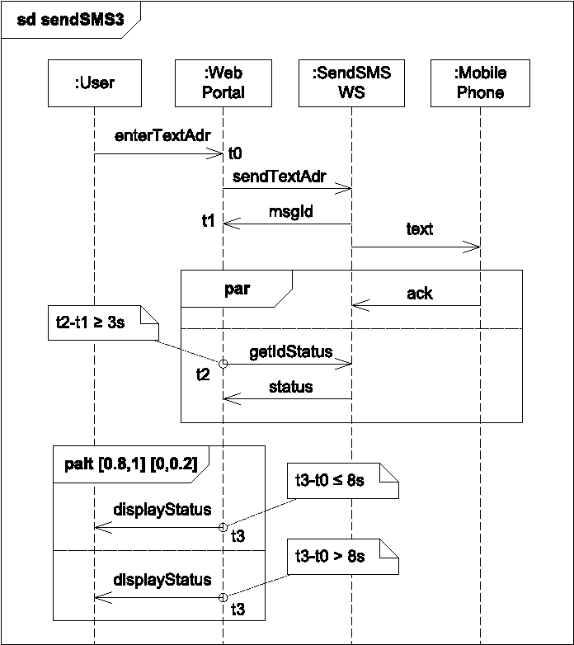
Taken from:
Stepwise refinement of sequence diagrams with soft real-time constraints
Notes:
Building blocks Which, what + (C | P):
Conceptual/generic BBs
Physical/specific BBs
Connectors Which, what + (C | P):
Conceptual/generic Conns
Physical/specific Conns
View – concern – stakeholder (1..*):
…
…
…
Extra-functional requirements (Y + motivation) | N :
Security:
Availability & reliability:
Maintainability:
Performance and scalability:
Distribution (Y + motivation) | N:
Because …
Clarity/Semantics ( ☺ | 😐 | ☹) + motivation:
Because …

Slide 7
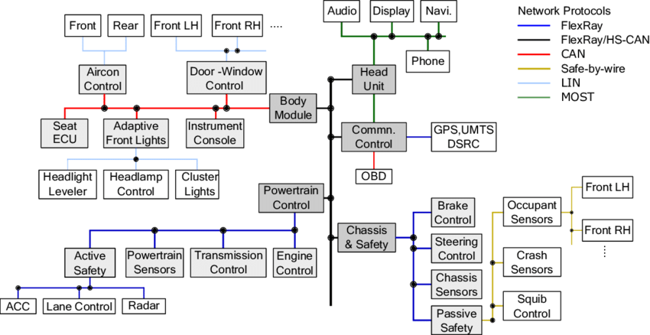
Taken from:
Enhancing Automotive Embedded Systems with FPGAs
Notes:
Building blocks Which, what + (C | P):
Conceptual/generic BBs
Physical/specific BBs
Connectors Which, what + (C | P):
Conceptual/generic Conns
Physical/specific Conns
View – concern – stakeholder (1..*):
…
…
…
Extra-functional requirements (Y + motivation) | N :
Security:
Availability & reliability:
Maintainability:
Performance and scalability:
Distribution (Y + motivation) | N:
Because …
Clarity/Semantics ( ☺ | 😐 | ☹) + motivation:
Because …

Slide 8
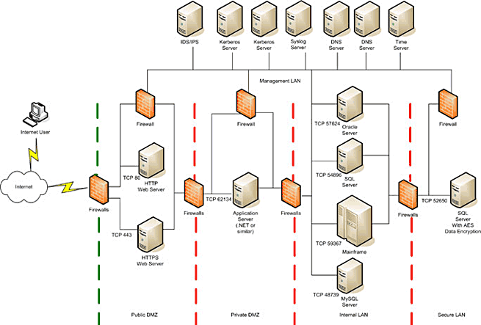
Taken from: https://rsmus.com/what-we-do/services/risk-advisory/the-ultra-secure-network-architecture.html
Notes:
Building blocks Which, what + (C | P):
Conceptual/generic BBs
Physical/specific BBs
Connectors Which, what + (C | P):
Conceptual/generic Conns
Physical/specific Conns
View – concern – stakeholder (1..*):
…
…
…
Extra-functional requirements (Y + motivation) | N :
Security:
Availability & reliability:
Maintainability:
Performance and scalability:
Distribution (Y + motivation) | N:
Because …
Clarity/Semantics ( ☺ | 😐 | ☹) + motivation:
Because …

Slide 9
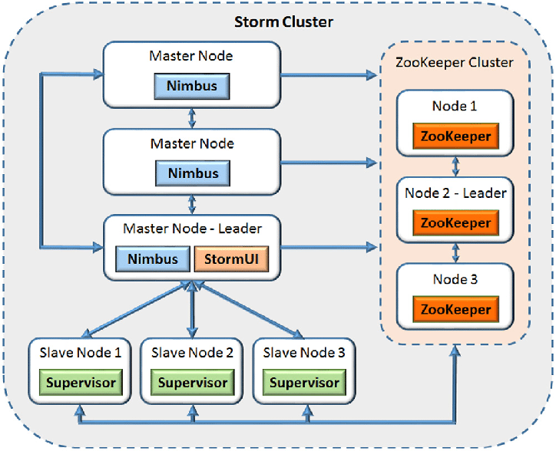
Taken from:
https://doi.org/10.1016/j.future.2017.08.051
Notes:
Building blocks Which, what + (C | P):
Conceptual/generic BBs
Physical/specific BBs
Connectors Which, what + (C | P):
Conceptual/generic Conns
Physical/specific Conns
View – concern – stakeholder (1..*):
…
…
…
Extra-functional requirements (Y + motivation) | N :
Security:
Availability & reliability:
Maintainability:
Performance and scalability:
Distribution (Y + motivation) | N:
Because …
Clarity/Semantics ( ☺ | 😐 | ☹) + motivation:
Because …

Slide 10
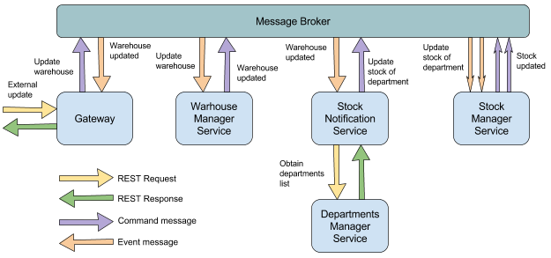
Taken from:
https://concisesoftware.com/is-rest-best-for-micorservices-architecture/
Notes:
Building blocks Which, what + (C | P):
Conceptual/generic BBs
Physical/specific BBs
Connectors Which, what + (C | P):
Conceptual/generic Conns
Physical/specific Conns
View – concern – stakeholder (1..*):
…
…
…
Extra-functional requirements (Y + motivation) | N :
Security:
Availability & reliability:
Maintainability:
Performance and scalability:
Distribution (Y + motivation) | N:
Because …
Clarity/Semantics ( ☺ | 😐 | ☹) + motivation:
Because …

Slide 11
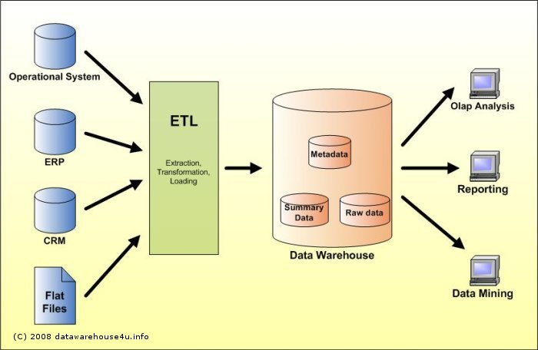
Taken from:
https://www.datawarehouse4u.info/
Notes:
Building blocks Which, what + (C | P):
Conceptual/generic BBs
Physical/specific BBs
Connectors Which, what + (C | P):
Conceptual/generic Conns
Physical/specific Conns
View – concern – stakeholder (1..*):
…
…
…
Extra-functional requirements (Y + motivation) | N :
Security:
Availability & reliability:
Maintainability:
Performance and scalability:
Distribution (Y + motivation) | N:
Because …
Clarity/Semantics ( ☺ | 😐 | ☹) + motivation:
Because …

Slide 12
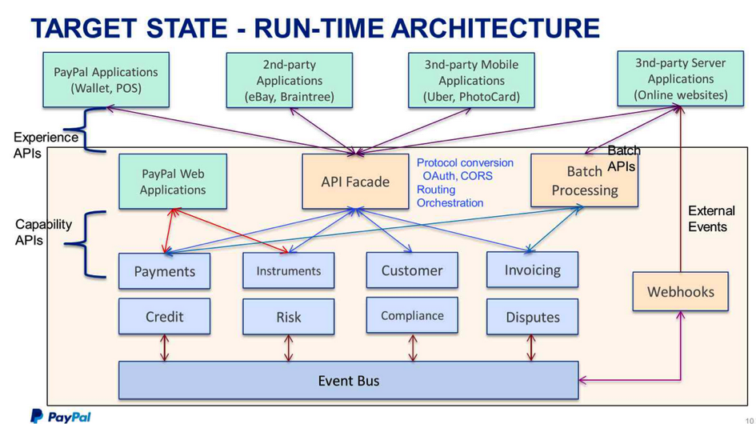
Taken from:
https://www.tibco.com/blog/2015/03/23/creating-business-value-by-example/
Notes:
Building blocks Which, what + (C | P):
Conceptual/generic BBs
Physical/specific BBs
Connectors Which, what + (C | P):
Conceptual/generic Conns
Physical/specific Conns
View – concern – stakeholder (1..*):
…
…
…
Extra-functional requirements (Y + motivation) | N :
Security:
Availability & reliability:
Maintainability:
Performance and scalability:
Distribution (Y + motivation) | N:
Because …
Clarity/Semantics ( ☺ | 😐 | ☹) + motivation:
Because …

