Slide 1
2IS80
Fundamentals of Informatics
Quartile 2, 2015–2016
Lecture 1: Introduction
Lecturer: Tom Verhoeff

Slide 2
Background
Relatively new course
accessible and useful for all TU/e bachelor students (1st, 2nd year)
Elective course
aimed at all future engineers
Technical and scientific content
focused on the conceptual level
Filling a gap
in the Bachelor College curriculum, where Informatics is missing

Slide 3
CS and non-CS Students
Non-CS students focus on
  computational concepts
CS students focus on
  global picture; how concepts are related (see forest for trees)
  application of these concepts elsewhere
It is also about developing an attitude:
  to view the world computationally
Notes:
Provides an opportunity to delve into some topics that you may already have heard of

Slide 4
Informatics
  Computer Science/Computing Science (CS):
  fundamental concepts to understand and explore the natural and artificial world in computational terms
  Information and Communication Technology (ICT):
  application of computer systems to solve real-world problems,
  including programming
Digital Literacy (DL):
  knowing how to use ICT for general purposes
  This course focuses on CS
Notes:
CS: Algorithm, DVD encoding; compare to physics “fundamental particles” and “the speed of light”
ICT: MatLab program
DL: Word processor, email

Slide 5
The Course Content
From: P.J. Denning. The great principles of computing.
American Scientist 98:369-372, 2010.
Category | Focus
Computation | What can and cannot be computed
Communication | Reliably moving information between locations
Coordination | Cooperation among (networked) entities
Recollection | Representing, storing, and retrieving information
Automation | Algorithms, machine learning, expert systems
Evaluation | Predicting performance and modeling complex systems
Design | Structuring (software) systems
Addressed in basic course Design
Addressed in basic course Modeling

Slide 6
Four Themes
Introduction
Automata (models of computation; computational mechanisms)
Algorithms (how to describe computations)
Information (efficient, reliable, secure communication & storage)
Computability (what can(not) be solved computationally)
Conclusion + special topics (randomization, quantum computing)

Slide 7
Learning Objectives
Students should have an idea of
  notion of computability
  models of computation
Students should be able to
  recognize aspects of computation in world around us
  apply techniques from informatics to understand and solve problems
Students should understand
  what algorithms are and what they are used for
  some principles of data representation, transmission, and encryption

Slide 8
Some logistics first
before we really get started …

Slide 9
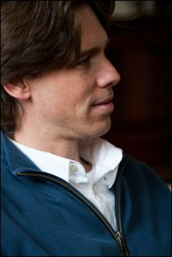

Staff
Lecturers:
Bas Luttik (3+3 lectures)
Bettina Speckmann (4 lectures)
Tom Verhoeff (1+3+1 lectures)
Instructors:
Wieger Wesselink (Group 1)
Jaap van der Woude (Group 2)
Arthur van Goethem (Group 3)
Assistants:
Geert Derks (Group 1)
Amber van der Heijden (Group 2)
Jimmy van Turnhout (Group 3)
Notes:
Michel Westenberg (logistics, web page)

Slide 10

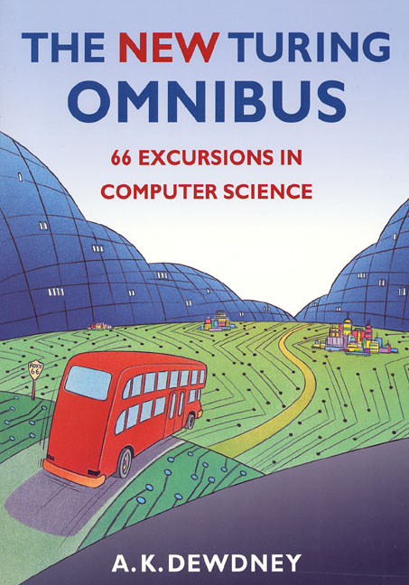
Study Material
Web page: www.win.tue.nl/~wstomv/edu/2is80
Book: Thomas H. Cormen
Algorithms Unlocked
mandatory
Also available as ebook
Reader: with selected chapters from
A. K. Dewdney
The New Turing Omnibus
mandatory
(Lecture Notes Shop)

Slide 11
Prerequisites
No specific prior knowledge is required
Inquisitive mind
Motivation to work on assignments

Slide 12
Grading scheme 2IS80
4 homework assignments, each counting for 10% of the final grade.
A written exam (closed book) which counts for the remaining 60% of the final grade.

Slide 13
Homework Assignments
Posted on web page on day of first lecture of each theme.
Due on Fridays, at 23:59, as PDF, submitted via peach.win.tue.nl.
Late assignments will not be accepted.
Must be typeset in English – e.g. use Latex!
File name scheme: Ai-LastName.pdf
If your name is Anton van Gelderland and you submit the 1st assignment, then your file must be named A1-vanGelderland.pdf.

Slide 14
Communication
Homework is handed in via peach.win.tue.nl (not by email)
You can use email to ask questions.
  Put the tag [2IS80] in the subject line.
  Your first point of contact is your instructor.

Slide 15
Code of Academic Honesty
Academic Honesty
All class work has to be done independently.
You are of course allowed to discuss the material presented in class, homework assignments, or general solution strategies with your classmates and others, but you have to formulate and write up your solutions by yourself.
You must not copy from the internet, your friends, or other textbooks. If you represent other people's work as your own then that constitutes fraud and will be dealt with accordingly.

Slide 16
Organization
Contact hours:
  Lectures Wednesday 7+8 AUD 8
  Friday 3+4 PAV B1
  Tutorials Wednesday 5+6 see web
  Lab Friday 1+2 see web
  Two-week cycle per theme
  Friday: work on practice set
  Wednesday: work on practice set
  Friday: finish homework assignment
  Wednesday: solutions and feedback are presented
Check studyguide on the web for details

Slide 17
Schedule
Details are on the study guide

Slide 18
Signing up and groups
You should have registered in Oase.
Three instruction/lab groups: see Oase/Studyweb

Slide 19
An Experiment
let’s get started …

Slide 20
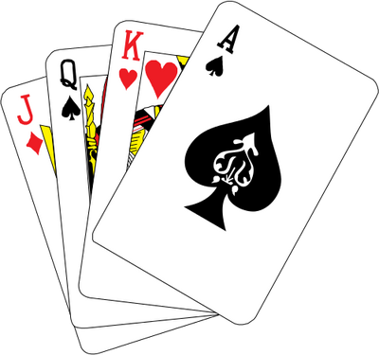
Card Trick
1 volunteer
27 playing cards
1 magician
Notes:
This took almost 15 minutes, so start no later than 15 minutes before the break.

Slide 21
Card Trick Informatics
The volunteer knows a secret, that the magician does not know
In each step, some information is conveyed
At the end, the magician has enough information to know the secret
The trick involves information processing, which can be described by an algorithm
You can reason about this algorithm, without executing it
No computer is involved
Details will be explained in Lecture 9

Slide 22
Secure Computation
2 volunteers
5 sectors
1 spinner

Slide 23
Secure Computation Informatics
Each volunteer knows a secret
  whether or not each is willing to practice together
In the computation, some information is conveyed and combined
At the end, the volunteers and audience only know the outcome
  viz., whether both want to practice together
The computation involves information processing, which can be described by an algorithm
You can reason about this algorithm, without executing it
No computer is involved
Details will be explained in Lecture 11

Slide 24
History
The birth of a science …

Slide 25
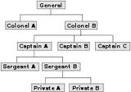
Society
Success of human race (homo sapiens) is based on our ability to operate in groups using sophisticated forms of communication
Information about location of
  food
  shelter
  danger and safety
Tracking of human relationships (also information)
  Groups need organization (hierarchy)
  Healthy population: need to avoid incest
Administration (record keeping)
  Property (flooding of the Nile)
  Trading
  Taxes, census
  Money, banking

Slide 26
Information Carriers
Sounds
Marks on rocks and trees
Knots in ropes
Signs on clay tablets, parchment, papyrus
Writing systems
Book printing
  Language can live in diverse carriers
Electro-magnetic waves
Magnetic tape (audio, digital)
Magnetic disks
Optical disks, optical fiber
Semiconductors (flash memory)
Quantum bits (qbits)

Slide 27
Engineering & Technology
The Age of Gravity
The Age of Heat
The Age of Electromagnetism
The Age of Information
The Age of Systems
See Engineering: A Very Short Introduction by David Blockley (Oxford Press, 2012)

Slide 28
Information Processing: Computation
Initially, done by human beings without much tool support
Notes:
Antikythera mechanism

Slide 29
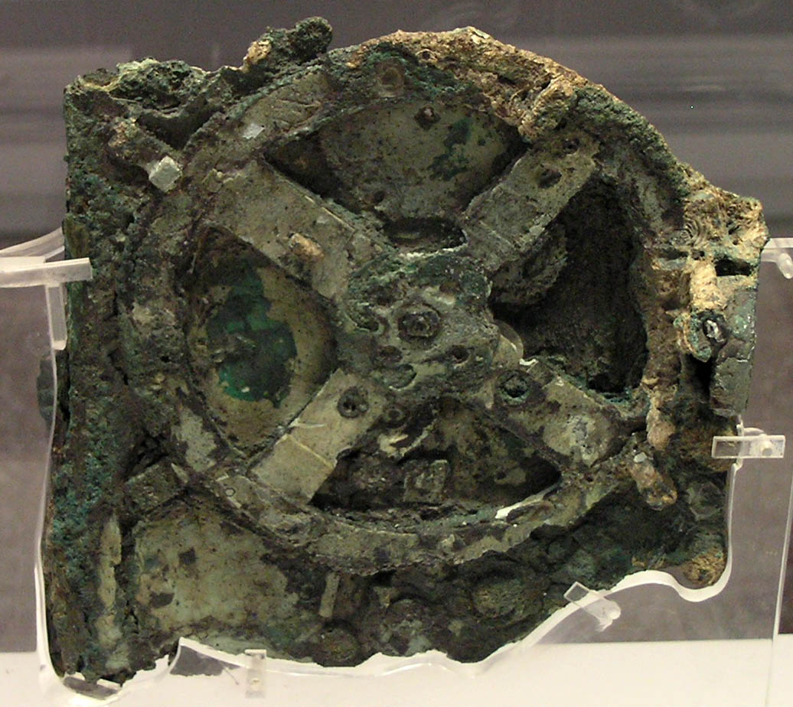
Planetarium (Antikythera mechanism)
Notes:
1st century BC

Slide 30
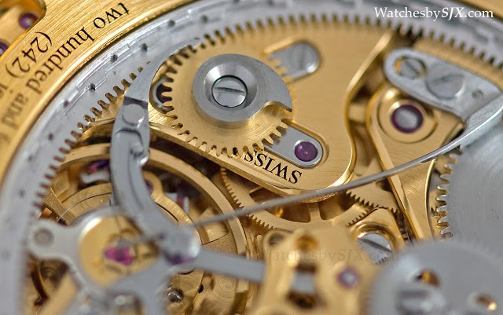
Clock with gears, springs, and pointers

Slide 31
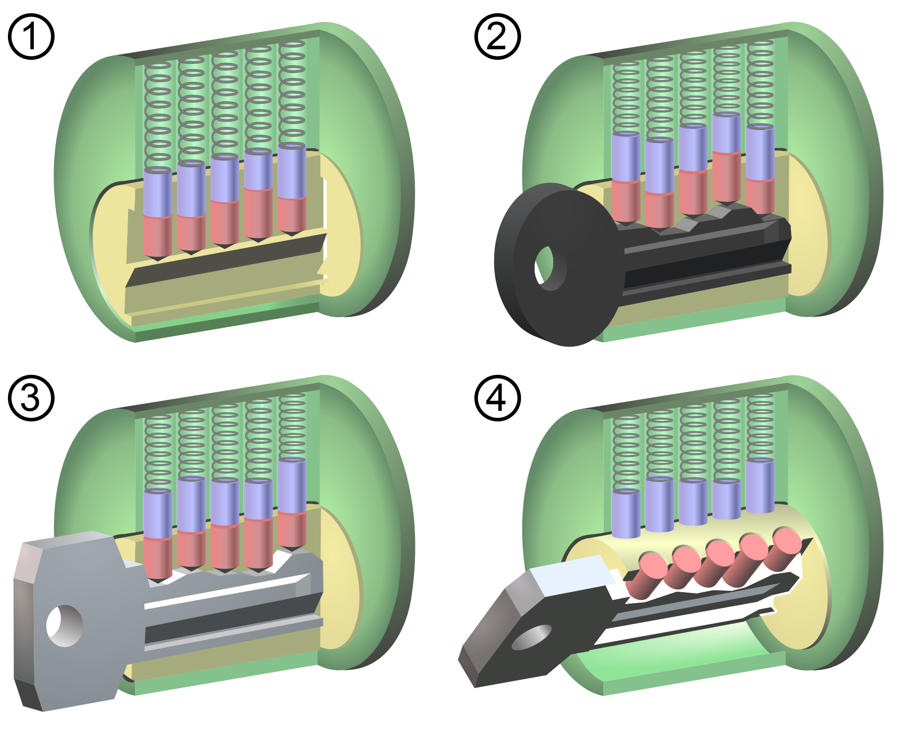
Lock and Key

Slide 32
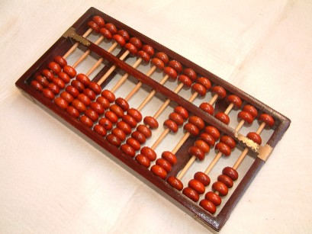
Abacus

Slide 33
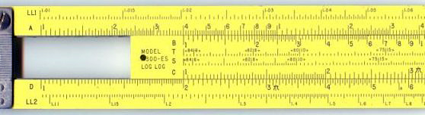
Slide Rule

Slide 34
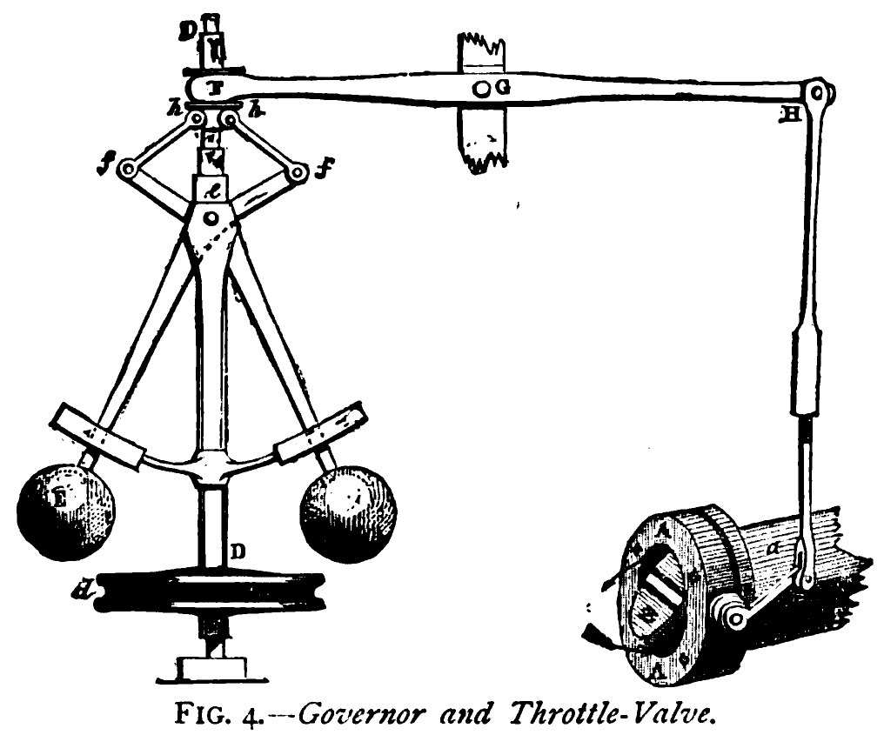
Centrifugal governor
Notes:
Sense and control

Slide 35
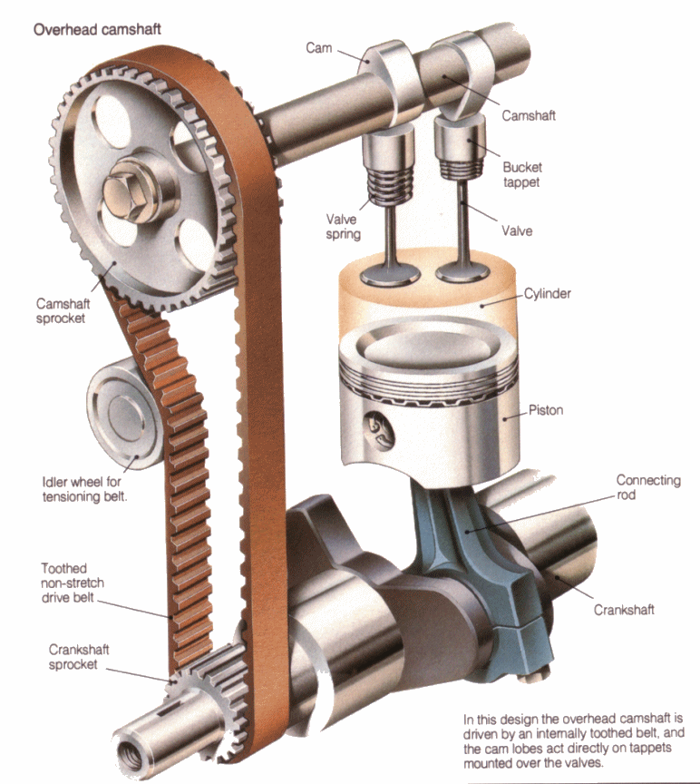
Camshaft

Slide 36
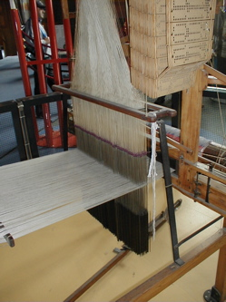
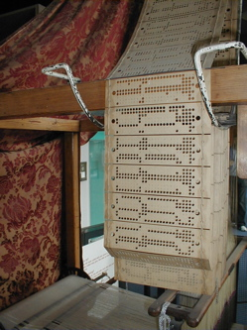
Jacquard’s loom, with punched cards

Slide 37
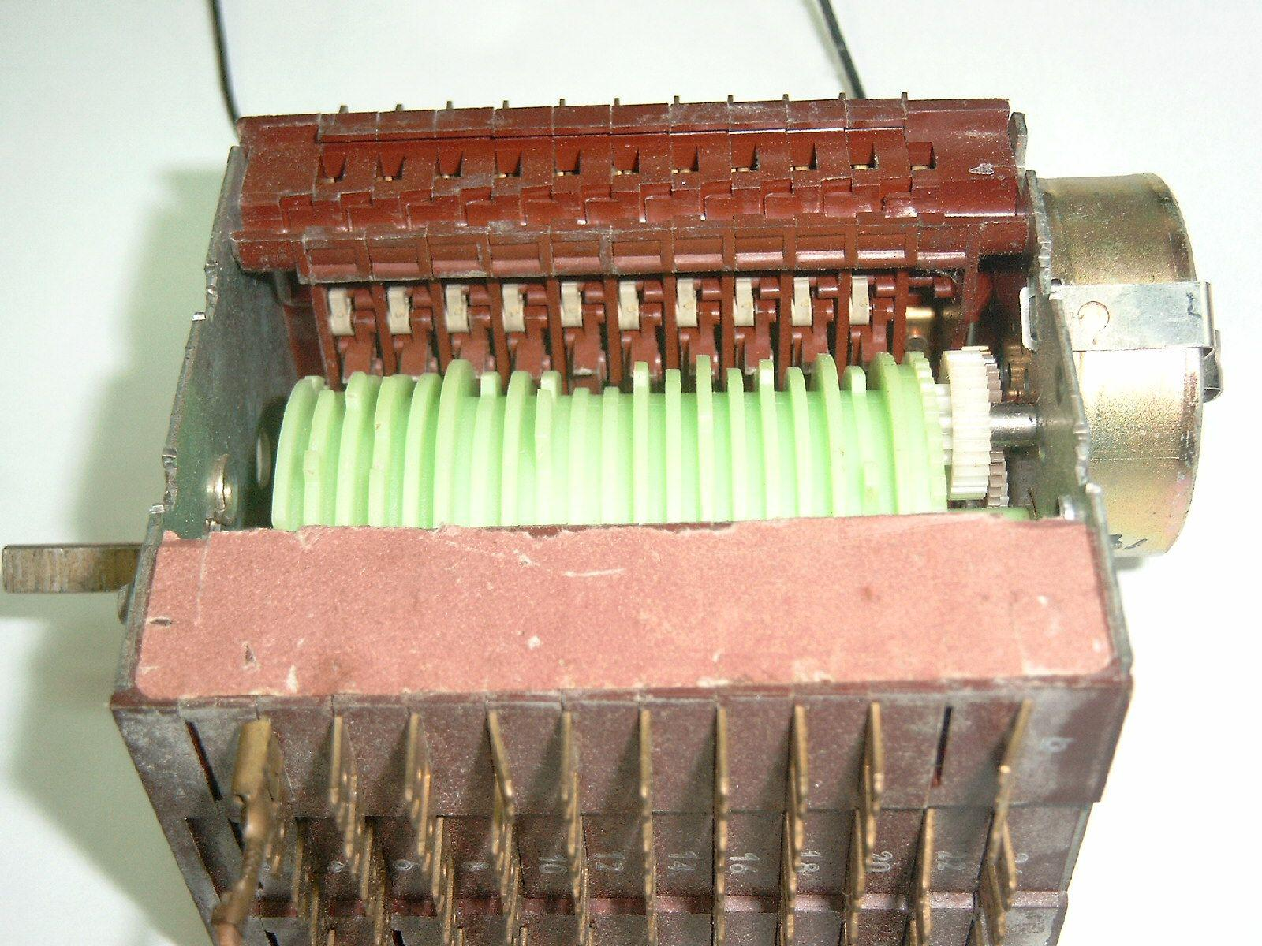
Rotating drum sequencer
Notes:
In old telephone exchanges, old laundry machines and dish-washers

Slide 38
Information and Computation
Information can be studied separate from a carrier: digital domain
Information can be digitized
Digital information can be converted to affect the physical world
Informatics deals with information and its processing (computation) in a way that abstracts from physical carriers
Compare this to
  how mathematics deals with numbers
  how physics deals with energy

Slide 39
Cyberspace
Society has become much more information-centered
The virtual world of cyberspace is integral part of everyday reality
Digital ownership, copyright, privacy, identity, even existence
James Gleick, The Information: A History, A Theory, A Flood. Pantheon, 2011.

Slide 40
The Fourth Great Scientific Domain
Physical Sciences
Life Sciences
Social Sciences
Computational Sciences (Informatics)
  Software Science
  Web Science
  Data Science
  Systems Science
Notes:
Master Programs within CS

Slide 41
Pillars of Scientific Method
Experimental methods
Theoretical methods
Computational methods
  Large-scale data analysis
  Simulation (next to experimentation)
  Computational models (next to classical models, e.g. PDE)
Notes:
Virtual wind tunnels are used in the design of cars and airplanes

Slide 42
Modern Engineer
Needs to use information tools (search, communicate, cooperate)
Needs to use computational tools
Needs to deal with information-rich models (e.g. BIM)
Needs to deal with computational models (e.g. catalytic reactions)
BIM = Building Information Model

Slide 43
Conclusion
Fundamentals of Informatics will
  not make you an informatics expert
But it will
  introduce you to fundamental informatics concepts
    cf. fundamental particles in physics
  help you to tap a vast arsenal of knowledge and to avoid reinventing the wheel
  enable you to communicate better with informatics experts
  whet your appetite for specialized informatics courses

Slide 44
Announcements
This week
  Exploratory assignment about automata
  www.win.tue.nl/~wstomv/edu/2is80/explore-automata
Friday 1+2
  First lab session
  Before lab session:
    Read the indicated reading material
    Try the relevant problems in the practice set

