Slide 1
2IS80 Fundamentals of Informatics
Quartile 2, 2015–2016 Lecture 11: Information, Cryptography
Lecturer: Tom Verhoeff

Slide 2
Theme 3: Information

Slide 3
Road Map for Information Theme
Problem: Communication and storage of information
Lecture 9: Compression for efficient communication
Lecture 10: Protection against noise for reliable communication
Lecture 11: Protection against adversary for secure communication
Sender
Channel
Receiver
Storer
Memory
Retriever
Notes:
More uniform terminology: Writer / Reader; Producer / Consumer

Slide 4
Shannon’s Coding Theorems
Source Coding Theorem (Shannon, 1948):
There is a precise limit on compression: the source entropy
Channel Coding Theorem (Shannon, 1948):
There is a precise limit on efficiency loss on a noisy channel to achieve (almost 100%) reliability: the effective channel capacity
Sender
Encoder
Channel
Decoder
Receiver
Sender
Encoder
Channel
Decoder
Receiver
Noise
Notes:
Major results in Lectures 9 & 10
Upper and lower bounds on efficient & reliable lossless communication
Channel capacity is obtained by subtracting the entropy of the noise

Slide 5
Secure Communication
Situation and approach
Terminology:
Sender ➔ Alice; Receiver ➔ Bob; Enemy ➔ Eve (eavesdropper)
Unencoded / decoded message ➔ plaintext
Encoded message ➔ ciphertext
Encode / decode ➔ encrypt / decrypt (or sign / verify)
Eve
Enemy
Alice
Bob
Sender
Encoder
Channel
Decoder
Receiver
Plaintext
Encrypt
Sign
Ciphertext
Decrypt
Verify
Plaintext
Notes:
Note the double arrow between channel and enemy

Slide 6
Information Security Concerns
Confidentiality: enemy cannot obtain information from message
E.g. also not partial information about content
Authenticity: enemy cannot pretend to be a legitimate sender
E.g. send a message in name of someone else
Integrity: enemy cannot tamper with messages on channel
E.g. replace (part of) message with other content unnoticed
Enemy
Enemy
Enemy
1.
2.
3.
Channel
Channel
Channel
Notes:
There are more security concerns:
Availability, cf. Denial of Service attack
Non-Repudiation: cannot deny that you had that message
E.g. you should not be able to deny later that you initiated a money transfer.
But they are outside the scope of this course.

Slide 7
Can’t Compression Provide Confidentiality?
What are the symbol statistics after good compression?
In favor: Result looks random: P(0) ≈ P(1) ≈ ½, etc.
Against: the compression algorithm will become known
Against: Obscurity ≠ Security
Notes:
Why random looking: if not, then further compression is possible
Cf. next slide on Kerckhoffs’ Principle

Slide 8
Kerckhoffs’ Principle (1883)
Kerckhoffs: “A cryptosystem should be secure, even if everything about the system, except the key, is public knowledge”
The security should be in the difficulty of getting the secret key
Shannon: “the enemy knows the system being used”
“one ought to design systems under the assumption that the enemy will immediately gain full familiarity with them”
No security through obscurity
Notes:
A key is any selectable parameter
Shannon (1945, 1949): “Communication Theory of Secrecy Systems”
Many people will need to know the algorithms
Someone will eventually leak them (bribed, tortured, loose lipped, dissatisfied, disillusioned)

Slide 9
Criteria for Secure Encryption
Knowing the encryption algorithm and the ciphertext,
but without knowing the key,
it should be more costly to recover any information about plaintext
than the value of that information.
It should not take significantly less effort than trying all keys
Enemy can do no better than apply brute force
The key space (set of all keys) should be sufficiently large
Notes:
More costly, but not necessarily impossible
Must not only prevent complete recovery of all information; also of parts.
Number of possible keys matters. Relates to key size.

Slide 10
One-Time Pad to Ensure Confidentiality
Sender and receiver somehow agree on uniformly random key
One key bit per plaintext bit
One-time pad contains sheets with random numbers, used once
Encode: add key bit to plaintext bit modulo 2 ➔ ciphertext bit
0 ⊕ 0 = 0; 1 ⊕ 0 = 1; 0 ⊕ 1 = 1; 1 ⊕ 1 = 0
Decode: add key bit to ciphertext bit modulo 2 (same as encode!)
Enemy
Sender
Encoder
Channel
Decoder
Receiver
Key
Key
Notes:
Addresses: Confidentiality, using a pre-shared key
Addition modulo 2 = exclusive-or = XOR; subtraction = addition
Shannon: entropy of uniformly random key = 1; swamps plaintext for enemy
H(plaintext ⊕ key) = 1, even if H(plaintext) < 1; evens out statistical fingerprint
Trying all keys does not help.
When challenged: can construct new key to reveal any plaintext!

Slide 11
Why One-Time Pad Decoding Works
Encode:
ciphertext = plaintext ⊕ key
Decode:
ciphertext ⊕ key
= [ by definition of ciphertext ]
(plaintext ⊕ key) ⊕ key
= [ by associativity of ⊕: order of ⊕ evaluation is irrelevant ]
plaintext ⊕ (key ⊕ key)
= [ each bit is its own ⊕-inverse: 0 ⊕ 0 = 0; 1 ⊕ 1 = 0 ]
plaintext ⊕ 0
= [ 0 is identity of ⊕: 0 ⊕ 0 = 0; 1 ⊕ 0 = 1 ]
plaintext
Notes:
Properties of modular (clock) arithmetic

Slide 12
One-Time Pad: Perfect Secrecy
What can enemy do, when knowing just the ciphertext?
Given ciphertext C, consider any plaintext P
P could have been the original plaintext for C
Take key = P ⊕ C; then, encoding P with this key yields
P ⊕ key
= [ choice of key ]
P ⊕ ( P ⊕ C )
= [ ⊕ is associative ]
( P ⊕ P ) ⊕ C
= [ properties of ⊕: a ⊕ a = 0; a ⊕ 0 = a ]
C
For each given ciphertext, all plaintexts are equally probable
Enemy has no clue, provided key is random
Even brute force trying of all keys will not work
Notes:
Proved by Shannon during WW II
N.B. length P = length C
Pr(P = 0 | C = 0) = 50% if key bits are uniformly random
H(plaintext) = H(plaintext | ciphertext) = entropy in plaintext given the ciphertext [conditional entropy]
The key acts as noise with p = 0.5
Even if part of the plaintext is known, this will not help in recovering the remainder.
Alternatively: if key is “perfectly” random, then so is ciphertext, regardless of plaintext
Also see Deniable Encryption: https://en.wikipedia.org/wiki/Deniable_encryption

Slide 13
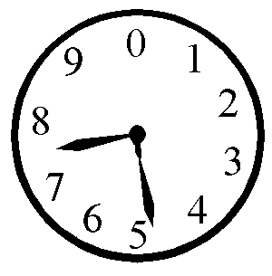
Application: Pin Hiding & Secret Sharing
How to hide your decimal PIN code P (plaintext)?
Choose random key k with same length
Subtract digit-wise modulo 10 to obtain cipher C = P ⊖ K
2 4 6 8 (PIN P)
8 9 3 9 (random key K)
4 5 3 9 (ciphertext C)
Store K and C in two different places
Or: give them to two persons
Or: send them along two separate channels
Each number by itself provides no information about PIN P
Together they can reconstruct the PIN P = C ⊕ K
Given just one, when forced, you can make any PIN appear
Notes:
E.g. protect launch code for nuclear missiles.
Why is splitting in half (first two digit versus last two digits) not a good idea?
10⁴ PINs; when given two digits, only 10² possibilities (not half the number, but square root)
Modulo 10 = clock arithmetic (drop multiples of 10)
Can use more than one key, to split into more than two parts.
Again: deniable encryption

Slide 14
Trade-offs for One-Time Pad
Very simple, efficient (once you have the key), and perfect
Requires as many random symbols as length of plaintext
Must use a fresh key for every message
Randomness is costly to generate
Doubles number of bits to communicate
Parties need to agree on random key (one-time pad) securely
Communicate it beforehand, or afterwards over secure channel
Chicken–egg problem
Neither the key, nor the ciphertext by itself can reveal plaintext
Perfect secrecy
It is important that the enemy does not get both (and knows it)
Notes:
Any pattern in the key, i.e. H(key) < 1, weakens the encryption

Slide 15
Symmetric Cryptography: Shared Secret Key
Block cipher:
Chop plaintext into equal size blocks
Encrypt each block separately, using the same secret key
Key can be shorter than plaintext
Encryption with secret key:
Could add modulo 2, like the one-time pad
This results in a substitution cipher
Could involve more elaborate ‘slicing and dicing’
Shannon: ‘Confusion and diffusion’; substitution and transposition
There are various ‘secure’ standards (e.g. AES)
Given the ciphertext, limited number of plaintexts possible
Enemy can try keys: security is proportional to number of keys
Notes:
Addresses: Confidentiality; can be used for authenticity and integrity (outside scope)
Encryption with key is deterministic, and inverse is easy (given the key).
Enemy can try to exploit weaknesses: e.g. expected statistical properties of plaintext (e.g. written in English). When trying keys, you could recognize the plaintext.
First compressing plaintext helps to disguise statistical fingerprint.

Slide 16
Cipher Block Chaining: Motivation
E.g. message consists of sequence of 8-bit colors, block size 8 bit
Cipher Block Chaining:
Each plaintext block is first added to previous ciphertext block
Plaintext
Ciphertext, with
blocks encrypted separately
Ciphertext, with
cipher block chaining
Notes:
Images from Wikipedia: Tux, the Linux penguin
Blocks encrypted separately = Electronic Code Book (ECB) mode
ECB: Ciphertext inherits statistical fingerprint from plaintext

Slide 17
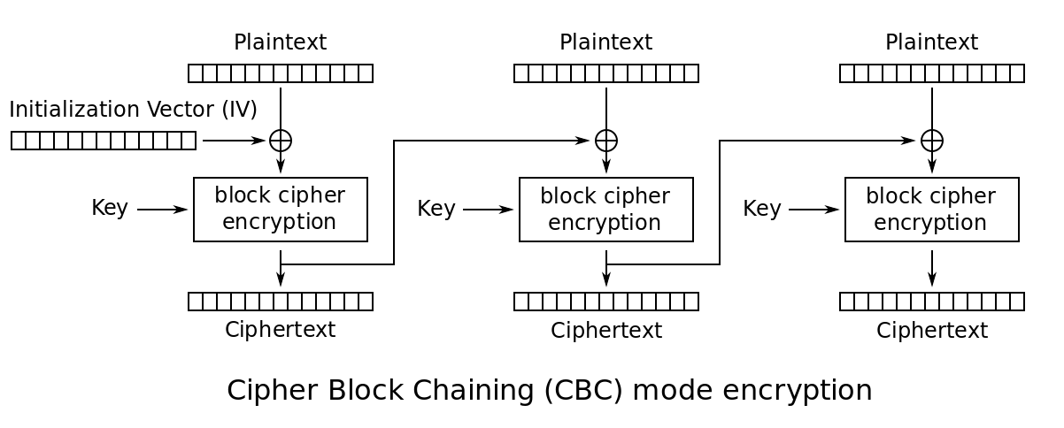
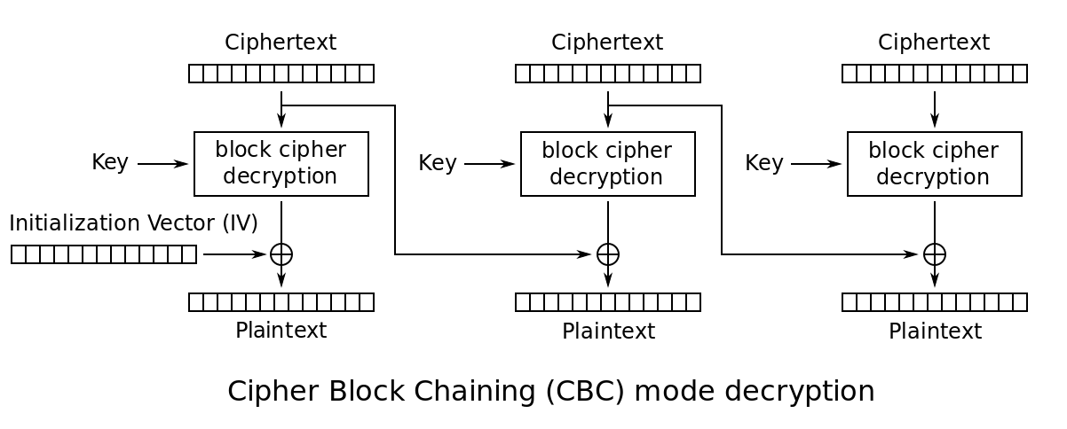
Cipher Block Chaining: Implementation
Notes:
Images from Wikipedia
ECB: can encrypt/decrypt blocks in parallel
Cipher Block Chaining (CBC): add modulo 2 = XOR
CBC: cannot encrypt in parallel, can decrypt in parallel
Initialization vector for first plaintext block
There are other modes as well (beyond scope).

Slide 18
Trade-offs for Symmetric Cryptography
Improves confidentiality, but not authenticity or integrity
Each pair of persons, who want to communicate securely as a pair, needs their own secret key
N persons: N (N-1) / 2 pairs ≈ ½ N² keys
Key needs to be agreed upon securely
Key needs to be chosen randomly (no pattern)
Key is shorter than one-time pad, and is reused on multiple blocks
Danger: provides opportunity to break the code
Relatively fast
Notes:
Agreement is symmetric
Padding

Slide 19
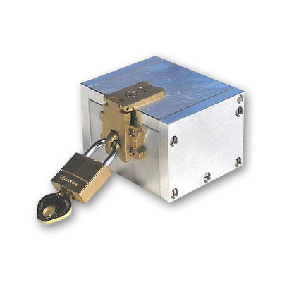
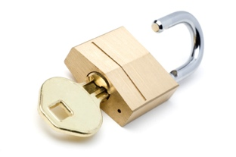
Security without Shared Keys: Challenge
Alice and Bob each have their own padlock-key combination
Lock A with key A
Lock B with key B
They have a strong box that can be locked with padlocks
How can Alice send a message securely to Bob?
Without also sending keys around

Slide 20
Security without Shared Keys: Solution
Alice:
Puts message in box
Locks box with her lock A, keeping key A
Sends box to Bob
Bob:
Cannot open lock A
Adds his lock B, keeping key B; box is not locked twice
Sends box back to Alice
Alice:
Cannot open lock B
Removes her lock A; box remains locked with lock B
Sends box again to Bob
Bob:
Removes his lock B
Takes message from box
Notes:
Requires that encrypt and decrypt commute (can be interchanged)
Inefficient: involves three communications: a protocol
Can use this costly technique to determine a shared secret key

Slide 21
Diffie–Hellman Trick Visualized
Insecure
channel
Alice
Bob

Slide 22
Security without Shared Key: Attempt
Alice:
Chooses long random key R_{A}
Adds her key to plaintext P (modulo 2): C₁ = P ⊕ R_{A}
Sends ciphertext C₁ to Bob
Bob:
Chooses long random key R_{B}
Adds his key to C₁: C₂ = C₁ ⊕ R_{B} = P ⊕ R_{A} ⊕ R_{B}
Sends ciphertext C₂ back to Alice
Alice:
Adds her key to C₂: C₃ = C₂ ⊕ R_{A} = P ⊕ R_{A} ⊕ R_{B} ⊕ R_{A} = P ⊕ R_{B}
Sends C₃ again to Bob
Bob:
Adds his key to C₃: C₃ ⊕ R_{B} = P ⊕ R_{B} ⊕ R_{B} = P
Notes:
This is a protocol.
It is not secure!

Slide 23
Weakness in Attempt
Each ciphertext by itself provides perfect secrecy
C₁ = P ⊕ R_{A}; C₂ = P ⊕ R_{A} ⊕ R_{B}; C₃ = P ⊕ R_{B}
However, if enemy obtains all three ciphertexts, then
C₁ ⊕ C₂ ⊕ C₃
= [ definition of C₁, C₂, C₃ ]
( P ⊕ R_{A} ) ⊕ ( P ⊕ R_{A} ⊕ R_{B} ) ⊕ ( P ⊕ R_{B} )
= [ ⊕ is associative: can regroup terms ]
P ⊕ R_{A} ⊕ P ⊕ R_{A} ⊕ R_{B} ⊕ P ⊕ R_{B}
= [ ⊕ is commutative: can reorder terms ]
P ⊕ P ⊕ P ⊕ R_{A} ⊕ R_{A} ⊕ R_{B} ⊕ R_{B}
= [ each bit is its own ⊕-inverse: a ⊕ a = 0 ]
P ⊕ 0 ⊕ 0 ⊕ 0
= [ 0 is identity of ⊕: a ⊕ 0 = a ]
P
Notes:
Also, each pair is perfectly secret.
This weakness can be “fixed” by using a different operator than ⊕:
Modular exponentiation (Diffie–Hellman key exchange):
Agree on 1 < g < p-1, p is large prime, g is primitive root mod p;
Consider operation (c^{x}) mod p
Observe that (cª)^{b} = c^{ab} = (c^{b})ª (also mod p)
Inverse of modular exponentiation = discrete log = hard
Can use this to establish shared secret key.

Slide 24
Asymmetric Cryptography
Each party has a key pair:
private key K_{private} (kept secret; only known by one party)
public key K_{public} (made publicly available to everyone)
Given the public key, it is hard to find corresponding private key
Encryption function E(key, text)
Decryption function D(key, text)
ciphertext = E(K_{public}, plaintext) ⇔ plaintext = D(K_{private}, ciphertext)
Given the ciphertext and public key, it is hard to find plaintext
Given the ciphertext and private key, it is easy to find plaintext
Sender encrypts plaintext with public key of receiver
Receiver decrypts cipthertext with own private key
Notes:
Encryption uses a one-way trapdoor function.
Difficulty of calculating inverse depends on whether you know the private key (the trapdoor).

Slide 25
Practical Public-key Crypto: RSA
Generate key pair:
Generate two random large primes P and Q
Compute product N = P * Q
Take e coprime (no common divisor) to R = (P – 1) * (Q – 1)
And d with e * d = 1 (mod R)
Publish N and e as public key; keep P, Q, d private
Encrypt plaintext m as m^{e} (mod N)
Decrypt ciphertext c as c^{d} (mod N)
Security depends on mathematical assumptions
For key pair generation: integer factorization is considered hard
For encryption: discrete root extraction is considered hard
Notes:
Finding large primes, multiplying large numbers, and finding coprime are easy.
Easy to scale up: use larger primes.
Why decryption works: requires math (number theory) beyond scope of this course.
The assumptions have not been proved.

Slide 26
Other Uses of Asymmetric Cryptography
Digital signature helps ensure
Authenticity: did the claimed sender really send this message?
Integrity: is the received message really the message sent?
Sign message (create detached signature) :
Sender ‘decrypts’ message with own private key
Only this sender can sign this way
Verify (detached signature for given message m):
Receiver ‘encrypts’ signature with sender’s public key
Encryption result should equal m
If verification fails, then
Either the signature was not valid, or the message was modified
Everyone (with public key) can verify signature
Notes:
In practice: sign secure hash of message, because hash is shorter than message

Slide 27
Man-in-the-Middle Attack
Alice wants to send confidential message to Bob
Alice requests Bob’s public key
Eve intercepts Bob’s public key, and returns her own public key
Alice encrypts message with this (Eve’s) public key
Eve intercepts ciphertext, decrypts it, and reads / modifies it
Eve then re-encrypts message with Bob’s real public key
Bob receives ciphertext, and decrypts it
Alice and Bob cannot detect this breach of security
If Alice signs the plaintext, then Eve can read but not modify message
If Alice signs the ciphertext, then Bob will detect re-encryption
Notes:
However, signatures can also suffer from man-in-the-middle attack:
Eve intercepts Alice’ public key and gives her (Eve’s) public key to Bob (with the name of Alice on it).

Slide 28
Man-in-the-Middle Attack Visualized

Slide 29
Trade-offs for Asymmetric Cryptography
Pairwise secure communication in group of N persons:
N key pairs needed (cf. ½ N² keys for symmetric crypto)
Key management:
Why can you trust a public key? Public Key Infrastructure (PKI)
Man-in-the-middle attack
Complexity of inverting (breaking) the one-way functions
Prime factorization of large numbers
Discrete logarithms modulo large primes
Relatively slow
Longer keys needed than for symmetric crypto
Notes:
Encryption differs with direction of communication (asymmetric).
You can distinguish who encrypted the message.
It private key leaked, then all messages (from everyone) encrypted to it become readable.
If private key lost, then all messages encrypted to it are lost.

Slide 30
Hybrid Crypto System
Combine good elements of symmetric and asymmetric crypto
To repair weaknesses
Use (slower) public-key crypto to
encrypt secret keys
create signatures
Use (faster) secret-key crypto to
encrypt messages

Slide 31
GPG: GNU Privacy Guard
Hybrid crypto system
Based on open Pretty Good Privacy (PGP) standard
Available on Windows, Mac, Linux
Integrates with other software tools (e.g. email clients)
Supports key and trust management
Web of trust: sign keys of others
Notes:
Phil Zimmermann (1991), to support human rights activists.

Slide 32
Summary of Crypto
Secure communication and storage of information
Confidentiality (no reading by enemy): encrypt
Authenticity (no tricking by enemy): sign
Integrity (no tampering by enemy: sign
Kerckhoffs’ Principle, Shannon's maxim
Symmetric crypto: shared secret key
Encrypt and decrypt with identical key
One-time pad: perfect secrecy
Cipher block chaining
Asymmetric crypto: public key + private key
One-way trapdoor functions
Encrypt with receiver’s public key, and decrypt with private key
Sign with sender’s private key, and verify with public key
RSA, GPG
Notes:
Includes links to Wikipedia

Slide 33
Summary of Information Theme
Efficient, reliable, and secure communication:
No computation in problem: information received unchanged
Known limits on what can and cannot be achieved
Heavy computations in solution: information is en/decoded
Efficient: adapt to source characteristics (statistics)
Reliable: adapt to channel characteristics (noise)
Secure: adapt to enemy characteristics
Confidentiality
Authenticity
Integrity

Slide 34
Digital Communication Stack
Efficiency:
Remove
Redundancy
Security:
Increase
Complexity
Reliability:
Add
Redundancy
Source
Encoder
Sign &
Encrypt
Channel
Encoder
Sender
Noise
Channel
Enemy
Source
Decoder
Decrypt
& Verify
Channel
Decoder
Receiver
Notes:
Also continuous variants

Slide 35
Applications
Digital audio (CD)
Digital telecommunication (GSM)
Digital video (DVD)
Digital television broadcasting
Internet
Webshops
Internet banking
Electronic voting
Anonymous digital money
Bitcoins
Notes:
Electronic voting: you also want ability to verify that your vote was counted
Anonymous digital money:
no central accounting
need to prevent that the same number is spent twice

Slide 36
Secure Computation: Example
How can third party determine average age of a group,
without discovering more about the ages than the average?
Notes:
Can mix crypto and computation; no longer pure communication.
Especially important in databases.
Third party puts large random number on ticket.
Each person, in turn, adds their age and returns new ticket with sum.
Third party subtracts initial random number.

Slide 37
Announcements
Deadline for Assignment 3: Fri 18 Dec 2015, 23:59
Khan Academy: Gambling with Secrets (Cryptography)
Especially 4, 8, optionally 7
Crypto part (Lecture 11) involves GPG: www.gnupg.org
Windows, Mac, Linux versions available
GPG Quick Start
Next theme: Limits on Computability

