Slide 1
Fundamentals of Informatics
Lecture 12
The Halting Problem
Bas Luttik
Notes:
The next three lectures will be about the limits of computation; it will be about problems that we cannot solve by computers.
I have been really looking forward to these lectures! First, because they are about deep insights into the nature of computing. Second, because it will be a challenge to convey the ideas to you; there are quite advanced.

Slide 2
Are computers omnipotent?
A quote from TIME magazine (1984):
“Put the right kind of software into a computer, and it will do whatever you want it to. There may be limits on what you can do with the machines themselves, but there are no limits on what you can do with software”.
Primary goal of the day: to convince you that the above statement is very wrong! Computers cannot be programmed to do anything you like, and this is fundamental!
Secondary goal of the day: to convince you that the world will always need smart and well-trained computer scientists.
Notes:
The quote is from an editor of a software magazine.

Slide 3

Algorithms should be provably correct!
A complete description of an algorithm consists of three parts:
  the algorithm
  a proof of the algorithm’s correctness
  a derivation of the algorithm’s running time
Algorithmic problem P
Algorithm A
Algorithm verifier
Yes: algorithm A correctly solves problem P
No: algorithm A does not correctly solve problem P
Notes:
Here’s an example of a smart computer scientist: prof. Speckmann. She has taught you something about the design and analysis of algorithms.
We need people like Bettina Speckmann! For sure, we need her to design smart algorithms. But couldn’t we make her life a little bit easier by designing an automatic algorithm verifier? Then she can concentrate on designing the algorithm and analyzing its running time.

Slide 4
Algorithms should provably terminate!
To prove correctness (with a loop invariant) we need to show three things:
  initialization
  maintenance
  termination: the loop terminates, and when it does the invariant helps to show that the algorithm is correct.
Algorithm A
Termination verifier
Yes: A terminates on every valid input
No: A does not terminate on every valid input
Notes:
Let’s, for now, focus on the termination issue.

Slide 5
The termination problem
Will the following loops terminate if the initial value of x is positive?
while x < 15 do set x to x+1
  Yes (irrespective of the initial value of x)
while x ≠ 1 do set x to x-2
  Yes if the initial value is an odd positive number; No otherwise.
while x ≠ 1 do
    if x is even
      then set x to x/2
      else set x to 3x+1
  Nobody knows for sure (yet)!
Notes:
The third termination problem is Collatz

Slide 6
Solving the termination problem
How would you solve the termination problem?
This will not work: if the simulation does not terminate, the termination verifier will never report anything!
Naïve (and incorrect!) idea for building a termination verifier:
Write algorithm that can simulate any other algorithm.
To find out whether algorithm A terminates on input I, simulate the execution of A on I.
If the simulation terminates, then say yes.
If the simulation does not terminate, then say no.
We shall argue in this lecture that it is fundamentally impossible!
First, however, we move the problem to the well-delineated setting of Turing machines.
Notes:
The third loop on the previous slide already illustrates that solving the termination problem is hard. But it does not yet convincingly show that it is really impossible.

Slide 7
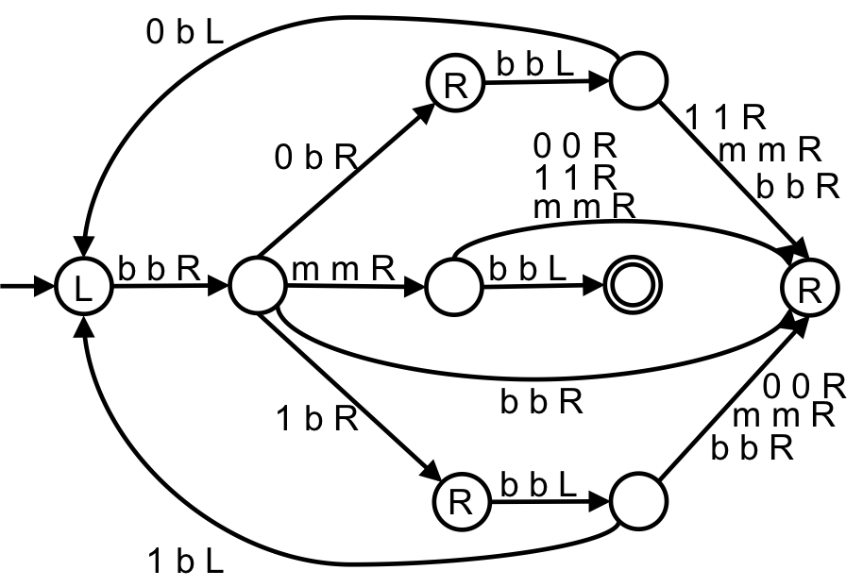
To refresh your memory
A Turing machine consists of
A finite collection of states (with a special initial state and some halting states)
A finite alphabet of tape symbols
A transition table determining for every combination of a non-halting state and scanned tape symbol:
    a new tape symbol,
    a direction of movement, and
    a next current state.
“Everything that can be computed with a computer (now and in the future), can be computed by some Turing machine”
Church-Turing thesis
There exist so-called universal TMs capable of simulating the behavior of any other TM on the basis of an on-tape description.
All TMs have a TM-readable description

Slide 8
Constructing Turing machines
Exercises
Construct a Turing machine L that only has a terminating computation on input sequence 0; the terminating computation should result in output sequence 0. On every other input sequence the computation of L does not terminate. (Assume that input sequences consist of 0s and 1s only).
Construct a Turing machine D that duplicates the input sequence separating the two copies with the symbol #. (You may assume that the input sequence consists of 0s and 1s only.)
Construct a Turing machine L;D that first runs L and then runs D on its input sequence.
It is straightforward to ‘compose’ Turing machines (sequentially).

Slide 9
The Halting Problem for TMs
Given a Turing machine M and an input sequence s, determine whether M’s computation on s will eventually terminate.
11001011101101
1110100011101010101
description of M
input sequence s for M
#
T
T outputs 1 if M halts on s, and 0 if M does not halt s
T reports “yes” if M halts on s, and “no” if M does not halt s
0
1
no
yes
Notes:
Assumptions:
T reads descriptions of TMs and their input in binary, separated by #
T produces 1 for yes and 0 for no.
Assumptions are not restrictive.

Slide 10
The exTerminator
Note: If T exists, then X exists too and it must have a description!
description of M
X
D
description of M
input sequence s for M
description of M
description of M
T
go into infinite loop unless input sequence is 0
0/1
L
0

Slide 11
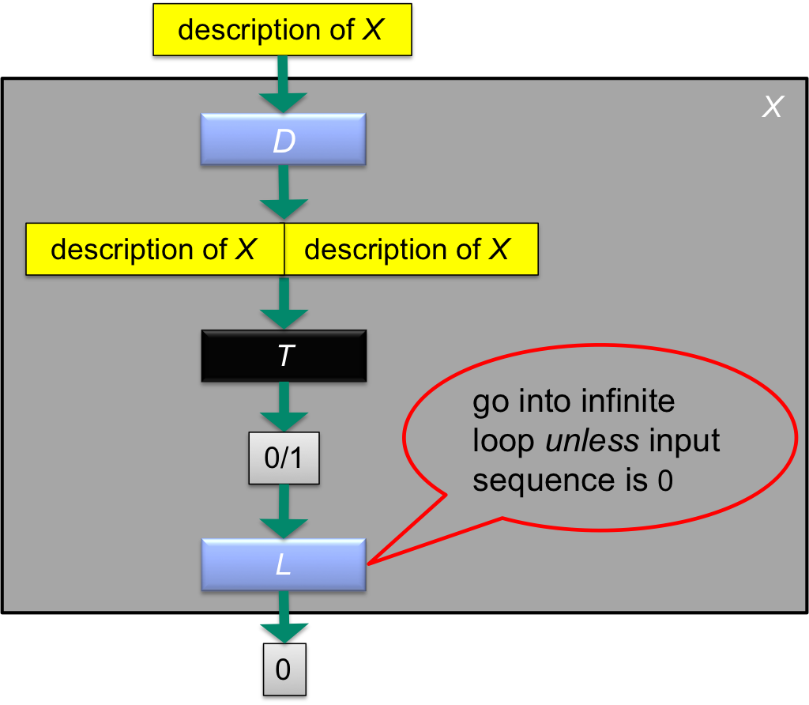
A termination issue
Does X terminate on its own description?
If X terminates on its own description, then T reports 1. So L goes into an infinite loop, and thus X does not terminate. Contradiction!
If X does not terminate on its own description, then T reports 0. So L terminates, and thus X terminates. Contradiction!
Both possible answers lead to a logical contradiction.
Something must be wrong; it can only be our assumption that T exists.
Conclusion: there does not exist a Turing machine that can determine for every arbitrary TM M and input s whether M terminates on s.

Slide 12
Halting problem explained
For a nice animation of the proof of the unsolvability of the halting problem, see:
https://youtu.be/92WHN-pAFCs

Slide 13
Questions
Can’t we adapt the idea of universal Turing machines to solve the halting problem?
It is easy to characterize the inputs on which some particular Turing machine (e.g., the Loop-machine or the Duplicator) will terminate. Why does this not contradict the unsolvability of the halting problem?

Slide 14
Decision problems
A decision problem is a set of related yes/no questions, usually infinitely many.
For instance, the halting problem (“given TM M and input s, decide whether M terminates on s”) consists of questions:
  Does M₀ terminate on s₀?
  Does M₀ terminate on s₁?
  Etc.
  Does M₁ terminate on s₀?
  Etc.
Solvable
there is an algorithm* that correctly answers all the questions of a decision problem
Unsolvable
there is no algorithm* that correctly answers all the questions of a decision problem
*By the Church-Turing thesis, we can replace algorithm by Turing machine.
Notes:
Alternative example: the primality decision problem (“given a natural number, decide whether it is prime”) consists of the questions “Is 0 prime?”, “Is 1 prime?”, “Is 2 prime?”, etc.

Slide 15
More decision problems
Given a 10-digit number, is it a valid credit card number?
  solvable!
A decision problem consisting of finitely many questions only is solvable!
Does the algorithm
  while x ≠ 1 do if x is even then set x to x/2 else set x to 3x+1
  halt for every x?
  solvable!
Given a (finite) graph G, vertices v and u in G, and integer k, is there a path in G of length less than k?
  solvable!

Slide 16

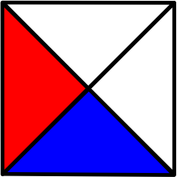

Tiling a room
Tile types:
Is it possible to tile every room of arbitrary size with these tile types?
Yes!

Slide 17


Tiling a room
Tile types:
Is it possible to tile every room of arbitrary size with these tile types?
?
?
No!

Slide 18
The Tiling Problem
Given a set of tile types, decide whether every room can be tiled using tiles of that type.
The Tiling Problem is unsolvable!
So: there is no a computer program (and there will never be!) that decides whether arbitrary finite sets of tile types can tile rooms any size.

Slide 19
The world of computational problems
Given a 10-digit number, is it a valid credit card number?
Given a graph G, vertices v and u in G, and integer k, is there a path in G of length less than k?
Solvable
Given a computer program and a set of requirements, does the program satisfy the requirements?
Unsolvable
Given a set of tile types, can every room be tiled?
Notes:
Many problems are solvable.
But there is class of problems (including program verification, tiling problems, matching problems, etc)
Next lecture, we will discuss how to prove that other problems are unsolvable.
Problems that are algorithmically solvable not necessarily are suitable to solve using computers; we will go into that next lecture.

Slide 20
Algorithms should provably terminate!
To prove correctness (with a loop invariant) we need to show three things:
  initialization
  maintenance
  termination: when the loop terminates, the invariant (usually along with the reason that the loop terminated) gives useful property that helps show that the algorithm is correct.
Algorithmic problem P
Algorithm A
A termination verifier (or, in fact, any program that verifies anything interesting about algorithms) cannot be built!
Not now, not tomorrow, not in the far future!
Not with more powerful hardware, not with more sophisticated software!
It is fundamentally impossible!
Termination verifier
Yes: A terminates on every valid input
No: A does not terminate on every valid input
Notes:
We need people like Bettina!

Slide 21
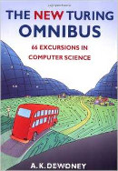
Material
Chapter 59 (see reader) presents a proof of the unsolvability of the Halting problem.
Chapter 66 (see reader) sheds more light on the Church-Turing thesis.
Deadline:
January 15, 2016

Slide 22

Recommended reading
David Harel:
Computers LTD (What they really can’t do)
Oxford University Press, 2003.

