Slide 1
2IS80 Fundamentals of Informatics
Quartile 2, 2015–2016 Lecture 15: Conclusion
Lecturer: Tom Verhoeff

Slide 2
Road Map
Historic Introduction
Core Themes:
Models of Computation : Finite Automata, Turing Machines
Algorithms: Computations for Problem Solving
Information: Communication & Storage
Limits of Computation
Forward-looking Conclusion

Slide 3
Models of Computation
Capture the fundamental nature of computation
Finite Automata
Turing Machines
Universal Turing Machine
Random Access Machine
Fundamental differences in computational power
Regular: FA
Universal: TM, UTM, RAM
Robust boundaries

Slide 4
Algorithms
Studies fundamental computational problems
Effective (reliable) solutions
Efficient (fast) solutions, and how measure that
Abstracts from engineering details of machines used for execution
Avoids details of ‘real’ programming languages

Slide 5
Information
Fundamental ‘stuff’ operated on by computations
Communication
Storage
Encoding and decoding
Fundamental limits on
Efficiency
Reliability (and trade-off with efficiency)
Security
Confidentiality
Authenticity
Integrity

Slide 6
Limits of Computation
Fundamental limits on what can be computed
In principle: decidable vs undecidable
In practice: tractable vs intractable
Robust boundaries

Slide 7
Conclusion: Looking Forward

Slide 8
What Else Is, or Will Be, There
Other computational mechanisms:
Cellular Automata
Other types of algorithms:
Randomness, Randomized Algorithms
Other physical possibilities for computation and communication:
Molecular/DNA Computing
Quantum Cryptography
Quantum Computing

Slide 9
Cellular Automaton (CA)
Linear arrangement of cells
Each cell is in one of two states: on/off, 0/1, black/white
Next state determined by its own state and that of both neighbors
For each of these 2³ = 8 possible combinations: one next state
All cells change state together, synchronously
 | x |  |  | x
 | x |  |  | x
 | x |  |  | x
 | x |  |  | x
 | x |  |  | x
 | x |  |  | x
 | x |  |  | x
 | x |  |  | x
… |  |  |  |  |  |  |  |  |  |  | …
… | 0 | 0 | 0 | 1 | 0 | 1 | 1 | 1 | 0 | 0 | …
… |  |  |  |  |  |  |  |  |  |  | …
… |  |  |  |  |  |  |  |  |  |  | …
Notes:
Compare to Finite Automaton.
Example initial state is based on De Bruijn sequence.
Example uses Rule 30 = 16 + 8 + 4 + 2.

Slide 10
CA Example: Rule 30
Notes:
60 generations of initial state of preceding slide.

Slide 11
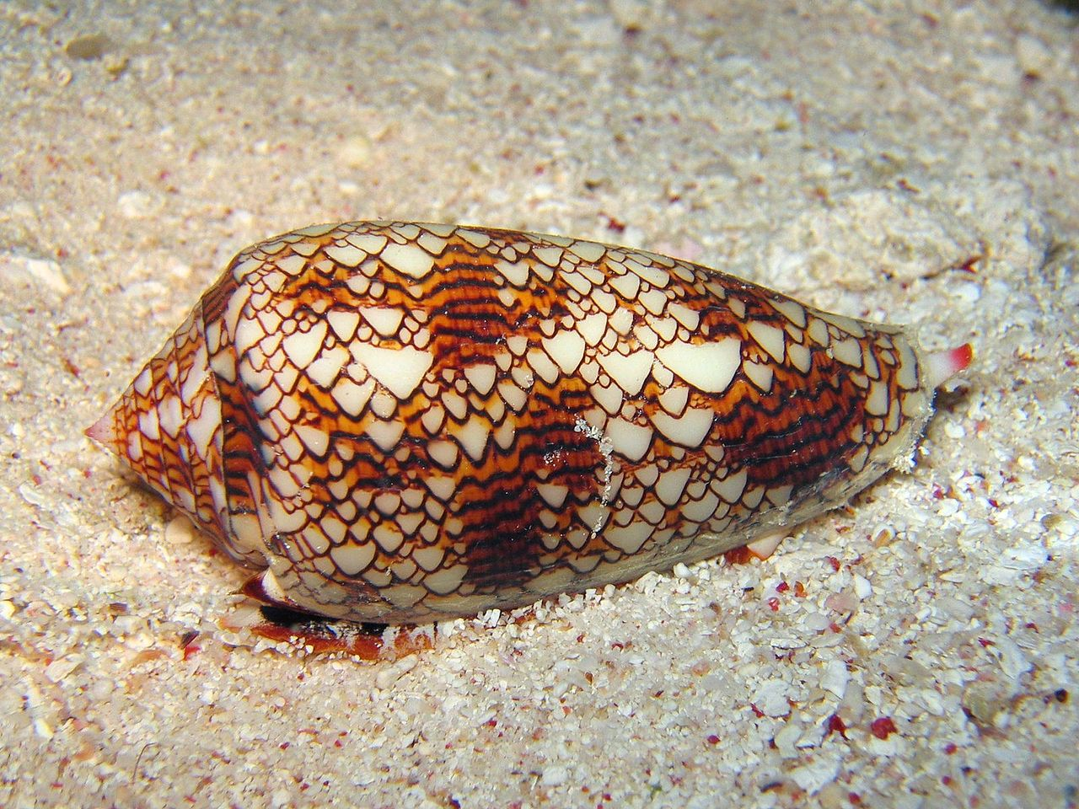
CA Analysis
Elementary CA-rule specified by 8 bits
2⁸ = 256 next state functions possible
All these 256 rules have been investigated
Classification of possible behaviors:
Stabilize: reach all-0 or all-1
Become (semi-)periodic: oscillating, or traveling pattern
Pseudo-random
Universal (”complex”, “interesting”)
Applications: physics, chemistry, biology, …
Notes:
Mathematica demo (movie on next slide).
Image from Wikipedia: Conus textile exhibits a cellular automaton pattern on its shell

Slide 12
CA Example: Rule 109
Notes:
60 generations from that same initial state.

Slide 13
All Elementary Cellular Automata
Notes:
Movie showing all rules applied to the same initial configuration, one after the other.

Slide 14
Randomness
What is true randomness?
Unpredictable: No algorithm exists to predict next symbol
Nondeterministic: Fundamentally undetermined / open
Stochastic: Following mathematical axioms of probability theory
Chaotic: Extremely sensitive to initial conditions
Incompressible: without shorter algorithmic description
Randomized algorithms
Psuedo-random number generation (PRNG)
Period
Seed for reproducibility
Cryptographically secure
Cellular Automaton, Game of Life
Also: predicting the future
Notes:
Notion of randomness could only be defined better using the notion of an algorithm.

Slide 15
Algorithmic Information Theory
Consider a specific bit sequence
Even without knowing any probabilistic basis for its generation, you might be able to describe (communicate) it in fewer bits
E.g. a sequence of one thousand 1s, or (10)⁵⁰⁰
Just send a program that generates the intended sequence
You do need to agree on a programming language
Data = program
Interpret = execute
Notes:
A decoder can be viewed a special-purpose machine that reconstructs the communicated string by ‘executing’/interpreting its input

Slide 16
Lists versus Generators (in Python)
def fiblist(n): """ Returns list of Fibonacci numbers < n."""
result = [ ]
a, b = 0, 1
while a < n:
result.append(a)
a, b = b, a + b
return result
def fibgen(n): """ Returns generator for Fibonacci numbers < n."""
a, b = 0, 1
while a < n:
yield a
a, b = b, a + b
print sum(fiblist(1000)) # first stores all numbers in a list
print sum(fibgen(1000)) # does not store the numbers

Slide 17
How to Solve (NP) Hard Problems
Sacrifice something to improve efficiency
Approximation algorithms sacrifice accuracy
Randomized algorithms sacrifice reliability
Heuristic algorithms sacrifice optimality
Notes:
In practice

Slide 18
Randomized Algorithms
Cf. Ch. 6 of Algorithmic Adventures by Juraj Hromkovic
Hardware is not 100% reliable
Sacrificing some algorithmic reliability to improve efficiency is ok
Randomized algorithms sacrifice reliability to improve efficiency
The towel stacking problem
Primality testing
derandomization
Notes:
Towel

Slide 19
Bit-String Equality Problem

Slide 20
Randomized Comm. Protocol: WITNESS
Notes:
p has approx. 26 decimal digits, 86 bits
s also

Slide 21
WITNESS: Communication Cost

Slide 22
WITNESS: Reliability Definitions

Slide 23
WITNESS: Reliability Analysis

Slide 24
Improve Reliability by Repetition

Slide 25
Nature Computes
Analog versus digital computers
Modulation and demodulation: to get into and out of physical world
It from bit (Wheeler):
Information and computation at the core of physics
Instead of matter and energy
Gerard ’t Hooft
The Cellular Automaton Interpretation of Quantum Mechanics
Peter Bentley
Digital Biology

Slide 26
DNA Computing
Cf. Ch. 8 of Algorithmic Adventures by Juraj Hromkovic
In 1994, Len Adleman (known of RSA public-key cryptography)
used synthetic DNA to solve an instance of the Hamiltonian Path Problem (an NP-complete problem)
It involves a clever encoding of the graph in DNA fragments
Nodes, directed edges, and their connectivity
These DNA fragments combine, by complementarity, to form paths of the graph
Various molecular techniques select only the relevant paths
Mobilizes massive parallelism on the molecular level
No follow up, to date: tricky; error-prone; does not scale well

Slide 27
Quantum Computing
Cf. Ch. 9 of Algorithmic Adventures by Juraj Hromkovic
Google Quantum Computing Playground
Quantum bit, also known as qubit
Qubit state is superposition of classical states: a |0⟩ + b |1⟩
a and b are complex amplitudes, with |a|² + |b|² = 1
|a|² = probability to observe 0; |b|² = probability to observe 1
System of N classical bits has N degrees of freedom
System of N qubits has 2^{N} degrees of freedom (entanglement)
One complex amplitude per classical state
N=3: a₀|000⟩ + a₁|001⟩ + a₂|010⟩ + a₃|011⟩ + … + a₇|111⟩
Entangled state of two qubits: ( |00⟩ + |11⟩ ) / √2
Quantum gate operates on full quantum state of qubit sequence
Exponential amount of work in terms of classical bits

Slide 28
Quantum Computer
Works in theory
Building blocks demonstrated in isolation, on small scale
Extremely specialized equipment
Complete prototypes still under development
Various algorithms available
Integer factorization (15 = 3 x 5)
Challenges:
Initialize entangled state of all qubits
Protect the quantum state against decoherence
Apply error-free quantum operations
Read out the final state
Notes:
Experts are convinced of the theory.

Slide 29
Quantum Cryptography
Exploits entanglement for secure communication
Eavesdropping is detectable
Commercially available

Slide 30
Fundamentals of Informatics
We hope you enjoyed the fun(damentals)

Slide 31
Summary
Cellular Automaton
Conway’s Game of Life
Golly
Randomness
History of Randomness
Randomized Algorithm
Cryptographically secure pseudo-random number generation
Digital Physics, Digital Biology
DNA Computing
Quantum Cryptography
Quantum Computer
Google Quantum Computing Playground
Juraj Hromkovic, Algorithmic Adventures, Springer 2009
Notes:
With links to Wikipedia articles.

Slide 32
Announcements
Written exam
Discussion of old exam; prepare your questions in advance

