Slide 1
Fundamentals of Informatics
Lecture 2
Finite Automata and Regular Expressions
Bas Luttik

Slide 2
What are the fundamental capabilities and limitations of computing devices?
Notes:
Derived questions:
What is a computing device?
What is computation? What does it mean to compute something?
How can we explore the capabilities and limitations without being able to experiment?
Fundamental is key.

Slide 3

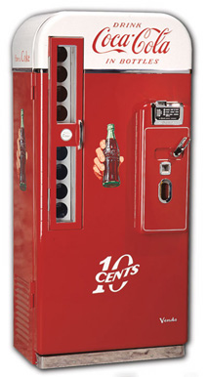
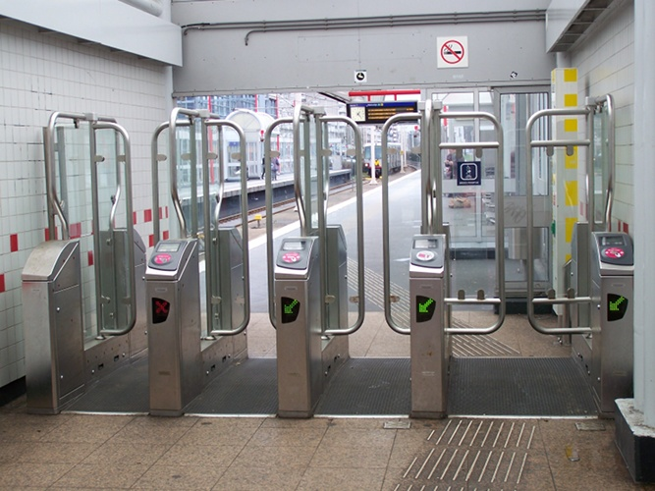
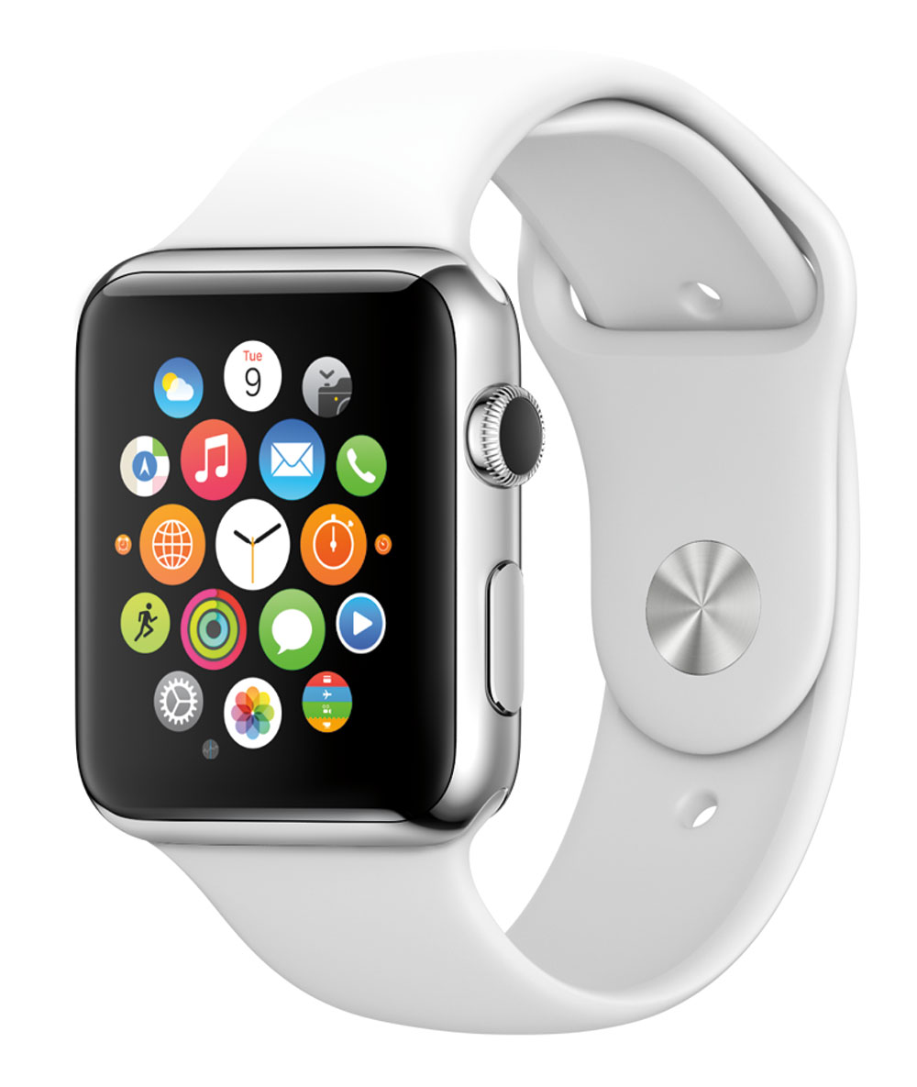
Automata
Notes:
Goal: to study automata from conceptual point of view.
Abstract from implementation details (which is not to say that these are not important).
Coming 3 lectures: study theoretical model of automaton/computer
Today: simple (not very powerful) type of automata (vending machines, turnstiles, etc.)
Friday and next week: Turing machine as the theoretical model of computer

Slide 4
The OV chip card automaton
The gate can be open or closed (i.e., it has two ‘observed’ states).
When the gate is closed and the machine detects a valid chip card, it opens.
When the gate is open and someone passes through, it closes.
pass
pass
Closed
Open
chip card
chip card
Notes:
We (only) consider the observable behaviour of the chip card automaton.
The automaton, in this representation, has a one-bit memory.

Slide 5
A simple vending machine
0
insert 5
close
insert 10
return
return
close
5
insert 5
10+
insert 10
close
return
insert 5
insert 10
Notes:
From the outside, we cannot really see the difference between the state labelled 0 and the state labelled 5.

Slide 6
Definition
A finite automaton consists of
A finite collection of states
    exactly one of these states is marked to be the initial state
    some states are marked to be accepting states
A finite alphabet of input symbols
A transition table determines a next current state for every possible combination of current state and input symb
Example:
 | a | b
q₀ | q₁ | q₀
q₁ | q₂ | q₁
q₂ | q₃ | q₂
q₃ | q₃ | q₃
states: q₀, q₁, q₂, q₃
  initial state: q₀
  accepting states: q₀, q₁, q₂
input symbols: a, b
transition table:
Notes:
Widespread use:
Hardware design
Software design
Linguistics (grammar)
Biology (neurological systems)
Business process optimisation
...

Slide 7
State-transition diagram
Example:
 | a | b
q₀ | q₁ | q₀
q₁ | q₂ | q₁
q₂ | q₃ | q₂
q₃ | q₃ | q₃
states: q₀, q₁, q₂, q₃
  initial state: q₀
  accepting states: q₀, q₁, q₂
input symbols: a, b
transition table:
Accepting states are denoted by double circles.
The initial state has a small incoming arrow
Transitions are denoted by labeled arrows
Non-accepting states are denoted by single circles.
We prefer presentation as a state-transition diagram:
a
a
a
q₀
q₁
q₂
q₃
b
b
b
a, b

Slide 8
Exploring automata
Consider Automaton 10 at
http://www.win.tue.nl/~wstomv/edu/2is80/explore-automata/.
Can we reconstruct it by exploration?
If we, in addition, know that the automaton has 4 states, then we can completely reconstruct it:
a
a
q₀
q₁
a
b
a
b
q₂
q₃
b
b
Notes:
Without extra knowledge, we could never reconstruct the automaton simply by exploring it.
But if we know that it only has four states, then complete exploration can be done with the following sequences:
ε-
a+
b-
bb+
bba-
aa-
bbab-
bbb+
ab-
abb+
aab-
ba-
bab-

Slide 9
Definition
A finite automaton consists of
A finite collection of states
    exactly one of these states is marked to be the initial state
    some states are marked to be accepting states
A finite alphabet of input symbols
A transition table determines a next current state for every possible combination of current state and input symb
Example:
 | a | b
q₀ | q₁ | q₂
q₁ | q₁ | q₂
q₂ | q₀ | q₃
q₃ | q₀ | q₃
states: q₀, q₁, q₂, q₃
  initial state: q₀
  accepting states: q₁, q₃
input symbols: a, b
transition table:

Slide 10
Definition
A finite automaton consists of
A finite collection of states
    exactly one of these states is marked to be the initial state
    some states are marked to be accepting states
A finite alphabet of input symbols
A transition table determines a next current state for every possible combination of current state and input symb
Note: finite automata (as defined above) are deterministic:
every state has exactly one outgoing transition per input symbol!
transition tables may not have empty entries.

Slide 11
A simple vending machine
0
insert 5
close
insert 10
return
return
close
5
10+
Examples of ‘open door’ sequences:
insert 5, insert 5
insert 10
insert 10, close insert 10
insert 5, insert 10, close, insert 5, insert 5
…
insert 5
insert 10
close
return
insert 5
insert 10

Slide 12
Language accepted by an automaton
To determine whether a finite automaton accepts a sequence of input symbols:
Let the initial state be the current state.
Repeat: take the left-most symbol from the sequence, and look up in the transition table what should be the new current state after processing the symbol.
When there are no symbols left in the sequence, check if the current state is an accepting state. If so, then the automaton accepts the sequence; otherwise, it does not.
The language of an automaton is the set of all sequences of input symbols it accepts.

Slide 13
Example
a
a
a
q₀
q₁
q₂
q₃
b
b
b
a, b
a
a
b
b
The string
is:
accepted!
Notes:
Accepted language consists of all strings with less than three a’s.

Slide 14
Example
a
a
a
q₀
q₁
q₂
q₃
b
b
b
a, b
a
a
b
a
The string
is:
not accepted!
Notes:
Accepted language consists of all strings with less than three a’s.

Slide 15
Example
a
a
a
q₀
q₁
q₂
q₃
b
b
b
a, b
Accepted sequences:
aabb
ε (the empty sequence)
bbbbb
aabbbbb
…
Non-accepted sequences:
aaba
aaab
aaababababa
bababa
…
What is the language accepted by this automaton?
Notes:
Accepted language consists of all strings with less than three a’s.

Slide 16
Designing Finite Automata
Example 1
Design a finite automaton (with input symbols a and b) that accepts the language consisting all sequences with at least two a’s.
a
a
b
b
a, b

Slide 17
Designing Finite Automata
Example 2
Design a finite automaton (with input symbols a and b) that accepts the language consisting all sequences with an even number of b’s.
b
b
a
a

Slide 18
Designing Finite Automata
Example 3
Design a finite automaton (with input symbols a and b) that accepts the language consisting all sequences with at least two a’s and an even number of b’s.
a
a
even number of b’s
a
b
b
b
b
b
b
a
a
a
two a’s detected

Slide 19
Designing Finite Automata
Exercise
Design a finite automaton (with input symbols a and b) that accepts the language consisting all sequences with the pattern aa and an even number of b’s.
a
a
even number of b’s
a
b
b
b
b
b
b
a
a
a
subsequence aa detected

Slide 20
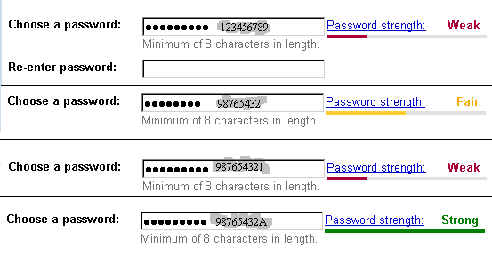
Application: password policy
A strong password
has length greater than or equal to 8
contains one or more uppercase characters
contains one or more lowercase characters
contains one or more numeric values
contains one or more special characters
The above describes the language of strong passwords.
Given the rules above it is straightforward to construct a finite automaton accepting exactly all strong passwords (and no weak passwords).

Slide 21
Regular expressions
A regular expression is an expression that can be obtained by a number of applications of the following rules:
input symbols a, b, c, 0, 1, … are regular expressions;
if r₁ and r₂ are regular expressions, then so is their concatenation r₁r₂ and their sum r₁+r₂; and
if r is a regular expression, then so is its iteration r*.
Examples:
a* consists of the sequences ε, a, aa, aaa, aaaa, …
(a+b)*(aaa)(a+b)* consists of all sequences with the pattern aaa
a*(ba*ba*)* consists of all sequences with an even number of b’s

Slide 22
Example regular expressions
Exercise (non-trivial!):
Give a regular expression for the language consisting all sequences over a, b, with an even number of b’s that contain the pattern aa.
Notes:
a*(ba*ba*)*(aa)a*(ba*ba*)* + a*ba*(ba*ba*)*(aa)a*ba*(ba*ba*)*

Slide 23
Applications
E-mail addresses: [a-z0-9._%-]⁺@[a-z0-9.-]⁺.[a-z]^{{2,4}}
    [a-z0-9._%+-] abbreviates a+…+z+0+…+9+.+%+-
    r⁺ abbreviates rr*
    r^{{2,4}} abbreviates rr+rrrr
Valid dates: (19+20)[0-9][0-9]-(0[1-9]+1[012])-(0[1-9]+[12][0-9]+3[01])
Credit card numbers:
  (4[0-9]^{{12}}([0-9]^{{3}}+ε)? # Visa
  + 5[1-5][0-9]^{{14}} # MasterCard
  + 3[47][0-9]^{{13}} # American Express
  + 3(0[0-5]+[68][0-9])[0-9]^{{11}} # Diners Club
  + 6(011+5[0-9]^{{2}})[0-9]^{{12}} # Discover
  + (2131+1800+35[0-9]^{{3}})[0-9]^{{11}} # JCB
…

Slide 24
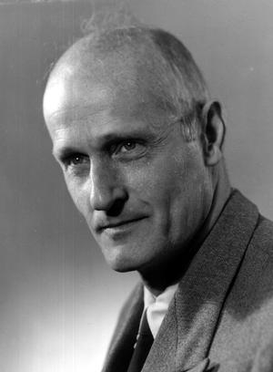
Kleene’s theorem (1956)
There is a direct correspondence between the languages described by a regular expression, and those accepted by a finite automaton:
every language described by a regular expression is accepted by some finite automaton
and, moreover,
every language accepted by a finite automaton is described by a regular expression
Stephen Kleene
(1909-1994)
Disclaimer: for this result it is necessary to add symbols ε and Ø denoting the empty language and the language containing the empty string to the language of regular expressions; we left them out for simplicity.
Notes:
In fact, there are straightforward methods for
constructing a finite automaton that accepts the language denoted by a regular expression, and
associating a regular expression with a finite automaton.
So: the validity of e-mail addresses, dates, credit card numbers can be checked with a finite automaton!

Slide 25
Regular languages
Languages accepted by a finite automaton (or, equivalently: described by a regular expression) are called regular.
Fundamental question:
Is every language regular?
Consider, e.g., the language of marked palindromes consisting of all sequences of the shape sms⁻¹ in which s is a sequence of symbols, m is a special marker symbol and s⁻¹ is the reverse of s.
There is no finite automaton that accepts the language of marked palindromes.
So, the answer to the above fundamental questions is: NO!

Slide 26
Some concluding remarks
Variations on the definition of finite automaton (e.g., Moore machines, Mealy machines, …) are particularly relevant in hardware design.
We have discussed so-called deterministic finite automata by requiring a complete transition table (for every combination of a state and an input symbol there is a next state). This requirement can be relaxed, yielding non-deterministic finite automata.
Finite state automata are useful to model devices with a very limited memory. We need automata with unbounded memory to model more sophisticated computational devices.
In the next lecture we will introduce Turing machines as a conceptual model of conventional computers.

Slide 27
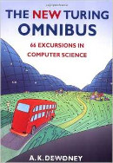
Material
Reading material:
Chapter 2: Finite Automata
(see reader, for sale in dictatenverkoop)
Practice material:
Assignment:
Assignment A1
deadline: Friday 20-11-2015
Practice set P1
(Practice set and assignment available in OASE.)

