Slide 1
Fundamentals of Informatics
Lecture 3
Turing Machines
Bas Luttik

Slide 2
Example regular expressions
Give regular expressions for the language consisting of
all sequences over a, b containing the pattern aa:
(a+b)*(aa)(a+b)*
all sequences over a, b with an even number of b’s:
a*(ba*ba*)*
all sequences over a, b with an odd number of b’s:
a*ba*(ba*ba*)*
all sequences over a, b, with an even number of b’s that contain the pattern aa:
a*(ba*ba*)*(aa)a*(ba*ba*)* + a*ba*(ba*ba*)*(aa)a*ba*(ba*ba*)*

Slide 3
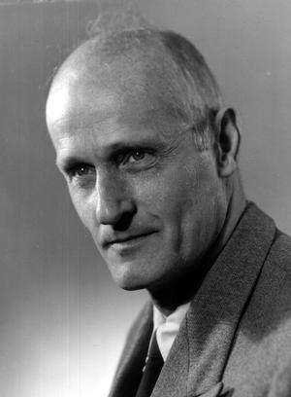
Kleene’s theorem (1956)
There is a direct correspondence between the languages described by a regular expression, and those accepted by a finite automaton:
every language described by a regular expression is accepted by some finite automaton
and, moreover,
every language accepted by a finite automaton is described by a regular expression
Stephen Kleene
(1909-1994)
Disclaimer: for this result it is necessary to add symbols ε and Ø denoting the empty language and the language containing the empty string to the language of regular expressions; we left them out for simplicity.
Notes:
In fact, there are straightforward methods for
constructing a finite automaton that accepts the language denoted by a regular expression, and
associating a regular expression with a finite automaton.
So: the validity of e-mail addresses, dates, credit card numbers can be checked with a finite automaton!

Slide 4
Regular languages
Languages accepted by a finite automaton (or, equivalently: described by a regular expression) are called regular.
Fundamental question:
Is every language regular?
Consider, e.g., the language of marked palindromes consisting of all sequences of the shape sms⁻¹ in which s is a sequence of symbols, m is a special marker symbol and s⁻¹ is the reverse of s.
There is no finite automaton that accepts the language of marked palindromes.
So, the answer to the above fundamental questions is: NO!

Slide 5
Computer (mathematical model)
Can we model a computer as a finite automaton?
Any particular computer has a finite amount of memory and therefore has finitely many states.
But there is no intrinsic bound on the number of states.
Therefore, finite automata are unsatisfactory as mathematical model if our goal is to predict which type of problems can be solved with a computer.
Let’s analyze what it means to compute!
(as Alan Turing did back in 1936)

Slide 7
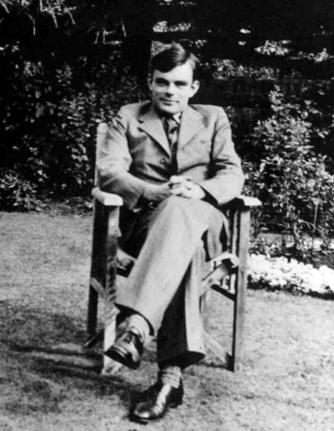
The essence of computation
A person carrying out a computation operates under the following constraints:
at each stage only a small number of symbols receive attention;
action at each stage depends on symbols receiving attention, and current state of mind of person
4231
77
x
29617
296170
+
325787
Alan Turing (1912-1954)
4
2
3
1
x
7
7
1
7
(remember 2)
=
7
4
2
3
1
x
7
7
=
2
9
6
1
7
+
2
9
6
1
7
0
=
7
4
2
3
1
x
7
7
=
2
9
6
1
7
+
2
9
6
1
7
0
=
3
2
5
7
8
7

Slide 8
Computation (down to bare minimum)
How large should the alphabet of symbols be?
finitely many
How many symbols should be observed simultaneously in a computation?
one is enough!
How many states of mind?
finitely many
Turing’s conclusion in 1936, after careful analysis:
computation is carried out by writing symbols in squares on a tape;
at each step the person performing the computation pays attention to the symbol written in exactly one of these squares;
her next action depends only on this symbol and her state of mind;
this next action consists of writing a new symbol on the square and shifting attention to square immediately to the left or right.

Slide 9
Turing machine (conceptual)
A Turing machine is an automaton consisting of:
a finite control;
a finite alphabet of tape symbols
a two-way infinite tape subdivided into squares
each square contains a symbol or is blank (in diagrams we use the symbol ◻ to denote a blank square)
a read/write head that scans the contents of one square at a time and can move left or right.

Slide 10
Turing machine (definition)
A Turing machine consists of
A finite collection of states
exactly one of these states is marked to be the initial state
some states are so-called halting states
A finite alphabet of tape symbols including a special symbol ◻
A transition table determining for every combination of a non-halting current state and scanned tape symbol:
a new tape symbol (to be written on the position of the scanned tape symbol),
a direction of movement of the tape head (L or R), and
a next current state.

Slide 11
Example
states: q, h
initial state: q
halting states: h
tape symbols: 0, 1, ◻
transition table:
current state | symbol scanned | symbol written | motion | next state
q | 0 | 1 | R | q
q | 1 | 0 | R | q
q | ◻ | ◻ | L | h
We prefer to present a Turing machine as a state-transition diagram:
Transitions in a state-transition diagram for a Turing machine are labeled with ‘triples’ consisting of
<symbol scanned> <symbol written> <motion>
0 1 R
1 0 R
◻◻L
q
h
For clarity, we may depict halting states with a double circle (but we sometimes forget!)

Slide 12
Turing machine: computation
A computation of a Turing machine starts in the initial state, with some input sequence of symbols on the tape and the tape head on the left-most symbol of the sequence (if it is non-empty).
The machine then repeatedly performs the following operation, until it enters a halting state:
on the basis of the current state and the scanned tape symbol it
looks up the corresponding row in the table,
carries out the appropriate actions (write new symbol, move the tape head), and
enters the next state.
The sequence that is found on the tape after the computation has halted is its output sequence.
We assume that the input sequence is either the empty sequence, or a non-empty sequence of non-blank symbols written consecutively on the tape.

Slide 13
Exercise
Consider the following Turing machine:
0 1 R
1 0 R
◻◻L
q
h
Determine the result of the computation of this Turing machine:
input sequence | output sequence
11
00
001
110
10101
01010
ε
ε
This Turing machine inverts binary sequences.

Slide 14
Constructing Turing machines
Example
Construct a Turing machine that multiplies a binary number by 2:
0 0 R
1 1 R
◻0 L
q
h

Slide 15
Example TM: (unary) multiplication
An L (or an R) in a state means: go left (or right) after writing the scanned symbol and stay in the same state, unless there is an outgoing arrow with the scanned symbol.
Example
The following Turing machine performs multiplication of unary numbers (e.g., on the input sequence 111x11 it yields the output sequence 111111).
◻*R
L
R
L
L
◻◻L
11L
1◻L
xxL
L
L
◻1R
x◻L
◻◻L
* * R
*◻L
xxL
L
R
R
1◻L
11R
Notes:
Animation corresponds to running the Turing machine on 11x1

Slide 16
Want to see more?
There are many Turing machine simulators available online, for instance, at
http://morphett.info/turing/turing.html

Slide 17
Computations may not terminate…
Exercise
Design a Turing machine that, when started with a non-empty sequence of 0s and 1s on the tape, has a terminating computation only if the binary input sequence on the tape represents an even number:
0 0 R
1 1 R
◻◻L
0 0 R
1 1 R
◻◻R
0 0 R
1 1 R
◻◻R

Slide 18
Turing machines as language acceptors
The language of a Turing machine is the collection of all input sequences on which it halts.

Slide 19
Exercise
q₀
◻◻R
h
a a R
a a R
a◻R
◻◻L
◻◻L
q₁
l
Question: Which language does it accept?
Answer: It accepts the language (aa)*.

Slide 20
Turing machines as language acceptors
The language of a Turing machine is the collection of all input sequences on which it halts.
It is straightforward to convert a finite automaton into a Turing machine that accepts precisely the same language:
for every input symbol a, replace every transition with label “a” of the finite automaton by a transition with label “a a R”;
add from every accepting state of the finite automaton a transition with label “◻◻R” to a new halting state;
add from every non-accepting state of the finite automaton a transition with label “◻◻R” to a new state; this new state has, moreover, transitions with labels “a a R” for every input symbol and a transition with label “◻◻R”
How about the converse? Is every language of a Turing machine accepted by some finite automaton?

Slide 21
Marked palindromes
Exercise
Design a Turing machine that accepts the language of marked palindromes (sms⁻¹ with s a sequence of 0s and 1s, and s⁻¹ its reverse).
0◻L
◻◻L
R
1 1 R
0◻R
0 0 R
m m R
1 1 R
◻◻R
m m R
L
◻◻R
m m R
◻◻L
R
◻◻R
0 0 R
1◻R
m m R
◻◻R
R
◻◻L
1◻L
Notes:
Animation corresponds to running the Turing machine on 001m100.

Slide 22
Marked palindromes
Exercise
Design a Turing machine that accepts the language of marked palindromes (sms⁻¹ with s a sequence of 0s and 1s, and s⁻¹ its reverse).
0◻L
◻◻L
R
1 1 R
0◻R
0 0 R
m m R
1 1 R
◻◻R
m m R
L
◻◻R
m m R
◻◻L
R
◻◻R
0 0 R
1◻R
m m R
◻◻R
R
◻◻L
1◻L
Notes:
Animation corresponds to running the Turing machine on 001m100.

Slide 23
Robustness (example 1)
We could modify the definition of Turing machines by adding a third type of motion for the tape head:
S for stay at the current position
Question:
Are Turing machines with an additional S motion for the tape head more powerful than Turing machines with only the motions L and R?
Answer:
No. We can always transform a Turing machine with S motions to one without S motions, by replacing
We mean to express that there is a transition for every symbol in the alphabet of the Turing machine that writes the same symbol back and causes the tape head to move left.
x y S
by
x y R
? ? L
The resulting Turing machine computes/accepts the same.

Slide 24
Robustness (example 2)
We could (further) modify the definition of Turing machines by having two (or more) tapes.
An entry in the transition table would then look like:
current state | symbol scanned (tape 1) | symbol written (tape 1) | motion (tape 1) | symbol scanned (tape 2) | symbol written (tape 2) | motion (tape 2) | next state
… | … | … | … | … | … | … | …
q₀ | a | c | L | ◻ | d | L | q₁
… | … | … | … | … | … | … | …
Question:
Are Turing machines with two tapes more powerful than Turing machines with one tape?
Answer:
No. We can always transform a Turing machine with two tapes to one with one tape computing/accepting the same (see Ch.31 of NTO).

Slide 25
Robustness
Turing machines do not get fundamentally more (or less) powerful if we:
allow multiple tapes
allow multi-dimensional tapes
allow tapes that are bounded on one side
allow non-determinism
restrict the alphabet of tape symbols
Moreover, every other (realistic) mathematical model of computation conceived so far can be ‘simulated’ with a Turing machine, and hence is not more powerful.

Slide 26
Turing power
As language acceptors Turing machines are (far) more powerful than finite automata (e.g., there exists a Turing machine that accepts the language of marked palindromes, for which there is no finite automaton)
As computational devices, Turing machines have clearly delineated the fundamental limits of computation:
everything that can be computed (now and in the future), can be computed by some Turing machine
Disclaimer: This is not to say that a Turing machine can do everything a computer can do. For instance, computers can interact with their environment, which (conventional) Turing machines can’t.

Slide 27
Material
Reading material for this lecture:
Chapter 31: Turing Machines (see reader)
(Slides and practice material can be found in OASE.)
Deviations from text in reader:
Chapter 31 specifies a Turing machine as a collection of quintuples, instead of with a transition table; the difference is only cosmetic.
Chapter 31 uses the symbol b for blank; we prefer ◻.
Chapter 31 mentions, besides L and R, also an S-motion for the tape head. It is not needed (as we have seen), we shall not use it, and therefore we left it out from our definition.

