Slide 1
Fundamentals of Informatics
Lecture 4
From Turing Machines to Algorithms
Bas Luttik

Slide 2
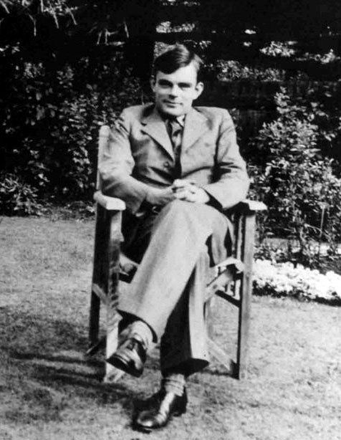
Turing machine (conceptual)
A Turing machine is an automaton consisting of:
a finite control;
a finite alphabet of tape symbols
a two-way infinite tape subdivided into squares
each square contains a symbol or is blank (in diagrams we use a special symbol b to denote a blank square)
a read/write head that scans the contents of one square at a time and can move left or right.

Slide 3
Turing machine (definition)
A Turing machine consists of
A finite collection of states
exactly one of these states is marked to be the initial state
some states are so-called halting states
A finite alphabet of tape symbols including a special symbol ◻
A transition table determining for every combination of a non-halting current state and scanned tape symbol:
a new tape symbol (to be written on the position of the scanned tape symbol),
a direction of movement of the tape head (L or R), and
a next current state.

Slide 4
Turing machine: computation/language
A computation of a Turing machine starts in the initial state with some input sequence of symbols on the tape and the tape head on the left-most symbol of the sequence (if it is non-empty).
The machine then repeats until it enters a halting state:
look up row in transition table for current state and scanned tape symbol,
carry out the described actions (write new symbol, move the tape head), and
enter next state.
The sequence that is found on the tape after the computation has halted is its output sequence.
The language accepted by a Turing machine is the collection of all input sequences on which it halts.

Slide 5
Example
1. states: q₀, q_{1,} h, l
initial state: q₀
halting states: h
2. tape symbols: a, ◻
3. transition table:
current state | symbol scanned | symbol written | motion | next state
q₀ | a | a | R | q₁
q₀ | ◻ | ◻ | R | h
q₁ | a | a | R | q₀
q₁ | ◻ | ◻ | L | l
l | a | ◻ | L | l
l | ◻ | ◻ | L | l
q₀
◻◻R
h
a a R
a a R
a◻R
◻◻L
◻◻L
q₁
l
Question: Which language does it accept?
Answer: It accepts the language (aa)*.

Slide 6
Robustness 1.1
We could modify the definition of Turing machines by adding a third type of motion for the tape head:
S for stay at the current position
Question:
Are Turing machines with an additional S motion for the tape head more powerful than Turing machines with only the motions L and R?
Answer:
No. We can always transform a Turing machine with S motions to one without S motions, by replacing
x y S
by
x y R
? ? L
The resulting Turing machine computes/accepts the same.

Slide 7
Robustness 1.2
We could (further) modify the definition of Turing machines by having two (or more) tapes.
An entry in the transition table would then look like:
current state | symbol scanned (tape 1) | symbol scanned (tape 2) | next state | symbol written (tape 1) | symbol written (tape 2) | motion (tape 1) | motion (tape 2)
… | … | … | … | … | … | … | …
q₀ | a | b | q₁ | c | d | S | L
… | … | … | … | … | … | … | …
Question:
Are Turing machines with two tapes more powerful than Turing machines with one tape?
Answer:
No. We can always transform a Turing machine with two tapes to one with one tape computing/accepting the same (see Ch.31 of NTO).

Slide 8
Random Access Machines (conceptual)
Instr | Meaning
LDA a | Load AC with contents at a
LDI a | Load AC with contents at address stored at a
STA a | Store contents of AC at a
STI a | Store contents of AC at address stored at a
ADD a | Add contents at a to contents of AC
SUB a | Subtract contents at a from AC
JMP l | Jump to instruction labeled l
JMZ l | Jump to instruction labeled l if AC has contents 0
HLT | halt

Slide 9
Detecting duplicates
Consider a sequence of numbers (in the range 1..255)
a₁,a₂,…,a_{n}
Can you think of a recipe to detect whether the sequence has duplicates?
Duplicates
Initialize a table with 255 rows with a 0 on every row
Go through the sequence and for each a_{i} do
if the a_{i}th row in the table is not 0, then
output a_{i} and stop
else
write a 1 at the a_{i}th row in the table

Slide 10
Detecting duplicates with a RAM
Duplicates
LDI 3 (get ith number)
ADD 4 (add appropriate offset to row)
STA 5 (store row)
LDI 5 (get number stored at row)
JMZ 9 (if 0, then go to 9)
LDA 3 (if 1, then get index i)
STA 2 (and store it at the answer address)
HLT (stop execution)
LDA 1 (get the number (stored at) 1)
STI 5 (store it at the appropriate row)
LDA 3 (get index i)
SUB 4 (subtract max index stored at 4)
JMZ 8 (if i is max index, then stop)
LDA 3 (get index i again)
ADD 1 (add the number stored at 1)
STA 3 (store new value of i at 3)
JMP 1 (go back to the first instruction)

Slide 11
Detecting duplicates with a RAM
Duplicates
LDI 3 (get ith number)
ADD 4 (add appropriate offset to row)
STA 5 (store row)
LDI 5 (get number stored at row)
JMZ 9 (if 0, then go to 9)
LDA 3 (if 1, then get index i)
STA 2 (and store it at the answer address)
HLT (stop execution)
LDA 1 (get the number (stored at) 1)
STI 5 (store it at the appropriate row)
LDA 3 (get index i)
SUB 4 (subtract max index stored at 4)
JMZ 8 (if i is max index, then stop)
LDA 3 (get index i again)
ADD 1 (add the number stored at 1)
STA 3 (store new value of i at 3)
JMP 1 (go back to the first instruction)
AC
1 | 1 | constant
2 | 0 | answer
3 | 6 | index i
4 | 9 | max index
5 | 0 | row
6 | 3 | a₁
7 | 2 | a₂
8 | 2 | a₃
9 | 4 | a₄
10 | 0 | TABLE
11 | 0
12 | 0
13 | 0
14 | 0
 | :

Slide 12
Detecting duplicates with a RAM
Duplicates
LDI 3 (get ith number)
ADD 4 (add appropriate offset to row)
STA 5 (store row)
LDI 5 (get number stored at row)
JMZ 9 (if 0, then go to 9)
LDA 3 (if 1, then get index i)
STA 2 (and store it at the answer address)
HLT (stop execution)
LDA 1 (get the number (stored at) 1)
STI 5 (store it at the appropriate row)
LDA 3 (get index i)
SUB 4 (subtract max index stored at 4)
JMZ 8 (if i is max index, then stop)
LDA 3 (get index i again)
ADD 1 (add the number stored at 1)
STA 3 (store new value of i at 3)
JMP 1 (go back to the first instruction)
AC | 3
1 | 1 | constant
2 | 0 | answer
3 | 6 | index i
4 | 9 | max index
5 | 0 | row
6 | 3 | a₁
7 | 2 | a₂
8 | 2 | a₃
9 | 4 | a₄
10 | 0 | TABLE
11 | 0
12 | 0
13 | 0
14 | 0
 | :

Slide 13
Detecting duplicates with a RAM
Duplicates
LDI 3 (get ith number)
ADD 4 (add appropriate offset to row)
STA 5 (store row)
LDI 5 (get number stored at row)
JMZ 9 (if 0, then go to 9)
LDA 3 (if 1, then get index i)
STA 2 (and store it at the answer address)
HLT (stop execution)
LDA 1 (get the number (stored at) 1)
STI 5 (store it at the appropriate row)
LDA 3 (get index i)
SUB 4 (subtract max index stored at 4)
JMZ 8 (if i is max index, then stop)
LDA 3 (get index i again)
ADD 1 (add the number stored at 1)
STA 3 (store new value of i at 3)
JMP 1 (go back to the first instruction)
AC | 12
1 | 1 | constant
2 | 0 | answer
3 | 6 | index i
4 | 9 | max index
5 | 0 | row
6 | 3 | a₁
7 | 2 | a₂
8 | 2 | a₃
9 | 4 | a₄
10 | 0 | TABLE
11 | 0
12 | 0
13 | 0
14 | 0
 | :

Slide 14
Detecting duplicates with a RAM
Duplicates
LDI 3 (get ith number)
ADD 4 (add appropriate offset to row)
STA 5 (store row)
LDI 5 (get number stored at row)
JMZ 9 (if 0, then go to 9)
LDA 3 (if 1, then get index i)
STA 2 (and store it at the answer address)
HLT (stop execution)
LDA 1 (get the number (stored at) 1)
STI 5 (store it at the appropriate row)
LDA 3 (get index i)
SUB 4 (subtract max index stored at 4)
JMZ 8 (if i is max index, then stop)
LDA 3 (get index i again)
ADD 1 (add the number stored at 1)
STA 3 (store new value of i at 3)
JMP 1 (go back to the first instruction)
AC | 12
1 | 1 | constant
2 | 0 | answer
3 | 6 | index i
4 | 9 | max index
5 | 12 | row
6 | 3 | a₁
7 | 2 | a₂
8 | 2 | a₃
9 | 4 | a₄
10 | 0 | TABLE
11 | 0
12 | 0
13 | 0
14 | 0
 | :

Slide 15
Detecting duplicates with a RAM
Duplicates
LDI 3 (get ith number)
ADD 4 (add appropriate offset to row)
STA 5 (store row)
LDI 5 (get number stored at row)
JMZ 9 (if 0, then go to 9)
LDA 3 (if 1, then get index i)
STA 2 (and store it at the answer address)
HLT (stop execution)
LDA 1 (get the number (stored at) 1)
STI 5 (store it at the appropriate row)
LDA 3 (get index i)
SUB 4 (subtract max index stored at 4)
JMZ 8 (if i is max index, then stop)
LDA 3 (get index i again)
ADD 1 (add the number stored at 1)
STA 3 (store new value of i at 3)
JMP 1 (go back to the first instruction)
AC | 0
1 | 1 | constant
2 | 0 | answer
3 | 6 | index i
4 | 9 | max index
5 | 12 | row
6 | 3 | a₁
7 | 2 | a₂
8 | 2 | a₃
9 | 4 | a₄
10 | 0 | TABLE
11 | 0
12 | 0
13 | 0
14 | 0
 | :

Slide 16
Detecting duplicates with a RAM
Duplicates
LDI 3 (get ith number)
ADD 4 (add appropriate offset to row)
STA 5 (store row)
LDI 5 (get number stored at row)
JMZ 9 (if 0, then go to 9)
LDA 3 (if 1, then get index i)
STA 2 (and store it at the answer address)
HLT (stop execution)
LDA 1 (get the number (stored at) 1)
STI 5 (store it at the appropriate row)
LDA 3 (get index i)
SUB 4 (subtract max index stored at 4)
JMZ 8 (if i is max index, then stop)
LDA 3 (get index i again)
ADD 1 (add the number stored at 1)
STA 3 (store new value of i at 3)
JMP 1 (go back to the first instruction)
AC | 0
1 | 1 | constant
2 | 0 | answer
3 | 6 | index i
4 | 9 | max index
5 | 12 | row
6 | 3 | a₁
7 | 2 | a₂
8 | 2 | a₃
9 | 4 | a₄
10 | 0 | TABLE
11 | 0
12 | 0
13 | 0
14 | 0
 | :

Slide 17
Detecting duplicates with a RAM
Duplicates
LDI 3 (get ith number)
ADD 4 (add appropriate offset to row)
STA 5 (store row)
LDI 5 (get number stored at row)
JMZ 9 (if 0, then go to 9)
LDA 3 (if 1, then get index i)
STA 2 (and store it at the answer address)
HLT (stop execution)
LDA 1 (get the number (stored at) 1)
STI 5 (store it at the appropriate row)
LDA 3 (get index i)
SUB 4 (subtract max index stored at 4)
JMZ 8 (if i is max index, then stop)
LDA 3 (get index i again)
ADD 1 (add the number stored at 1)
STA 3 (store new value of i at 3)
JMP 1 (go back to the first instruction)
AC | 1
1 | 1 | constant
2 | 0 | answer
3 | 6 | index i
4 | 9 | max index
5 | 12 | row
6 | 3 | a₁
7 | 2 | a₂
8 | 2 | a₃
9 | 4 | a₄
10 | 0 | TABLE
11 | 0
12 | 0
13 | 0
14 | 0
 | :

Slide 18
Detecting duplicates with a RAM
Duplicates
LDI 3 (get ith number)
ADD 4 (add appropriate offset to row)
STA 5 (store row)
LDI 5 (get number stored at row)
JMZ 9 (if 0, then go to 9)
LDA 3 (if 1, then get index i)
STA 2 (and store it at the answer address)
HLT (stop execution)
LDA 1 (get the number (stored at) 1)
STI 5 (store it at the appropriate row)
LDA 3 (get index i)
SUB 4 (subtract max index stored at 4)
JMZ 8 (if i is max index, then stop)
LDA 3 (get index i again)
ADD 1 (add the number stored at 1)
STA 3 (store new value of i at 3)
JMP 1 (go back to the first instruction)
AC | 1
1 | 1 | constant
2 | 0 | answer
3 | 6 | index i
4 | 9 | max index
5 | 12 | row
6 | 3 | a₁
7 | 2 | a₂
8 | 2 | a₃
9 | 4 | a₄
10 | 0 | TABLE
11 | 0
12 | 1
13 | 0
14 | 0
 | :

Slide 19
Detecting duplicates with a RAM
Duplicates
LDI 3 (get ith number)
ADD 4 (add appropriate offset to row)
STA 5 (store row)
LDI 5 (get number stored at row)
JMZ 9 (if 0, then go to 9)
LDA 3 (if 1, then get index i)
STA 2 (and store it at the answer address)
HLT (stop execution)
LDA 1 (get the number (stored at) 1)
STI 5 (store it at the appropriate row)
LDA 3 (get index i)
SUB 4 (subtract max index stored at 4)
JMZ 8 (if i is max index, then stop)
LDA 3 (get index i again)
ADD 1 (add the number stored at 1)
STA 3 (store new value of i at 3)
JMP 1 (go back to the first instruction)
AC | 6
1 | 1 | constant
2 | 0 | answer
3 | 6 | index i
4 | 9 | max index
5 | 12 | row
6 | 3 | a₁
7 | 2 | a₂
8 | 2 | a₃
9 | 4 | a₄
10 | 0 | TABLE
11 | 0
12 | 1
13 | 0
14 | 0
 | :

Slide 20
Detecting duplicates with a RAM
Duplicates
LDI 3 (get ith number)
ADD 4 (add appropriate offset to row)
STA 5 (store row)
LDI 5 (get number stored at row)
JMZ 9 (if 0, then go to 9)
LDA 3 (if 1, then get index i)
STA 2 (and store it at the answer address)
HLT (stop execution)
LDA 1 (get the number (stored at) 1)
STI 5 (store it at the appropriate row)
LDA 3 (get index i)
SUB 4 (subtract max index stored at 4)
JMZ 8 (if i is max index, then stop)
LDA 3 (get index i again)
ADD 1 (add the number stored at 1)
STA 3 (store new value of i at 3)
JMP 1 (go back to the first instruction)
AC | -3
1 | 1 | constant
2 | 0 | answer
3 | 6 | index i
4 | 9 | max index
5 | 12 | row
6 | 3 | a₁
7 | 2 | a₂
8 | 2 | a₃
9 | 4 | a₄
10 | 0 | TABLE
11 | 0
12 | 1
13 | 0
14 | 0
 | :

Slide 21
Detecting duplicates with a RAM
Duplicates
LDI 3 (get ith number)
ADD 4 (add appropriate offset to row)
STA 5 (store row)
LDI 5 (get number stored at row)
JMZ 9 (if 0, then go to 9)
LDA 3 (if 1, then get index i)
STA 2 (and store it at the answer address)
HLT (stop execution)
LDA 1 (get the number (stored at) 1)
STI 5 (store it at the appropriate row)
LDA 3 (get index i)
SUB 4 (subtract max index stored at 4)
JMZ 8 (if i is max index, then stop)
LDA 3 (get index i again)
ADD 1 (add the number stored at 1)
STA 3 (store new value of i at 3)
JMP 1 (go back to the first instruction)
AC | -3
1 | 1 | constant
2 | 0 | answer
3 | 6 | index i
4 | 9 | max index
5 | 12 | row
6 | 3 | a₁
7 | 2 | a₂
8 | 2 | a₃
9 | 4 | a₄
10 | 0 | TABLE
11 | 0
12 | 1
13 | 0
14 | 0
 | :

Slide 22
Detecting duplicates with a RAM
Duplicates
LDI 3 (get ith number)
ADD 4 (add appropriate offset to row)
STA 5 (store row)
LDI 5 (get number stored at row)
JMZ 9 (if 0, then go to 9)
LDA 3 (if 1, then get index i)
STA 2 (and store it at the answer address)
HLT (stop execution)
LDA 1 (get the number (stored at) 1)
STI 5 (store it at the appropriate row)
LDA 3 (get index i)
SUB 4 (subtract max index stored at 4)
JMZ 8 (if i is max index, then stop)
LDA 3 (get index i again)
ADD 1 (add the number stored at 1)
STA 3 (store new value of i at 3)
JMP 1 (go back to the first instruction)
AC | 6
1 | 1 | constant
2 | 0 | answer
3 | 6 | index i
4 | 9 | max index
5 | 12 | row
6 | 3 | a₁
7 | 2 | a₂
8 | 2 | a₃
9 | 4 | a₄
10 | 0 | TABLE
11 | 0
12 | 1
13 | 0
14 | 0
 | :

Slide 23
Detecting duplicates with a RAM
Duplicates
LDI 3 (get ith number)
ADD 4 (add appropriate offset to row)
STA 5 (store row)
LDI 5 (get number stored at row)
JMZ 9 (if 0, then go to 9)
LDA 3 (if 1, then get index i)
STA 2 (and store it at the answer address)
HLT (stop execution)
LDA 1 (get the number (stored at) 1)
STI 5 (store it at the appropriate row)
LDA 3 (get index i)
SUB 4 (subtract max index stored at 4)
JMZ 8 (if i is max index, then stop)
LDA 3 (get index i again)
ADD 1 (add the number stored at 1)
STA 3 (store new value of i at 3)
JMP 1 (go back to the first instruction)
AC | 7
1 | 1 | constant
2 | 0 | answer
3 | 6 | index i
4 | 9 | max index
5 | 12 | row
6 | 3 | a₁
7 | 2 | a₂
8 | 2 | a₃
9 | 4 | a₄
10 | 0 | TABLE
11 | 0
12 | 1
13 | 0
14 | 0
 | :

Slide 24
Detecting duplicates with a RAM
Duplicates
LDI 3 (get ith number)
ADD 4 (add appropriate offset to row)
STA 5 (store row)
LDI 5 (get number stored at row)
JMZ 9 (if 0, then go to 9)
LDA 3 (if 1, then get index i)
STA 2 (and store it at the answer address)
HLT (stop execution)
LDA 1 (get the number (stored at) 1)
STI 5 (store it at the appropriate row)
LDA 3 (get index i)
SUB 4 (subtract max index stored at 4)
JMZ 8 (if i is max index, then stop)
LDA 3 (get index i again)
ADD 1 (add the number stored at 1)
STA 3 (store new value of i at 3)
JMP 1 (go back to the first instruction)
AC | 7
1 | 1 | constant
2 | 0 | answer
3 | 7 | index i
4 | 9 | max index
5 | 12 | row
6 | 3 | a₁
7 | 2 | a₂
8 | 2 | a₃
9 | 4 | a₄
10 | 0 | TABLE
11 | 0
12 | 1
13 | 0
14 | 0
 | :

Slide 25
Detecting duplicates with a RAM
Duplicates
LDI 3 (get ith number)
ADD 4 (add appropriate offset to row)
STA 5 (store row)
LDI 5 (get number stored at row)
JMZ 9 (if 0, then go to 9)
LDA 3 (if 1, then get index i)
STA 2 (and store it at the answer address)
HLT (stop execution)
LDA 1 (get the number (stored at) 1)
STI 5 (store it at the appropriate row)
LDA 3 (get index i)
SUB 4 (subtract max index stored at 4)
JMZ 8 (if i is max index, then stop)
LDA 3 (get index i again)
ADD 1 (add the number stored at 1)
STA 3 (store new value of i at 3)
JMP 1 (go back to the first instruction)
AC | 7
1 | 1 | constant
2 | 0 | answer
3 | 7 | index i
4 | 9 | max index
5 | 12 | row
6 | 3 | a₁
7 | 2 | a₂
8 | 2 | a₃
9 | 4 | a₄
10 | 0 | TABLE
11 | 0
12 | 1
13 | 0
14 | 0
 | :

Slide 26
Detecting duplicates with a RAM
Duplicates
LDI 3 (get ith number)
ADD 4 (add appropriate offset to row)
STA 5 (store row)
LDI 5 (get number stored at row)
JMZ 9 (if 0, then go to 9)
LDA 3 (if 1, then get index i)
STA 2 (and store it at the answer address)
HLT (stop execution)
LDA 1 (get the number (stored at) 1)
STI 5 (store it at the appropriate row)
LDA 3 (get index i)
SUB 4 (subtract max index stored at 4)
JMZ 8 (if i is max index, then stop)
LDA 3 (get index i again)
ADD 1 (add the number stored at 1)
STA 3 (store new value of i at 3)
JMP 1 (go back to the first instruction)
AC | 2
1 | 1 | constant
2 | 0 | answer
3 | 7 | index i
4 | 9 | max index
5 | 12 | row
6 | 3 | a₁
7 | 2 | a₂
8 | 2 | a₃
9 | 4 | a₄
10 | 0 | TABLE
11 | 0
12 | 1
13 | 0
14 | 0
 | :

Slide 27
Detecting duplicates with a RAM
Duplicates
LDI 3 (get ith number)
ADD 4 (add appropriate offset to row)
STA 5 (store row)
LDI 5 (get number stored at row)
JMZ 9 (if 0, then go to 9)
LDA 3 (if 1, then get index i)
STA 2 (and store it at the answer address)
HLT (stop execution)
LDA 1 (get the number (stored at) 1)
STI 5 (store it at the appropriate row)
LDA 3 (get index i)
SUB 4 (subtract max index stored at 4)
JMZ 8 (if i is max index, then stop)
LDA 3 (get index i again)
ADD 1 (add the number stored at 1)
STA 3 (store new value of i at 3)
JMP 1 (go back to the first instruction)
AC | 11
1 | 1 | constant
2 | 0 | answer
3 | 7 | index i
4 | 9 | max index
5 | 12 | row
6 | 3 | a₁
7 | 2 | a₂
8 | 2 | a₃
9 | 4 | a₄
10 | 0 | TABLE
11 | 0
12 | 1
13 | 0
14 | 0
 | :

Slide 28
Detecting duplicates with a RAM
Duplicates
LDI 3 (get ith number)
ADD 4 (add appropriate offset to row)
STA 5 (store row)
LDI 5 (get number stored at row)
JMZ 9 (if 0, then go to 9)
LDA 3 (if 1, then get index i)
STA 2 (and store it at the answer address)
HLT (stop execution)
LDA 1 (get the number (stored at) 1)
STI 5 (store it at the appropriate row)
LDA 3 (get index i)
SUB 4 (subtract max index stored at 4)
JMZ 8 (if i is max index, then stop)
LDA 3 (get index i again)
ADD 1 (add the number stored at 1)
STA 3 (store new value of i at 3)
JMP 1 (go back to the first instruction)
AC | 11
1 | 1 | constant
2 | 0 | answer
3 | 7 | index i
4 | 9 | max index
5 | 11 | row
6 | 3 | a₁
7 | 2 | a₂
8 | 2 | a₃
9 | 4 | a₄
10 | 0 | TABLE
11 | 0
12 | 1
13 | 0
14 | 0
 | :

Slide 29
Detecting duplicates with a RAM
Duplicates
LDI 3 (get ith number)
ADD 4 (add appropriate offset to row)
STA 5 (store row)
LDI 5 (get number stored at row)
JMZ 9 (if 0, then go to 9)
LDA 3 (if 1, then get index i)
STA 2 (and store it at the answer address)
HLT (stop execution)
LDA 1 (get the number (stored at) 1)
STI 5 (store it at the appropriate row)
LDA 3 (get index i)
SUB 4 (subtract max index stored at 4)
JMZ 8 (if i is max index, then stop)
LDA 3 (get index i again)
ADD 1 (add the number stored at 1)
STA 3 (store new value of i at 3)
JMP 1 (go back to the first instruction)
AC | 0
1 | 1 | constant
2 | 0 | answer
3 | 7 | index i
4 | 9 | max index
5 | 11 | row
6 | 3 | a₁
7 | 2 | a₂
8 | 2 | a₃
9 | 4 | a₄
10 | 0 | TABLE
11 | 0
12 | 1
13 | 0
14 | 0
 | :

Slide 30
Detecting duplicates with a RAM
Duplicates
LDI 3 (get ith number)
ADD 4 (add appropriate offset to row)
STA 5 (store row)
LDI 5 (get number stored at row)
JMZ 9 (if 0, then go to 9)
LDA 3 (if 1, then get index i)
STA 2 (and store it at the answer address)
HLT (stop execution)
LDA 1 (get the number (stored at) 1)
STI 5 (store it at the appropriate row)
LDA 3 (get index i)
SUB 4 (subtract max index stored at 4)
JMZ 8 (if i is max index, then stop)
LDA 3 (get index i again)
ADD 1 (add the number stored at 1)
STA 3 (store new value of i at 3)
JMP 1 (go back to the first instruction)
AC | 0
1 | 1 | constant
2 | 0 | answer
3 | 7 | index i
4 | 9 | max index
5 | 11 | row
6 | 3 | a₁
7 | 2 | a₂
8 | 2 | a₃
9 | 4 | a₄
10 | 0 | TABLE
11 | 0
12 | 1
13 | 0
14 | 0
 | :

Slide 31
Detecting duplicates with a RAM
Duplicates
LDI 3 (get ith number)
ADD 4 (add appropriate offset to row)
STA 5 (store row)
LDI 5 (get number stored at row)
JMZ 9 (if 0, then go to 9)
LDA 3 (if 1, then get index i)
STA 2 (and store it at the answer address)
HLT (stop execution)
LDA 1 (get the number (stored at) 1)
STI 5 (store it at the appropriate row)
LDA 3 (get index i)
SUB 4 (subtract max index stored at 4)
JMZ 8 (if i is max index, then stop)
LDA 3 (get index i again)
ADD 1 (add the number stored at 1)
STA 3 (store new value of i at 3)
JMP 1 (go back to the first instruction)
AC | 1
1 | 1 | constant
2 | 0 | answer
3 | 7 | index i
4 | 9 | max index
5 | 11 | row
6 | 3 | a₁
7 | 2 | a₂
8 | 2 | a₃
9 | 4 | a₄
10 | 0 | TABLE
11 | 0
12 | 1
13 | 0
14 | 0
 | :

Slide 32
Detecting duplicates with a RAM
Duplicates
LDI 3 (get ith number)
ADD 4 (add appropriate offset to row)
STA 5 (store row)
LDI 5 (get number stored at row)
JMZ 9 (if 0, then go to 9)
LDA 3 (if 1, then get index i)
STA 2 (and store it at the answer address)
HLT (stop execution)
LDA 1 (get the number (stored at) 1)
STI 5 (store it at the appropriate row)
LDA 3 (get index i)
SUB 4 (subtract max index stored at 4)
JMZ 8 (if i is max index, then stop)
LDA 3 (get index i again)
ADD 1 (add the number stored at 1)
STA 3 (store new value of i at 3)
JMP 1 (go back to the first instruction)
AC | 1
1 | 1 | constant
2 | 0 | answer
3 | 7 | index i
4 | 9 | max index
5 | 11 | row
6 | 3 | a₁
7 | 2 | a₂
8 | 2 | a₃
9 | 4 | a₄
10 | 0 | TABLE
11 | 1
12 | 1
13 | 0
14 | 0
 | :

Slide 33
Detecting duplicates with a RAM
Duplicates
LDI 3 (get ith number)
ADD 4 (add appropriate offset to row)
STA 5 (store row)
LDI 5 (get number stored at row)
JMZ 9 (if 0, then go to 9)
LDA 3 (if 1, then get index i)
STA 2 (and store it at the answer address)
HLT (stop execution)
LDA 1 (get the number (stored at) 1)
STI 5 (store it at the appropriate row)
LDA 3 (get index i)
SUB 4 (subtract max index stored at 4)
JMZ 8 (if i is max index, then stop)
LDA 3 (get index i again)
ADD 1 (add the number stored at 1)
STA 3 (store new value of i at 3)
JMP 1 (go back to the first instruction)
AC | 7
1 | 1 | constant
2 | 0 | answer
3 | 7 | index i
4 | 9 | max index
5 | 11 | row
6 | 3 | a₁
7 | 2 | a₂
8 | 2 | a₃
9 | 4 | a₄
10 | 0 | TABLE
11 | 1
12 | 1
13 | 0
14 | 0
 | :

Slide 34
Detecting duplicates with a RAM
Duplicates
LDI 3 (get ith number)
ADD 4 (add appropriate offset to row)
STA 5 (store row)
LDI 5 (get number stored at row)
JMZ 9 (if 0, then go to 9)
LDA 3 (if 1, then get index i)
STA 2 (and store it at the answer address)
HLT (stop execution)
LDA 1 (get the number (stored at) 1)
STI 5 (store it at the appropriate row)
LDA 3 (get index i)
SUB 4 (subtract max index stored at 4)
JMZ 8 (if i is max index, then stop)
LDA 3 (get index i again)
ADD 1 (add the number stored at 1)
STA 3 (store new value of i at 3)
JMP 1 (go back to the first instruction)
AC | -2
1 | 1 | constant
2 | 0 | answer
3 | 7 | index i
4 | 9 | max index
5 | 11 | row
6 | 3 | a₁
7 | 2 | a₂
8 | 2 | a₃
9 | 4 | a₄
10 | 0 | TABLE
11 | 1
12 | 1
13 | 0
14 | 0
 | :

Slide 35
Detecting duplicates with a RAM
Duplicates
LDI 3 (get ith number)
ADD 4 (add appropriate offset to row)
STA 5 (store row)
LDI 5 (get number stored at row)
JMZ 9 (if 0, then go to 9)
LDA 3 (if 1, then get index i)
STA 2 (and store it at the answer address)
HLT (stop execution)
LDA 1 (get the number (stored at) 1)
STI 5 (store it at the appropriate row)
LDA 3 (get index i)
SUB 4 (subtract max index stored at 4)
JMZ 8 (if i is max index, then stop)
LDA 3 (get index i again)
ADD 1 (add the number stored at 1)
STA 3 (store new value of i at 3)
JMP 1 (go back to the first instruction)
AC | -2
1 | 1 | constant
2 | 0 | answer
3 | 7 | index i
4 | 9 | max index
5 | 11 | row
6 | 3 | a₁
7 | 2 | a₂
8 | 2 | a₃
9 | 4 | a₄
10 | 0 | TABLE
11 | 1
12 | 1
13 | 0
14 | 0
 | :

Slide 36
Detecting duplicates with a RAM
Duplicates
LDI 3 (get ith number)
ADD 4 (add appropriate offset to row)
STA 5 (store row)
LDI 5 (get number stored at row)
JMZ 9 (if 0, then go to 9)
LDA 3 (if 1, then get index i)
STA 2 (and store it at the answer address)
HLT (stop execution)
LDA 1 (get the number (stored at) 1)
STI 5 (store it at the appropriate row)
LDA 3 (get index i)
SUB 4 (subtract max index stored at 4)
JMZ 8 (if i is max index, then stop)
LDA 3 (get index i again)
ADD 1 (add the number stored at 1)
STA 3 (store new value of i at 3)
JMP 1 (go back to the first instruction)
AC | 7
1 | 1 | constant
2 | 0 | answer
3 | 7 | index i
4 | 9 | max index
5 | 11 | row
6 | 3 | a₁
7 | 2 | a₂
8 | 2 | a₃
9 | 4 | a₄
10 | 0 | TABLE
11 | 1
12 | 1
13 | 0
14 | 0
 | :

Slide 37
Detecting duplicates with a RAM
Duplicates
LDI 3 (get ith number)
ADD 4 (add appropriate offset to row)
STA 5 (store row)
LDI 5 (get number stored at row)
JMZ 9 (if 0, then go to 9)
LDA 3 (if 1, then get index i)
STA 2 (and store it at the answer address)
HLT (stop execution)
LDA 1 (get the number (stored at) 1)
STI 5 (store it at the appropriate row)
LDA 3 (get index i)
SUB 4 (subtract max index stored at 4)
JMZ 8 (if i is max index, then stop)
LDA 3 (get index i again)
ADD 1 (add the number stored at 1)
STA 3 (store new value of i at 3)
JMP 1 (go back to the first instruction)
AC | 8
1 | 1 | constant
2 | 0 | answer
3 | 7 | index i
4 | 9 | max index
5 | 11 | row
6 | 3 | a₁
7 | 2 | a₂
8 | 2 | a₃
9 | 4 | a₄
10 | 0 | TABLE
11 | 1
12 | 1
13 | 0
14 | 0
 | :

Slide 38
Detecting duplicates with a RAM
Duplicates
LDI 3 (get ith number)
ADD 4 (add appropriate offset to row)
STA 5 (store row)
LDI 5 (get number stored at row)
JMZ 9 (if 0, then go to 9)
LDA 3 (if 1, then get index i)
STA 2 (and store it at the answer address)
HLT (stop execution)
LDA 1 (get the number (stored at) 1)
STI 5 (store it at the appropriate row)
LDA 3 (get index i)
SUB 4 (subtract max index stored at 4)
JMZ 8 (if i is max index, then stop)
LDA 3 (get index i again)
ADD 1 (add the number stored at 1)
STA 3 (store new value of i at 3)
JMP 1 (go back to the first instruction)
AC | 8
1 | 1 | constant
2 | 0 | answer
3 | 8 | index i
4 | 9 | max index
5 | 11 | row
6 | 3 | a₁
7 | 2 | a₂
8 | 2 | a₃
9 | 4 | a₄
10 | 0 | TABLE
11 | 1
12 | 1
13 | 0
14 | 0
 | :

Slide 39
Detecting duplicates with a RAM
Duplicates
LDI 3 (get ith number)
ADD 4 (add appropriate offset to row)
STA 5 (store row)
LDI 5 (get number stored at row)
JMZ 9 (if 0, then go to 9)
LDA 3 (if 1, then get index i)
STA 2 (and store it at the answer address)
HLT (stop execution)
LDA 1 (get the number (stored at) 1)
STI 5 (store it at the appropriate row)
LDA 3 (get index i)
SUB 4 (subtract max index stored at 4)
JMZ 8 (if i is max index, then stop)
LDA 3 (get index i again)
ADD 1 (add the number stored at 1)
STA 3 (store new value of i at 3)
JMP 1 (go back to the first instruction)
AC | 8
1 | 1 | constant
2 | 0 | answer
3 | 8 | index i
4 | 9 | max index
5 | 11 | row
6 | 3 | a₁
7 | 2 | a₂
8 | 2 | a₃
9 | 4 | a₄
10 | 0 | TABLE
11 | 1
12 | 1
13 | 0
14 | 0
 | :

Slide 40
Detecting duplicates with a RAM
Duplicates
LDI 3 (get ith number)
ADD 4 (add appropriate offset to row)
STA 5 (store row)
LDI 5 (get number stored at row)
JMZ 9 (if 0, then go to 9)
LDA 3 (if 1, then get index i)
STA 2 (and store it at the answer address)
HLT (stop execution)
LDA 1 (get the number (stored at) 1)
STI 5 (store it at the appropriate row)
LDA 3 (get index i)
SUB 4 (subtract max index stored at 4)
JMZ 8 (if i is max index, then stop)
LDA 3 (get index i again)
ADD 1 (add the number stored at 1)
STA 3 (store new value of i at 3)
JMP 1 (go back to the first instruction)
AC | 2
1 | 1 | constant
2 | 0 | answer
3 | 8 | index i
4 | 9 | max index
5 | 11 | row
6 | 3 | a₁
7 | 2 | a₂
8 | 2 | a₃
9 | 4 | a₄
10 | 0 | TABLE
11 | 1
12 | 1
13 | 0
14 | 0
 | :

Slide 41
Detecting duplicates with a RAM
Duplicates
LDI 3 (get ith number)
ADD 4 (add appropriate offset to row)
STA 5 (store row)
LDI 5 (get number stored at row)
JMZ 9 (if 0, then go to 9)
LDA 3 (if 1, then get index i)
STA 2 (and store it at the answer address)
HLT (stop execution)
LDA 1 (get the number (stored at) 1)
STI 5 (store it at the appropriate row)
LDA 3 (get index i)
SUB 4 (subtract max index stored at 4)
JMZ 8 (if i is max index, then stop)
LDA 3 (get index i again)
ADD 1 (add the number stored at 1)
STA 3 (store new value of i at 3)
JMP 1 (go back to the first instruction)
AC | 11
1 | 1 | constant
2 | 0 | answer
3 | 8 | index i
4 | 9 | max index
5 | 11 | row
6 | 3 | a₁
7 | 2 | a₂
8 | 2 | a₃
9 | 4 | a₄
10 | 0 | TABLE
11 | 1
12 | 1
13 | 0
14 | 0
 | :

Slide 42
Detecting duplicates with a RAM
Duplicates
LDI 3 (get ith number)
ADD 4 (add appropriate offset to row)
STA 5 (store row)
LDI 5 (get number stored at row)
JMZ 9 (if 0, then go to 9)
LDA 3 (if 1, then get index i)
STA 2 (and store it at the answer address)
HLT (stop execution)
LDA 1 (get the number (stored at) 1)
STI 5 (store it at the appropriate row)
LDA 3 (get index i)
SUB 4 (subtract max index stored at 4)
JMZ 8 (if i is max index, then stop)
LDA 3 (get index i again)
ADD 1 (add the number stored at 1)
STA 3 (store new value of i at 3)
JMP 1 (go back to the first instruction)
AC | 11
1 | 1 | constant
2 | 0 | answer
3 | 8 | index i
4 | 9 | max index
5 | 11 | row
6 | 3 | a₁
7 | 2 | a₂
8 | 2 | a₃
9 | 4 | a₄
10 | 0 | TABLE
11 | 1
12 | 1
13 | 0
14 | 0
 | :

Slide 43
Detecting duplicates with a RAM
Duplicates
LDI 3 (get ith number)
ADD 4 (add appropriate offset to row)
STA 5 (store row)
LDI 5 (get number stored at row)
JMZ 9 (if 0, then go to 9)
LDA 3 (if 1, then get index i)
STA 2 (and store it at the answer address)
HLT (stop execution)
LDA 1 (get the number (stored at) 1)
STI 5 (store it at the appropriate row)
LDA 3 (get index i)
SUB 4 (subtract max index stored at 4)
JMZ 8 (if i is max index, then stop)
LDA 3 (get index i again)
ADD 1 (add the number stored at 1)
STA 3 (store new value of i at 3)
JMP 1 (go back to the first instruction)
AC | 1
1 | 1 | constant
2 | 0 | answer
3 | 8 | index i
4 | 9 | max index
5 | 11 | row
6 | 3 | a₁
7 | 2 | a₂
8 | 2 | a₃
9 | 4 | a₄
10 | 0 | TABLE
11 | 1
12 | 1
13 | 0
14 | 0
 | :

Slide 44
Detecting duplicates with a RAM
Duplicates
LDI 3 (get ith number)
ADD 4 (add appropriate offset to row)
STA 5 (store row)
LDI 5 (get number stored at row)
JMZ 9 (if 0, then go to 9)
LDA 3 (if 1, then get index i)
STA 2 (and store it at the answer address)
HLT (stop execution)
LDA 1 (get the number (stored at) 1)
STI 5 (store it at the appropriate row)
LDA 3 (get index i)
SUB 4 (subtract max index stored at 4)
JMZ 8 (if i is max index, then stop)
LDA 3 (get index i again)
ADD 1 (add the number stored at 1)
STA 3 (store new value of i at 3)
JMP 1 (go back to the first instruction)
AC | 1
1 | 1 | constant
2 | 0 | answer
3 | 8 | index i
4 | 9 | max index
5 | 11 | row
6 | 3 | a₁
7 | 2 | a₂
8 | 2 | a₃
9 | 4 | a₄
10 | 0 | TABLE
11 | 1
12 | 1
13 | 0
14 | 0
 | :

Slide 45
Detecting duplicates with a RAM
Duplicates
LDI 3 (get ith number)
ADD 4 (add appropriate offset to row)
STA 5 (store row)
LDI 5 (get number stored at row)
JMZ 9 (if 0, then go to 9)
LDA 3 (if 1, then get index i)
STA 2 (and store it at the answer address)
HLT (stop execution)
LDA 1 (get the number (stored at) 1)
STI 5 (store it at the appropriate row)
LDA 3 (get index i)
SUB 4 (subtract max index stored at 4)
JMZ 8 (if i is max index, then stop)
LDA 3 (get index i again)
ADD 1 (add the number stored at 1)
STA 3 (store new value of i at 3)
JMP 1 (go back to the first instruction)
AC | 8
1 | 1 | constant
2 | 0 | answer
3 | 8 | index i
4 | 9 | max index
5 | 11 | row
6 | 3 | a₁
7 | 2 | a₂
8 | 2 | a₃
9 | 4 | a₄
10 | 0 | TABLE
11 | 1
12 | 1
13 | 0
14 | 0
 | :

Slide 46
Detecting duplicates with a RAM
Duplicates
LDI 3 (get ith number)
ADD 4 (add appropriate offset to row)
STA 5 (store row)
LDI 5 (get number stored at row)
JMZ 9 (if 0, then go to 9)
LDA 3 (if 1, then get index i)
STA 2 (and store it at the answer address)
HLT (stop execution)
LDA 1 (get the number (stored at) 1)
STI 5 (store it at the appropriate row)
LDA 3 (get index i)
SUB 4 (subtract max index stored at 4)
JMZ 8 (if i is max index, then stop)
LDA 3 (get index i again)
ADD 1 (add the number stored at 1)
STA 3 (store new value of i at 3)
JMP 1 (go back to the first instruction)
AC | 8
1 | 1 | constant
2 | 8 | answer
3 | 8 | index i
4 | 9 | max index
5 | 11 | row
6 | 3 | a₁
7 | 2 | a₂
8 | 2 | a₃
9 | 4 | a₄
10 | 0 | TABLE
11 | 1
12 | 1
13 | 0
14 | 0
 | :

Slide 47
Detecting duplicates with a RAM
Duplicates
LDI 3 (get ith number)
ADD 4 (add appropriate offset to row)
STA 5 (store row)
LDI 5 (get number stored at row)
JMZ 9 (if 0, then go to 9)
LDA 3 (if 1, then get index i)
STA 2 (and store it at the answer address)
HLT (stop execution)
LDA 1 (get the number (stored at) 1)
STI 5 (store it at the appropriate row)
LDA 3 (get index i)
SUB 4 (subtract max index stored at 4)
JMZ 8 (if i is max index, then stop)
LDA 3 (get index i again)
ADD 1 (add the number stored at 1)
STA 3 (store new value of i at 3)
JMP 1 (go back to the first instruction)
AC | 8
1 | 1 | constant
2 | 8 | answer
3 | 8 | index i
4 | 9 | max index
5 | 11 | row
6 | 3 | a₁
7 | 2 | a₂
8 | 2 | a₃
9 | 4 | a₄
10 | 0 | TABLE
11 | 1
12 | 1
13 | 0
14 | 0
 | :

Slide 48
Robustness 2.0
For every TM there exists a RAM that computes exactly the same result.
For every RAM there exists a TM that computes exactly the same result.
The RAM program includes a list of instructions for every combination of state and tape symbol
RAMs and TMs have equal computational power!

Slide 49
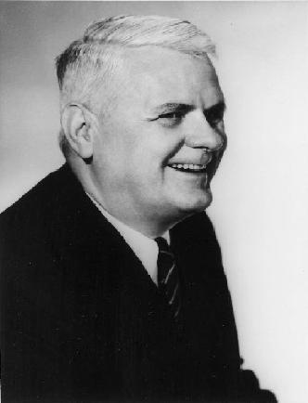
Church-Turing thesis
“Everything that can be computed with a computer (now and in the future), can be computed by some Turing machine”
But one particular Turing machine is designed for one particular computational task, whereas computers can be programmed to do ‘any’¹ computational task.
Doesn’t this make computers more powerful?
Turing showed that it doesn’t!
¹ Or so it seems; towards the end of the course we shall put this in perspective!

Slide 50
Universal Turing machines
A universal Turing machine is a Turing machine that can be programmed to behave as any other Turing machine.
General idea:
Input sequence of universal Turing machine:
a description of some Turing machine M
an input sequence s for M
Output sequence of universal Turing machine on such input sequence:
the output sequence M would produce on the input sequence s

Slide 51
How can we ‘describe’ a TM?
states: q, h
initial state: q₀, q_{1,} h, l
halting states: h
tape symbols: a, ◻
transition table:
current state | symbol scanned | next state | symbol written | motion
q₀ | a | q₁ | a | R
q₀ | ◻ | h | ◻ | R
q₁ | a | q₀ | a | R
q₁ | ◻ | l | ◻ | L
l | a | l | ◻ | L
l | ◻ | l | ◻ | L
A Turing machine can be completely described by listing the entries of its transition table. (Note: columns in table have been reordered for convenience!)
Using an encoding of states, tape symbols and motion as binary numbers:
q0->00, q1->01, l->10, h->11, a->1, ◻->0, L->0, R->1
we can encode an entry as a binary number:
(e.g., 0010111 encodes the first row of the transition table).

Slide 52
How can we ‘describe’ a TM?
current state | symbol scanned | next state | symbol written | motion
q₀ | a | q₁ | a | R
q₀ | ◻ | h | ◻ | R
q₁ | a | q₀ | a | R
q₁ | ◻ | l | ◻ | L
l | a | l | ◻ | L
l | ◻ | l | ◻ | L
Code:
q0->00
q1->01
l->10
h->11
a->1
◻->0
L->0
R->1
Exercise: Encode the transition table as a list of binary numbers separated by the symbol X.
0010111X0001101X0110011X0101000X1011000X1001000

Slide 53
A two-tape universal Turing machine
Let M denote the Turing to be simulated.
Assumptions regarding tape usage:
The alphabet of M consists of only one symbol a.
Tape 2 represents the tape of the Turing machine to be simulated.
Tape 1 stores description of M as a list of binary numbers separated by X’s and enclosed in Y’s
Left of the left-most Y we find the code of the current state and the currently scanned symbol on Tape 2.
1:
001Y0010111X0001101X0110011X0101000X1011000X1001000Y
2:
aaa

Slide 54
A two-tape universal Turing machine
The UTM operates according to the following algorithm:
Search the entry that matches the code on the left of Y
Replace code left of Y by code of new state and tape symbol
Do the associated actions (writing a new symbol, moving the head) on Tape 2
Write the code of the symbol currently scanned by the head of Tape 2 directly left of the left-most Y
Go back to 1.
001Y0010111X0001101X0110011X0101000X1011000X1001000Y
011Y0010111X0001101X0110011X0101000X1011000X1001000Y
011Y0010111X0001101X0110011X0101000X1011000X1001000Y
1:
011Y0010111X0001101X0110011X0101000X1011000X1001000Y
011Y0010111X0001101X0110011X0101000X1011000X1001000Y
001Y0010111X0001101X0110011X0101000X1011000X1001000Y
2:
aaa
aaa

Slide 55
UTM: find matching entry
Try to match next entry
No luck!
◻◻R
R
L
A 0 R
1 B R
0 A L
0 A L
1 B L
X X L
to next slide
Y Y R
R
◻◻R
L
R
1 B L
Y Y L
Exclude entries already visited from next search
B 1 R
0 A R
Found!
R
Notes:
Start with <code of initial state><code of first symbol on primary tape>Y<code of quintuple>X<code of quintuple>X … X<code of quintuple>Y
Head of secondary tape is placed on the left-most Y.
Go left on tape 1, replacing all encountered 0’s by A’s and 1’s by B’s (stay put on tape 2, keeping symbol)
Go right again, until left-most A or B, replace it by 0 or 1, respectively.
Find first 0 or 1.
If match (between symbols found in 2 and 3), then go left again and return to 2
If no match otherwise, then go to the end of the quintuple (find X or Y).
If this was the last quintuple (Y is found) then halt;
Otherwise, continue searching for the quintuple (note that the behaviour in the initial state is such that it disables all quintuples to its left…this basically ‘disables’ the quintuple)

Slide 56
UTM: execute transition
A 0 L
◻◻R
Y Y L
B 1 L
L
R
0 A R
A A S ?◻L
L
0 A L
1 A R
B B S ? a L
◻◻L
from previous slide
? 0 R ◻◻S
Y Y R
◻◻R
R
R
R
? 1 R a a S
1 B L
0 B R
A A S ? ◻R
R
1 B R
B B S ? a R
Y Y S
L
R
to previous slide
◻◻R
Y Y L
Copy codes of next state and symbol to be written
Perform associated actions on tape 2
Notes:
We start in the situation, say,
011YAABABBBXAAABBABXABB0011X0101000X1011000X1001000Y
Now, we should replace 011 at the beginning by 001, write the symbol 0 on the primary tape, move its head to the left, read the symbol from the primary tape, put it on the right position, and replace all A’s and B’s by 0’s and 1’s

Slide 57
Universal Turing machine
The preceding slides define a universal Turing machine.
We used two tapes and S motion to simulate a Turing machine with only one tape and no S motion. Did we cheat?
No, we didn’t: there is a robustness result saying that a two-tape Turing machine with S motion can be transformed into a one-tape Turing machine without S motion that computes the same thing!
We used extra symbols. Did we cheat?
No, we didn’t: there is a robustness result saying that any Turing machine can be simulated with having only one symbol.

Slide 58
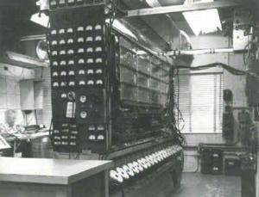
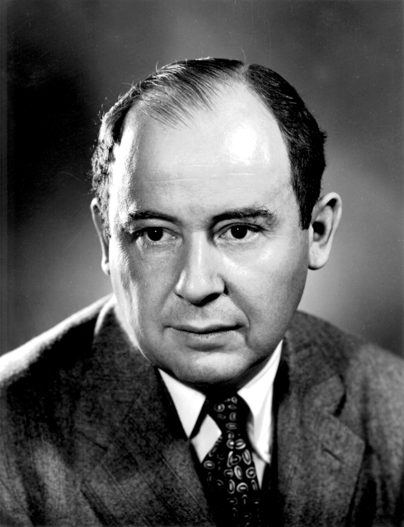
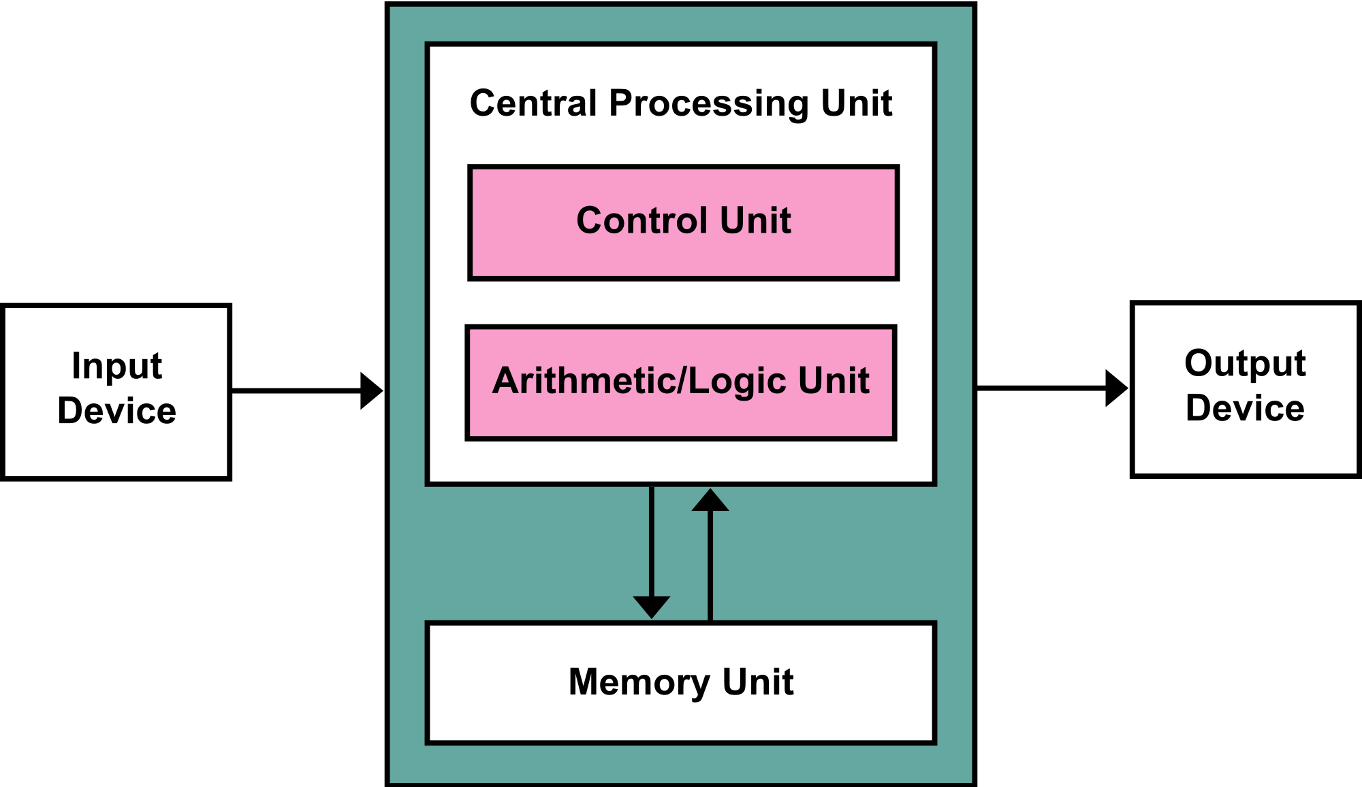
From UTM to stored program computer
John von Neumann
(1903-1957)

Slide 59
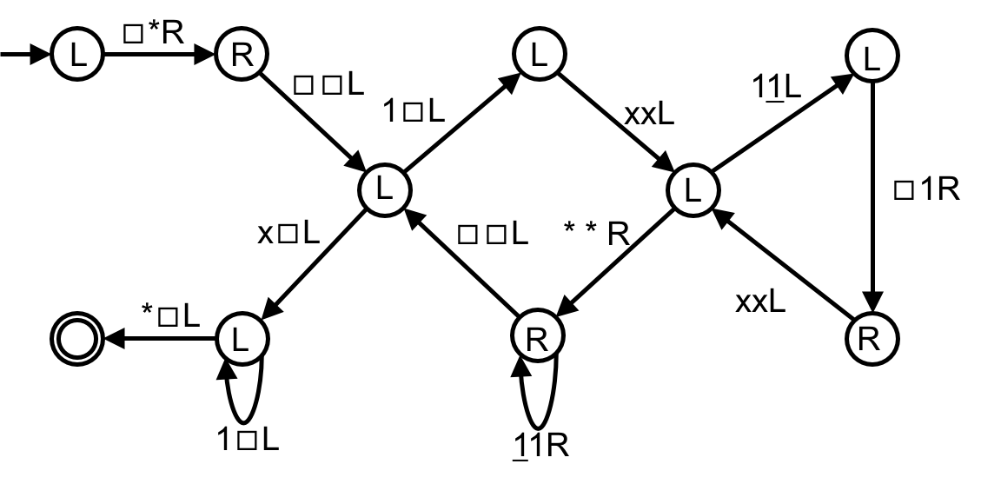
Example: (unary) multiplication
This Turing machine description can be interpreted as a precise solution to a computational problem
Multiply
Place * at the left end of the sequence
Go to the right end of the sequence
While there are 1s to the right of x, do the following
Erase the right-most 1
While not all 1s between * and x are underlined, do the following
Underline the right-most 1 between * and x that is not underlined
Write a 1 in the first blank square at the left end of the sequence
Remove the underlinings
Erase *, x, and all symbols in between
Notes:
Animation corresponds to running the Turing machine on 11x11

Slide 60
From Automata to Algorithms
“An algorithm is a set of steps to accomplish a task that is described precisely enough that a computer can run it.”

Slide 61
Data
In Turing machines: data are stored on tape (sequential access)
Computers have random access memory
In algorithms:
a chunk of data can be assigned to a variable
chunks of data of the same type can be aggregated into an array
An array is like a table in which every entry has an index and we can directly access the element at that index.
For example, if A is an array then A[i] denotes its ith element.
Index | Planet
1 | Mercury
2 | Venus
3 | Earth
4 | Mars
5 | Jupiter

Slide 62
A simple algorithm
Linear-Search(A, n, x)
Inputs:
A: an array
n: the number of elements in A to search through
x: the value to be searched for
Outputs: Either an index i for which A[i] = x, or Not-Found
Set answer to Not-Found
For each index i, going from 1 to n, in order:
If A[i] = x, then set answer to the value of i
Return the value of answer as the output

Slide 63
Material
Reading material for lecture 4:
Chapter 31: Turing Machines
Chapter 17: Random Access Machines
Chapter 66: Church’s Thesis
Chapter 51: Universal Turing Machines

