Slide 1
2ITX0
Applied Logic
Quartile 2, 2019–2020
Lecture 5: Information Theory
Lecturer: Tom Verhoeff
Study Material: https://www.win.tue.nl/~wstomv/edu/2itx0/

Slide 2
Road Map
SAT/SMT Solving: The power of propositions
Information Theory: Communication & Storage
Program Correctness: How to reason about programs
Notes:
Models of computation: abstract machines of varying complexity and computational power
Algorithms: abstract programs for abstract machines; avoids technicalities of computing
A huge encyclopedia of (efficient) algorithms for a large collection of computational problems

Slide 3
Theme 2: Information Theory

Slide 4
Road Map for Information Theory Theme
Problem: Communication and storage of information
  Not modified by computation, but communicated/stored ‘as is’
Lecture 5: A quantitative theory of information
Lecture 6: Compression for efficient communication
Lecture 7: Protection against noise for reliable communication
Lecture 8: Protection against adversary for secure communication
Sender
Channel
Receiver
Storer
Memory
Retriever
Notes:
Although no modification is wanted, this will still involve many computations.
Major applications: telephony, radio/television broadcasting, internet
We will usually speak about “channel”, but that can also mean “memory”.

Slide 5
Study Material
Slide sets, Practice Exercises P2a, P2b, P2c
Efficient communication:
  Syllabus Ch. 4 through §4.7
  Khan Academy, Computerphile: See Canvas
Reliable communication:
  Syllabus §4.8–4.13
  Khan Academy, Computerphile: See Canvas
Secure communication:
  Syllabus §4.14–4.23
  Khan Academy, Computerphile: See Canvas

Slide 6
What is Information?
That which conveys a message
Shannon (1948): “The fundamental problem of communication is that of reproducing at one point either exactly or approximately a message selected at another point.”
That which conveys a selection, a choice …
among multiple, distinguishable options
You consume information when obtaining an answer to a question
Possibly, it concerns an incomplete answer
Information reduces uncertainty in the receiver
Notes:
Claude Shannon (1948), “A Mathematical Theory of Communication”

Slide 7
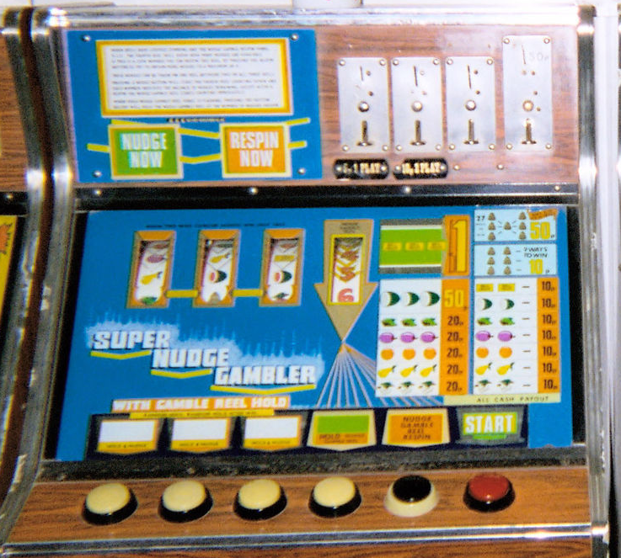
Examples
Input to slot machine: choice of button to press
Output from slot machine: choice of symbols to show
Input to SMS editor: choice of symbols in message
Output from SMS receiver: choice of symbols in message
Input to Algorithm: choice of input data
Output from Algorithm: choice of result, or output data
Notes:
Image credits: https://en.wikipedia.org/wiki/Slot_machine#/media/File:Old_fruit_machines_in_Teignmouth_10-08-06.jpg

Slide 8
Meaning of Information
Shannon (1948): “Frequently the messages have meaning;
  that is they refer to or are correlated according to some system with certain physical or conceptual entities.
  These semantic aspects of communication are irrelevant to the engineering problem.
  The significant aspect is that the actual message is one selected from a set of possible messages.
  The system must be designed to operate for each possible selection, not just the one which will actually be chosen since this is unknown at the time of design.”
Notes:
Quoted from “A Mathematical Theory of Communication”, The Bell System Technical Journal, Vol. 27, pp. 379–423, 623–656, July, October, 1948.
What the major engineering problems are varies over time.
In the past, they were different from nowadays.
The future will be different again.
Theory should be developed for the appropriate context.

Slide 9

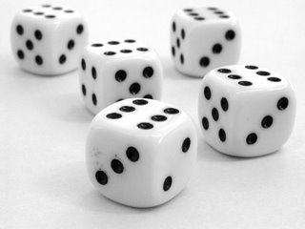
How to Measure Information? (1)
The amount of information received depends on:
  The number of possible messages
  More messages possible ⇒ more information
  The outcome of a dice roll versus a coin flip
Notes:
Qualitative understanding of information
Encode each coin flip in one bit (0 vs 1), and a card “color” in 2 bits
Encode each dice roll in … bits: 2 not enough, 3 is “overkill”
log₂ N bits, where N is number of messages to be distinguished
Can you encode each of the 6 dice rolls into log₂ 6 = 2.585 bits?

Slide 10
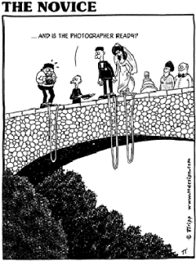

How to Measure Information? (2)
The amount of information received also depends on:
  Probabilities of messages
  Lower probability ⇒ more information
Notes:
Qualitative understanding of information
Bride / groom answer ‘Yes’ versus ‘No’ to ‘Will you marry … ?’
Image sources:
https://www.shutterstock.com/image-illustration/buttons-yes-no-12302527

Slide 11
Amount of Information
The amount of information correlates to the amount of surprise
  To the amount of reduction in uncertainty
Shannon’s Probabilistic Information Theory
  (There is also an Algorithmic Information Theory.)
Notes:
Key insight by Shannon: take into account the probabilities, and how to do so

Slide 12
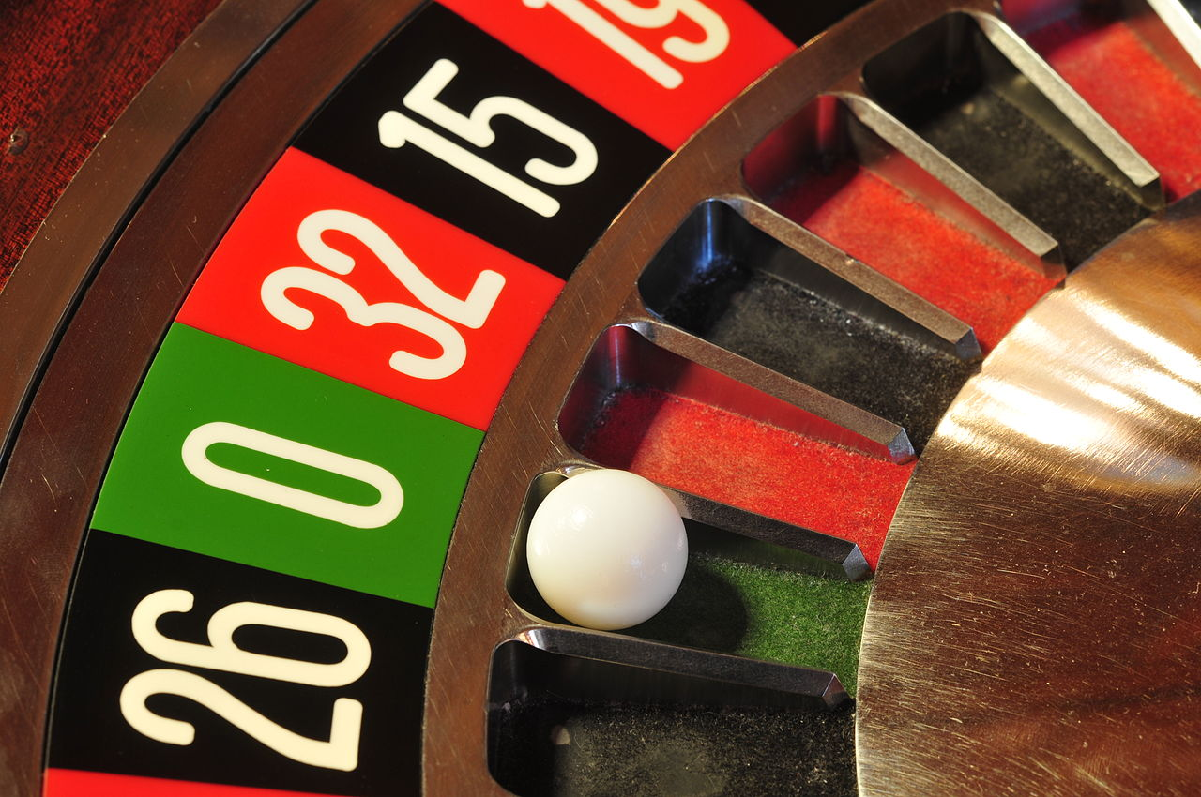
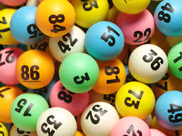
Anti-Information
Anti-Information: creates uncertainty
People like to consume information
Willing to pay for anti-information, to get into a situation where they can enjoy consumption of information: gambling, lottery
Noise in communication channel increases uncertainty
Notes:
Image sources:
https://en.wikipedia.org/wiki/Roulette
https://guardianlv.com/2014/05/gambling-and-lottery-addiction/

Slide 13
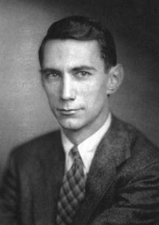
Quantitative Definition of Information
Due to Shannon (1948): incorporates role of probability
Let S be the set of possible answers (messages)
Let P(A) be the probability of answer A:
  0 ≤ P(A) ≤ 1 for all A ∈ S
  (all probabilities sum to 1)
Amount of information (measured in bits) in answer A:
Notes:
Shannon (1948): in particular, he incorporated the role of probability
Why the minus sign? Otherwise it would be negative (probabilities are ≤ 1)
Why a logarithm? There are 2^{N} sequences of N bits.
log pq = log p + log q
Image source: https://webmuseum.mit.edu/detail.php?module=people&type=related&kv=12372

Slide 14
Unit of Information
1 bit = receiving an answer whose probability equals 0.5
bit = binary digit
Using another logarithm base: scales by a factor
Natural logarithm: information unit nat
1 bit = 0.693147 nat
1 nat = 1.4427 bit
Notes:
log₂ x = log x / log 2

Slide 15
Properties of Information Measure
I(A) → ∞, if P(A) → 0 (an impossible answer never occurs)
I(A) = 0 (no information), if P (A) = 1 (certainty): log 1 = 0
0 ≤ I(A) < ∞, if 0 < P(A) ≤ 1
I(A) > I(B), if and only if P(A) < P(B):
  lower probability ⇒ higher amount of information
I(AB) ≤ I(A) + I(B): information is subadditive
  AB stands for receiving answers A and B
I(AB) = I(A) + I(B) (additive), if A and B are statistically independent
  P(AB) = P(A) P(B) (this motivates the logarithm)
Notes:
The last property motivates the choice of a logarithm
N.B. I(AB) = I(A) is possible (if B is repeating what was already said in A)

Slide 16
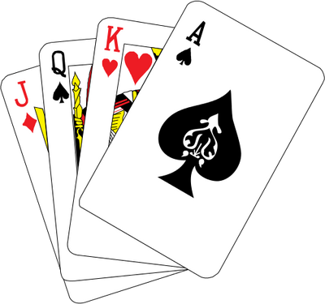
Card Trick
2 volunteers
27 playing cards
1 magician
Notes:
This took almost 15 minutes, so start no later than 15 minutes before the break.
Image source: https://unixtitan.net/poker-vector.html

Slide 17
Card Trick Informatics
The volunteer knows a secret, that the magician does not know
  a choice of 1 from 27
  approx. 4.755 bit
In each step, some information is conveyed
  a choice of 1 from 3
  approx. 1.585 bit
The magician obtains just enough information to know the secret
  3 x 1.585 = 4.755

Slide 18
Communicate Choices
How to encode ternary choices efficiently on binary channel?
Binary channel: communicates bits (0, 1)
Ternary choice: symbols A, B, C
How many bits needed per symbol?
Notes:
First with binary choices, then card “color” (choice among 4)
log₂ N, because there are 2^{N} sequences of N bits
Can do it in 2 bit / symbol
Ideal: log₂ 3 = 1.58496
Consider groups of symbols: blocks of 2 symbols ➔ 3² = 9 virtual symbols, requires 4 bits
3 symbols➔ 3³ = 27 virtual symbols, requires 5 bits, i.e. 5/3 = 1.66667 per symbol on average
5 symbols➔ 3⁵ = 243 virtual symbols, requires 8 bits, i.e. 8/5 = 1.6 per symbol on average
How to encode binary choices efficiently on ternary channel?

Slide 19
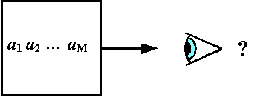
Information Source
Produces a sequence of messages (answers, symbols)
  From given finite set (alphabet)
  With given probability distribution
Discrete memoryless:
  messages are independent and identically distributed
With memory (not covered in this course):
  probabilities depend on state (past messages sent)
Notes:
Memory: e.g., letter U is more probable after Q
Cf. Finite Automaton
Sender can be modeled as an information source

Slide 20
Entropy
Entropy H(S) of information source S:
  Average amount of information per message
  Average = expectation = (arithmetic) mean
  Weighted by probabilities
Discrete memoryless information source:
Measured in bits
Notes:
Base-2 logarithm: bits

Slide 21
Entropy: Example 1
Source: 2 messages, probabilities p and 1 – p = q
Notes:
H(0.11) = 0.4999
– log₂ 0.11 = 3.184 multiplied by 0.11 ➔ 0.350
– log₂ 0.89 = 0.168 multiplied by 0.89 ➔ 0.150
Cf. Decision Tree Mining in Q3 generic engineering course Data Analytics

Slide 22
Entropy: Example 2
Source: N messages, each with probability p = 1 / N

Slide 23
Entropy: Example 3
Source: 3 messages, probabilities p, p, and 1 – 2p = q
Notes:
Maximum entropy when p = 1/3: all messages equally probable

Slide 24
Properties of Entropy
Consider information source S with N messages
Entropy bounds: 0 ≤ H(S) ≤ log₂ N
H(S) = 0 if and only if P(A) = 1 for some message A∈S (certainty)
H(S) = log₂ N if and only if P(A) = 1/N for all A∈S (max. uncertainty)
Notes:
Conditions when extremes are achieved

Slide 25
Lower Bound on Comparison Sorting
Sorting N distinct items (keys), based on pairwise comparisons,
  requires, in the worst case, Ω(N log N) comparisons
Initial uncertainty: looking for 1 sorted order among N! permutations
  A choice of 1 from N! = N x (N-1) x . . . x 2 x 1
  Uncertainty = – log₂ 1/N! ≈ N log₂ N
Each comparison provides a choice of 1 from 2
  Yields ≤ 1 bit per comparison, on average
N.B. Can sort faster when not using pairwise comparisons
  Counting Sort
  Radix Sort
Notes:
Select one (viz. the sorted order) among the N! permutations of N keys
All permutations equally probable
Information content is log₂ N! = Ω(N log₂ N)
Each comparison yields at most 1 bit of information; hence, Ω(N log₂ N) comparison needed
N.B. A comparison could yield 0 bits: if you already know a < b and b < c, then asking a < c yields no (new) information

Slide 26
Shannon’s Source Coding Theorem (1948)
Given: information source S with entropy H
On average, each message of S can be encoded in ≈ H bits
More precisely:
  For every ε > 0,
  there exist lossless encoding/decoding algorithms, such that
  each message of S is encoded in < H + ε bits, on average
  No lossless algorithm can achieve average < H bits / message
Sender
Encoder
Channel
Decoder
Receiver

Slide 27
Notes about Source Coding Theorem
The Source Coding Theorem does not promise that the encoding always succeeds in using < H + ε bits for every message
It only states that this is accomplished on average
  That is, in the long run, measured over many messages
  Cf. the Law of Large Numbers
This theorem motivates the relevance of entropy:
  H is a limit on the efficiency
Assumption: all channel symbols (bits) cost the same
  Cost: time, energy, matter
Notes:
What is a disadvantage of packing more messages together? Higher latency (encoded bits arrive after a longer delay)

Slide 28
Proof of Source Coding Theorem
The proof is technically involved (outside scope of 2ITX0)
However, it is noteworthy that basically any ‘random’ code works
It involves encoding of multiple symbols (blocks) together
The more symbols are packed together, the better the entropy can be approached
The engineering challenge is to find codes with practical source encoding and decoding algorithms (easy to implement, efficient to execute)
Notes:
Key ideas of the proof:
For large n, most n-block symbols occur with very low probability.
All the others are about equally probable.

Slide 29
Card Trick Explanation
Write target number minus one in base 3
  17 ➔ 16 = 1x9 + 2x3 + 2x1 = 122₃
Use trits (ternary digits) from right to left when collecting piles
    0 ➔ put selected pile on top
    1 ➔ put selected pile in the middle
    2 ➔ put selected pile at the bottom

Slide 30
Summary
Information, unit of information, information source, entropy
Efficient communication and storage of information
Source coding: compress data, remove redundancy
Shannon’s Source Coding Theorem: limit on lossless compression
Notes:
Slide includes links to Wikipedia

Slide 31
Announcements
Practice Sets 2a, 2b, 2c
Compression part (Lecture 6) will use Tom’s JavaScript Machine (requires web browser)
Crypto part (Lecture 8) will use GPG: www.gnupg.org
  Windows, Mac, Linux versions available

