Slide 1
2ITX0 Applied Logic
Quartile 2, 2019–2020
Lecture 6: Compression
Lecturer: Tom Verhoeff
Study Material: https://www.win.tue.nl/~wstomv/edu/2itx0/

Slide 2
Logistics
Deadline for Assignment A1: Today 23:59 Check that Ans stored your submission!

Slide 3
Theme 2: Information Theory

Slide 4
Road Map for Information Theory Theme
Problem: Communication and storage of information
Not modified by computation, but communicated/stored ‘as is’
Lecture 5: A quantitative theory of information
Lecture 6: Compression for efficient communication
Lecture 7: Protection against noise for reliable communication
Lecture 8: Protection against adversary for secure communication
Sender
Channel
Receiver
Storer
Memory
Retriever
Notes:
Although no modification is wanted, this will still involve many computations.
Major applications: telephony, radio/television broadcasting, internet
We will usually speak about “channel”, but that can also mean “memory”.

Slide 5
Shannon’s Source Coding Theorem (1948)
Given: information source S with entropy H
On average, each message of S can be encoded in ≈ H bits
More precisely:
For every ε > 0,
there exist lossless encoding/decoding algorithms, such that
each message of S is encoded in < H + ε bits, on average
No lossless algorithm can achieve average < H bits / message
Sender
Encoder
Channel
Decoder
Receiver

Slide 6
Source Coding: Example 1
2 messages, A and B, each with probability 0.5
H = – 0.5 log₂ 0.5 – 0.5 log₂ 0.5 = 0.5 + 0.5 = 1 [bit]
Encode A as 0, and B as 1
Mean number of bits per message: 0.5 * 1 + 0.5 * 1 = 1
Notes:
Trivial

Slide 7
Source Coding: Example 2
3 messages, A, B, C, with probabilities ¼, ¼, ½
H = – ¼ log₂ ¼ – ¼ log₂ ¼ – ½ log₂ ½ = ½ + ½ + ½ = 1.5 [bit]
Encode A as 00, B as 01, and C as 10:
Mean number of bits per message: ¼ * 2 + ¼ * 2 + ½ * 2 = 2
Can be improved (on average):
Encode A as 00, B as 01, and C as 1
½ * 1 + ¼ * 2 + ¼ * 2 = 1.5 bits / message (expected)
NOTE: Can still be decoded uniquely
Notes:
Variable-length code words
Decoding is a concern: here, it works.
Ideal compression, entropy is reached

Slide 8
Source Coding: Example 3
2 messages, A and B, with probabilities 0.1 and 0.9
H = – 0.1 log₂ 0.1 – 0.9 log₂ 0.9 = 0.33 + 0.14 = 0.47 [bit]
Encode A as 0 and B as 1
1 bit / message
Can be improved (on average):
Notes:
– log₂ 0.1 = 3.322; – log₂ 0.9 = 0.152
Variable-length to variable-length code
Why does this code “work”; that is, why can it be decoded?
N.B. Only bits (0/1) are sent; no blanks or commas or separators
Example to decode: 11010001011 ➔ BBBBBBBAABBBBBA
A kind of run-length encoding: 0, 1, 2, or 3-or-more adjacent B

Slide 9
Source Coding: Example 4
3 messages, A, B, and C, each with probability 1/3 (H = 1.58)
Encode A as 00, B as 01, and C as 10: 2 bits / message
Can be improved (on average)
27 sequences of 3 messages (equiprobable)
Encode each sequence of 3 messages in 5 bits (32 possibilities)
Mean number of bits per message: 5/3 = 1.67
243 sequences of 5 messages, encode in 8 bits (256 possibilities)
Mean number of bits per message: 8/5 = 1.6
Notes:
Could encode C as just 1: mean number of bits / message goes to 5/3 (is decodable)
Fixed-length blocks, fixed-length code words
How about dice rolls? 6 messages, probability 1/6 (H = 2.585)
How large should the groups be, to go below 2.6 bits / symbol on average?

Slide 10
Encoding, Decoding
Encoding: mapping
sequences of input symbols ➔ sequences of output symbols
BBBBBBBAABBBBBA ➔ 11010001011
Decoding: inverse mapping for encoding
Compression ratio (also know as the code’s rate):
(average) number of input symbols / number of output symbols
Compression ratio < 1: output longer than input
Compression ratio > 1: output is shorter than input

Slide 11
Kinds of Encodings
Block code:
cut input sequence into blocks of symbols
map each input block to an output block
BBBBBBBAABBBBBA ➔ 11010001011
BBB | BBB | BA | A | BBB | BBA ➔ 1 | 1 | 010 | 00 | 1 | 011
need to ensure that decoding is uniquely possible
output blocks are also known as code words
Fixed-length code:
all input blocks have same size
all output blocks have same size
Variable-length code:
blocks not of fixed length

Slide 12
Prefix-free Codes
Example:
Suppose both 01 and 0110 are code words
What to do after receiving 01…?
Does the block end here, or is it still incomplete?
Variable-length code is called prefix-free, when
no code word is the prefix (beginning) of another code word
v is prefix of vw
A block code can be uniquely decoded from left to right
without requiring special separator symbols (spaces, commas)
if and only if it is prefix-free

Slide 13
Huffman’s Algorithm
Given a set of messages with probabilities
Constructs an optimal prefix-free binary encoding
Repeatedly
Combine two least probable messages Y and Z into a new virtual message YZ, with P(YZ) = P(Y) + P(Z)
Y and Z can be distinguished by one additional bit
Until all messages are combined

Slide 14
Huffman’s Algorithm: Example
P(A) = 0.1, P(B) = 0.2, P(C) = 0.25, P(D) = 0.45 (entropy = 1.815)
Combine A + B into AB
P(C) = 0.25, P(AB) = 0.3, P(D) = 0.45
Combine C + AB into CAB
P(D) = 0.45, P(CAB) = 0.55
Combine D + CAB into DCAB
P(DCAB) = 1.0
Code for D starts with 0, code for CAB starts with 1
Code for C proceeds with 0, code for AB with 1
Code for A proceeds with 0, for B with 1
Encode A as 110, B as 111, C as 10, D as 0
Average code length = 1.85 bit / message
A
B
C
0
1
D
0
1
0
1
Notes:
Average number of bits per message =
0.1x3 + 0.2x3 + 0.25x2 + 0.45x1 = 0.3 + 0.6 + 0.5 + 0.45 = 1.85
There can be a lot of freedom: 0/1 choice; more than two equal probabilities

Slide 15
Average Length of Variable-length Code
Message | Codeword | Length | Probability | Product
A | 110 | 3 | 0.1 | 3x0.1 = 0.3
B | 111 | 3 | 0.2 | 3x0.2 = 0.6
C | 10 | 2 | 0.25 | 2x0.25 = 0.5
D | 0 | 1 | 0.45 | 1x0.45 = 0.45
Total |  |  | 1.00 | 1.85

Slide 16
Finite Automaton to Recognize Codewords
Notes:
The code words of a prefix-free variable-length code can be recognized by a finite automaton.
In the accepting state, another complete codeword was received.
This is that FA for the previous example.

Slide 17
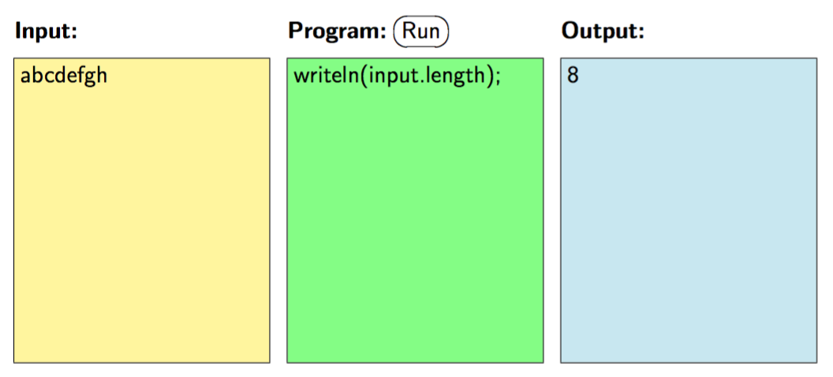
Tom’s JavaScript Machine
TJSM can help you with some calculations
See Practice Set P3, exercise 4
Programs:
Count Text
Convert Freq. to Prob.
Calculate Entropy
Huffman Assistant
Tree Encoder
Avg. Code Length
Demo
BCDADCDBDCDBDCDADCDB

Slide 18
Huffman’s Algorithm: Example on TJSM
In Tom’s JavaScript Machine (TJSM),
apply Huffman_assistant.js to input
{ "a": 0.1, "b": 0.2, "c": 0.25, "d": 0.45 }
doing the appropriate merges,
obtaining the sequence
[ "a+b”, "c+ab”, "d+cab” ]
In TJSM,
apply encode_tree.js to these merges,
obtaining the encoding table
{ "a": "110”, "b": "111”, "c": "10”, "d": "0” }

Slide 19
Drawbacks of Huffman Compression
Not universal: only optimal for a given probability distribution
Very sensitive to noise: an error has ripple effect in decoding
Variants:
Blocking (first, combine multiple symbols into super-symbols)
Fixed-length blocks
Variable-length blocks (cf. Run-Length Coding)
Two-pass version:
First pass determines statistics and optimal coding tree
Second pass encodes
Now also need to communicate the coding tree
Adaptive Huffman compression
Update statistics and coding tree, while encoding
Notes:
Advantages? Simple, optimal, efficient (construction, encoding, decoding)
Earlier attempts at constructing optimal encoding: combine large probabilities (wrong!)
Present example of ripple effect on blackboard.
BA > 111110 > 101110 > CBD

Slide 20
Lempel–Ziv–Welch (LZW) Compression
Adaptive
Sender builds a dictionary to recognize repeated subsequences
Receiver reconstructs dictionary while decompressing
Universal
Works for arbitrary probability distribution
When text is long
Used in ZIP
Notes:
Image: https://www.drupal.org/files/project-images/zip.png

Slide 21
Lossless Compression Limit 2
No encoding/decoding algorithm exists that compresses every symbol sequence into a shorter sequence without loss
Proof: By pigeonhole principle
There are 2^{n} binary sequences of length n
For n = 3: 000, 001, 010, 011, 100, 101, 110, 111 (8 sequences)
Shorter: 0, 1, 00, 01, 10, 11 (6 sequences)
There are 2^{n} – 2 non-empty binary sequences of length < n
Assume an encoding algorithm maps every n-bit sequence to a shorter binary sequence
Then there exist two n-bit sequences that get mapped to the same shorter sequence
The decoding algorithm cannot map both back to their original
Therefore, the compression is lossy
Notes:
Shannon’s Source Coding Theorem provides Limit 1 (the entropy)
Does there exist encoding/decoding algorithm that compresses every sequence into a shorter sequence?
10 pigeons arrive at 9 pigeonholes. What do you know for sure?

Slide 22
Compression Concerns
Sender and receiver need to agree on encoding/decoding algorithm
Optionally, send decoding algorithm to receiver (adds overhead)
Better compression ➔ larger blocks needed ➔ higher latency
Latency = delay between sending and receiving each bit
Better compression ➔ less redundancy ➔ more sensitive to errors
More about this in last lecture: Algorithmic Information Theory

Slide 23
5-Card Trick
1 magician
52 playing cards
1 assistant
1 face-down card
4 face-up cards
Notes:
Show trick with sorted deck of 27 playing cards.
Explanation (to be shown later, using 27 SET cards)
Each question is a ternary question about one aspect:
Is it a squiggle, rectangle, or ellipse?
Is it red, blue, or green?
Are there one, two, or three objects?
Also observe what is invariant under the reordering of the cards
Image source: https://unixtitan.net/poker-vector.html

Slide 24
Algorithm for Assistant
5 random cards, ≤ 4 suits : ≥ 1 duplicate suit
Distance between two values on clock: ≤ 6
Put higher duplicate suit face-down (leftmost)
Put lower duplicate suit face-up (rightmost)
Encode distance (1 through 6) by permutation of 3 remaining cards
Magician: reverse algorithm
1 | A B C
2 | A C B
3 | B A C
4 | B C A
5 | C A B
6 | C B A

Slide 25
Summary
Information, unit of information, information source, entropy
Efficient communication and storage of information
Source coding: compress data, remove redundancy
Shannon’s Source Coding Theorem: limit on lossless compression
Prefix-free variable-length binary codes
Huffman’s algorithm
Notes:
Slide includes links to Wikipedia

Slide 26
Announcements
Practice Sets 2a, 2b, 2c
Uses Tom’s JavaScript Machine (requires web browser)
Crypto part (Lecture 8) will use GPG: www.gnupg.org
Windows, Mac, Linux versions available

