Slide 1
2ITX0
Applied Logic
Quartile 2, 2019–2020
Lecture 7: Error Control
Lecturer: Tom Verhoeff
Study Material: https://www.win.tue.nl/~wstomv/edu/2itx0/

Slide 2
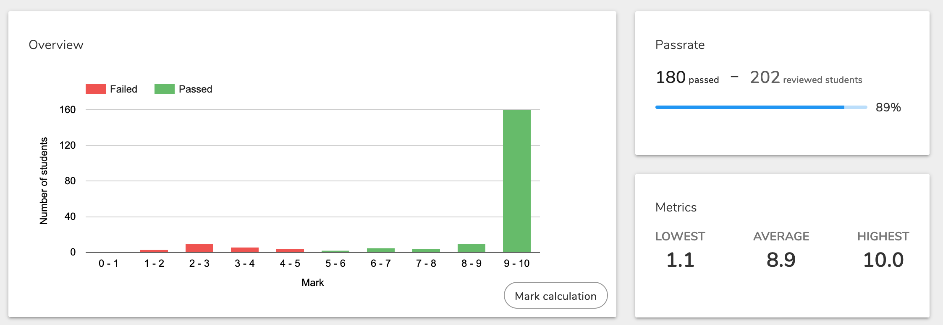
Analytics for Assignment 1

Slide 3
Theme 2: Information Theory

Slide 4
Road Map for Information Theory Theme
Problem: Communication and storage of information
  Not modified by computation, but communicated/stored ‘as is’
Lecture 5: A quantitative theory of information
Lecture 6: Compression for efficient communication
Lecture 7: Protection against noise for reliable communication
Lecture 8: Protection against adversary for secure communication
Sender
Channel
Receiver
Storer
Memory
Retriever
Notes:
Although no modification is wanted, this will still involve many computations.
Major applications: telephony, radio/television broadcasting, internet
We will usually speak about “channel”, but that can also mean “memory”.

Slide 5
Summary of Lectures 5+6
Information, unit of information, information source, entropy
Source coding: compress symbol sequence, reduce redundancy
Shannon’s Source Coding Theorem: limit on lossless compression
  Converse: The more you can compress without loss, the less information was contained in the original sequence
Prefix-free variable-length codes
  Unique decoding property
Huffman’s algorithm: generates an optimal compression algorithm
  Given the probability distribution
Notes:
Includes links to Wikipedia.
Imagine a (memoryless) information source producing messages with know probability distribution.
A 0.1, B 0.2, C 0.25, D 0.45
How to encode (compress) this most efficiently? Shannon’s Source Coding Thm gives a bound: the entropy

Slide 6
Noisy Channel
The capacity of a communication channel measures how many bits, on average, it can deliver reliably per transmitted bit
A noisy channel corrupts the transmitted symbols ‘randomly’
Noise is anti-information
The entropy of the noise must be subtracted from the ideal capacity (i.e., from 1) to obtain the (effective) capacity of the channel+noise
Sender
Channel
Receiver
Noise

Slide 7
Noisy Channel Model
Some forms of noise can be modeled as a discrete memoryless source, whose output is ‘added’ to the transmitted message bits
  Noise bit 0 leaves the message bit unchanged: x + 0 = x
  Noise bit 1 flips the message bit: x + 1 (modulo 2) = 1 – x
  Known as binary symmetric channel with bit-error probability p
Notes:
Erasure: you can see that a bit was damaged, but not what it was originally.

Slide 8
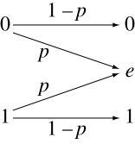
Other Noisy Channel Models
Binary erasure channel
  An erasure is recognizably different from correctly received bit
Burst-noise channel
  Errors come in bursts; has memory
Notes:
Erasure: location of error is known
E.g. unreadable digit in a handwritten bank account number
Burst: scratch on CD/DVD
Directly after an error, another error is more likely

Slide 9
Binary Symmetric Channel: Examples
p = ½
  Entropy in noise: H(p) = 1 bit
  Effective channel capacity = 0
  No information can be transmitted
p = 1/12 = 0.083333
  Entropy in noise: H(p) ≈ 0.414 bit
  Effective channel capacity < 0.6 bit
  Out of every 7 bits,
    7 * 0.414 ≈ 2.897 bits are ‘useless’
    Only 4.103 bits remain for information
What if p > ½ ?
Sender
Channel
Receiver
Noise
Notes:
p = 1/12, cf. Hamming (7, 4) code:
Before coding: P(no error / 4 source bits) = (11/12)⁴ = 0.71 (71%); P(error) = 0.29 (29%)
After coding:
P(no error / 4 source bits) = (11/12)⁷ = 0.54 (54%)
P(1 bit error) = 7(1/12)(11/12)⁶ = 0.35 (35%)
P(>1 bit error) = 0.11 (11%)
If p > ½, then first flip every received bit,
to obtain binary symmetric channel with error probability 1 – p.
Hence, we assume p < ½.

Slide 10
How to Protect against Noise?
Repetition code
  Repeat every source bit k times
    Code rate = 1/k (efficiency loss)
    Introduces considerable overhead (redundancy, inflation)
  k = 2: can detect a single-bit error in every pair
    Cannot correct even a single error
  k = 3: can correct a single-bit error, and detect double-bit error
    Decode by majority voting
      100, 010, 100 ➔ 000; 011, 101, 110 ➔ 111
    Cannot correct two or more errors per triple
      In that case, ‘correction’ makes it even worse
Can we do better, with less overhead, and more protection?
Notes:
In general, increase redundancy, so that error becomes apparent
Naïve coding: can improve reliability as much as desired,
But loss of efficiency increases without bound.
----- Meeting Notes (10/12/14 17:28) -----
BREAK

Slide 11
Shannon’s Channel Coding Theorem (1948)
Given:
  channel with effective capacity C, and
  information source S with entropy H
If H < C, then for every ε > 0,
  there exist encoding/decoding algorithms, such that
  symbols of S are transmitted with a residual error probability < ε
If H > C, then the source cannot be reproduced without loss of at least H – C
Sender
Encoder
Channel
Decoder
Receiver
Noise
Notes:
Residual error = error after decoding

Slide 12
Notes about Channel Coding Theorem
The (Noisy) Channel Coding Theorem does not promise error-free transmission
It only states that the residual error probability can be made as small as desired
  First: choose acceptable residual error probability ε
  Then: find appropriate encoding/decoding (depends on ε)
It states that a channel with limited reliability can be converted into a channel with arbitrarily better reliability (but not 100%), at the cost of a fixed drop in efficiency
  The initial reliability is captured by the effective capacity C
  The drop in efficiency is no more than a factor 1 / C
  I.e., code rate (compression ratio) is at least (no worse than) C
Alternatively: effective capacity C = rate of best code as residual error probability -> 0
Notes:
Code rate measures efficiency of encoding.

Slide 13
Proof of Channel Coding Theorem
The proof is technically involved (outside scope of 2IS80)
Again, basically ‘random’ codes works
It involves encoding of multiple symbols (blocks) together
The more symbols are packed together, the better reliability can be
The engineering challenge is to find codes with practical channel encoding and decoding algorithms (easy to implement, efficient to execute)
This theorem also motivates the relevance of effective capacity
Notes:
What is a disadvantage of packing more messages together? Higher latency (encoded bits arrive after a longer delay)

Slide 14
Error Control Coding
Use excess capacity 1 – C to transmit error-control information
Encoding is imagined to consist of source bits and error-control bits
  Sometimes bits are ‘mixed’
Code rate = number of source bits / number of channel bits in encoding
  Higher code rate is better (less overhead, less efficiency loss)
Error-control information is redundant, but protects against noise
  Compression would remove this information
Notes:
Code rate measures efficiency of encoding.

Slide 15
Error-Control Coding Techniques
Two basic techniques for error control:
  Error-detecting code, with feedback channel and retransmission in case of detected errors
  Error-correcting code (a.k.a. forward error correction)
    No feedback channel
Channel
Sender
Noise
Receiver
Back Ch.
Notes:
Feedback channel may be infeasible: far-away sattelite, CD/DVD

Slide 16
Error-Detecting Codes: Examples
Append a parity control bit to each block of source bits
  Extra (redundant) bit, to make total number of 1s even
  Can detect a single bit error (but cannot correct it)
  Code rate = k / (k+1), for k source bits per block
  Sacrifices half of all (k+1)-bit words for error detection
  k = 1 yields repetition code with code rate ½
Append a Cyclic Redundancy Check (CRC)
  E.g. 32 check bits computed from block of source bits
  Also used to check quickly whether files differ: compare CRCs

Slide 17
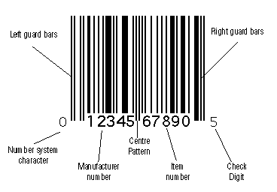
Practical Error-Detecting Decimal Codes
  Dutch Bank Account Number
  International Standard Book Number (ISBN)
  Universal Product Code (UPC)
  Burgerservicenummer (BSN)
    Dutch Citizen Service Number
  Student Identity Number at TU/e
These all use a single check digit (incl. X for ISBN)
  International Bank Account Number (IBAN): two check digits
Typically protect against single digit error, and adjacent digit swap (a kind of special short burst error)
  Main goal: detect human accidental error
Notes:
Image source: http://www.computalabel.com/Images/UPCIL.GIF

Slide 18
An Experiment
With a “noisy” channel

Slide 19
Number Guessing with Lies
Also known as Ulam’s Game
Needed: one volunteer, who can lie
Notes:
See separate slide set: Ulam’s Game

Slide 20
The Game
Volunteer picks a number N in the range 0 through 15
Magician asks seven Yes–No questions
Volunteer answers each question, and may lie once
Magician then tells number N, and which answer was a lie (if any)
How can the magician do this?

Slide 21
Question Q₁
Is your number one of these:
1, 3, 4, 6, 8, 10, 13, 15

Slide 22
Question Q₂
Is your number one of these?
1, 2, 5, 6, 8, 11, 12, 15

Slide 23
Question Q₃
Is your number one of these?
8, 9, 10, 11, 12, 13, 14, 15

Slide 24
Question Q₄
Is your number one of these?
1, 2, 4, 7, 9, 10, 12, 15

Slide 25
Question Q₅
Is your number one of these?
4, 5, 6, 7, 12, 13, 14, 15

Slide 26
Question Q₆
Is your number one of these?
2, 3, 6, 7, 10, 11, 14, 15

Slide 27
Question Q₇
Is your number one of these?
1, 3, 5, 7, 9, 11, 13, 15

Slide 28
Figuring it out
Place the answers a_{i} in the diagram
Yes ➔ 1, No ➔ 0
For each circle, calculate the parity
  Even number of 1’s is OK
  Circle becomes red, if odd
No red circles ⇒ no lies
Answer inside all red circles and outside all black circles was a lie
Correct the lie, and calculate N = 8 a₃ + 4 a₅ + 2 a₆ + a₇
a₁
a₅
a₃
a₇
a₄
a₆
a₂
Notes:
Parity of a number k = 0 if k is even, else 1
With children, you can tell them they must lie at least six times.
How does that work?

Slide 29
Hamming (7, 4) Error-Correcting Code
Every block of 4 source bits is encoded in 7 bits
  Code rate = 4/7
Encoding algorithm:
  Place the four source bits s₁s₂s₃s₄
  Compute three parity bits p₁p₂p₃
  such that each circle contains
  an even number of 1s
  Transmit s₁s₂s₃s₄p₁p₂p₃
  Changing 1 source bit s_{i}, changes ≥ 2 parity bits
Decoding algorithm can correct 1 error per code word
  Redo the encoding, using differences in received and computed parity bits to locate an error
p₃
s₁
s₂
s₄
p₂
s₃
p₁
Notes:
Do example on blackboard. 1010 -> 101
Compute: p1 = s2 + s3 + s4; p2 = s1 + s3 + s4; p3 = s1 + s2 + s4 (modulo 2)
What happens if more than one error occurs in a code word?

Slide 30
How Can Error-Control Codes Work?
Each bit error changes one bit of a code word
  1010101 ➔ 1110101
In order to detect a single-bit error,
  any one-bit change of a code word should not yield a code word
(Cf. prefix-free code: a shorter prefix of a code word is not itself a code word; in general: each code word excludes some other words)
Hamming distance between two symbol (bit) sequences:
  Number of positions where they differ
Notes:
Image: https://people.rit.edu/rmb5229/320/project3/images/hamming_example_optimized.jpg

Slide 31
Error-Detection Bound
In order to detect all single-bit errors in every code word, the Hamming distance between all pairs of code words must be ≥ 2
  A pair at Hamming distance 1 could be turned into each other by a single-bit error
  2-Repeat code:
To detect all k-bit errors, Hamming distances must be ≥ k+1
  Otherwise, k bit errors can convert one code word into another
  Hamming (7, 4) code: distance between code words ≥ 3
  It can detect all 2-bit errors
Notes:
Blackboard: 2-Repetition code 00 versus 11: distance 2
If Hamming distance between all pairs of code words is ≥m, then m–1 bit errors can be detected

Slide 32
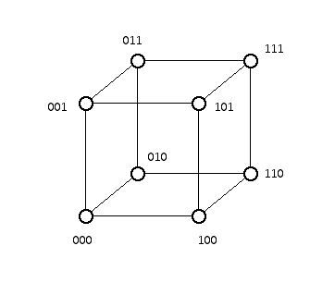
Error-Correction Bound
In order to correct all single-bit errors in every code word, the Hamming distance between all pairs of code words must be ≥ 3
  A pair at distance 2 has ≥ 1 word in between, at distance 1:
3-Repeat code: distance(000, 111) = 3
To correct all k-bit errors, Hamming distances must be ≥ 2k+1
  Otherwise, a received word with k bit errors cannot be decoded
Notes:
With minimum distance 2k+1, the code can also be used to detect up to 2k-bit errors.

Slide 33
How to Correct Errors
Binary symmetric channel:
  Smaller number of bit errors is more probable (more likely)
  Apply maximum likelihood decoding
  Decode received word to (any) nearest code word
    Also known as minimum-distance decoding
  3-Repeat code: code words 000 and 111

Slide 34
Good Codes Are Hard to Find
Nowadays, families of good error-correcting codes are known
  Code rate close to effective channel capacity
  Low residual error probability
Consult an expert
Notes:
Rate does not go to zero

Slide 35
Combining Source & Channel Coding
In what order to do source & channel encoding & decoding?
Source
Encoder
Channel
Encoder
Sender
Noise
Channel
Source
Decoder
Channel
Decoder
Receiver
Notes:
How many ways to put 4 en/decoders in? 4! = 24
Clearly, encode before channel, decode after channel: leaves 2 * 2 = 4 possibilities
Clearly, source/channel encode order must match source/channel decode order: 2 possibilities
Source coding adapts to source characteristics
Channel coding adapts to channel (noise) characteristics
View Channel-Encoder+Noisy-Channel+Channel-Decoder is reliable channel

Slide 36
Summary
Noisy channel, effective capacity, residual error
Error control coding, a.k.a. channel coding; detection, correction
Channel coding: add redundancy to limit impact of noise
  Code rate
Shannon’s Noisy Channel Coding Theorem: limit on error reduction
Repetition code
Hamming distance, error detection and error correction limits
  Maximum-likelihood decoding, minimum distance decoding
Hamming (7, 4) code
  Ulam’s Game: Number guessing with a liar
Notes:
Includes links to Wikipedia articles.

Slide 37
Announcements
Practice Sets P2b, P2c
  Uses Tom’s JavaScript Machine (requires web browser)
Khan Academy: Language of Coins (Information Theory)
  Especially: Videos 1, 4, 9, 10, 12–15
Crypto part (Lecture 8) will use GPG: www.gnupg.org
  Windows, Mac, Linux versions available

